Slide 1

Tritium retention in plasma-facing components
E. Pajuste,
A. S. Teimane, A. Vitins, L. Avotina, A. Lescinskis,
P. Kalnina, R.J. Zabolockis, M. Sondars

Slide 2
OUTLINE
ITER Like Wall plasma facing materials
Tritium sources in JET vacuum vessel
Tritium measurement methods at UoL
Tritium in plasma facing materials
E. Pajuste| WP PWIE 2022 Reporting Meeting | Julich| 2023| Page 2

Slide 3
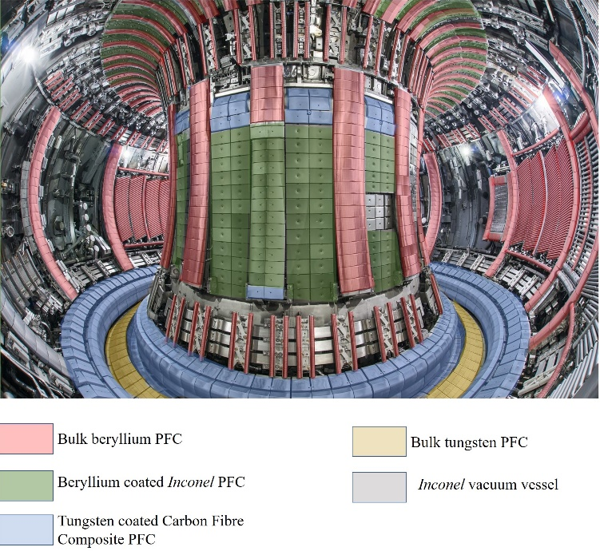
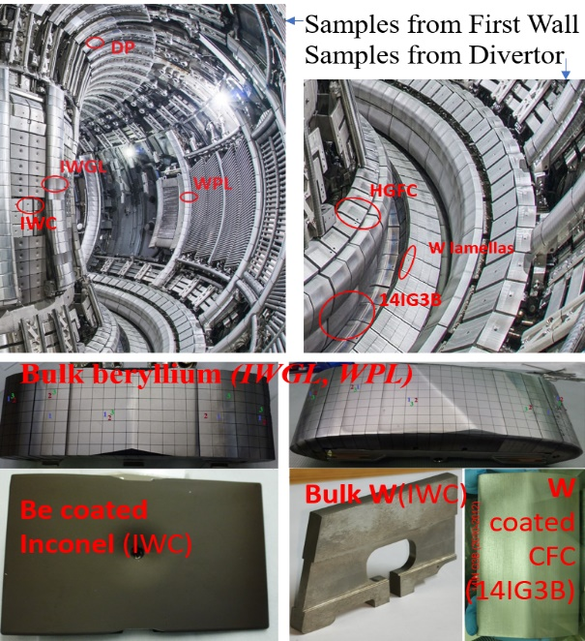
Plasma facing materials in ITER Like Wall
ITER-Like-Wall (ILW) project has been carried out at Joint European Torus (JET) to test plasma facing materials relevant to International Thermonuclear Experimental Reactor
E.Pajuste, Physica Scripta, 2021
E. Pajuste| WP PWIE 2022 Reporting Meeting | Julich| 2023| Page 3

Slide 4
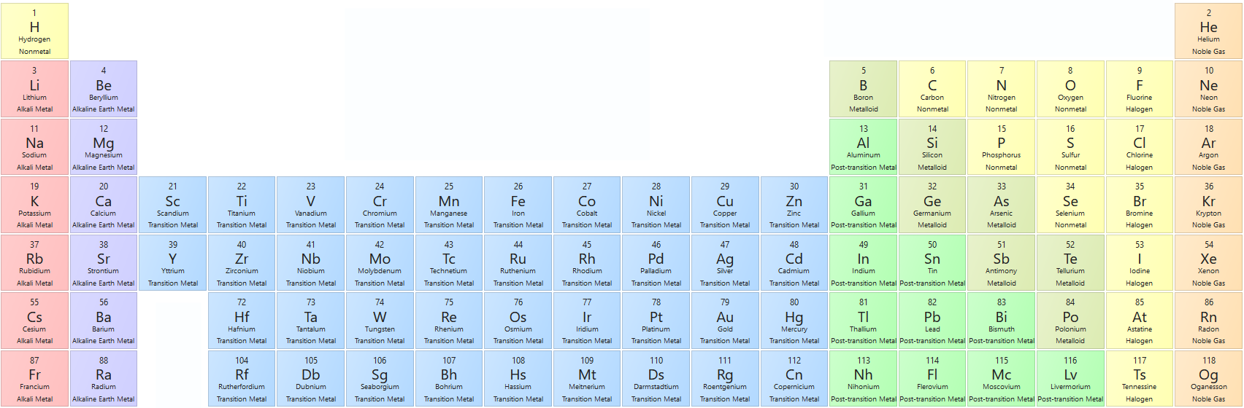
Plasma facing materials in ITER Like Wall
PFM possess very different properties and, therefore, each requires a different approach for the measurements of tritium trapped in the bulk
Beryllium
Inconel 718*
Element(s) | Be | W | Ni₅₃Fe₁₉Cr₁₉NbMoTi | C
Atomic mass | 9 | 74 | ~27 | 12
Density, g·cm⁻³ | 1.18 | 19.3 | 8.1 | 1 -2
Linear thermal expansion, K⁻¹ | 11.4·10⁻⁶ | 4.5·10⁻⁶ | 11.2·10⁻⁶ | (-1-2)·10⁻⁶ [G. Pintsuk. 2009]
Melting point, ºC | 1287 | 3422 | 1370-1430 | 3500
H chemistry | BeH₂ unstable | WH₂ and WH₄ unstable | Only possible at high pressures (nickel) | Forms stable hydrocarbons
Tungsten
CFC
* Nickel based alloy
E. Pajuste| WP PWIE 2022 Reporting Meeting | Julich| 2023| Page 4

Slide 5
Tritium in JET vacuum vessel
During the ITER Like Wall campaigns up to 2021 only stable hydrogen isotopes have been introduced in the vacuum vessel of JET.
Possible sources of tritium:
in-vessel tritium inventory remaining from previous D–T campaigns;
energetic tritium ion production as a result of D–D reaction;
tritium production in neutron-induced transmutation of beryllium.
E. Pajuste| WP PWIE 2022 Reporting Meeting | Julich| 2023| Page 5

Slide 6
Previous D–T campaigns
Preliminary Tritium Experiment (PTE) in 1991 [1]
First Deuterium-Tritium Experiment (DTE1) in 1997 [2,3]
Trace Tritium Experiment (TTE) in 2003 [4].
In total 35,39 g (5 ·10²⁴atoms or 9 PBq) of tritium has been introduced (5 mg – PTE, 35 g – DTE1 and 380 mg – TTE)
If to take into account decay of T in 2021 the activity would be ~3PBq.
Most of the remained tritium must be removed together with the extracted CFC tiles during change to ILW metallic tiles.
[1] Team, J.E.T., 1992, Nuclear Fusion. 32(2): 187.
[2] Jacquinot, J., V.P. Bhatnagar, J.G. Cordey, et al., 1999, Nuclear Fusion. 39(2): 235.
[3] Keilhacker, M., A. Gibson, C. Gormezano, et al., 1999, Nuclear Fusion. 39(2): 209.
[4] Zastrow, K.D., J.M. Adams, B. Yu, et al., 2004, Plasma Physics and Controlled Fusion. 46(12B): B255.
E. Pajuste| WP PWIE 2022 Reporting Meeting | Julich| 2023| Page 6

Slide 7
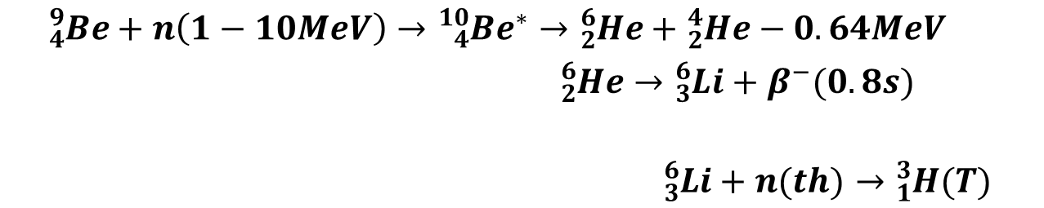
D - D reaction
$${}_{1}^{2}H(H)+{}_{1}^{2}{H (D)→{}_{1}^{3}{H (T)}+{}_{1}^{1}{H (H)}+4.03MeV}$$
Produced tritium kinetic energy is 1.01 MeV that leads to its ability to implant into the material[6]
Neutron induced beryllium transmutations
$${}_{4}^{9}{Be+n\left(1−10MeV\right)→{}_{4}^{10}{{Be}^{∗}}→{}_{2}^{6}{He}+{}_{2}^{4}{He}−0.64MeV}$$
$${}_{2}^{6}{He→}{}_{3}^{6}{Li}+β^{−}(0.8s)$$
$${}_{3}^{6}{Li}+n(th)→{}_{1}^{3}{H(T)}$$
Can be considered to have the lowest contribution since the overall neutron yield are very low: for ILW1 and ILW2 ~5∙10¹⁹ neutrons in total.
E. Pajuste| WP PWIE 2022 Reporting Meeting | Julich| 2023| Page 7
[6] Rubel, M., Journal of Fusion Energy, 2019. 38(3): p. 315-329.

Slide 8
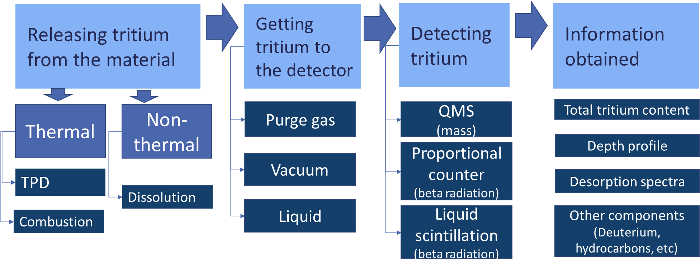
Concepts of tritium measurement
Tritium concentration in PFMs from the ITER Like Wall after D-D campaigns are very small - several orders of magnitude less than that of deuterium.
High sensitivity of the measurement is critical
E. Pajuste| WP PWIE 2022 Reporting Meeting | Julich| 2023| Page 8

Slide 9

Dissolution/etching method
Materials to be applied for: bulk metals, metallic coatings
Based on controlled dissolution/etching of metallic matrix and measurement of tritium being released
Tritium measurment in gasous phase (proportional gas flow detector)
Purge gas
Plasma facing surface
Me
HT, DT, T²
Me⁺
T⁺,
DTO, HTO
T0 interstitial
T+ chemically bonded to impurities
HT, DT or T2 in pores
Tritum measurement by the means of liquid scintillation
Dissolution/etching
Me
Tritium measurements based on its radioactivity
$$A_{T_{total}}=A_{T_{gas}}+A_{T_{liquid}}$$
If dissolution/ etching rate is controlled - depth profile can be assessed of tritium released in the gas phase
E. Pajuste| WP PWIE 2022 Reporting Meeting | Julich| 2023| Page 9

Slide 10
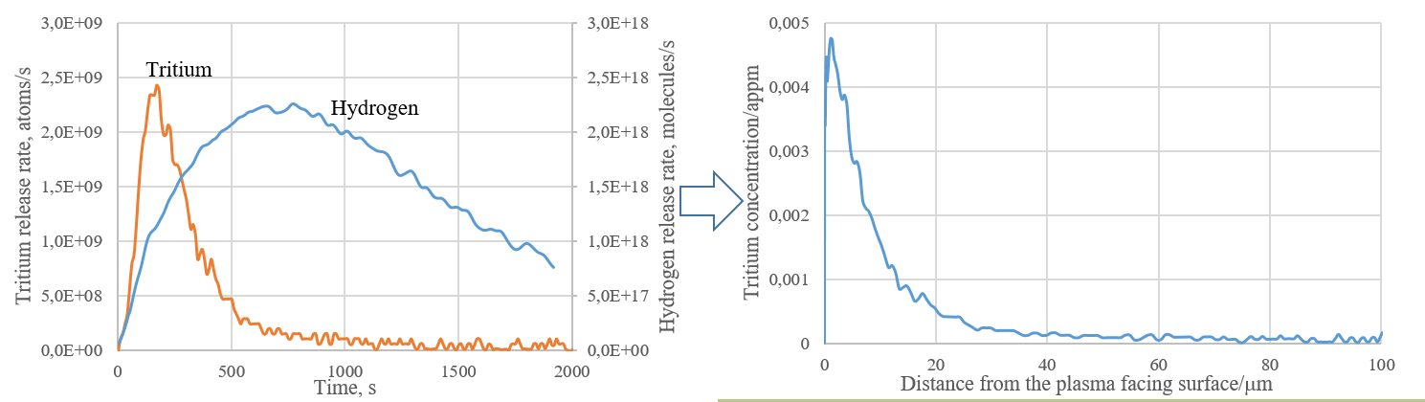
Dissolution method - beryllium
Be⁰ + 2H⁺ → Be ²⁺ + 2H⁰
H⁰ + H⁰ → H_{2 (gas ph.)}
H⁰+T⁰ _{(solid phase)} → HT _{(gas ph.)}
T₂ _{(solid ph.)} → T_{2 (gas ph.)}
T⁺_{(solid ph.)} → T⁺ _{(liquid ph.)}
Successive layers of Be are removed using diluted sulphuric acid and amount of evolved hydrogen (depicted as ‘H’) and released tritium (depicted as ‘T’) measured.
Simultaneous etching of the metal surface and measurements of the released tritium in purge gas (proportional counter) and solution (liquid scintillation)
E. Pajuste| WP PWIE 2022 Reporting Meeting | Julich| 2023| Page 10

Slide 11
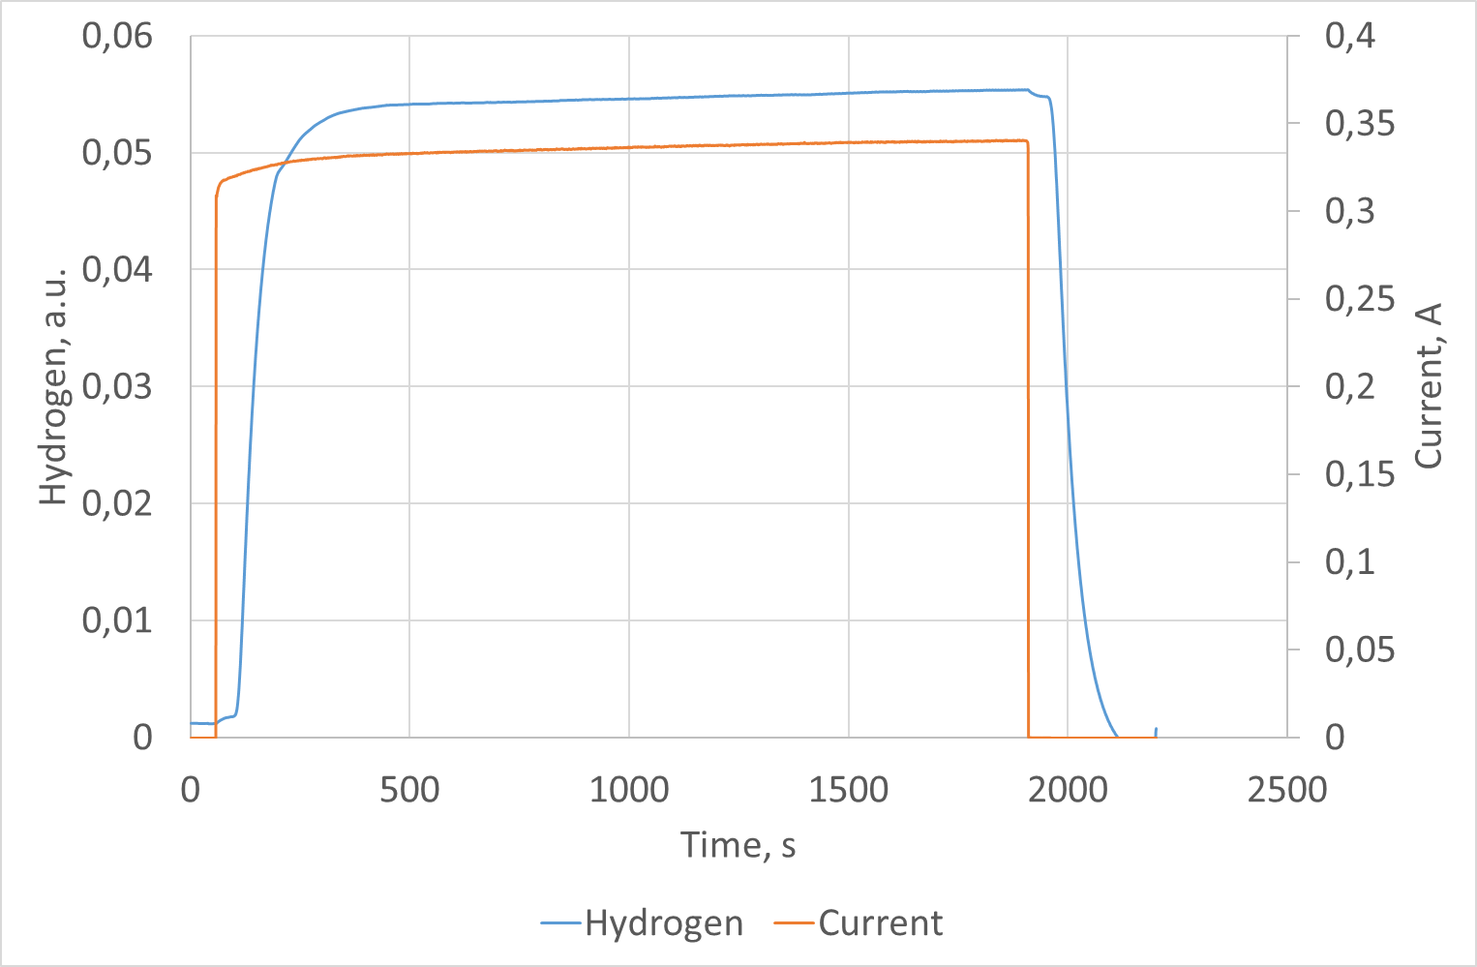
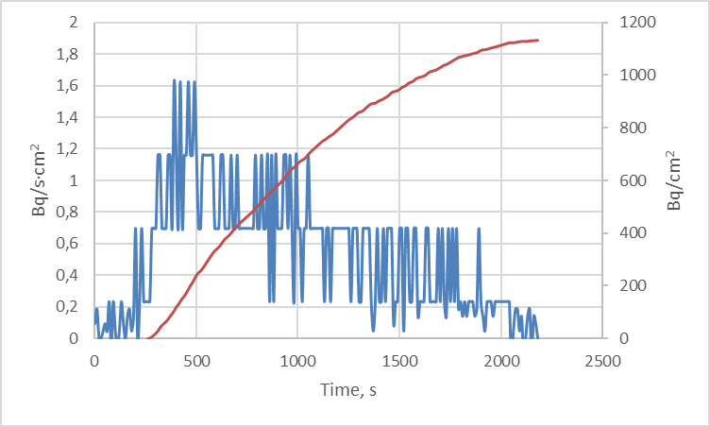
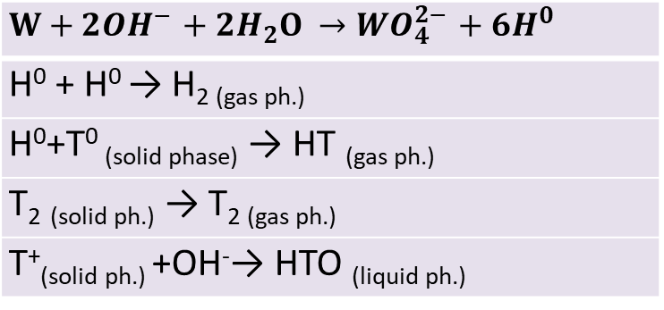
Electrochemical etching- tungsten
Successive layers of W are removed using electrochemically in 35% KOH solution where both electrodes are tungsten.
Amount of evolved hydrogen (depicted as ‘H’) and released tritium (depicted as ‘T’) measured. Applied voltage ~3V.
$$W+2{OH}^{−}+2H_{2}O →{WO}_{4}^{2−}+6H^{0}$$
H⁰ + H⁰ → H_{2 (gas ph.)}
H⁰+T⁰ _{(solid phase)} → HT _{(gas ph.)}
T₂ _{(solid ph.)} → T_{2 (gas ph.)}
T⁺_{(solid ph.)} +OH⁻→ HTO _{(liquid ph.)}
E. Pajuste| WP PWIE 2022 Reporting Meeting | Julich| 2023| Page 11

Slide 12

Combination of etching methods for layered structures
Successive layers of Be are removed using 4 mol/L sulphuric acid, whereas Inconel - by electrochemical etching in the same solution by applying the 3V voltage.
E. Pajuste| WP PWIE 2022 Reporting Meeting | Julich| 2023| Page 12

Slide 13
Thermal desorption
Materials to be applied for: all
Based on controlled thermal treatment and measurement of tritium being released as a result of diffusion
Tritium measurement in gaseous phase (proportional gas flow detector)
Purge gas
HTO,DTO,
HT, DT, T₂
Plasma facing surface
Me, CFC,
mixed
Me, CFC,
mixed
Heating
Rate ~5 K·min⁻¹
T_{max} ~1300K
Before monitor the zinc bed at ~400ºC converts HTO/DTO to HT, DT, and traces of T₂
T0 interstitial
T+ chemically bonded to impurities
HT, DT or T2 in pores
E. Pajuste| WP PWIE 2022 Reporting Meeting | Julich| 2023| Page 13

Slide 14
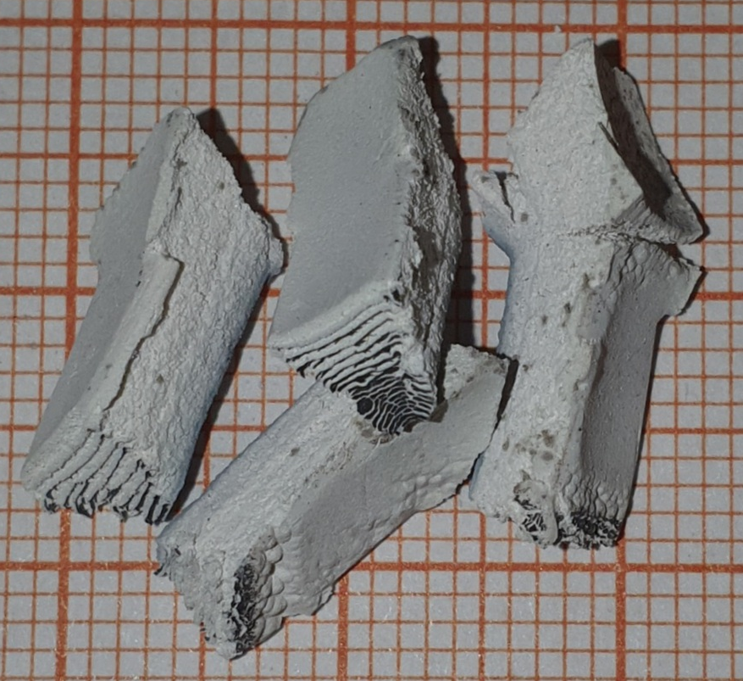
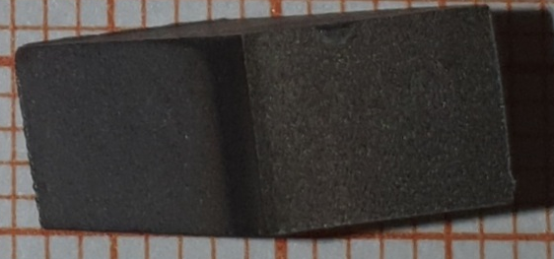
Full combustion
Materials to be applied for: all combustible
Based on full oxidation of material (destruction of the matrix) itself and and measurement of tritium being released
All tritium species are oxidized to water form
HTO,DTO,
HT, DT, T₂
Plasma facing surface
Me, CFC,
mixed
Measured by the means of liquid scintillation
MeO , CO₂,
T0 interstitial
T+ chemically bonded to impurities
HT, DT or T2 in pores
Heating in moistened air
~1100K
Example of Be specimen
E. Pajuste| WP PWIE 2022 Reporting Meeting | Julich| 2023| Page 14

Slide 15


COMPARISON OF METHODS
Dissolution/etching
TDS
Full combustion
Information on
  total tritium amount
  depth profile
  chemical state (can be adapted)
In layered materials information on tritium in each layer can be assessed
Fast
No elevated temperatures used (safe)
Information on
  total tritium amount
  Desorption spectra
Tritium trapping energies can be assessed
Applicable to all kinds of material
High sensitivity
Information on
  total tritium amount
Can be assumed that all tritium is measured since the «hosting matrix» is fully destroid.
ADTVANTAGES
Not all tritium might be measured if not sufficient layer thickness is etched (remains in bulk)
Some data might be lost if tritiated water vapor condensates before reaching the Zn bed
Time consuming
Limited information on tritium initial state in the material
DISADTVANTAGES
E. Pajuste| WP PWIE 2022 Reporting Meeting | Julich| 2023| Page 15

Slide 16
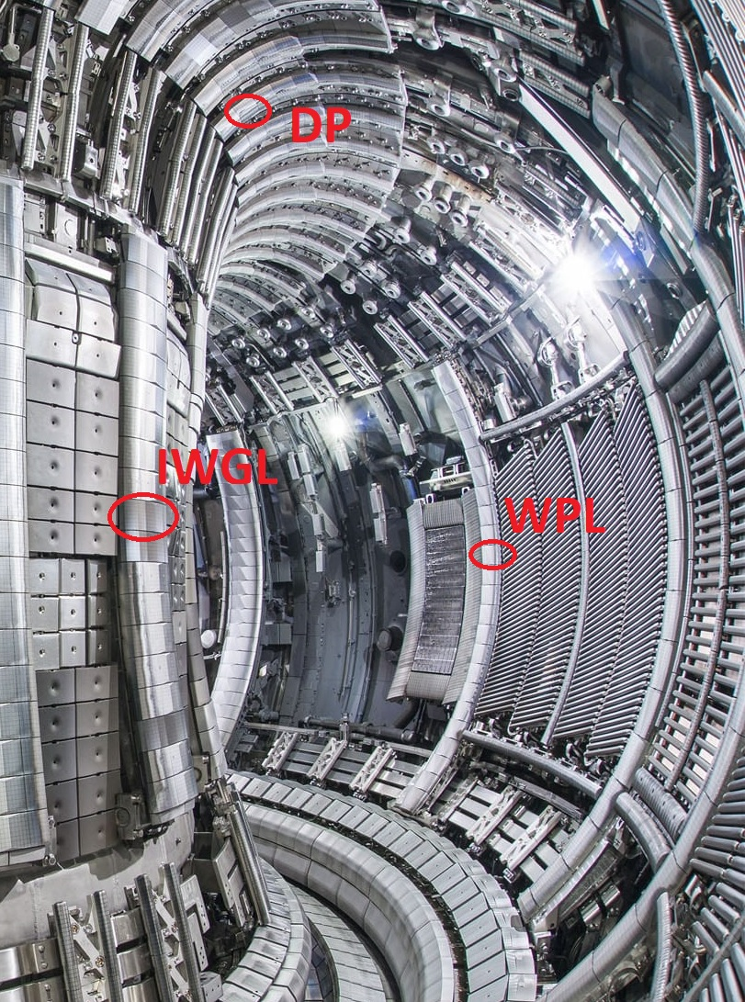
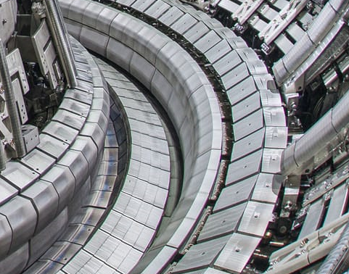
Studied materials
Walls
Bulk beryllium tiles from 3 positions - inner wall (IWGL), outer wall (WPL) and upper part (DP) of the vessel
Beryllium coated Inconle tile from the inner wall (IWC) (indicative position in the vessel regarding toroidal direction)
IWC
Divertor
Tungsten coated CFC tiles - High Field Gap Closure tile (HFGC), divertor tile No 1 (14ING1A) and No 3 (14IG3B),
HGFC
Bulk tungsten lamellas – divertor lamella A24
W lamellas
14IG3B
E. Pajuste| WP PWIE 2022 Reporting Meeting | Julich| 2023| Page 16

Slide 17
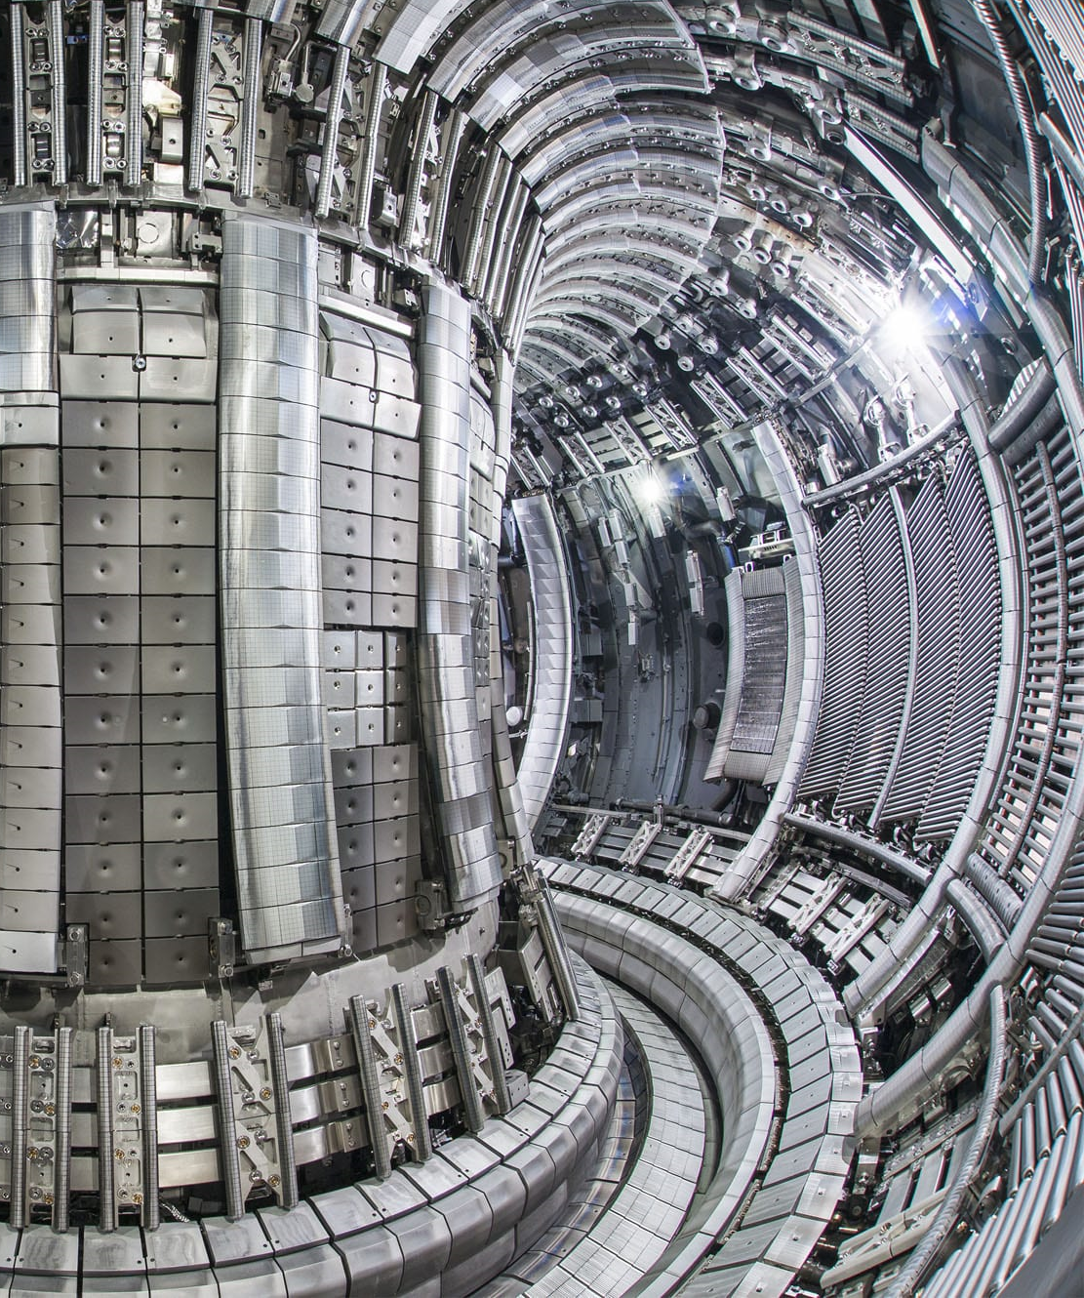
Tritium distribution in vessel (2011-2012)
Bulk Be
2x10¹² T atoms/cm²
Bulk Be
(2-9)x10¹² T atoms/cm²
Be/Inconel*
15x10¹² T atoms/cm²
Bulk Be
(5-40)x10¹² T atoms/cm²
W/CFC
(1-10)x10¹² T atoms/cm²
Bulk W
3.5x10¹² T atoms/cm²
W/CFC
2x10¹² T atoms/cm²
* Particular sample has been 2011 -2015
E. Pajuste| WP PWIE 2022 Reporting Meeting | Julich| 2023| Page 17

Slide 18
Tritium concentration beryllium tiles
Tritium concentration at particular positions in vacuum vessel in tiles exposed to each campaign and tiles exposed throughout all campaigns
Position, mm | T atoms/cm² x10¹² |  |  |  |  | %
 | ILW1 | ILW2 | ILW3 | Sum | 1-3
Outer wall tile WPL
-146 | 15 | 18 | 33 | 66 | 39 | 59
-33 | 16 | 22 | 39 | 77 | 81 | 105
98 | 4 | 21 | 11 | 35 | 15 | 42
146 | 3 | 2 | 4,6 | 10 | 2,5 | 25
Inner wall tile IWGL
-145 | 2 | 0.5 | 0.3 | 3 | 2.4 | 77
-92 | 4 | 2 | 0.4 | 6 | 2.5 | 41
145 | 2.1 | 1.2 | 0.5 | 4 | 1.2 | 32
E. Pajuste| WP PWIE 2022 Reporting Meeting | Julich| 2023| Page 18

Slide 19
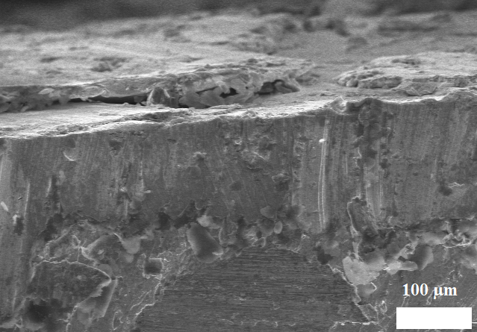
Tritium distribution in layered material
Beryllium coated Inconel
Beryllium coating
1.5x10¹³ atoms per cm²
Inconel substrate
4x10¹¹ atoms per cm²
More than 97% of the measured tritium is accumulated in the thin beryllium coating
E. Pajuste| WP PWIE 2022 Reporting Meeting | Julich| 2023| Page 19

Slide 20
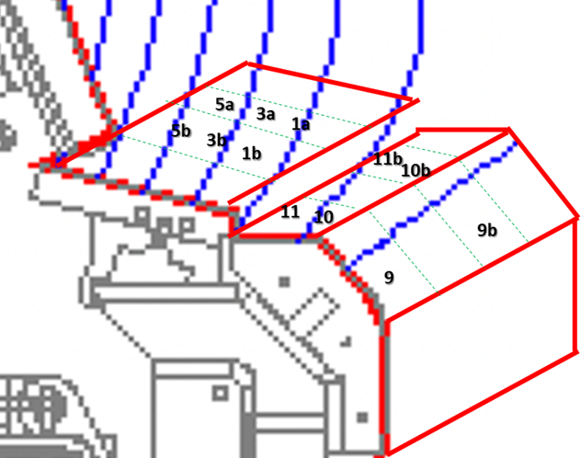
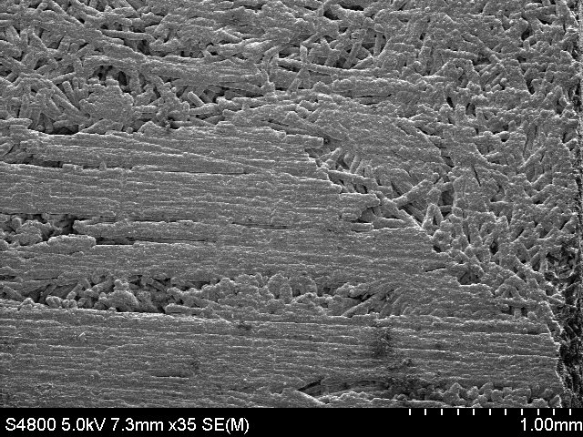
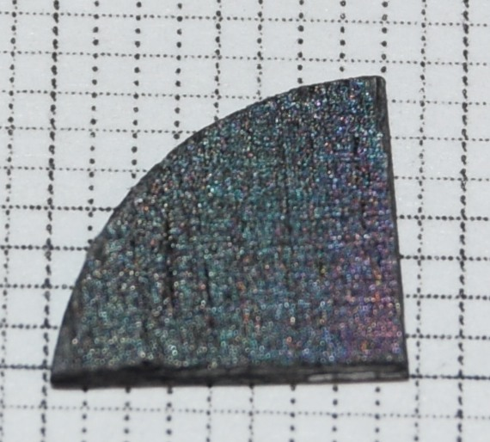
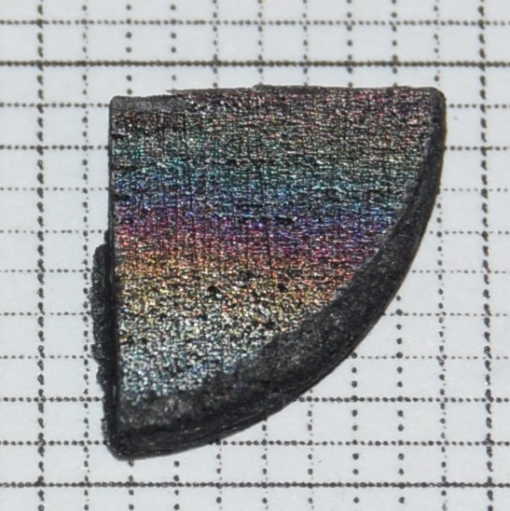
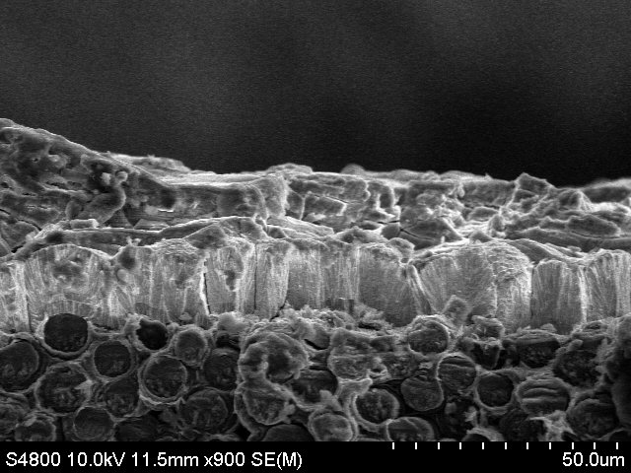
Tritium concentration - divertor, W/CFC
2 mm
Samples of a~1 mm surface layer (ranges up to 1,5 mm). Tritium accumulation might be further than that into the bulk
2 mm
E. Pajuste| WP PWIE 2022 Reporting Meeting | Julich| 2023| Page 20

Slide 21
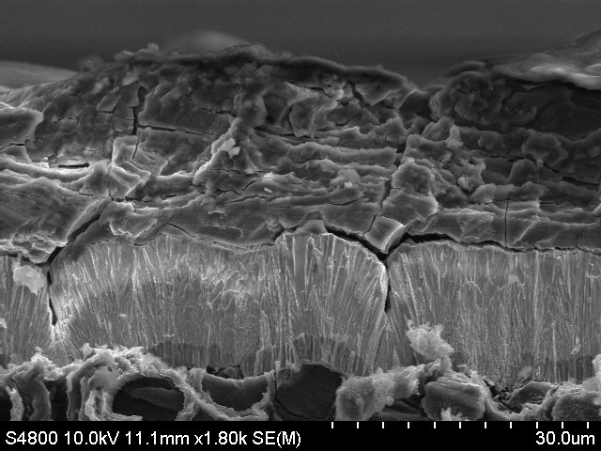
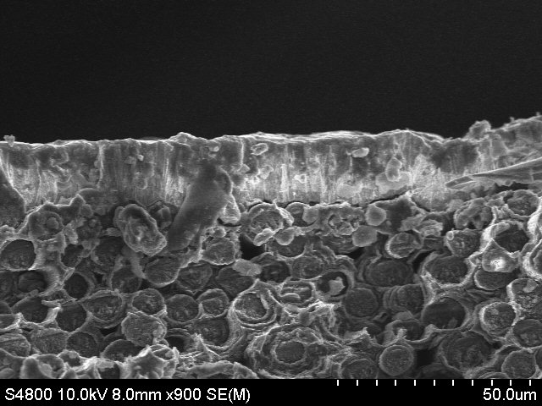
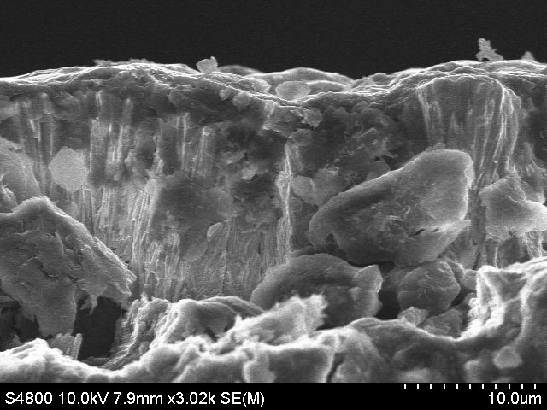
TDS
1 a
5 a

Slide 22
Summary
Tritium concentration in plasma facing materials is in range from 10¹⁰ to 10¹⁴ atoms per cm²
Variances in tritium accumulation behaviour in different vacuum vessel locations indicate differences in dominant sources: implantation of energetic T ions, D-D reaction products, in outer wall and tritium co-deposition with erosion products on the inner wall and upper parts of vacuum vessel
There are several approaches for tritium measurements depending on the material type and the required information and can be adapted also the mixed materials such as coating and substrate
Methods based on tritium radioactivity measurements can be applied to trace amount measurements – T total amount, thermal desorption spectra, depth estimation in PFMs with T concentration down to 10¹⁰ atoms per cm2

Slide 23
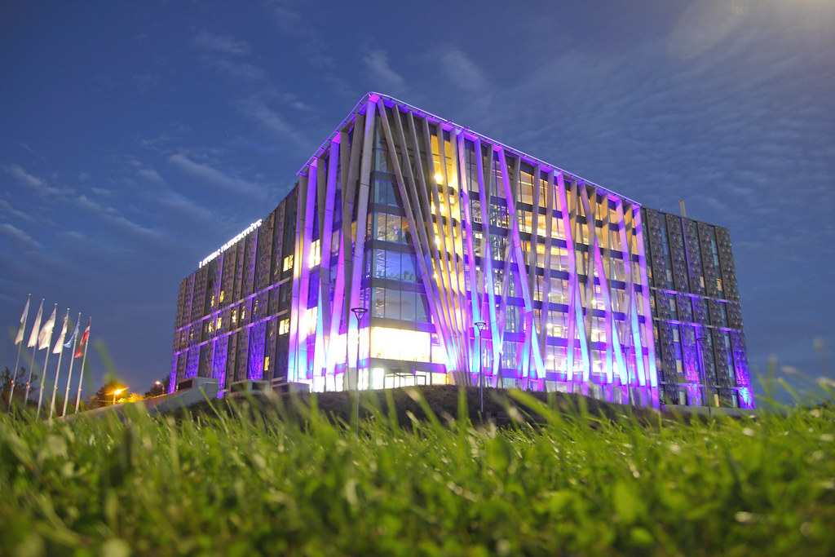
Thank you for your attention!
Asoc. Prof. Elina Pajuste
Institute of Chemical Physics
University of Latvia
Jelgavas 1, Riga, Latvia
elina.pajuste@lu.lv
University of Latvia Academic Center of Natural Sciences

