Slide 1

WP PWIE: SP B final reporting 2022 /
SP B elaborated plans for 2023
SPL B: Antti Hakola
Notes:
Please Indicate your subproject

Slide 2
Introduction to SP B
SP B deals with experimental erosion, deposition, and material migration investigations, in linear devices and laboratories as well as in EUROfusion toroidal devices
Emphasis put on post-exposure analyses (and pre-characterization) besides the experiments
  NB! In toroidal devices experiments primarily under other EUROfusion WPs (WP TE, WP W7X)
The SP B work in 2022 was a direct continuation of the research themes introduced in 2021 – essentially a two-year program with small adaptations upon transition from 2021 to 2022
  Details of individual tasks refined in a series of kick-off meetings (separately for each activity area) in March 2022
  Task monitoring via email in July and September and in the PWIE Progress Meeting in October
Emphasis put on defining deliverables to address broader entities rather than manage a number of scattered tasks
  Comparative erosion experiments on the involved linear devices
  Extracting material-migration pathways on AUG, WEST, and W7-X tiles and samples
  Round-robin studies of produced reference coatings
In addition, thematic meetings organized in smaller subgroups
  Conclusions on the analysis campaign of WEST C3 marker samples – jointly with CEA
  Role of surface roughness in sputtering/erosion – jointly with SP D
  Brainstorming events on sample production, sample exposures and dust investigations
All material of the past meetings available in INDICO, see https://indico.euro-fusion.org/category/325/

Slide 3
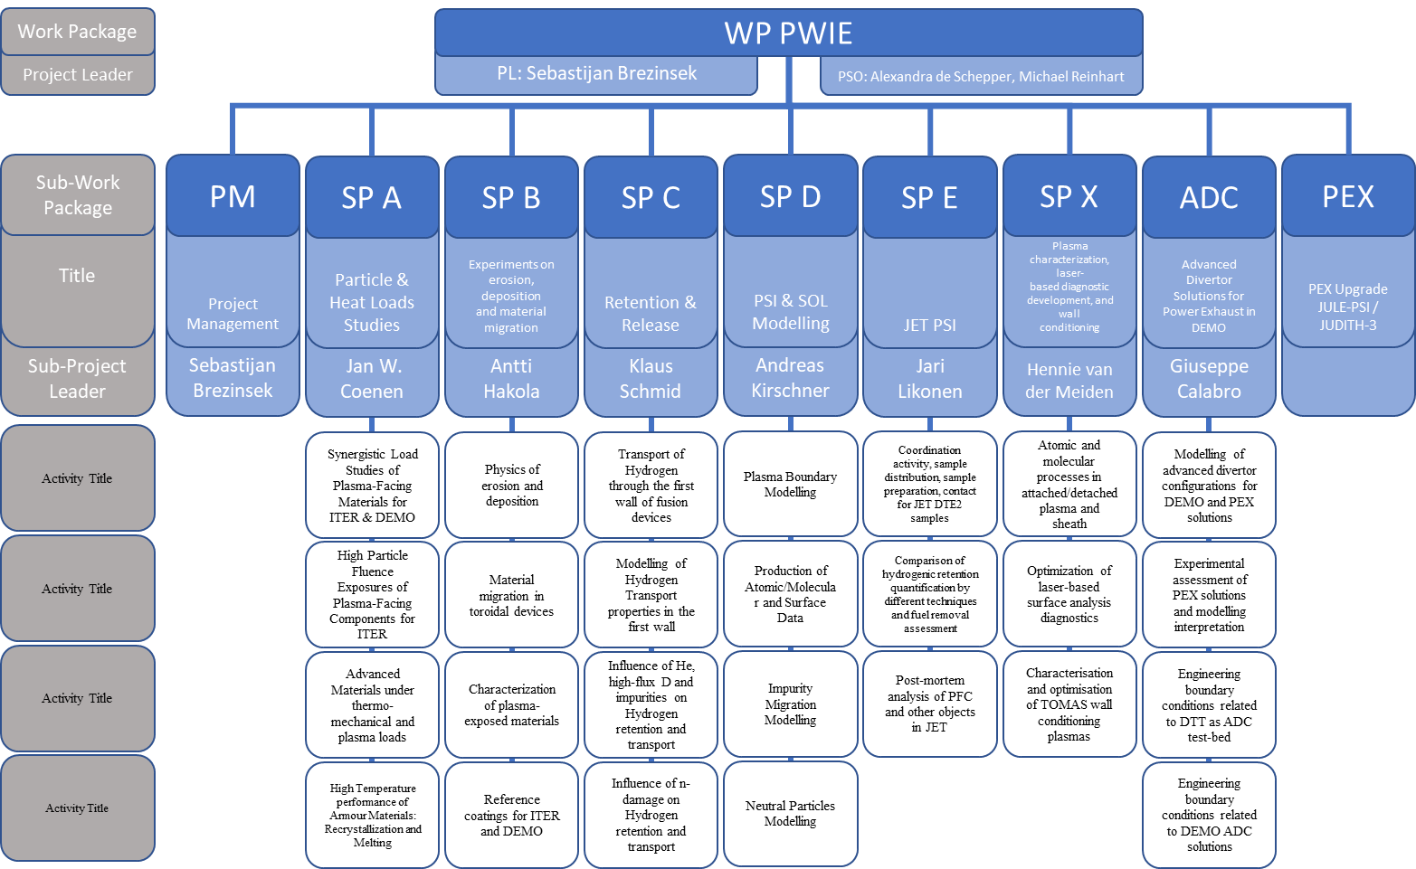
PWIE 2022: SP B
DPL for ADC: Giuseppe Calabro

Slide 4
PWIE 2023: SP B
SP B will continue in 2023 almost according to the breakdown established back in 2021 – with the following changes:
Dust investigations under a separate activity area SP B.5 (new tasks and tasks shifted from SP B.1)
Shifting all ”service work” related to surface analyses of tokamak/stellarator samples under SP B.3
  SP B.2 concentrates on analysis of the outcomes of specific experiments
Re-considering the program for producing Be samples under SP B.4
  We may want to focus on JET-relevant deposits and assist in the preparation of the JET LIBS project
Updated activity areas:
SP B.1: Physics of erosion and deposition (no dust)
SP B.2: Material migration in toroidal devices (special experiments on AUG and W7-X)
SP B.3: Characterization of plasma-exposed materials (all post-exposure analyses)
SP B.4: Reference coatings for ITER and DEMO (including surface analyses of the reference layers)
SP B.5: Production of metallic dust in toroidal devices (including dust production on AUG, WEST, MAGNUM-PSI)
Only small changes to the envelope of PMs (=integral over all the activity areas) allocated to each RU
  Reductions mainly due to limitations in the PWIE budget
After this review event, the details of the tasks will be defined in a series of kick-off meetings in March-April

Slide 5
SP B Milestones 2022
Relevant Work Package Milestones for SP B extracted from WP PWIE PMP 2022
WM31 | SP B | Effective sputtering yields and erosion rates of W model systems with varying impact angles, morphologies, and surface structures at varying plasma conditions available (ITER+DEMO) | 31.12.2022
WM32 | SP B | Erosion and re-deposition patterns on selected marker samples and plasma-facing components, extracted from ASDEX Upgrade (2019-2021), WEST (C4, C5), and W7-X (OP1.2B) elucidated (ITER+DEMO) | 31.12.2022
WM33 | SP B | Be- and W-based reference coatings produced with composition, fuel content, and structure similar to those of typical co-deposited layers in tokamaks (ASDEX Upgrade, WEST, JET) (ITER+DEMO) | 31.12.2022
WM34 | SP B | Post-mortem analysis of material samples and components exposed to medium and high flux operation campaigns 2021/2022 in MAGNUM-PSI and PSI-2 performed. | 31.12.2022
Main reasons for delays:
Unavailibity of MAGNUM-PSI and slow start of GyM
Lengthy process for defining specifications of samples and their exposures in linear facilities
No new WEST samples

Slide 6
SP B Milestones 2023
Relevant Work Package Milestones for SP B extracted from WP PWIE PMP 2023
WM57 | SP B | Dependence of W erosion/deposition rates on plasma flux and impurity composition available for W model systems and role of CX neutrals on sputtering in past experiments reported. (ITER+DEMO) | 31.12.2023
WM58 | SP B | Erosion and re-deposition patterns and characteristics of W nanostructures on marker samples originating from ASDEX Upgrade helium experiments determined. (ITER+DEMO) | 31.12.2023
WM59 | SP B | W marker samples and ITER-like plasma-facing units removed after the WEST C5 campaign characterized and comparison made between C3, C4 , and C5 incl. helium results. (ITER+DEMO) | 31.12.2023
WM60 | SP B | Fuel-containing Be+O and W+O samples produced, exposed in linear facilities, and characterized for their similarities to existing or expected layers in tokamaks (ASDEX Upgrade, WEST, JET). (ITER+DEMO) | 31.12.2023
New ingredients
Role of CX neutrals on erosion and assessing the outcomes of most recent helium experiments
Completing analyses of WEST C4 marker samples and starting C5 sample analyses
Detailed comparison between reference layers and tokamak co-deposits

Slide 7
SP B Deliverables 2022
Activity | Deliverable ID(s) | Title
SP B.1 | D001, D007 (2021 transfer) | Erosion rates of W model systems and composition and structure of re-deposited layers in MAGNUM-PSI at varying plasma conditions (DIFFER)
SP B.1 | D002 | Effective sputtering yields of W model systems with varying morphologies in pure and mixed plasmas in GyM and by hypervelocity dust impacts (ENEA)
SP B.1 | D003 | Erosion rates and angular distribution of W model systems with varying morphologies as well as composition and structure of re-deposited layers in PSI-2 at varying plasma conditions (FZJ)
SP B.1 | D004, D006 | Effective sputtering yields of W model systems with varying morphologies and structures, including angular distributions of sputtered particles, and re-deposited W layers following exposure to controlled D and impurity ion beams (ÖAW, VR)
SP B.1 | D005, D008 (2021 transfer) | Size distribution and composition of Be and W dust formed during air and water leaks (IAP)
SP B.2 | D001 | Erosion, re-deposition, and fuel-retention patterns on selected WEST PFUs after C3, C4, and C5 campaigns (CEA)
SP B.2 | D002, D003 | Balance between gross and net erosion of plasma-facing materials, including components with different surface roughness and morphology, in controlled L- and H-mode plasma experiments (JSI, VTT)
SP B.2 | D004, D005, D006, D007, D008, D009, D010, D11 (2021 transfer IPPLM) | Characterization of marker samples and coatings from selected plasma experiments on AUG, WEST, and/or W7-X with conclusions (FZJ, MPG, VR, IPPLM, RBI)
SP B.3 | D001 | Database on ageing, erosion, and fuel-retention behavior of selected WEST PFUs (CEA)
SP B.3 | D002, D003, D004, D005, D006, D007, D008, D009 (2021 transfer IPPLM) | Characterization of selected AUG, WEST and/or W7-X wall tiles and plasma-exposed reference samples (FZJ, IPPLM, IST, IAP, MPG, NCSRD, VTT)
SP B.4 | D001 | W-based coatings with pre-defined properties (incl. SEM, AFM, TDS characterization) produced for analyses and plasma experiments (ENEA)
SP B.4 | D002, D009 (2021 transfer) | Be and W-based coatings with pre-defined properties (incl. SEM, XRD, GDOES, TDS characterization) produced for analyses and plasma experiments (IAP)
SP B.4 | D003, D004, D005, D006, D007, D008 | Characterization of selected Be and/or W reference samples (CEA, CIEMAT, IST, JSI, RBI, VTT)
All deliverables reported and can be considered to be completed – except for technical shifts into 2023

Slide 8
SP B Deliverables 2023
Activity | Deliverable ID(s) | Title
SP B.1 | D001 | Erosion rates of W and W+O model systems in MAGNUM-PSI at varying fluxes, fluences, and impurity contents (DIFFER)
SP B.1 | D002 | Erosion rates of W and W+O model systems in GyM at varying fluxes, fluences, and impurity contents (ENEA)
SP B.1 | D003 | Erosion rates of W and W+O model systems in PSI-2 at varying fluxes, fluences, and impurity contents (FZJ)
SP B.1 | D004, D005 | Effective sputtering yields of nanostructured W model systems following exposure to controlled ion beams (ÖAW + VR for surface analyses)
SP B.2 | D001 | Erosion and deposition patterns on marker and ITER-like PFUs after WEST C5 campaign (CEA)
SP B.2 | D002, D003, D004 | Qualification of W fuzz production in AUG He plasmas (FZJ); Balance between gross and net erosion in AUG He plasmas and comparison with available D data (VTT); Erosion, deposition, and surface modification patterns on samples exposed to AUG He plasmas (MPG)
SP B.2 | D005, D006 | Erosion and deposition characteristics on samples exposed to OP1.2a, OP1.2b, and OP2 campaigns on W7-X (FZJ); Erosion and deposition characteristics of manipulator samples from OP2 experiments in W7-X (MPG)
SP B.3 | D001-D010 | Characterization of selected AUG, WEST and/or W7-X wall tiles and plasma-exposed reference samples (FZJ, IAP, IPPLM, IST, JSI, MPG, NCSRD, RBI, VR, VTT)
SP B.3 | D011 (2022 transfer IPPLM) | SEM, TEM and FIB characterization of selected samples from experiments on WEST and W7-X with conclusions (IPPLM)
SP B.4 | D001 | W-based coatings with pre-defined composition and morphology for experiments in linear plasma facilities (ENEA)
SP B.4 | D002, D003 | W-based coatings with pre-defined composition and morphology for experiments in linear plasma facilities (IAP); Be-based coatings with pre-defined composition and morphology for comparison with data from tokamaks (IAP)
SP B.4 | D004-D010 | Characterization of selected Be and/or W reference samples (CEA, CIEMAT, IPPLM, IST, JSI, RBI, VTT)
SP B.5 | D001 | Hypervelocity dust impacts on W and W+O model systems and comparison with data from tokamaks (ENEA)
SP B.5 | D002 | Database of the characteristics of produced Be and W dust particles and comparison with data from tokamaks (IAP)
SP B.5 | D003 | Document on the characteristics and amount of dust generated on ASDEX Upgrade and WEST during past experimental campaigns and on the connection of arcing on dust production (MPG)
SP B.5 | D004 | Document on the physical and remobilization characteristics of dust produced on ASDEX Upgrade and MAGNUM-PSI (VR)

Slide 9
SP B.1 – Physics of erosion and deposition – selected results from 2022 and plans for 2023

Slide 10
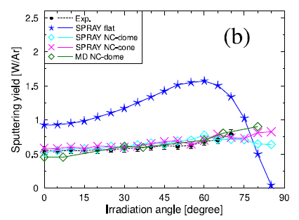
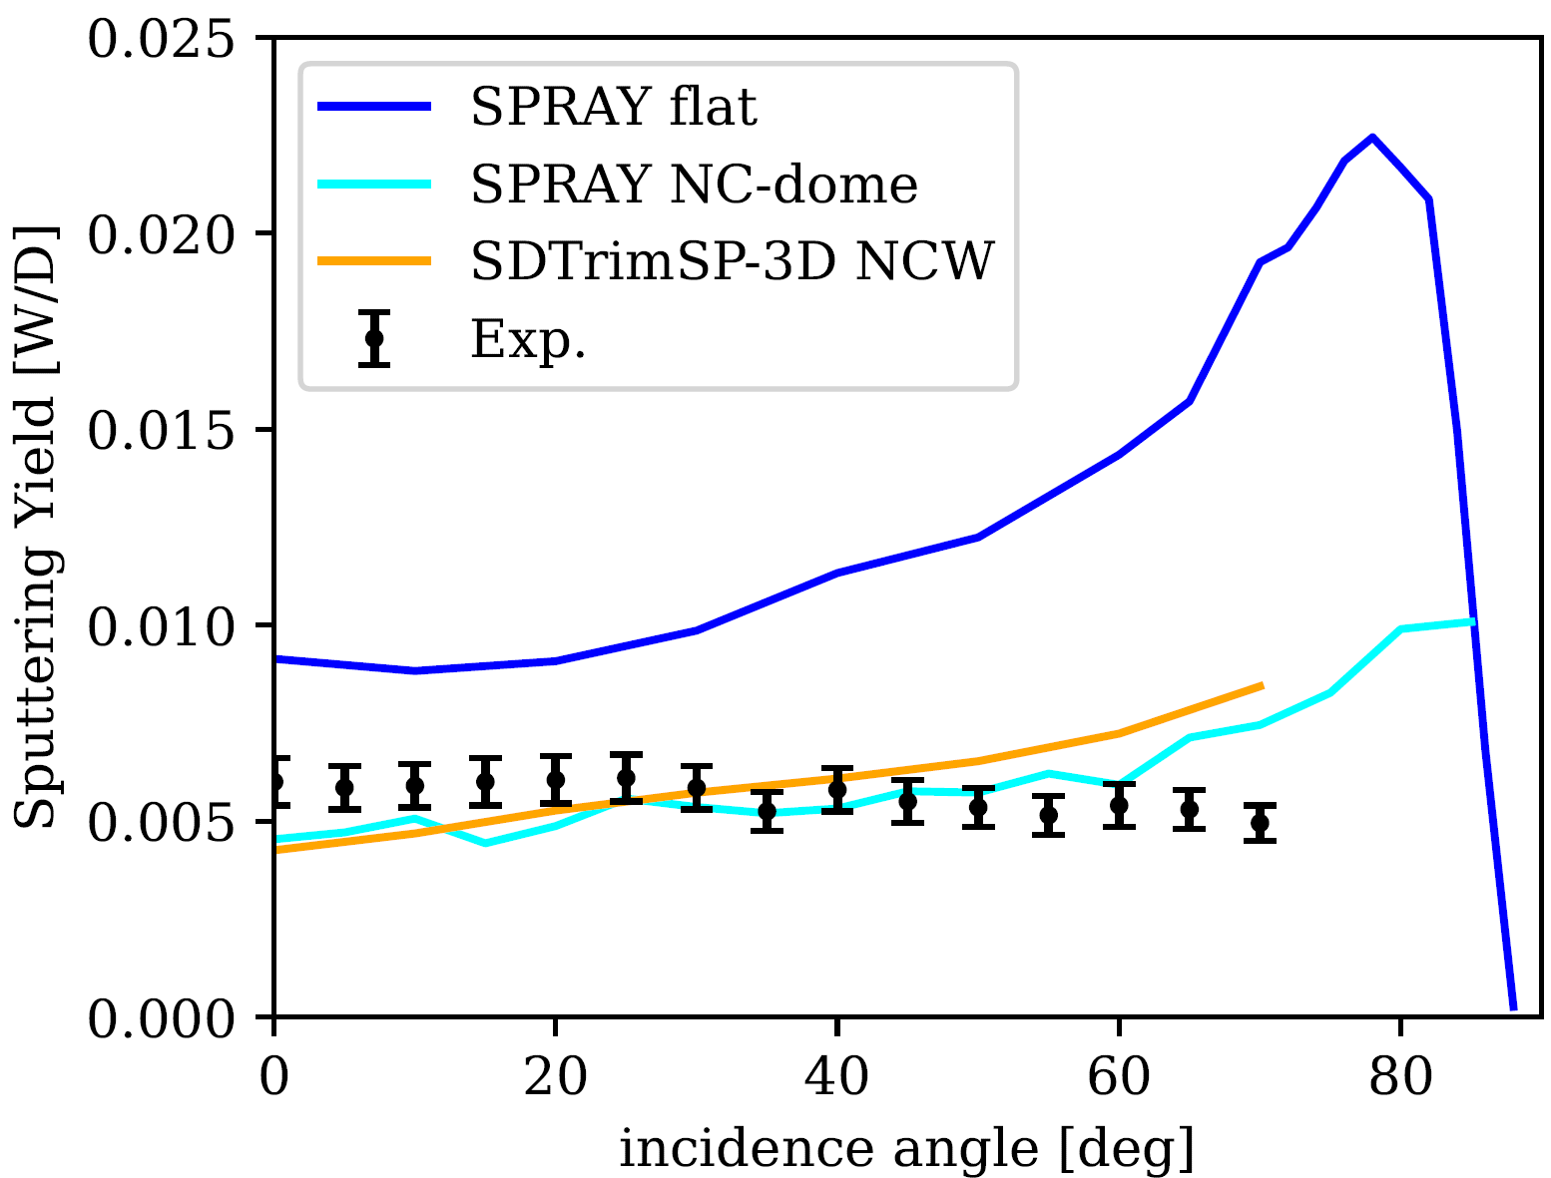
SPB.1: Effective sputtering yields of W model systems and re-deposits in lab conditions
  Key goals for the 2022 task:
  Describe influence of morphology on sputtering for Gaussian rough surfaces
  Cooperation with UPM: created oriented nanocolumnar W (NCW) on QCM samples
    QCM experiments with Ar and D bombardment of NCW at TU Wien
  Cooperation with University of Helsinki for MD simulations of NCW
    Comparison with SPRAY (see SP D task 2022) and MD-PARCAS, SDTrimSP-3D
SEM cross-section
SEM top-view
QCM vs. simulations 1keV Ar⁺
QCM vs. simulations 1keV D⁺
height = 500 nm, diameter = 50 nm, areal density = 58%
[1] https://doi.org/10.1016/j.surfin.2022.101924
[2] https://doi.org/10.1103/PhysRevMaterials.6.075402
Deliverable: PWIE.SPB.1.T002.D004, D006
Status: completed
Facilities: 5 days accelerator (VR)
Human Resources: 5 PM + 3 PM
Involved RU: ÖAW, VR
Linked WP or TSVV: WP ENR-MAT.01.VR, SP D.2.T002
C. Cupak et al. (ÖAW), D. Primetzhofer et al. (VR)

Slide 11
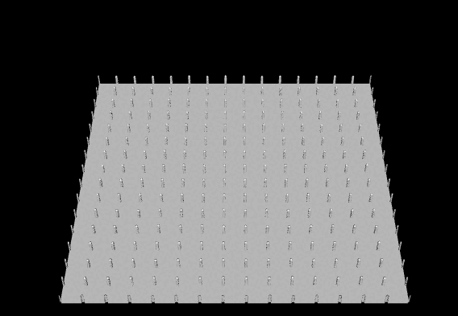
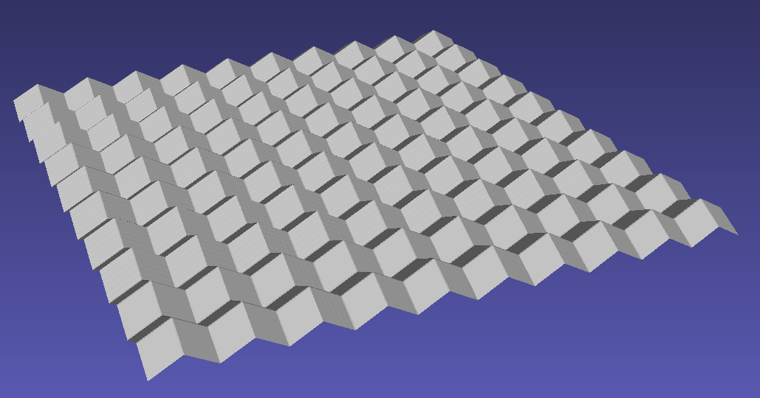
SPB.1: Effective sputtering yields of nanostructured W model systems following exposure to controlled ion beams
  Main plans for 2023:
  Nano-columnar tungsten (NCW):
    Optimise shape of NCW with SPRAY to minimise sputter yields
    Deploy optimised NCW as real samples on QCM (at UPM)
    QCM experiments + simulations (static trends with SPRAY)
    Study dynamic erosion of NCW both experimentally (QCM) and numerically (SDTrimSP-3D, MD-PARCAS)
  Pyramidal W samples:
    Cooperation with ENEA (A. Uccello, D. Dellasega, M. Pedroni et al.)
    Continue experimental investigations with QCM methods
    Support with numerical simulations (SPRAY)
  In all cases co-operation with the SP D tasks
C. Cupak et al. (ÖAW), D. Primetzhofer et al. (VR)

Slide 12
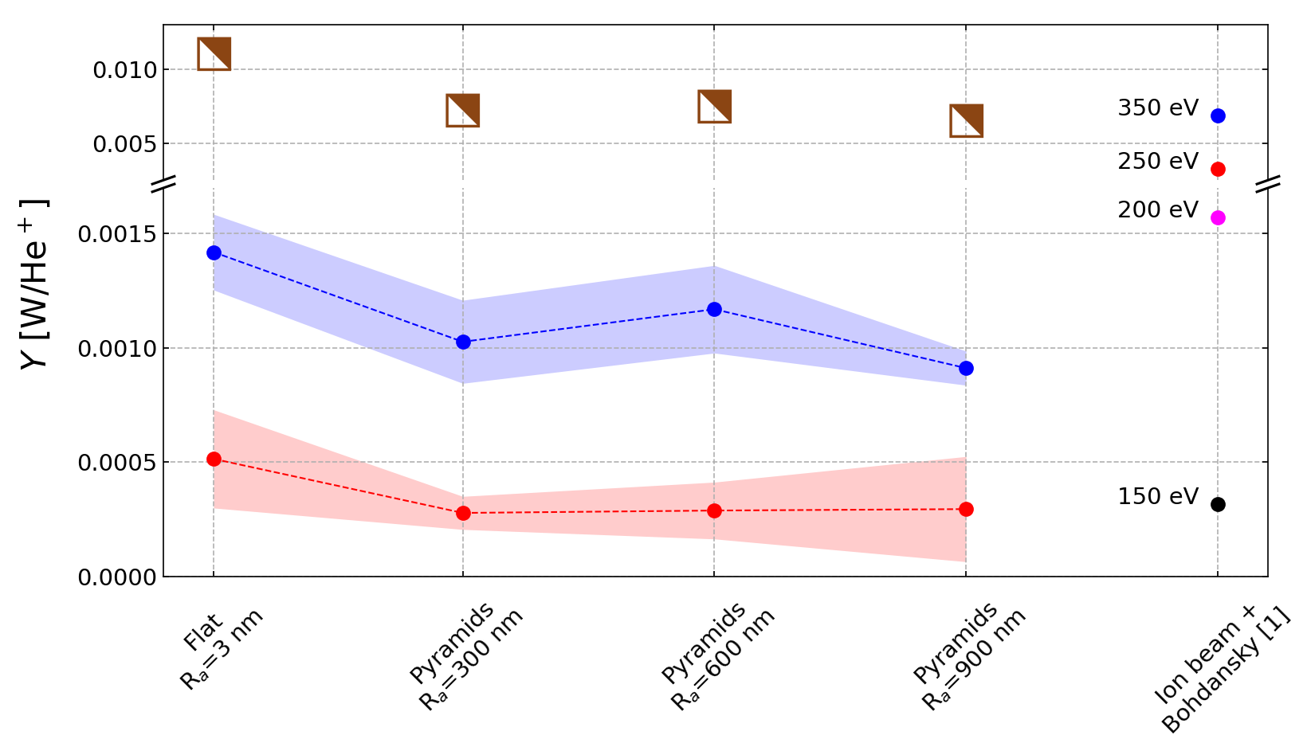
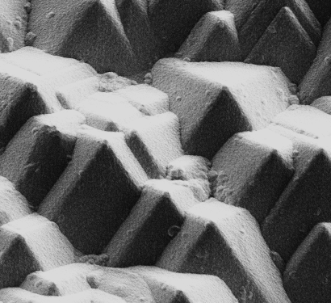
SPB.1: Role of roughness in sputtering of W by GyM He plasma
Exposure of W/Si samples: 6 He⁺ energies @ 4.0e24 He⁺ m⁻²
He⁺ energy [eV] | 30 | 80 | 150 | 200 | 250 | 350
Sputtering E_{th} of W_{bulk} by He⁺ ~110 eV [1]
Pyr. R_{a} = 300 nm
No significant topography and morphology modifications → quasi-static Y
from SP D.3
ERO2.0
350 eV
350 eV
Y from mass loss data Δm
Pyr. R_{a} = 900 nm
SP B.4
250 eV
10 μm
No erosion for E_{ion} ≤ 200 eV
Y_{Δm} ≪ Y_{Ion} → similar to what was observed in other LPD experiments [2]
  He atoms on the surface potentially shield W lattice atoms reducing their sputtering probability
  Also explains Y_{Δm} ≪ Y_{ERO} at 350 eV
For E_{ion} ≥ 250 eV → Y_{Flat,Δm} > Y_{Pyramids,Δm}
[1] W. Eckstein, et al., IPP 9/82 Sputtering data [2] R.P. Doerner, Scr. Mater. 143 (2018) 137-141
Deliverable: PWIE.SPB.1.T002.D002
Status: in progress (estimated completion by 28.02.2023)
Facilities: 20 days GyM – will be used fully
Human Resources: 4 PM
Involved RU: ENEA
Linked WP or TSVV: SP D.1.T002, SP D.3.T002
A. Uccello et al. (ENEA)

Slide 13
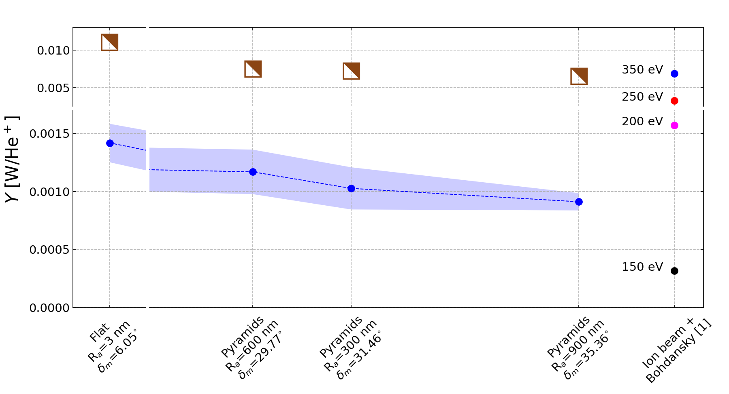
SPB.1: Role of roughness in sputtering of W by GyM He plasma
Exposure of W/Si samples: 6 He⁺ energies @ 4.0e24 He⁺ m⁻²
He⁺ energy [eV] | 30 | 80 | 150 | 200 | 250 | 350
Sputtering E_{th} of W_{bulk} by He⁺ ~110 eV [1]
Pyr. R_{a} = 300 nm
No significant topography and morphology modifications → quasi-static Y
from SP D.3
ERO2.0
350 eV
350 eV
Pyr. R_{a} = 900 nm
Y from mass loss data Δm
SP B.4
10 μm
Non-monotonous behaviour of Y_{Δm} and Y_{ERO} at E_{ion} = 350 eV if R_{a} is used for characterising surfaces
Mean value of surface inclination angle distribution, 𝛿_{m} → key-parameter determining erosion of samples, rather than R_{a} [3]
[1] W. Eckstein, et al., IPP 9/82 Sputtering data [3] C. Cupak, et al., Appl. Surf. Sci. 570 (2021) 151204
Deliverable: PWIE.SPB.1.T002.D002
Status: in progress (estimated completion by 28.02.2023)
Facilities: 20 days GyM – will be used fully
Human Resources: 4 PM
Involved RU: ENEA
Linked WP or TSVV: SP D.1.T002, SP D.3.T002
A. Uccello et al. (ENEA)

Slide 14
SPB.1: Erosion rates of W and W+O model systems in GyM
Task to be performed in 2023
Elucidate sputtering and re-deposition properties of W and W+O model systems (from SP B.4) in specific plasma conditions of GyM
Apply helium plasma with a few impinging He⁺ energies and sample-holder bias voltage value
Scan the fluence
Participate in cross-machine experiments → PSI-2 and MAGNUM-PSI also involved
  Possible goal: investigate effect of ion flux on exposure outcomes
  How: select one fluence value (at least) accessible to all 3 LPDs
  For example, ~1.5e25 He⁺m⁻² (i.e. He plasma fluence with GyM after a working-day)
A. Uccello et al. (ENEA)

Slide 15
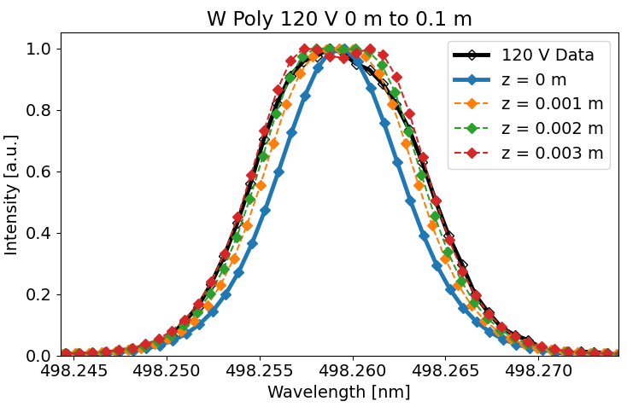
SPB.1: Erosion rates of W model systems and composition of re-deposited layers in PSI-2
Erosion and re-deposition of W studied using spectroscopy in PSI-2
  W targets: poly W, W (111), W (110), W (100)
First spectroscopic data sets available for benchmarking codes
  Interpretation of the data is sensitive to the position of the line-of-sight (z in the figure on the right)
  3D emission model was developed and completed in 2022
Very small differences in erosion rates observed between the different W targets in the studied energy range (see bottom figure on the right)
  Results consistent for different gases (Ne, Ar, Kr) at 20 - 180 eV and different spectral lines (401 nm, 498 nm, 505 nm)
@498 nm
Deliverable: PWIE.SPB.1.T002.D003
Status: completed
Facilities: 15 days PSI-2
Human Resources: 7 PM
Involved RU: FZJ
Linked WP or TSVV: N/A
O. Marchuk et al. (FZJ)

Slide 16
SPB.1: Erosion rates of W model systems and composition of re-deposited layers in PSI-2
Erosion and re-deposition of W studied using spectroscopy in PSI-2
  W targets: poly W, W (111), W (110), W (100)
First spectroscopic data sets available for benchmarking codes
  Interpretation of the data is sensitive to the position of the line-of-sight (z in the figure on the right)
  3D emission model was developed and completed in 2022
Very small differences in erosion rates observed between the different W targets in the studied energy range (see bottom figure on the right)
  Results consistent for different gases (Ne, Ar, Kr) at 20 - 180 eV and different spectral lines (401 nm, 498 nm, 505 nm)
Plans for 2023:
Using multi-pass laser absorption system at PSI-2 and a new position of the manipulator to alleviate the problem related to asymmetric line shapes due to hollow plasma profiles
Participation in cross-machine experiments (PSI-2, GyM, MAGNUM-PSI)
@498 nm
Deliverable: PWIE.SPB.1.T002.D003
Status: completed
Facilities: 15 days PSI-2
Human Resources: 7 PM
Involved RU: FZJ
Linked WP or TSVV: N/A
O. Marchuk et al. (FZJ)

Slide 17
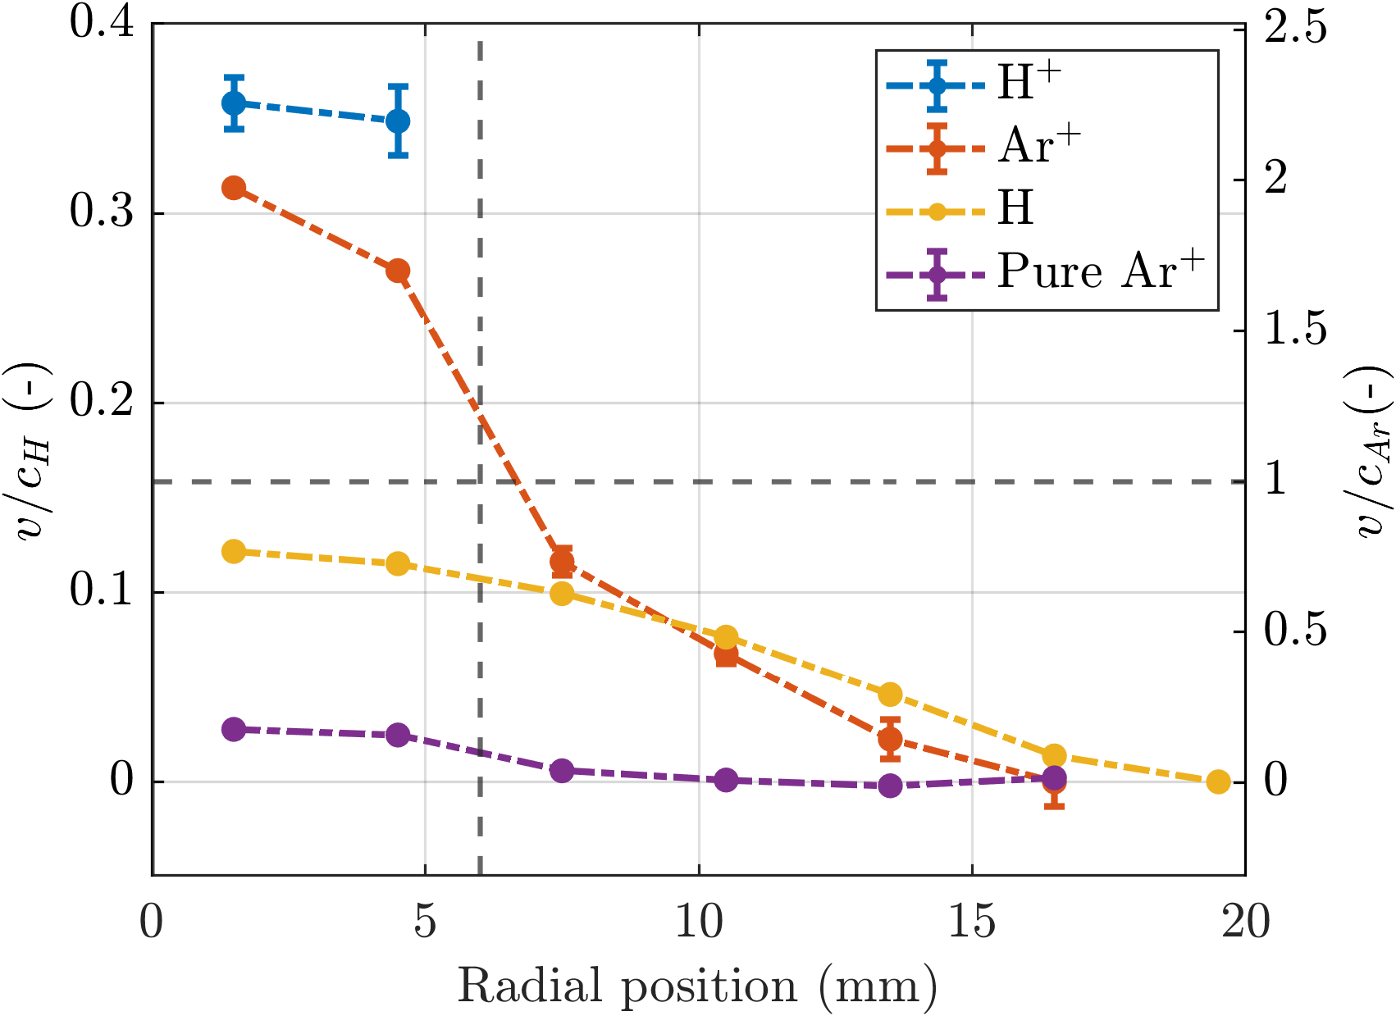
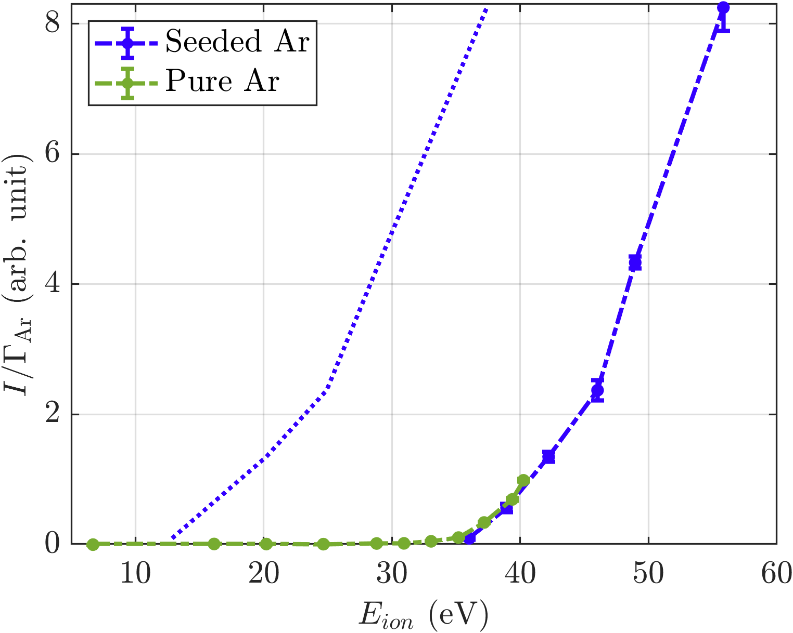



SPB.1: Entrainment under ITER-like plasma conditions and its influence on the erosion of tungsten
ITER edge plasma will be much denser than for current tokamaks
  The high density allows for impurity entrainment
  Seeded impurities are accelerated towards the plasma flow velocity
Increase in sputtering by entrainment
  Ar+H plasma generated with Magnum-PSI
  The velocity of argon impurities is close to the hydrogen flow velocity and exceeds 𝑐_{𝐴𝑟}
  Entrainment results in a considerable increase in ion impact energy for the argon impurities
FWHM
$$E_{ion}=\left(fM_{u}^{2}+1.5\right)k_{b}T_{i}−eV_{bias}$$
$$M_{u}=0.5$$
$f=$mass ratio between impurity & plasma species
$M_{u}=$ upstream Mach number
Deliverable: PWIE.SPB.1.T002.D001, D007
Status: completed
Facilities: 5 + 4 days MAGNUM-PSI, 0 + 1 days accelerator
Human Resources: 4 PM + 4 PM
Involved RU: DIFFER
Linked WP or TSVV: None
M. Cornelissen et al. (DIFFER)

Slide 18
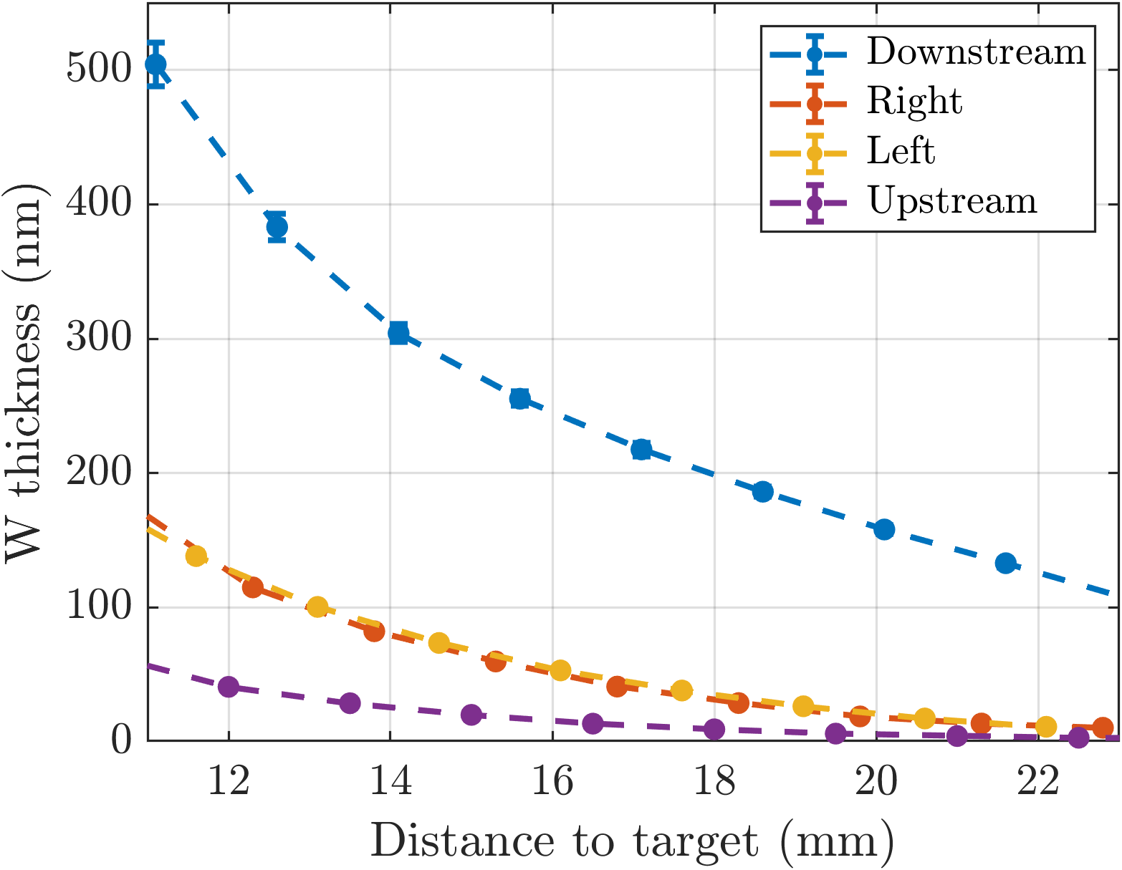
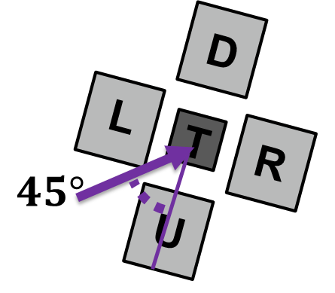
SPB.1: Erosion rates of W and W+O model systems in MAGNUM-PSI at varying fluxes, fluences, and impurity contents
Sputtered tungsten may be re-deposited by entrainment
  Sputtered tungsten can be dragged back to the surface by the plasma flow
  Seeded impurities are accelerated towards the plasma flow velocity
Observed increase in re-deposition by entrainment
  Dense Ar plasma generated with Magnum-PSI:
  More tungsten re-deposition on witness plates downstream than upstream.
  Re-deposition by entrainment is dominant for low 𝑻_{𝒆} and high 𝒏_{𝒆} plasmas.
2023 plans
Further entrainment studies
  Measure entrainment closer to the plasma sheath edge
  Acquire re-deposition rate from complete re-deposition profiles
Comparative erosion studies of the model systems
  Separate discussion to agree on the flux and fluence regimes for efficient cross-correlation between MAGNUM-PSI, PSI-2 and GyM
Deliverable: PWIE.SPB.1.T002.D001, D007
Status: completed
Facilities: 5 + 4 days MAGNUM-PSI, 0 + 1 days accelerator
Human Resources: 4 PM + 4 PM
Involved RU: DIFFER
Linked WP or TSVV: None
M. Cornelissen et al. (DIFFER)

Slide 19
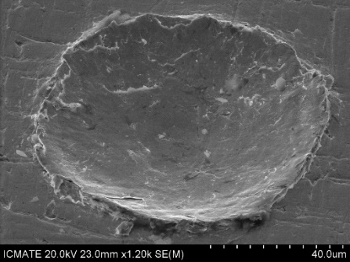
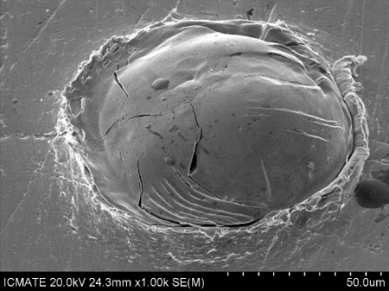
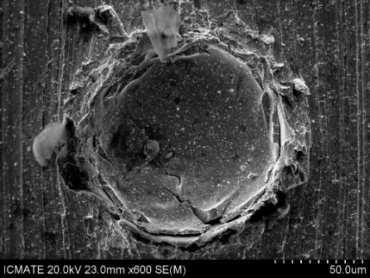
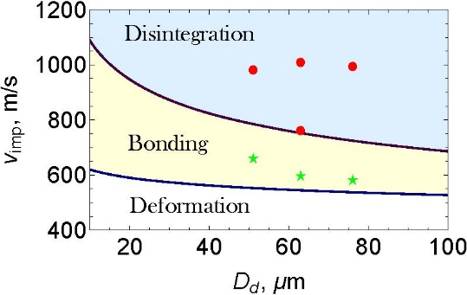
SPB.1: Surface erosion by hypervelocity W dust impacts
Monodisperse W spherical dust has been shot on W samples at v_{i} impact velocity: 580 ≤ v_{i} [m/s] ≤ 3190 → three regimes of impacts identified.
Deformation regime, 200 ÷ 600 m/s → shallow crater formation.
Bonding or cold spray regime, 600 ÷ 1000 m/s → sticking of dust on target.
Partial disintegration regime, 1÷ 4 km/s → material splash ejection and fragmentation.
Empirical damage laws extracted from experimental data & found critical erosion and bonding velocities → results presented at SOFT 2022
Excavated volume material estimated for single impacts.
Deliverable: PWIE.SPB.1.T002.D002
Status: completed
Facilities: None
Human Resources: 4 PM
Involved RU: ENEA
Linked WP or TSVV: None (for this part)
M. De Angeli et al. (ENEA)

Slide 20
SPB.1: Surface erosion by hypervelocity W dust impacts
Monodisperse W spherical dust has been shot on W samples at v_{i} impact velocity: 580 ≤ v_{i} [m/s] ≤ 3190 → three regimes of impacts identified.
Plans for 2023: Characterize surface erosion of W and W+O model systems induced by hypervelocity W dust impacts → under SP B.5 (details to be agreed separately)
Deformation regime, 200 ÷ 600 m/s → shallow crater formation.
Bonding or cold spray regime, 600 ÷ 1000 m/s → sticking of dust on target.
Partial disintegration regime, 1÷ 4 km/s → material splash ejection and fragmentation.
Empirical damage laws extracted from experimental data & found critical erosion and bonding velocities → results presented at SOFT 2022
Excavated volume material estimated for single impacts.
Deliverable: PWIE.SPB.1.T002.D002
Status: completed
Facilities: None
Human Resources: 4 PM
Involved RU: ENEA
Linked WP or TSVV: None (for this part)
M. De Angeli et al. (ENEA)

Slide 21
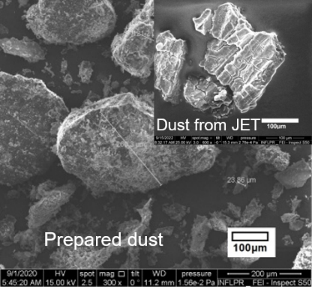
SPB.1: Be and W dust formed during air and water leaks
Be dust generation in air and water environment using alumina ball milling
Particle size and morphology determined using SEM microscopy
Preferred crystal orientation analyzed using XRD
Thermal outgassing using TDS, identified molecules: O₂, N₂, H₂O, BeO, Be₃N₂, Be(OH)₂
Particle size and morphology:
30-500 μm particles prepared & collected by sieving
Rough surfaces for dust particles → similarities to dust from JET
XRD Measurements
Shifts to small angles due to tensile stress in the Be polycrystalline structure.
BeO diffraction present for samples prepared in wet conditions
TDS analysis of samples:
More BeO, H₂O, N₂, Be(OH)₂ and less Be, O₂ and Be₃N₂ at wet conditions → water present in Be dust as pure H₂O, oxygen to form BeO and (OH) to form Be(OH)₂
Deliverable: PWIE.SPB.1.T002.D005, D008
Status: completed
Facilities: None
Human Resources: 2 PM + 2 PM
Involved RU: IAP
Linked WP or TSVV: WP ENR-MAT.01.IAP
C. Lungu, T. Acsente et al. (IAP)

Slide 22
SPB.1: Be and W dust formed during air and water leaks
Be dust generation in air and water environment using alumina ball milling
Particle size and morphology determined using SEM microscopy
Preferred crystal orientation analyzed using XRD
Thermal outgassing using TDS, identified molecules: O₂, N₂, H₂O, BeO, Be₃N₂, Be(OH)₂
Plans for 2023: Parametric scans (incl. gas inclusions) for understanding physics of Be dust production → under SP B.5 (details to be agreed separately, in the light of ITER considerations)
Particle size and morphology:
30-500 μm particles prepared & collected by sieving
Rough surfaces for dust particles → similarities to dust from JET
XRD Measurements
Shifts to small angles due to tensile stress in the Be polycrystalline structure.
BeO diffraction present for samples prepared in wet conditions
TDS analysis of samples:
More BeO, H₂O, N₂, Be(OH)₂ and less Be, O₂ and Be₃N₂ at wet conditions → water present in Be dust as pure H₂O, oxygen to form BeO and (OH) to form Be(OH)₂
Deliverable: PWIE.SPB.1.T002.D005, D008
Status: completed
Facilities: None
Human Resources: 2 PM + 2 PM
Involved RU: IAP
Linked WP or TSVV: WP ENR-MAT.01.IAP
C. Lungu, T. Acsente et al. (IAP)

Slide 23
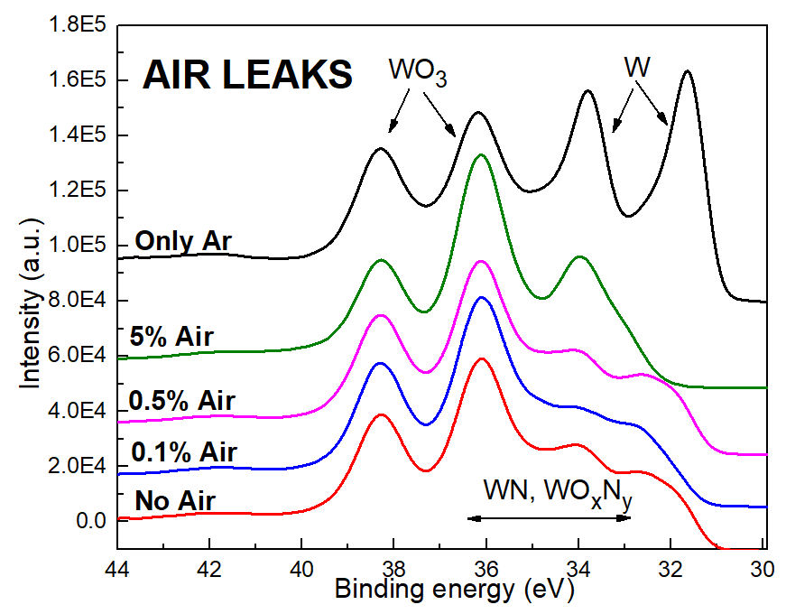
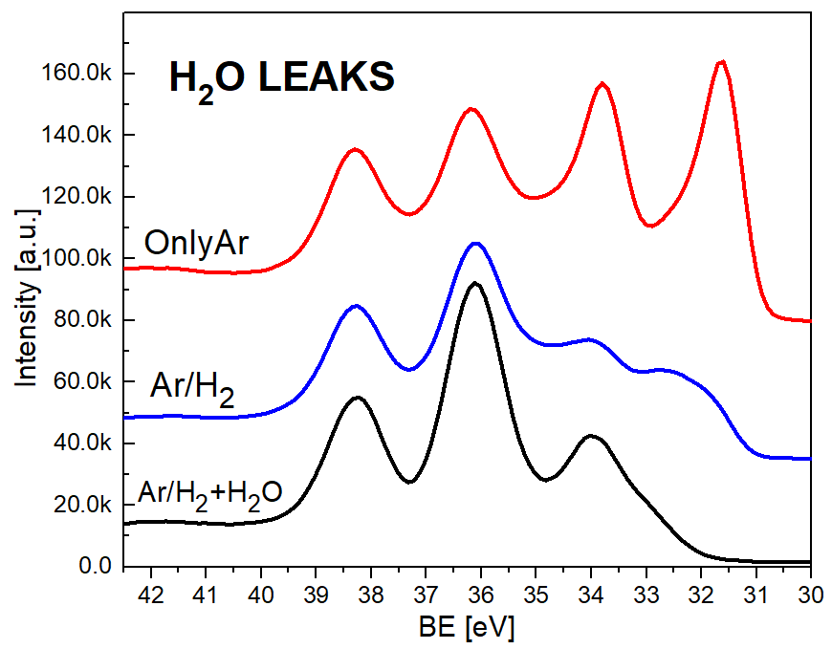
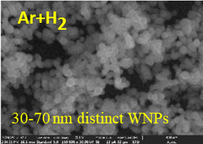
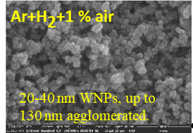
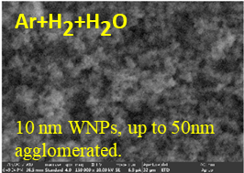
SPB.1: Be and W dust formed during air and water leaks
Synthesis of W dust in presence of air and H₂O leaks using MSGA (Magnetron Sputtering Gas Aggregation) operated with high H₂ contents:
Air leaks (0.1-5%) obtained with low flow rate mass flow controllers
Leaks of H₂O (~3e-7 Pa m³ s⁻¹) performed using a homemade device
Synthesis of W dust in the presence of air and water leaks
The W dust synthesis rate decreases rapidly in the presence of air or H₂O leaks due to the W target poisoning
Results presented in SOFT 2022
Air and H₂O leaks lead to oxidation and nitriding of the W dust
Air and water leaks lead to agglomeration of the W dust
Deliverable: PWIE.SPB.1.T002.D005, D008
Status: completed
Facilities: None
Human Resources: 2 PM + 2 PM
Involved RU: IAP
Linked WP or TSVV: WP ENR-MAT.01.IAP
C. Lungu, T. Acsente et al. (IAP)

Slide 24
SPB.1: Be and W dust formed during air and water leaks
Synthesis of W dust in presence of air and H₂O leaks using MSGA (Magnetron Sputtering Gas Aggregation) operated with high H₂ contents:
Air leaks (0.1-5%) obtained with low flow rate mass flow controllers
Leaks of H₂O (~3E-7 Pa m³ s⁻¹) performed using a homemade device
Synthesis of W dust in the presence of air and water leaks
The W dust synthesis rate decreases rapidly in the presence of air or H₂O leaks due to the W target poisoning
Results presented in SOFT 2022
Plans for 2023: A database with characteristics of laboratory-produced dust will be initiated, for further comparison with data from tokamak → under SP B.5
Air and H₂O leaks lead to oxidation and nitriding of the W dust
Air and water leaks lead to agglomeration of the W dust
Deliverable: PWIE.SPB.1.T002.D005, D008
Status: completed
Facilities: None
Human Resources: 2 PM + 2 PM
Involved RU: IAP
Linked WP or TSVV: WP ENR-MAT.01.IAP
C. Lungu, T. Acsente et al. (IAP)

Slide 25
SP B.2 – Material migration in toroidal devices - selected results from 2022
SP B.3 – Characterization of plasma-exposed materials – selected results from 2022
+ plans for 2023

Slide 26
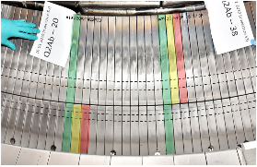
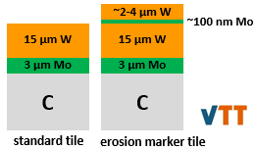
SPB.2 & SPB.3: Erosion and deposition patterns on WEST PFUs removed after C3 and C4 campaigns
Goal #1: Determine and compare erosion, (re-)deposition, and fuel retention patterns on C3, C4, and C5 marker Plasma Facing Units (PFUs) → joint exercise between 11 Research Units under SP B.2, SP B.3(,and SP X.2)
Status of the work (as of early February)
Full-tile analyses (MPG)
  completed for C3, C4, and C5 marker PFUs
Core samples (VTT) and their analyses
  completed for C3 marker PFUs
  almost done for C4 marker PFUs → final analysis meeting pending
  ongoing for additional standard PFUs → TOF-ERDA at RBI
  scheduled for C5 marker PFUs in early 2023 (coring ongoing)
ISP
OSP
Plans for 2023:
Finish C4 sample analyses
Proceed with C5 sample analyses
Deliverables: PWIE.SPB.2.T002.D001, D007, D008, D009, D010, D011
PWIE.SPB.3.T002.D001, D003, D004, D005, D006, D007, D008, D009
Status: completed Facilities: ~20 days accel. (IST, JSI, MPG, NCSRD, RBI, VR, VTT)
Human Resources: ~20 PM
Involved RU: CEA, IAP, IPPLM, IST, JSI, MPG, NCSRD, RBI, UT, VR, VTT
Linked WP or TSVV: WP TE
Coordinators: E. Bernard, M. Diez (CEA)

Slide 27
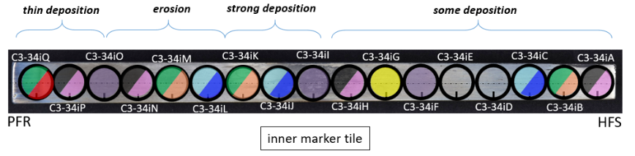
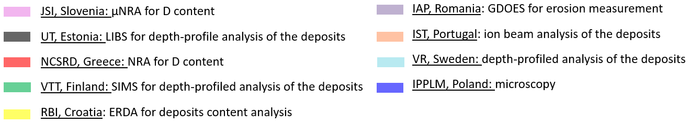
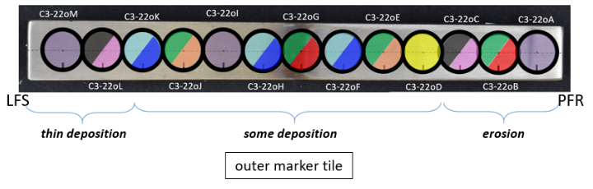
SPB.2 & SPB.3: Erosion and deposition patterns on WEST PFUs removed after C3 and C4 campaigns
Distribution matrix of C3 and C4 and C5 core samples
*
*
*
* C3 results reported in I. Jogi et al., Journal of Nucl. Eng. 2023
Deliverables: PWIE.SPB.2.T002.D001, D007, D008, D009, D010, D011
PWIE.SPB.3.T002.D001, D003, D004, D005, D006, D007, D008, D009
Status: completed Facilities: ~20 days accel. (IST, JSI, MPG, NCSRD, RBI, VR, VTT)
Human Resources: ~20 PM
Involved RU: CEA, IAP, IPPLM, IST, JSI, MPG, NCSRD, RBI, UT, VR, VTT
Linked WP or TSVV: WP TE
Coordinators: E. Bernard, M. Diez (CEA)

Slide 28
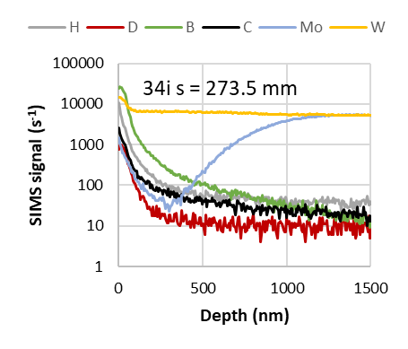
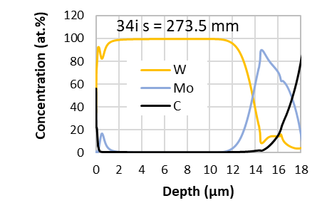
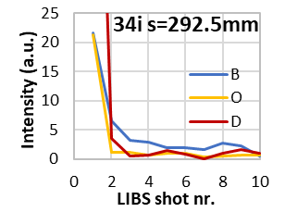
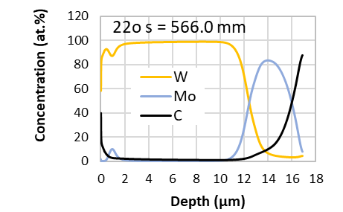
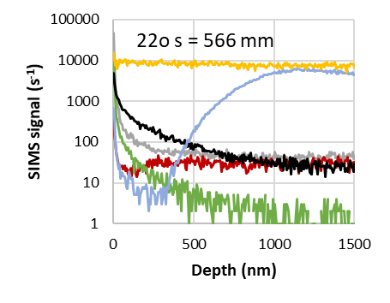
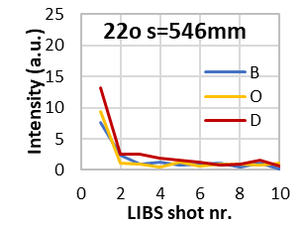
SPB.2 & SPB.3: Erosion and deposition patterns on WEST PFUs removed after C3 and C4 campaigns
LIBS
SIMS
Comparison made between GDOES, SIMS, and LIBS for the depth profiles of different elements on selected C3 samples
LIBS also proven to be a working tool for determining composition of deposited layers
C3-34iP
C3-34iO
C3-34iO
C3-22oL
C3-22oM
C3-22oM
Deliverables: PWIE.SPB.2.T002.D001, D007, D008, D009, D010, D011
PWIE.SPB.3.T002.D001, D003, D004, D005, D006, D007, D008, D009
Status: completed Facilities: ~20 days accel. (IST, JSI, MPG, NCSRD, RBI, VR, VTT)
Human Resources: ~20 PM
Involved RU: CEA, IAP, IPPLM, IST, JSI, MPG, NCSRD, RBI, UT, VR, VTT
Linked WP or TSVV: WP TE
I. Jõgi (UT, SP X.2), A. Hakola (VTT), E. Grigore (IAP)

Slide 29
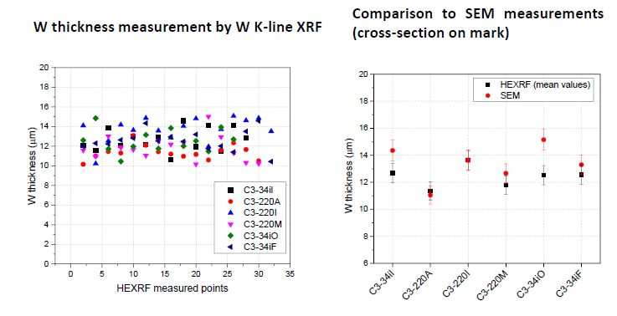
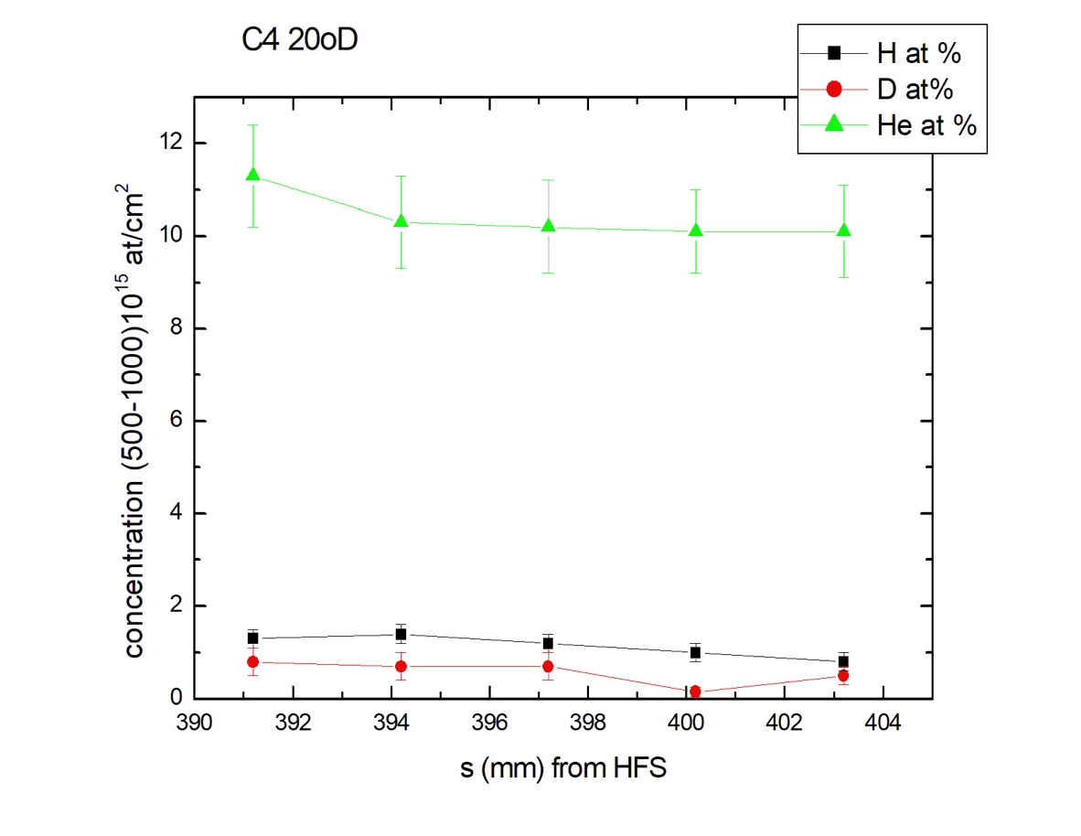
SPB.2 & SPB.3: Erosion and deposition patterns on WEST PFUs removed after C3 and C4 campaigns
I. Bogdanovic Radovic (RBI), I. Tiseanu (IAP), S. Markelj (JSI), E. Alves (IST), P. Petersson (VR)
Examples of additional results collected since the review meeting in October
  TOF-ERDA measurements for the elemental maps on the C4 marker samples → focus on He and light impurities
  X-ray fluorescence studies of several C3 marker samples → W thickness measurements agree with SEM
  Additional PIXE, RBS and NRA investigations of C4 marker samples → determining D, B, C, O levels on the surface
Example of TOF-ERDA results from sample C4-20oD
Comparison between XRF and SEM analysis for W thickness on C3 samples
Deliverables: PWIE.SPB.2.T002.D001, D007, D008, D009, D010, D011
PWIE.SPB.3.T002.D001, D003, D004, D005, D006, D007, D008, D009
Status: completed Facilities: ~20 days accel. (IST, JSI, MPG, NCSRD, RBI, VR, VTT)
Human Resources: ~20 PM
Involved RU: CEA, IAP, IPPLM, IST, JSI, MPG, NCSRD, RBI, UT, VR, VTT
Linked WP or TSVV: WP TE

Slide 30
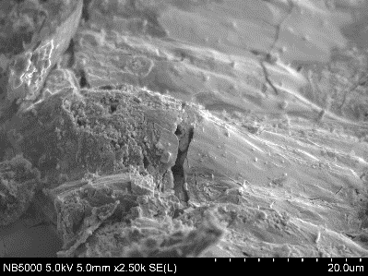
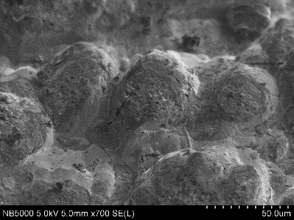
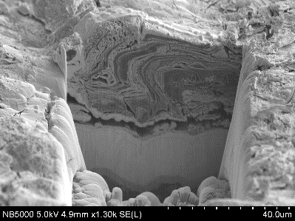
SPB.2 & SPB.3: Erosion and deposition patterns on WEST PFUs removed after C3 and C4 campaigns
Examples of microscopy studies of samples from the inner divertor after the C4 campaign
Thick deposits (>50 μm) with a complex structure observed
Some deposits contain sheets/flakes, distributed inhomogeneously which further contain spherical/elongated elements and stratified structures; directional bands rich in W visible on top
EDS measurements indicate increased signals for B, O, C and Cu
b)
SEM images of the deposit morphology, sample J.
SEM images of the deposit and marker layer cross-sections, sample J.
Deliverables: PWIE.SPB.2.T002.D001, D007, D008, D009, D010, D011
PWIE.SPB.3.T002.D001, D003, D004, D005, D006, D007, D008, D009
Status: completed Facilities: ~20 days accel. (IST, JSI, MPG, NCSRD, RBI, VR, VTT)
Human Resources: ~20 PM
Involved RU: CEA, IAP, IPPLM, IST, JSI, MPG, NCSRD, RBI, UT, VR, VTT
Linked WP or TSVV: WP TE
E. Fortuna et al. (IPPLM)

Slide 31
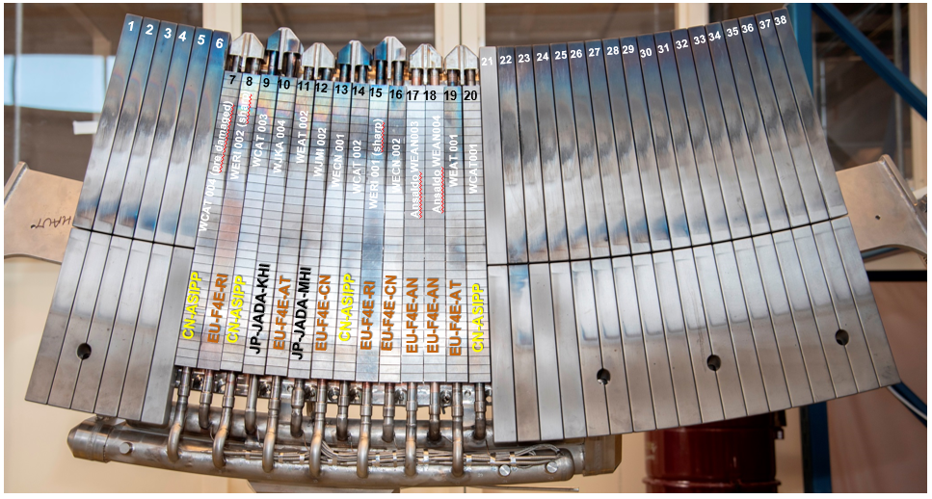
SPB.2 & SPB.3: Erosion and deposition patterns on WEST PFUs removed after C3 and C4 campaigns
Goal #2: Repeat the exercise for selected ITER-like PFUs removed after WEST Phase I operations
Focus on PFU#13 for the moment (exposed to C3+C4)
Status of the work:
Full-tile analyses: completed
@CEA
Confocal microscopy on the top surface
Microscopic observations
@ MPG
RBS/NRA + SEM/EDX/FIB on the top surface
RBS/NRA on the poloidal gaps
Monoblock samples and their analyses: Delayed
Completed/ongoing for some monoblocks
Samples cutting scheduled for beginning 2023
Samples analysis scheduled to start mid-2023
Deliverables: PWIE.SPB.2.T002.D001, D004, D007, D008, D009, D010
PWIE.SPB.3.T002.D001, D002, D003, D004, D005, D006, D007, D008
Status: delayed Facilities: ~20 days accel. (IST, JSI, MPG, NCSRD, RBI, VR, VTT)
Human Resources: ~20 PM
Involved RU: CEA, IAP, IPPLM, IST, JSI, MPG, NCSRD, RBI, UT, VR, VTT
Linked WP or TSVV: WP TE
Coordinators: E. Bernard, M. Diez (CEA)

Slide 32
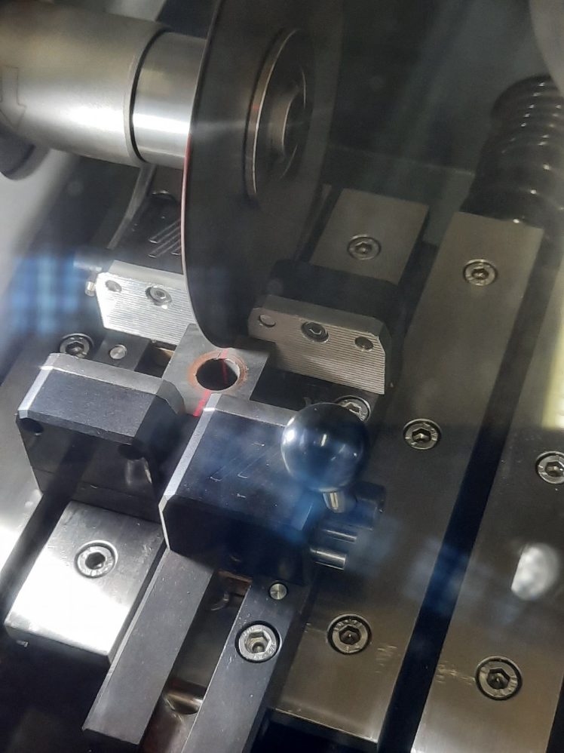
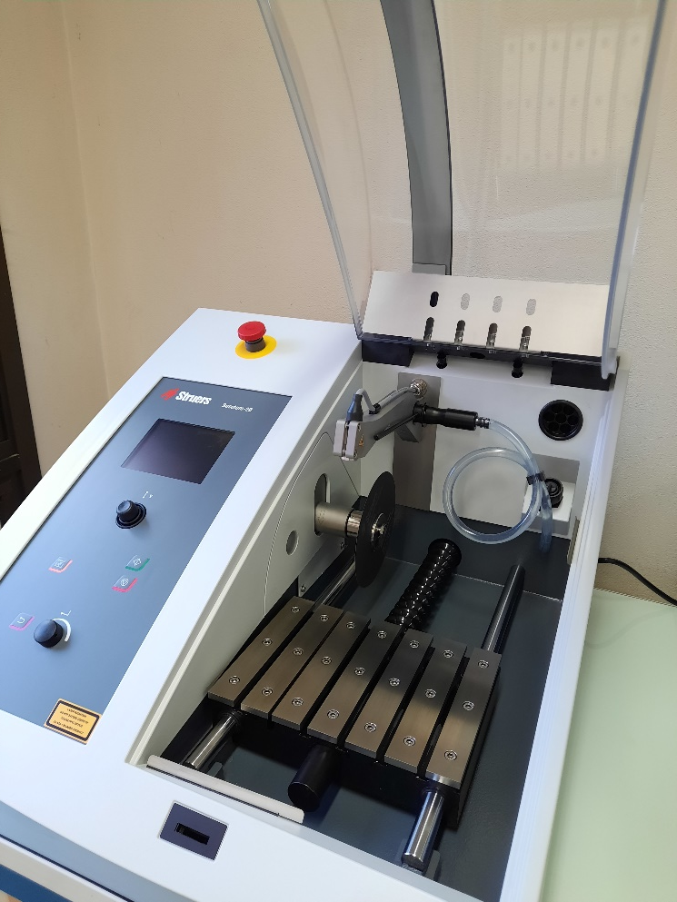
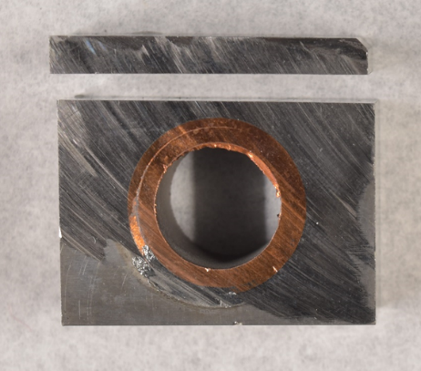
SPB.2 & SPB.3: Erosion and deposition patterns on WEST PFUs removed after C3 and C4 campaigns
January 2023 : a new cutting machine has arrived to speed up the characterization of ITER-like PFUs
water-free precision cutting machine
equipped with a diamond saw to cut hard materials such as W
Coordinators: E. Bernard, M. Diez (CEA)

Slide 33
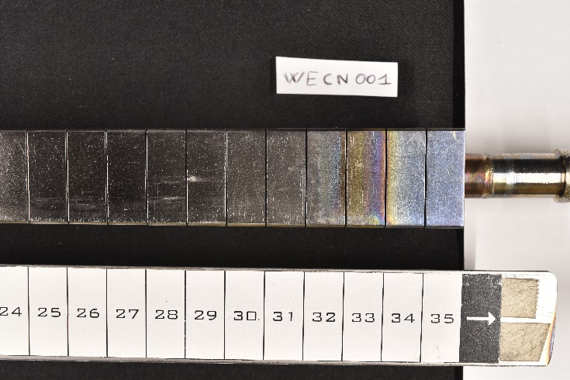
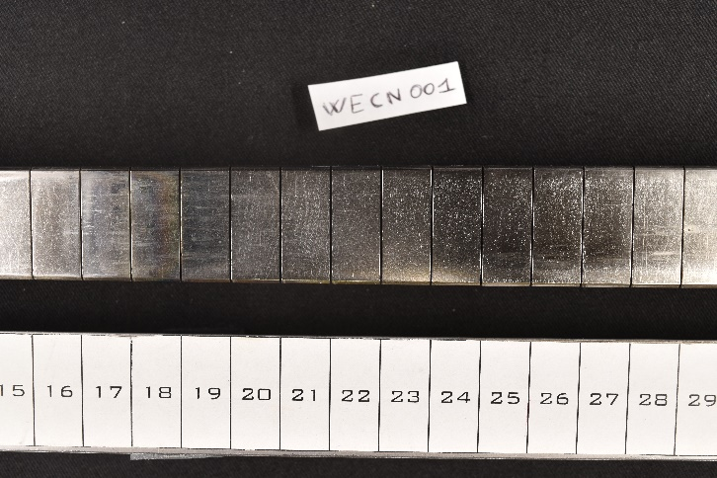
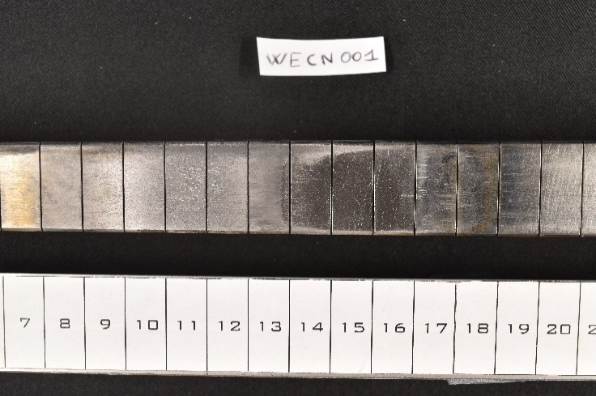
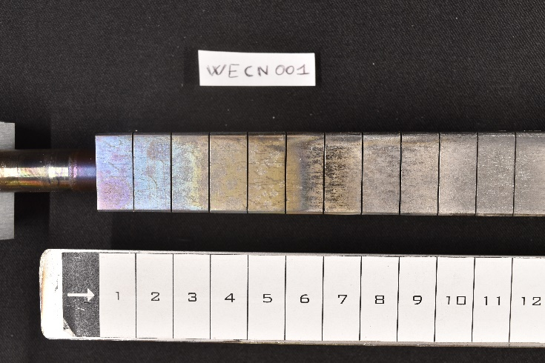
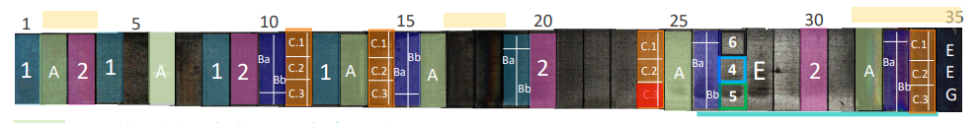
SPB.2 & SPB.3: Erosion and deposition patterns on WEST PFUs removed after C3 and C4 campaigns
Distribution matrix of C3+C4 ITER-like PFU#13
The sample analysis in 2023 is organized as follow:
Batch A: composition variation on the plasma exposed surface
Batch B: He and microstructure
Batch C: fuel retention
Batch D: optical Hot Spot
Batch E: surface modification over toroidal direction
Will be discussed during a dedicated meeting
→ Doodle to come soon
Deliverables: PWIE.SPB.2.T002.D001, D004, D007, D008, D009, D010
PWIE.SPB.3.T002.D001, D002, D003, D004, D005, D006, D007, D008
Status: delayed Facilities: ~20 days accel. (IST, JSI, MPG, NCSRD, RBI, VR, VTT)
Human Resources: ~20 PM
Involved RU: CEA, IAP, IPPLM, IST, JSI, MPG, NCSRD, RBI, UT, VR, VTT
Linked WP or TSVV: WP TE
Coordinators: E. Bernard, M. Diez (CEA)

Slide 34
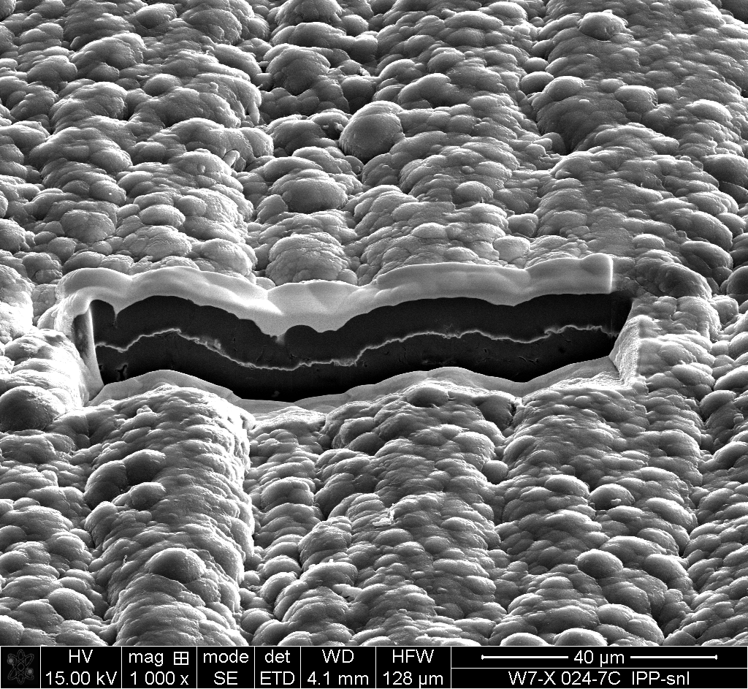
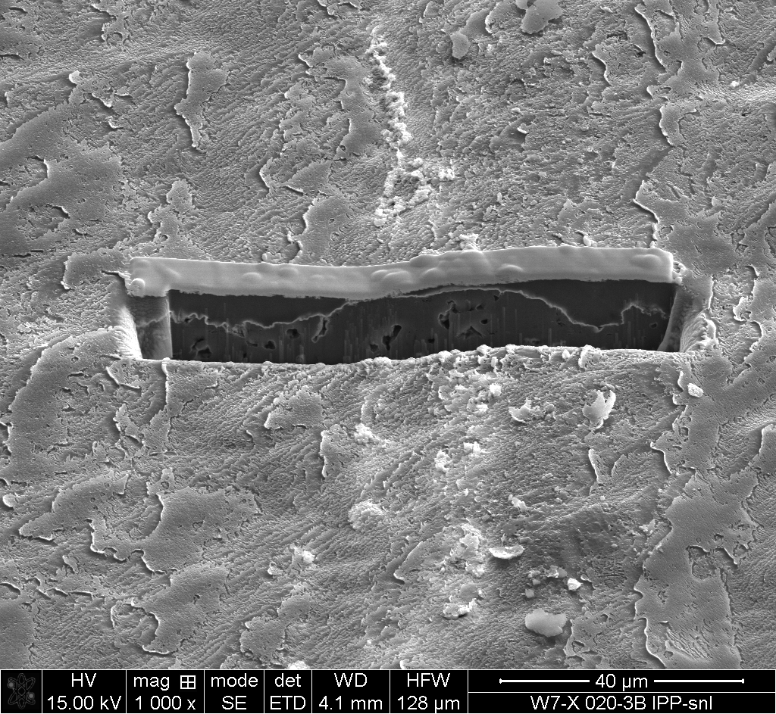
SPB.2 & SPB.3: Characterization of TDUs removed from W7-X after the OP1.2B campaign
Work concentrated on the analyses of different Test Divertor Units (TDUs) and other samples
  marker TDUs for erosion/deposition and surface-roughening studies during OP1.2B
Main results
Plasma exposure smoothens the surface and creates specific surface patterns
Simulated and experimental erosion rates in OP1.2A and OP1.2B agree within a factor of 2; surface roughness plays a strong role
Reduced erosion from OP1.2A to OP1.2B due to smaller O concentration (boronizations) → erosion in OP1.2B dominated by H
Initial
Strike line
40 µm
Deliverables: PWIE.SPB.2.T002.D004, D006, D008, D009, D011
PWIE.SPB.3.T002.D002, D003, D006
Status: completed Facilities: ~15 days accelerator (FZJ, MPG, VR, VTT)
Human Resources: ~10 PM
Involved RU: FZJ, IPPLM, MPG, VR, VTT
Linked WP or TSVV: WP W7X
M. Mayer et al. (MPG)

Slide 35
SPB.2: Erosion and deposition characteristics of manipulator samples from OP2 experiments in W7-X
Plans for 2023
Samples: Material qualified, manufactured, pre-characterised
        Fine-grain graphite, polished and unpolished
        Al and Al with 7 or 30 nm a-C:D layer
Planned exposures with the multi-purpose manipulator
        Carbon erosion during glow-discharge cleaning
        Boron deposition during boronizations
        Carbon erosion during selected discharges in far scrape-off layer
        Hydrogen deposition and charge-exchange fluxes in selected discharges in far scrape-off layer
        Tungsten deposition and transport using laser blow-off
5 mm
10 mm
12 mm
M. Mayer et al. (MPG)

Slide 36

SPB.2 & SPB.3: Characterization of TDUs removed from W7-X after the OP1.2B campaign
Work concentrated on the analyses of different Test Divertor Units (TDUs) and other samples
  selected TDUs/samples for determining deposition of impurities (incl. ¹³C and various metals) and surface modification patterns
20 TDU target elements (TE) extracted for ¹³C analyses, using the reaction ¹³C(d,p₀)¹⁴C
Additional ¹³C(³He,p)¹²C measurements from the vicinity of gas puff location (not yet analyzed)
Main results
High ¹³C deposition around injection holes: >10²⁰ atoms cm⁻² in 10 cm perimeter
Vicinity shows saturated regions (white), thickness > 6 µm (up to 100 µm by SEM)
100 µm
SEM image of a delaminated layer ~1 mm apart from one injection hole
2D ¹³C deposition on HM39TM200h+300h
Deliverables: PWIE.SPB.2.T002.D004, D006, D008, D009, D011
PWIE.SPB.3.T002.D002, D003, D006
Status: completed Facilities: ~15 days accelerator (FZJ, MPG, VR, VTT)
Human Resources: ~10 PM
Involved RU: FZJ, IPPLM, MPG, VR, VTT
Linked WP or TSVV: WP W7X
M. Racinski et al. (FZJ)

Slide 37


SPB.2 & SPB.3: Characterization of TDUs removed from W7-X after the OP1.2B campaign
Work concentrated on the analyses of different Test Divertor Units (TDUs) and other samples
  selected TDUs/samples for determining deposition of impurities (incl. ¹³C and various metals) and surface modification patterns
Main results
Direction to TM100h (top side): 1 peak, shifted away from the pumping gap
Direction to TM300h (bottom side): splitting into 2 peaks
Secondary peak along the strike line (-80-(-250 mm)): low deposition but regular pattern across the TE (nm range)
Deliverables: PWIE.SPB.2.T002.D004, D006, D008, D009, D011
PWIE.SPB.3.T002.D002, D003, D006
Status: completed Facilities: ~15 days accelerator (FZJ, MPG, VR, VTT)
Human Resources: ~10 PM
Involved RU: FZJ, IPPLM, MPG, VR, VTT
Linked WP or TSVV: WP W7X
M. Racinski et al. (FZJ)

Slide 38




SPB.2 & SPB.3: Characterization of TDUs removed from W7-X after the OP1.2B campaign
Work concentrated on the analyses of different Test Divertor Units (TDUs) and other samples
  SEM/TEM/EDS observations of TDUs with damaged zones
tile HM19TM400hTE1
TEM image from the matte area showing homogeneous layer with some large pores (Zone I) and a heterogeneous layer (Zone II) with a clearly porous structure
zone I
Damaged zone on sample 5a
deposit
SEM image of the matte area below the damage. Deposit with impurities present.
zone II
substrate
Deliverables: PWIE.SPB.2.T002.D004, D006, D008, D009, D011
PWIE.SPB.3.T002.D002, D003, D006
Status: completed Facilities: ~15 days accelerator (FZJ, MPG, VR, VTT)
Human Resources: ~10 PM
Involved RU: FZJ, IPPLM, MPG, VR, VTT
Linked WP or TSVV: WP W7X
E. Fortuna et al. (IPPLM)

Slide 39

SPB.2 & SPB.3: Analysis of AUG samples
A. Hakola et al. (VTT), M. Balden and K. Krieger et al. (MPG), M. Racinski et al. (FZJ), I. Bogdanovic Radovic et al. (RBI), S. Markelj and M. Kelemen et al. (JSI)
See next slides & separate talk
Rohde et al., 2023, NME 34, 101320
Ratynskaia et al., submitted NME
See next slides
Krieger et al., submitted NF
Krieger et al., submitted NME
Rohde et al., 2021, NME 29, 101083
Deliverables: PWIE.SPB.2.T002.D002, D003, D004, D005, D010
PWIE.SPB.3.T002.D002, D006, D008
Status: completed Facilities: ~13 days accelerator (JSI, MPG, RBI, VTT)
Human Resources: ~10 PM
Involved RU: FZJ, JSI, MPG, RBI, VTT
Linked WP or TSVV: WP TE

Slide 40


SPB.2 & SPB.3: Analysis of AUG samples
A. Hakola et al. (VTT), M. Balden and K. Krieger et al. (MPG), M. Racinski et al. (FZJ), I. Bogdanovic Radovic et al. (RBI), S. Markelj and M. Kelemen et al. (JSI)
Au marker samples and roughness samples – reported in PSI 2022
Study net/gross erosion of Au and effect of roughness on erosion in H-mode
Increasing surface roughness reduces net erosion but less than in L-mode
Net-erosion rates in H-mode 2-5 times higher than in L-mode
Exposure to H-mode conditions results in strong local variations in the poloidal and toroidal erosion/deposition profiles
Top: Poloidal net erosion/deposition profiles for different roughness samples
Bottom: Poloidal net erosion profiles (a) for the 5×5 mm² and 1×1 mm² Au marker spots in H-mode and (b) for the 5×5 mm² Au marker spots during different L- and H-mode experiments
Deliverables: PWIE.SPB.2.T002.D002, D003, D004, D005, D010
PWIE.SPB.3.T002.D002, D006, D008
Status: completed Facilities: ~13 days accelerator (JSI, MPG, RBI, VTT)
Human Resources: ~10 PM
Involved RU: FZJ, JSI, MPG, RBI, VTT
Linked WP or TSVV: WP TE
A. Hakola et al. (VTT)

Slide 41
SPB.2 & SPB.3: Analysis of AUG samples
A. Hakola et al. (VTT), M. Balden and K. Krieger et al. (MPG), M. Racinski et al. (FZJ), I. Bogdanovic Radovic et al. (RBI), S. Markelj and M. Kelemen et al. (JSI)
Detailed ion-beam measurements of the roughness samples
Mo erosion at strike point largest for the samples with the lowest roughness – in agreement with lab studies
RBS spectrum hard to model in SIMNRA → combination of roughness, material mixing, and oxidization
Roughness “≈100” nm
Roughness “≈300” nm
Roughness “≈ 1” µm
Measuring direction (poloidal)
Deliverables: PWIE.SPB.2.T002.D002, D003, D004, D005, D010
PWIE.SPB.3.T002.D002, D006, D008
Status: completed Facilities: ~13 days accelerator (JSI, MPG, RBI, VTT)
Human Resources: ~10 PM
Involved RU: FZJ, JSI, MPG, RBI, VTT
Linked WP or TSVV: WP TE
S. Markelj et al. (JSI)

Slide 42

SPB.2 & SPB.3: Analysis of AUG samples
A. Hakola et al. (VTT), M. Balden and K. Krieger et al. (MPG), M. Racinski et al. (FZJ), I. Bogdanovic Radovic et al. (RBI), S. Markelj and M. Kelemen et al. (JSI)
Exposure of samples to helium plasmas
Exposure of samples with (i) W fuzz, (ii) bulk W, and (iii) Pt markers to L- and H-mode discharges
Main goals to study formation & erosion of W fuzz and comparing erosion to published results from D plasmas
Deliverables: PWIE.SPB.2.T002.D002, D003, D004, D005, D010
PWIE.SPB.3.T002.D002, D006, D008
Status: completed Facilities: ~13 days accelerator (JSI, MPG, RBI, VTT)
Deliverables: PWIE.SPB.2.T002.D002, D003, D004, D005, D010
PWIE.SPB.3.T002.D002, D006, D008
Status: completed Facilities: ~13 days accelerator (JSI, MPG, RBI, VTT)
Human Resources: ~10 PM
Involved RU: FZJ, JSI, MPG, RBI, VTT
Linked WP or TSVV: WP TE
Human Resources: ~10 PM
Involved RU: FZJ, JSI, MPG, RBI, VTT
Linked WP or TSVV: WP TE

Slide 43

SPB.2 & SPB.3: Analysis of AUG samples
A. Hakola et al. (VTT), M. Balden and K. Krieger et al. (MPG), M. Racinski et al. (FZJ), I. Bogdanovic Radovic et al. (RBI), S. Markelj and M. Kelemen et al. (JSI)
Status of analyses of W fuzz and bulk W samples
Around the H-mode strike line: (i) W fuzz samples show partial fuzz erosion; (ii) bulk W samples (polished) show erosion (100 – 250 nm)
before
after
before
after
H-mode
x
x
2 μm
L-mode
SEM image of a cross-section before and after AUG He campaign
Deliverables: PWIE.SPB.2.T002.D002, D003, D004, D005, D010
PWIE.SPB.3.T002.D002, D006, D008
Status: completed Facilities: ~13 days accelerator (JSI, MPG, RBI, VTT)
Human Resources: ~10 PM
Involved RU: FZJ, JSI, MPG, RBI, VTT
Linked WP or TSVV: WP TE
M. Rasinski et al. (FZJ)

Slide 44
SPB.2 & SPB.3: Analysis of AUG samples
A. Hakola et al. (VTT), M. Balden and K. Krieger et al. (MPG), M. Racinski et al. (FZJ), I. Bogdanovic Radovic et al. (RBI), S. Markelj and M. Kelemen et al. (JSI)
Status of analyses of W fuzz and bulk W samples
Above the H-mode strike line: W fuzz samples show fuzz being removed/modified, formation of new fuzz with thickness <1 μm, and formation of nano-bubbles below the surface
after
Main results so far
Below H-mode strike line: deposition of W
Near the H-mode strike line: erosion of fuzz and bulk W samples
Above H-mode strike line: formation of new fuzz and existing fuzz being removed/modified
Visible traces of arcing, mostly at fuzzy surfaces
  Arcs removed fuzz but did not damage underlying material
before
x
H-mode
2 μm
L-mode
SEM image of a cross-section before and after AUG He campaign
Deliverables: PWIE.SPB.2.T002.D002, D003, D004, D005, D010
PWIE.SPB.3.T002.D002, D006, D008
Status: completed Facilities: ~13 days accelerator (JSI, MPG, RBI, VTT)
Human Resources: ~10 PM
Involved RU: FZJ, JSI, MPG, RBI, VTT
Linked WP or TSVV: WP TE
M. Rasinski et al. (FZJ)

Slide 45
SPB.2 & SPB.3: Analysis of AUG samples
A. Hakola et al. (VTT), M. Balden and K. Krieger et al. (MPG), M. Racinski et al. (FZJ), I. Bogdanovic Radovic et al. (RBI), S. Markelj and M. Kelemen et al. (JSI)
Status of analyses of W fuzz and bulk W samples
Above the H-mode strike line: W fuzz samples show fuzz being removed/modified, formation of new fuzz with thickens below 1 mm, and formation of nano-bubbles below the surface
Plans for 2023:
More in-depth analysis of the exposed samples
Study fuzz formation in detail
Investigation on the localized fuzz growth – correlation with W grain orientation
after
Main results so far
Below H-mode strike line: deposition of W
Near the H-mode strike line: erosion of fuzz and bulk W samples
Above H-mode strike line: formation of new fuzz and existing fuzz being removed/modified
Visible traces of arcing, mostly at fuzzy surfaces
  Arcs removed fuzz but did not damage underlying material
before
x
H-mode
2 μm
L-mode
SEM image of a cross-section before and after AUG He campaign
Deliverables: PWIE.SPB.2.T002.D002, D003, D004, D005, D010
PWIE.SPB.3.T002.D002, D006, D008
Status: completed Facilities: ~13 days accelerator (JSI, MPG, RBI, VTT)
Human Resources: ~10 PM
Involved RU: FZJ, JSI, MPG, RBI, VTT
Linked WP or TSVV: WP TE
M. Rasinski et al. (FZJ)

Slide 46


SPB.2 & SPB.3: Analysis of AUG samples
A. Hakola et al. (VTT), M. Balden and K. Krieger et al. (MPG), M. Racinski et al. (FZJ), I. Bogdanovic Radovic et al. (RBI), S. Markelj and M. Kelemen et al. (JSI)
Status of analyses of the Pt markers
SEM analyses indicate (i) coverage of the markers with deposits below/around the H-mode strike line and (ii) strong erosion and indications of fuzz formation above the H-mode strike line
First ion-beam analyses made → analyses ongoing
Deliverables: PWIE.SPB.2.T002.D002, D003, D004, D005, D010
PWIE.SPB.3.T002.D002, D006, D008
Status: completed Facilities: ~13 days accelerator (JSI, MPG, RBI, VTT)
Human Resources: ~10 PM
Involved RU: FZJ, JSI, MPG, RBI, VTT
Linked WP or TSVV: WP TE
M. Balden et al. (MPG)

Slide 47
SP B.4 – Reference coatings for ITER and DEMO – selected results from 2022 and plans for 2023

Slide 48
SPB.4: Overview of activities
SP B.4 deals with production of W and Be reference samples according to agreed Master Excel – latest update in September 2022 to come up with a manageable plan for the period 2021-2022
Several RUs involved in characterization of the produced reference layers as well as the outcomes of their exposure into plasmas in linear machines (MAGNUM-PSI, PSI-2, GyM)
Excerpt from the Master File – this particular table contains 251 lines…
Research Unit | Specifications | Size (mm3) | Thickness (um) | Gas | Temperature (deg C) | Substrate | # of samples | To whom? | Comments | WP and SP | Produced by
ENEA-POLIMI | W-HiPIMS | PSI-2 geometry | >0,4 |  | Nominal | graphite, polished | 1 | FZJ | FIB marking @ FZJ before PSI-2 experiments | SP B.1 | 06/2022
ENEA-POLIMI | W-HiPIMS | PSI-2 geometry | >0,4 |  | Nominal | graphite, low roughness, Ra = 100 nm | 1 | FZJ | FIB marking @ FZJ before PSI-2 experiments | SP B.1 | 06/2022
ENEA-POLIMI | W-HiPIMS | PSI-2 geometry | >0,4 |  | Nominal | graphite, medium roughness, Ra = 300 nm | 1 | FZJ | FIB marking @ FZJ before PSI-2 experiments | SP B.1 | 06/2022
ENEA-POLIMI | W-HiPIMS | PSI-2 geometry | >0,4 |  | Nominal | graphite, polished | 6 | FZJ | PSI-2 experiments | SP B.1 | 06/2022
ENEA-POLIMI | W-HiPIMS | PSI-2 geometry | >0,4 |  | Nominal | graphite, low roughness, Ra = 100 nm | 6 | FZJ | PSI-2 experiments | SP B.1 | 06/2022
ENEA-POLIMI | W-HiPIMS | PSI-2 geometry | >0,4 |  | Nominal | graphite, medium roughness, Ra = 300 nm | 6 | FZJ | PSI-2 experiments | SP B.1 | 06/2022
Coordinator: A. Hakola (VTT)

Slide 49
SPB.4: Overview of activities
SP B.4 deals with production of W and Be reference samples according to agreed Master Excel – latest update in September 2022 to come up with a manageable plan for the period 2021-2022
Several RUs involved in characterization of the produced reference layers as well as the outcomes of their exposure into plasmas in linear machines (MAGNUM-PSI, PSI-2, GyM)
Plans for 2023: Produce a new Master File based on the present priorities in the ITER and DEMO research plans → W layers should have an even higher emphasis
W and W+O coatings with well-defined compositions and morphologies for “comparative” PSI-2, MAGNUM-PSI, and GyM erosion experiments
Production of a series of JET-relevant Be samples (TBD) for assisting LIBS commissioning
Comparison of implanted and co-deposited W+O+D layers
Excerpt from the Master File – this particular table contains 251 lines…
Research Unit | Specifications | Size (mm3) | Thickness (um) | Gas | Temperature (deg C) | Substrate | # of samples | To whom? | Comments | WP and SP | Produced by
ENEA-POLIMI | W-HiPIMS | PSI-2 geometry | >0,4 |  | Nominal | graphite, polished | 1 | FZJ | FIB marking @ FZJ before PSI-2 experiments | SP B.1 | 06/2022
ENEA-POLIMI | W-HiPIMS | PSI-2 geometry | >0,4 |  | Nominal | graphite, low roughness, Ra = 100 nm | 1 | FZJ | FIB marking @ FZJ before PSI-2 experiments | SP B.1 | 06/2022
ENEA-POLIMI | W-HiPIMS | PSI-2 geometry | >0,4 |  | Nominal | graphite, medium roughness, Ra = 300 nm | 1 | FZJ | FIB marking @ FZJ before PSI-2 experiments | SP B.1 | 06/2022
ENEA-POLIMI | W-HiPIMS | PSI-2 geometry | >0,4 |  | Nominal | graphite, polished | 6 | FZJ | PSI-2 experiments | SP B.1 | 06/2022
ENEA-POLIMI | W-HiPIMS | PSI-2 geometry | >0,4 |  | Nominal | graphite, low roughness, Ra = 100 nm | 6 | FZJ | PSI-2 experiments | SP B.1 | 06/2022
ENEA-POLIMI | W-HiPIMS | PSI-2 geometry | >0,4 |  | Nominal | graphite, medium roughness, Ra = 300 nm | 6 | FZJ | PSI-2 experiments | SP B.1 | 06/2022
Coordinator: A. Hakola (VTT)

Slide 50




SPB.4: Production of W-based reference coatings
Main research areas in 2022:
W coatings on flat and rough surfaces, 500 nm thick (GyM, ÖAW) ~60 samples
  substrate preparation by ISTP-CNR (chemical/plasma etching) + W deposition by HiPIMS
  Flat and pyramidal-Si substrates as well as flat and rough graphite
W coatings on Mo, 1 μm thick, for the LIBS studies ~100 samples
  Compact W films (HiPIMS)
  Amorphous-like W+O and W+N+O films, with varying O and N concentrations (PLD)
  SIMS of W+O films (CIEMAT) indicate transition from W+O at ~1.1 µm to a W layer (thickness ~0.2 µm); O variations between or across samples cannot be determined
Si pyram.
Rough Gr.
AFM
SEM
Si pyram.
Si pyram.
EDXS
200 nm
200 nm
W compact
W+O
W+N+O
Deliverable: PWIE.SPB.4.T002.D001, D004
Status: completed
Facilities: None
Human Resources: 3 PM + 3 PM
Involved RU: ENEA, CIEMAT
Linked WP or TSVV: SP X.2.T002, SP B.1.T002.D001-D003
M. Passoni et al. (ENEA), D. Alegre et al. (CIEMAT)

Slide 51



SPB.4: Production of W-based reference coatings
Plans for 2023
Production of crystalline oriented W-based coatings for ion beam exposures – SP B.1 (ÖAW)
  determine the dependence of the sputtering yield on impact angle and crystallographic orientation
Production of compact and amorphous W-based coatings for Linear Plasma Devices – SP B.1
  comparative exposures in non-fuzzy regime in GyM, PSI-2 and MAGNUM
  exposures in fuzzy regime (PSI-2) of different kinds of W to highlight fuzzy W growth dynamics
Work on tailoring of porous W-based coatings to better mimic layered porous redeposits found in tokamaks
C. Cupak et al. Applied Surface Science 570 (2021) 151204
M. Rasinski et al, Fus. Eng. & Des. 86 (2011) 1753
Porous W

Slide 52
SPB.4: Production of Be- and W-based reference coatings
Main research areas in 2022:
Production of W-based layers – mainly for LIBS development and exposures in linear devices
  W+He(5 at.%)+D(5 at.%); W+Ne (5 at.%); W+Ne(5 at.%)+D (5 at.%); W+O(5 at.%); W+O(5 at.%)+D(10 at.%)
  Samples exhibit smooth and uniform profiles for the gases – however, Ne detection difficult
  TOF-ERDA analysis in agreement with GDOES and used for calibrating the H/D/He concentrations
sample | H (at.%) | D (at.%) | He (at.%) | ¹⁴N (at.%) | ¹⁶O (at.%) | W (at.%)
W+He+D | 1.7 ± 0.3 | 8.9 ± 1.4 | 18 ± 1 | 4.5 ± 0.6 | 4.4 ± 0.6 | 59 ± 4
 | 1.1 ± 0.2 | 11.2 ± 1.5 | 16.2 ± 1.5 | 4.7 ± 0.6 | 4.4 ± 0.6 | 61 ± 4
TOF-ERDA data for two W+He+D coatings
GDOES depth profiles for a W+He+D coating (left D profile, right He profile)
GDOES depth profiles for a W+O+D coating
Deliverable: PWIE.SPB.4.T002.D002, D007, D009
Status: completed
Facilities: 5 days accelerator (RBI)
Human Resources: 9 PM + 2 PM
Involved RU: IAP, RBI
Linked WP or TSVV: SP X.2.T002, SP B.1.T002.D001-D003
E. Grigore et al. (IAP), I. Bogdanovic Radovic et al. (RBI)

Slide 53
SPB.4: Production of Be- and W-based reference coatings
C. Porosnicu et al. (IAP), I. Bogdanovic Radovic (RBI), A. Hakola (VTT)
Main research areas in 2022:
Production of Be-based layers – for systematic parametric studies
  Be+O+D (5, 10 and 20 at.%) – 16 samples – and Be+D (5-10 at.%) at 4 different temperatures - 44 samples
  Be with D or H (~20 at.%), 5 μm thick – 110 samples in total - thermally treated at different temperatures
  Clear differences in the D release patterns observed with the annealing temperature!
Thermal treatment scheme for Be-D and Be-H
D release from Be-D samples (on Si)
D release from Be-D samples (on W)
Deliverable: PWIE.SPB.4.T002.D002, D007, D008, D009
Status: completed
Facilities: 5 + 1 days accelerator (RBI, VTT)
Human Resources: 9 PM + 2 PM + 2 PM
Involved RU: IAP, RBI, VTT
Linked WP or TSVV: SP X.2.T002, SP B.1.T002.D001-D003

Slide 54


SPB.4: Production of Be- and W-based reference coatings
Main research areas in 2022:
Production of Be-based layers – for systematic parametric studies
  Be with D or H (~20 at.%), 5 μm thick – 110 samples in total - thermally treated at different temperatures
Be+D
Be+H
Top: XRD results indicate
Shift of the (1 0 1) peak at > 300ºC due to tensile stress
Grain size to decrease from 52 to 18 nm with the annealing temp.
Bottom: TOF-ERDA results show
D or H ratio to drop systematically with the annealing temperature
Oxygen below 1 at. %, H levels stay at ~10 at.% at RT
No other impurities → high quality of the coatings
C. Porosnicu et al. (IAP), I. Bogdanovic Radovic (RBI), A. Hakola (VTT)
Deliverable: PWIE.SPB.4.T002.D002, D007, D008, D009
Status: completed
Facilities: 5 + 1 days accelerator (RBI, VTT)
Human Resources: 9 PM + 2 PM + 2 PM
Involved RU: IAP, RBI, VTT
Linked WP or TSVV: SP X.2.T002, SP B.1.T002.D001-D003

Slide 55
SPB.4: Production of Be- and W-based reference coatings
Main research areas in 2022:
Production of Be-based layers – for systematic parametric studies
  Be with D or H (~20 at.%), 5 μm thick – 110 samples in total - thermally treated at different temperatures
Be+D
Be+H
Plans for 2023: Details to be discussed – one possibility is indeed to produce relevant Be layers that could help the JET LIBS commissioning project
Top: XRD results indicate
Shift of the (1 0 1) peak at > 300ºC due to tensile stress
Grain size to decrease from 52 to 18 nm with the annealing temp.
Bottom: TOF-ERDA results show
D or H ratio to drop systematically with the annealing temperature
Oxygen below 1 at. %, H levels stay at ~10 at.% at RT
No other impurities → high quality of the coatings
C. Porosnicu et al. (IAP), I. Bogdanovic Radovic (RBI), A. Hakola (VTT)
Deliverable: PWIE.SPB.4.T002.D002, D007, D008, D009
Status: completed
Facilities: 5 + 1 days accelerator (RBI, VTT)
Human Resources: 9 PM + 2 PM + 2 PM
Involved RU: IAP, RBI, VTT
Linked WP or TSVV: SP X.2.T002, SP B.1.T002.D001-D003

Slide 56

SPB.4: Raman studies of Be+H/Be+D samples
The produced Be+D and Be+H films analyzed using Raman spectroscopy
The results for the FWHM of the main Raman peak indicate
  Less defects by heating
  Clear difference in H and D samples at T < 150°C – samples with D more defective
The relevant A_{PDOS}/A_{E2G} and A_{2PDOS}/A_{PDOS} parameters evolve with heating
  No correlation with grain size as obtained by XRD
  Defects most likely in crystallites in the bulk
  No clear detection of BeD or BeH formation!?
Deliverable: PWIE.SPB.4.T002.D003
Status: completed
Facilities: None
Human Resources: 2 PM
Involved RU: CEA
Linked WP or TSVV: None
C. Pardanaud et al. (CEA)

Slide 57


SPB.4: Characterization of Be+D samples produced at different temperatures – examples of results
Main research results in 2022:
Characterization of the Be+D and Be+O+D (5-10 at.%) samples produced at 4 different temperatures – SEM, EDX, XRD, XPS, TDS, RBS, NRA
  The surface depth profiles for the light elements, however, are quite similar
  Increased surface temperature seems also lead to increased O and Be concentrations on the surface (but only observed for one series of samples)
  Generally: BeO thickness ~5 nm, N present as nitrides in subsurface region (1-2 at.%), C as contamination and as carbide in subsurface region (~3-6 at.%)
Be 1s
Be 1s
Be-D (10%), RT
Be-D (5%), 400 °C
Be-oxide
~5 nm
Be-oxide
~5 nm
O 1s
O 1s
C 1s
C 1s
Deliverable: PWIE.SPB.4.T002.D005, D006; PWIE.SPB.3.T002.D007
Status: completed
Facilities: 3 + 3 days accelerator (IST, NCSRD)
Human Resources: 2 PM + 4 PM + 3 PM
Involved RU: IST, JSI, NCSRD
Linked WP or TSVV: None
E. Alves (IST), M. Panjan et al. (JSI), K. Mergia (NCSRD)

Slide 58




SPB.4: Characterization of Be+D samples produced at different temperatures – examples of results
Main research results in 2022:
Characterization of the Be+D and Be+O+D (5-10 at.%) samples produced at 4 different temperatures – SEM, EDX, XRD, XPS, TDS, RBS, NRA
  Increasing deposition temperature increases both the roughness and the crystallite size but decreases the lattice constant
  Increasing deposition temperature also changes the surface texture and makes it more enhanced towards [100] and [101] directions
  Decrease of D content as the deposition temperature increases
Be+D (10 at.%), R_{a}~400 nm
RT
100 ºC
200 ºC
400 ºC
Be+D (10 at.%), R_{a}~400 nm
30 μm
30 μm
30 μm
30 μm
Be+D (10 at.%), R_{a}~400 nm
Deliverable: PWIE.SPB.4.T002.D005, D006; PWIE.SPB.3.T002.D007
Status: completed
Facilities: 3 + 3 days accelerator (IST, NCSRD)
Human Resources: 2 PM + 4 PM + 3 PM
Involved RU: IST, JSI, NCSRD
Linked WP or TSVV: None
E. Alves (IST), M. Panjan et al. (JSI), K. Mergia (NCSRD)

Slide 59
SP B.5 – Production of metallic dust in toroidal devices –plans for 2023

Slide 60
SPB.5: Overview of activities
SP B.5 aims assessing the amount of dust that will be produced in toroidal devices during their normal and off-normal experimental operations
  Consists of ongoing activities on the role of hypervelocity dust impacts on PFCs and characterization of laboratory-made W and Be dust – previously under SP B.1
  New activities on reviewing the present understanding of dust amounts, production, and characteristics on AUG and WEST (MPG) as well as remobilization of dust on AUG and MAGNUM-PSI (VR)
Details of the activities to be defined in a separate meeting – main points to be considered
  Ensure that the dust applied in laboratory experiments would be representative for fusion-reactor conditions
  Putting all the data available from present devices together to see if extrapolations can be made for metallic dust generation in DEMO – or if there are gaps that would call for new experimental activities in >2024

