Slide 1






TSVV 6 – Impurity Sources, Transport, and Screening
G. Ciraolo on behalf of the TSVV 6 team
3rd WP PWIE Project meeting– February 2023

Slide 2

TSVV 6: Impurity Sources, Transport, and Screening
Aims
  Establish an integrated modelling suite to predict the W impurity distribution in DEMO, including W source generation, W screening, W transport, W exhaust and its impact on the plasma performance.
  Develop 3D kinetic transport models for heavy impurities (including W) and seeding species like Ar, Kr, Xe in the SOL and pedestal regions of DEMO.
  Assess the effects of 3D perturbations and ELM suppression techniques on the W impurity distribution in ITER reference scenarios, along with their implications for DEMO.

Slide 3
TSVV 6: Impurity Sources, Transport, and Screening
Key Deliverables
Validated suite of 3D codes and transport models to describe in an integrated way the W content and its distribution in metallic devices, in particular DEMO and ITER, with discrimination of main chamber and divertor sources, screening, transport, and exhaust along with its impact on the main plasma dynamics and performance.
Assessment of the W influx, W screening, and W transport in ITER plasmas envisaged for pre-fusion and fusion power operation with semi-detached divertor and application of resonant magnetic perturbations for ELM suppression. Discussion of the impact on a potential loss of semi-detachment and ELM suppression on the W influx, W screening, and W transport in those ITER scenarios.
Applications of the developed model. Assessment of the seeding impurity screening and transport in DEMO and ITER scenarios

Slide 4

CONSORTIUM AND PARTICIPANTS
Commitment of the TSVV Task team members during the period 2021-2023, and indication beyond 2023
The table below summarizes the commitment of team members in terms of pm for each year between 2021 and 2025, with values beyond 2023 being indicative. Table received on IMS
Team member | Beneficiary | 2021 | 2022 | 2023 | 2024 | 2025
G Ciraolo | CEA | 8 | 8 | 8 | 8 | 8
H Bufferand | CEA | 6 | 6 | 6 | 6 | 6
E Gravier | CEA/UL | 5 | 5 | 5 | 5 | 5
M Raghunathan | CEA/AMU | 6 | 6 | 6 | 0 | 0
Y. Marandet | CEA/AMU | 4 | 4 | 4 | 4 | 4
D. Harting | FZJ | 8 | 6 | 6 | 6 | 6
S. Rode | FZJ | 6 | 6 | 6 | 6 | 6
J. Romazanov/A Knieps | FZJ | 0 | 4 | 6 | 6 | 6
H. Kumpulainen | VTT (Aalto Univ) | 6 | 6 | 6 | 6 | 6
Postdoc/PhD | EPFL | 0 | 0 | 0 | 6 | 6
M. Eder | OEAW (Graz TU) | 6 | 6 | 6 | 0 | 0
ACH resources | ACH | 1 | 1 | 1 | 6 | 6
TOTAL |  | 59+1 | 59+1 | 59+1 | 54+6 | 54+6

Slide 5
Teams and NUMERICAL TOOLS
Expertise / codes
  CEA / FR FCM : SOLEDGE3X-EIRENE, GYSELAX
  FZJ : EMC3-EIRENE and KIT module, ERO2.0
  GRATZ TU: kinetic modeling of ion transport with GORILLA code
  AALTO UNIV. : integrated modeling core-edge JET plasma, W transport with JINTRAC-ERO2.0 package
  EPFL: theoretical framework, tungsten impurity transport in 3D equilibria (VENUS-LEVIS code)
  Aalto Univ. : integrated modeling core-edge JET plasma
PROJECT ORGANIZED WITH RESPCT TO THE 3 KEY DELIVERABLES WITH MILESTONES AND DELIVERABLES

Slide 6
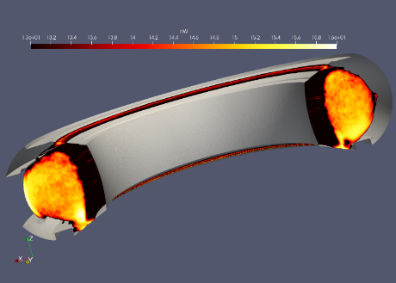
KEY DELIVERABLE 1, task 1 and short term milestones
Task 1 for key deliverable 1: numerical development and verification of SOLEDGE3X, EMC3-EIRENE and ERO2.0 codes
ID | Milestone-description | participants | Target date
M1.1 | Implementation of a 3D wall (i.e. with objects toroidally localized) in SOLEDGE3X-EIRENE | H. Bufferand, M. Raghunathan | 12/2021
M1.2 | Integrating Gorilla orbit tracing code into EIRENE, first step: test of the efficiency of resulting combination in axisymmetric tokamak geometry | M. Eder, M. Raghunathan Y Marandet | 12/2021
M1.3 | Develop interface for importing SOLEDGE3X plasma backgrounds into ERO2.0 | H. Bufferand, J. Romazanov, PhD student CEA (funded by other means) | 06/2022
Ongoing simulations with a 3D wall with SOLEDGE3X using fluid neutrals
Ongoing work (K Galazka, Y Marandet) for coupling SOLEGDE3X and EIRENE with a 3D wall
very promising results on Gorilla, now to see how to integrate in EIRENE (Y Marandet and D Harting)
Done

Slide 7
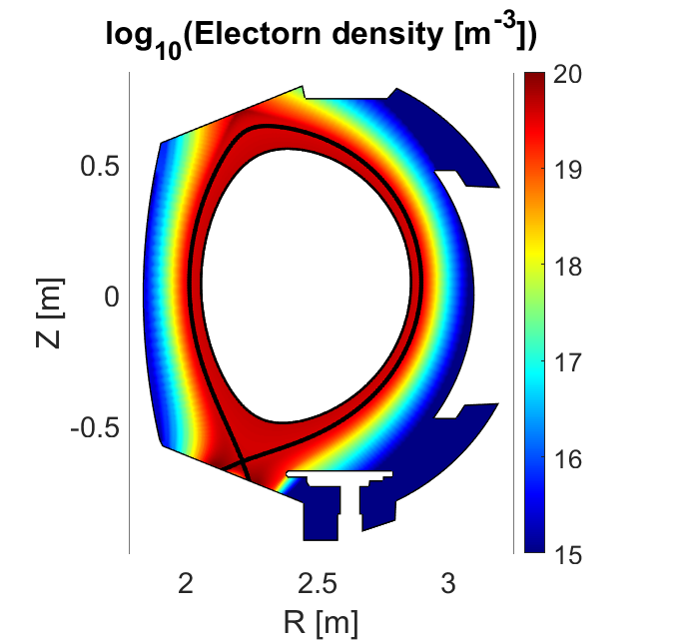
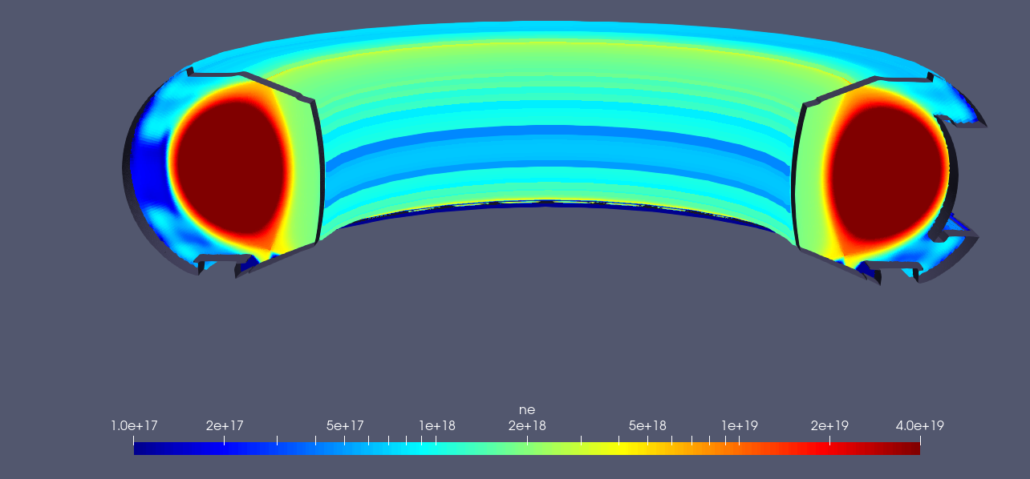
TASK1 for key deliverable 1: numerical development and verification of SOLEDGE3X, EMC3-EIRENE and ERO2.0 code
Milestone 2021: Implementation of a 3D wall (i.e. with objects toroidally localized) in SOLEDGE3X-EIRENE
2D Axysimmetric wall
3D simulation with Non-Axysimmetric wall
SOLEDGE plasma background using fluid neutrals

Slide 8
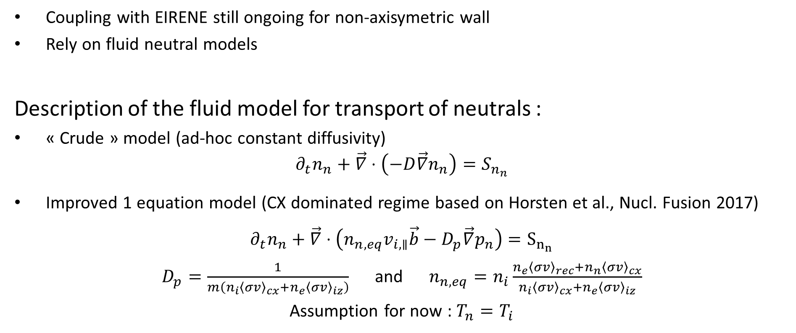
FLUID MODEL FOR TRANSPORT OF NEUTRALS IN SOLEDGE3X
Status for modeling neutrals in 3D:
Coupling with EIRENE still ongoing for non-axisymetric wall
Rely on fluid neutral models
Description of the fluid model for transport of neutrals :
« Crude » model (ad-hoc constant diffusivity)
$$∂_{t}n_{n}+\vec{∇}⋅\left(−D\vec{∇}n_{n}\right)=S_{n_{n}}$$
Improved 1 equation model (CX dominated regime based on Horsten et al., Nucl. Fusion 2017)
$$∂_{t}n_{n}+\vec{∇}⋅\left({n_{n,eq}v_{i,∥}\vec{b}−D}_{p}\vec{∇}p_{n}\right)=S_{n_{n}}$$
$D_{p}=\frac{1}{m\left(n_{i}{〈σv〉}_{cx}+n_{e}{〈σv〉}_{iz}\right)}$ and $n_{n,eq}=n_{i}\frac{n_{e}{〈σv〉}_{rec}+n_{n}{〈σv〉}_{cx}}{n_{i}{〈σv〉}_{cx}+n_{e}{〈σv〉}_{iz}}$
Assumption for now : $T_{n}=T_{i}$

Slide 9

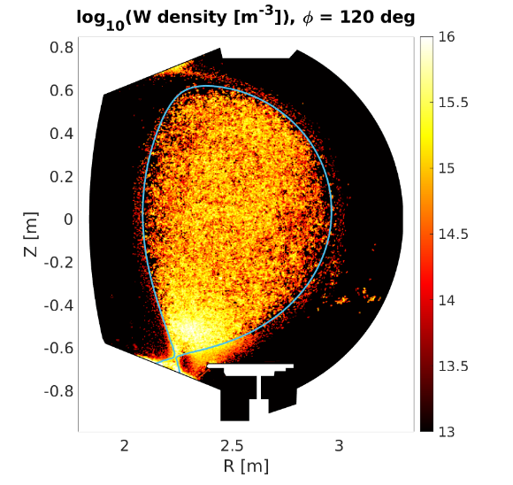
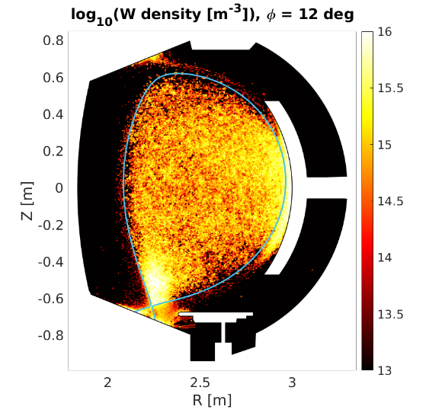

MODELING TRANSPORT OF TUNGSTEN IN A 3D PLASMA BACKGROUND
Milestone June 2022: Develop interface for importing SOLEDGE3X plasma backgrounds into ERO2.0 for W transport
3D simulation with Non-Axysimmetric wall
SOLEDGE plasma background with fluid neutrals
Poloidal maps of W density at two different toroidal angle
3D density map of W obtained with ERO2.0 using the soledge backrgound
Comparison between W transport in 2D vs 3D plasma background (S. Di Genova, PSI 2022)

Slide 10
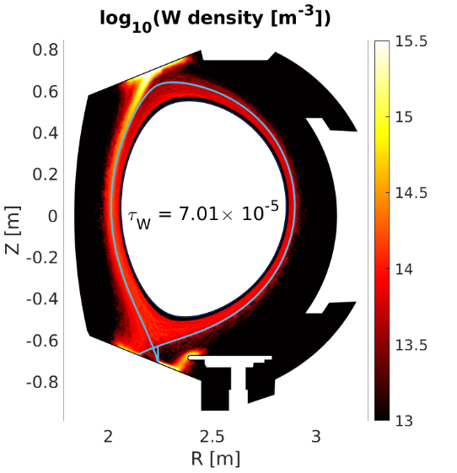
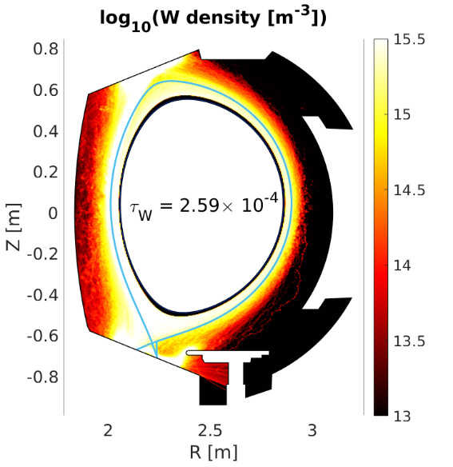
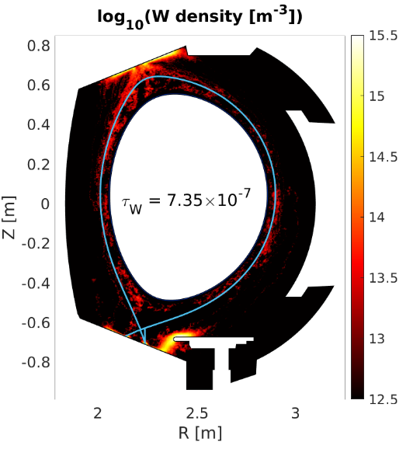
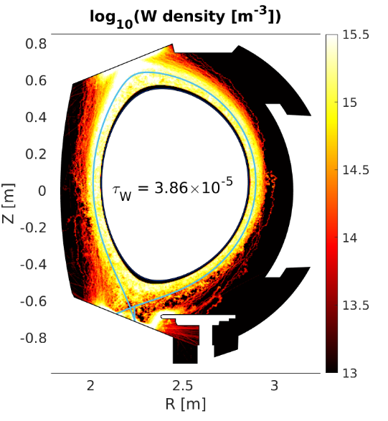

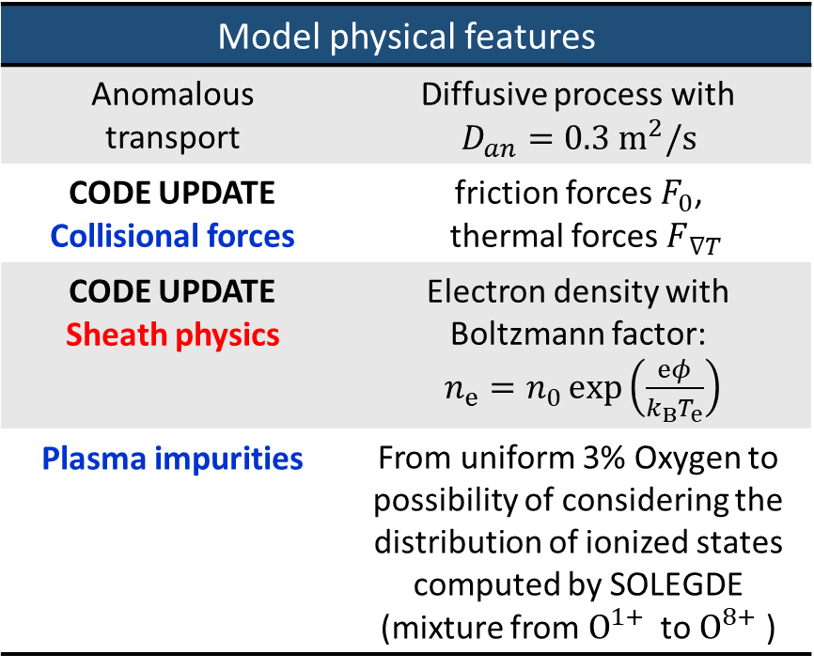


Improving W migration description
I year simulations
II year simulations
Model physical features
Anomalous transport | Diffusive process with $$D_{an}=0.3 m^{2}/s$$
CODE UPDATE Collisional forces | friction forces $F_{0}$, thermal forces $F_{ ∇T}$
CODE UPDATE Sheath physics | Electron density with Boltzmann factor: $n_{e}=n_{0}\exp\left(\frac{eφ}{k_{B}T_{e}}\right)$
Plasma impurities | From uniform 3% Oxygen to possibility of considering the distribution of ionized states computed by SOLEGDE (mixture from $O^{1+}$ to $O^{8+}$ )
$$[s]$$
$$[s]$$
$$[s]$$
$$[s]$$
Penetration of W into the core region increases accordingly to experimental measurements (S Di Genova et al, in preparation)

Slide 11
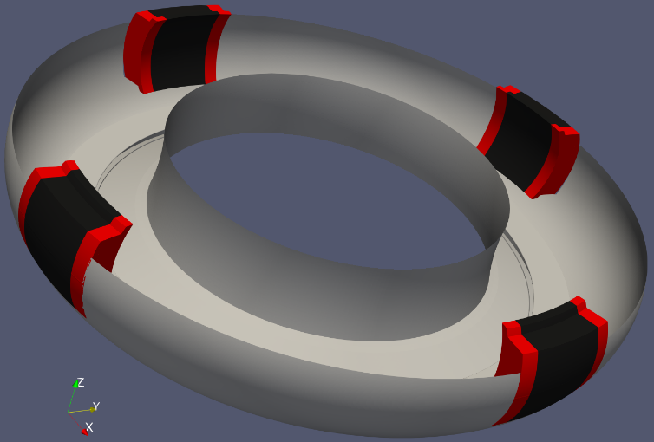
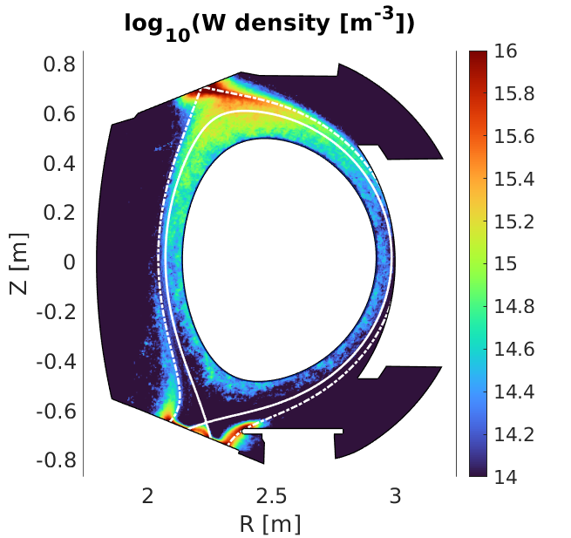
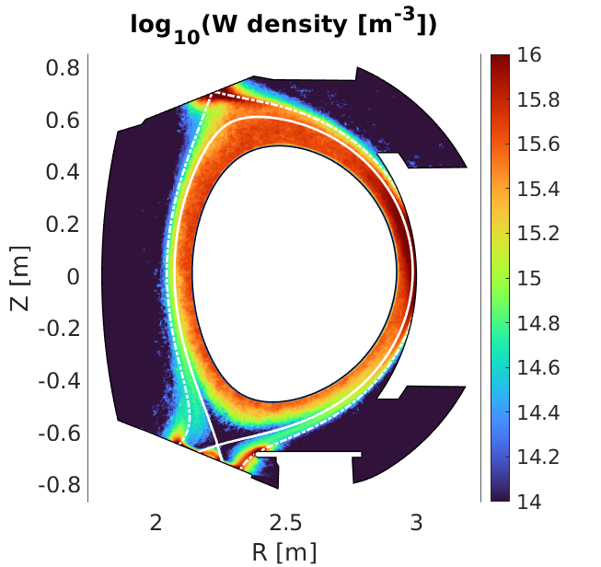
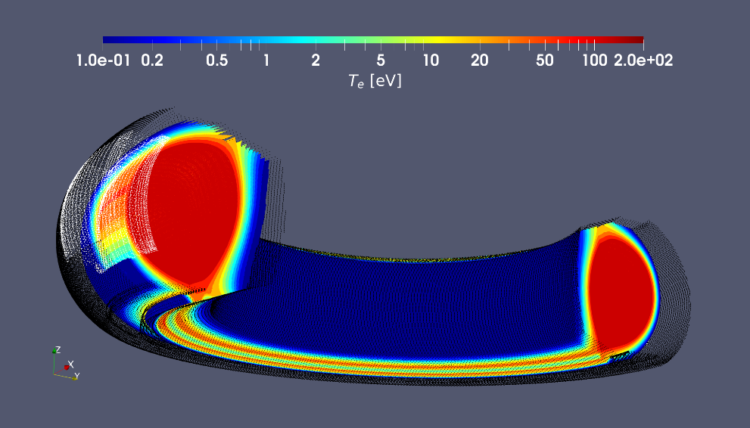
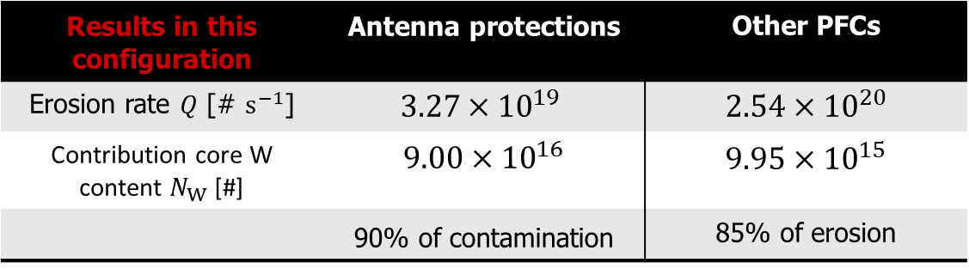
INVESTIGATION OF W CORE CONTAMINATION in west geometry DUE TO ANTENNA LIMITER WITH 3D SOLEDGE-ERO2.0 SIMULATIONS
Without Antenna erosion
With Antenna erosion
3D asymmetric wall model:Radial Outer Gap: 1.5 cm
Results in this configuration | Antenna protections | Other PFCs
Erosion rate $Q$ [# $s^{−1}$] | $$3.27×{10}^{19}$$ | $$2.54×{10}^{20}$$
Contribution core W content $N_{W}$ [#] | $$9.00×{10}^{16}$$ | $$9.95×{10}^{15}$$
 | 90% of contamination | 85% of erosion
SOLEDGE background plasma
(S Di Genova, NME 2023)

Slide 12
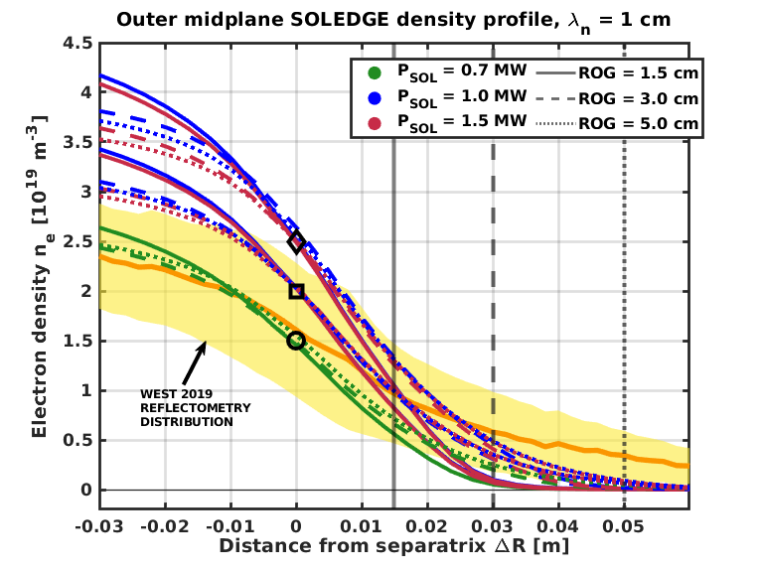
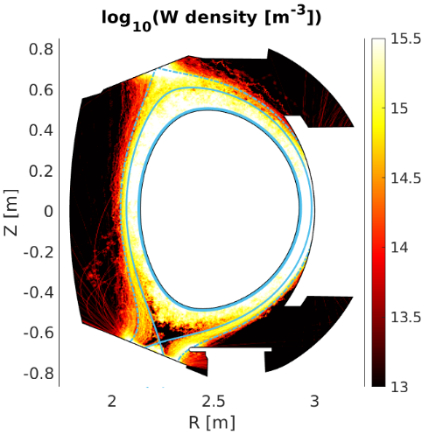
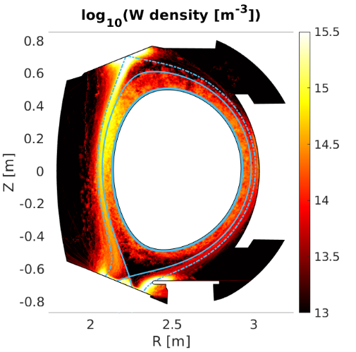
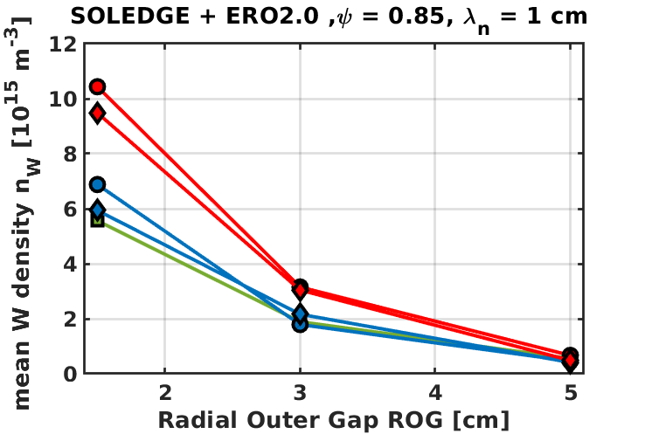
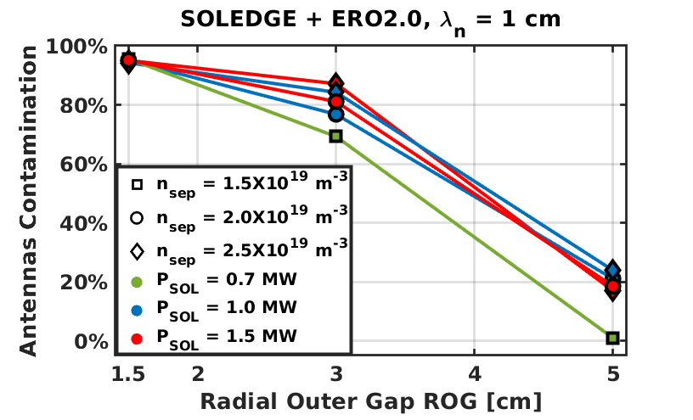
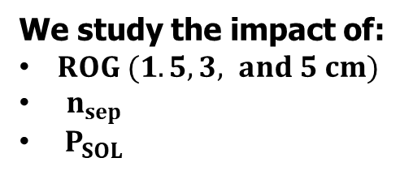
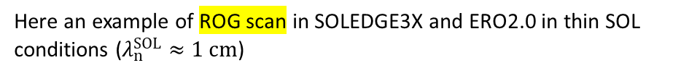
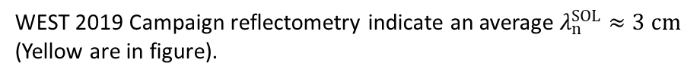
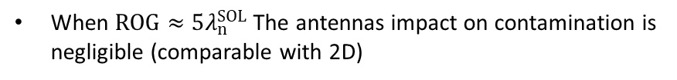
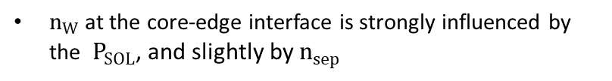
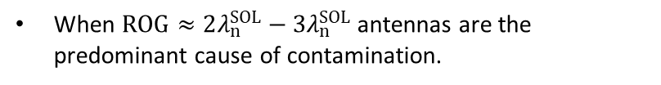
ONGOING investigation on Antenna position and W core contamination using 3D SOLEDGE-ERO2.0 simulations
Radial Outer Gap (ROG) = R_{Ant} - R_{Sep}
We study the impact of:
$ROG (1.5, 3, and 5 cm)$
$n_{sep}$
$P_{SOL}$
Here an example of ROG scan in SOLEDGE3X and ERO2.0 in thin SOL conditions ($λ_{n}^{SOL}≈1 cm$)
ROG = 1.5 cm
ROG = 5 cm
$n_{W}$ at the core-edge interface is strongly influenced by the $P_{SOL}$, and slightly by $n_{sep}$
When $ROG≈2λ_{n}^{SOL}−3λ_{n}^{SOL}$ antennas are the predominant cause of contamination.
WEST 2019 Campaign reflectometry indicate an average $λ_{n}^{SOL}≈3 cm$ (Yellow are in figure).
When $ROG≈5λ_{n}^{SOL}$ The antennas impact on contamination is negligible (comparable with 2D)
A similar study with larger transport coefficient helps gaining insight in “large” SOL conditions.

Slide 13
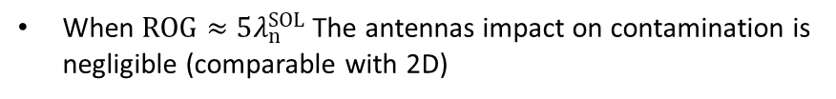
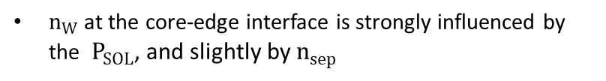
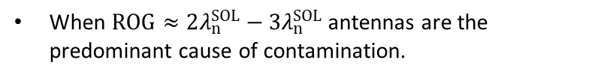
ONGOING investigation on Antenna position and W core contamination using 3D SOLEDGE-ERO2.0 simulations
$n_{W}$ at the core-edge interface is strongly influenced by the $P_{SOL}$, and slightly by $n_{sep}$
When $ROG≈2λ_{n}^{SOL}−3λ_{n}^{SOL}$ antennas are the predominant cause of contamination.
When $ROG≈5λ_{n}^{SOL}$ The antennas impact on contamination is negligible (comparable with 2D)

Slide 14
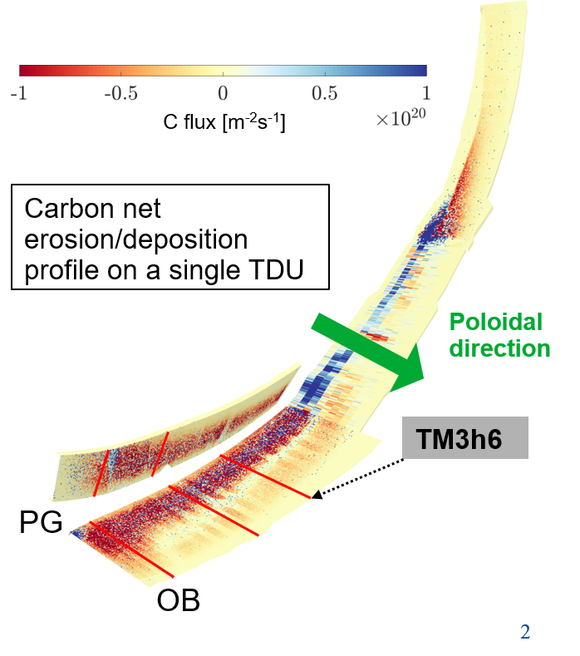
ERO2.0 simulations and validation on W7X experiments
W7-X simulations:
  Develop EMC3-EIRENE + ERO2.0 integrated 3D workflow
  Validate the workflow using W7-X experiments (intrinsic ¹²C erosion: spectroscopy, markers tiles; ¹³C tracer experiment: post-mortem analysis)
¹²C erosion and transport:
  Simulations done + benchmarked with post-mortem, see M. Zhao et al., NF-2022
¹³C tracer injection and transport:
  Simulations done + benchmarked with post-mortem, see E. Wüst et al., NME-2022
More simulations are planned (taking into account erosion by neutrals and various other model improvements) to achieve better match with experiment
Simulation of W tiles from OP1.2 and comparison with experiment (M. Mayer): work in progress, need to repeat with higher statistics

Slide 15
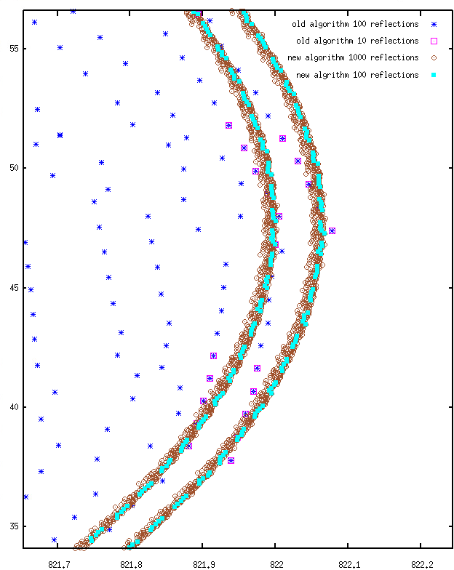
Kinetic modelling of impurities with kit Eirene module
Milestone 2021: Implementation of Kinetic Ion Transport module in EMC3-EIRENE for low Z impurities
Current Status of EMC3-EIRENE Kinetic Ion Transport Module
ID | Milestone-description | participants | Target date
M1.13 | Implementation of EIRENE Kinetic Ion Trace module in EMC3 for low Z impurities | D. Harting, Postdoc FZJ | 12/2021
M1.14 | Assess applicability of EIRENE-KIT with EMC3 for recycling and sticky impurities (for low Z species) | D. Harting, Postdoc FZJ | 06/2022
New accurate implementation of grad-B and curvature drift-movement
  Completely redesigned core part of KIT with EMC3 (field aligned local curvilinear coordinate system of the EMC3 cell)
  Banana orbit correctly described
Re-designed treatment of anomalous diffusion
  Add time step limit to avoid huge diffusion steps
Currently improving coulomb collision description
Examples of new results on banana orbits: very small numerical diffusion
HARTING D. et al., Nucl. Mater. Energy 33, 101279 (2022)

Slide 16
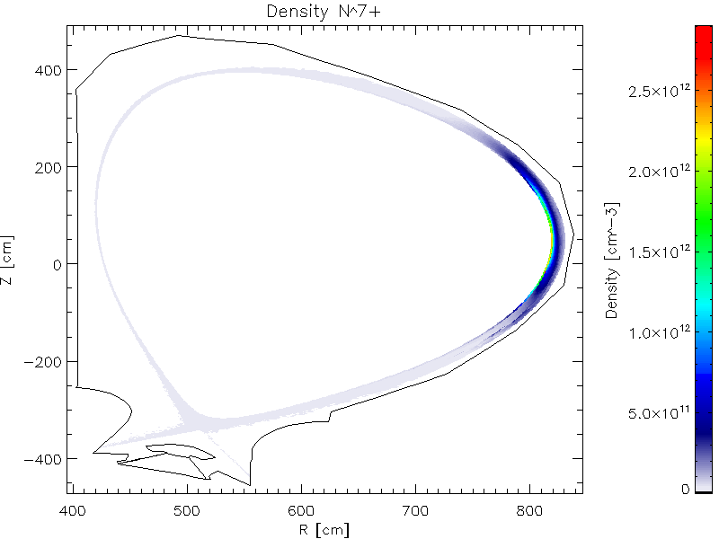
Implementation of Kinetic Ion Transport module in EMC3-EIRENE for low Z impurities
First stable simulation for Nitrogen seeding with an ITER plasma background
N7+ density map
ITER background plasma with
P_{SOL} = 20MW and n_{sep} = 1x10¹⁹ m³
Nitrogen puffed from top of machine
N¹⁺ – N⁴⁺ mainly located in divertor due to recycling
N⁵⁺ trapped in magnetic mirror on HFS of
X-point
N⁶⁺ – N⁷⁺ need higher T_{e} and thus are trapped in magnetic mirror at OMP
Improvements to be made on the treatment of coulomb collisions
HARTING D. et al., Nucl. Mater. Energy 33, 101279 (2022)

Slide 17
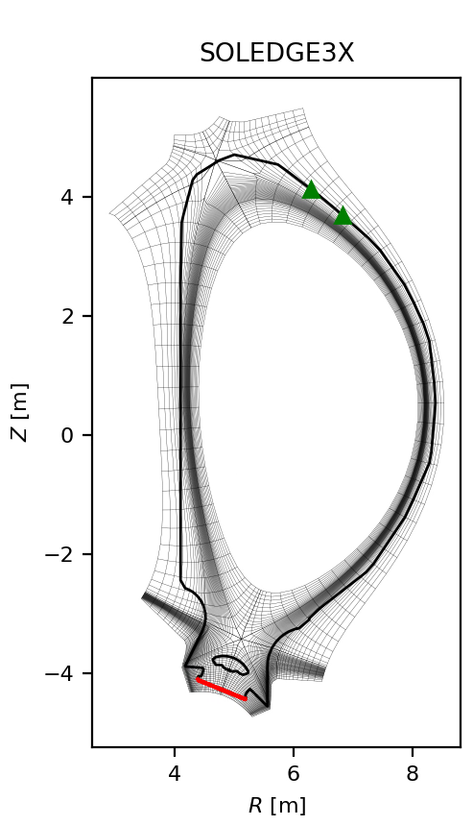
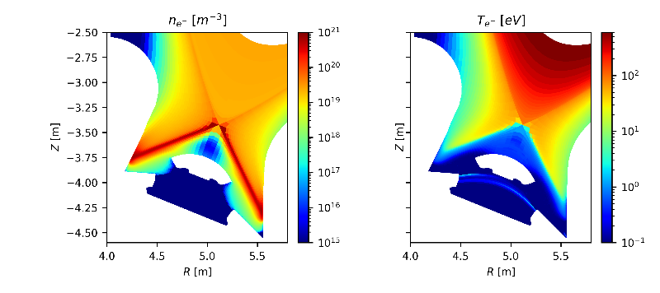

Key Deliverable 2: Assessment of the W influx, W screening, and W transport in ITER plasmas
ID | Milestone-description | participants | Target date
M2.2 | 2D Plasma background in semi-detached conditions (no RMP) | D. Harting, H. Bufferand, G. Ciraolo, N. Rivals | 12/2021
      20MW (PFPO-1)
      L-mode transport
      Pure H
      Advanced options in EIRENE (elastic ion col., MAR, neutral-neutral col.)
SOLEDGE3X computational domain
Gas puff
Temperature and density in the divertor region

Slide 18
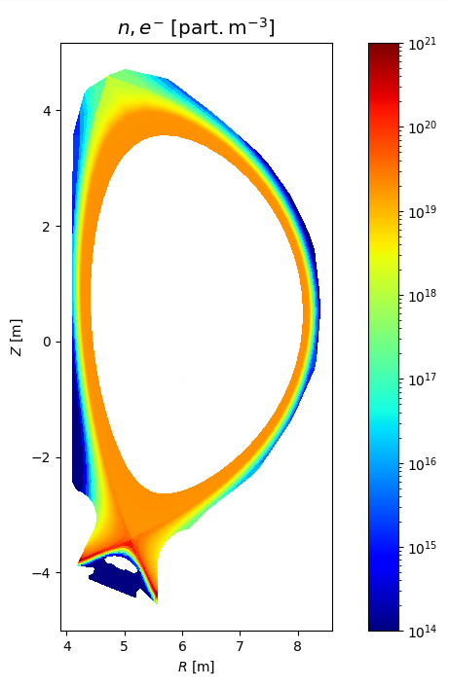
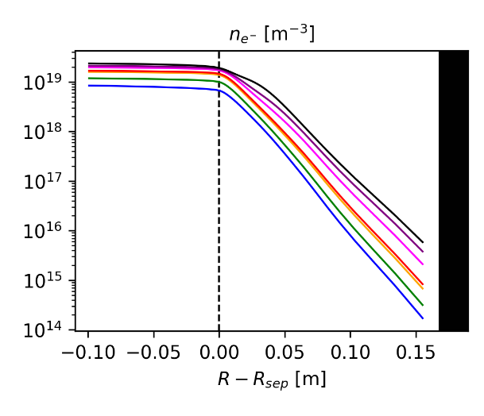
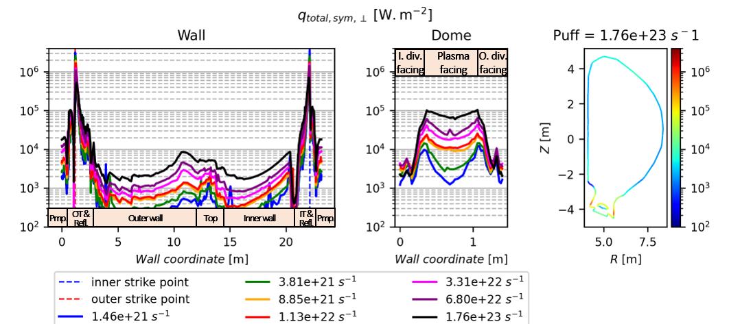
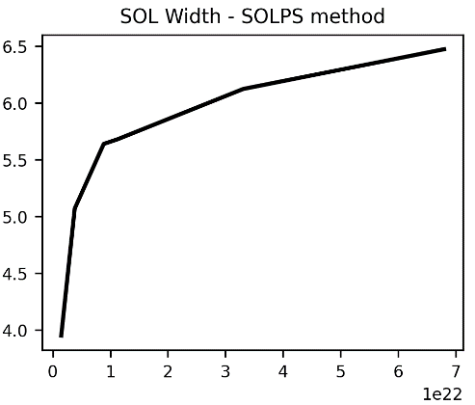
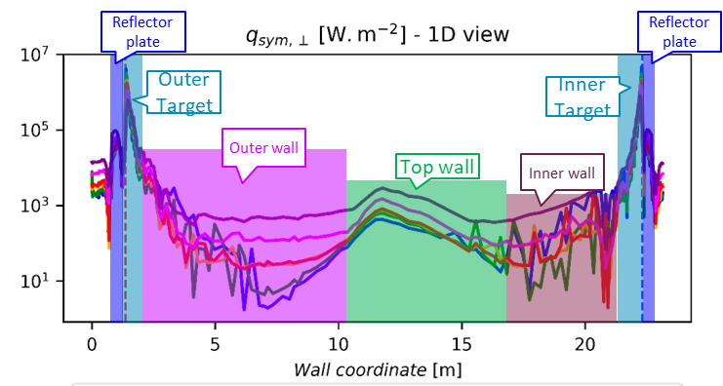
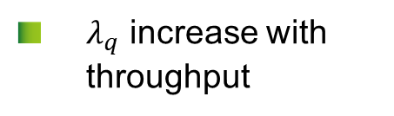




SOLEDGE SIMULATIOND for low power L-mode ITER case: Increasing the throughput from attached to semi-detached plasma
Illustration case at medium throughput (3.31 x 10²² e⁻.s⁻¹):
  Throughput [e⁻.s⁻¹]:
  $n_{e}$[m⁻³]
  $n_{e}$[m⁻³] OMP
  $λ_{q}$[mm]
Gas puff
  $λ_{q}$ increase with throughput
  Strong plasma-wall interaction:
    Top
    Outer lower wall
Pump
[N. Rivals et al, NME 2022]

Slide 19
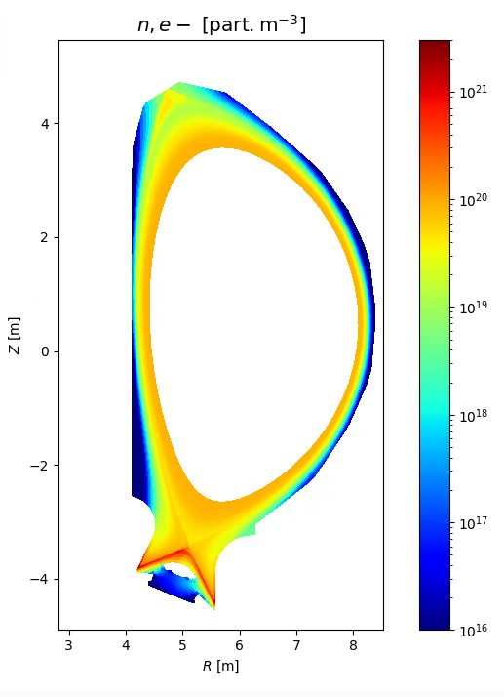
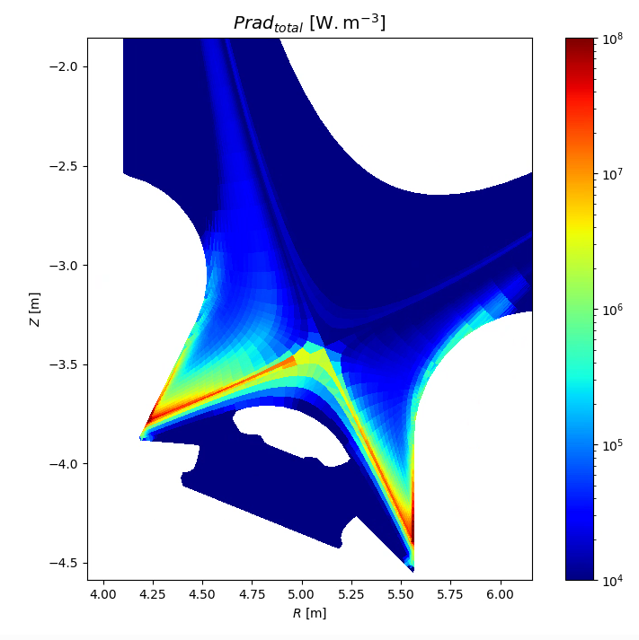
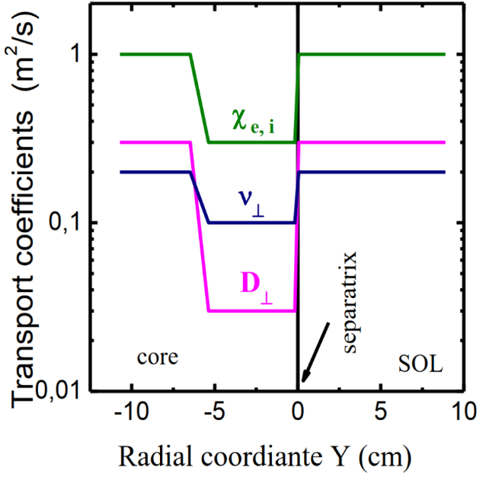
Key Deliverable 3: Assessment of the seeding impurity screening and transport in ITER scenarios.
ONGOING 2D SOLEDGE SIMULATIONS FOR ITER H-MODE PLASMA IN FPO PHASE WITH 100MW INJECTED POWER AND Ne SEEDING AND He ASHES
ELECTRON DENSITY
Pin = 100MW FPO Q=10 plasma
D
Neon seeded
Helium fusion products
H-mode transport barrier
Advanced neutral modelling (MAR, neutral-neutral collisions)
RADIATED POWER
RADIAL PROFILE OF TRANSPORT COEFFICIENTS
(N Rivals et al, in preparation)
M3.2 | 2D ITER Plasma background in semi-detached conditions (no RMP) and N/Ne/… seeding (both with EMC3-EIRENE and SOLEDGE3X with fluid impurities as reference case) | milestone expected for 03/2023

Slide 20
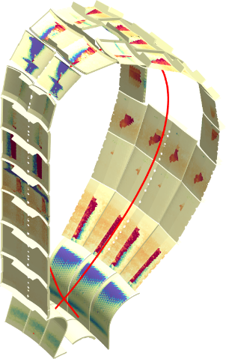
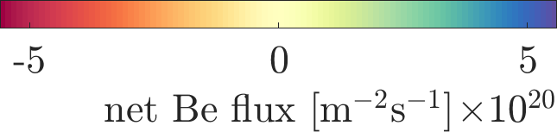
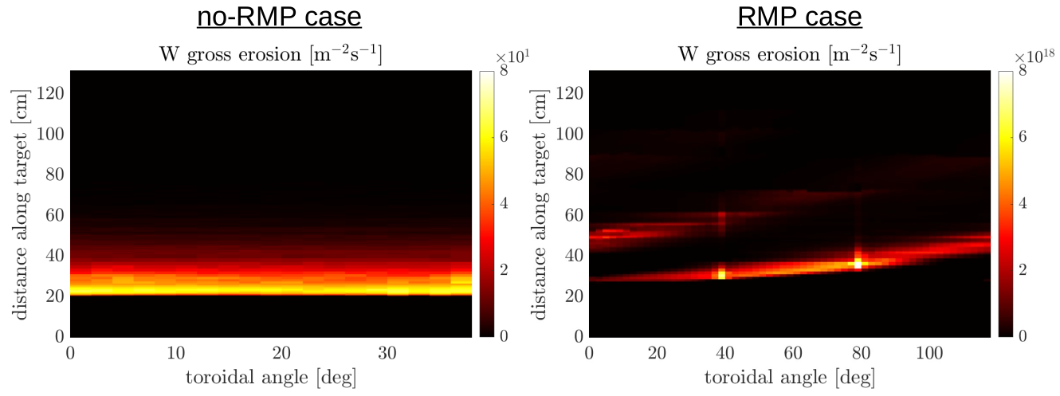
ERO2.0 simulations for IMPURITY transport in 2D/3D ITER plasma
Key Deliverable 2: Assessment of the W influx, W screening, and W transport in ITER plasmas
ERO2.0 runs using 2D ITER plasma backgrounds (OEDGE):
  Previous work (J. Romazanov et al. CPP-2019, NME-2021, NF-2022) focused on Be FW erosion
  Next step: repeat with considering the W divertor
ERO2.0 runs using 2D/3D ITER plasma backgrounds with+w/o RMPs (EMC3-EIRENE) is work-in-progress:
  4 EMC3-EIRENE PFPO plasma backgrounds by Heinke Frerichs: 2 with and w/o RMPs, each in low + high density
  Implementation of EMC3-EIRENE to ERO2.0 data transfer was adapted to tokamaks
  First preliminary W gross erosion obtained on inner target for low-density case
  Under investigation: improvement of B-field interpolation
Be net
erosion
Be net
deposition
Deliverables for 2022-2023
D2.1 | Characterization of W transport on 2D ITER plasma backgrounds obtained in M2.2 using ERO2.0 (post processing) | 01/2023
D2.2 | Analysis of EMC3-EIRENE ITER plasma background with 3D perturbation in semi-detached conditions (full 3D solution) | 12/2022

Slide 21
SUMMARY and Next steps
Project overall in line with the objectives set out in the intial proposal
Next steps (end of 2023)
  Implement complex magnetic geometries into SOLEDGE3X (first with ripple effects)
    Operators aligned with 𝑏 ⃗ no-longer lie in the flux surface (parallel diffusion so far treated as a 2D operator in the [𝜑,𝜃] plane)
    New generic operator class now defined in SOLEDGE3X enables general 3D diffusion (parallel diffusion now 3D operator coupling all mesh points)
    Advection was already treated in 3D
  SOLEDGE3X 3D plasma background with fluid impurities and validation on WEST experiment in double null configuration
  ERO2.0 runs on SOLEDGE3X WEST plasma backgrounds and comparison with experimental results

Slide 22
Next steps on Kinetic impurity modeling
2023 milestone for Code development:
  EIRENE-KIT module: Assessment on the applicability of EIRENE-KIT with EMC3 for recycling and sticky impurities
  ERO2.0
    Erosion in multi-component plasma (e.g. D⁰, D⁺, T⁰, T⁺, He⁰, He⁺, He²⁺, + seeding species)
    Assist merging of developments from CEA + Aalto: improved W sputtering; CX energy distributions
  Benchmark between ERO2.0 with EIRENE-KIT:
    Consistent usage of Fokker-Planck collision term
    Cross-check individual trajectories + ensembles in selected cases (e.g. ITER)
Comparison with experiments and validation
W7-X simulations:
  Develop EMC3-EIRENE + ERO2.0 integrated 3D workflow
  Validate the workflow using W7-X experiments (intrinsic ¹²C erosion: spectroscopy, markers tiles; ¹³C tracer experiment: post-mortem analysis)

Slide 23
Milestones on iter simulations
Characterization of W transport on 2D ITER plasma backgrounds obtained in M2.2 using ERO2.0 (post processing)
Analysis of EMC3-EIRENE ITER plasma background with 3D perturbation in semi-detached conditions (full 3D solution)
characterization of W transport using ERO2.0 runs on 3D ITER plasma backgrounds obtained in M2.4
10/2023
12/2023
08/2023

Slide 25
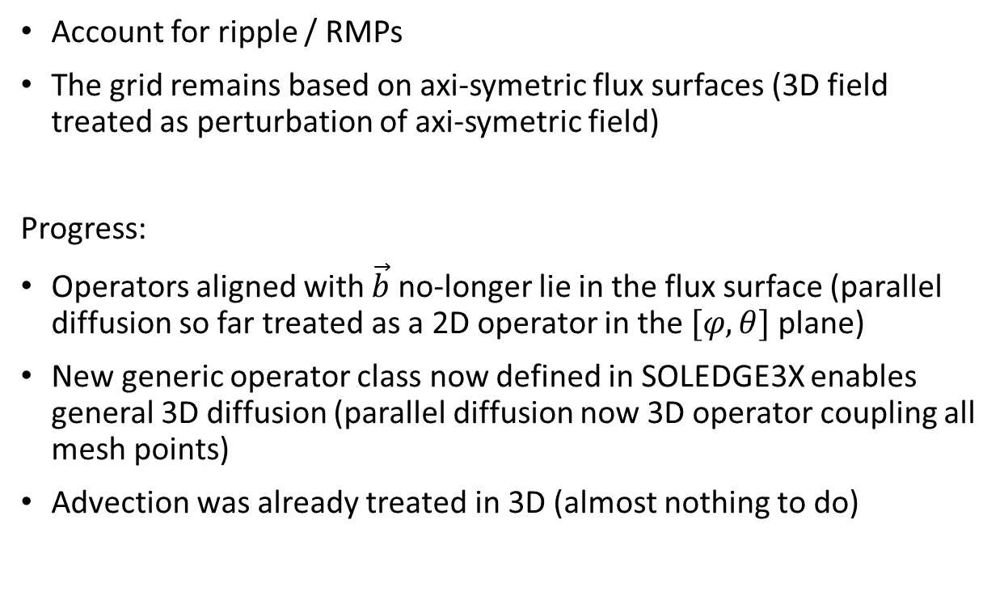
SUMMARY and Next steps: SOLEDGE3X code development
ID | Milestone-description | Target date
M1.1 | Implementation of a 3D wall (i.e. with objects toroidally localized) in SOLEDGE3X-EIRENE | 12/2021
M1.3 | Develop interface for importing SOLEDGE3X plasma backgrounds into ERO2.0 | 06/2022
M1.5 | Implement complex magnetic geometries into SOLEDGE3X (first with ripple effects) | 03/2023
Moving towards 3D magnetic field
Account for ripple / RMPs
The grid remains based on axi-symetric flux surfaces (3D field treated as perturbation of axi-symetric field)
Progress:
Operators aligned with $\vec{b}$ no-longer lie in the flux surface (parallel diffusion so far treated as a 2D operator in the $[φ,θ]$ plane)
New generic operator class now defined in SOLEDGE3X enables general 3D diffusion (parallel diffusion now 3D operator coupling all mesh points)
Advection was already treated in 3D (almost nothing to do)

Slide 28
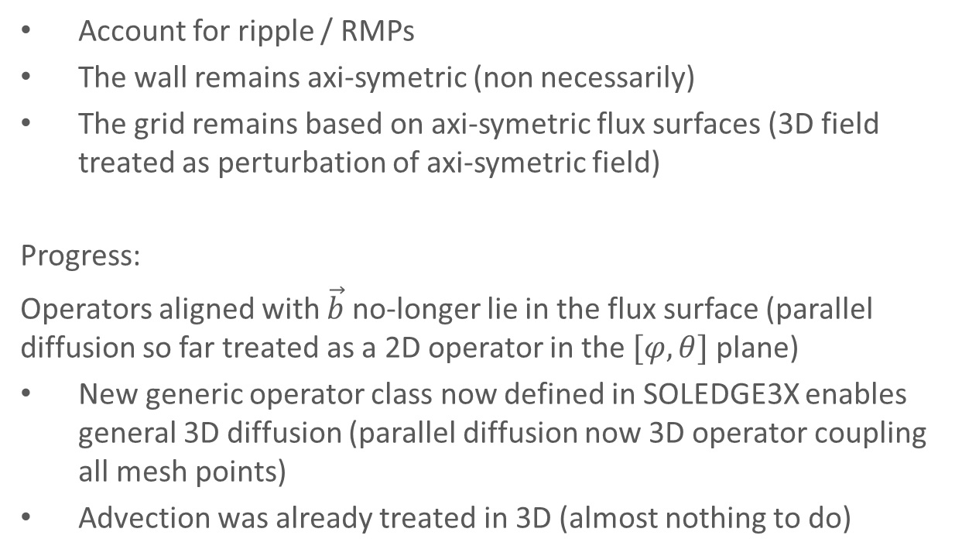
Moving towards 3D magnetic field
Purpose: Simulate non-axisymetric magnetic field in SOLEDGE3X
ID | Milestone-description | Target date
M1.1 | Implementation of a 3D wall (i.e. with objects toroidally localized) in SOLEDGE3X-EIRENE | 12/2021
M1.3 | Develop interface for importing SOLEDGE3X plasma backgrounds into ERO2.0 | 06/2022
M1.5 | Implement complex magnetic geometries into SOLEDGE3X (first with ripple effects) | 03/2023
Account for ripple / RMPs
The wall remains axi-symetric (non necessarily)
The grid remains based on axi-symetric flux surfaces (3D field treated as perturbation of axi-symetric field)
Progress:
Operators aligned with $\vec{b}$ no-longer lie in the flux surface (parallel diffusion so far treated as a 2D operator in the $[φ,θ]$ plane)
New generic operator class now defined in SOLEDGE3X enables general 3D diffusion (parallel diffusion now 3D operator coupling all mesh points)
Advection was already treated in 3D (almost nothing to do)

Slide 29
KEY DELIVERABLE 1, task 2 and short term milestones, deliverables
Task 2 for key deliverable 1: GyselaX (and VENUS-LEVIS) code development for investigation for W transport in the pedestal region
ID | Milestone-description | participants | Target date
M1.19 | Implementation of a source term in the vorticity equation of GyselaX code | E. Gravier, PhD student CEA/UL (funded by other means) | 12/2021
M1.20 | Generation of transport barriers by sheared poloidal flows, triggered by a vorticity source (poloidal momentum), with GyselaX code. | E. Gravier, PhD student CEA/UL (funded by other means) | 12/2022
E Gravier (IJL and Univ. Lorraine)
Fully achieved

Slide 30
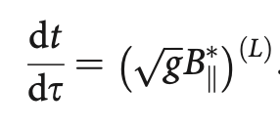
Integrating GORILLA into EIRENE
Purpose: modelling of impurity transport in Soledge3X-EIRENE
GORILLA: mesh-based symplectic integration method for guiding-center orbits
Advantages of GORILLA:
Computational efficiency (up to 10x faster than RK4)
Physically correct long time orbit dynamics
  Symplectic: preserved total energy, magnetic moment, phase-space volume, …
Formulation in general curvilinear coordinates
  Well-suited for edge plasma (no flux coordinates)
Tetrahedral mesh used in GORILLA
Principal achievement within 1st year of TSVV 6:
Correct Hamiltonian time dynamics (necessary for statistics)
Objective:
Computation of guiding-center orbit statistics in Soledge3X-EIRENE domain
(particle and flow densities)

Slide 31
Integration of kinetic ion tracers into EIRENE and SOLEDGE3X
EIRENE-KIT: Extending field line tracing by drift and mirror force [1,2]
GORILLA: Mesh-based 3D symplectic guiding-center tracer [3]
Two coupling approaches in Monte-Carlo codes
  Compute fluid quantities from statistics of ion tracer
  Directly hand particle between neutral and ion tracer on (de-)ionization
[1] F. Schluck, Contributions to Plasma Physics, vol. 60, p. e201900144, 2020.
[2] D.V. Borodin and EIRENE-NGM-DEVELOPERS, 28th IAEA Fusion Energy Conference, May 2021.
[3] M. Eder et al., Phys. Plasmas 27, 122508, 2020.

Slide 32
Task 3 for key deliverable 1: Validation of numerical tools on selected experiments on WEST, W7X and JET
M1.31 | Execute and validate JINTRAC simulations in JET ELMy H-mode plasmas, characterise dominant transport process leading to core W accumulation, including ELMs | H. Kumpulainen | 03/2023

Slide 34










Improving W migration description
the simulations were updated in order to reduce prompt re-deposition and get closer to experimental estimations of $n_{W}$ (~${10}^{15} m^{−3}$)
Old simulation
CODE UPDATE:
Ion thermal force:
$$\vec{χ}=\frac{\vec{v}−{\vec{v}}_{i}}{u_{i}}$$
$${\vec{F}}_{∇T_{i}} =−\frac{Λ}{10\sqrt{π^{3}}}\left(1+\frac{m_{i}}{m}\right){\left(\frac{ZZ_{i}e^{2}}{ε_{0}}\right)}^{2}\frac{e^{−χ_{i}^{2}}}{{u_{i}T}_{i}^{2}}\left({\vec{q}}_{i}−2\left({\vec{q}}_{i}⋅{\vec{χ}}_{i}\right) {\vec{χ}}_{i}\right)$$
$$u_{i}=\sqrt{\frac{2T_{i}}{m_{i}}}$$
$$[s]$$
$${\vec{q}}_{i}≈−60{ T}_{i}^{\frac{5}{2}}∇T_{i} [W m^{−2}]$$
CODE UPDATE:
Electron density Boltzmann distribution
inside the Magnetic pre-sheath:
$$n_{e}\left(x\right)=n_{e}^{0}e^{\frac{φ\left(x\right)}{k_{b}T_{e}}}$$
Updated simulations
NEW SIMULATION SETTINGS:
3% Oxygen mixture from $O^{1+}$ to $O^{8+}.$ $O^{n+}$ concentration coming from an educated guess based on SOLEDGE modelling (Increases erosion as well!)
$$[s]$$
New simulations present separatrix average $n_{W}$ up to 150 times higher than old ones
But the erosion rate is only 3 times higher

Slide 35







Thermal forces
Kinetic model [D. Reiser, NF, 1998-Y. Homma et al.,JCP, 2013]
Friction forces:
$${\vec{q}}_{i}≈−60{ T}_{i}^{\frac{5}{2}}∇T_{i} [W m^{−2}]$$
$${\vec{F}}_{0} =−\frac{Λ}{4π}\left(1+\frac{m_{i}}{m}\right){\left(\frac{ZZ_{i}e^{2}}{ε_{0}}\right)}^{2}\frac{n_{i}}{2T_{i}}\left(\frac{\operatorname{erf}\left(χ_{i}\right)−χ_{i}\operatorname{erf}{′\left(χ_{i}\right)}}{χ_{i}^{3}}\right){\vec{χ}}_{i}$$
$$\vec{χ}=\frac{\vec{v}−{\vec{v}}_{i}}{u_{i}}$$
[P. Stangeby, 2001]
$${\vec{F}}_{∇T}$$
If Temperature gradients are non-negligible:
Ion thermal force:
$$u_{i}=\sqrt{\frac{2T_{i}}{m_{i}}}$$
$$\vec{B}$$
$${\vec{F}}_{∇T_{i}} =−\frac{Λ}{10\sqrt{π^{3}}}\left(1+\frac{m_{i}}{m}\right){\left(\frac{ZZ_{i}e^{2}}{ε_{0}}\right)}^{2}\frac{e^{−χ_{i}^{2}}}{{u_{i}T}_{i}^{2}}\left({\vec{q}}_{i}−2\left({\vec{q}}_{i}⋅{\vec{χ}}_{i}\right) {\vec{χ}}_{i}\right)$$
$${\vec{F}}_{0}$$
Electron density inside the MPS:
ERO2.0 +
Thermal forces +
MPS el. density drop
$$n_{e}\left(x\right)=n_{e}^{0}e^{\frac{φ\left(x\right)}{k_{b}T_{e}}}$$
ERO2.0 STD
ERO2.0 +
MPS el. density drop

Slide 36






Divertor targets: strong local redeposition
Low density background
High density background
W from Baffle redeposits on the OT
Non-local dep. < 1%

Slide 37





Baffle contamination: two different magnetic configurations
55797
ERO2.0 Input parameters:
$D_{⊥}^{an}=1 m^{2}/s$
Future simulations to investigate X-point height influence on W contamination
54067
#55797: low X-point
#54067: high X-point
Simulation power 2.5 MW
Separatrix density: 2.1e19 m-3
Penetration factor $τ_{W}$: 1e-6 s
Simulation power 3 MW
Separatrix density: 2.5e19 m-3
Penetration factor $τ_{W}$: 1e-11 s

