Slide 1

“Theory, Simulation, Verification and Validation”
TSVV Task 7: Plasma-Wall Interaction in DEMO
WP PWIE Meeting | 08.02.2023
D. Matveev on behalf of TSVV-7 team

Slide 2

TSVV-07 Plasma-Wall Interaction in DEMO
Aims of the project
Establish an integrated modelling suite capable to treat complex 3D wall geometry
to predict steady-state PWI in DEMO
Provide safety-relevant information for DEMO reference scenarios
concerning first-wall erosion, dust, and fuel inventory
Develop and apply modelling capabilities to treat PWI in DEMO-relevant transients regarding their impact on PFC integrity

Slide 3
TSVV-07 Plasma-Wall Interaction in DEMO
Objectives
Assessment of steady-state W erosion rates for first wall and divertor
Mapping of preferential W re/co-deposition locations
Assessment of dust mobilization from likely dust production sites (dust survival rates and dust accumulation maps)
Assessment of PFC response to transients: melting and splashing (melt-stability, likelihood of splashing, droplet-to-dust conversion rates)
Assessment of W erosion rates for locations affected by transients
Assessment of tritium in-vessel inventory (co-deposition, bulk retention with He-induced and neutron damage)

Slide 4






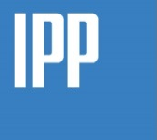







TSVV-07
PWI in DEMO
Team codes & contributions
FZJ | ERO2.0, CRDS | Impurity transport and PWI: erosion-deposition mapping. Fuel retention.
IPP Garching | SDTrimSP, TESSIM, RAVETIME | PWI data. Fuel retention. Uncertainty quantification.
KTH | MEMENTO, MIGRAINE | Material response to transient heat loads. Dust/droplet mobilization and transport.
IPP Prague | SPICE & BIT | Kinetic (PIC+MC) modelling of complex plasma sheath.
JSI | BIT | Kinetic (PIC) modelling of dynamic SOL.
CEA/USPN | MHIMS, FESTIM | Fuel retention.
VTT/Helsinki | MD, potential development | Interatomic potentials, MD modelling for PWI.

Slide 5
TSVV-07 Plasma-Wall Interaction in DEMO
Team members
FZJ: D. Matveev, C. Baumann, J. Romazanov, S. Brezinsek
KTH: S. Ratynskaia, L. Vignitchouk, P. Tolias, E. Thoren, P. Konstantinos
IPP-CAS: D. Tskhakaya, M. Komm, A. Podolník
USPN: J. Mougenot, Y. Charles
CEA: R. Delaporte-Mathurin, E. Hodille, C. Grisolia, F. Montupet-leblond,
IPP: U. Von Toussaint, K. Schmid
Helsinki: F. Granberg, F. Kporha
JSI: J. Kovačič, S. Costea

Slide 6

TSVV-07
    External input: plasma background, wall geometry, material choice, steady-state
    and transient heat loads – interaction with DCT, WPs (PWIE, DES, MAT), …
PWI in DEMO
Interaction scheme
Post-processing: extraction of parameters to the wall (e.g. CX fluxes and distributions)
PWI
erosion, morphology
PIC
sheath collisionality, ion fluxes & distributions, heat loads, thermionic current
ERO2.0
local and global
impurity transport
(castellation, roughness)
PWI
(erosion, morphology,
layer formation)
Fuel retention
co-deposition, n-damage
Dust
mobilization, transport
deposition mapping
Transients
melting
splashing
ACH support: IMAS compatibility, code optimization for HPC

Slide 7
TSVV-07 Timeline

Slide 8

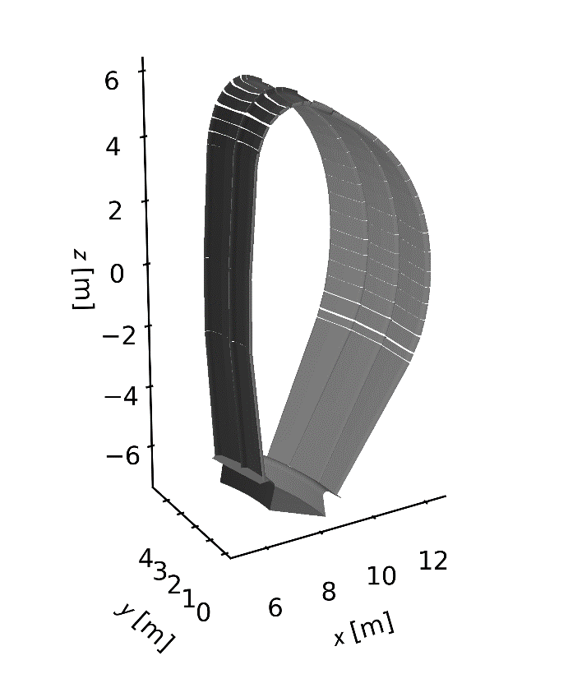
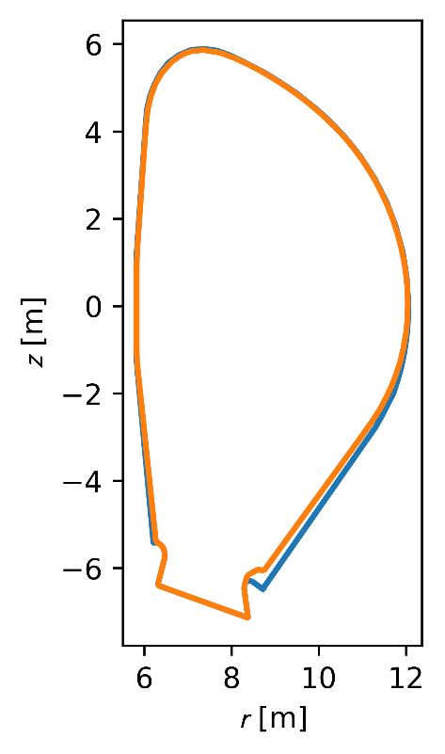
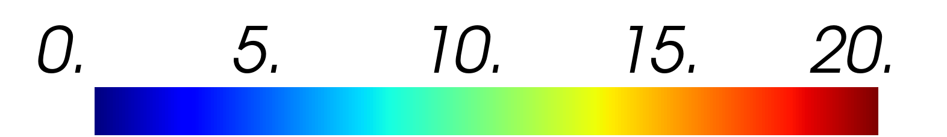
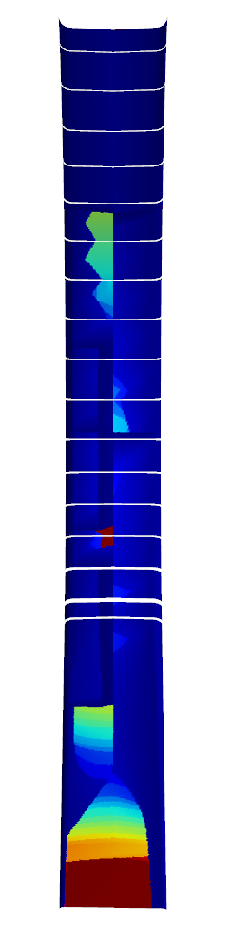
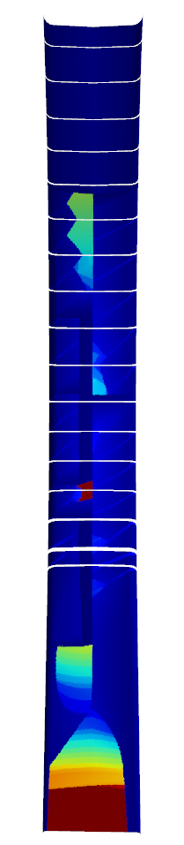
TSVV-07 progress
    Tasks 2022
    Full 3D ERO2.0 simulations using existing PWI databases, sheath models and the plasma solution
    Wall geometry, plasma equilibrium (baseline 2017), SOLPS-ITER plasma solution [F. Subba et al 2021 Nucl. Fusion 61 106013],
    neutral fluxes (not yet angular and energy resolved), magnetic shadowing and extrapolation to the wall implemented in ERO2.0
2D wall
3D wall
connection length [m]
PFCFlux
ERO2.0
© C. Baumann

Slide 9
TSVV-07 progress
    Tasks 2022
    Full 3D ERO2.0 simulations using existing PWI databases, sheath models and the plasma solution
    Wall geometry, plasma equilibrium (baseline 2017), SOLPS-ITER plasma solution [F. Subba et al 2021 Nucl. Fusion 61 106013],
    neutral fluxes (not yet angular and energy resolved), magnetic shadowing and extrapolation to the wall implemented in ERO2.0
Neutral fluxes
© C. Baumann & F. Subba
D
Ar
© C. Baumann
Extrapolation of plasma
parameters to the wall
He
0

Slide 10
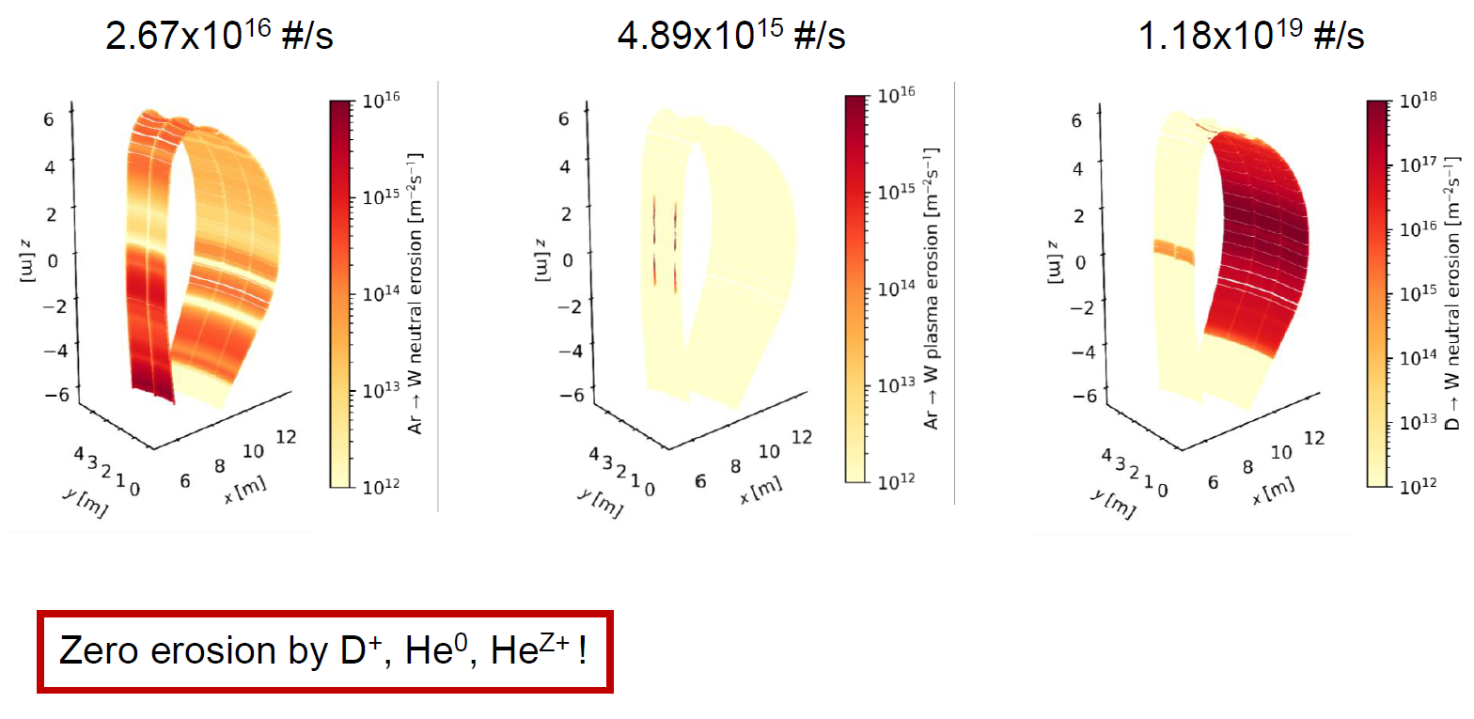
TSVV-07 progress
    Tasks 2022
    Full 3D ERO2.0 simulations using existing PWI databases, sheath models and the plasma solution
    First preliminary simulations of W erosion
Here: globally constant
ion impurity concentrations
based on integrated
volumetric SOLPS data
• D⁺ ~ 0.855
• He²⁺ ~ 0.134
• He⁺ ~ 0.008
• Ar¹³⁺ ~ 0.003
(mean charge state of Ar)
© C. Baumann

Slide 11
TSVV-07 progress
    Ongoing work
    Full 3D ERO2.0 simulations using existing PWI databases, sheath models and the plasma solution
    Accounting for charge state resolved impurity concentrations and fluxes
! Recent ERO2.0 update
has introduced fully charge state resolved impurity concentrations and respective PWI, so that
new erosion results
are coming soon
! SOLPS-ITER solution with extended grid will be very important – is pending (DCT)
© C. Baumann

Slide 12
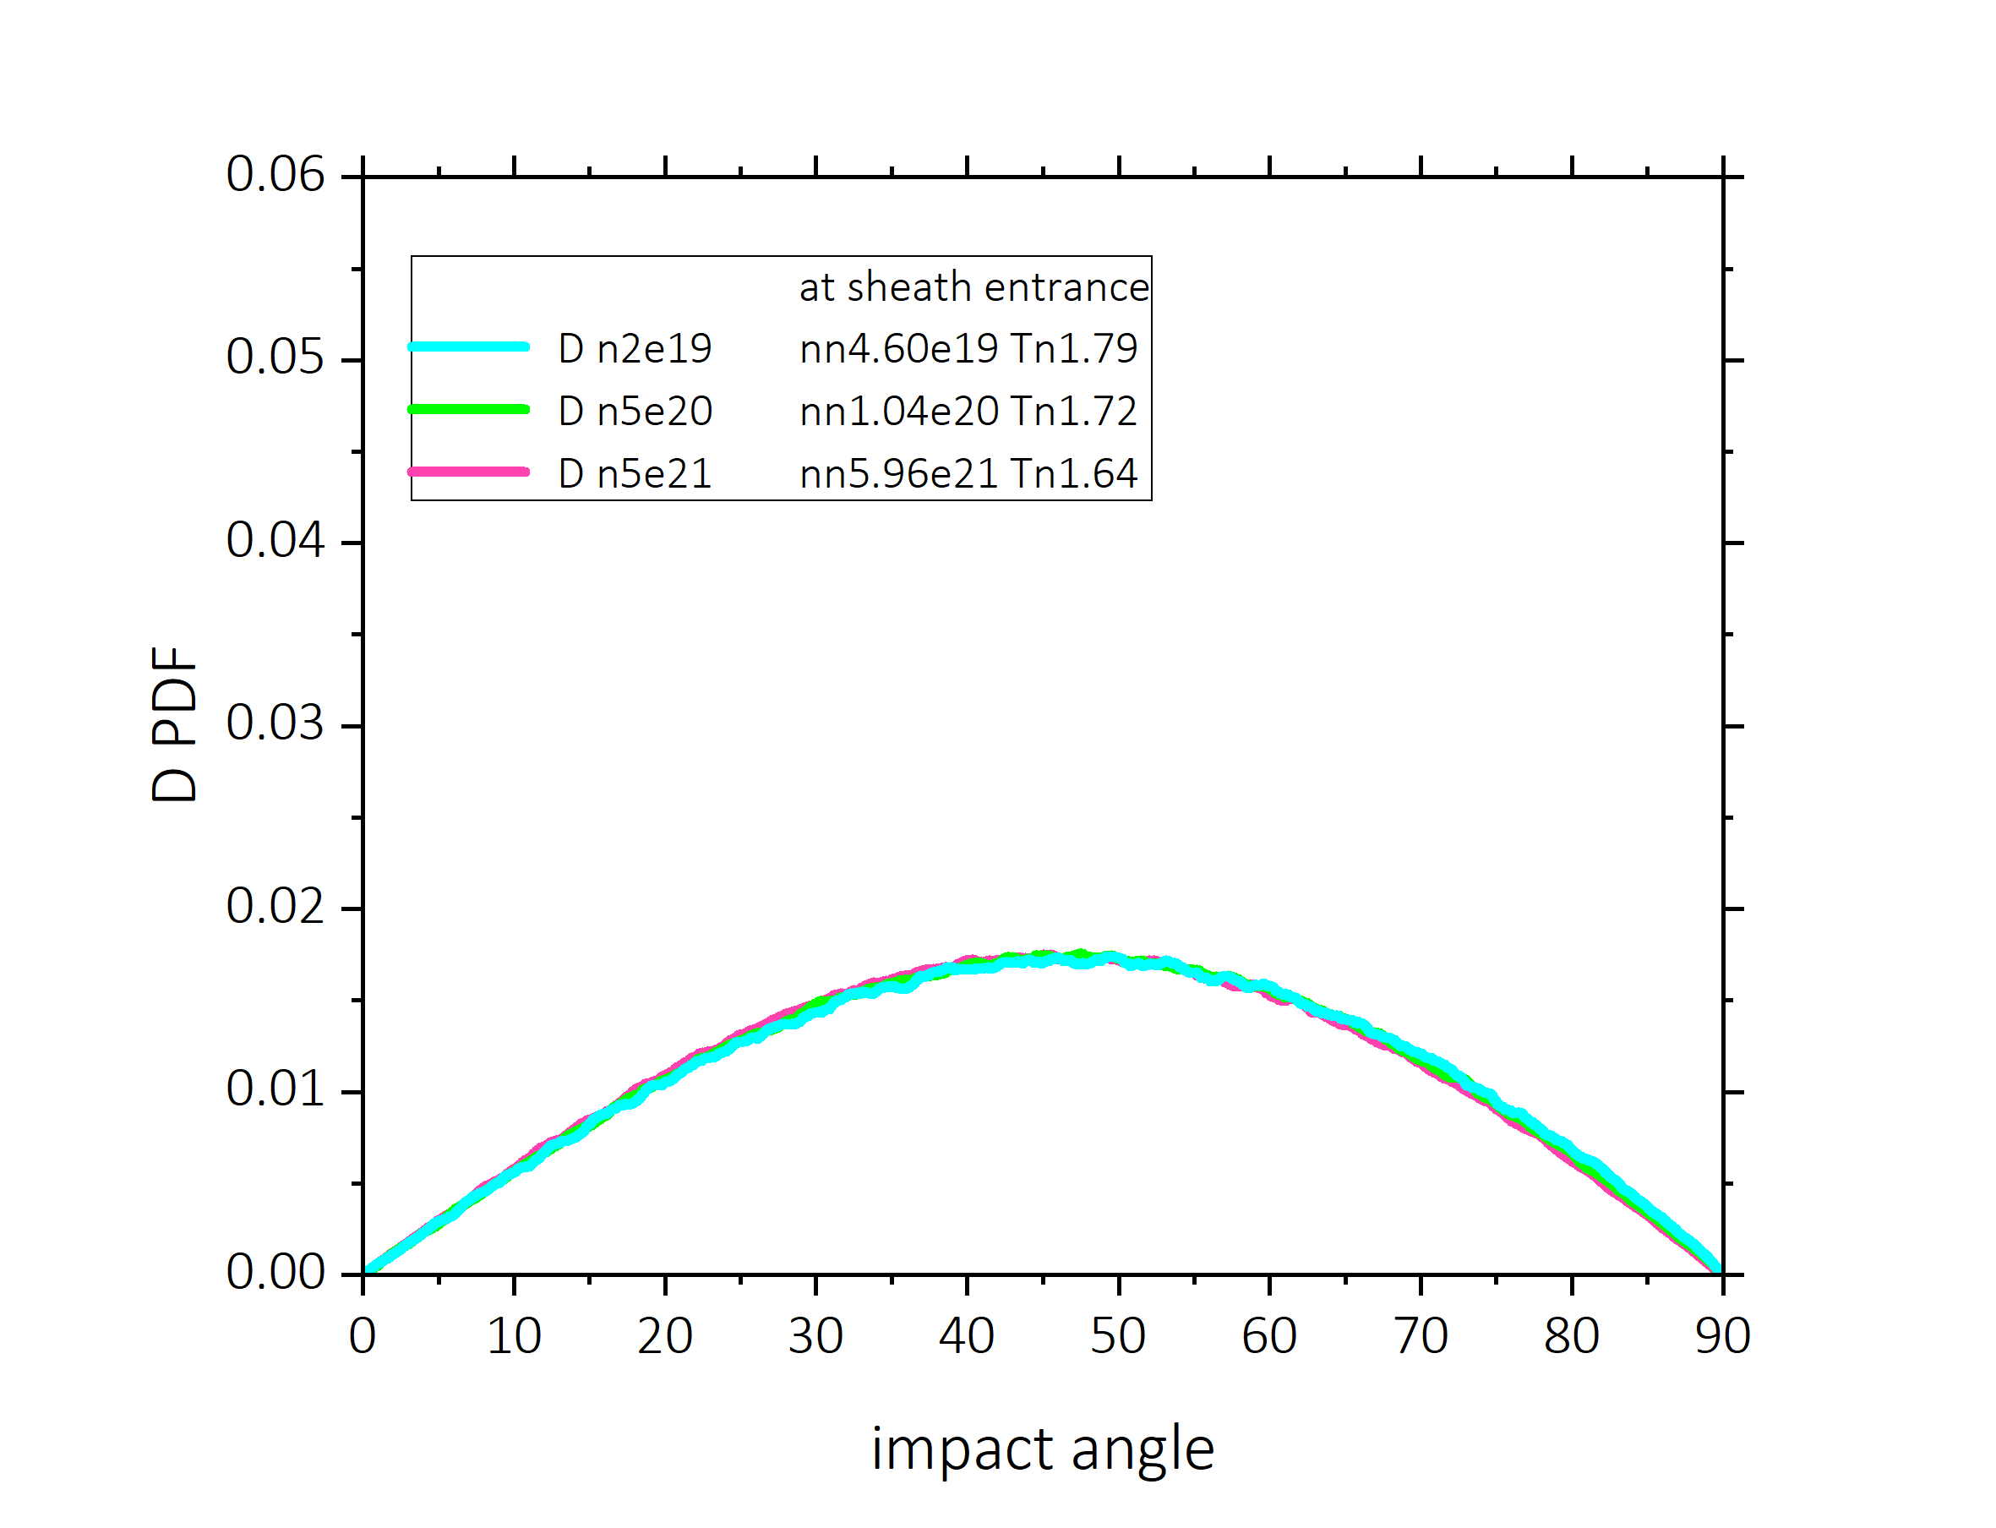
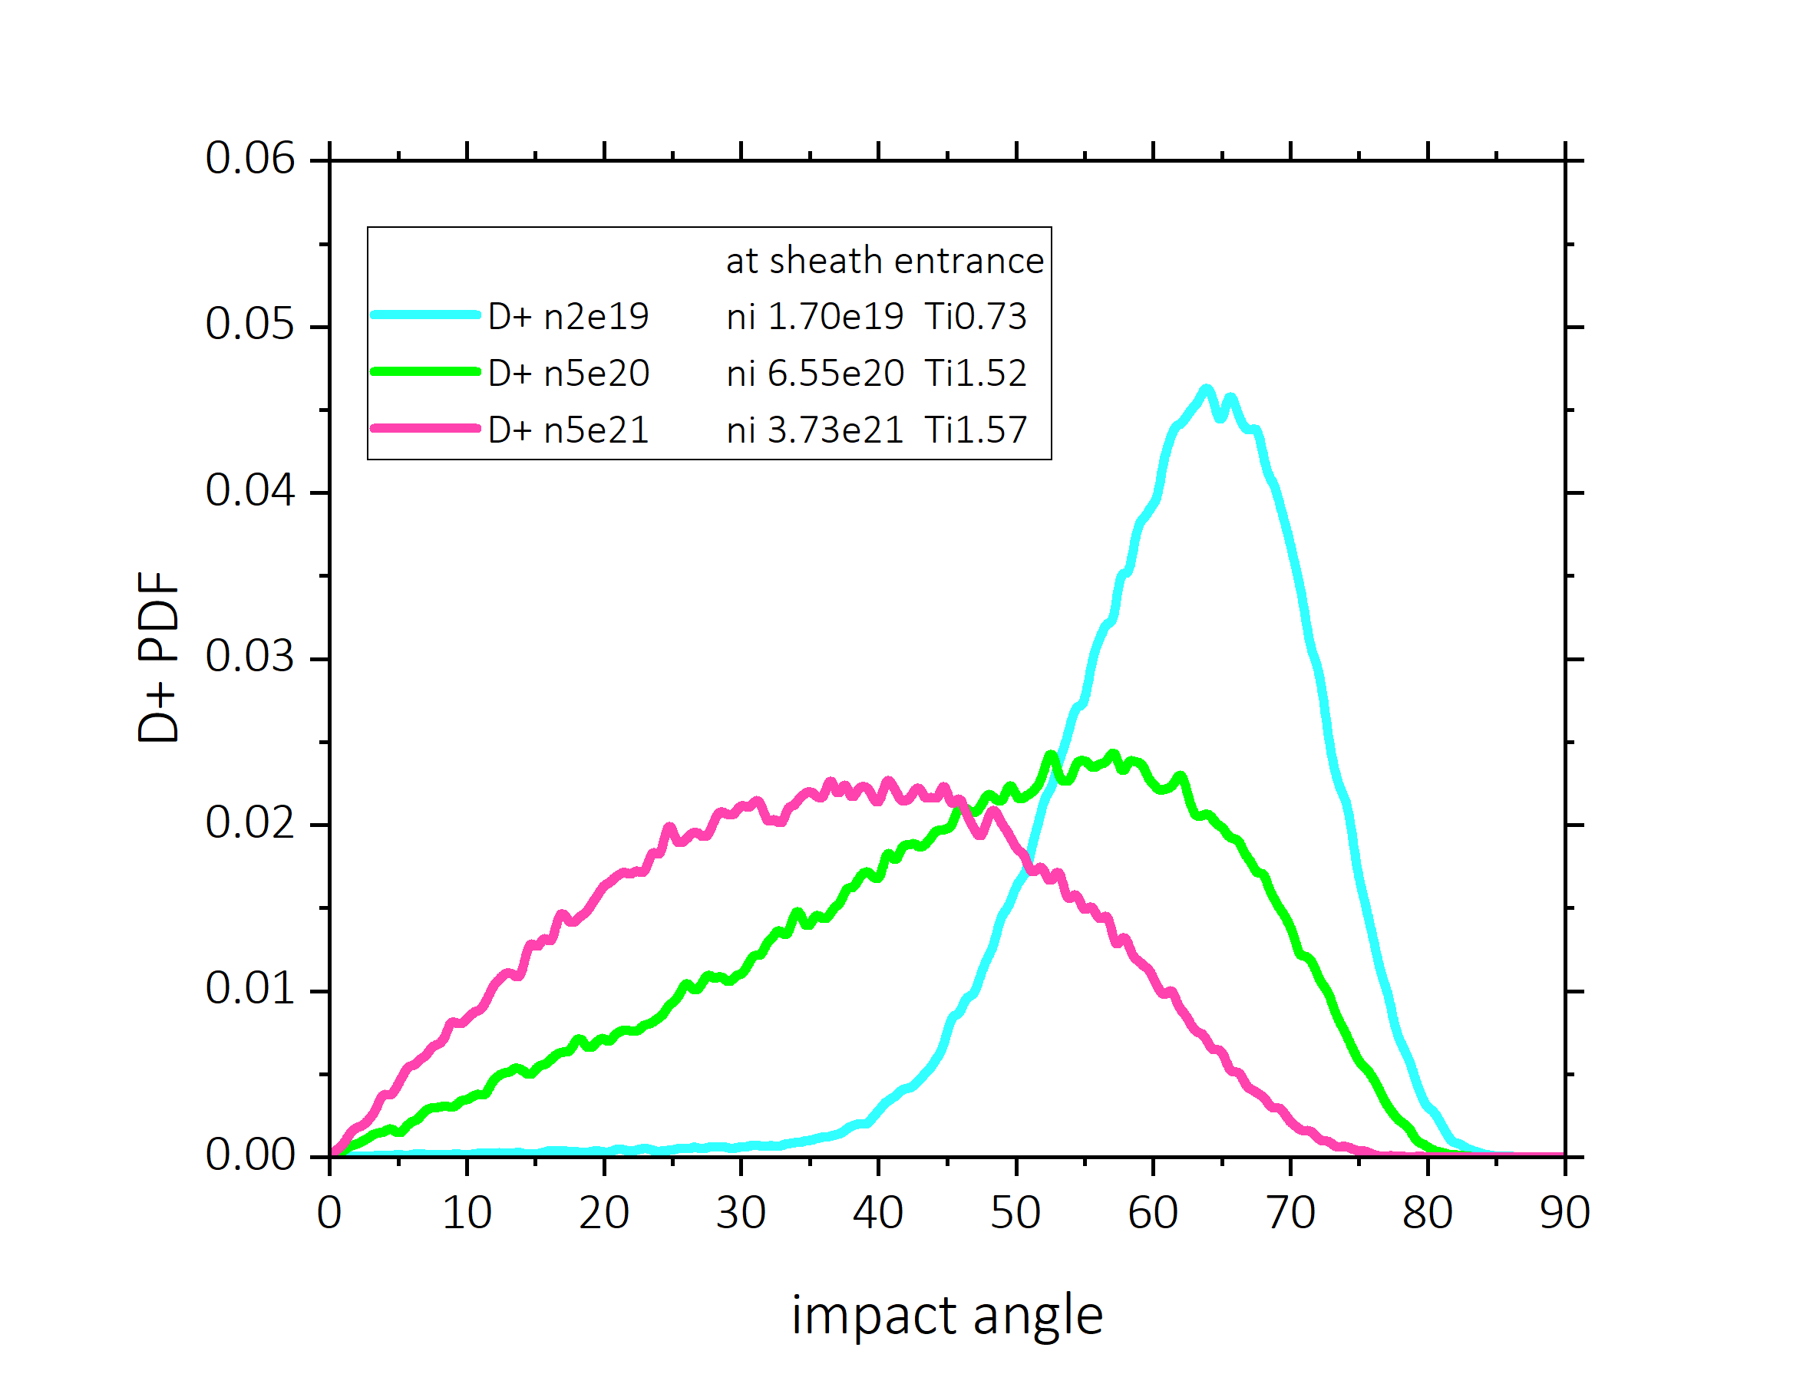
TSVV-07 progress
    Tasks 2022
    Dedicated PIC studies with BIT-1 for DEMO-relevant high-density divertor sheath
    as relevant input for erosion, dust transport and transient melting simulations
    Simulations for DEMO relevant divertor sheath
    with densities up to 5x10²¹ m⁻³ indicate that
    neutrals dominate heat loads
  The angular distributions of impacting ions are strongly affected in the collisional sheath and acquire the shape similar to the distribution of neutrals for the highest density cases
neutrals
ions
© D. Tskhakaya
Characteristics of the high density divertor sheath, such as plasma parameters and impact energies and angles of ions and neutrals are available for implementation in ERO2.0 for simulations of divertor erosion

Slide 13
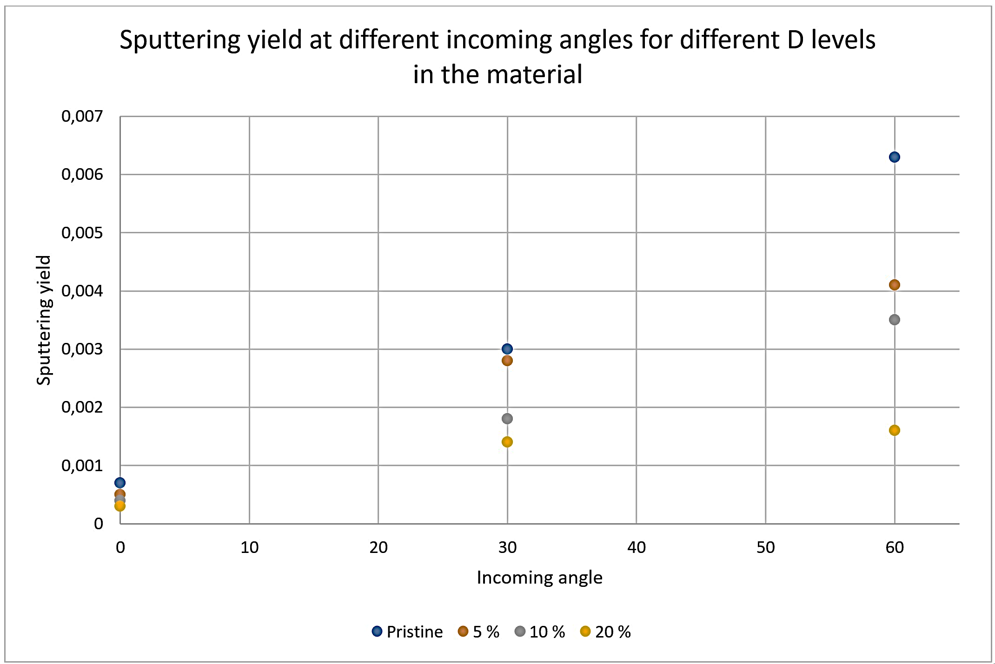
TSVV-07 progress
    Tasks 2022
    MD simulations utilizing available W-H
    interatomic potentials to simulate supersaturated W
    surfaces under ion irradiation
    Yet static only simulations due to forced usage
    of slow Tersoff-type interatomic potential
    Studied pure and supersaturated W irradiated by
    D and D₂ ions → no difference due to molecules
    5%atD, 10%atD, 20%atD
    0º, 30º, 60º angles of incidence
    Supersaturation decreases the sputtering yield that
    seems to be not due to dilution, neither enhanced
    reflection, work in progress
© F. Granberg

Slide 14
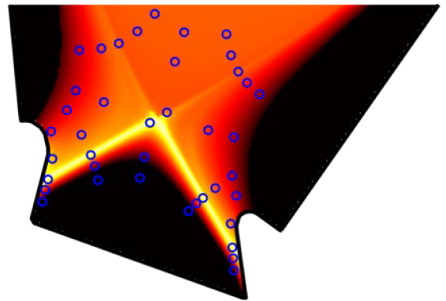
TSVV-07 progress
    Tasks 2022
    Dedicated dust transport simulations with MIGRAINe (aiming at net deposition locations provided by ERO2.0 simulations)
    Based on 2021 MIGRAINe simulations using ITER geometries
    and low-power plasma profiles, estimates of long-term W dust inventory
    evolution in 12 remobilization scenarios were refined [Vignitchouk 2022]
    Simple Markov chain fit models improved to sub-percent errors
    Dust distributions shift to larger sizes as time evolves
    (small dust does not survive in plasma due likely vaporization)
    Sampled DEMO plasma profiles are similar to ITER high recycling
    conditions considered for the dust survival studies
    Work in progress: MIGRAINe modifications to allow multiple
    impurity species and ion charge states are in progress
    Simulations for ERO2.0 deposition location maps expected in 2023
Sampling of plasma conditions
from DEMO plasma profiles (Te)
© L. Vignitchouk

Slide 15
TSVV-07 progress
    Tasks 2022
    PIC simulations with SPICE to identify whether the escaping current
    scales with electron thermal velocity or on ion sound speed
    Simulations of thermionic emission (TE) with secondary electron
    emission (SEE) and electron backscattering (EBS) confirm the validity of
    the earlier developed semi-empirical scaling model [Komm 2020, Tolias 2023]
    In the case of high density emissive sheath and normal magnetic field inclination
    that is relevant for exposed leading edges, the transition to the space-charge
    limited regime will not take place before W melting, thus implying that the
    monotonic potential profile regime is most relevant for melt motion applications
    Implementation of representative values of surface heat fluxes and halo current densities during DEMO VDEs
    for transient melting simulations with MEMOS-U MEMENTO
    The MEMOS-U model was re-implemented in a new code using the open-source AMReX adaptive meshing framework
    For current DEMO design, the thermal and the current quench of VDEs are considered relevant for melting
    (WPDES, late 2022) – assessment of melt layer stability in these conditions is pending
© M. Komm

Slide 16
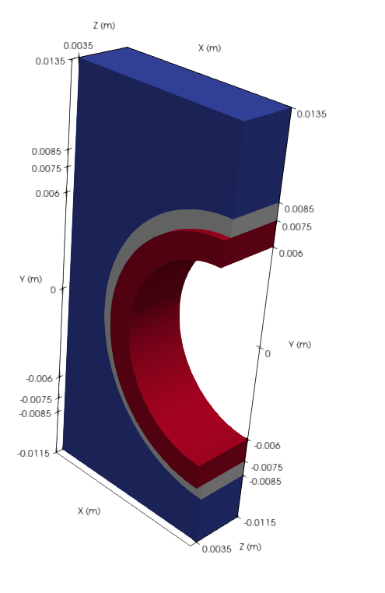
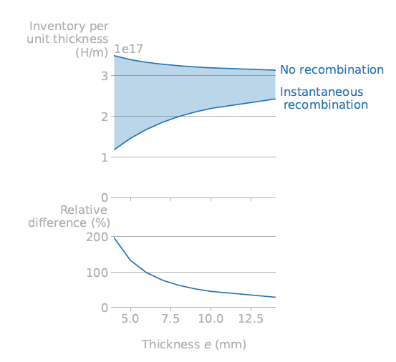
TSVV-07 progress
    Tasks 2022
    Retention and permeation studies for DEMO main chamber and divertor with TESSIM-X, MHIMS, FESTIM, RAVETIME
    Highlights: implementation of Soret effect, introduction of source terms for n-induced defects, work on mobile dislocations,
    H-He interaction, simulations of the role of interface conditions and 3D effects for ITER-like W monoblocks
ITER-Like
DEMO monoblock
© K. Schmid
W
Cu
5 mm
© R. Delaporte
CuCrZr
1 mm
Role on Soret effect
on permeation
1.5 mm
t= 10⁴s

Slide 17
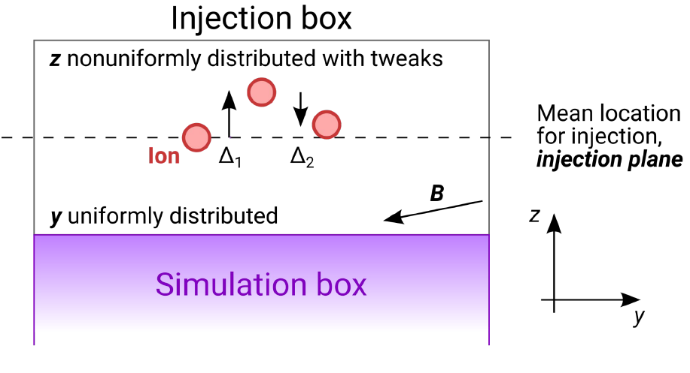
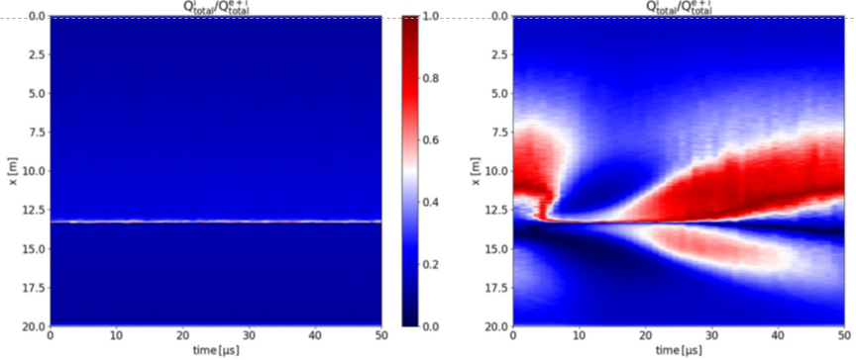
TSVV-07 progress
    Tasks 2022
    Implementation of the gyro-motion module in SDTrimSP-3D
    Gyro-module implemented, optimization and implementation of crystalline lattice capabilities are on the way / validation
    Future work: cross-check with ERO2.0, evaluation of sample exposures in AUG, cross-validation with MARLOWE and MD
    Implementation of non-uniform injection schemes in SPICE
    For the cases of non-uniform plasma density, temperature
    Implementation of non-steady-state sources in BIT1 (blobs)
    Steady-state vs Blob-filament
    (total power flux)
© A. Podolnik
© J. Kovacic

Slide 18
TSVV-07 Plasma-Wall Interaction in DEMO
Tasks 2023 (1/2)
Implement the MD erosion data under D/T supersaturation into ERO2.0.
Implement the PIC-inferred sheath characteristics into the ERO2.0 code.
Perform full 3D ERO2.0 simulations using updated databases and sheath models. New plasma?
Provide erosion-deposition maps and wall lifetime for the main chamber and divertor of DEMO.
Perform MEMENTO simulations of PFC response under VDEs. Assess macroscopic surface modifications in form of melting, melt re-solidification and possibly splashing. In case of splashing, analyze the size and velocity distributions of droplets.
Perform dedicated dust transport simulations with MIGRAINe for net deposition locations provided by ERO2.0 simulations.

Slide 19
TSVV-07 Plasma-Wall Interaction in DEMO
Tasks 2023 (2/2)
Perform SDTrimSP-3D simulations for rough surfaces of specific morphology and in particular
that of re-solidified melt resulting from MEMENTO to obtain effective erosion yields.
Perform PIC simulations with SPICE codes to obtain heat loads and ion penetration into gaps of divertor and limiter monoblocks under DEMO sheath conditions.
Perform TESSIM-X and FESTIM simulations of fuel accumulation in DEMO PFC with relevant material structure and fuel permeation to coolant, accounting for neutral damage. Cross-validate the results of both codes.
Develop with help of ML approach an interatomic potential for W-O.
Prepare an extensive integrated report for the DEMO conceptual design review regarding the DEMO wall lifetime in steady-state and transients and regarding fuel uptake, retention and permeation.

Slide 20
TSVV-07 Timeline

Slide 21
Milestones 2024
Role of gaps between divertor and limiter monoblocks is addressed by ERO (impurity deposition).
SDTrimSP-3D results regarding rough surfaces are incorporated into ERO. Results are cross-validated
on selected cases using built-in morphology model of ERO.
SDTrimSP-1D coupling to ERO is finalized.
Final results on W-O potential development are reported.
Intermediate results on W-O-H potential development are reported.
Role of He clustering on H diffusion and retention is assessed.
Preliminary BIT2 simulations are reported (kinetic sheath simulations for the entire poloidal cross-section).
IMAS compatibility has been implemented.
UQ interface implementations for SDTrimSP codes and RAVETIME are finalized.
MIGRAINe transport simulations are performed for droplets released in DEMO plasma transients.
Milestones 2025
Final results on W-O-H potential development are reported.
Role of He clustering on mechanical properties of W is assessed.
BIT2 simulations are finalized and compared to 1D cases.
SDTrimSP-3D coupling to ERO is finalized.
UQ studies with SDTrimSP codes and with RAVETIME are performed.
IMAS compatibility between codes and their interfacing is complete and tested.

