Slide 1
Review of 2022 tasks and plans for 2023
K. Schmid
and SP-C taskholders:
    E. Bernard, T. Morgan, A. Houben , A. Manhard, S. Markelj, T. Schwarz-Selinger, L. Ciupinski, F. Aumayer, D. Primezhofer, Y. Ferro, M. Lavrentiev, R. Bisson, J. Zavaznik, K. Kremer, M. Vadrucci, V. Nemanic, L. Gao

Slide 2
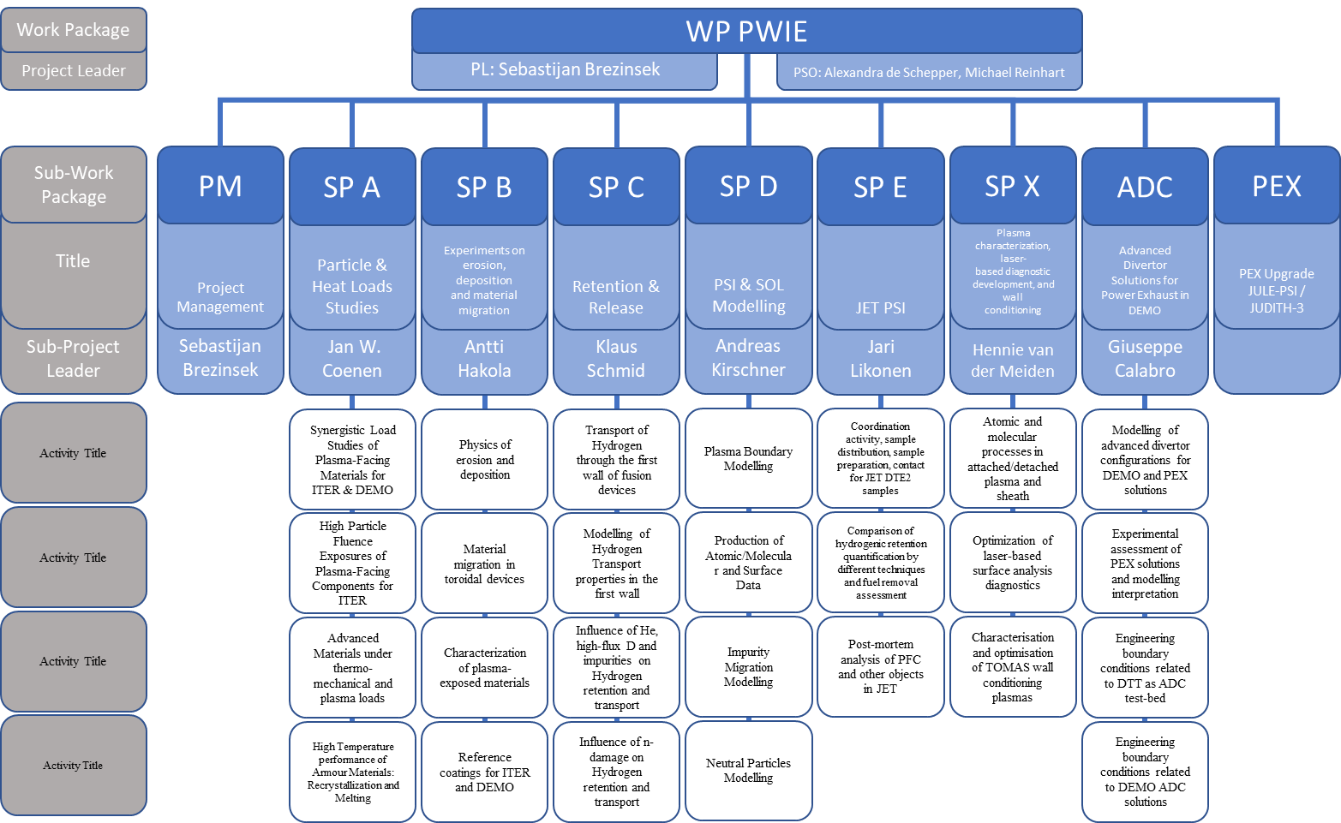
Overview
DPL for ADC: Giuseppe Calabro
Modelling of standard
and advanced divertor
configurations for DTT

Slide 3
Milestones 2022
WP-M ID | WBS ID | WP Milestone Title | Due Date
WM35 | SP C | Documented He retention in displacement-damaged W and its influence on H retention (ITER+DEMO) | 31.12.2022
WM36 | SP C | T-permeation from solid into gas vs. liquid phase on exit side (DEMO) | 31.12.2022
WM37 | SP C | Uptake of energetic D-ions vs. thermal D-atoms into W under first wall conditions quantified (DEMO+ITER) | 31.12.2022
WM38 | SP C | The impact of ion-induced W damage with proton-induced damage on fuel retention with the aid of depth-resolved laser-based analysis techniques compared (ITER+DEMO) | 31.12.2022
Done already in Oct. 2022
Done already in Dez. 2022
Done already in Dez. 2022
Still outstanding...

Slide 4
SP-C tasks
23 Tasks
Activity | Deliverables | Task
SP C.1 | D001 | Permeation (D,T) through Liquid/Solid interfaces with interface characterization (CEA)
SP C.1 | D002 | Dynamic measurements of deuterium retention and isotope exchange in W (DIFFER)
SP C.1 | D003 | Influence of ELMs on deuterium retention and outgassing in W (DIFFER)
SP C.1 | D004 | Gas driven permeation through and retention in W, Steel, W on Steel and W on Cu (FZJ)
SP C.1 | D005 | Measurement and modelling of Ion Driven Permeation in W, Cu and Fe-Ni alloys "heavy alloys" (MPG)
SP C.1 | D006 | Compare D permeation through W with D atoms and 300 eV/D ions (JSI, MPG)
SP C.1 | D007 | FIB/SEM/EDX analysis of material interfaces in multi material permeation samples (IPPLM)
SP C.1 | D008 | Studying the influence of (re-deposited) W on EUROFER on D retention (OEAW, VR)
SP C.2 | D001 | H diffusion and segregation at the Cu/W interface (CEA)
SP C.2 | D002 | DFT calculations of defects in W in the presence of H and He (UKAEA)
SP C.3 | D001 | Study the effect of O or C layers on D: bulk vs surface uptake - from 1 monolayer to a few hundred of nanometers (CEA)
SP C.3 | D003 | Influence of surface oxide films on the uptake of deuterium into the metallic tungsten in dependence on D ion energy and fluence (MPG)
SP C.3 | D003 | Influence of surface oxide films on the release of deuterium into the metallic tungsten in dependence on film thickness (MPG)
SP C.3 | D003 | XRD and Raman of Oxide films on W in cooperation with MPG (JSI, MPG)
SP C.3 | D002 | Permeation barrier properties of chromia grown on dense Cr films on Eurofer (JSI)
SP C.3 | D003 | Comparing He cluster nucleation in defect free and e-beam-damaged W (MPG)
SP C.3 | D004 | E-beam irradiation of single crystal W from MPG (ENEA)
SP C.3 | D002 | Influence of surface microstructure due to low energy He irradiation on D uptake studied in situ (JSI, MPG)
SP C.3 | D003 | Self-damaged W samples for JSI investigation (MPG)
SP C.4 | D001 | Simulation of neutron-damaged W by W self-damage at different dpa (6 W samples) (IPP)
SP C.4 | D002 | Exposition of W samples in PSI-2 D plasmas to load with D at low surface temperature (FZJ)
SP C.4 | D002 | Quantification of fuel content for 3 samples by NRA and TDS (MPG, FZJ)
SP C.4 | D002 | Quantification of fuel content for 3 samples by LIA-QMS and DP-LIBS (FZJ)
Most tasks were complete and reported during the meeting in October 2022
I won‘t repeat my presentation from October 2022
Only new results since October 2022 will be reported
(but the report slides from October are also in this power point file...)
In October all tasks were assumed to complete in 2022

Slide 5
SP C.1 Transport of Hydrogen through the first wall of fusion devices
Tasks in 2022
Task
Permeation (D,T) through Liquid/Solid interfaces with interface characterization (CEA)
Dynamic measurements of deuterium retention and isotope exchange in W (DIFFER)
Influence of ELMs on deuterium retention and outgassing in W (DIFFER)
Gas driven permeation through and retention in W, Steel, W on Steel and W on Cu (FZJ)
Measurement and modelling of Ion Driven Permeation in W, Cu and Fe-Ni alloys "heavy alloys" (MPG)
Compare D permeation through W with D atoms and 300 eV/D ions (JSI, MPG)
FIB/SEM/EDX analysis of material interfaces in multi material permeation samples (IPPLM)
Studying the influence of (re-deposited) W on EUROFER on D retention (OEAW, VR)

Slide 6
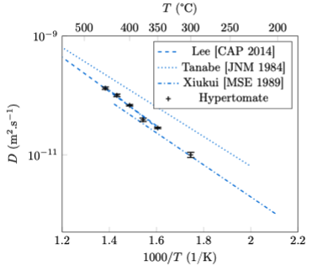

Permeation (D,T) through Liquid/Solid interfaces with interface characterization
SS316L readily forms a Cr₂O₃ oxide layer that perturbates permeation -> a Pd coating was added to our samples by the team of M. Cekada (JSI)
Hydrogen permeation experiments were performed using the Hypertomate device
Diffusivity is a straight line in the Arrhenius plot:
diffusion is interstitial in this temperature range,
i.e. the effect of trapping is negligible.
In literature, this is confirmed by DFT evaluations
of the diffusion energy (E_{D} = 0.5 eV)
Our tritium experiment works at room temperature:
with this data we can evaluate the timelag for a 300 µm thick sample
→ very long: 440 days ! Only because of interstitial processes…
Therefore permeation at room temperature cannot reasonably be measured through SS316L
… but we can measure desorption instead!
Elodie Bernard
Notes:
Please help me and add some notes here so I can figure out what to say about your slide / work

Slide 7
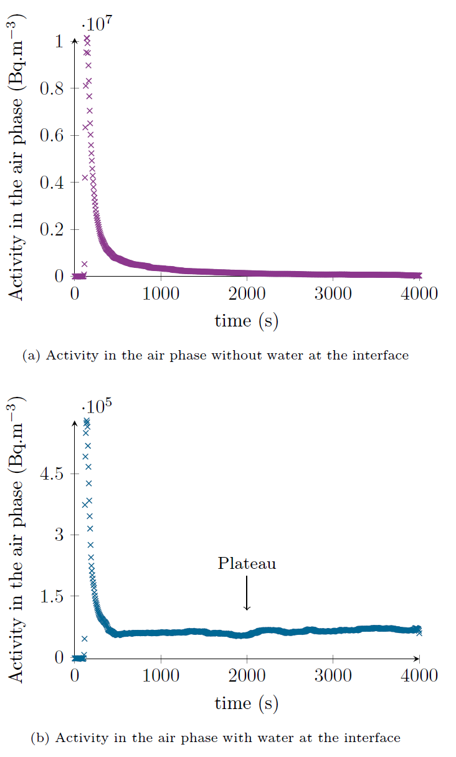
Permeation (D,T) through Liquid/Solid interfaces with interface characterization
We use Wapiti (WAter-interface Permeation In Tritium-exposed materIals) to measure tritium desorption.
One sample has only air downstream, two samples have water + air downstream
Loading: 275 mbar of pure T₂ are inserted upstream,
then the sample is heated up to 300°C for 45 minutes.
Once the sample is back to RT, upstream T₂ is removed.
Two strategies for the measurement:
bubblers + LSC for high activities,
ionisation chamber for lower activities
We notice a difference in the shape of the peaks when there is water vs. when there is none: different equilibrium!
There will be a talk on permeation through steels into water by E. Bernard
This work has also been performed on Eurofer97 and showed the importance of surfaces
-> it would be interesting to switch back to this material and study the oxides
Elodie Bernard
Notes:
This is loading from one side at 300°C then after cool down the outgassing from the loading side into air vs air above water is compared

Slide 8

Investigate dynamic inventory during exposure and influence of ELM like transients on post exposure retention.
Dynamic outgassing (DO) from tungsten was studied with NRA, nuclear reaction analysis. DO is important for the time in between fusion shots as we need high quality vacuum.
Two parameters were studied: Fluence (Do we observe saturation or does the retained amount increase with fluence?) and roughness. All samples were polished and to increase roughness a Murakami reagent was used
Outgassing is observed for all the samples.
24 hours at room T seems enough to stop DO
Higher roughness seem to lead to lower retention (W9 showed presence of C → more retention)
Plasma retention studies during plasma operation, UPP will be ready for this by the end of year
T. Morgan
Notes:
Please help me and add some notes here so I can figure out what to say about your slide / work

Slide 9
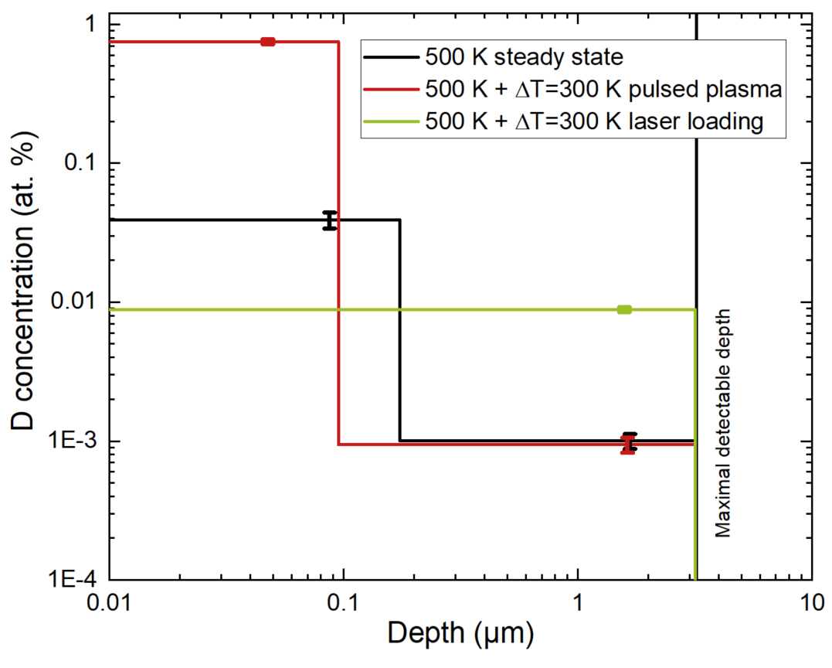

Influence of ELMs on deuterium retention and outgassing in W
Comparing effects of pulsed plasma and
laser loading on D retention in W
Expose W in Magnum-PSI and analyze with NRA and TDS
Insight in plasma conditions
Reliable NRA and TDS results to investigate
in bulk diffusion
Explanation of surface and bulk retention
Complete set of sample to compare
Compare different steady state temperatures by tuning cooling instead
of changing plasma heat flux
Notes:
(Comments in Bold refer to the bullet points in the slide. Text gives explanations of the bullet points)
Main goal of project: compare effect pulsed plasma and laser loading on D retention in W.
Two experimental weeks in Magnum-PSI are used.
One week in September a limited set of samples is obtained, because technical issues (lack of D) stopped the experiment.
Conclusions:
Good insight in plasma conditions. Heat flux calculations are performed on the pulsed plasma by measuring Te and Ne using Thomson scattering during the pulse.
NRA and TDS is performed. Results are reliable and consistent
Difference of factor 10 in bulk (from 0.1 microns) (Hopefully explained with samples exposed in December). The difference can be seen in the figure between green (high) and black and red (low).
High surface D concentration due to Cu impurities (probably co-deposition). This can be seen in the Figures for the red line.
Challenges:
Cu (from plasma source) deposition found, which influences the retention,
Unknown difference in diffusion is found between samples, maybe due to surface impurities.
Challenging temperature range for IR
One week in December: complete set of samples.
Improved IR measurements
Less Cu deposition
Complete set to compare (still to be analyzed using NRA and TDS)
Follow UP: At the moment the plasma is changed to change the steady state temperature, comparison between different temperature is therefore difficult. By tuning the cooling comparing would be easier, because the ion flux would be constant

Slide 10
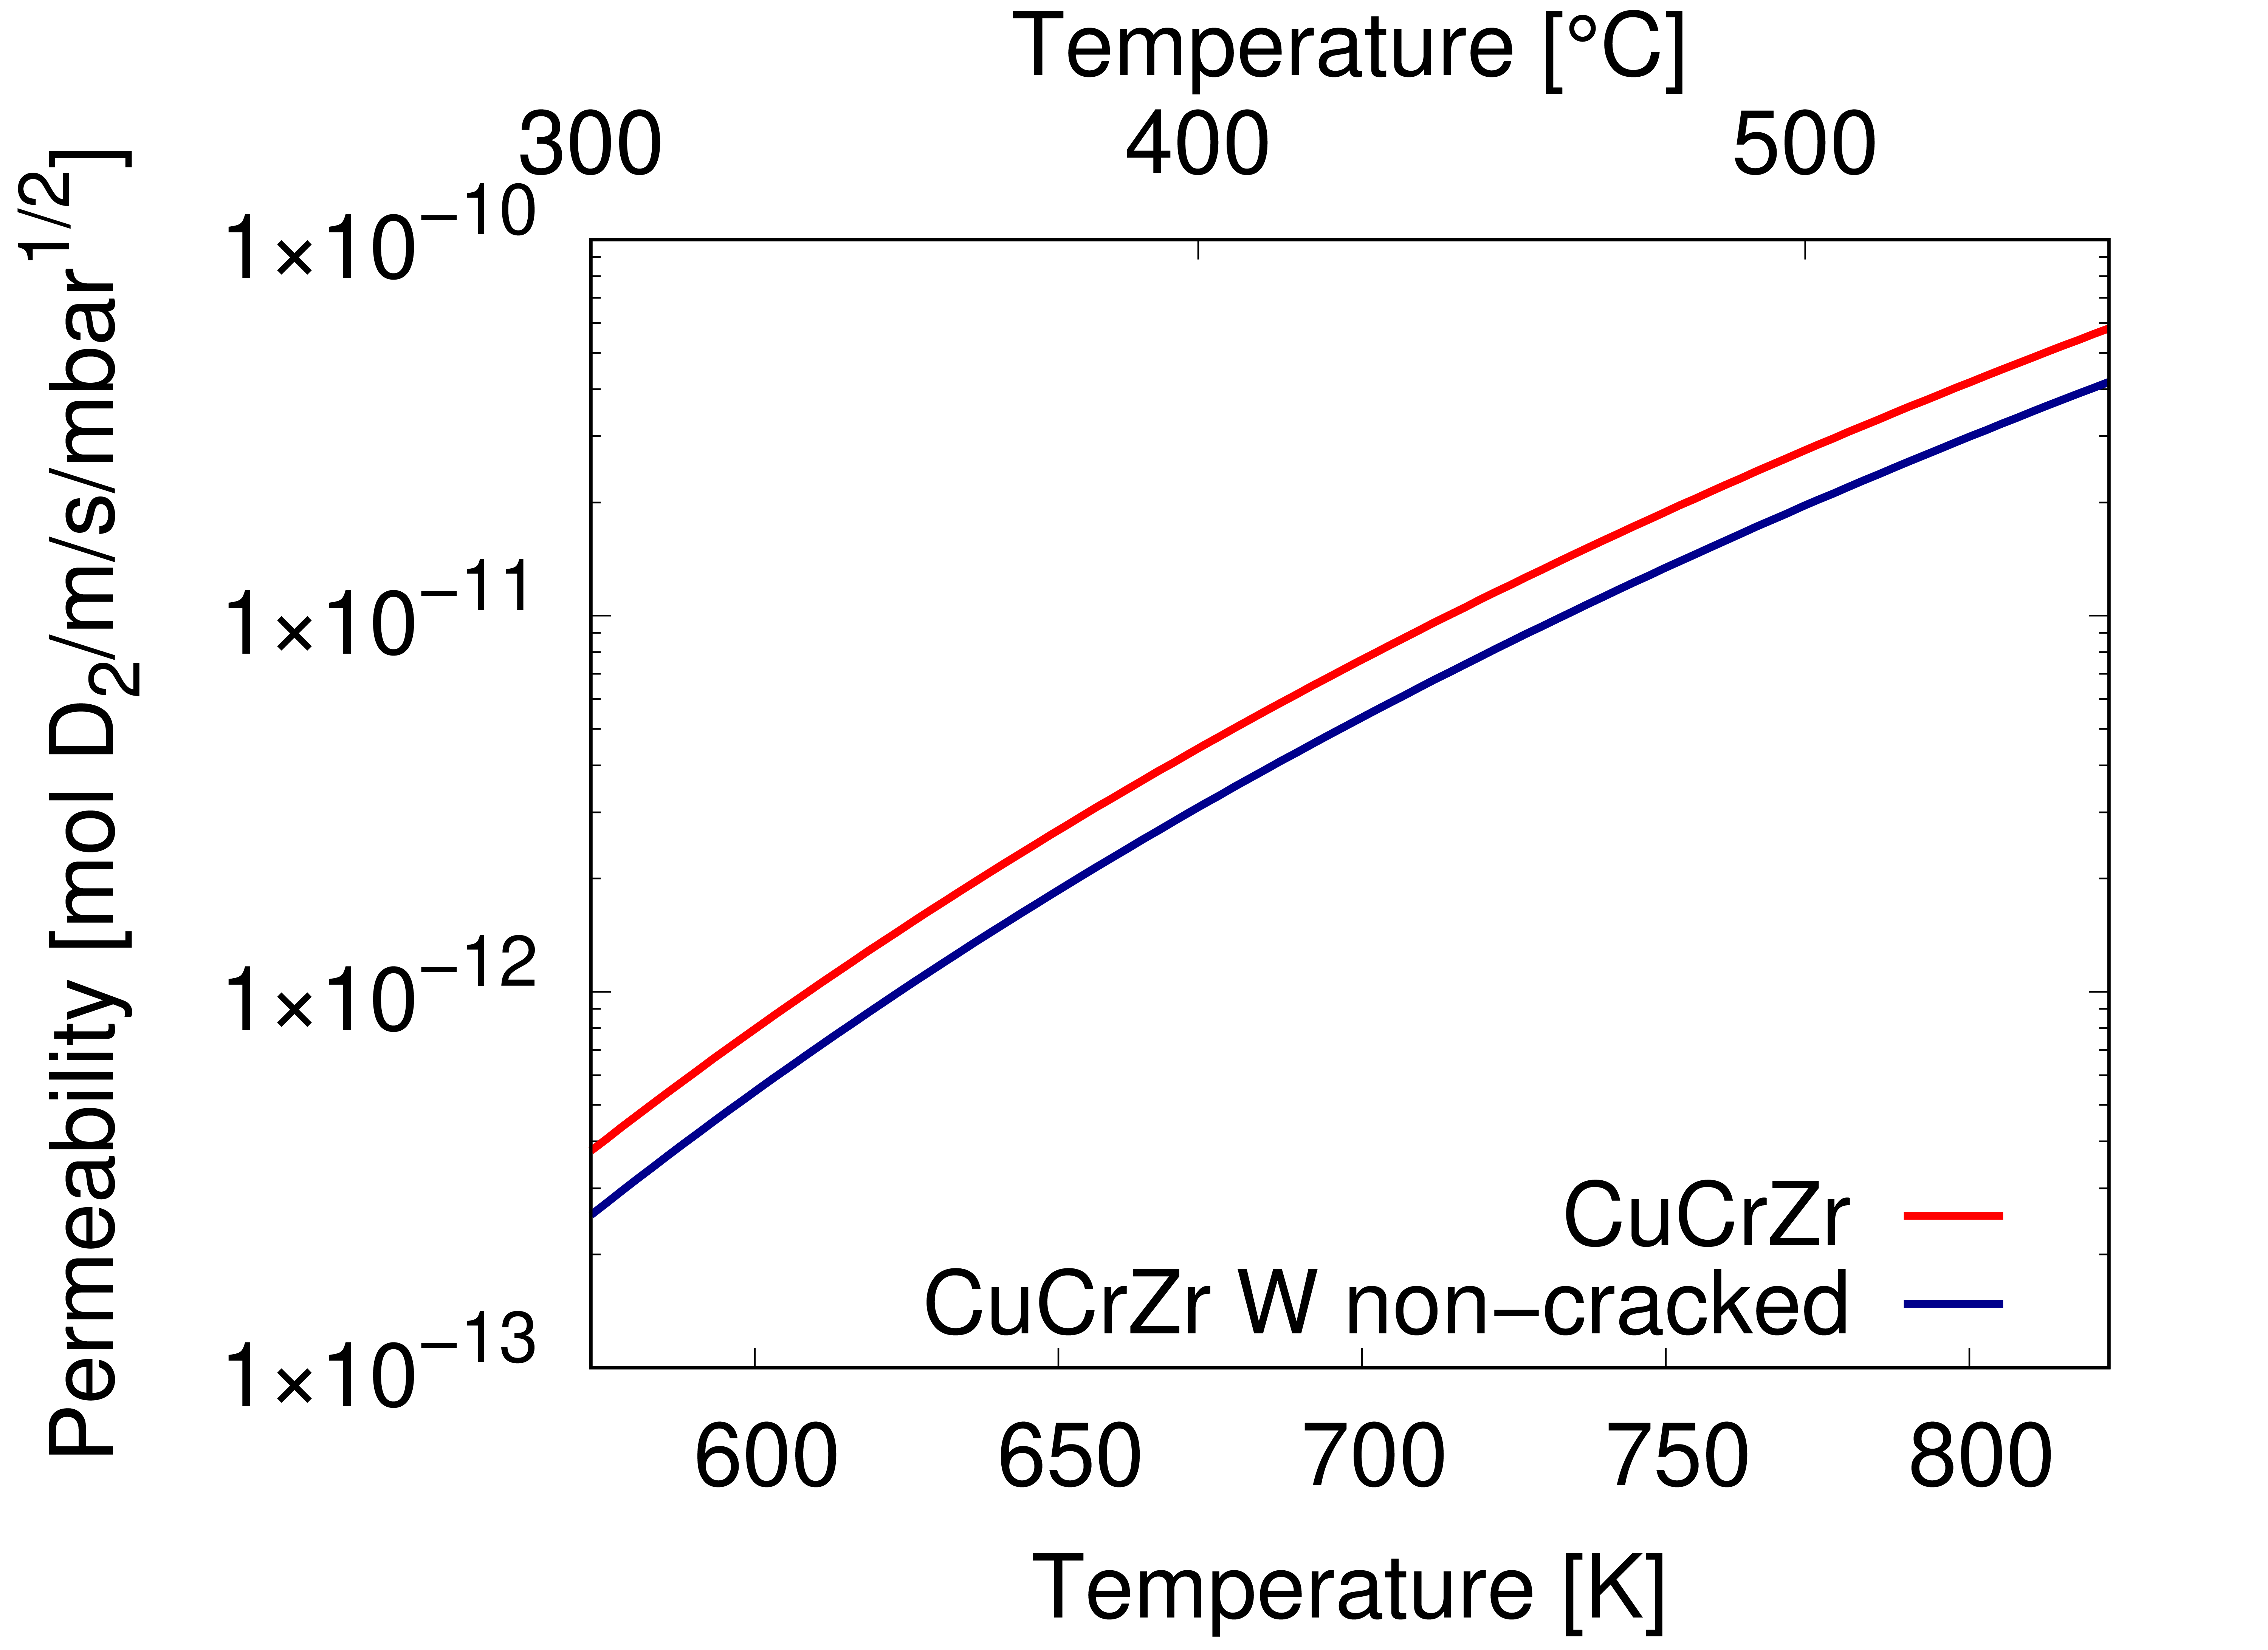
Gas driven permeation through CuCrZr vs W coated CuCrZr
Stable permeation measurement between 300° and 550°C, applied D pressure: 25-800 mbar
CuCrZr permeability is similar to bulk Cu permeability, diffusion limited → published in: A. Houben et al., NME 33 (2022), 101256 https://doi.org/10.1016/j.nme.2022.101256
Reduction of permeability due to the W layer
Permeation flux through W coated CuCrZr is diffusion limited → no influence of interface
Results and Conclusion:
Outlook:
Further analysis of the data: calculation of layer permeability, lag-time measurement
FIB/SEM investigation of W layer
Next year: Studies on the system W on steel with non-cracked W layers
Anne Houben
Notes:
Please help me and add some notes here so I can figure out what to say about your slide / work

Slide 11
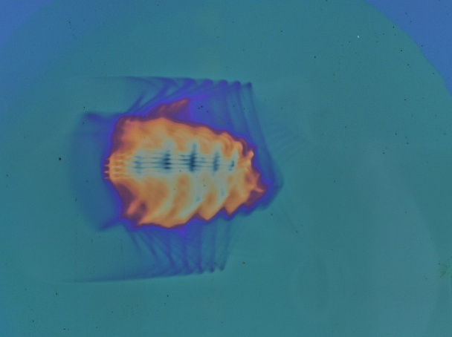
(b) comparison of measured and simulated permeation curves
Ion Driven Permeation in W, Cu and Fe-Ni alloys
(a) visualization of beam spot by erosion of a-C:H layer
Optimization of D₃⁺ ion beam and precise ion
flux density calibration
Benchmark experiments: 25 µm recrystallized W
TESSIM-X fit of experiment data: 580 K / 200 eV/D
Includes full histogram of ion fluxes
  Important for reproducing transients
Includes temperature jumps at beam on/off
  Reproduces signal jump in decay transient
Close quantitative match of steady-state current
  Diffusion-limited boundary conditions
  Calibrations of ion flux and QMS accurate
Slowed down by challenges outside of physics (hacker attack, etc.)
Proceed to measure W/FeNi and W/Cu layer systems and heavy alloys
Armin Manhard
Notes:
Beam optimization goal: intense beam ~1e20 D/m²s, impact energy 200 eV/D, beam fully on permeation sample (no halos on sample holder), stable beam over long times (several days; feedback-regulated ion source!)
Flux density calibration:
-> shown: a-C:H layer; very sensitive, gives detailed picture of beam shape; main issue: layer modification by main beam and charge exchange ions very difficult to quantify => adds to uncertainty
-> additional: sputtering of bulk Cu: appreciable sputter yield at 200 eV/D, reasonable uncertainty of yield (~10%); deep sputter crater (~25 µm) to minimize measurement uncertainty of eroded depth/volume
-> results: current measurement quite reliable under typical operating conditions; detailed histogram of flux densities across beam spot
-> NB: Only histogram important for permeation result (=integrated across beam spot!) => superposition of many different fluxes
For benchmarking: sample = 25 µm recrystallized W foil (2000 K) from PLANSEE
-> reasonably short breakthrough time
-> ideal substrate for FeNi-W bilayer samples as model system for W heavy alloy
-> issue: very fragile, difficult to seal => solved using Helicoflex gaskets (presently: max. temperature ~ 300°C / 600 K; high-temperature version ordered, 3 months delivery time…)
Fitting of permeation data at 580 K / 200 eV/D using TESSIM-X rate equation model
-> assumptions: diffusion-limited boundary conditions on both sides, diffusion coefficient by Holzner et al. (recent PhD thesis = “Frauenfelder reloaded”), 1 single trap
-> NB: can probably achieve better fit using multiple traps, but makes more sense doing this once data at higher temperatures is available
-> NB: need to measure at temperatures ~580 K or higher to avoid blistering on implantation side! (would lead to sample ageing and reduction of permeating D flux)
Implementation of measured ion flux histogram:
-> discretize measured histogram into 100 bins
-> superposition of 100 TESSIM-X calculations
-> yields same steady-state permeation flux as single calculation with averaged ion flux (as it should be!!!)
-> has no influence if no traps present
-> can have strong influence if trapping plays a role:
high-flux components (beam center) => fast breakthrough and saturation, but small contribution to total flux (small area!) => early onset of rise transient
low-flux components (beam edges, halos) => slower breakthrough and saturation, since trap filling limited by D flux
-> present example: difference of full histogram vs. averaged beam only moderate; reason: “sweet spot” near typical TDS peak; at different temperature the differences between both solutions can be substantial (shown by calculations)!
-> here: measured permeation curve can be reproduced very well by TESSIM-X model; free parameters: trap energy (best fit: 1.45 eV) & concentration (best fit: 1.2e-4)
NB: quite some ambiguity between solutions with similar parameters (e.g. slightly higher trap energy vs. slightly lower trap concentration)
-> steady state permeation flux quantitatively reproduced within ~10% -> within estimated uncertainty of QMS calibration + ion flux calibration -> taken into account by “fudge factor” x0.9 for simulated data
strong argument that calibrations were accurate & assumed boundary conditions are valid
(surface limit on implantation side => superpermeation, i.e., measured flux would be too high; surface limit on permeation side => measured flux would be (much) too low)
-> interesting detail: signal jump when beam is turned off:
pyrometer measuring directly on foil: ~3.5 K temperature jump (beam heating! Also occurs when beam is switched on) => implemented in simulations; duration of transient <1s!
effect mostly visible at beam-off: Diffusion coefficient D(T) suddenly reduced, concentration gradient dc/dx needs much longer to re-adjust -> instant drop of permeation current = D(T)*dc/dx
very accurately reproduced by model -> assumed diffusion barrier is correct!
Overall: on good track
Delays in 2022: many external influences (e.g., hacker attack against IPP, very long delivery times for important parts)
Plan for 2023: Proceed as originally planned: measure permeation through W/FeNi bi-layers from both sides to assess influence of material interface (samples currently in production); repeat similar procedure for W/Cu bi-layers; finally measure actual heavy alloys (test manufacturing of thin sample with thickness=~200 µm, diameter=21 mm successful)

Slide 12
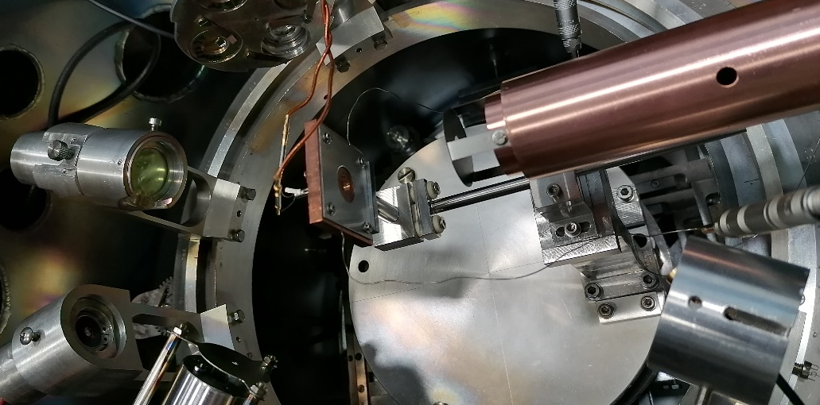
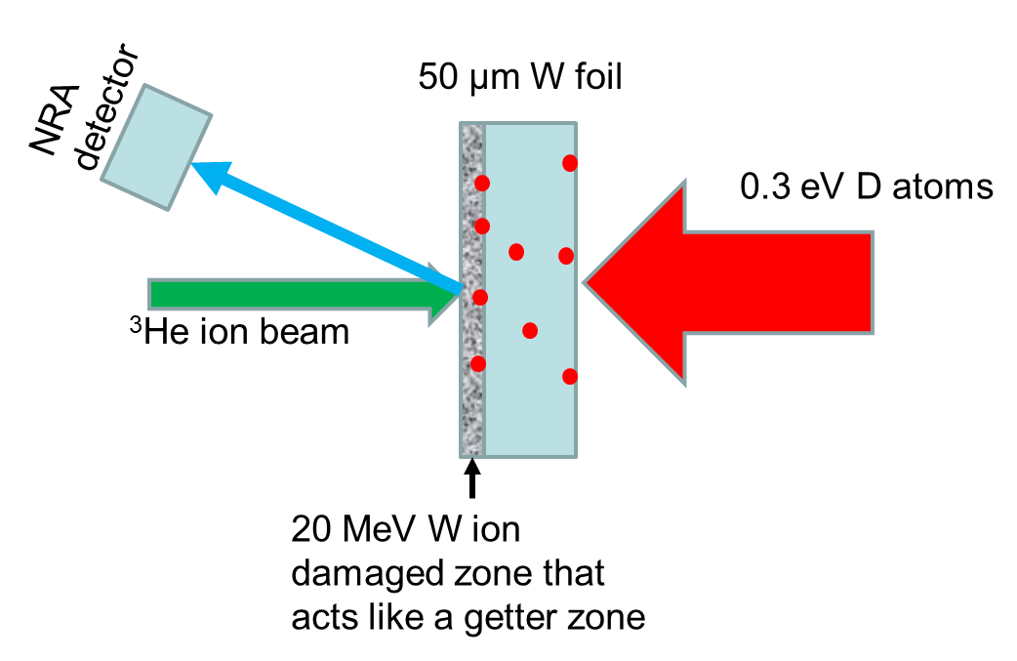

Compare D permeation through W with D atoms and 300 eV/D ions
Background
top view
Following B. Tyburska et al., Journal of Nuclear Materials 415 (2011) S680–S683 using a getter layer (2 µm self-damaged W) for permeating D
Expose to atom or ions upstream
In/situ NRA downstream
As function of fluence
Check: No D uptake from gas phase
But: 2% of upstream D atom flux on downstream side!
Protective Al₂O₃ (85 nm) layer with Ag (1 µm) spacer
(deposited by A. Manhard/MPG following Kapser et al. Nuclear Materials and Energy 12 (2017) 703–708.)
D atoms
/ ions
Downstream
Upstream
Good separation of D in Al₂O₃ and in W damaged layer
D in damaged W
D in Al₂O₃
Markelj
Notes:
Al2O3 layer 85 nm was deposited with spacer material Ag (1 um) to be able to separate the damaged layer from Al2O3. In the next slide is shown NRA spectrum how the D in Al2O3 can be separated from damaged layer.

Slide 13
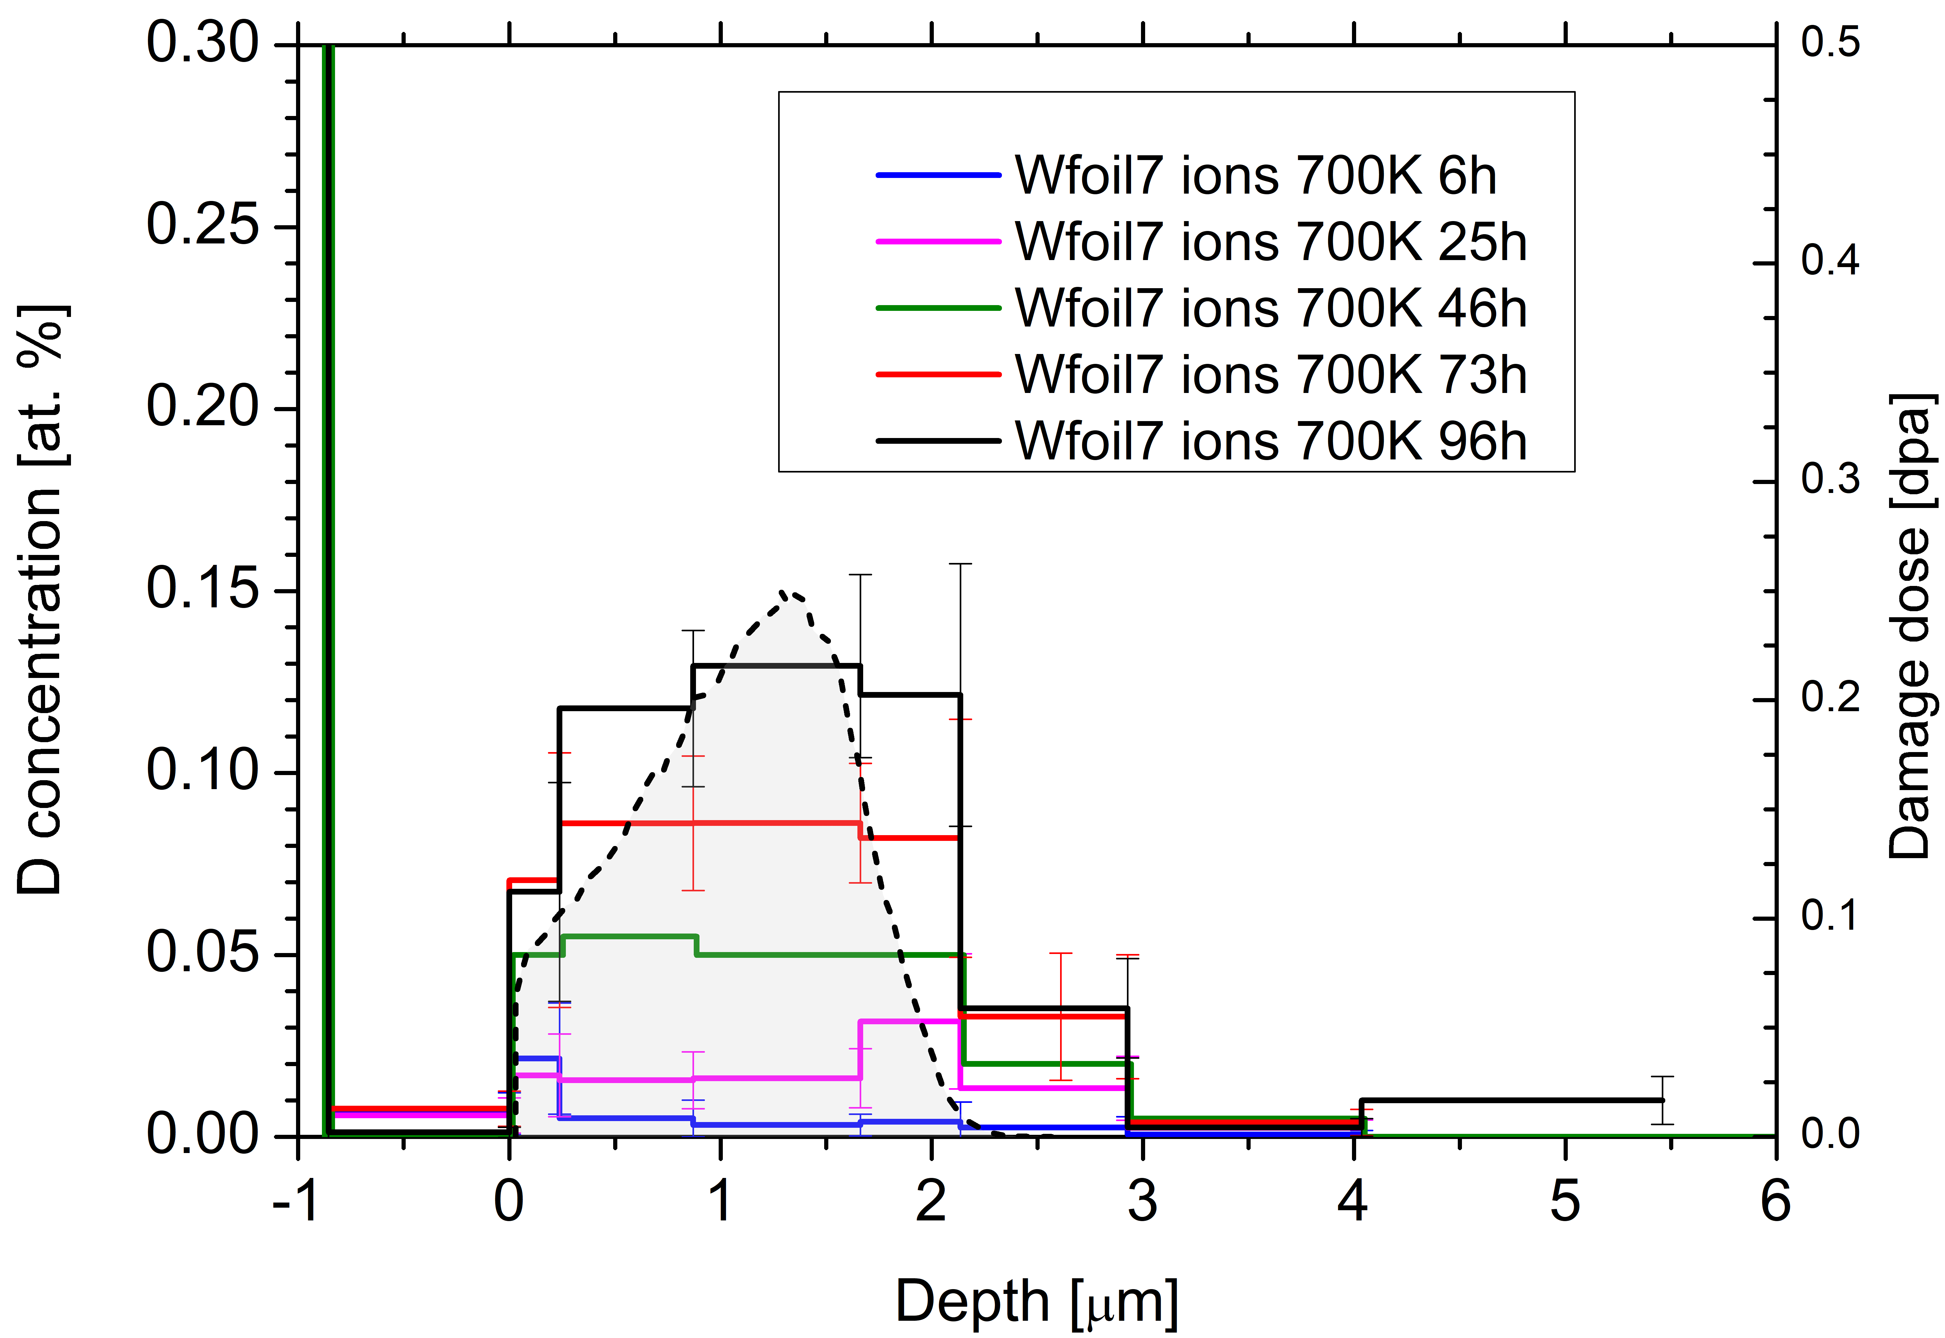
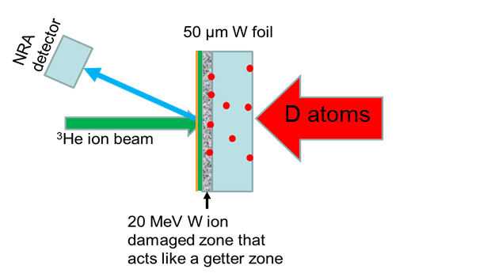
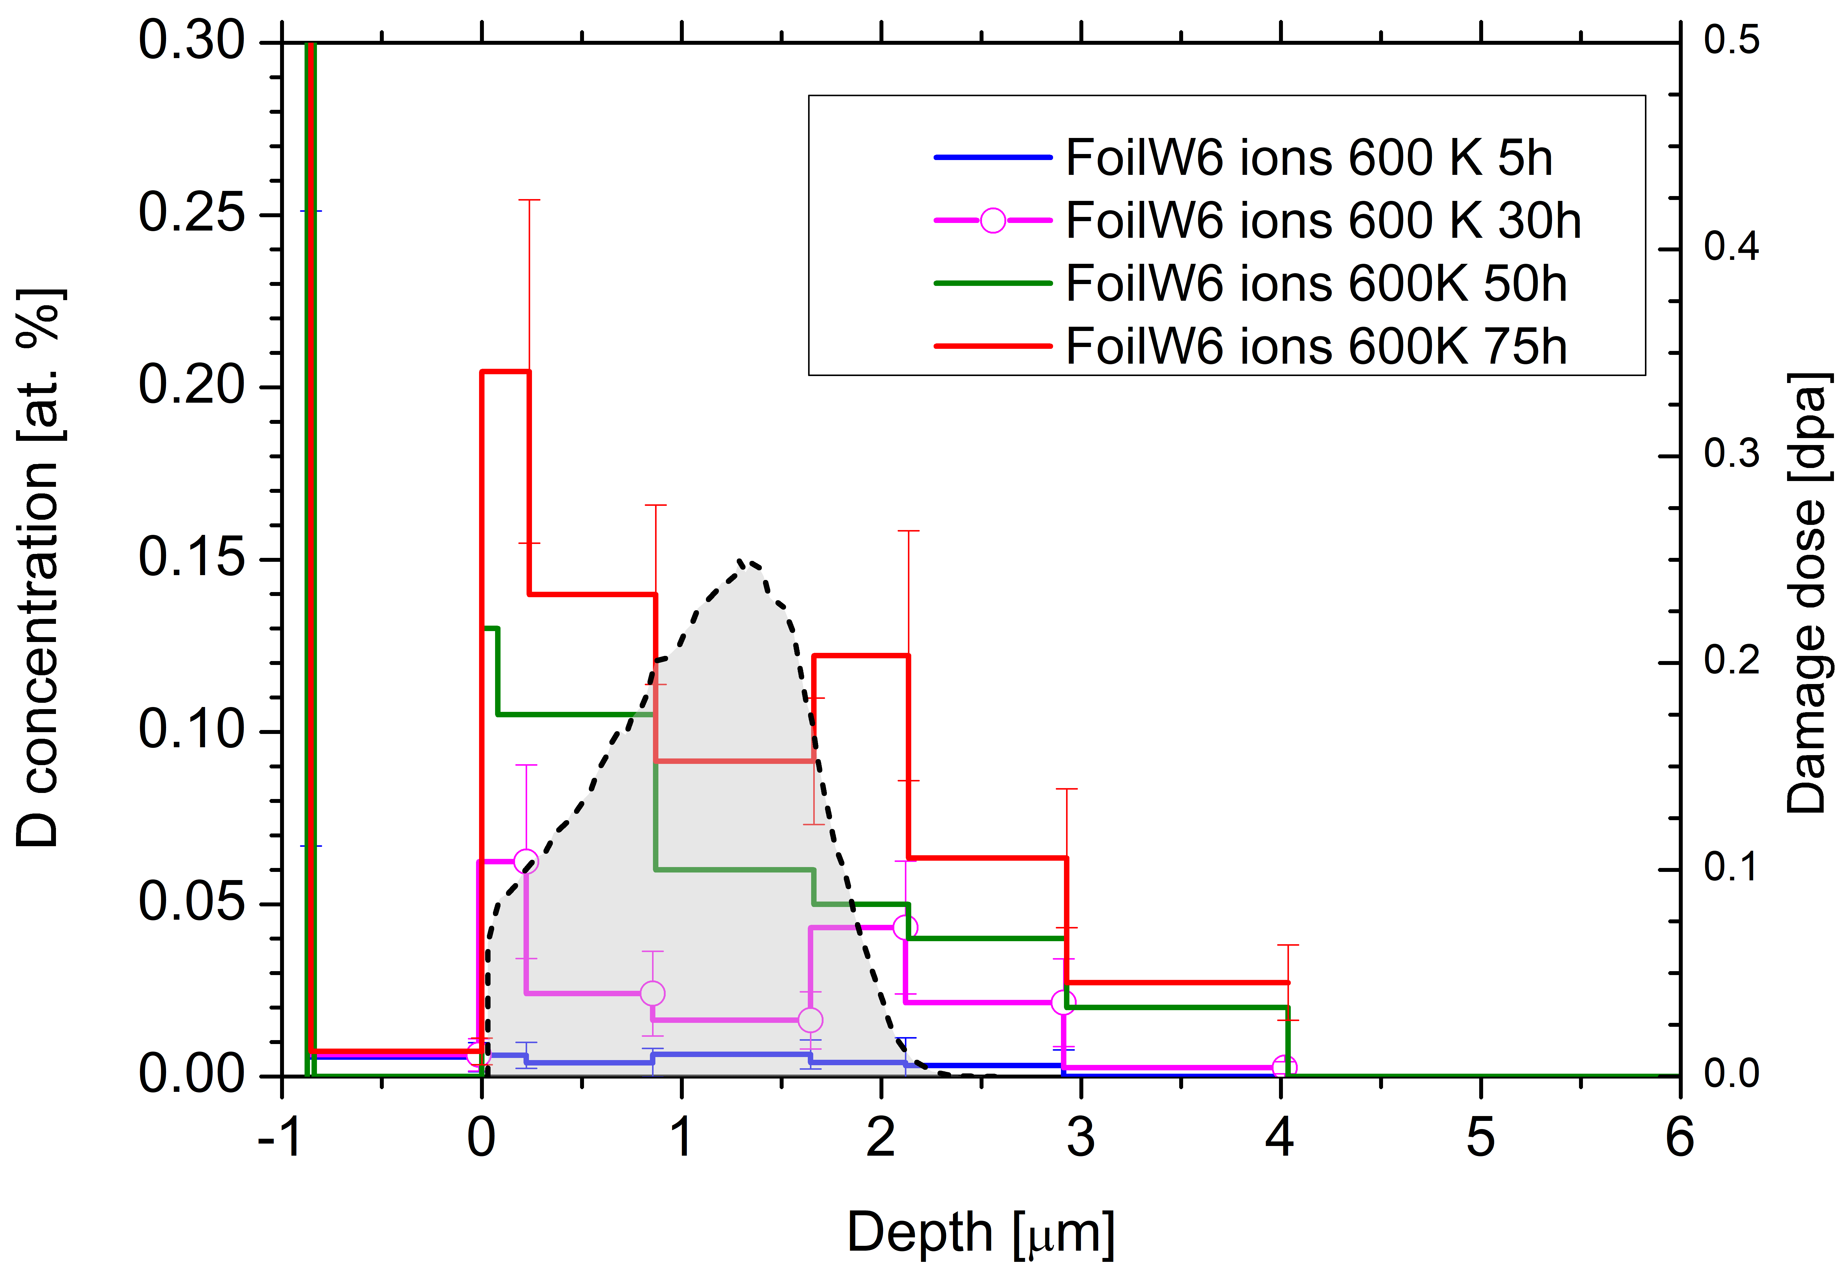
Compare D permeation through W with D atoms and 300 eV/D ions
Study the differences in D transport (permeation) in a W foil (recrystallized) between 0.3 eV D atoms and 300 eV/D ions based on in situ IBA during exposure
Experiment
Exposure to
D atoms (flux 5e18 D/m²) at 600/700 K for ~ 160 h/ 250 h (134 h present - ongoing)
D ions (flux ?e18 D/m²) for ~ 600/700 K for ~ 75 h/ 96h
D-ions
Observations
Measured D depth profiles on the downstream side
Ions - Surprise: No diffusion front visible but raising D concentration within damaged layer
Markelj
Notes:
The ion flux still needs to be measured by faraday cup to get the flux in the middle of the sample.

Slide 14
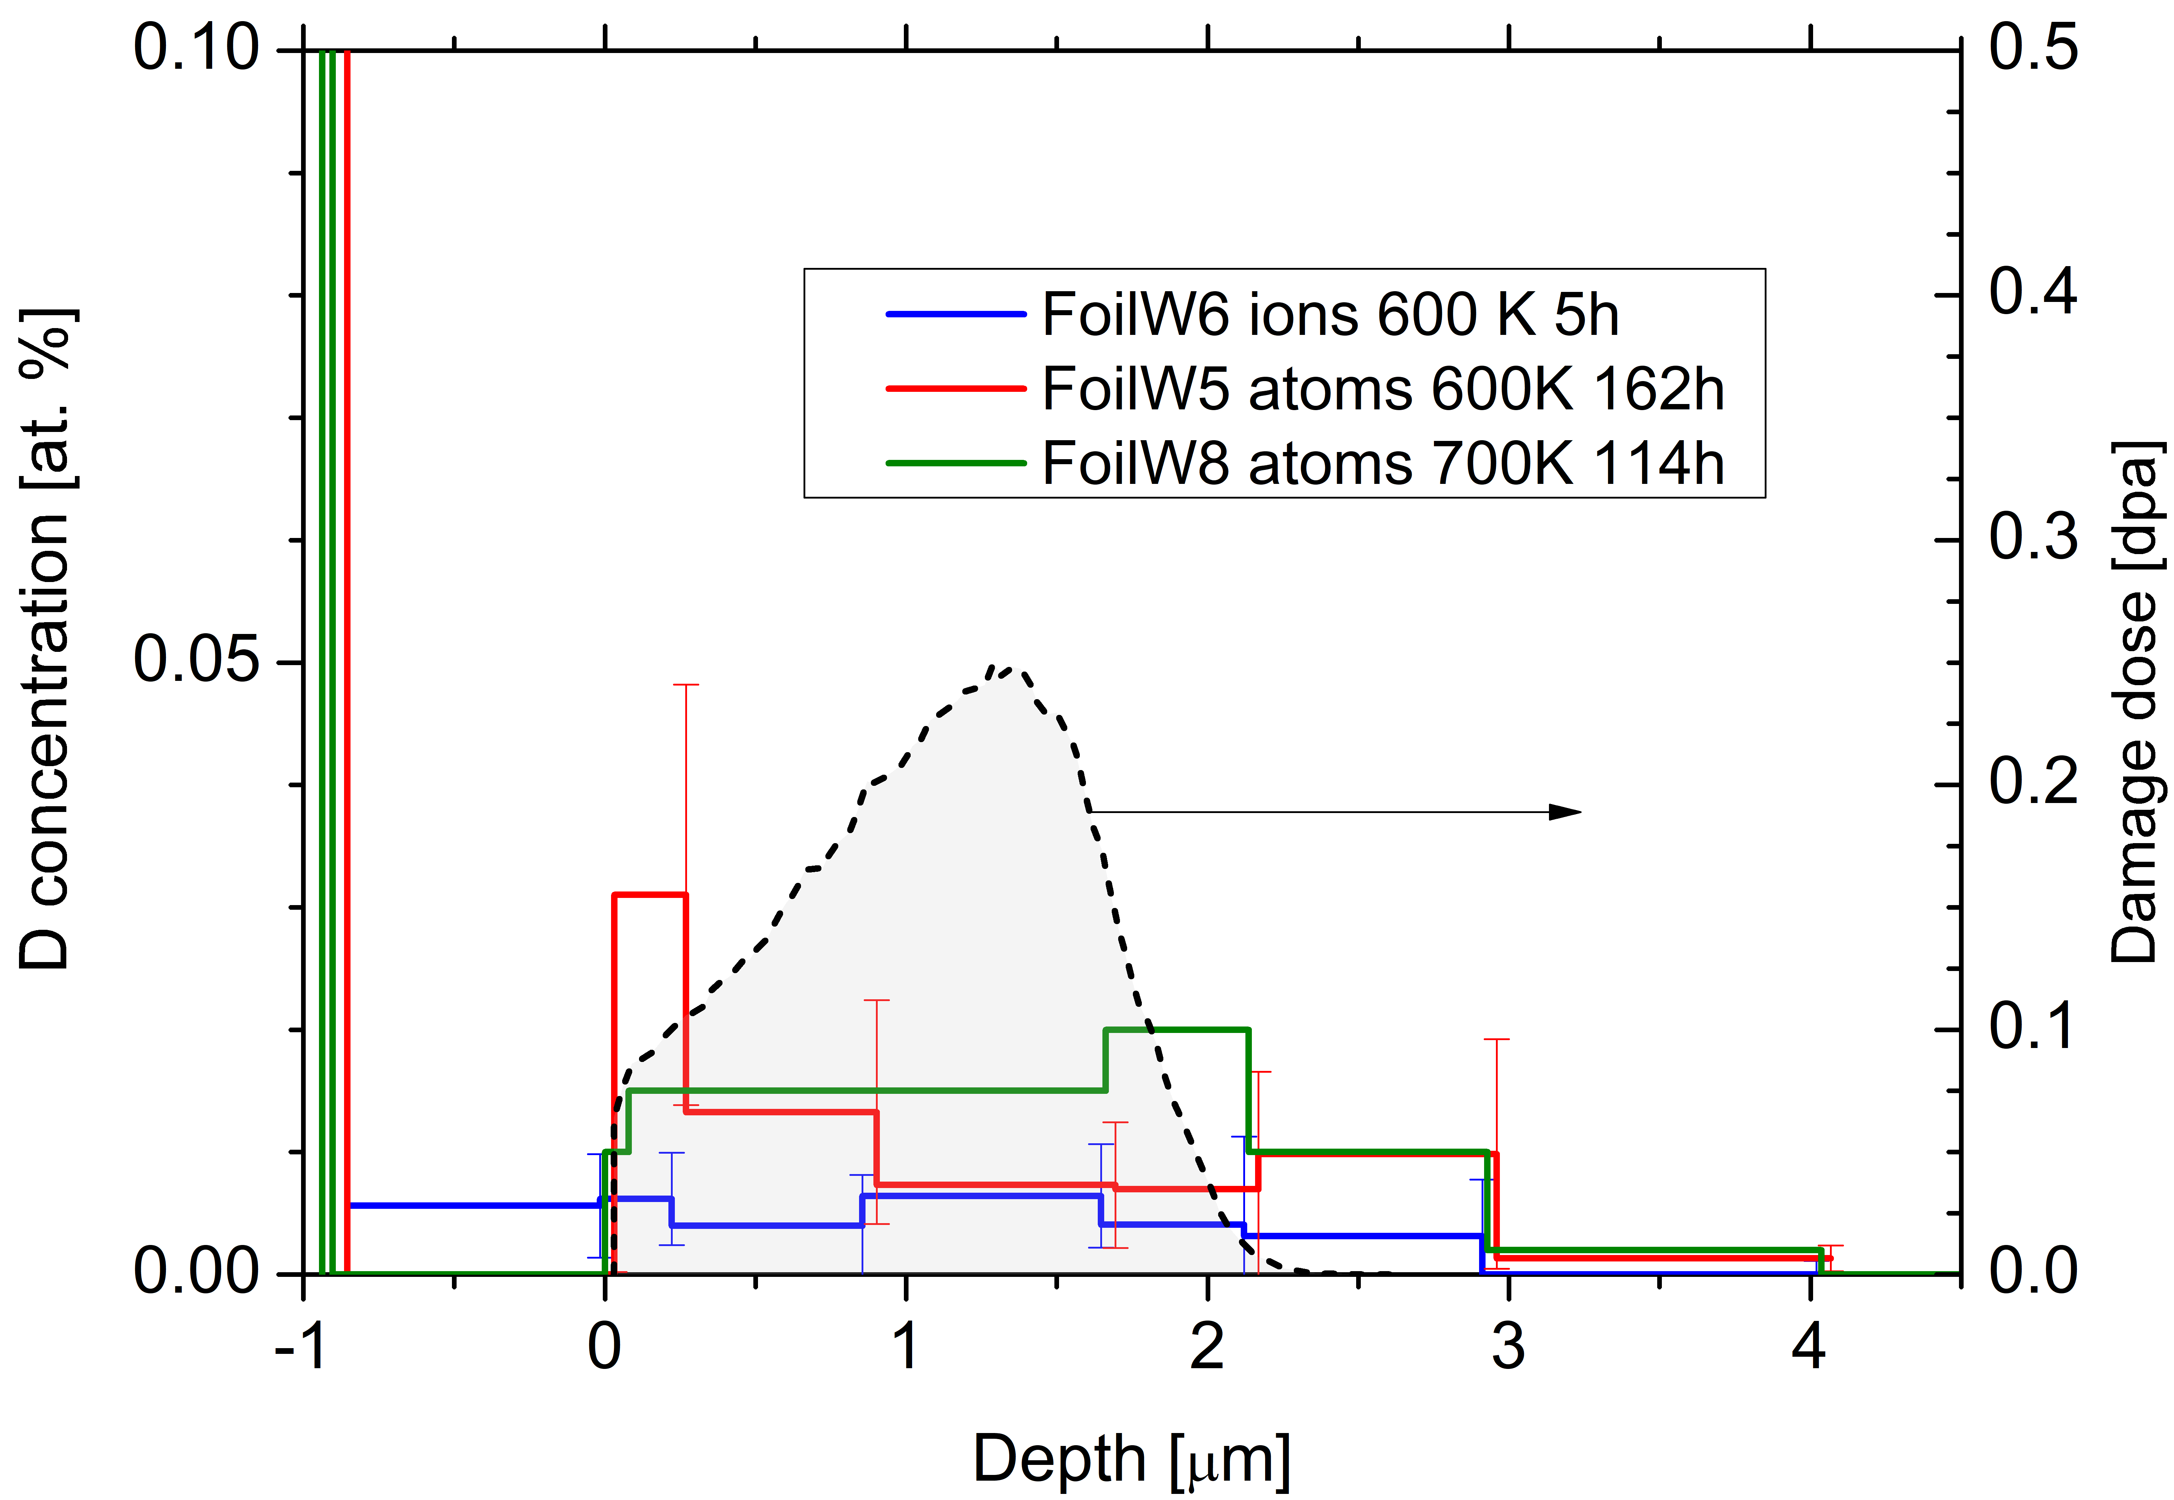
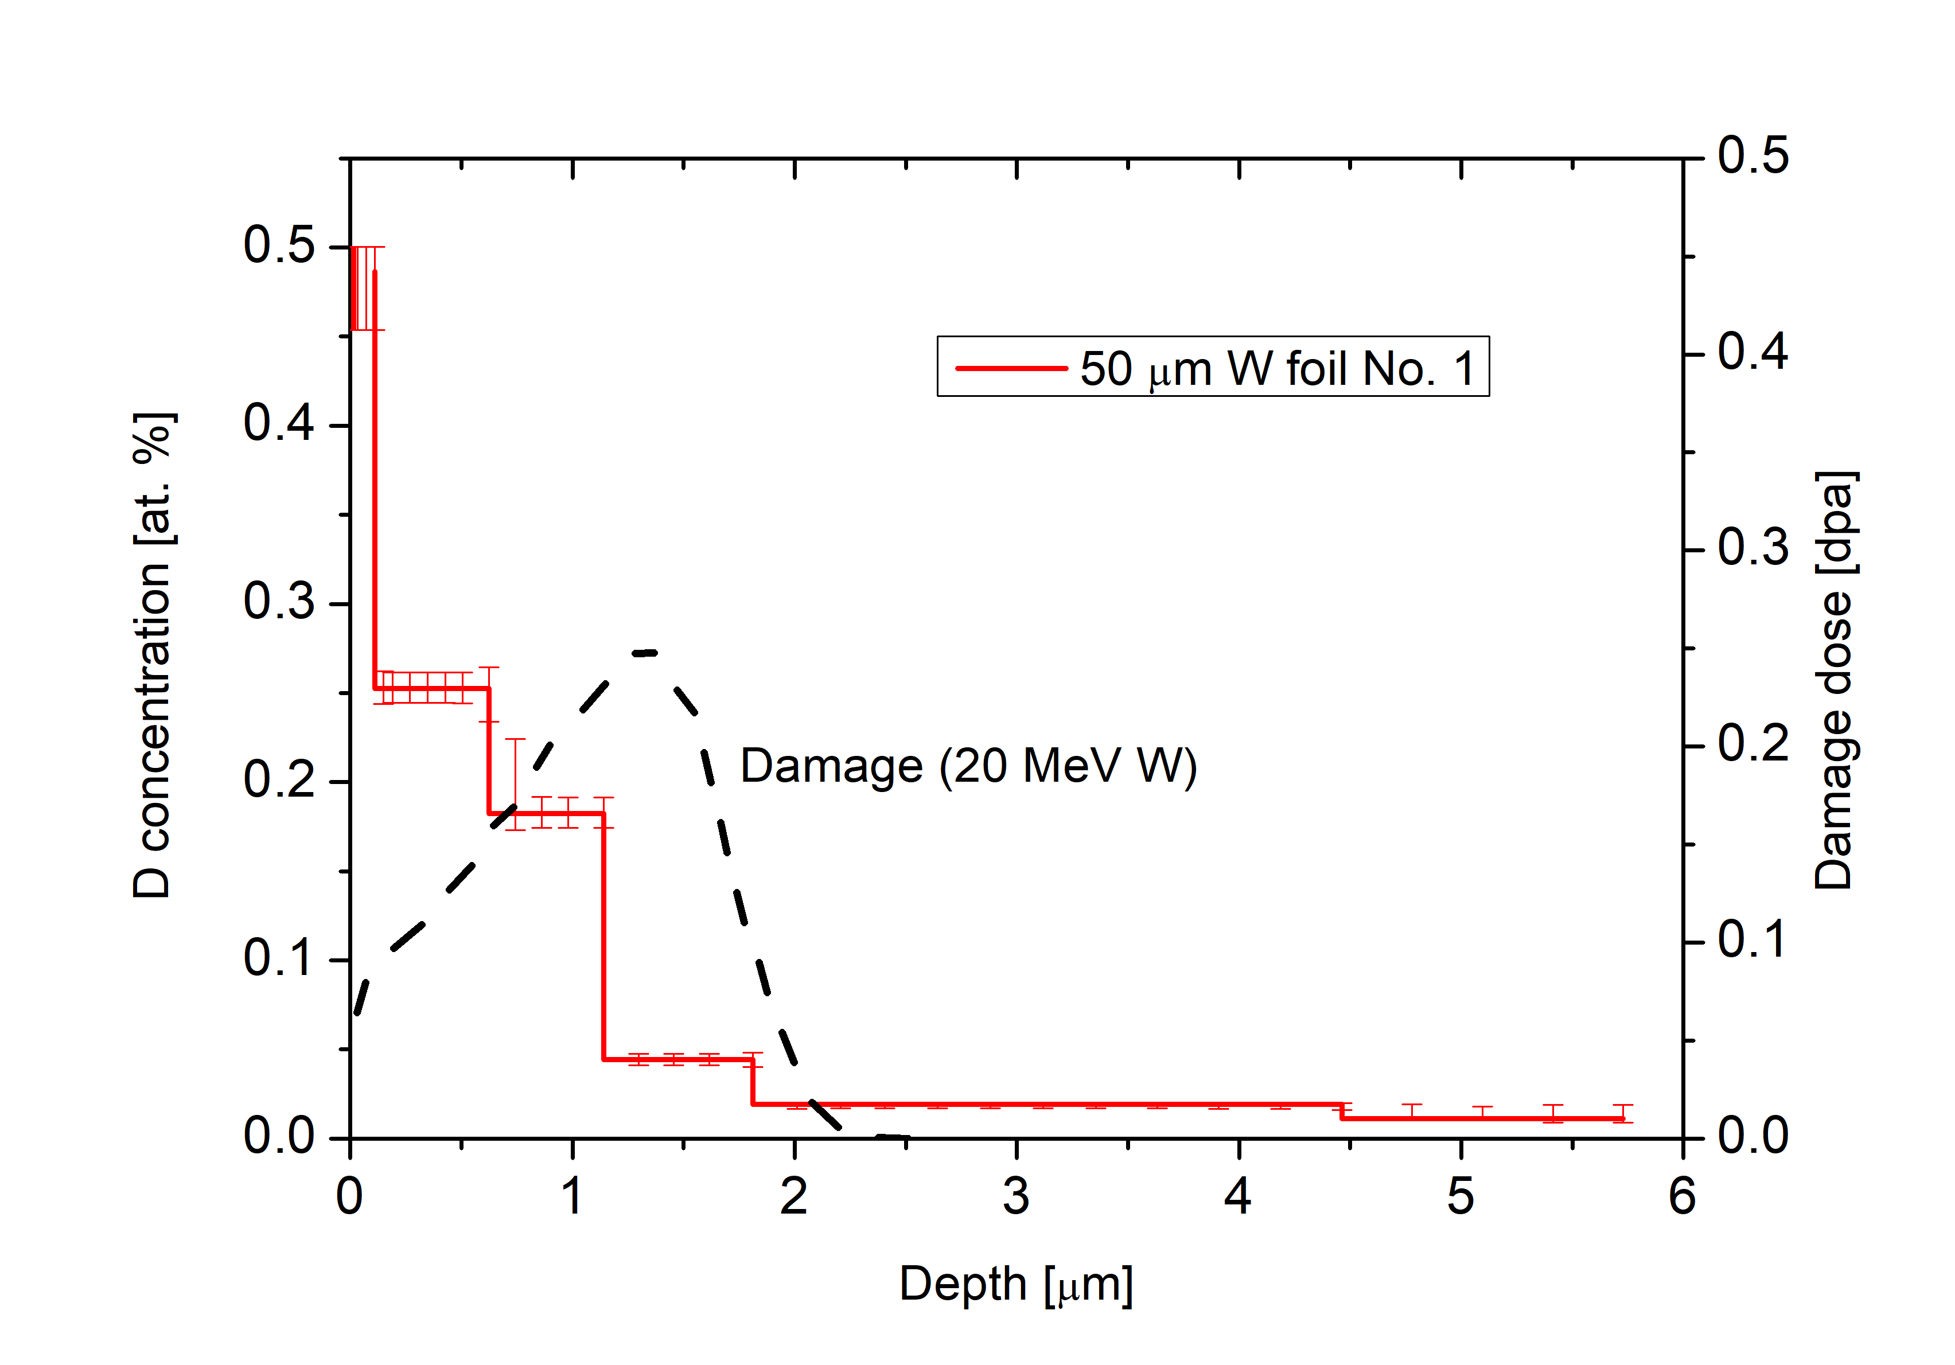
Compare D permeation through W with D atoms and 300 eV/D ions
Study the differences in D transport (permeation) in a W foil (recrystallized) between 0.3 eV D atoms and 300 eV/D ions based on in situ IBA during exposure
Experiment
Exposure to
D atoms (flux 5e18 D/m²) at 600/700 K for ~ 160 h/ 250 h (134 h present - ongoing)
D ions (flux ?e18 D/m²) for ~ 600/700 K for ~ 75 h/ 96h
Observations
Measured D depth profiles on the downstream side
Ions - Surprise: No diffusion front visible but raising D concentration within damaged layer
Atoms: Very low concentration and also ‘constant’ D concentration through the damaged layer – different compared to the depth profile measured at direct uptake of self-damaged W
For comparison - direct D uptake in self-damaged layer
Exposure: 120 h
Markelj
Notes:
The D NRA signal in damaged layer is small even after 162 h (7 days) of D atom exposure – from SIMNRA I can deduce we have 0.015 at. % of D in the damaged layer. From previous exposures when full, we get 0.3 at.% D atom concentration for this exposure temperature of 600 K. So this means the permeation is reaaaaally slow for D atoms.
The 700K exposure is still ongoing at the moment since after the 134 h the signal is a bit larger than for the 600 K and I would like to see how the damaged layer gets filled a bit more.

Slide 15
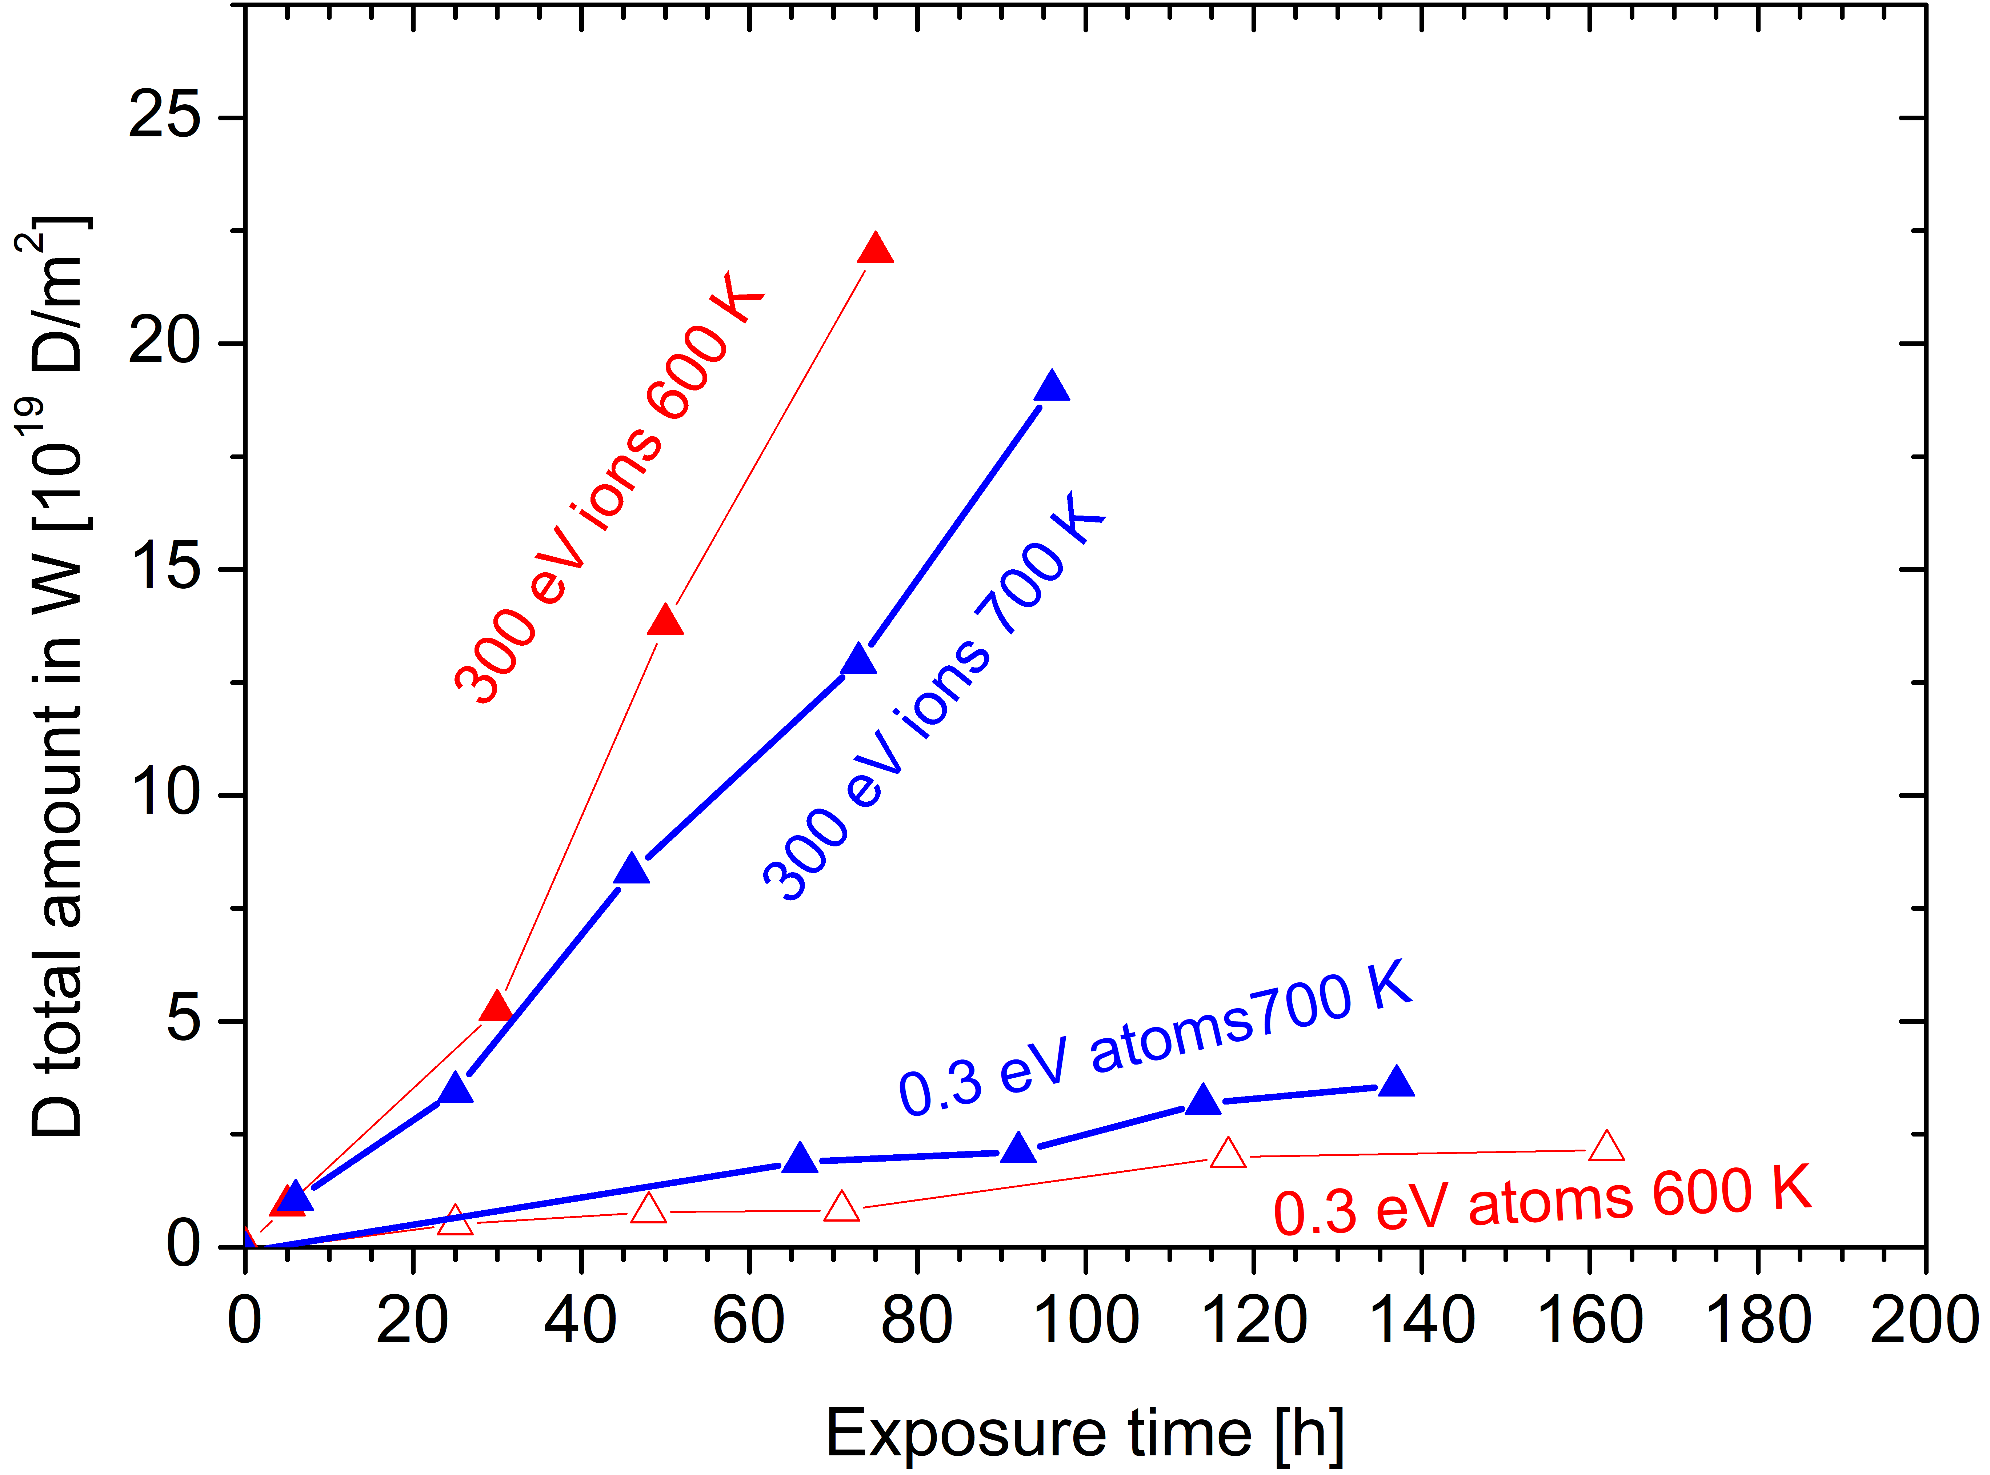
Compare D permeation through W with D atoms and 300 eV/D ions
Study the differences in D transport (permeation) in a W foil (recrystallized) between 0.3 eV D atoms and 300 eV/D ions based on in situ IBA during exposure
D atoms
/ ions
Experiment
Exposure to
D atoms at 600/700 K for ~ 160 h/ 250 h
D ion for ~ 600/700 K for ~ 75 h/ 96h
Observation
Very short “lag time” in all cases
Ions: slower increase at 700 K
Atoms: very slow – faster at 700 K
Reverse behavior ions versus atoms
For interpretation we need MRE modelling
Mixture of loss by de-trapping vs. Uptake efficiency
Next year – modelling and transport in H-filled W?
Markelj

Slide 16
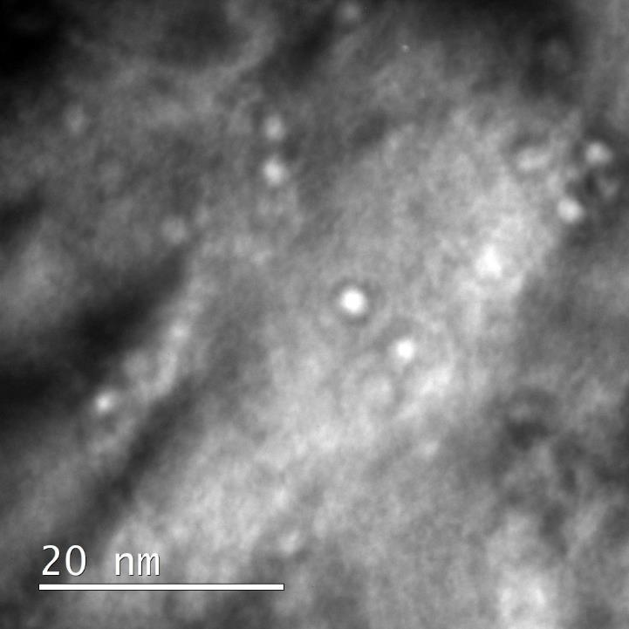

SP C.1 Transport of Hydrogen through the first wall of fusion devices
TEM analysis of void formation in self-damaged W
TEM characterization of samples prepared by Dr. Zibrov
  Helium nanobubbles and voids after self-damage
We developed sample preparation techniques which enables nanobubbles observations (succesfully repeated on several specimens)
Samples are milled with FIB followed by argon ions smoothening
New state-of-the-art high resolution analytical transmission electron microscope arrived at WUT! We are open to new collaborations!
IPPLM
Notes:
Please help me and add some notes here so I can figure out what to say about your slide / work

Slide 17
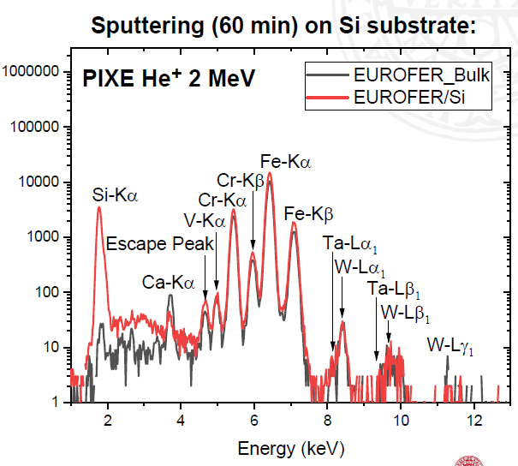


TU Wien (ÖAW) + Uppsala University (VR)
TDS and QCM measurements on
EUROFER preimplanted with D
EUROFER thin films successfully deposited on QCM resonator by magnetron sputtering at Uppsala University
Composition in good agreement with bulk EUROFER (validated with RBS, ERDA, PIXE,…)
TU Wien:
2 implantations of 2 keV D₂⁺ in EUROFER
a) TDS experiment without redeposited W layer
b) TDS experiment with redeposited W layer
Recording of net mass difference with QCM (during implanting and TDS)
TDS for identification of desorption peaks (if any up to max. T of 400°C)
Christian Cupak cupak@iap.tuwien.ac.at
Notes:
Our main task this year is to study the influence of a redeposited W layer on D retention in EUROFER. For this, we upgraded our experimental setup in 2021 to be capable of performing PVD of W on top of any sample in-situ.
Generally, our main experimental approach is a combination of TDS = temperature desorption spectroscopy with a quadrupole mass spectrometer and a QCM = quartz crystal microbalance.
While the TDS allows to identify threshold temperatures for desorption, the actual quantification of implanted/outgassed D should be achieved by the net mass change signal (which corresponds to a frequency change) of our QCM.
A major achievement in 2022 was the creation of the actual samples of interest: the deposited EUROFER layers on QCM crystals by means of magnetron sputtering at Uppsala University. These were used for the D implantation experiments at TU Wien. A good agreement was validated between the initial EUROFER crucible and the deposited thin film (for example, see the PIXE spectrum, but we also have RBS and ERDA data which would exceed the limit of two slides here).
After shipping to TU Wien, the next step was to compare the behaviour of Eurofer and Eurofer + redeposited W layer in terms of deuterium implantation/retention.

Slide 18
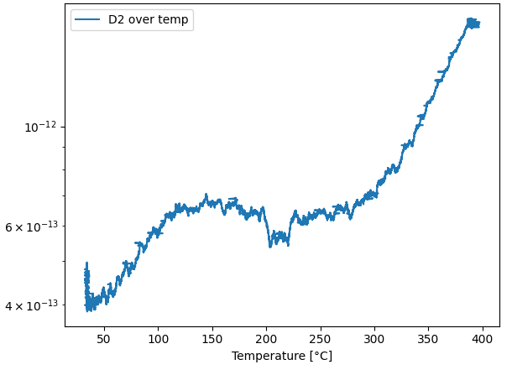
TU Wien (ÖAW) + Uppsala University (VR)
TDS and QCM measurements on
EUROFER preimplanted with D
Representative TDS data
TU Wien:
2 implantations of 2 keV D₂⁺ under 0° in EUROFER
a) TDS experiment without redeposited W layer
b) TDS experiment with redeposited W layer
TDS: small low temperature peak at 150°C (423K)
Good agreement with [1] (different ion energy though)
Rising TDS slope towards 400°C limit (limit by QCM)
QCM: both implantation and outgassing can be
compared in terms of mass change (see table)
Outgassing signal was challenging to evaluate
(3rd mode is very filigree method)
Evaluation finished, 2022 task completed
[1] Hollingsworth et al., Nucl Fusion 60 (2019), 016024
QMA signal [a.u.]
max. T for QCM
Maybe skip the QCM for 2023 thickness variation and just use a calibrated QMA instead
NRA depth profile after 400°C experiment would be nice
Experimental Case | D/m² implanted | D/m² outgassed
without redeposited W | 5.6 E+20 | 4.41 E+14
with redeposited W | 4.0 E+20 | -1.78 E+14
Christian Cupak cupak@iap.tuwien.ac.at
Notes:
First of all, the EUROFER coated QCM crystal was sputter cleaned to remove adsorbates from transport at atmosphere by 2keV Ar irradiation
Then, an initial implantation with 5.0 E+21 D2/m² was performed to saturate the sample with D (monitored by QCM).
Our QCM technically limits the maximum temperature of the TDS measurement (resonator gets destroyed beyond certain temperature), therefore we decided to heat only towards 400°C (see representative TDS plot). Since it must be expected that only a part of the retained D is getting mobile during our TDS, it must be assumed that the difference in mass measured by parallel QCM is deviating for the mass gain during the very first implantation and the mass loss of outgassing during the first TDS.
Therefore, the sample was again implanted with D after first TDS without a redeposited W layer, to enable better comparability (the data which is shown here in the table “without redeposited W”).
Finally, the sample was again re-implanted with D in a third measurement circle, before we deposited the W layer and performed the last TDS measurement.
In the table, the calculated mass changes from QCM, interpreted as D/m² are listed. A comparison between the implanted and the subsequently outgassed amount of D was intended, but the latter data on outgassing was very challenging to evaluate and may be taken with awareness. No robust values could be extracted in this special application as we observed a poor sensitivity of the 3rd mode QCM technique. While the 3rd mode technique of our QCM was shown to be capable of measuring mass changes during TDS experiments in earlier applications [2], we were able to gain insights to the limitations of this modus for more advanced experimental protocols, which therefore forms an additional key result of this year’s SP-C task.
Summarising, the experiments were conducted as initially planned and evaluated, therefore we declare our 2022 SP-C task being completed. We look forward to extend and consolidate our investigations on this topic in our 2023 task, which is already prepared together with our colleagues in Uppsala.
[2] R. Stadlmayr et al., Rev. Sci. Instr. 91, 125104 (2020); https://doi.org/10.1063/5.0012028

Slide 19
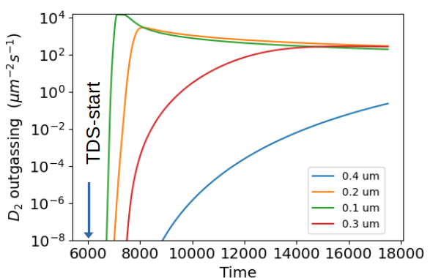
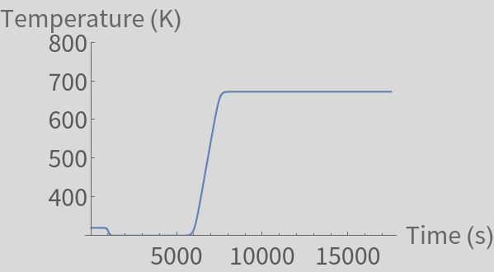
TU Wien (ÖAW) + Uppsala University (VR)
Qualitatively expected result in 2023...
Low solubility of D in W
  → W blocks outgassing from EUROFER
At high enough temperature permeation sets in
  → Thickness dependent time delay
Deep traps in W limit total D loss at low (673K) temperatures
Quick & Dirty TESSIM-X simulation of W on EUROFER
Klaus Schmid

Slide 20
SP C.1 Transport of Hydrogen through the first wall of fusion devices
Plan for 2023
Association | Title | Deliverables
CEA | Permeation (D,T) through Liquid/Solid interfaces with interface characterization | T Gas/Gas permeation vs T Gas/Liquid on EUROFER w/wo O-layers
DIFFER | "Dynamic measurements of deuterium retention and isotope exchange in W" | Evaluation of influence of plasma parameters and surface temperature on trapping and de-trapping post-exposure
DIFFER | Influence of ELMs on deuterium retention and outgassing in W | Compare pre-damaged (ELM-like laser pulse) W with simultaneously damaged (laser) W
MPG | Measurement and modelling of Ion Driven Permeation in W, Cu and Fe-Ni alloys "heavy alloys" | Ion-driven permeation through layered model systems: W on FeNi and FeNi ond W
JSI | study permeation on H-prefilled W foil | D permeated amount compared to non-H-filled W
IPP_LM | TEM analyis of material interfaces in W/Cu and W/EUROFER samples | TEM analysis of damaged W-samples
ÖAW | Studying the influence of (re-deposited) W on EUROFER on D retention | Variation of TDS with W-layer thickness on EUROFER

Slide 21
SP C.2 Modelling of Hydrogen Transport properties in the first wall
Tasks in 2022
Task
H diffusion and segregation at the Cu/W interface (CEA)
DFT calculations of defects in W in the presence of H and He (UKAEA)

Slide 22
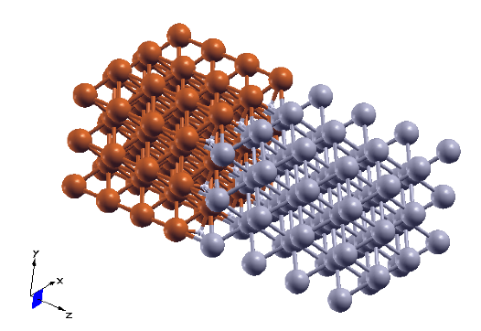

H diffusion and segregation at the W/Cu interface
Deliverable: Energy landscape of H at a W/Cu material interface
A DFT model of the W/Cu interface was built
-> orientation: W(001) with the Cu(001) surface
-> the structural distortion at the surface was determined
Hydrogen solubility
There will be a talk on DFT modeling of the W/Cu interface by Y. Ferro
-> it was determined in perfect Cu and W
-> it was also determined in pure distorted Cu and W (with the same geometry distortion as at the interface).
-> we are calculating the solution energy of H close to and at the interface (see graph)
The effect of the interface is to create a sink where
Hydrogen’s Isotope will possibly accumulate
What next ?
Your associations logo
-> The full energy path could reveal high energy barriers for diffusion, they will be computed
-> The effect of hydrogen accumulation could also be investigated for the year after.
& CEA
Yves Ferro
Notes:
We previously computed O adsorption energies on W(110) and of O+H co-desorption on W(110). Saturation takes place at completion of one monolayer of adsorbate (either H or O or H+O).
• Oxygen reduces the total amount of H on the surface at the same time it decreases H adsorption energy. If Oxygen is adsorbed at coverage 1 (saturation), H is not adsorbed on the surface,
• O diffusion on the surface and into the bulk was also investigated,
• H diffusion from the gas phase (H2), dissociation on the WO surface, then absorption into the bulk were computed,
• the total energy paths were computed for coverages in oxygen of 0.25 and 0.50. H diffusion was calculated up to the 8th interstitial position into the bulk. Coverage in H was chosen so that the surface is at saturation when the diffusing H atoms is on the surface. Otherwise, the surface is below saturation in H when the diffusing H is in the bulk or recombined in H2.
• In the following, saturation in hydrogen of the surface when the diffusing H is in the bulk or recombined in H2 will have to be considered. This way, oversaturation will be reached when the diffusing H atom is on the surface, which should have the effect of lowering the energy barriers.
• A draft paper is almost completed

Slide 23
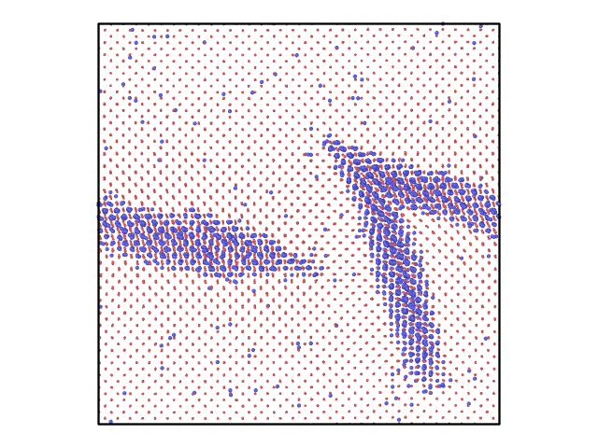

DFT calculations of defects in W in the presence of H
Investigated dependence of diffusion of hydrogen in
tungsten on hydrogen concentration
Molecular dynamics simulations using LAMMPS package on large W-H system and ab initio calculations using VASP program on systems with up to 1000 atoms
Molecular dynamics results found dramatic decrease
of hydrogen diffusion coefficient at concentrations
above 2 at. %
This decrease was found to be the result of formation
of large almost two-dimensional hydrogen clusters
Possibility of formation of clusters was further studied
in ab initio calculations. It was found that indeed two-
dimensional clusters are energetically stable
Final snapshot of molecular dynamics run of 65536 W atoms (red) and 4096 H atoms (blue). Temperature T = 1000 K, P = 0.
Physical model using kinetic Monte Carlo simulations will be created to
investigate hydrogen clustering under the realistic fusion conditions
Possibility of interstitials in tungsten to serve as clustering seeds will be studied
M.Yu. Lavrentiev, S.L. Dudarev, M. Boleininger
Notes:
Usually, it is assumed that hydrogen does not form clusters in tungsten, unlike e.g. helium. However, our molecular dynamics simulations of hydrogen diffusion in tungsten has found that above concentration of 1-2 at. %, diffusion slows down dramatically. The reason for that is formation of large two-dimensional hydrogen clusters. They hold H atoms and prohibit diffusion. It was initially thought this might be a defect of interatomic interaction potential used. However, ab initio calculations of rather large (up to 1000 atoms) W-H systems have shown that indeed, two-dimensional clustering of H atoms lowers the energy of the system, with energy gain being of the order of 0.25 eV per hydrogen atom. This effect might lead to drastic slowing of hydrogen diffusion across the first wall, and prevent leakage of tritium. Further studies are necessary, in particular whether defects in tungsten, such as self-interstitials, can serve as seeds for the formation of H clusters (this is something we also have seen in molecular dynamics simulations).

Slide 24
SP C.2 Modelling of Hydrogen Transport properties in the first wall
Plan for 2023
Association | Title | Deliverables
CEA | H diffusion and segregation at the Cu/W interface | Diffusion properties of hydrogen at the W/Cu interface: activation barriers for MRE modeling
UKAEA | DFT calculations of defects in W in the presence of H | Formation of Defects in the presence of H and/or He

Slide 25
SP C.3 Influence of He, high-flux D and impurities on Hydrogen retention and transport
Tasks in 2022
Task
Study the effect of O or C layers on D: bulk vs surface uptake - from 1 monolayer to a few hundred of nanometers (CEA)
Influence of surface oxide films on the uptake of deuterium into the metallic tungsten in dependence on D ion energy and fluence (MPG)
Influence of surface oxide films on the release of deuterium into the metallic tungsten in dependence on film thickness (MPG)
XRD and Raman of Oxide films on W in cooperation with MPG (JSI, MPG)
Permeation barrier properties of chromia grown on dense Cr films on Eurofer (JSI)
Comparing He cluster nucleation in defect free and e-beam-damaged W (MPG)
E-beam irradiation of single crystal W from MPG (ENEA)
Influence of surface microstructure due to low energy He irradiation on D uptake studied in situ (JSI, MPG)
Self-damaged W samples for JSI investigation (MPG)

Slide 26
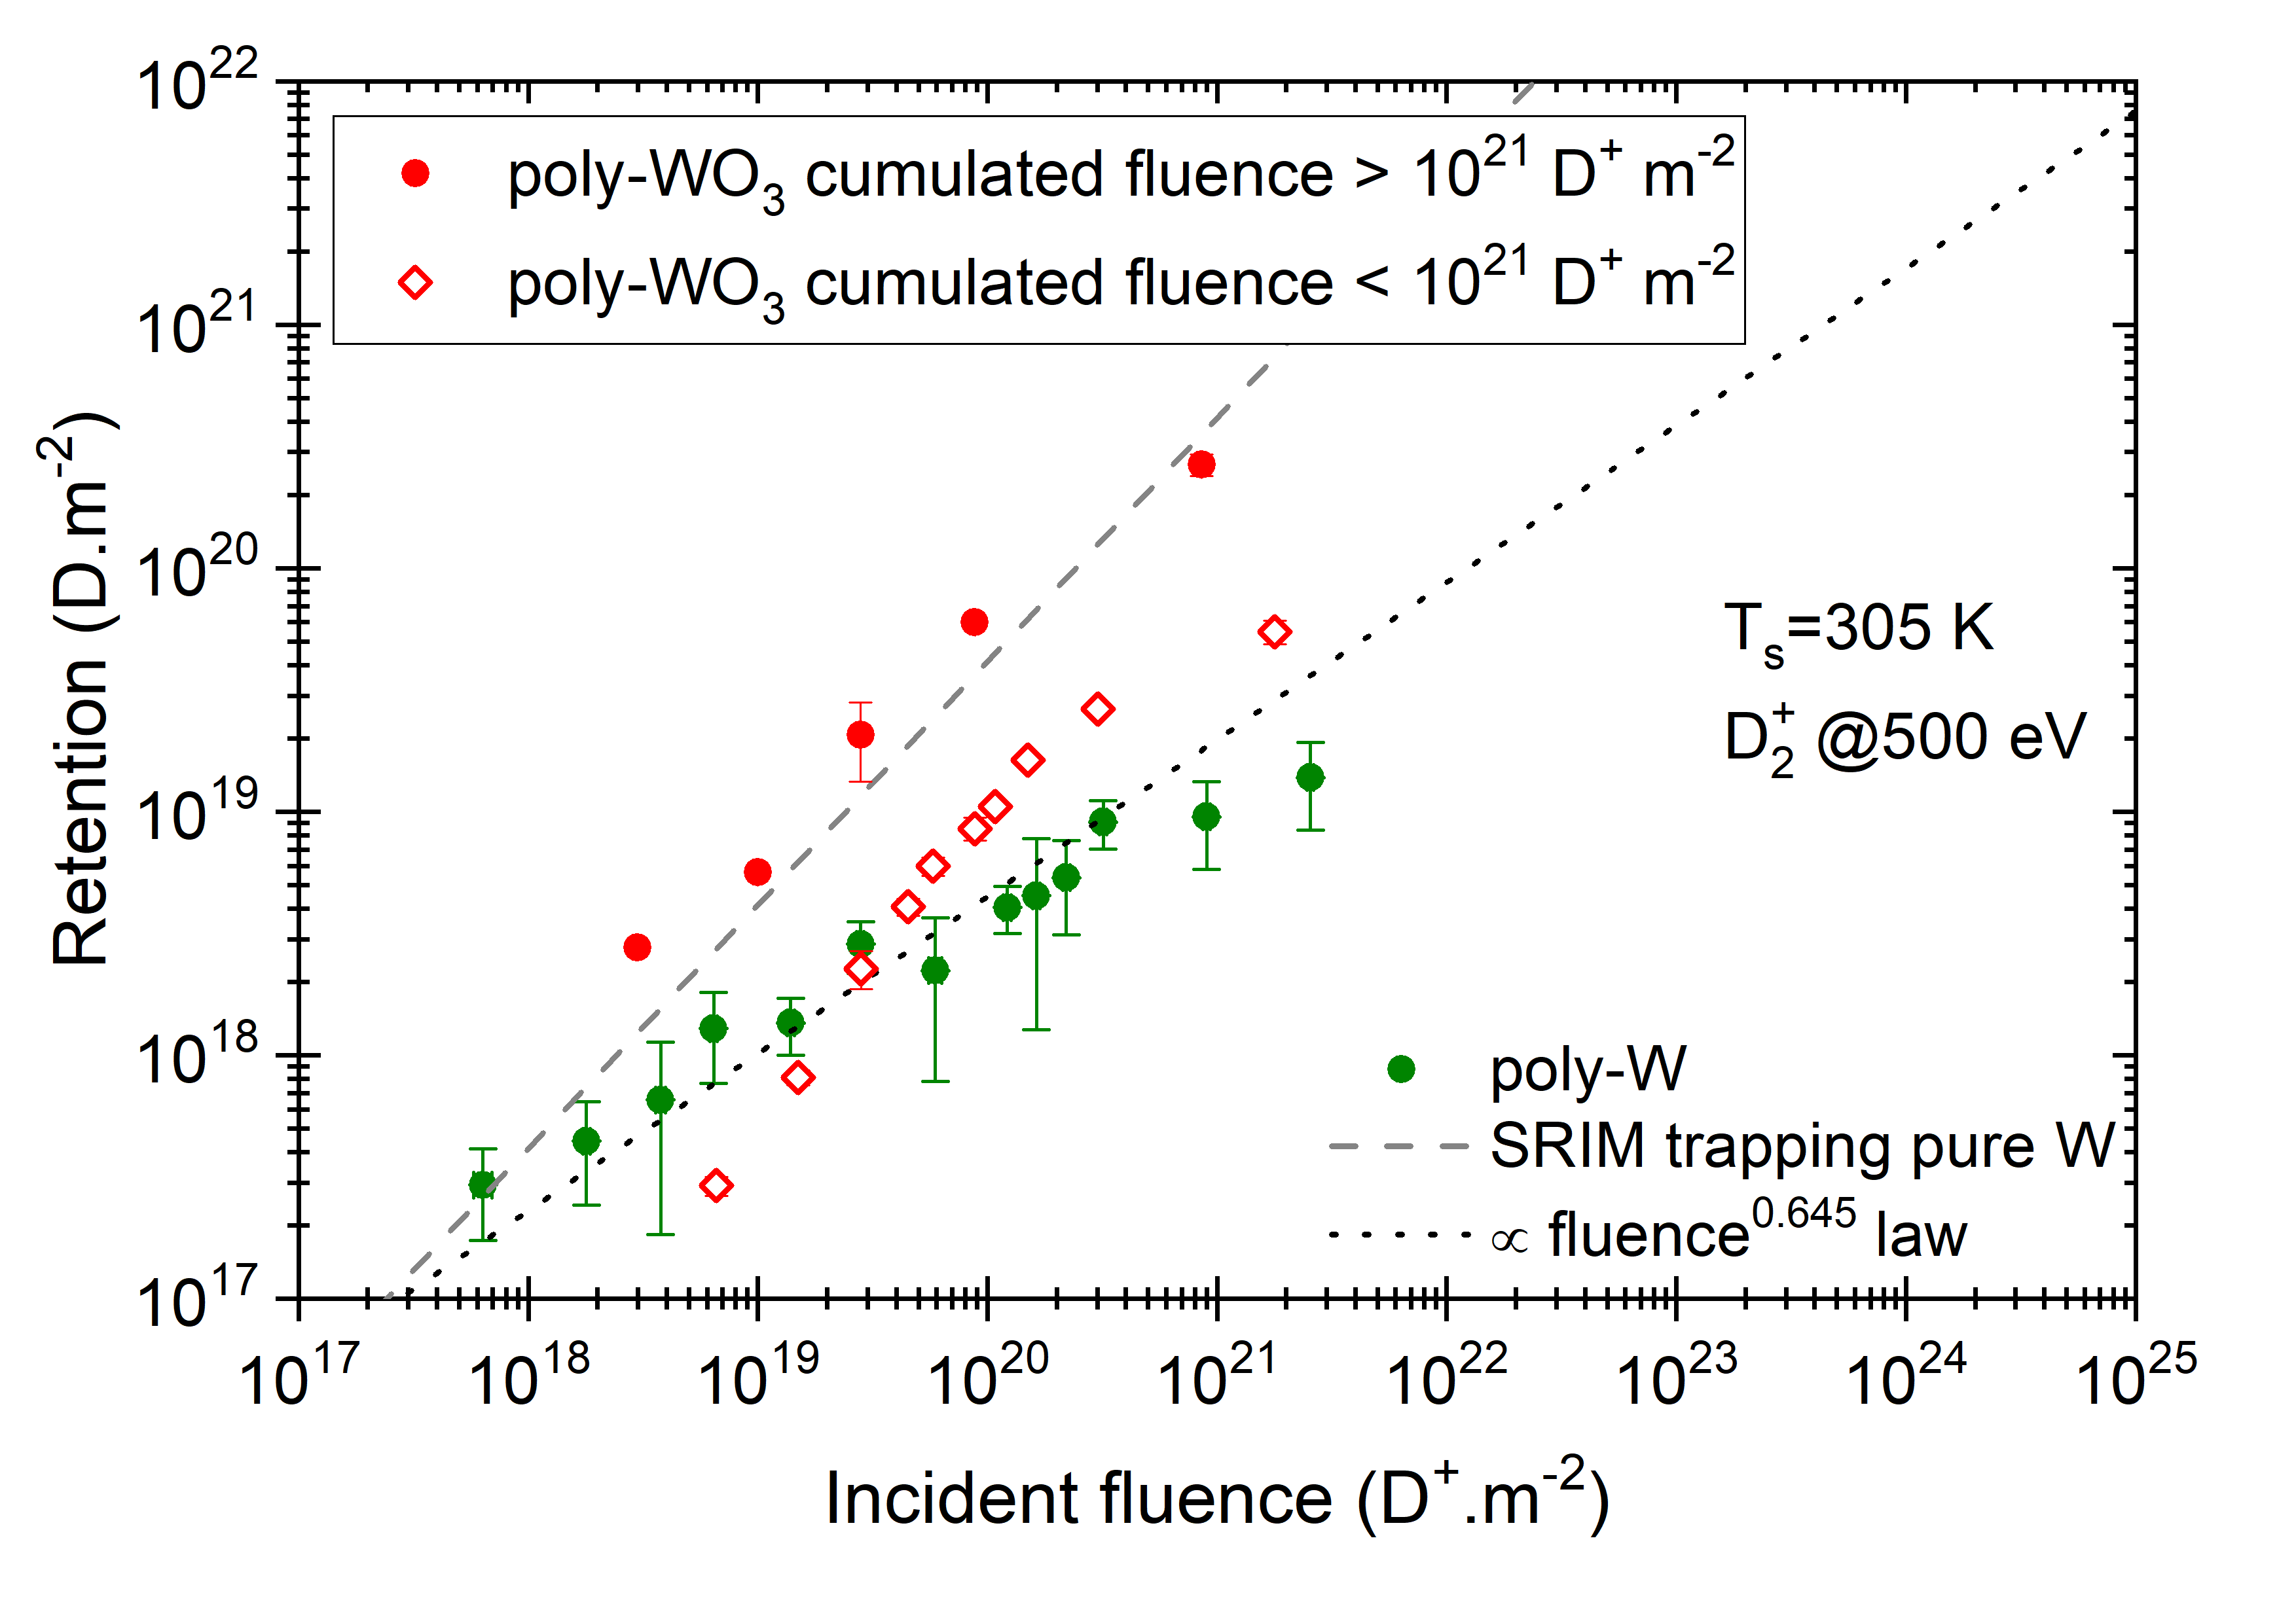
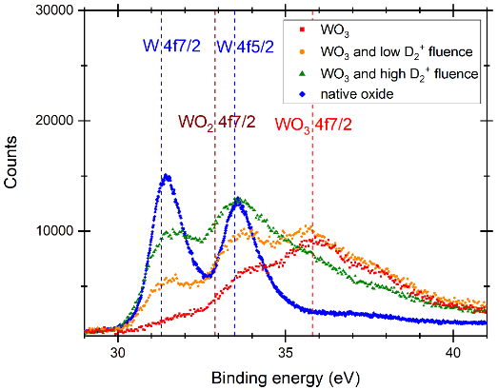


Task: Study the effect of O layers on D retention: from 1 monolayer to few 100s nm
Strategy: repeated D implantation on one WO₃ sample grown at 1073 K
2021
oxide with 150 nm thickness: D retention ?
D retention increases with fluence
At a given fluence, the cumulated fluence increases D retention → layer evolution ?
There will be a talk on Surface oxygen versus native oxide on tungstenby R. Bisson
2022
oxide with thickness below 100 nm: D retention ?
D retention dependence with fluence ?
XPS analysis of the 150 nm thick oxide after high cumulated fluence shows loss of oxygen
→ sample surface toward the native poly-W
Completion of the system upgrade for oxide growth at lower thickness
oxide growth below 100 nm ongoing
SP-C-1: Transport of Hydrogen through the first wall of fusion devices (from 03-AMU)
T. Angot, R. Bisson, C. Martin, M. Minissale – PIIM/AMU-CNRS

Slide 27
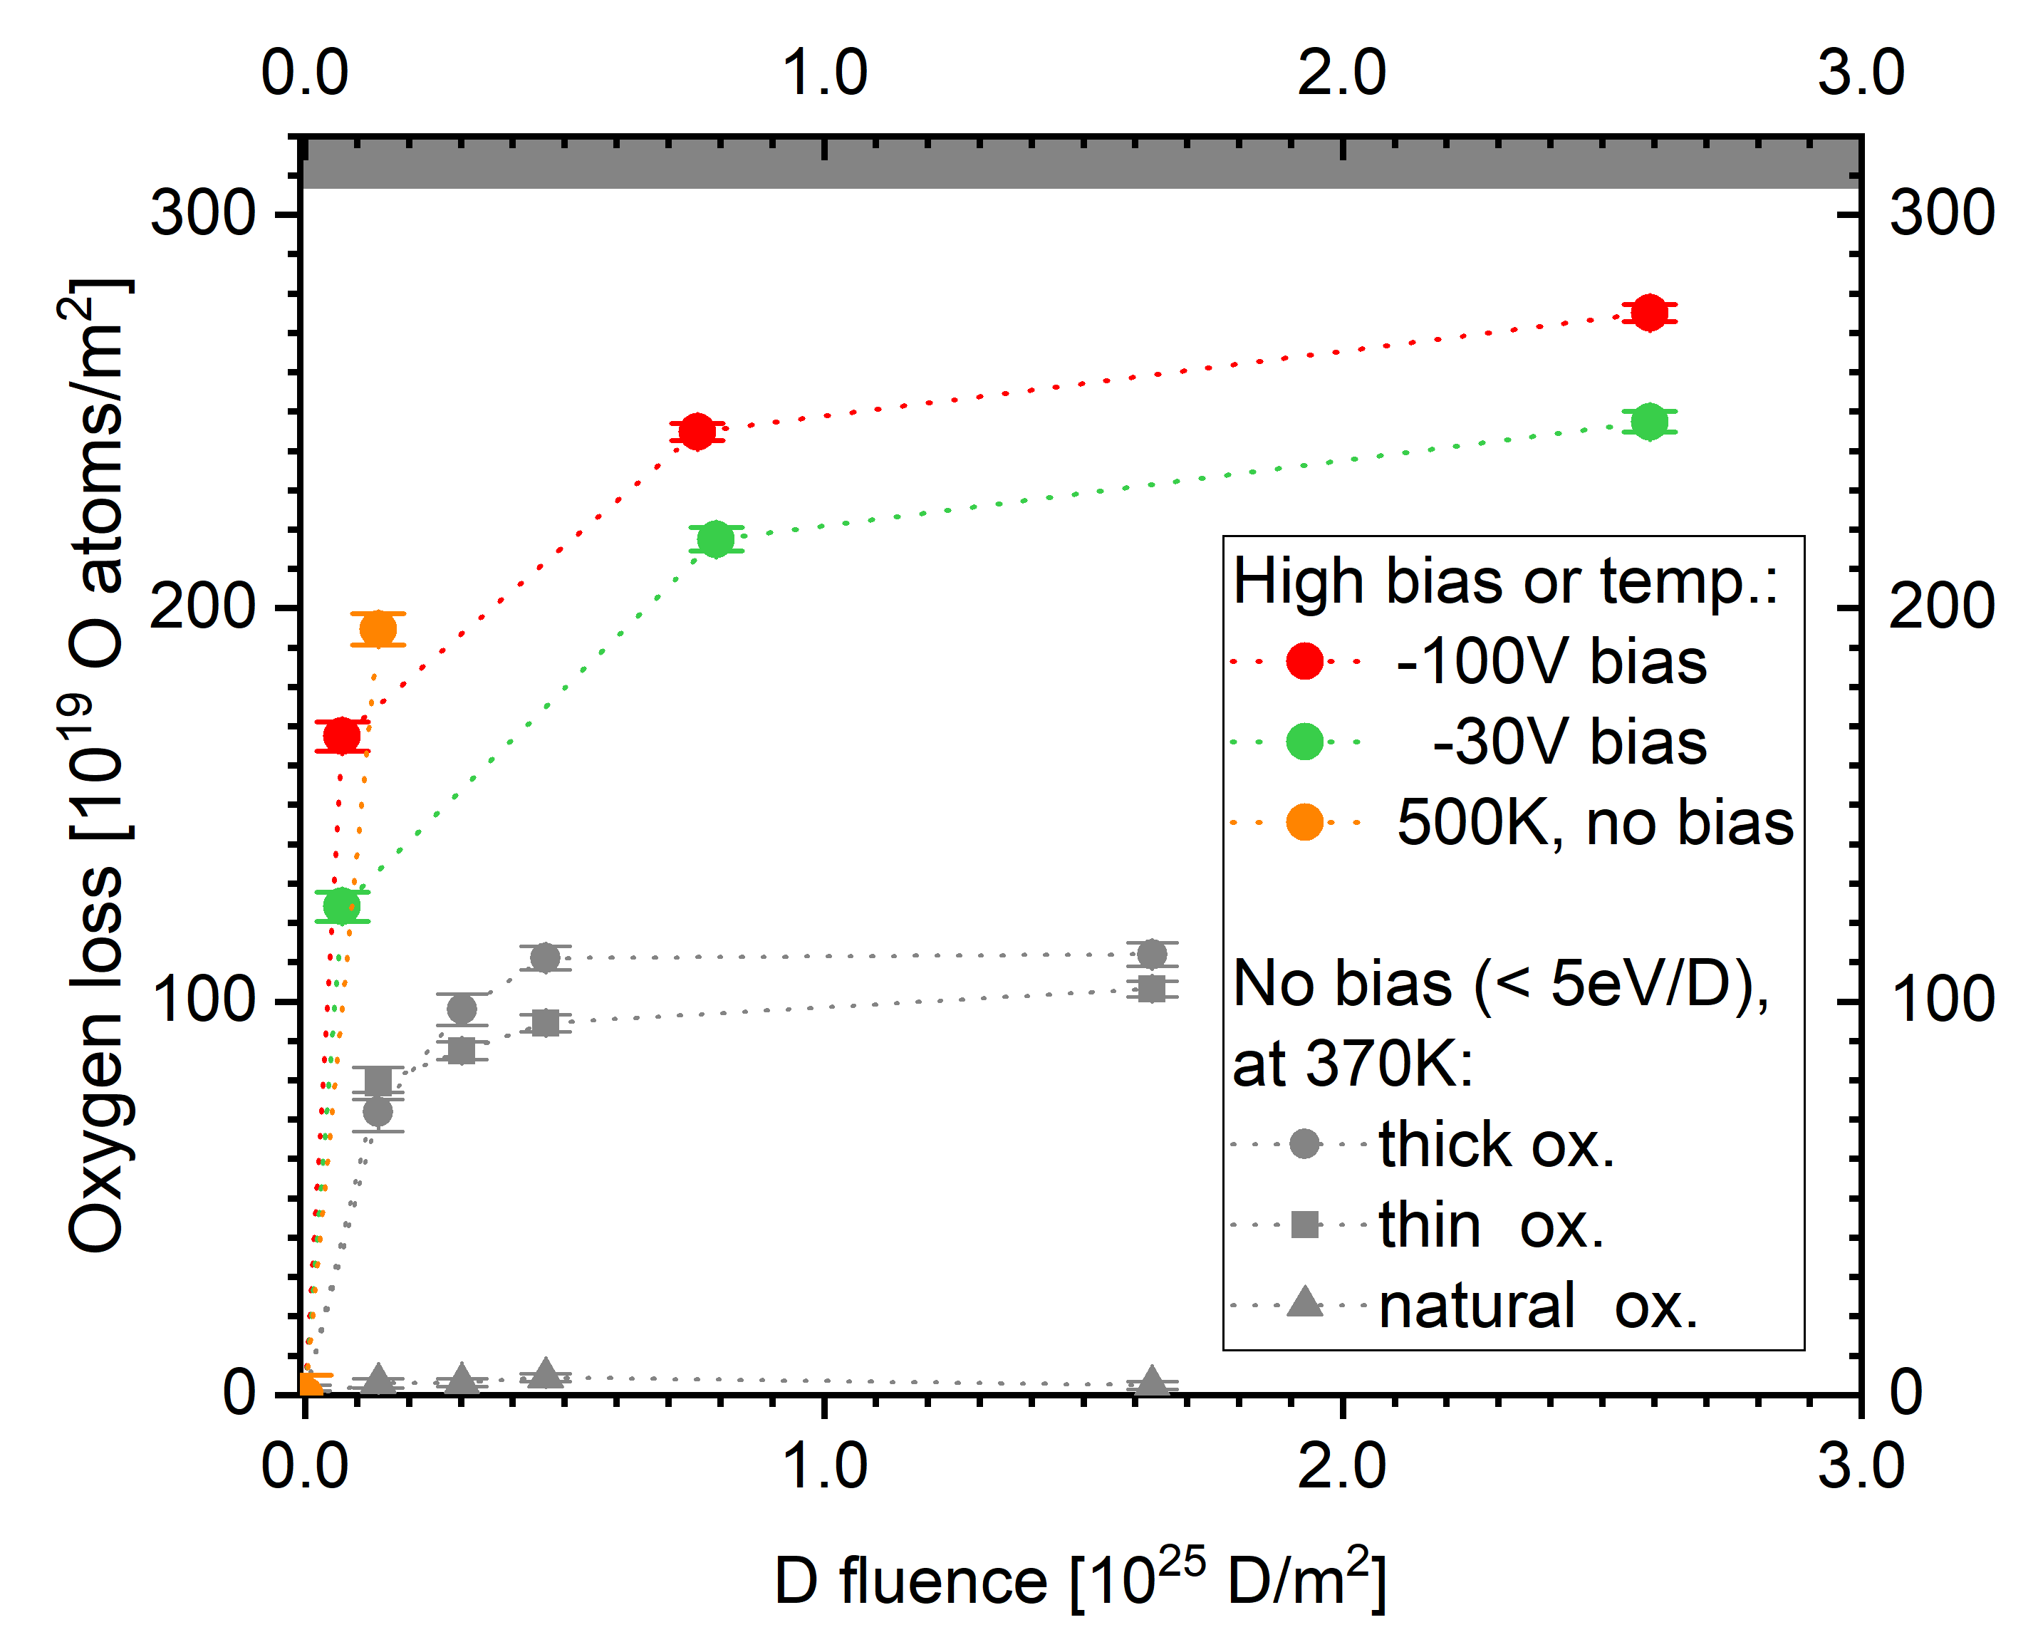

Energy and fluence dependence of D uptake through thin surface oxide films on tungsten - Results
Asses role of oxide in laboratory experiments:
Does it affect predications for reactor?
There will be a talk on the influnce of WO on uptake and release by K. Kremer
5eV/D: 30 nm oxide form stable D uptake barrier!
15, 38 eV/D: Oxide reduction degrades barrier
Extrapolation to natural oxide (1-2 nm):
→ Affects only D uptake studies with low fluence
(< 10²³ D/m²)
Oxygen loss depending on fluence for different plasma conditions
Second publication to uptake/oxide reduction on its way
In-situ studies with oxide free surface planned
Kristof Kremer
Notes:
Please help me and add some notes here so I can figure out what to say about your slide / work

Slide 28
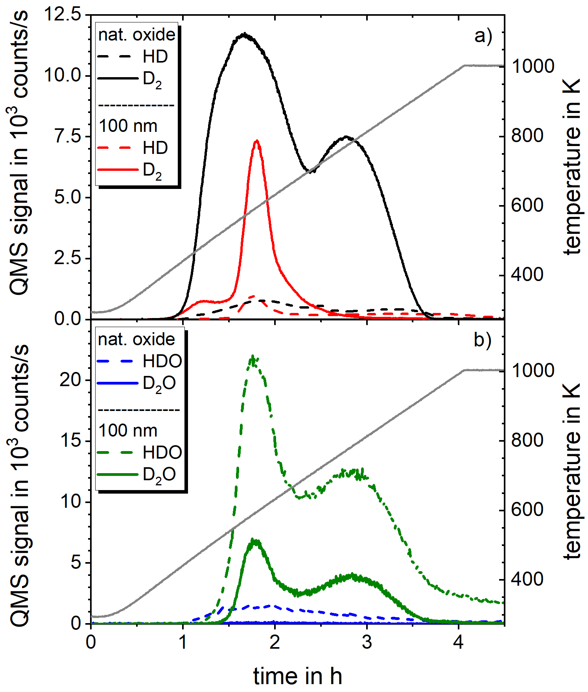
D release through thin surface oxide films on tungsten depending on oxide thickness - Results
Asses role of oxide in laboratory experiments:
Does it affect predications for reactor?
There will be a talk on the influnce of WO on uptake and release by K. Kremer
Oxide shifts first release peak:
→ Affects calculation of D binding energies
Chemical reaction above 500 K:
→ D mainly released as heavy water
→ Needs to be included for correct D amount!
Oxide films affect D release if ratio O/D > 5%
Even natural oxide films can have an effect!
TDS for natural (1-2 nm) and 100nm thick oxide
shift of first release peak
heavy water production
Investigation of oxide reduction process and
heavy water formation with TDS at 500 K
First results published in:
K. Kremer et al., Nuclear Materials and Energy, Volume 30, 2022, 101137, ISSN 2352-1791
Kristof Kremer
Notes:
Please help me and add some notes here so I can figure out what to say about your slide / work

Slide 29
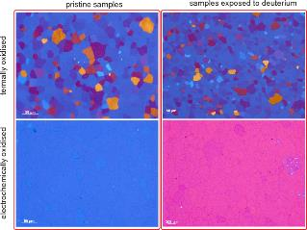
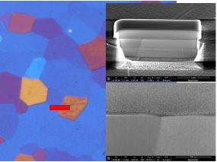
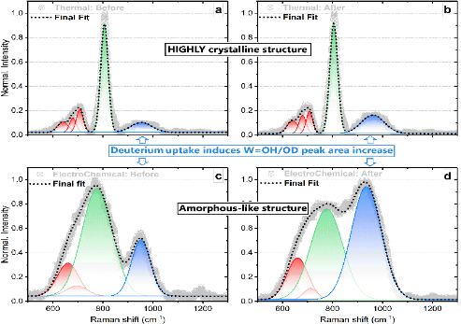
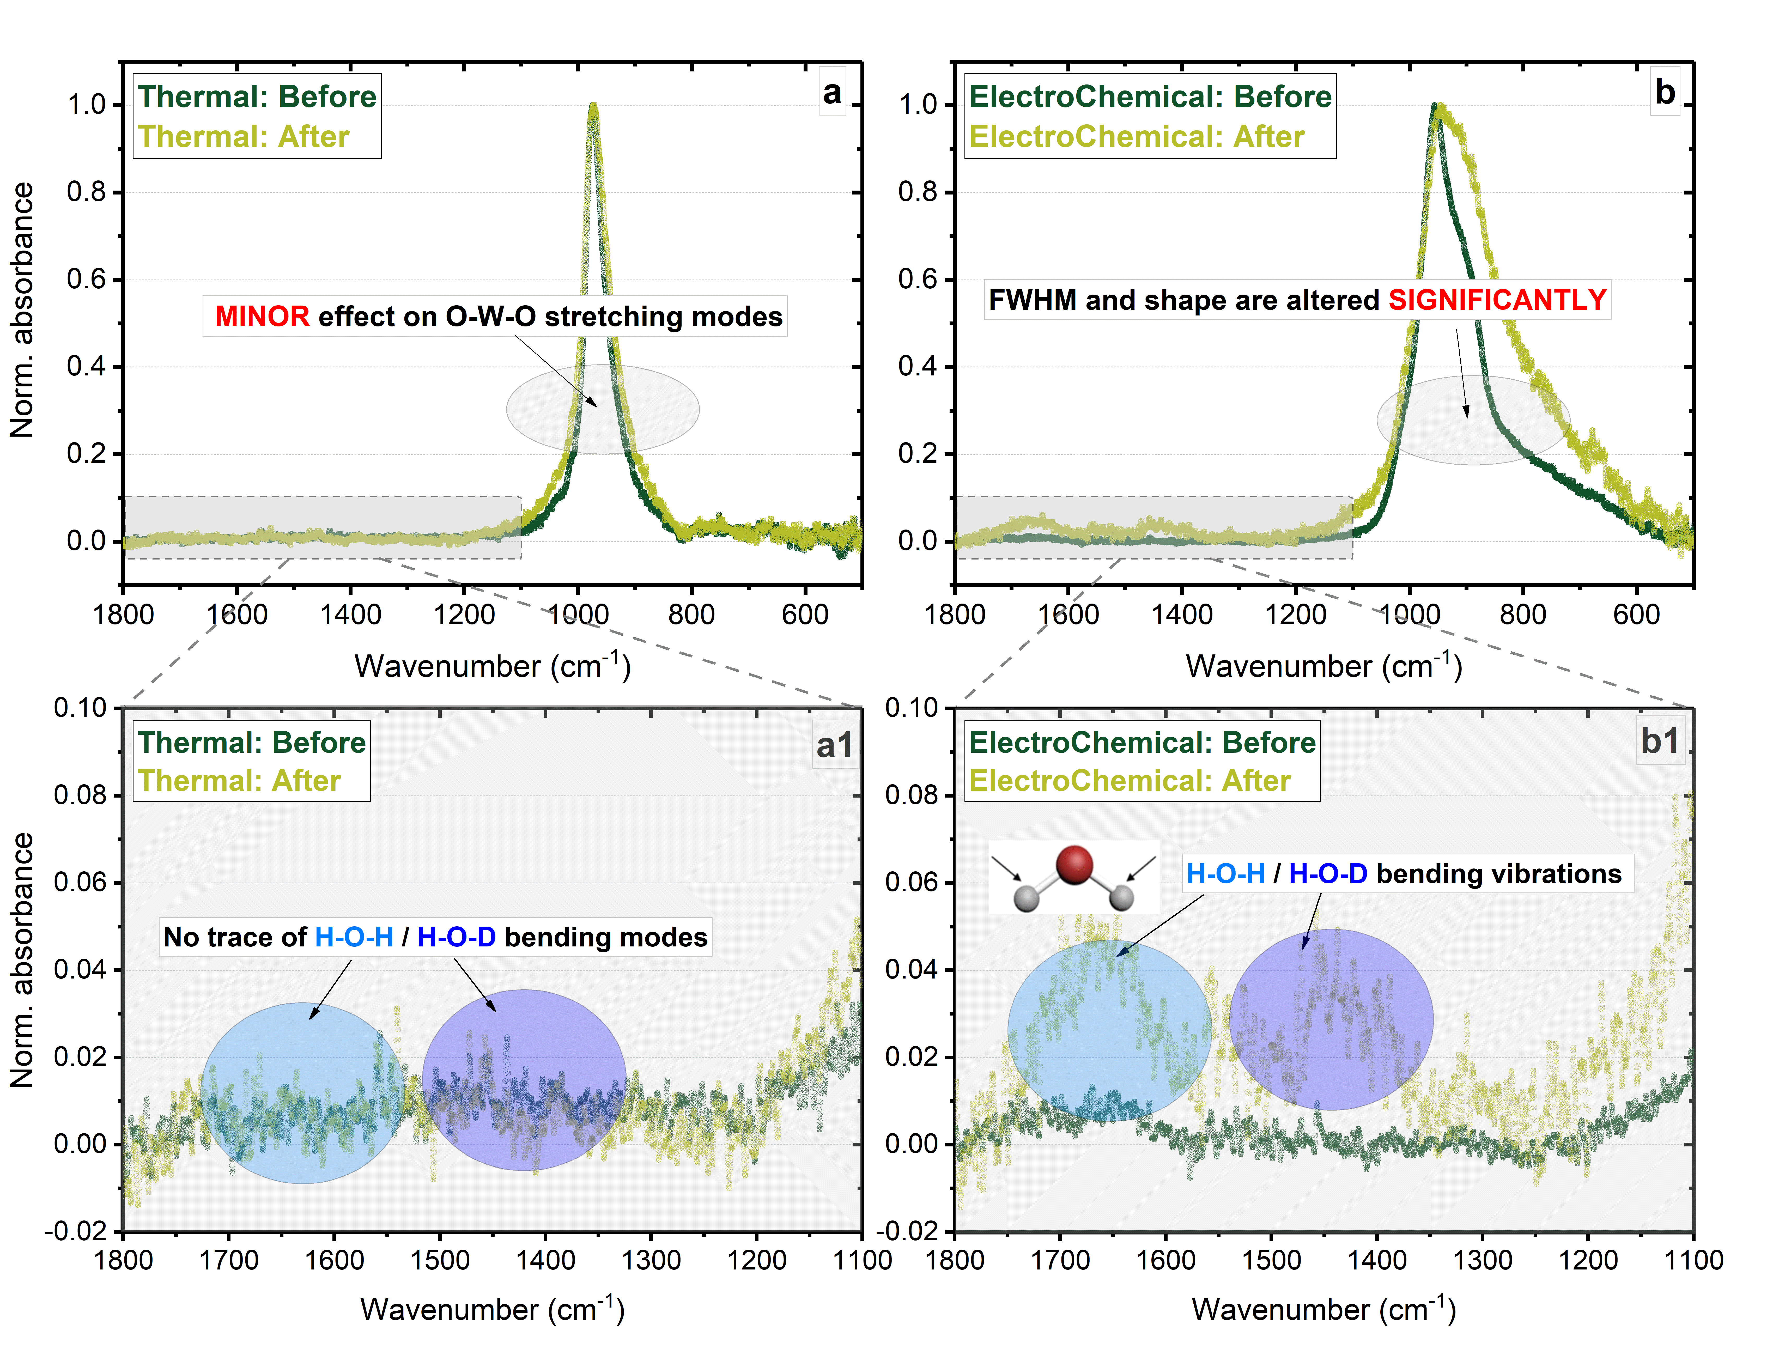


Task name: XRD and Raman of Oxide films on W
What we did:
with D
XRD, SEM, FIB and vibrational study of thermal and electrochemical WOx before & after D loading
How we did:
with D
XRD, GI-XRD, FTIR and µ-Raman spectroscopy
KEY answers obtained:
crystallinity: highly crystalline „thermal“ WOx, and amorphous electrochemical WOx
Annealing of am. electrochem. WOx results in mixtures of WOx and differs from “thermal” WOx
Deuterium uptake/retention is more favorable by electrochemical WOx
interaction with D results in W-hydroxides => more pronounced in electrochemical WOx
OL / FIB identical location thickness studies
pristine WOx ====> with D
with D
Electrochemical: Before
with D
Next goals:
Raman
FTIR
TEM annealing studies to reveal and understand WOx structural transformations influencing crystallinity, thickness and propensity towards D.
Kristof Kremer (IPP), Janez Zavašnik (IJS)
Notes:
The goal of the research was to experimentally investigate the behavior of W-oxides when exposed to deuterium. Differently prepared oxides were tested: (i) thermally-oxidized thin film, (ii) electrochemically grown W-oxide, and (iii) anealled electrochemically-grown oxide.
Analytical methods for material characterisation were SEM, FIB, XRD, GI-XRD, micro-RAMAN and FTIR analysis.
RAMAN analysis:
Thermally prepared sample: A narrow and intense “phase defining” peak (green) is located close to 807 cm-1 (W-O stretching vibration) indicates a presence of orthorhombic WOx crystalline lattice within thin film of thermally prepared sample. A set of “3 fitted red” peaks serve as an additional indicator of o-WOx occurrence (after a reference in Fulton paper, table 2 doi.org/10.1016/j.corsci.2019.108221). After a deuterium uptake there is an increased contribution of hydrated oxides (“blue” peaks in RAMAN fig. a-b ) into an overall spectra, as a consequence of retention of deuterium by W=O and creation of W-OH/W-OD bonds within a structure (reference: doi:10.1088/0031-8949/T167/1/014036). There is a double relative area increase of blue peak in thermally annealed sample after interaction with deuterium (see Raman fig. a-b) However, the is no observed influence on effect on sample crystallinity.
Electro-chemical sample: In this case, “green” peak is located at 777cm-1 and two additional helping modes placed at 696 and 660 cm-1 can give a hint that a dominant structure is monoclinic WO2 (reference: Fulton paper, table 2 doi.org/10.1016/j.corsci.2019.108221). Nevertheless, the width of “green” peak tells the structure more likely is AMORPHOUS, not crystalline. Or it is a purely crystalline WO2 (will be explored by GI-XRD). It seems that tungsten is not fully oxidized having valency of +4/+5 instead of typical +6 like in thermally prepared sample (we plan additional XPS study to explore this issue). After interaction with deuterium there is not only a HUGE change in “blue” W-OH/W-OD related Raman modes (3x area increment), but also a visible alteration of structure related W-O vibrations is observed (“blue” peaks in RAMAN fig. c-d ). Electrochemical sample is more affected by deuterium uptake.
FTIR analysis:
Raman is highly depended on structural properties and works for modes (vibrations) that induce changes in polarizability of molecule. FTIR probes changes in dipole moments, thus being complementary to RAMAN. Thus, structure related O-W-O vibrations of thermally fabricated sample undergo only slight widening after deuterium uptake (see FTIR fig a). Additionally, in this particular case, FTIR was not able to confirm the presence of hydroxides bounds (see FTIR fig a1). The opposite happens for electrochemically prepared WOx. In here, there is a drastical alteration (new modes occur) of O-W-O bonding environments, confirming a high structural sensitivity of the sample to the deuterium treatment (see FTIR fig b). Moreover, complementing RAMAN results, FTIR reveals a presence of bending vibrations (H-O-H at 1660cm-1) in both electrochemical samples (before and after deuterium uptake). It confirms the sample is more favorable to create hydroxides (most probably, a presence of small H-O-H small hump “dark green” curve in FTIR fig b1 is related to a WET origin of sample preparation). A crucial observation in FTIR fig b1 is much more intense 1660cm-1 mode and, more importantly, a new peak located at 1450cm-1 (H-O-D bending motion, reference: doi.org/10.1007/s10967-019-06734-z) confirming more favorable interaction of deuterium with electrochemical WOx, that that of thermally prepared tungsten oxide nanofilm.

Slide 30

Establishing He exposure and analysis procedure
2400 K annealed, polycryst. W
Creation of displacement-damage with 20 MeV W
Exposure to low flux He plasma (10¹⁸ He/m²s) at low energy (100 eV) to avoid creation of additional defects (energy transfer 8.3 eV << E_{displacement})
Depth-resolved DB-PAS at
shows no additional defects
Total He retention from Elastic Recoil Detection (ERDA) analysis: He retention depends on damage level
Depth profiling by anodic oxidation and dissolution of the oxide together with ERDA shows larger retention near the surface and less deep penetration of He when
displacement damage is present
Influence of displacement damage on He depth profiles
for low-flux, low-energy He exposure
WM35
Manuscript submitted to Nucl. Mater. Energy
Annemarie Kärcher
Notes:
Please help me and add some notes here so I can figure out what to say about your slide / work

Slide 31
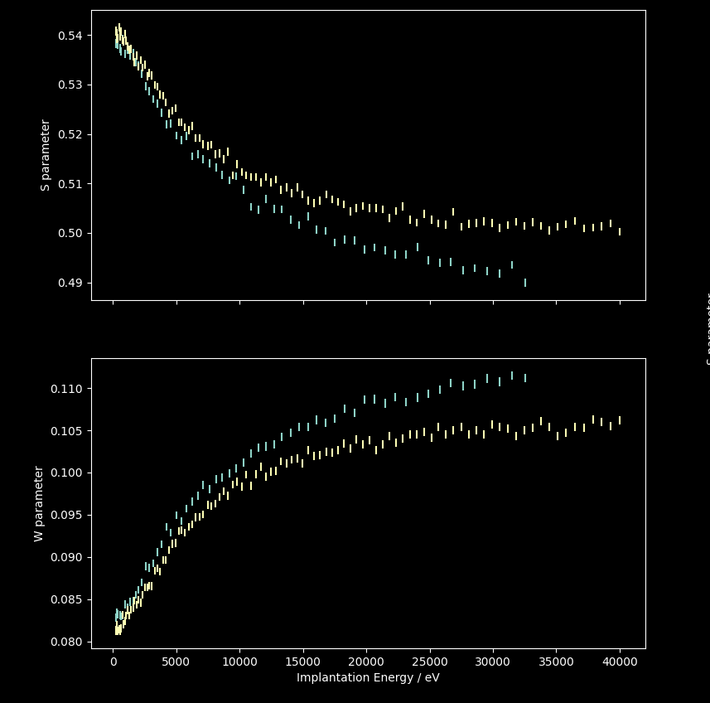


Difference in He retention in defect-free and e-beam damaged W
Preparation of tungsten single crystals (sc-W) and pre-characterization at MLZ Munich) with depth-resolved DB-PAS
Sc-W reference sample
Sc-W after 50 h e-beam irr.
Exposure for 10 and 50 h of e-beam at ENEA
to create homogeneously distributed
mono-vacancies (4.5 MeV, 0, 0.3, 1.2×10⁻⁴ dpa)
Second batch of exposures planned.
S parameter
50h of e-beam „hardly make a dent“
Post-characterization by depth resolved DB-PAS
Sample mean diffusion length [nm]
sc-W after 50 h e-irradiation 48 ± 1.3
sc-W after 10 h e-irradiation 54 ± 1.5
sc-W (reference) as prepared 58 ± 2.3
W parameter
Procedure for pending He exposure established
Sensitivity for ERDA setup increased
TDS up to 2600 K achieved
Post DB-PAS measurements under way
Implantation energy / keV
Depth resolved S and W parameter obtained by DB-PAS of 50 h irradiated sc-W
Annemarie Kärcher
Notes:
Please help me and add some notes here so I can figure out what to say about your slide / work

Slide 32
Permeation barrier properties of chromia grown on dense Cr films+Eurofer
Oxides influence H/D/T permeation rate through metal,
but the suppression mechanism is not well explained yet.
Native and mixed oxide grown in pure O₂ is transparent for H₂.
Gas-driven hydrogen permeation through Eurofer membrane was monitored in exposure to 95%H₂/5%O₂ gas mixture at 400°C.
An impermeable film is immediately formed in this gas mixture, but becomes permeable again in pure H₂.
The most probable explanation is that during the catalytic reaction, an ultrathin layer prevents hydrogen dissociation. Verifying chemical reactions at the surface is extremely challenging and proven only on Cr, but not yet on Fe.
Catalytic reaction maintained Eurofer
impermeable for ~1h, PRF>1000
All the planned experiments for 2022 have been realised.
Jozef Stefan Institute
Vincenc Nemanič, Marko Žumer, Janez Zavašnik, Matjaž Panjan
Notes:
In situ grown oxide films on Eurofer are well transparent for hydrogen. Adding 5% of oxygen to the upstream hydrogen, forms a completely impermeable layer on Eurofer, which contains only 8% of Cr. This fact suggests that the same mechanism responsible for suppression works on iron, too.
Dear Vincenc,
about the graph on your slide.
Do I understand correctly that:
Initially (t = 0) you start with a "clean" EUROFER membrane and expose it to a O2/H2 mixture at P~1020 (mbar?)
Over time you drop the pressure to P~990 (mbar) and permeation sets in because you remove the O2 and its then again pure H2 for which the sample is transparent.
regards
Klaus

Slide 33
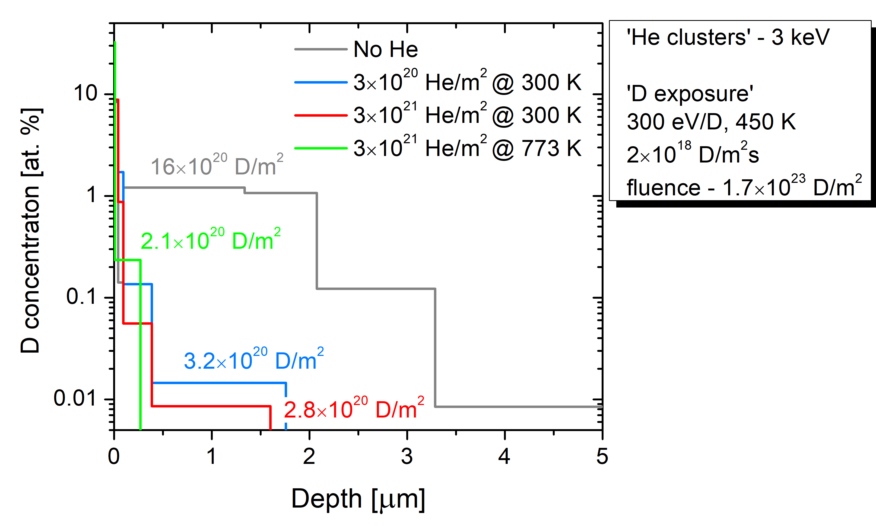

Influence of surface microstructure due to low energy
He irradiation on D uptake
Irradiate W by 3 keV He ions @ 773 K (He cluster/bubbles), self-damage by 20 MeV W to 2 microns and finally expose to
300 eV/D ions at 450 K to study D uptake (last year @ RT)
There will be a talk on the influence on near surface He by S. Markelj
NRA: D depth profiles in He irradiated samples and no He reference sample
Total D retention 7 times less in the He irradiated samples compared to only W irradiated
High D surface concentration – as for the RT case
Very small amount of D beyond 40 nm
He on the surface – barrier for D / increased recycling?
Retained D/m² ≈ implanted He/m²
(similar as for MeV He implantations by Bauer et al. 2019)
Sabina Markelj / Thomas Schwarz-Selinger
Notes:
D42 sample was additionally exposed for 48 hours and the D depth profile resulted in very similar D depth profile as after first D exposure that took 24 hours (– depth profile shown on bottom right on supporting slide 3). D retention is then 3.8e20 D/m2. No change in penetration depth. High surface peak remains. ERDA analysis planed on these samples.
Two additional samples were prepared and exposed to He fluence 3e20 for D plasma exposure (PlaQ) and for TDS.

Slide 34
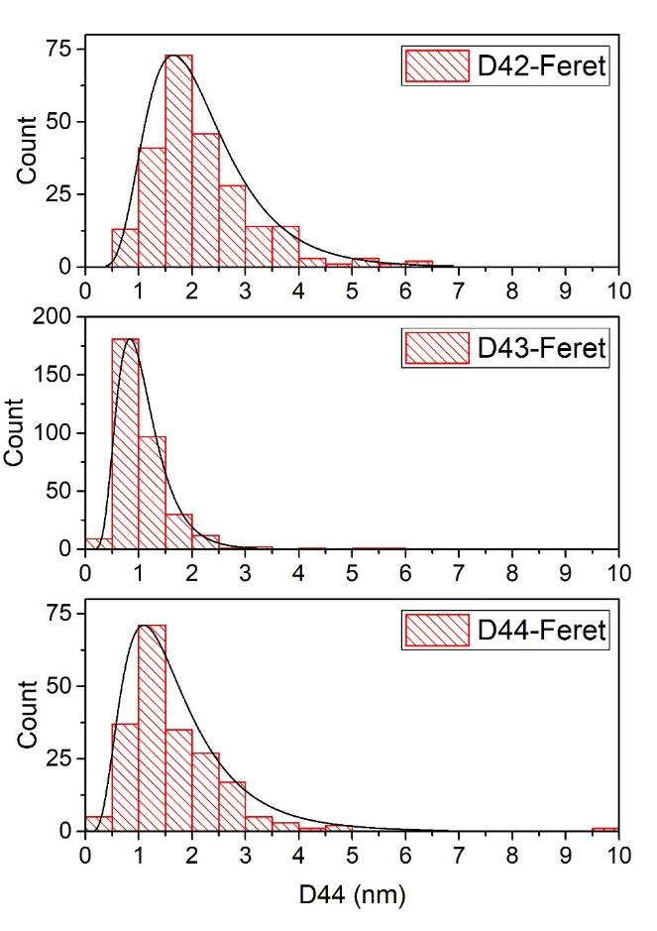
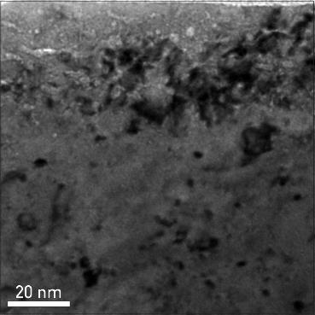
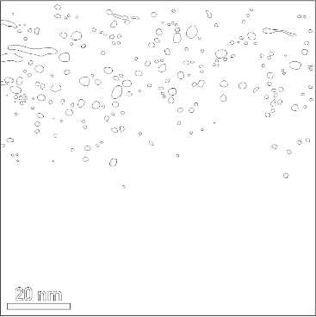
Influence of surface microstructure due to low energy
He irradiation on D uptake
Irradiate W by 3 keV He ions @ RT and 773 K (He cluster/bubbles), self-damage by 20 MeV W to 2 microns and finally expose to
300 eV/D ions at 450 K to study D uptake
He bubble size:
3⋅10²⁰ He/m² @ RT
TEM analysis of all three samples: nm-size bubbles in the first few nm bellow the surface
Smaller bubbles observed for the higher fluence
There will be a talk on the influence on near surface He by S. Markelj
W reference
3⋅10²¹ He/m² @ RT
3⋅10²¹ He/m² @ 773 K
all bubbles outlined (N=207)
Andreja Šestan / Janez Zavašnik
Notes:
TEM analysis of the He samples – distribution of He bubbles observed agrees with the calculated He profile and the depth where maximum D concentration is observed.

Slide 35
SP C.3 Influence of He, high-flux D and impurities on Hydrogen retention and transport
Plan for 2023
Association | Title | Deliverables
CEA | Study the effect of O or C layers on D: bulk vs surface uptake | #1 Influence of storage time on retention with O-layers on W #2 Fluence dependence on retention with C-layers on W
JSI | TEM analysis of He loaded self-damage W | Investigate presence of He-bubbles
MPG | Exposure of poly crystalline W to He plasmas to study He cluster formation | Retained He in W at low energies (< 100 eV) as function of flux (<10^19 He/m2)
JSI | Study of hydrogen permeation barrier in situ grown by oxygen/hydrogen mixture | Permeation reduction factor on chromia and Eurofer formed by oxygen/hydrogen mixture

Slide 36
SP C.4 Influence of n-damage on Hydrogen retention and transport
Tasks in 2022
Task
Simulation of neutron-damaged W by W self-damage at different dpa (6 W samples) (IPP)
Exposition of W samples in PSI-2 D plasmas to load with D at low surface temperature (FZJ)
Quantification of fuel content for 3 samples by NRA and TDS (MPG, FZJ)
Quantification of fuel content for 3 samples by LIA-QMS and DP-LIBS (FZJ)

Slide 37
Reference D-containing W samples for LIBS
What we did and why:
LIBS exhibit great potential on in situ determination of fuel retention after proper signal calibration.
Reference D-containing W samples are required to further explore the LIBS technique.
Which experiments/calculations were performed
1. Recrystallization of 12x double-forged W samples: eliminating the effect form unknown intrinsic defects
2. Self-damage (10.8 MeV W, 0.23 dpa) for 9x samples: to create high-density defects for D trapping
3. D 1e25/m² loading at PlaQ (5eV/D, 370K, 4x) & PSI-2 (40eV/D, 390K, 4 samples): D decoration
4. Partial degassing of 2-PlaQ-loaded samples
5. NRA D depth profiling of 4-PlaQ-loaded samples
Brilliant Results: to be expected in Nov. / Dec. 2022
WM38
Things will be done within this year:
1. Partial degassing of 2-PSI2-loaded samples
2. NRA D depth profiling of 4-PSI2-loaded samples
3. Dual-pulse LIBS measurements of all 8 samples
4. TDS of all 8 samples
5. Summary of the task
T. Schwarz-Selinger, Liang GAO, E. Wüst
Notes:
Please help me and add some notes here so I can figure out what to say about your slide / work

Slide 38
Reference D-containing W samples for LIBS
What we did and why:
LIBS exhibit great potential on in situ determination of fuel retention after proper signal calibration.
Reference D-containing W samples are required to further explore the LIBS technique.
Which experiments/calculations were performed
1. Recrystallization of 12x double-forged W samples: eliminating the effect form unknown intrinsic defects
2. Self-damage (10.8 MeV W, 0.23 dpa) for 9x samples: to create high-density defects for D trapping
3. D 1e25/m² loading at PlaQ (5eV/D, 370K, 4x) & PSI-2 (40eV/D, 390K, 4x samples): D decoration
4. Partial degassing of 2-PlaQ-loaded samples
5. NRA D depth profiling of 4-PlaQ-loaded and 4 PSI2-loaded samples
6. Dual-pulse LIBS measurements of the 4 PlaQ-loaded samples
Brilliant Results: to be expected in Jan. / Feb. 2023
Things will be done in early 2023:
1. Dual-pulse LIBS measurements of the 4 PSI2-loaded samples
2. TDS of all 8 samples
3. Summary of the task
T. Schwarz-Selinger, Liang GAO, E. Wüst
Notes:
Please help me and add some notes here so I can figure out what to say about your slide / work

Slide 39
SP C.4 Influence of n-damage on Hydrogen retention and transport
Plan for 2023
Association | Title | Deliverables
FZJ | Gas driven permeation through and retention in W, Steel, W on Steel and W on Cu | Permeation though p-damaged EUROFER
FZJ | Development of co-deposited D-W, He-W and D-He-W layers in magnetron-sputter device with good reproducibility | D, He or D&He contents in co-deposited D-W, He-W and D/He-W layers cross-checked by NRA, TDS, and DP-LIBS
MPG | Annealing of displacement damage of EUROFER below 600K | Trap site concentration as function of annealing temperature below 600K
MPG | Annealing of trap sites in He containing displacement damaged EUROFER | Temperature needed to anneal trap sites in He containing displacement damaged EUROFER
JSI | Uptake of atomic D into displacement damaged EUROFER | Uptake of atomic D as function of time

Slide 40
Conclusions
All but one task are completed and no delays are expected

Slide 41
Plans for 2023
The work on W will mainly be continued into next year
Some tasks will be completed however and I‘d like to shift the focus onto EUROFER
Preliminary results on retention in displacement damaged EUROFER
...not (yet) from a EUROFUSIO task, but might still be of interest
...explains why retention in EUROFER may be important in the future

Slide 42
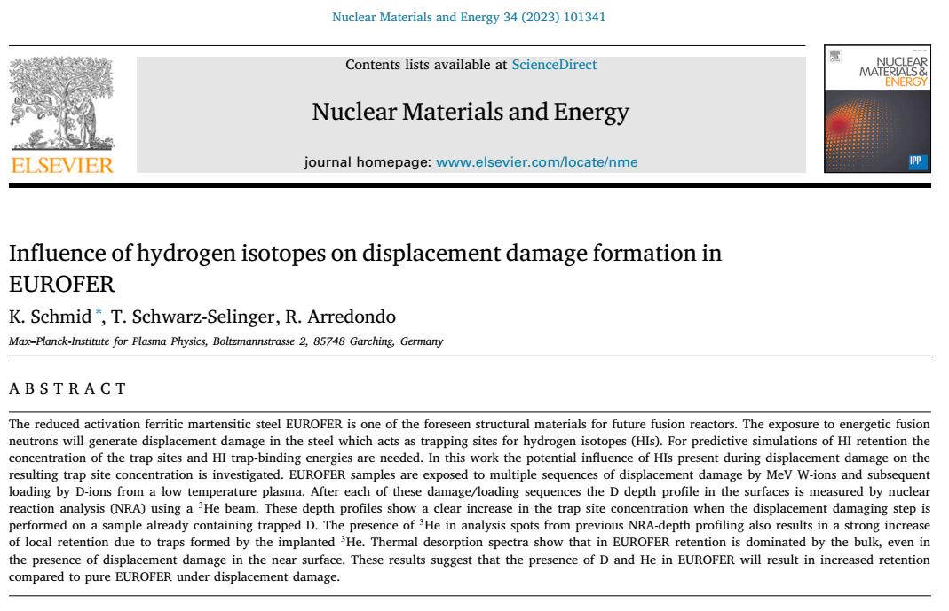
Recent work on displacement damaged EUROFER

Slide 43
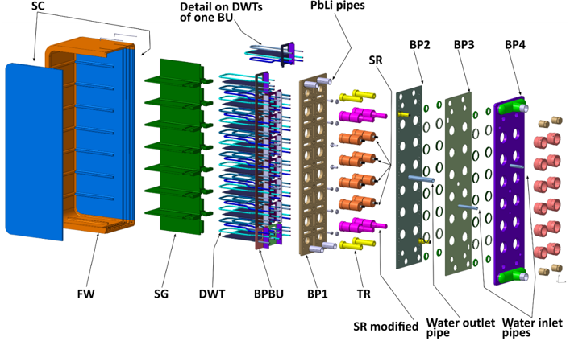
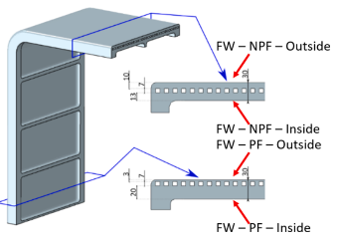
Why is retention in displacement damaged EUROFER important
ITER test blanke module [1]
CX-flux
ITER plasma
CX-flux
[1] J. Aubert at al Fusion Engineering and Design, Volume 160, 2020, 111921
Made of EUROFER
In contact with PbLi with dissolved T
Made of EUROFER with ~mm thick W armor layer
Loaded by D, T, (ions + gas), CX
Most of material between plasma and coolant is EUROFER
Current blanket design ignores trapping in EUROFER!

Slide 44
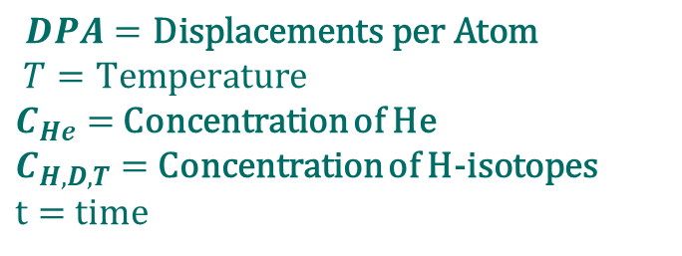

Why is retention in displacement damaged EUROFER important
Preliminary estimates on T-loss to EUROFER from TESSIM-X modeling [1,2]
They predict major retention via trapping threatening T-self-sufficiency
Reveiled major unknowns for displacement damaged EUROFER:
CX-fluxes and energies
Solubility of T in PbLi and EUROFER
Trap site concentration η
De-trapping energies E_{D}
Surface boundary condtions
$$η=η\left(DPA, T,C_{He},C_{SOL},t\right)$$
$DPA=\text{Displacements} \text{per} \text{Atom}$
$$T=\text{Temperature}$$
$C_{He}=$ Concentration of He
$C_{H,D,T}=$Concentration of H-isotopes
$t=$time
Here we can contribute
These dependencies are the focus of todays talk
[1] R. Arredondo et al Nuclear Materials and Energy 32 (2022) 101228
[2] R. Arredondo et al Nuclear Materials and Energy 28 (2021) 101039

Slide 45
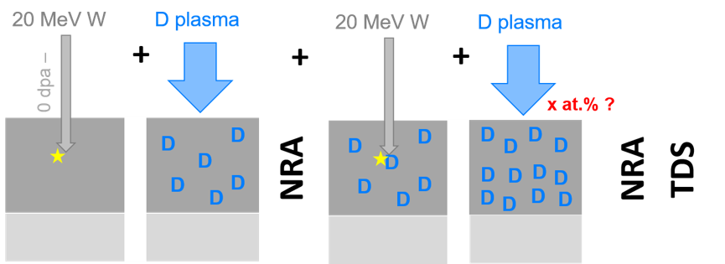
Experimental procedure
EUROFER97 samples from „batch #2“ were polished and outgassed at 870K
Remove (essentially all) H but still maintain EUROFER structure
Perform up to three damaging and loading sequences:
Damage 20MeV W-ions to damage saturation
Repeat
Subsequent displacement damage happens in D-containing EUROFER
Load with D to saturate generated defects
Measure D-retention within first 5 um using NRA
Taken from T. Schwarz-Selinger with permission

Slide 46
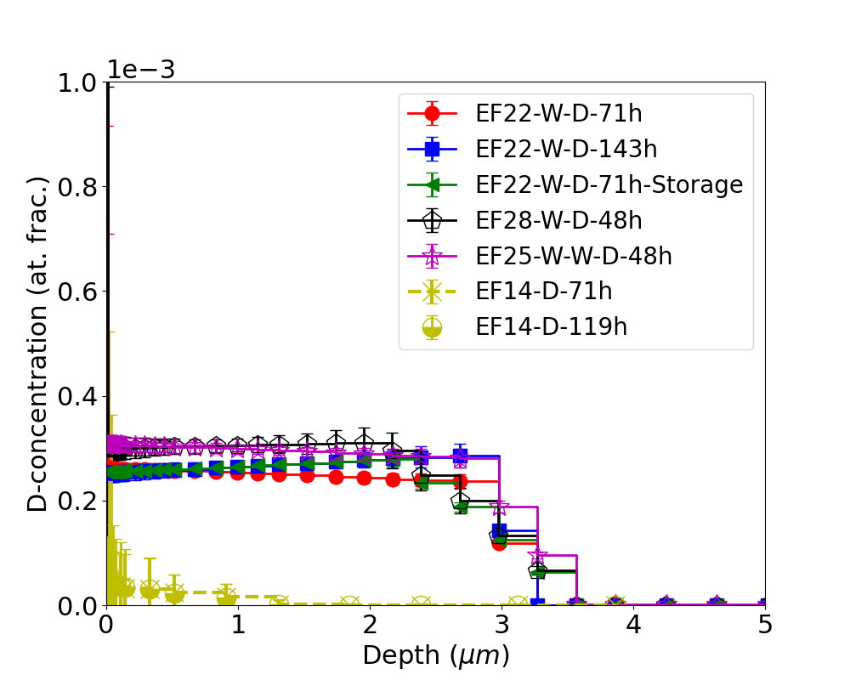
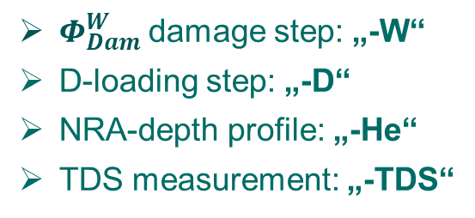
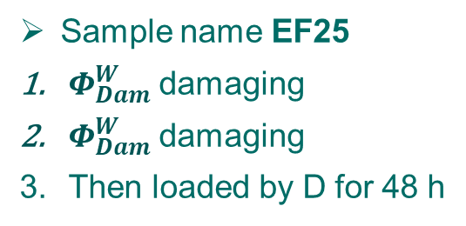
Experimental procedure
Load with D to saturate generated defects
PlaQ at floating potential (5eV/D)
Targets at 370K to:
  avoid outgassing after D-loading
  avoid blistering
Measure D-retention within first 5 um using NRA
Nomenclature reflects sample history
$Φ_{Dam}^{W}$damage step: „-W“
D-loading step: „-D“
NRA-depth profile: „-He“
TDS measurement: „-TDS“
E.g.: EF25-W-W-D-48h
NRA depth profiling using 8 Energies
Deconvolution using NRADC [1]
  Very low D-conc.
    → use PROL data only
Sample name EF25
$Φ_{Dam}^{W}$damaging
$Φ_{Dam}^{W}$damaging
Then loaded by D for 48 h
[1] K. Schmid et al NIM-B 281 (2012) p. 64

Slide 47
Results: Trapped amounts
Load with D to saturate generated defects
Measure D-retention within first 5 um using NRA
Decorate displacement damage generated traps with D → „Measure of trap site concentration“
Damaged
Low D-concentration in displacement damaged EUROFER O(10⁻⁴) vs. Tungsten O(10⁻²)
(Same as in [1])
Undamaged
[1] Fig. 14
Undamged EUROFER D-conc. O(10⁻⁵ to ⁻⁶)
Created near surface traps saturate after 48h
No outgassing after loading
Within experimental reproducibility and NRA uncertainty the depth profiles of damaged samples are identical in the above figure
Double damaging without presence of D does not increase trap site concentration
[1] O. Ogorodnikova, et. Al. Nucl. Fusion 57 (3) (2016) 036011

Slide 48
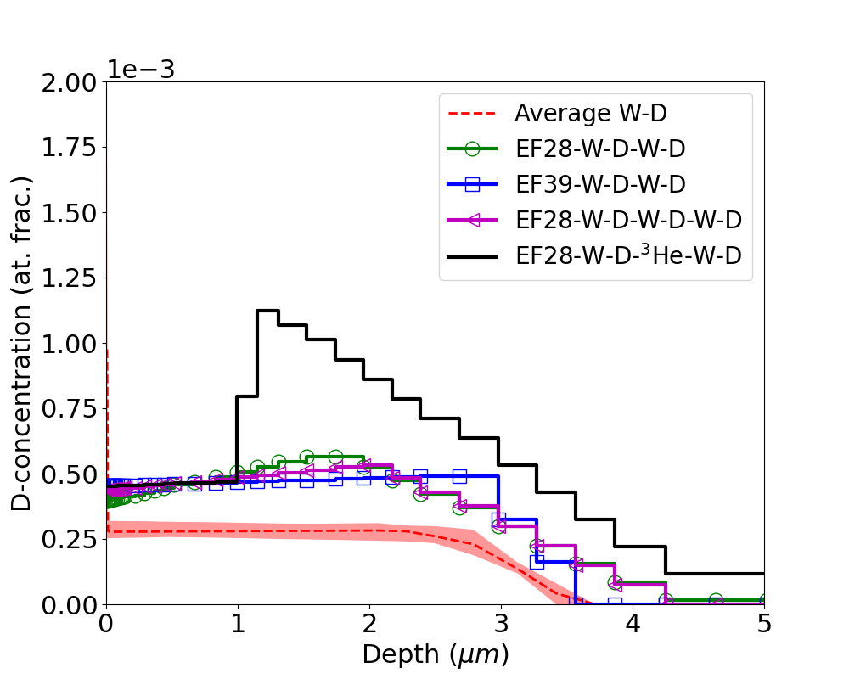
Results: Influence of He and D on defect creation
Repeat damaging / loading cycle in the presence of D and He
Double damaged samples have factor two more trap sites near the surface → Same effect as for W
Single damaged
Double damaged
Tripple damaged samples are identical to double damaged ones → Different from W
Tripple damaged
Double damaged +He
Effect is reproducable
x4
Effect of He presence far exceeds that of D
More than factor 4 increase in retention
x2
The He effect is not due to additional DPA by MeV He since the DPA is dominated by 20MeV W-ions
→ Probably a different defect type

Slide 49
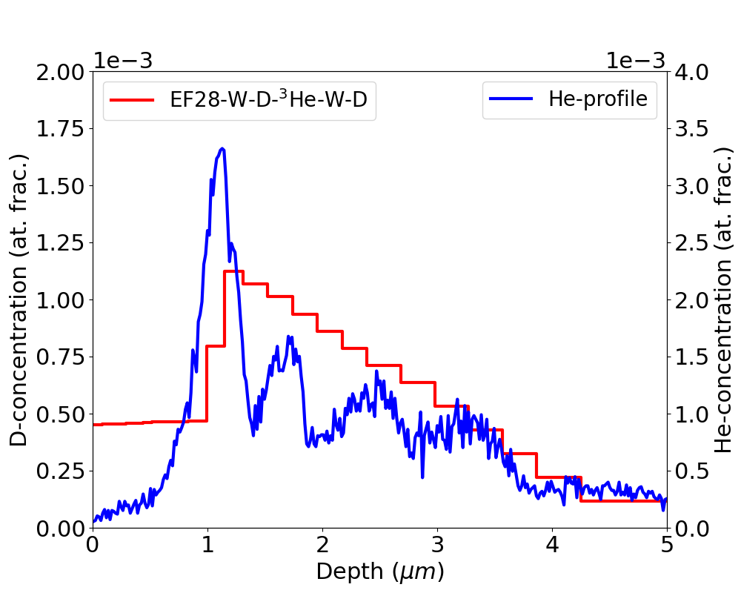
Results: Influence of He and D on defect creation
Repeat damaging / loading cycle in the presence of D and He
Double damaged samples have factor two more trap sites near the surface → Same effect as for W
Tripple damaged samples are identical to double damaged ones → Different from W
Effect of He presence far exceeds that of D
more than factor 4 increase in retention
D depth profile well correlates with He concentration profiles
There seems to be a He concentration threshold O(10⁻⁴)
(Reached in DEMO within ~ 1fpy [1,2])
SDTrim.SP calculated He concentrations for 8 NRA energies weighted by analysis fluence
[1] J. You, et al, Nucl. Mater. Energy Vol 23 (2020) 100745
[2] G. Federici, et al, Nucl. Fusion Vol 57 (9) (2017) 092002

Slide 50
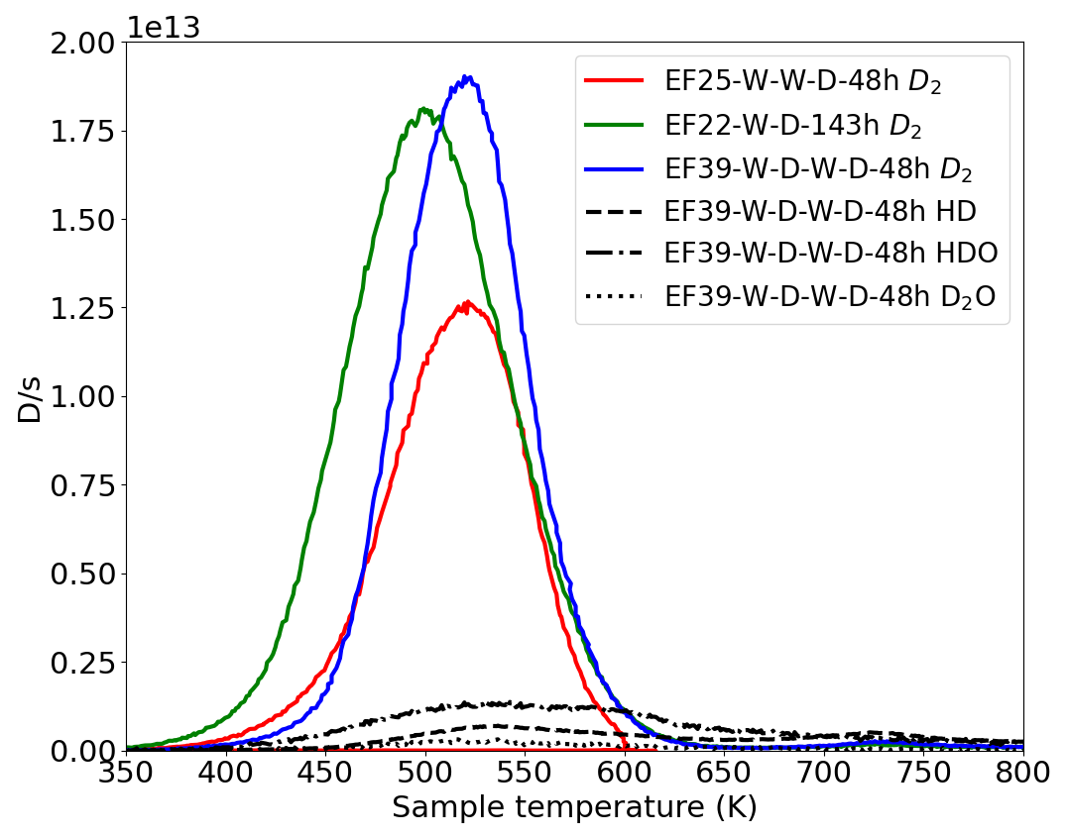
Results: Total amounts form TDS vs NRA
Measure TDS in TESS with 3K/min (slow) ramp
Signal is dominated by D₂
(HD and heavy water not important)
Increase from EF25 to EF39 (damaging + D) visible in TDS (for same D-loading time)
For same near surface NRA depth profile (EF25, EF22) increase of TDS signal with D loading time
Retention deep in bulk, outside NRA range is important
(Different from W)
Peak maximum shifts as different defect types (near surface DPA defects vs instrinsic bulk defects) dominate
→ Calls for TESSIM-X modeling!
Compare different damage and loading types
For EF39 D/s from D₂ vs HD, HDO and D₂0

Slide 51
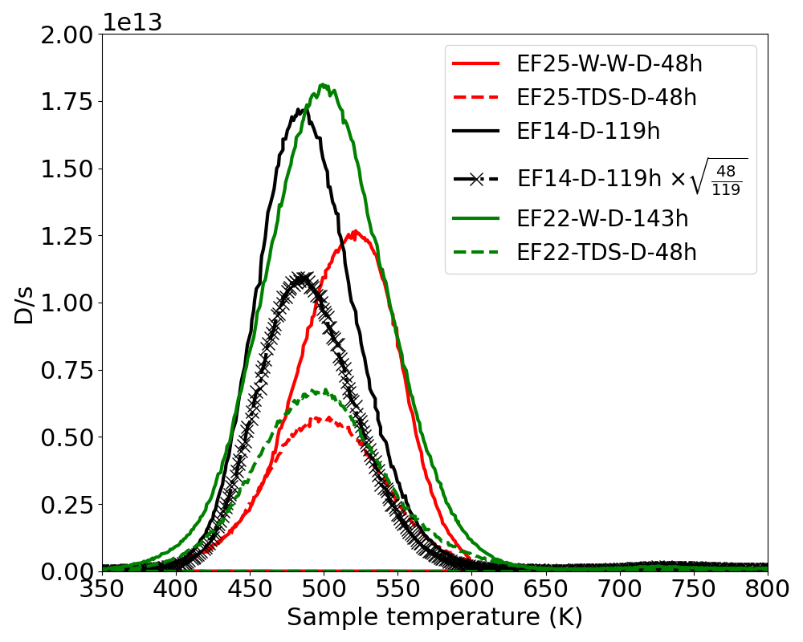
Results: Total amounts form TDS vs NRA
Measure TDS in TESS with 3K/min (slow) ramp
EF25 TDS up to 600K
EF22 TDS up to 800K
Un-damaged sample (EF14) retains almost as much as single damaged sample (EF22) when exposed for similar times
Retention deep in bulk, outside NRA range is important
(Different from W)
Reload samples with D (48h) after first TDS
Retention strongly reduced after TDS
Displacement damage completely annealed at 600K
(Within NRA sensitivity limits)
Scaling signal of undamged EF14 by loading time factor ~$\sqrt{\frac{48}{119}}$ still higher than EF25 and EF22 after reloading
Some intrinsic defects also anneal?
Different intrinsic defect concentrations?
Peak maximum shifts as different defect types (near surface DPA defects vs instrinsic bulk defects) dominate
→ Calls for TESSIM-X modeling!

Slide 52
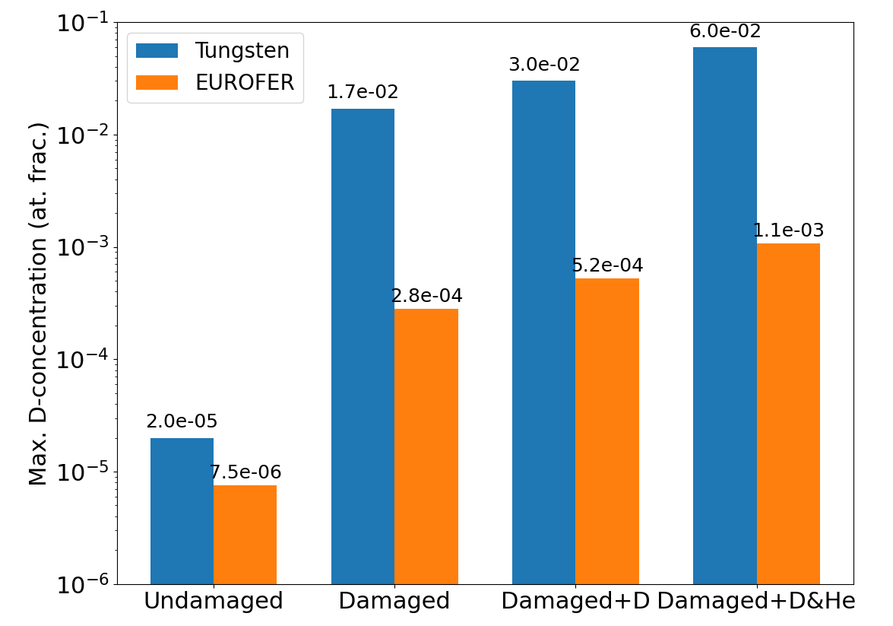
Summary
Tungsten vs EUROFER
Trapping increased siginificantly by DPA for both
D-Retention at 370K
Presence of D increases trap sites created during DPA for both
x2
x2
He implantation increases trap site concentration for both
Effect of He is not due to DPA but due to different He induced trap type
Generally trapped D-concentration a factor 100 lower in EUROFER than in W at 370K

