Slide 1

WP PWIE 2022 Reporting Meeting / 2023 Planning Meeting
Task: BB.S.05.01.T003-D0010:
Permeation (D,T) through 316L with Liquid/Solid interfaces
Elodie Bernard
elodie.bernard@cea.fr
Floriane Leblond, Mickaël Payet, Etienne Hodille
Klaus Schmid
Plasma-Wall Interactions & Exhaust in

Slide 2
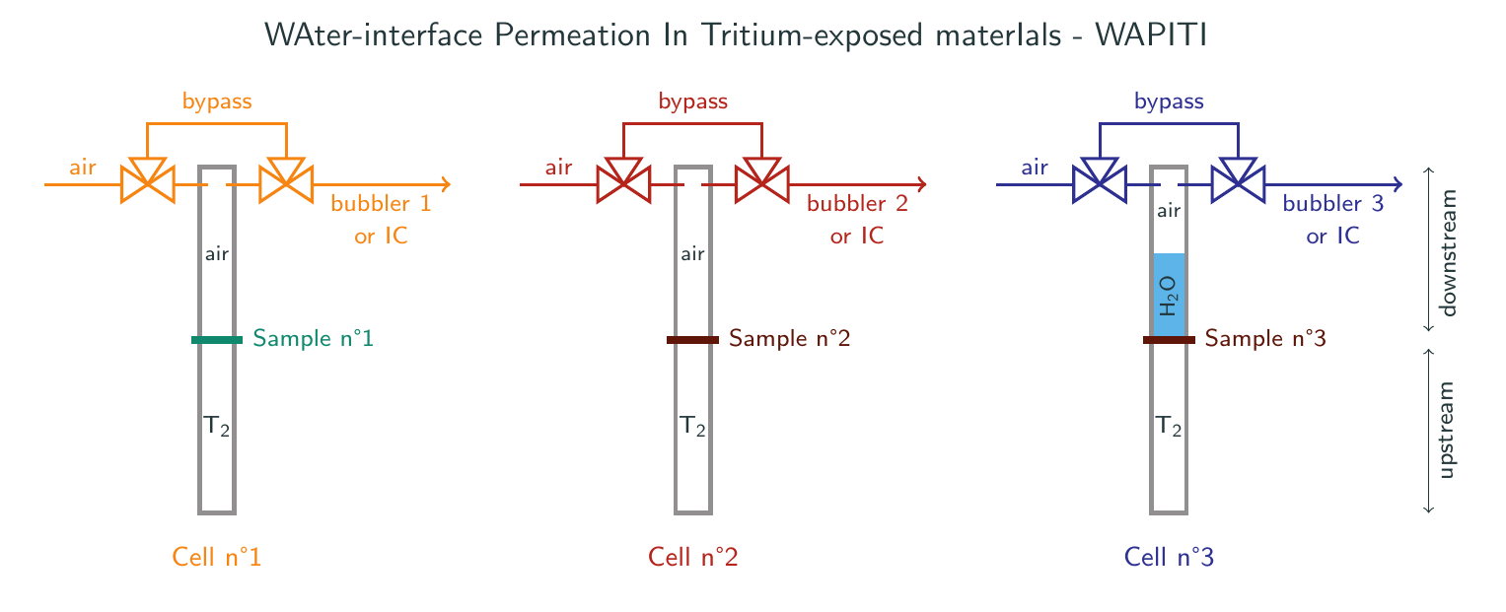
Overview of the Wapiti permeation device
Three permeation cells side-by-side, operating at room temperature
Water can be added downstream
Activity in the air phase is measured with bubblers + LSC or ionisation chambers
(depending on the activity) ; water is sampled and directly measured with LSC
Objectives: measuring RT tritium permeation through materials + comparing permeation when the downstream medium is air or water and air

Slide 3

Preliminary analysis – getting to know the material
Tritium experiments are costly, operator-intensive and complex:
we need to characterize the material with H/D experiments before doing them
(method tried and proved on Eurofer97)
Prior to our experiments, the samples are coated with a Pd layer by the team of M. Cekada (JSI) to avoid forming a Cr₂O₃ layer during permeation tests
H/D experiments
(permeation, TDS)
Tritium permeation
experiments
MHIMS simulations

Slide 4
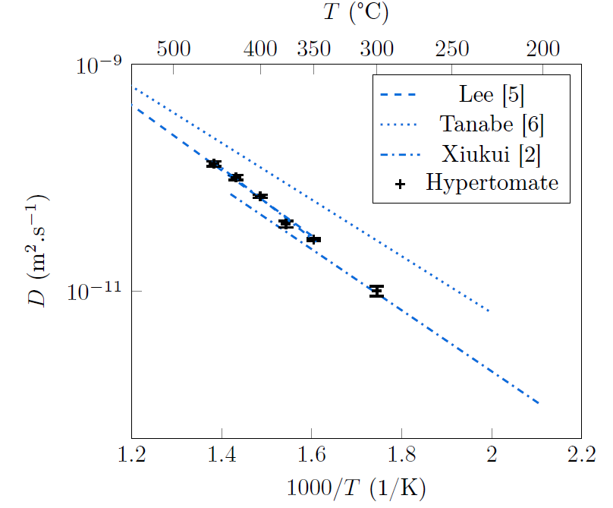
Preliminary H/D experiments
Hydrogen permeation experiments (gas-driven) are performed on SS316L samples between 200°C and 450°C
Arrhenius plot is a straight line :
Diffusion seems to be purely interstitial,
with E_{D} = 0.5 eV
This energy matches the fcc diffusion energy as
obtained with DFT in literature
We therefore consider that permeation is driven by interstitial processes: trapping is negligible

Slide 5
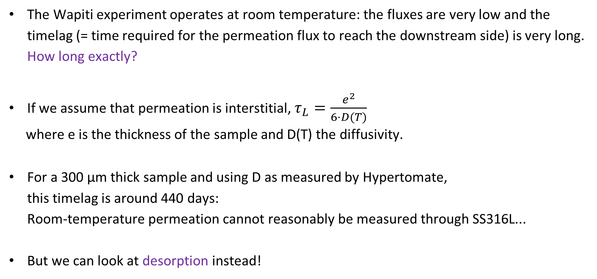
Estimation of the timelag at room temperature
The Wapiti experiment operates at room temperature: the fluxes are very low and the timelag (= time required for the permeation flux to reach the downstream side) is very long.
How long exactly?
If we assume that permeation is interstitial, $τ_{L}=\frac{e^{2}}{6⋅D(T)}$
where e is the thickness of the sample and D(T) the diffusivity.
For a 300 µm thick sample and using D as measured by Hypertomate,
this timelag is around 440 days:
Room-temperature permeation cannot reasonably be measured through SS316L...
But we can look at desorption instead!

Slide 6
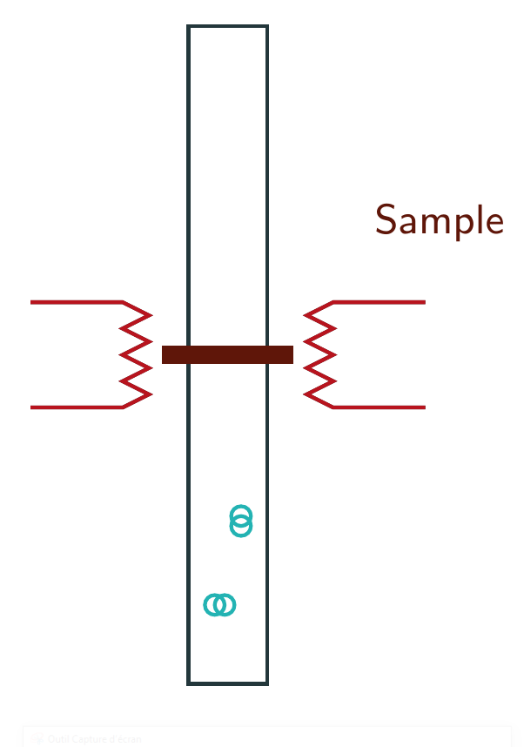

Definition of the operating conditions
To witness desorption, we need to load our sample with tritium
We expose the upstream side of the sample to gaseous tritium: 45 minutes at 300°C, then cooling down to RT (around 30 minutes)
Tritium is then removed from the upstream enclosure, desorption is measured on the other side

Slide 7
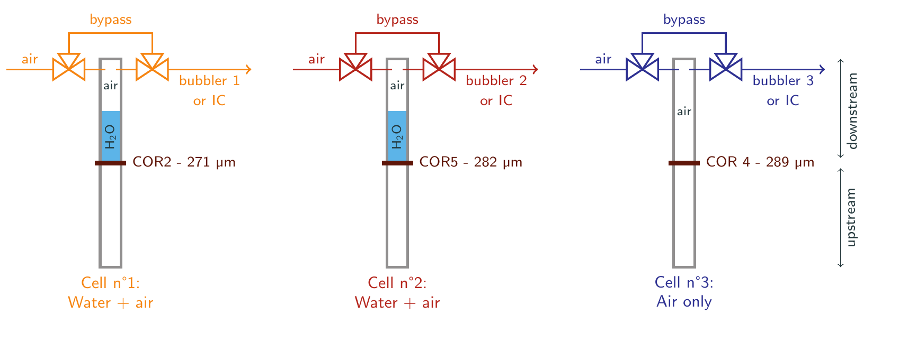
Overview of the Wapiti 316L desorption experiment
Same loading conditions for the three samples
  In cells 1 and 2: will tritium be found in the water? In the air? In both?
  In cell 3: how will the desorption flux into air compare to the other ones?

Slide 8
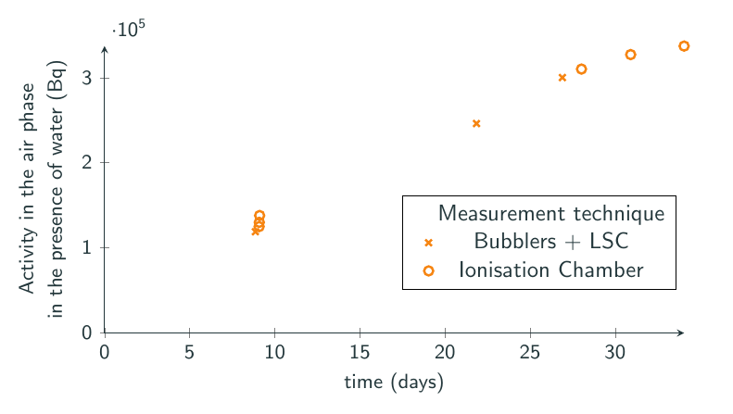
A measurement based on two detection techniques
Bubblers + LSC is used for high activities, IC for lower ones (memory effect, but real-time data!)
These two techniques work hand in hand

Slide 9
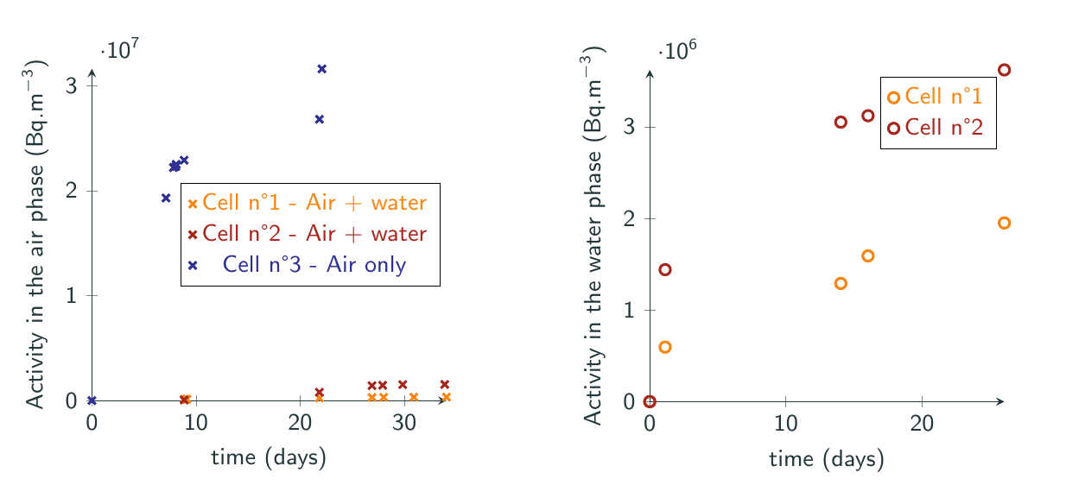
Comparison of desorption into air vs. into water
Flux into air (no water) > flux into water > flux into air in the presence of water

Slide 10
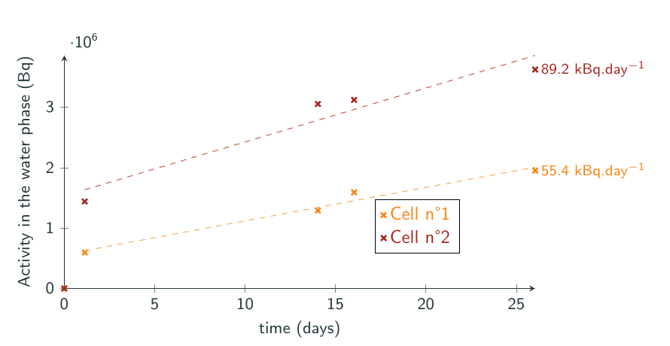
Desorption into the water phase
Large amounts of tritium found in the water phase
Smaller flux in cell 1

Slide 11
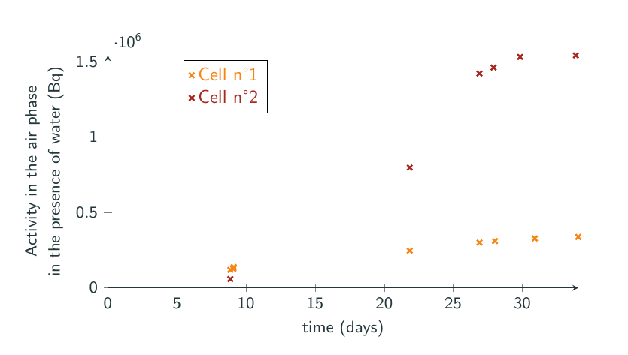
Desorption into the air phase, with water at the interface
Activity is around 5-10 times lower than in the water phase
Two possible mechanisms: T(solute in the material) -> T2(solute in water) -> T2 in air
or T (solute in the material) -> HTO (isotopic exchange) -> T2 in air
Activity still lower in cell 1

Slide 12
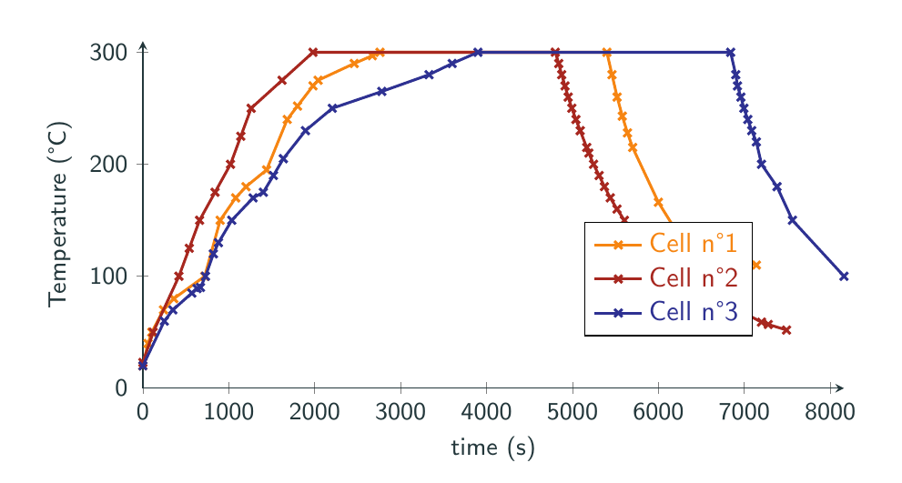
Discrepancies in the loading phases
All 3 samples spent 45 minutes at 300°C but the heating up phases were not exactly similar

Slide 13
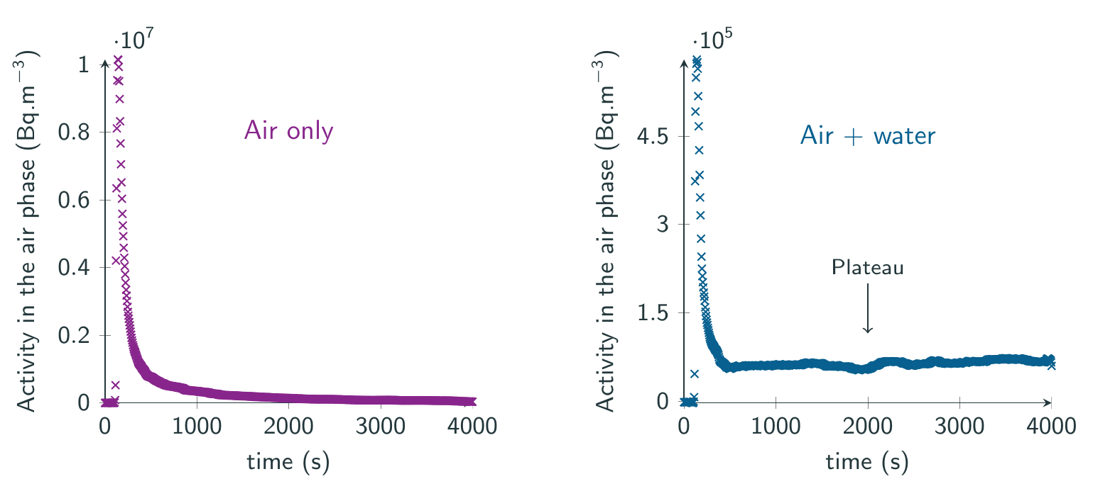
A different kind of equilibrium with or without water
In the absence of water downstream, the activity in the air phase goes down to zero in around 2000 s
In the presence of water downstream, the activity in the air phase does not go down to zero
and a plateau is visible -> possible dynamic T exchange between the (tritiated) water and the air phase

Slide 14
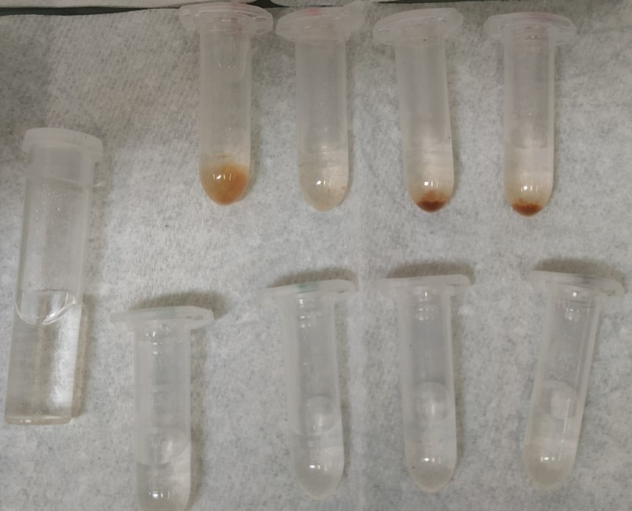
Proposed objectives for 2023
Data scattering on T desorption for SS316L in the presence of water
  Repeat the experiment to quantify the experimental error
  Adapt the T loading procedure (or temperature control) to minimize uncertainties
Checking how the desorption flux varies as a function of the T loading pressure would yield interesting data about the surfaces
T permeation study w/o water phase: study of Eurofer97 behavior
  Parametric study on the impact of oxide layers
Towards W permeation study
  W adapted permeation cell conceived and set up to test on Hypertomate (H/D)

Slide 15
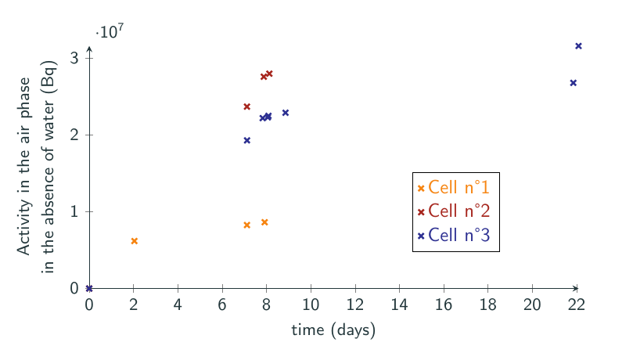
Desorption into the air phase, no water at the interface
Only a few points for cells 1 and 3: measurements performed before water was added downstream
Lower activity in cell 1

Slide 16
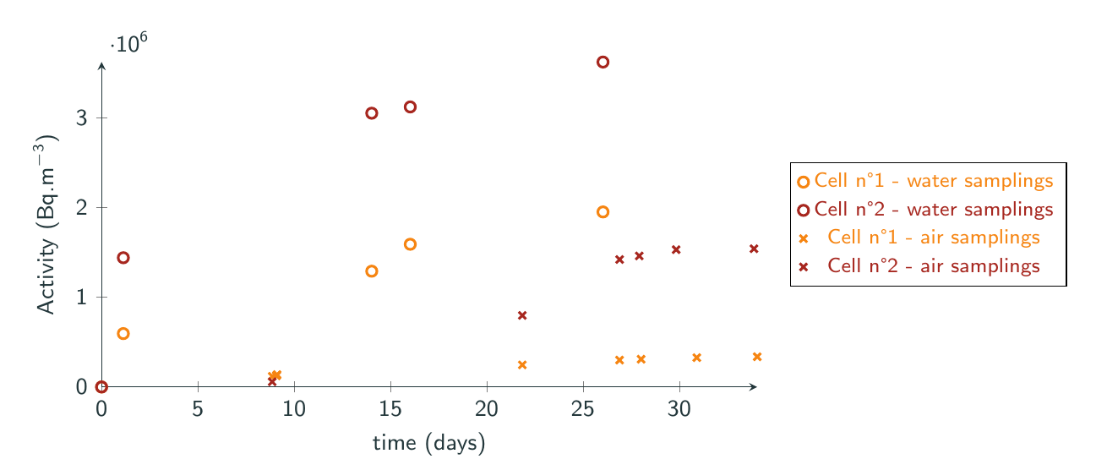
Comparison of the activity found in air and in water in cells 1 and 2
commentaire

