Slide 1

Hydrogen Permeation through Fusion Materials
A. Houben, M. Rasinski, S. Brezinsek, and Ch. Linsmeier
an.houben@fz-juelich.de

Slide 2
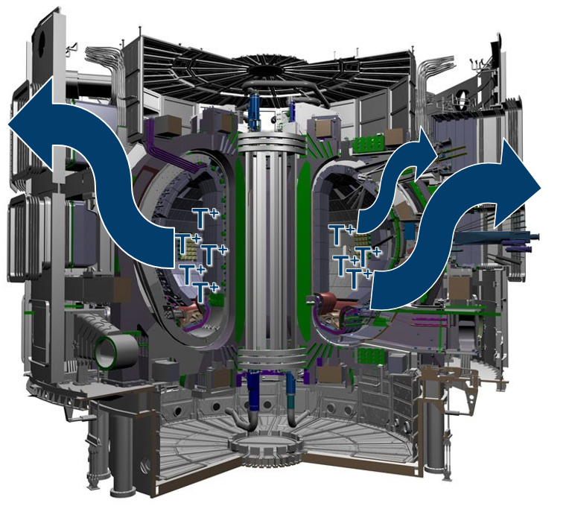
Motivation
Estimation and prevention of tritium permeation:
→ Fuel loss
→ Tritium accumulation
→ Release into the environment
Deuterium permeation studies:
→ ‘Pure’ materials: Eurofer97, 316L(N)-IG, Cu, CuCrZr-IG
→ Combined material systems:
→ Cu/316L(N)-IG
→ W/CuCrZr-IG
→ W/Eurofer97
Investigation of the Influence of:
→ Interfaces
→ Microstructure
Figure (edited): http://www.iter.org/

Slide 3
Permeation
Dissociation
Adsorption Absorption
Diffusion Solubility
Desorption
Recombination
Effective Permeability: → Microstructure, grain size, pores
→ Contamination of the surface
→ Interfaces
Effective permeability can be higher or lower as the ‘pure’ or ‘bulk’ permeation, in order to verify the influence on the permeation → measurement of samples with different microstructure, surface modifications…

Slide 4
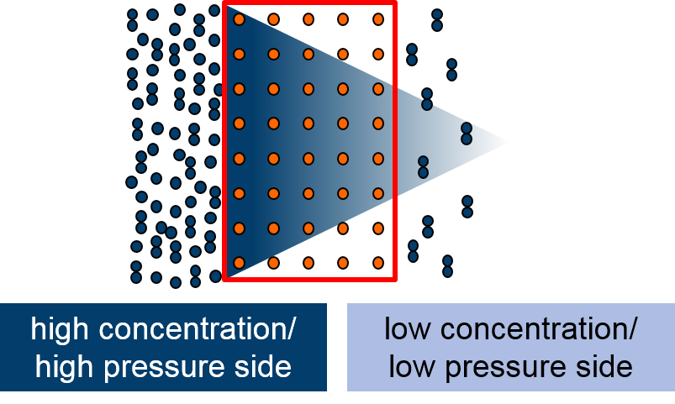
Gas / Ion Driven Permeation
Gas-driven:
→ General permeation behavior (physical understanding)
→ Measurement does not influence the surface and bulk
→ Pressure, temperature and sample thickness dependent measurements

Slide 5
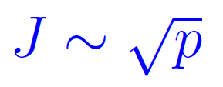


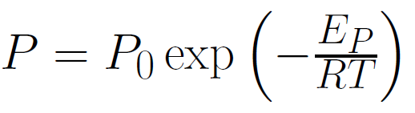


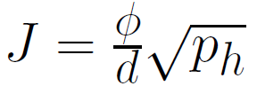

Gas Driven Permeation
Diffusion-limited:
Dependent on thickness
Surface (Interface) -limited:
Independent on thickness
$$1/d\sqrt{p}$$
Pressure dependence:
Temperature dependence:
d
rapid
slow
rapid
slow
rapid
slow
Lag-Time measurement:

Slide 6
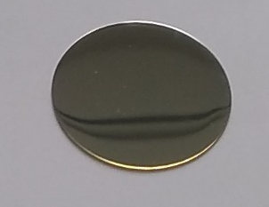
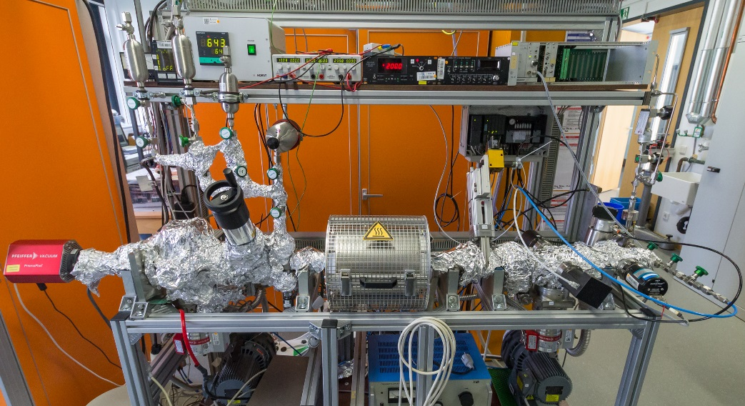
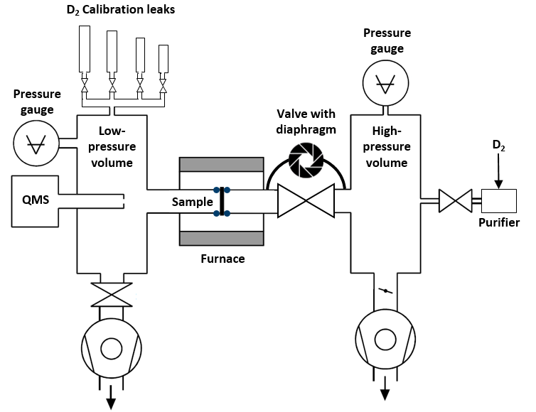
Experimental Setup
Gas-driven:
Ø: 25 mm
d: 0.3 mm
Permeation Setup @ FZJ
Picture: Stefan Kirtz
Measuring procedure:
→ Sample preparation
→ Evacuation: HPV/LPV ~10⁻⁹ mbar
→ Calibration
→ Pressure/temperature dependent measurement
→ Lag-Time measurement -> Diffusion

Slide 7
Comparison ‘pure’ Materials
Eurofer97
316L-IG
Fusion Steels:
→ Eurofer97 (DEMO):
→ Reduced activation steel
→ Martensitic/ferritic, distorted bcc
→ 316L(N)-ITER Grade
→ Nitrogen enhanced 316L
→ Austenitic, fcc
SEM
20 µm
SEM
20 µm
A. Houben et al., NME 19 (2019), 55-58
SEM (FIB):
Cu
CuCrZr
Cu and Cu Alloy
→ Cu:
→ Oxygen-free copper (commercial)
→ Small voids
→ CuCrZr-ITER Grade
→ ITER first wall panels
→ Cu with Cr precipitates
20 µm
20 µm
SEM
SEM
A. Houben et al., NME 33 (2022), 101256

Slide 8
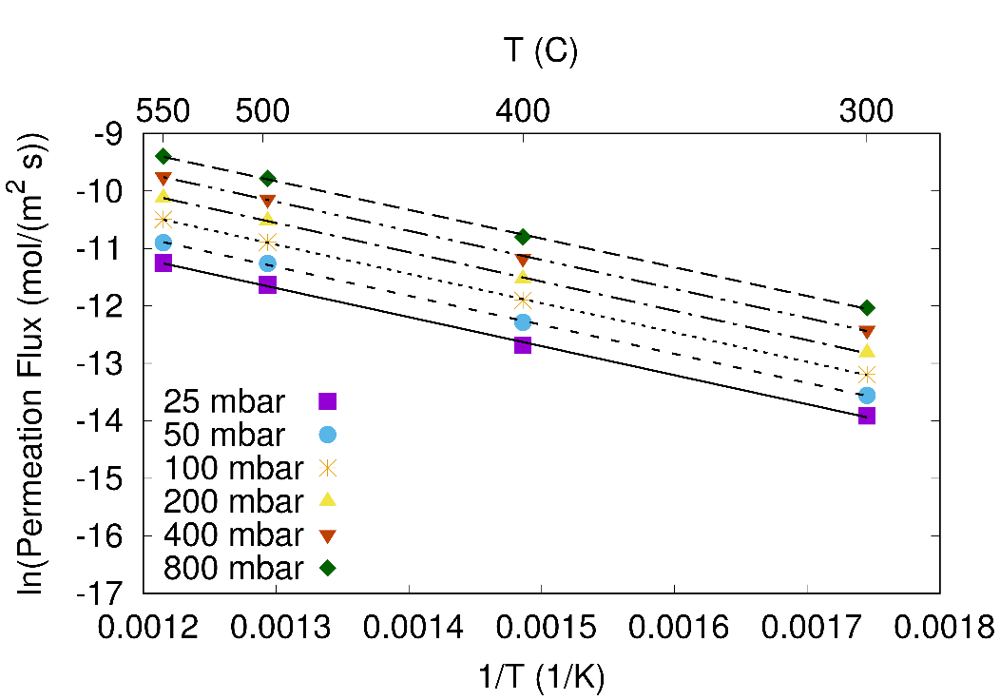
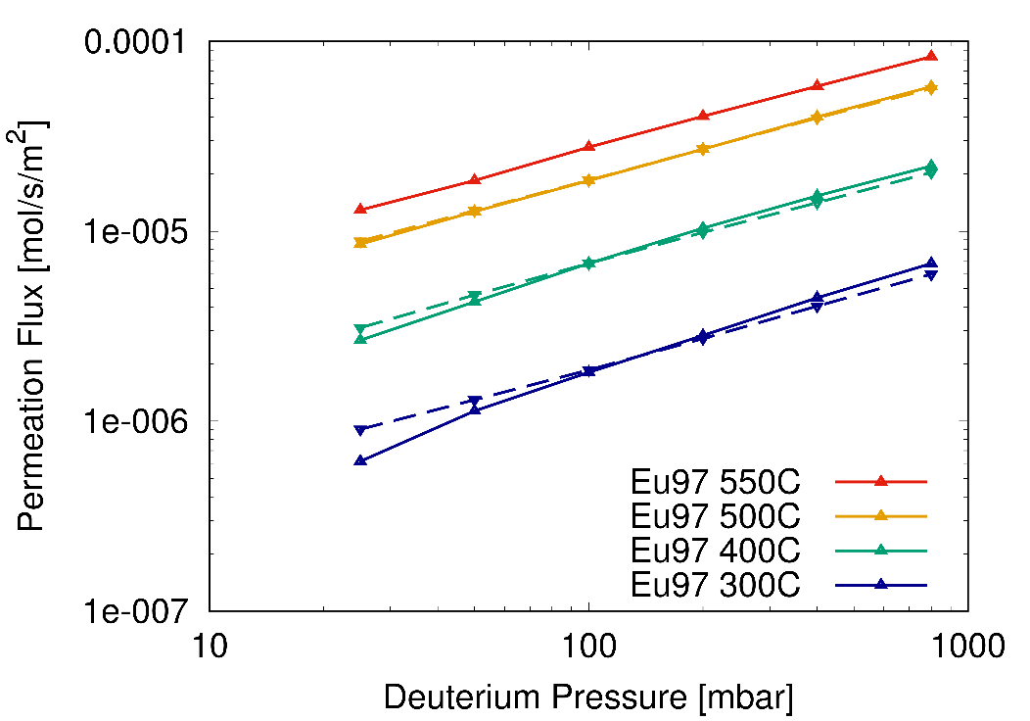
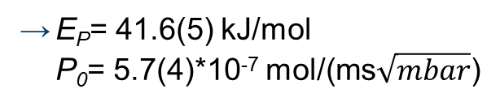
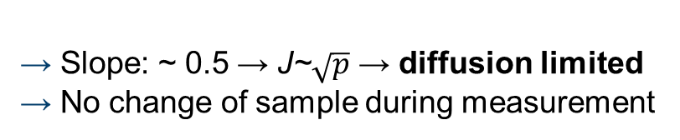
Measurement and Analysis
All ‘pure’ samples and substrates are ‘mirror’ polished, annealed and the thickness is ~ 0.3 mm
Gas-driven deuterium permeation flux measurements (measurement range: 300-550°C, 25-800 mbar):
Example Eurofer97:
Temperature dependence of stabilized permeation flux:
Arrhenius plot → fulfilled (measured T and p range)
→ Slope: ~ 0.5 → J~$\sqrt{p}$ → diffusion limited
→ No change of sample during measurement
→ E_{P}= 41.6(5) kJ/mol
P₀= 5.7(4)*10⁻⁷ mol/(ms$\sqrt{mbar}$)

Slide 9
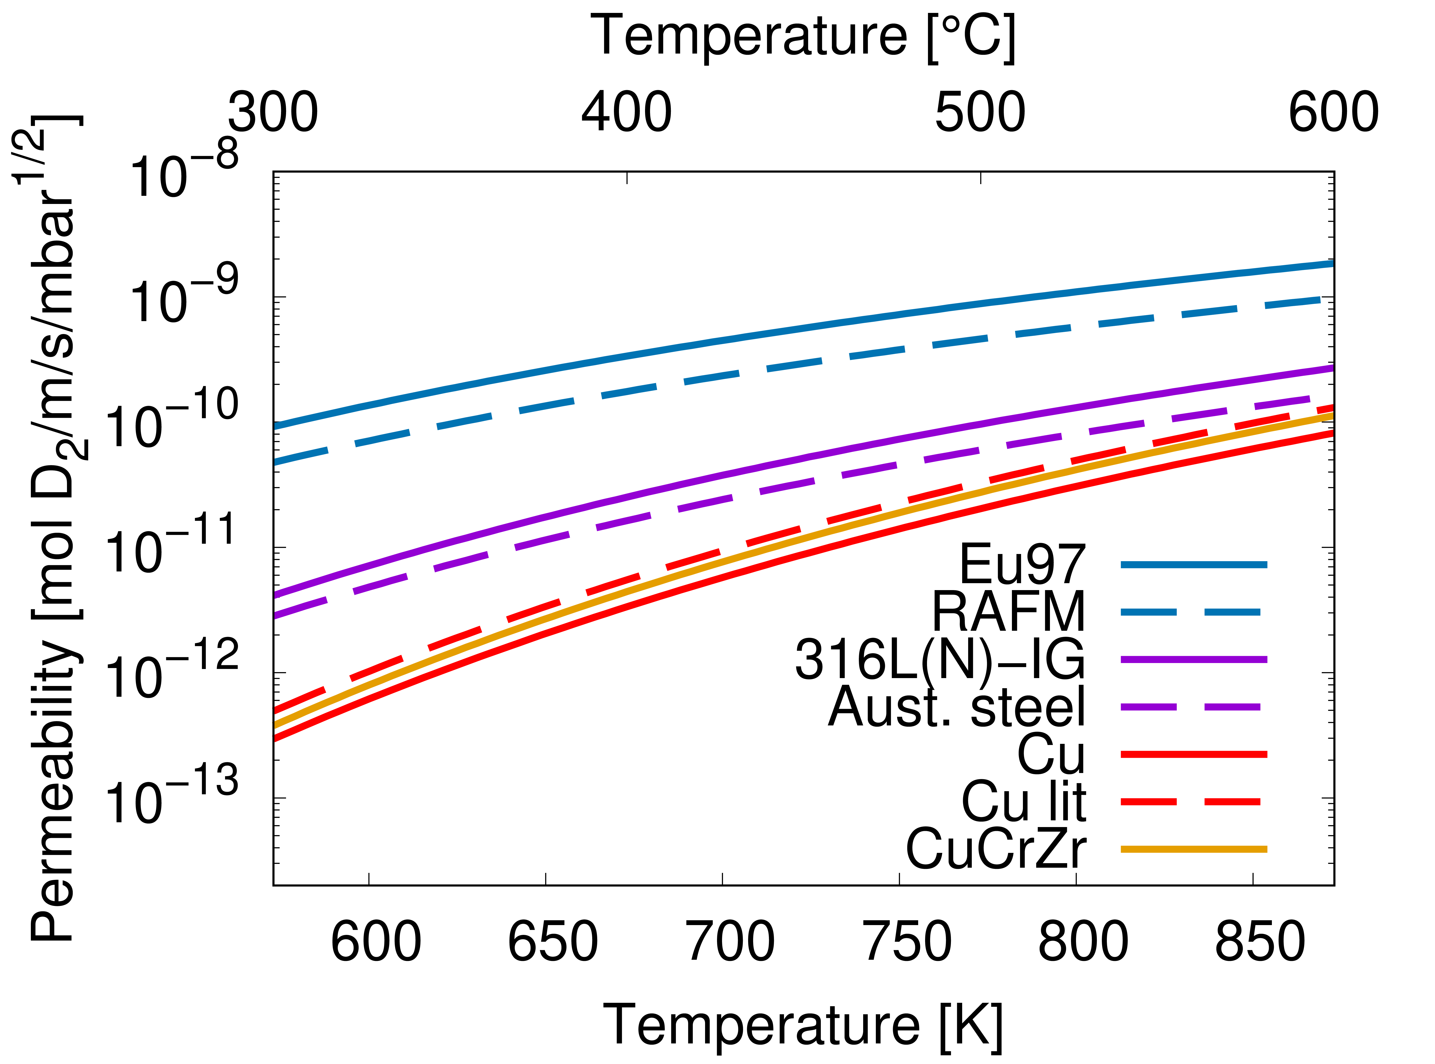
Conclusion – ‘Pure’ Materials
→ Comparable to literature values
→ Permeability of Eu97 higher than 316L
→ Permeability Cu / CuCrZr similar
→ Diffusion limited regime
Study combined material systems:
→ Influence of interfaces
→ Influence of microstructure
R. Causey et al., Comprehensive Nuclear Materials 2012, 511–549
Solid line: measured values
Dotted line: adapted literature values Causey, ‘mean value’ of published effective permeation data (bulk)

Slide 10
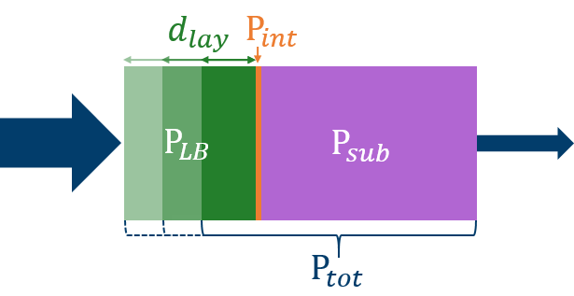
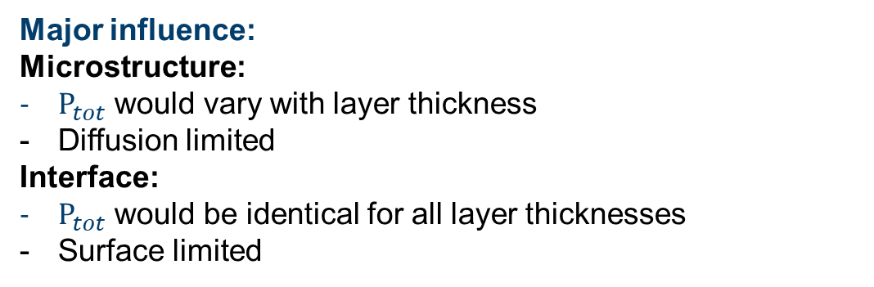
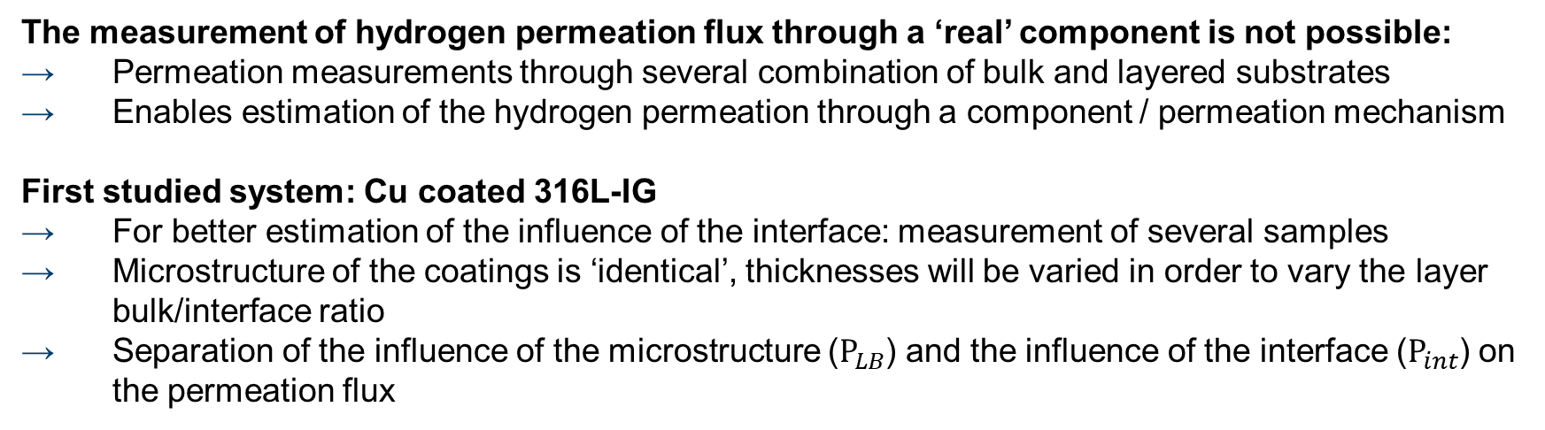
Interfaces and Microstructure
The measurement of hydrogen permeation flux through a ‘real’ component is not possible:
→ Permeation measurements through several combination of bulk and layered substrates
→ Enables estimation of the hydrogen permeation through a component / permeation mechanism
First studied system: Cu coated 316L-IG
→ For better estimation of the influence of the interface: measurement of several samples
→ Microstructure of the coatings is ‘identical’, thicknesses will be varied in order to vary the layer bulk/interface ratio
→ Separation of the influence of the microstructure ($P_{LB}$) and the influence of the interface ($P_{int}$) on the permeation flux
Major influence:
Microstructure:
$P_{tot}$ would vary with layer thickness
Diffusion limited
Interface:
$P_{tot}$ would be identical for all layer thicknesses
Surface limited
Deuterium permeation studies on 316L(N)-IG, Cu and 316L(N)-IG with Cu layer:
Comparison of pure, bare materials and the combination of steel and Cu
A. Houben et al., NME 33 (2022), 101256

Slide 11
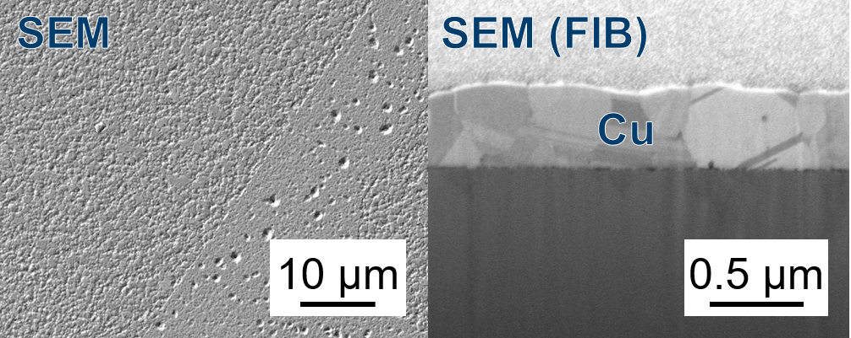
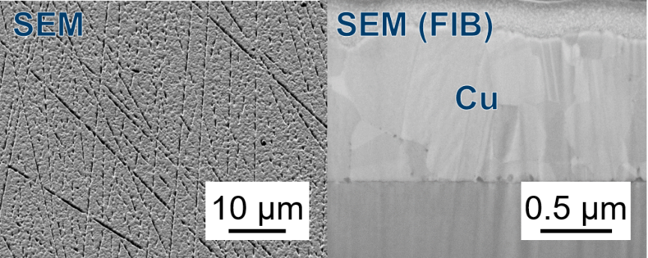
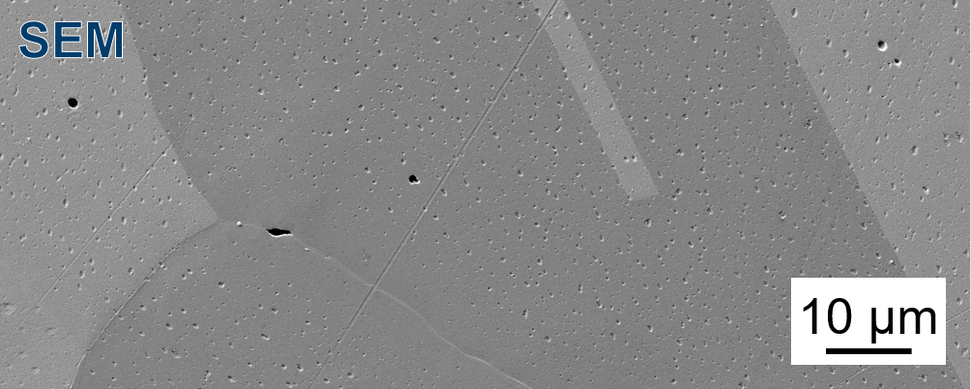
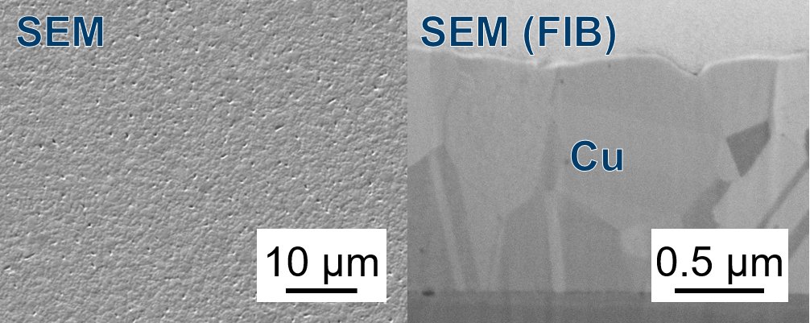
Cu coated 316L
316L-IG with Cu layer ‘thin’ (316L_Cu_thin):
Cu layered 316L substrates:
Magnetron sputter deposition, coated on one side
Annealed after deposition
Layer thickness: 316L_Cu_thin : ~490 nm
        316L_Cu_thick: ~980 nm
        316L_Cu_very_thick: ~1400 nm
        - ‘Clean’ interface, no cracks, no voids
        - Microstructure similar between layers
        - Surface different between layers
        - Microstructure very different to bulk Cu (no voids!):
316L-IG with Cu layer ‘thick’ (316L_Cu_thick):
Polished Cu (Cu):
316L-IG with Cu layer ‘very thick’ (316L_Cu_very_thick):

Slide 12
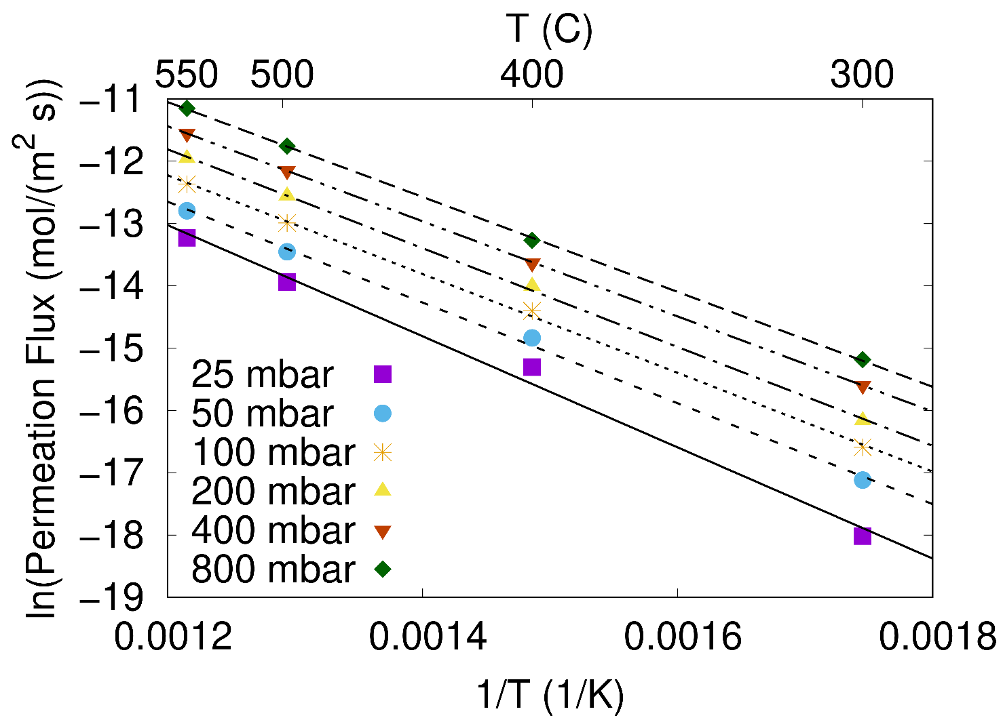
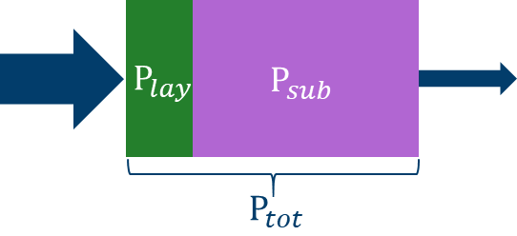
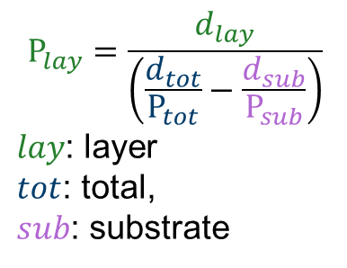
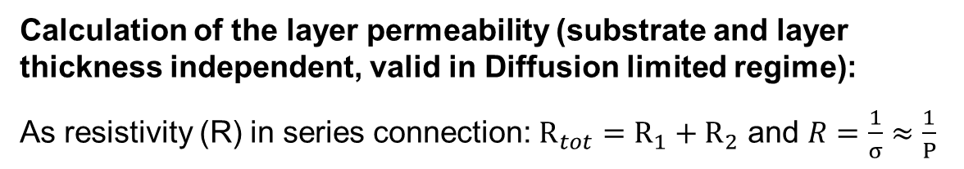

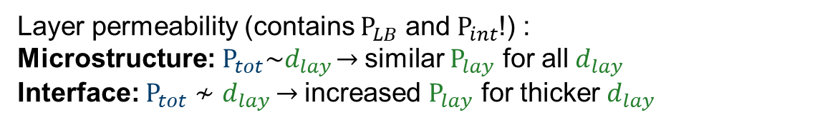
Measurements and Analysis
Gas-driven deuterium permeation flux measurements (measurement range: 300-550°C, 25- 800 mbar):
From the permeation flux (J_{P}) the effective permeability (P) can be obtained:
p/T-dependent measurements:
J_{P} $=\frac{P_{0}\sqrt{p}}{d}e^{\frac{−E_{P}}{RT}}$, $P=P_{0}e^{\frac{−E_{P}}{RT}}$
$P_{0}$: permeation constant, $E_{P}$: activation energy
For this 316L_Cu_thick sample:
$P_{0}=2.3(5)∙{10}^{−6}$ $\frac{mol}{ms\sqrt{mbar}}$, $E_{P}$ = 66(2) $\frac{kJ}{mol}$
Calculation of the layer permeability (substrate and layer thickness independent, valid in Diffusion limited regime):
As resistivity (R) in series connection: $R_{tot}=R_{1}+R_{2}$ and $R=\frac{1}{σ}≈\frac{1}{P}$
$$P_{lay}=\frac{d_{lay}}{\left(\frac{d_{tot}}{P_{tot}}−\frac{d_{sub}}{P_{sub}}\right)}$$
$lay$: layer
$tot$: total,
$sub$: substrate
316L_Cu_thick
Layer permeability (contains $P_{LB}$ and $P_{int}$!) :
Microstructure:$P_{tot}\sim d_{lay}$ → similar $P_{lay}$ for all $d_{lay}$
Interface: $P_{tot}≁d_{lay}$ → increased $P_{lay}$ for thicker $d_{lay}$

Slide 13
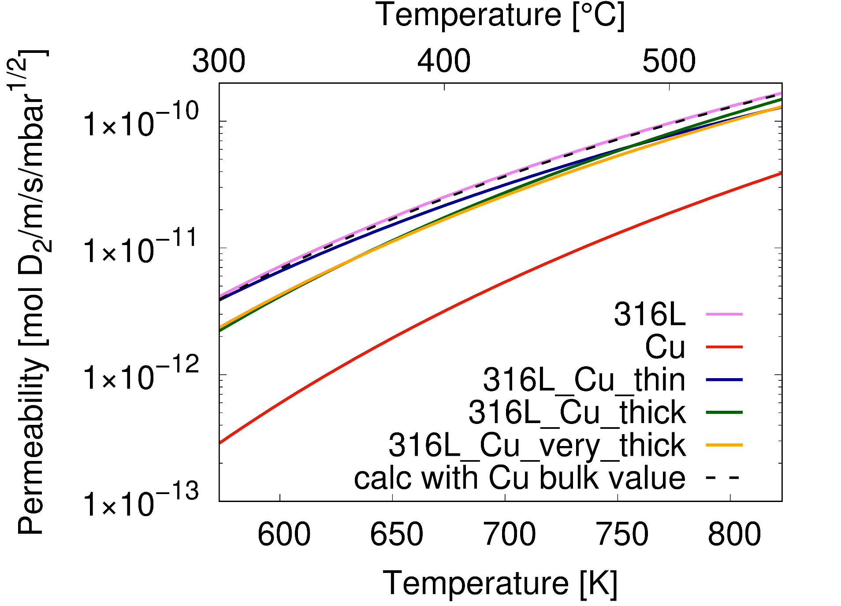
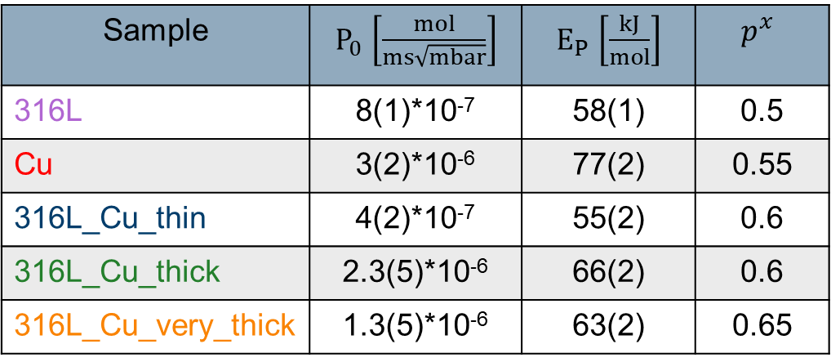
Results Cu coated 316L
Effective permeability (measurement range: 300-550°C, 25-800 mbar):
Sample | $P_{0}$ $\left[\frac{mol}{ms\sqrt{mbar}}\right]$ | $E_{P}$ $\left[\frac{kJ}{mol}\right]$ | $$p^{x}$$
316L | 8(1)*10⁻⁷ | 58(1) | 0.5
Cu | 3(2)*10⁻⁶ | 77(2) | 0.55
316L_Cu_thin | 4(2)*10⁻⁷ | 55(2) | 0.6
316L_Cu_thick | 2.3(5)*10⁻⁶ | 66(2) | 0.6
316L_Cu_very_thick | 1.3(5)*10⁻⁶ | 63(2) | 0.65
→ Reduction of permeability due to the coating (compared to the bare steel substrate 316L)
→ Reduction is larger as expected from calculation of the permeability with values 316L / Cu bulk
→ Permeabilities of layered substrates are different, dependent on layer thickness
→ Diffusion limited regime (only slight increase), similar ‘up’ and ‘down’ measurement values

Slide 14
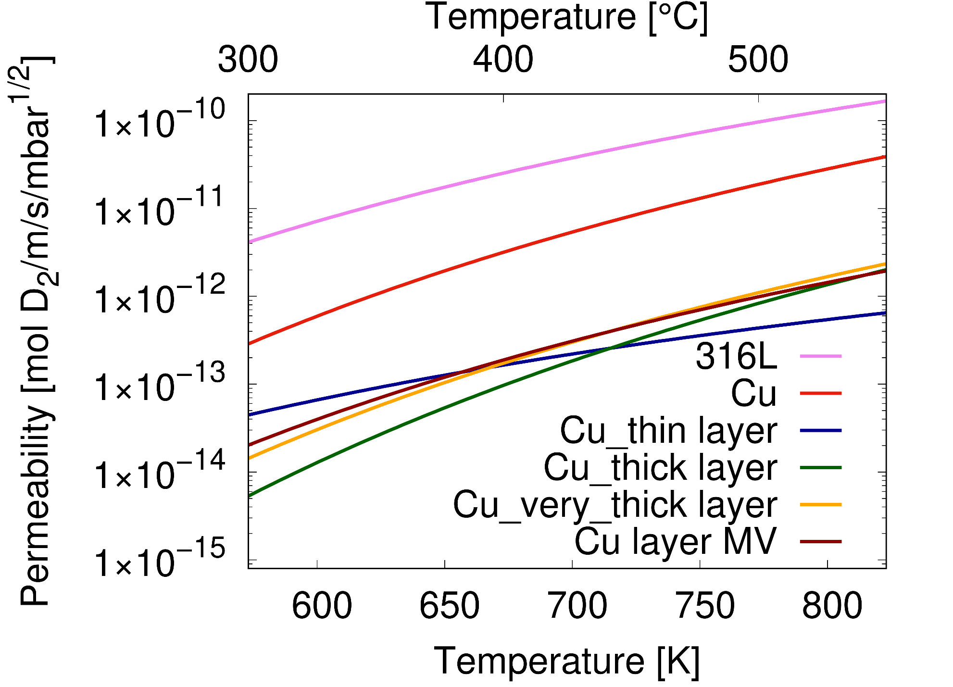
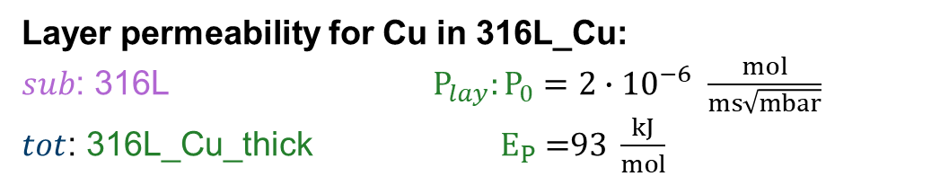
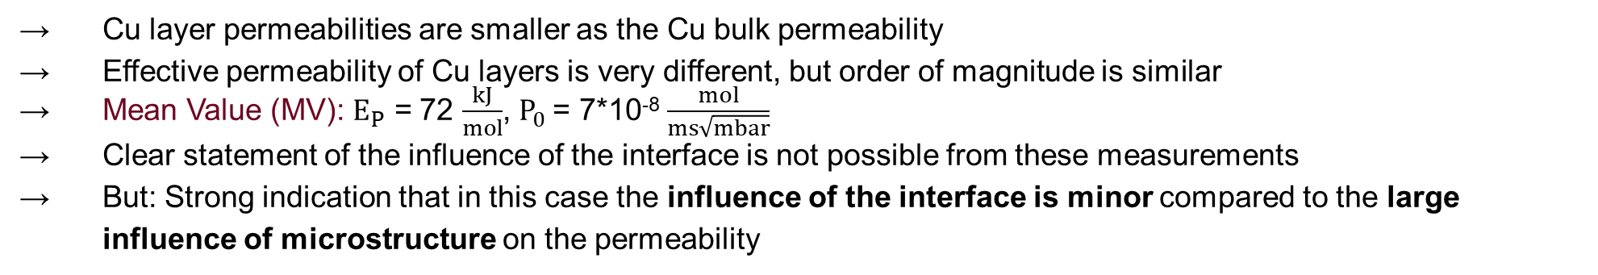
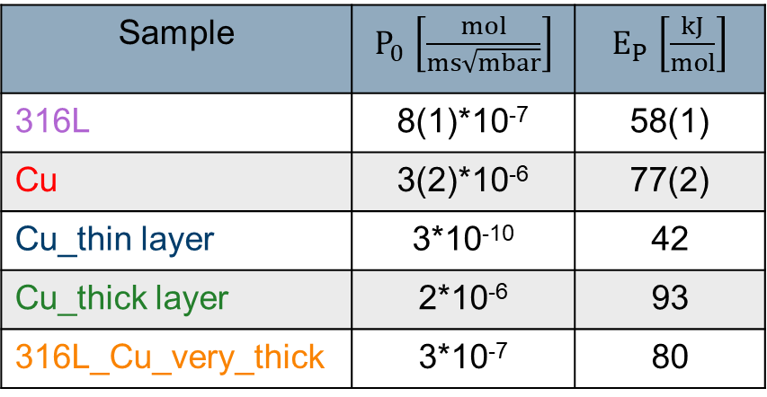
Results Cu coated 316L
Layer permeability for Cu in 316L_Cu:
$sub$: 316L ${ P}_{lay}: P_{0}=2∙{10}^{−6} \frac{mol}{ms\sqrt{mbar}}$
$tot$: 316L_Cu_thick $E_{P}\text{ =}\text{93} \frac{kJ}{mol}$
Sample | $P_{0}$ $\left[\frac{mol}{ms\sqrt{mbar}}\right]$ | $E_{P}$ $\left[\frac{kJ}{mol}\right]$
316L | 8(1)*10⁻⁷ | 58(1)
Cu | 3(2)*10⁻⁶ | 77(2)
Cu_thin layer | 3*10⁻¹⁰ | 42
Cu_thick layer | 2*10⁻⁶ | 93
316L_Cu_very_thick | 3*10⁻⁷ | 80
→ Cu layer permeabilities are smaller as the Cu bulk permeability
→ Effective permeability of Cu layers is very different, but order of magnitude is similar
→ Mean Value (MV): $E_{P}$ = 72 $\frac{kJ}{mol}$, $P_{0}$= 7*10⁻⁸ $\frac{mol}{ms\sqrt{mbar}}$
→ Clear statement of the influence of the interface is not possible from these measurements
→ But: Strong indication that in this case the influence of the interface is minor compared to the large influence of microstructure on the permeability
A. Houben et al., NME 33 (2022), 101256

Slide 15
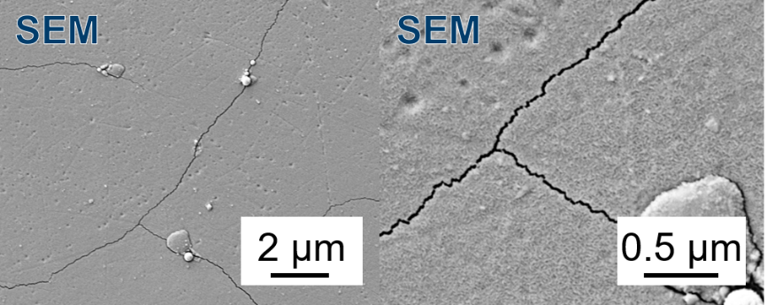
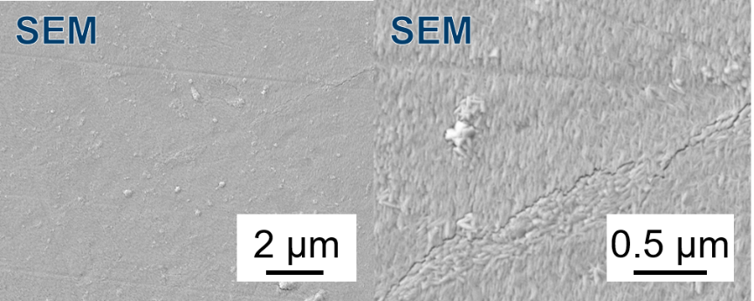
W coated CuCrZr-IG
Second studied system: W coated CuCrZr-IG
In order to avoid cracking of W layer due to differences in thermal expansion:
→ First attempt: thin W layer, max. temperature 450°C
→ Second attempt: W deposition at elevated substrate temperature of around 300°C
CuCrZr-IG with W layer ‘thin/cold’:
Magnetron sputter deposition, coated on one side
Layer thickness: ~100 nm
Annealed at 450°C after deposition
Cracks after annealing
Permeation measurement (T_{max}= 450°C): very similar to CuCrZr substrate (reasons: too thin layer, cracks?)
→ No conclusion can be drawn from the result!
CuCrZr-IG with W layer ‘hot’ (CuCrZr_W_hot):
Magnetron sputter deposition, coated on one side, T_{sub}~300°C
Layer thickness: ~ 350 nm
Annealed at 550°C after depositon
Very small cracks after annealing
W phase confirmed by XRD
→ Permeation measurement (T_{max}= 550°C)

Slide 16
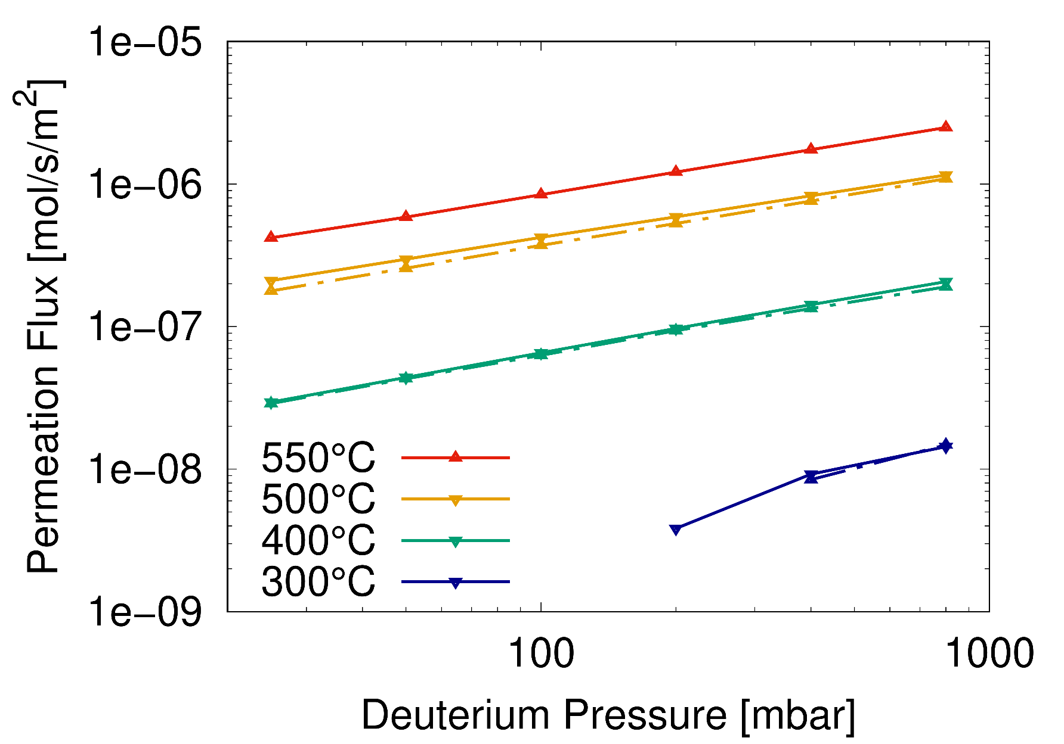
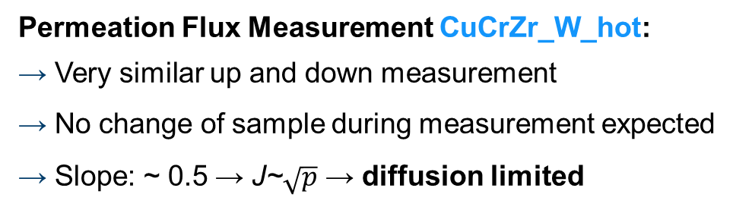
W coated CuCrZr-IG
Permeation Flux Measurement CuCrZr_W_hot:
→ Very similar up and down measurement
→ No change of sample during measurement expected
→ Slope: ~ 0.5 → J~$\sqrt{p}$ → diffusion limited

Slide 17
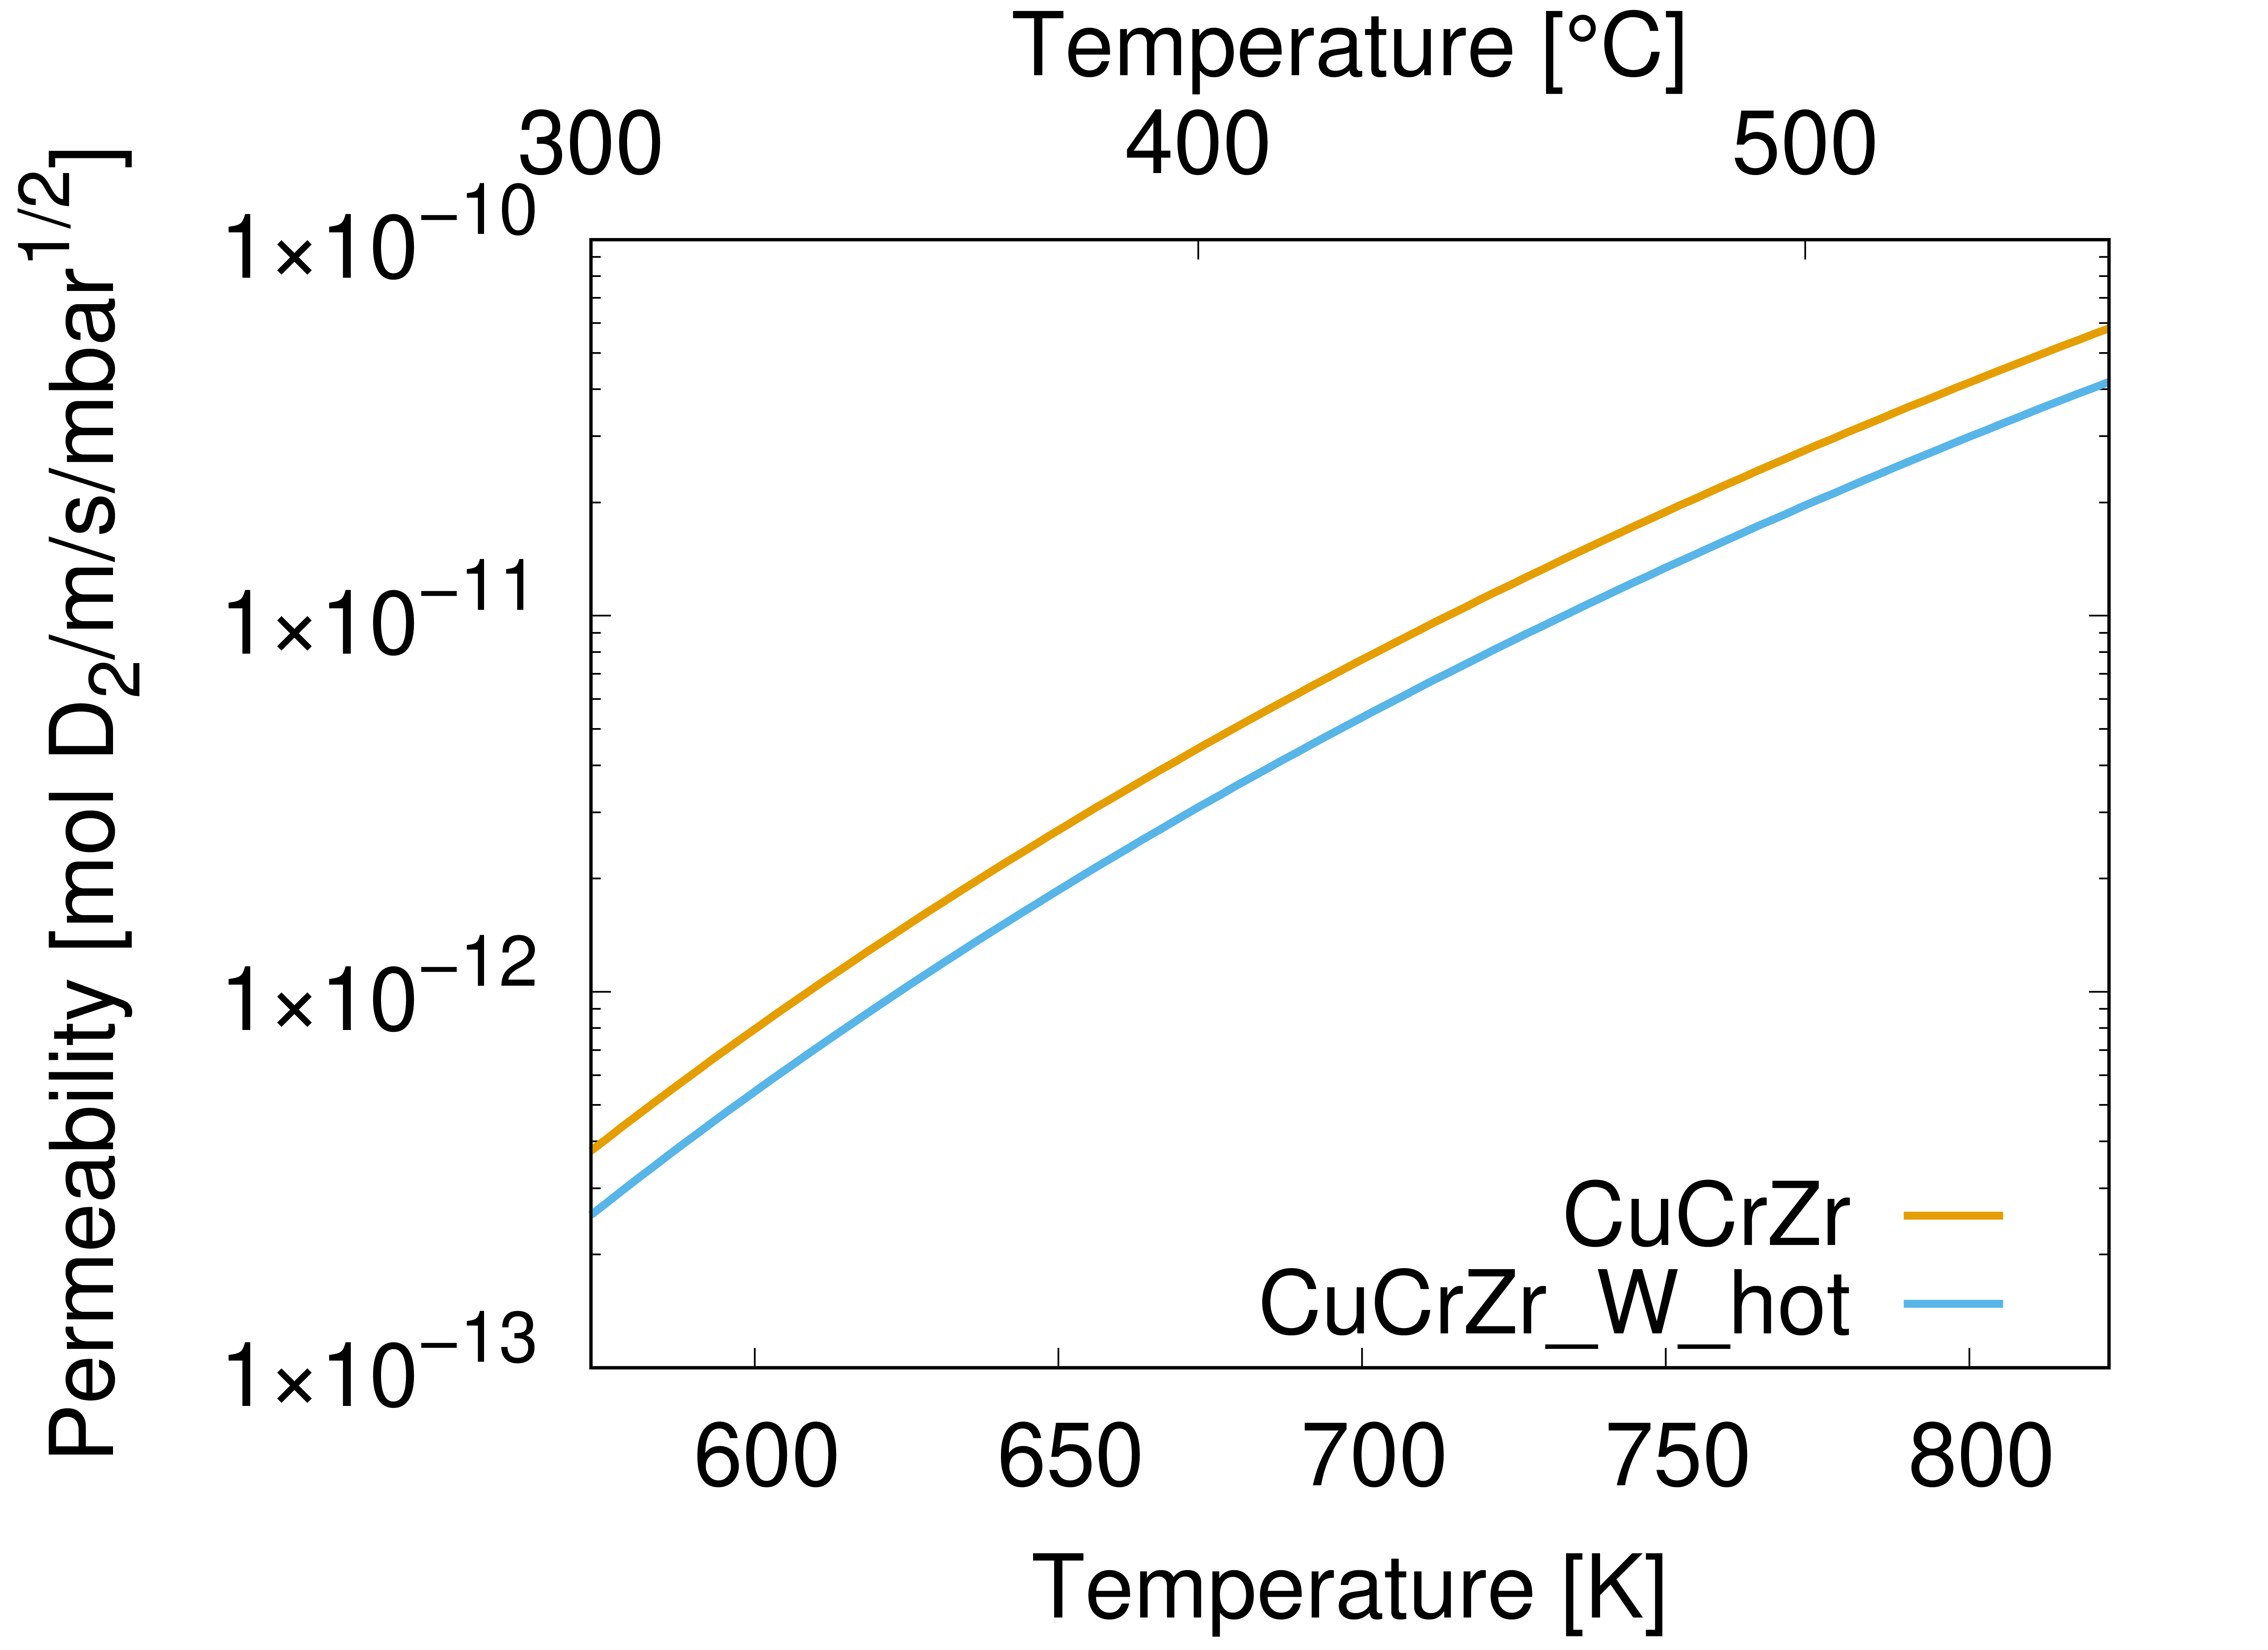
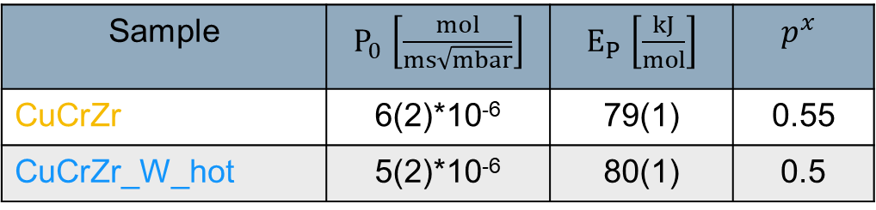
Results W coated CuCrZr
Effective permeability (measurement range: 300-550°C, 25-800 mbar):
Sample | $P_{0}$ $\left[\frac{mol}{ms\sqrt{mbar}}\right]$ | $E_{P}$ $\left[\frac{kJ}{mol}\right]$ | $$p^{x}$$
CuCrZr | 6(2)*10⁻⁶ | 79(1) | 0.55
CuCrZr_W_hot | 5(2)*10⁻⁶ | 80(1) | 0.5
→ Reduction of permeability due to the coating (compared to the bare CuCrZr)
→ Diffusion limited regime, similar ‘up’ and ‘down’ measurement values
→ Assumption: no measurable influence of interface

Slide 18
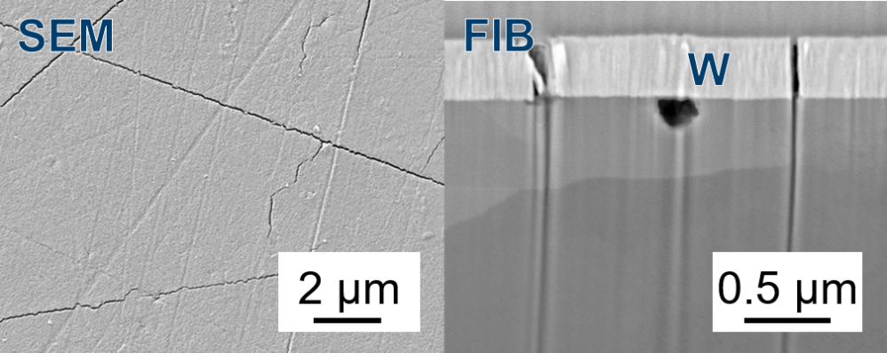
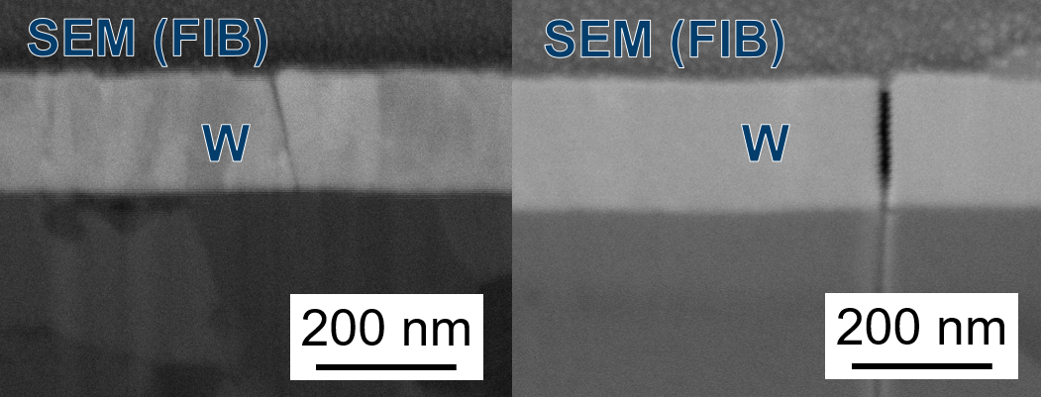
Comparison W coatings
CuCrZr_W_hot FIB/SEM after permeation measurement:
‘Clean’ interface: no intermediate phase
In addition to small cracks: straight lines
Straight cracks going completely through the W layer
Eu97_W FIB/SEM after annealing/permeation measurement:
W deposition without substrate heating
Crack propagation during measurement (non stable measurement)
Cracked W layer on Eurofer97: shortcuts to substrate
Large influence on permeation flux (increase)
A. Houben et al., NME 24 (2020), 100752
→ In CuCrZr_W_hot no influence of cracks on permeation measurement → ?

Slide 19
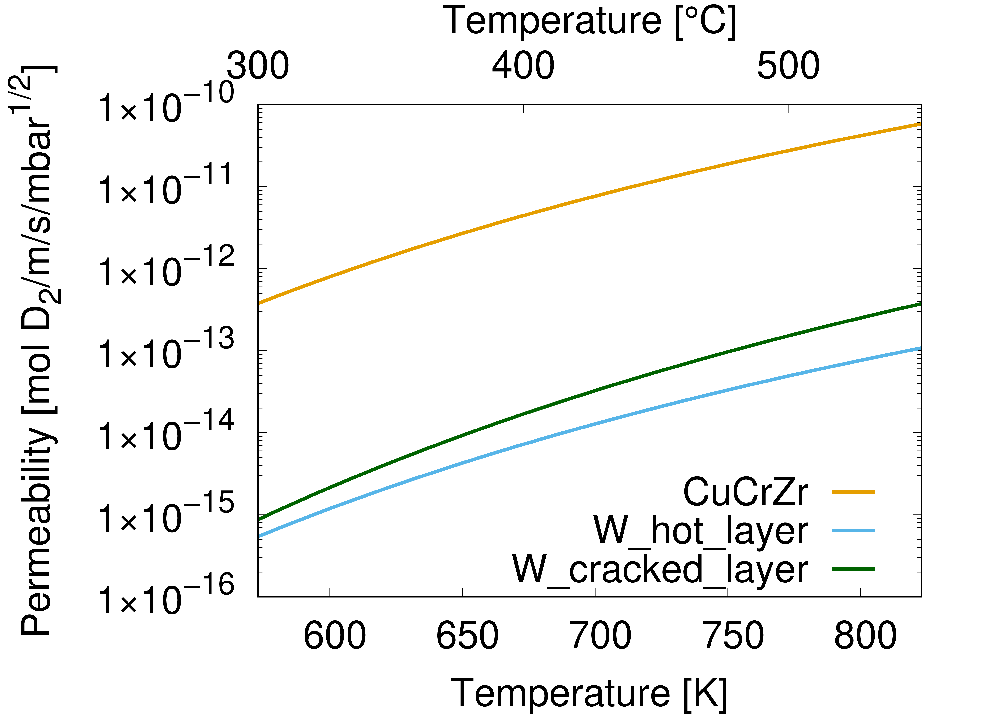
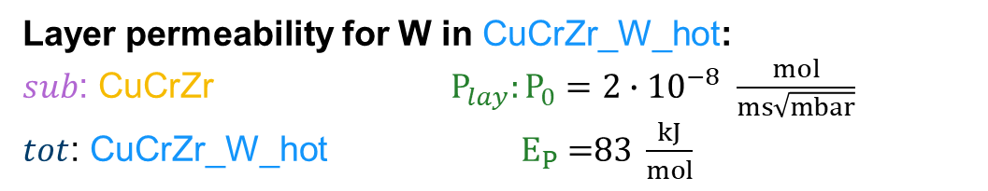
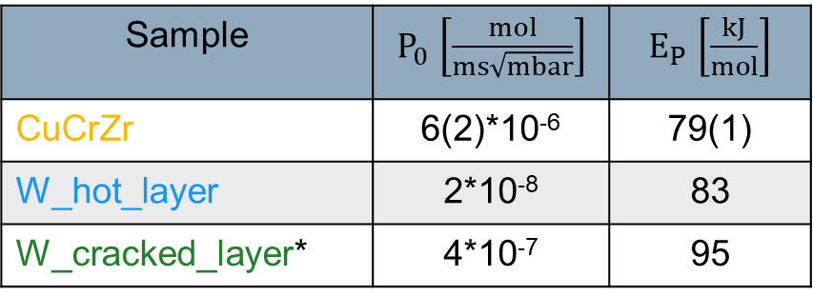
Results W coatings
Layer permeability for W in CuCrZr_W_hot:
$sub$: CuCrZr ${ P}_{lay}: P_{0}=2∙{10}^{−8} \frac{mol}{ms\sqrt{mbar}}$
$tot$: CuCrZr_W_hot $E_{P}\text{ =}\text{83} \frac{kJ}{mol}$
Sample | $P_{0}$ $\left[\frac{mol}{ms\sqrt{mbar}}\right]$ | $E_{P}$ $\left[\frac{kJ}{mol}\right]$
CuCrZr | 6(2)*10⁻⁶ | 79(1)
W_hot_layer | 2*10⁻⁸ | 83
W_cracked_layer* | 4*10⁻⁷ | 95
* W on Eu97: A. Houben et al., NME 24 (2020), 100752
→ W layer permeability is more than two orders of magnitude smaller compared to the CuCrZr permeability
→ The permeabilities of W coatings deposit on different substrates a similar (calculation of layer permeability)

Slide 20
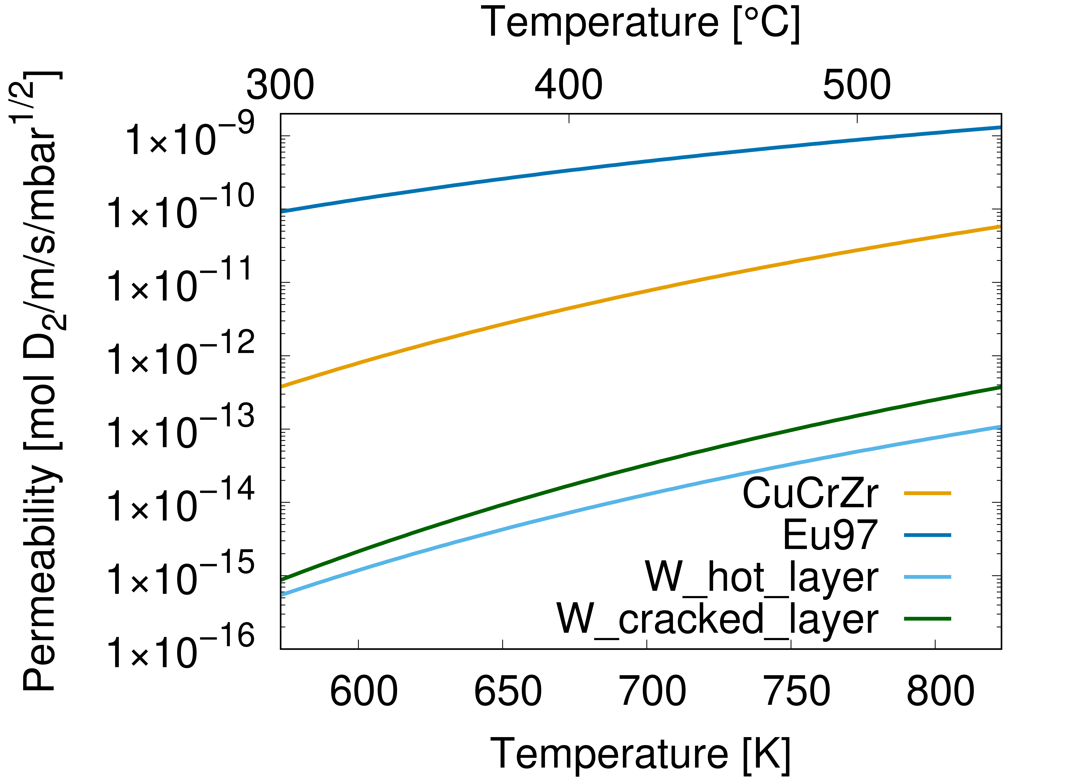
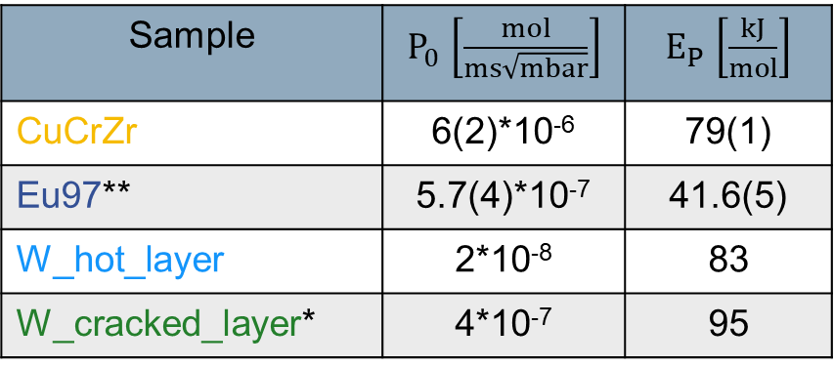
Results W coatings
Layer permeability for W in CuCrZr_W_hot / Eu97_W:
Sample | $P_{0}$ $\left[\frac{mol}{ms\sqrt{mbar}}\right]$ | $E_{P}$ $\left[\frac{kJ}{mol}\right]$
CuCrZr | 6(2)*10⁻⁶ | 79(1)
Eu97** | 5.7(4)*10⁻⁷ | 41.6(5)
W_hot_layer | 2*10⁻⁸ | 83
W_cracked_layer* | 4*10⁻⁷ | 95
* W on Eu97: A. Houben et al., NME 24 (2020), 100752
**A. Houben et al., NME 19 (2019), 55-58
→ W layer permeability is more than two orders of magnitude smaller compared to the CuCrZr permeability
→ The permeabilities of W coatings deposit on different substrates a similar (calculation of layer permeability)
→ Strong indication that in this case the influence of the interface is minor as well

Slide 21
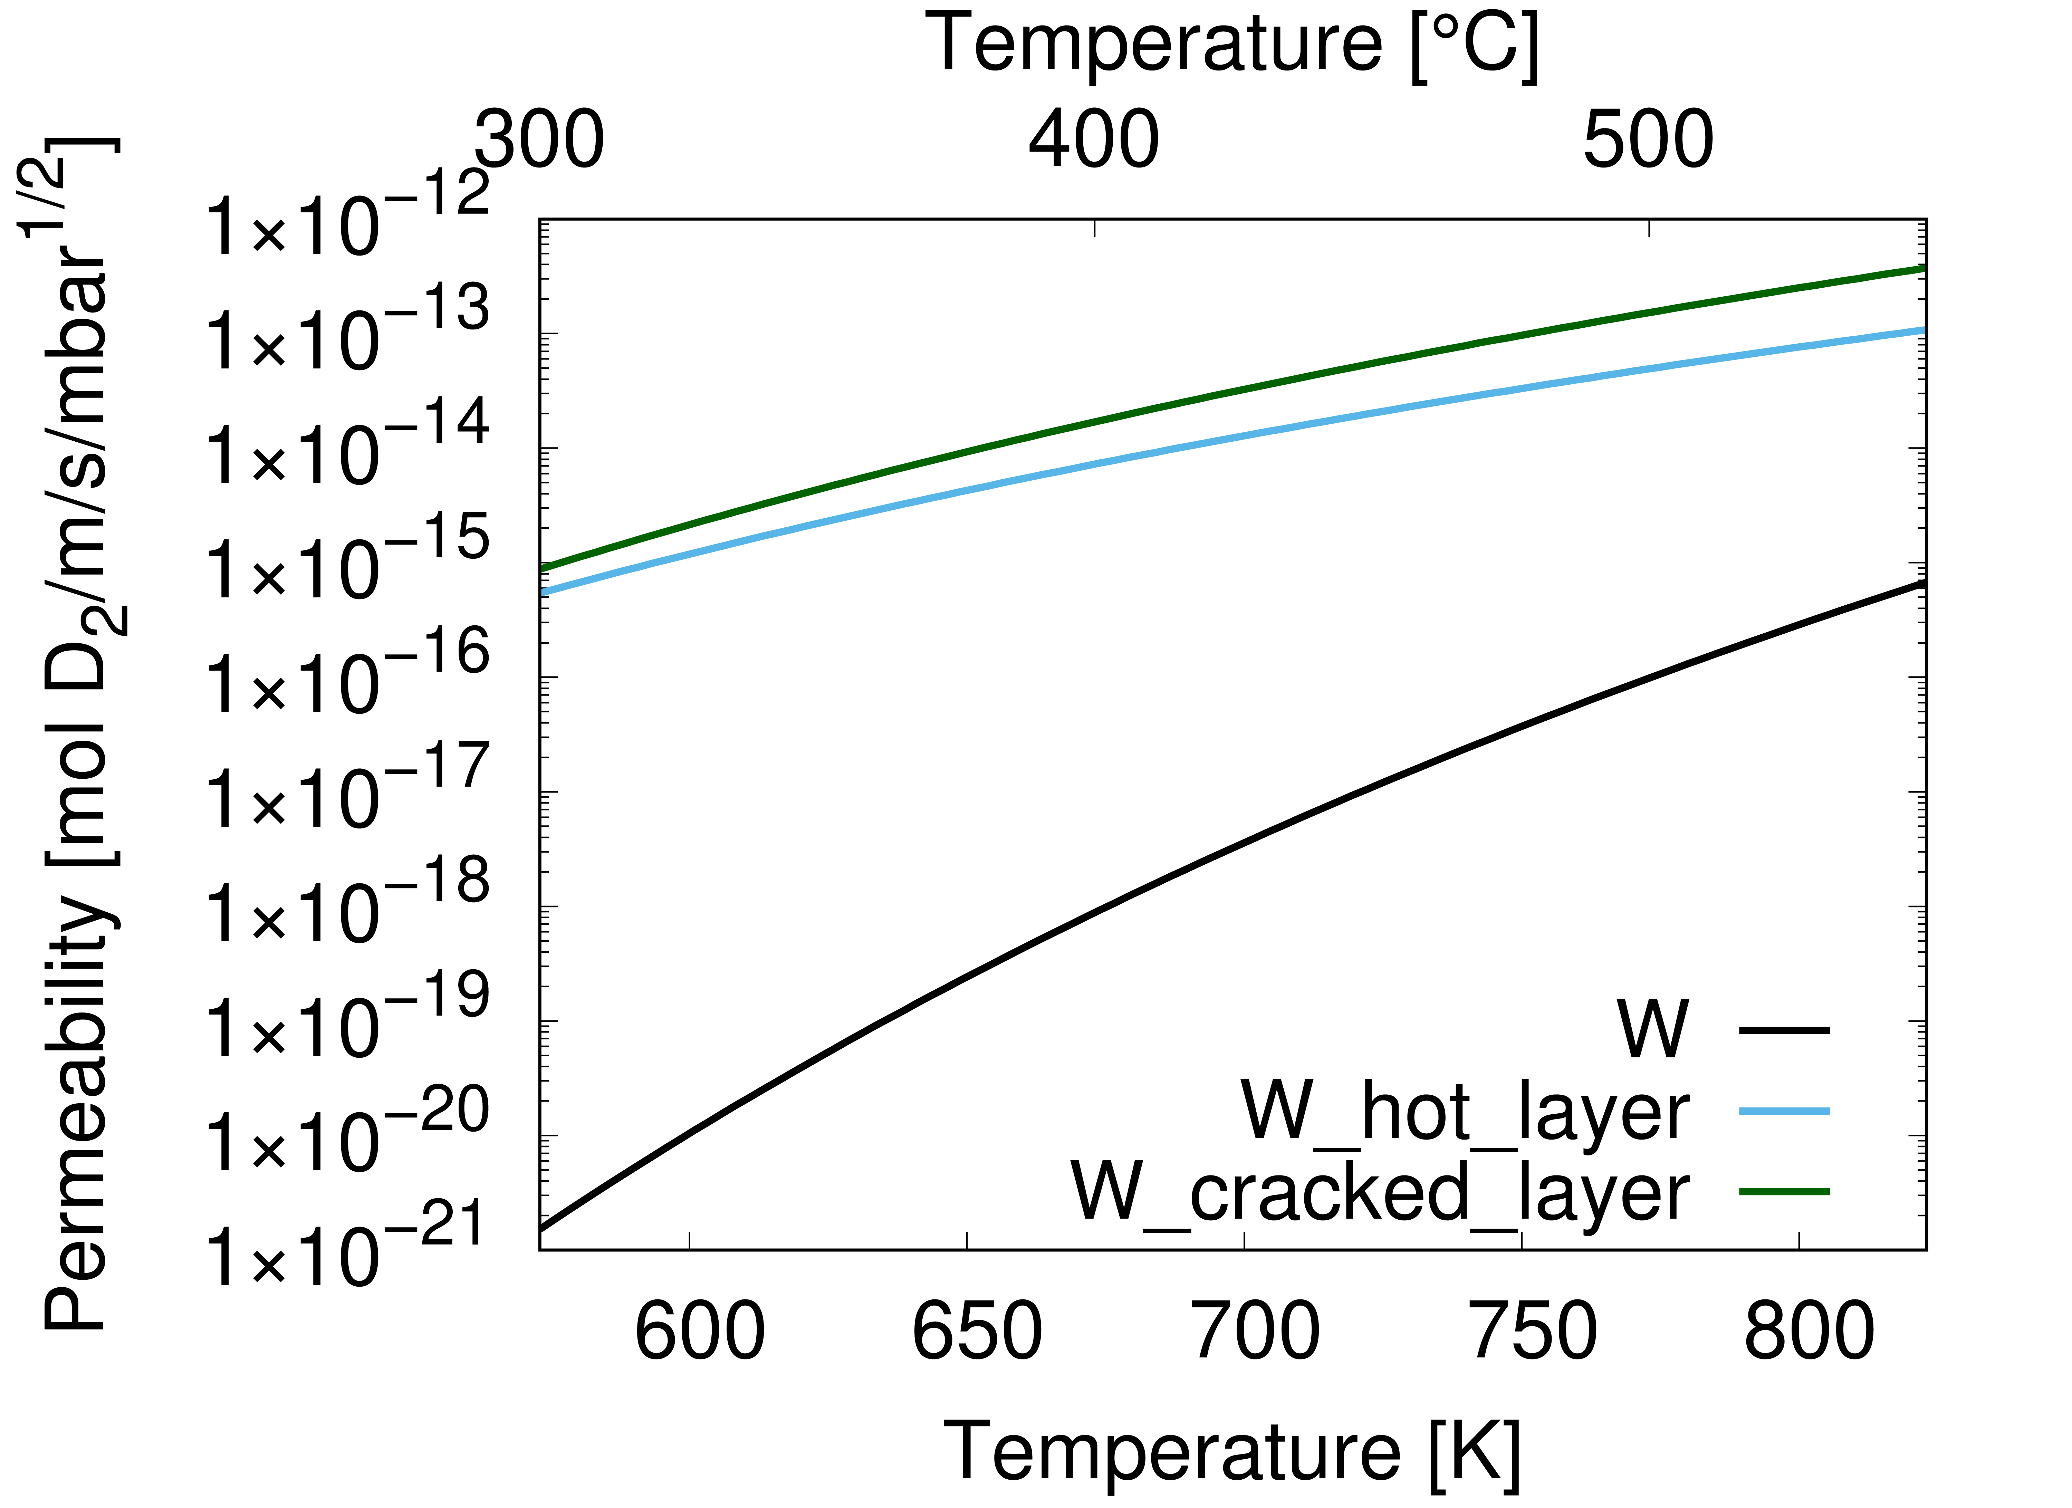
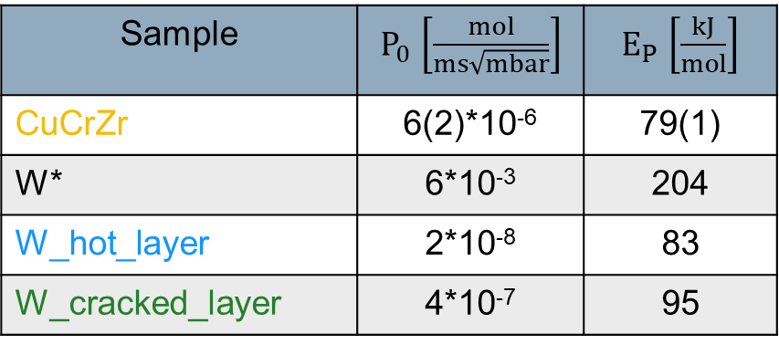
Results W coatings
Layer permeability for W in comparison to W bulk:
Sample | $P_{0}$ $\left[\frac{mol}{ms\sqrt{mbar}}\right]$ | $E_{P}$ $\left[\frac{kJ}{mol}\right]$
CuCrZr | 6(2)*10⁻⁶ | 79(1)
W* | 6*10⁻³ | 204
W_hot_layer | 2*10⁻⁸ | 83
W_cracked_layer | 4*10⁻⁷ | 95
* W bulk measured between 1100 K and 2400 K, adapted value from R. Causey et al., Comprehensive Nuclear Materials 2012, 511–549 (Frauenfelder)
→ W layer permeabilities are larger as the W bulk permeability (but: different T range!)
→ Strong indication that in this case the influence of the interface is minor compared to the large influence of microstructure on the permeability
→ Substrate heating during deposition leads to a reduction of cracks in the layer and an avoidance of crack propagation (stable permeation flux measurement, lower layer permeability)
→ Future plan for this year: same W deposition parameter (hot) for a W coated Eu97 sample

Slide 22
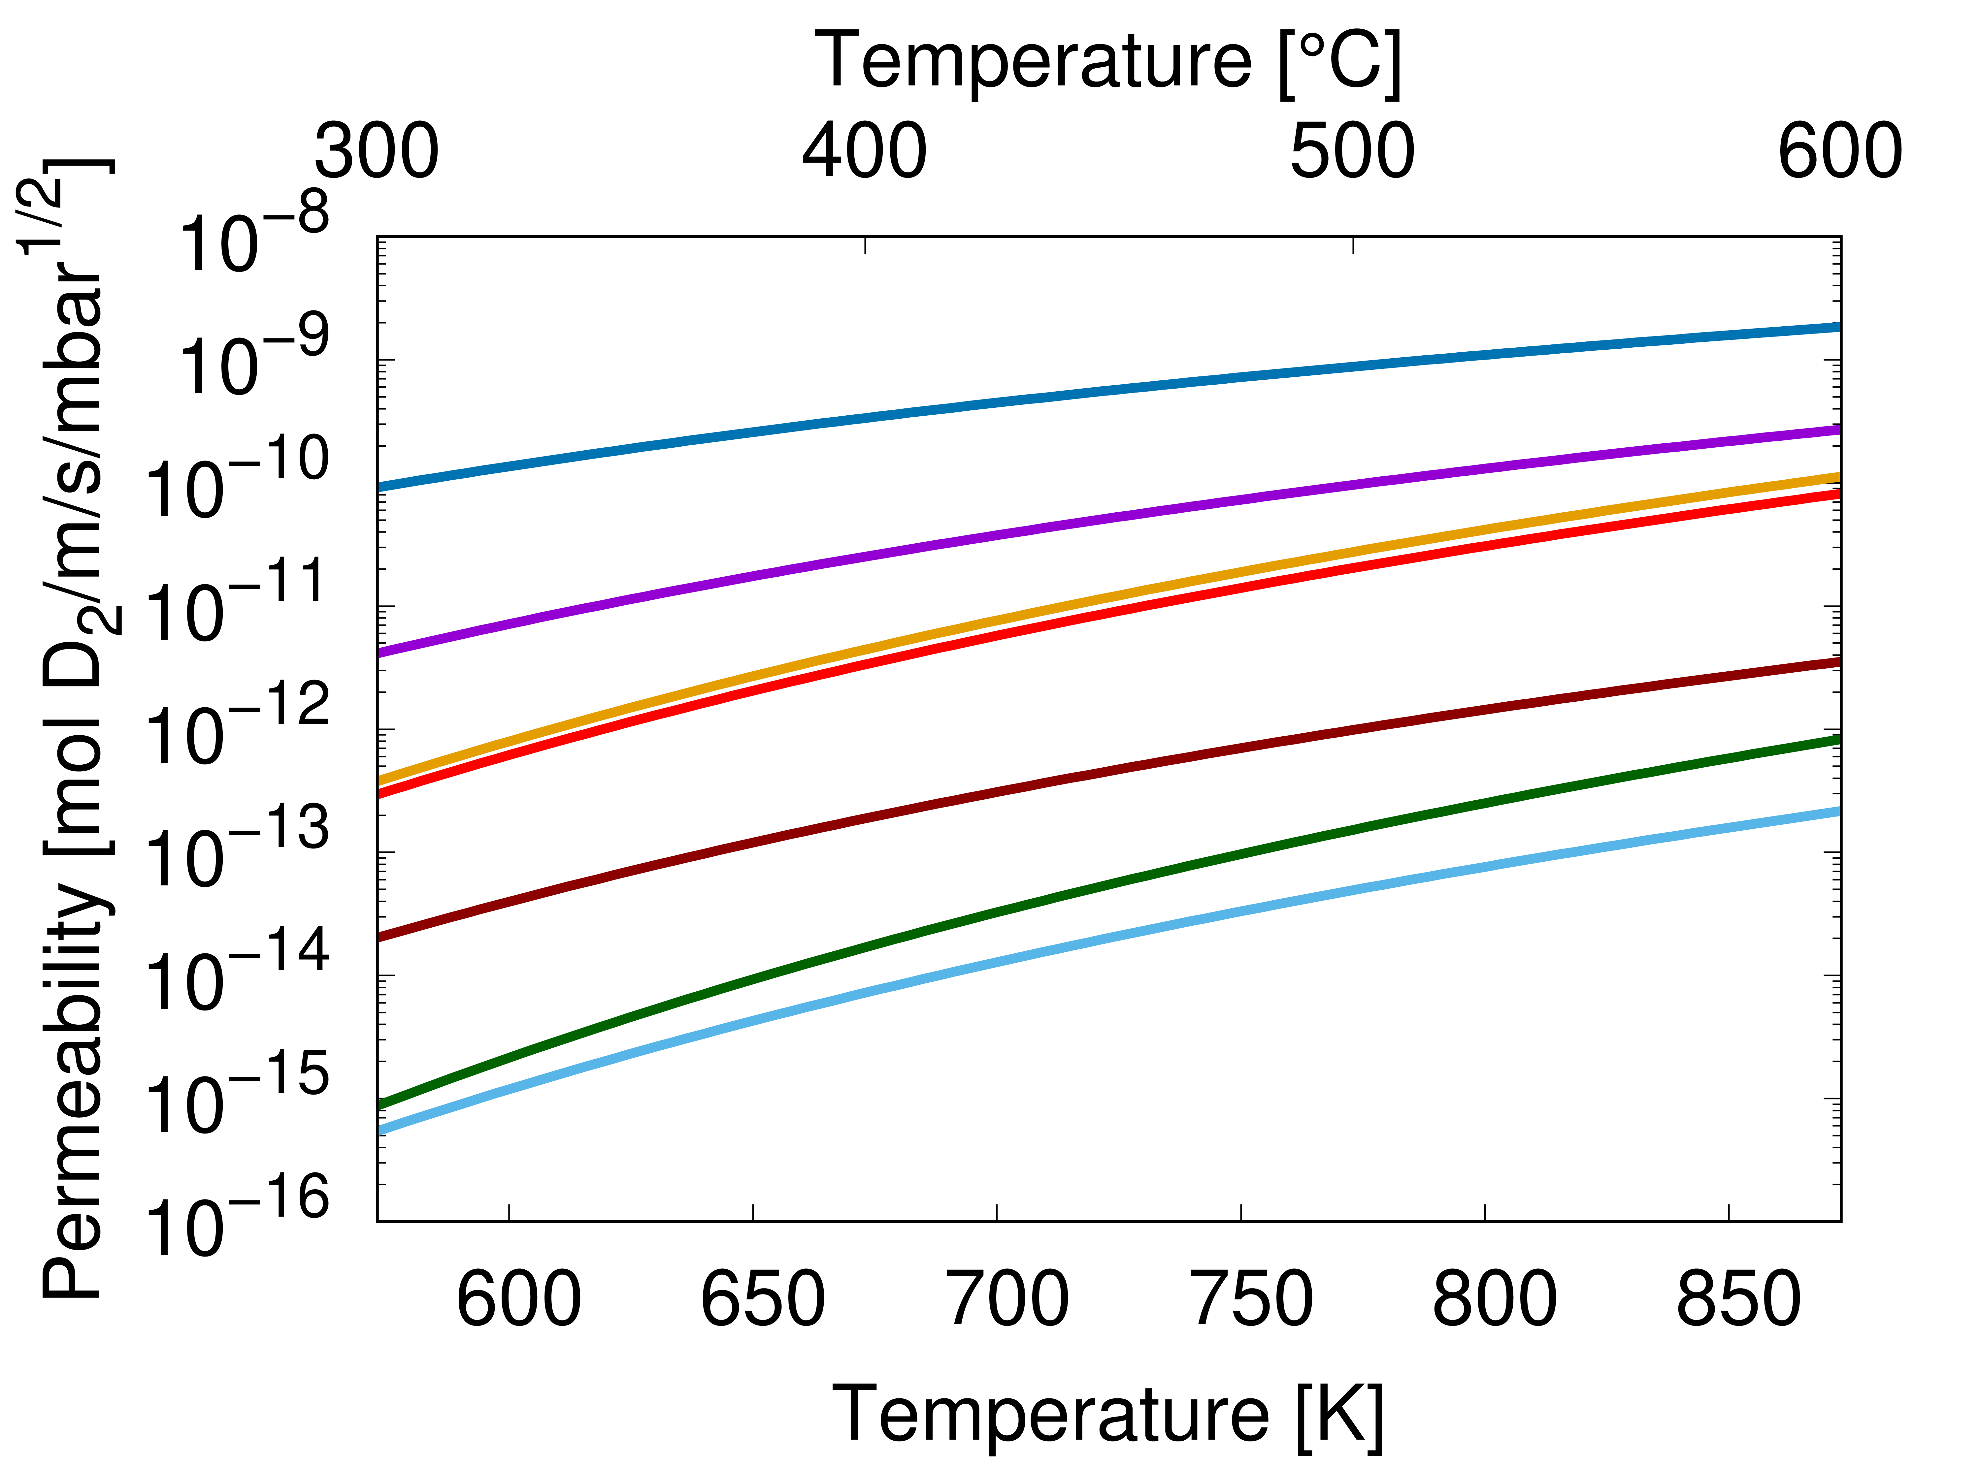
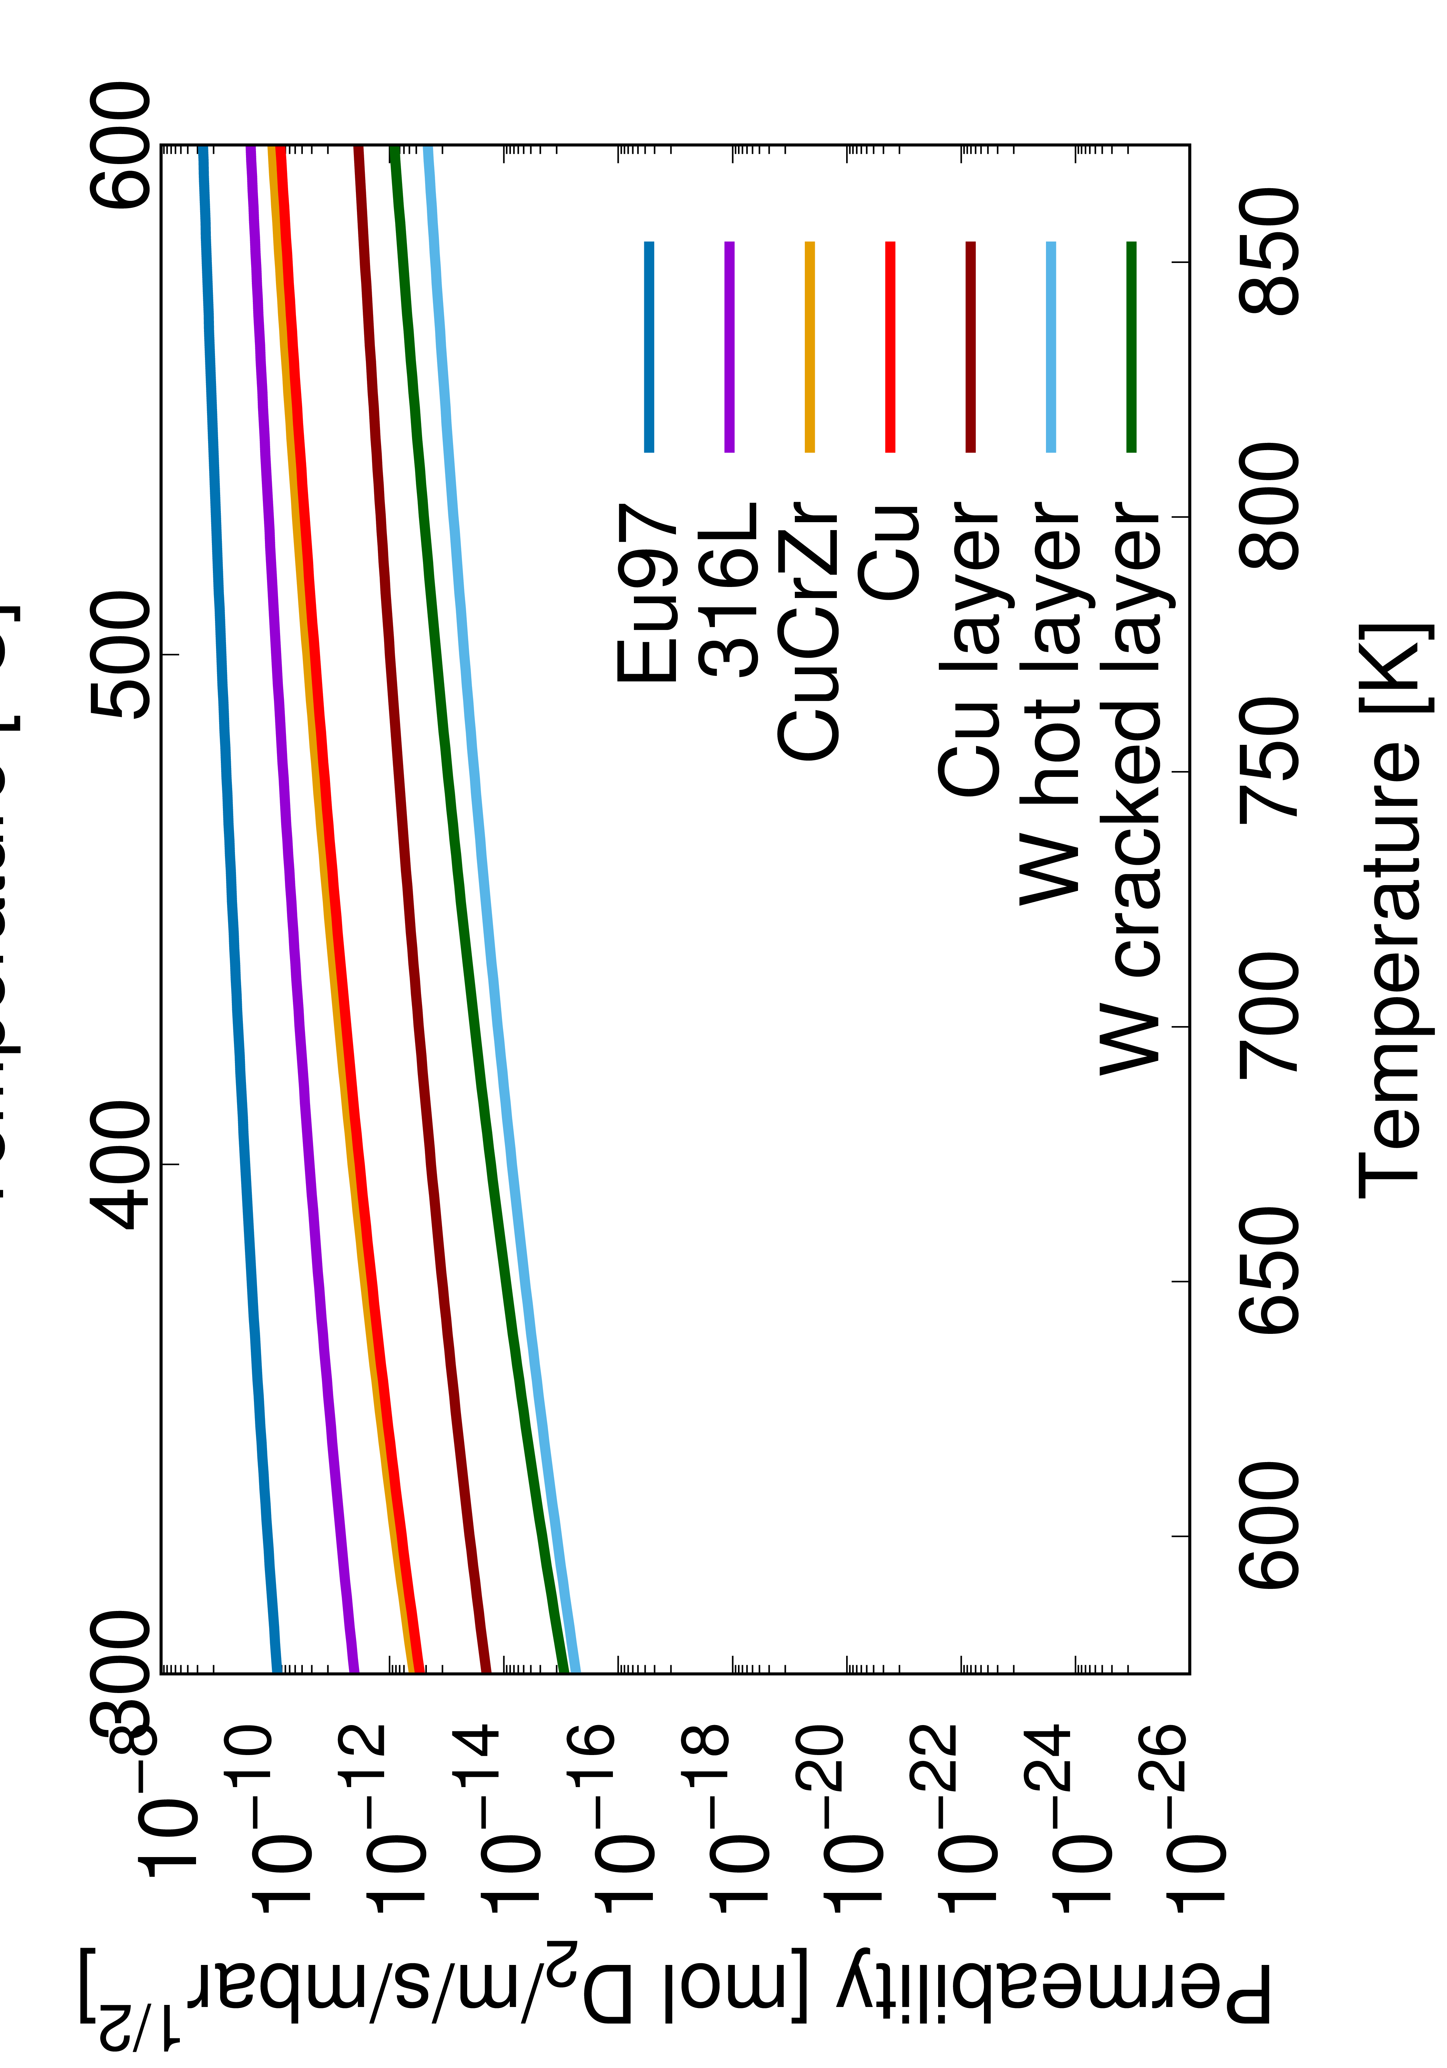
Conclusions
‘Pure’ Materials:
→ Polished samples → diffusion limited
→ Permeability of Eu97 higher than 316L
→ Permeability Cu / CuCrZr similar
Coated Substrates:
→ Influence of the interface is minor
→ Influence of the microstructure is large
→ Permeability of layer different to bulk permeability
→ Comparison of coatings deposited on different
substrates is possible
→ Increase of permeability due to cracks in layer
→ Substrate heating during deposition leads to a stable coating
Future Plans:
→ W hot coated Eurofer97
→ Permeation measurements on p-damaged Eurofer97

Slide 23


Thank you for your attention!
an.houben@fz-juelich.de
A part of this work has been carried out within the framework of the EUROfusion Consortium, funded by the European Union via the Euratom Research and Training Programme (Grant Agreement No 101052200 — EUROfusion and 2019-2020 under grant agreement No 633053). Views and opinions expressed are however those of the author(s) only and do not necessarily reflect those of the European Union or the European Commission. Neither the European Union nor the European Commission can be held responsible for them.

