Slide 1
WP PWIE meeting
6-9 February 2022
TSVV-5: Neutral gas dynamics in the edge
D. Borodin
on behalf of the TSVV-5 team

Slide 2
TSVV-5: Neutral Gas Dynamics in the Edge
Main simulation tool:
EIRENE code (and EIRENE-CFD packages) http://www.eirene.de/
We aim to transform it to IM- and HPC-ready neutral gas module (EIRENE-NGM) suitable for simulations on ITER and DEMO scale with large focus on (semi)detached divertor plasmas
FP-9 deliverables:
Neutral gas code that allows for an efficient use of HPC resources (towards exascale systems and/or HPC booster techniques) through suitable parallelization methods.
Revised and extended physics basis for the neutral gas model. Further development of the underlying collision-radiative model towards the full vibrational resolution for all hydrogen isotopes and specific impurities for seeding.
Improved (in contents and structure) Atomic and Molecular database for volumetric and surface processes. Database access through generalized interfaces to, e.g., atomic, molecular, nuclear and surface (AMNS) physics data.
Interfaces and boundary conditions necessary for future applications; modularization of the neutral gas code to facilitate coupling to computation fluid dynamics (CFD) codes (2D or 3D codes, turbulence codes, time-dependent) and possibly also to gyro-kinetic/gyrofluid plasma codes.
Strategy towards a validated predictive capability for integrated fusion reactor modelling for (semi-)detached divertor plasmas. Liaison with TSVV Tasks 3 and 4.
Neutral gas code that allows for an efficient use of HPC resources (towards exascale systems and/or HPC booster techniques) through suitable parallelization methods.
Revised and extended physics basis for the neutral gas model. Further development of the underlying collision-radiative model towards the full vibrational resolution for all hydrogen isotopes and specific impurities for seeding.
Improved (in contents and structure) Atomic and Molecular database for volumetric and surface processes. Database access through generalized interfaces to, e.g., atomic, molecular, nuclear and surface (AMNS) physics data.
Interfaces and boundary conditions necessary for future applications; modularization of the neutral gas code to facilitate coupling to computation fluid dynamics (CFD) codes (2D or 3D codes, turbulence codes, time-dependent) and possibly also to gyro-kinetic/gyrofluid plasma codes.
Strategy towards a validated predictive capability for integrated fusion reactor modelling for (semi-)detached divertor plasmas. Liaison with TSVV Tasks 3 and 4.
Code performance, parallelization, refactoring, domain decomposition, I/O for HPC, …
Improved physics and features incl. fluid-kinetic hybridisation (FKH) and improved CRMs
Improved AMNS data, both in structure/physics and content
EIRENE as NGM – restructuring, interfaces to other codes, time-dependent runs, kinetic ions
Validation with experiments and test of predictive capabilities for ITER and DEMO

Slide 3
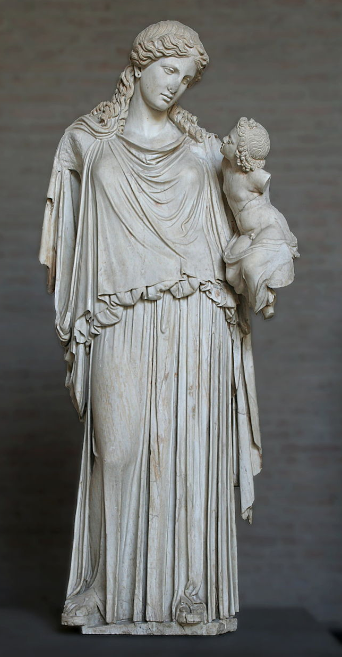
EIRENE-NGM-DEVELOPERS (TSVV-5)
D.V. BORODIN, F. Cianfrani, S. Wiesen, D. Harting, P.Börner, B.Küppers
Forschungszentrum Jülich, Institut für Energie- und Klimaforschung – Plasmaphysik, Germany
W. DEKEYSER, S. CARLI, M. BLOMMAERT, N. HORSTEN, W. VAN UYTVEN, M. BAELMANS
KU Leuven, Department of Mechanical Engineering, Belgium
B. MORTIER, G. SAMAEY, ..? E. LOEVBACK ?..
KU Leuven, Department of Computer Science,Belgium
Y. Marandet, P. Genesio
Aix-Marseille Univ., France
H. Bufferand
CEA, IRFM, France
E. WESTERHOF, J.G. MUNOZ
DIFFER - Dutch Institute for Fundamental Energy Research, Eindhoven, the Netherlands
M. GROTH, A. HOLM , A.CHanDRA
Department of Applied Physics, Aalto University, Espoo, Finland
H. LEGGATE ← HLST, ACH-MPG
DCU
ACH-VTT:
F. Granberg, J. Åström
O.LaPPI
ACH-IPPLM:
D.Yadykin
Yu.Yakovenko
Eirene with the infant Ploutos

Slide 4
Contributions to “all bells and whistles ITER run”
1) AMNS data structure and content 2) New CRMs for molecules (isotopes, resolution by rovibrational states)
3) Code development and maintenance
4) Kinetic ions
NGM with interfaces
Optimized massive parallelisation including domain decomposition
KUL
Code Modulisation
CEA
Time-resolved
FZJ
Adjoint approach
DIFFER
reduced models for isotopes in FW, outgassing etc.
Aalto
ITER scenario with semi-detachement
Reduced model AMNS data
Only joint effort makes it realistic on the 5 year time scale!
1) FE model for divertor target and FW
2) detachment in transients
3) Validatrion at Magnum-PS
Validation:
spectroscopy/bolometry at JET and MAGMUM,

Slide 5
Contributions to DEMO simulations
1) AMNS data structure and content 2) New CRMs for molecules (isotopes, resolution by rovibrational states)
3) Code development and maintenance
4) Kinetic ions
NGM with interfaces
Optimized massive parallelisation including domain decomposition
KUL
Code Modulisation
CEA
Fluid-kinetic hybridisation (FKH)
FZJ
DIFFER
Adjoint approach
reduced models for isotopes in FW, outgassing etc.
DEMO simulations
Aalto
Reduced model AMNS data
Only joint effort makes it realistic on the 5 year time scale!
Validation:
spectroscopy/bolometry at JET and MAGMUM,
FE model for divertor target and FW

Slide 6
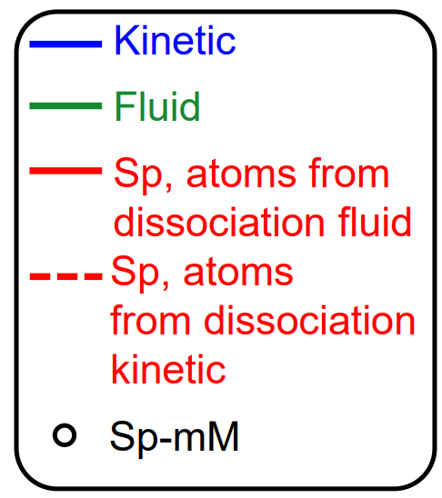
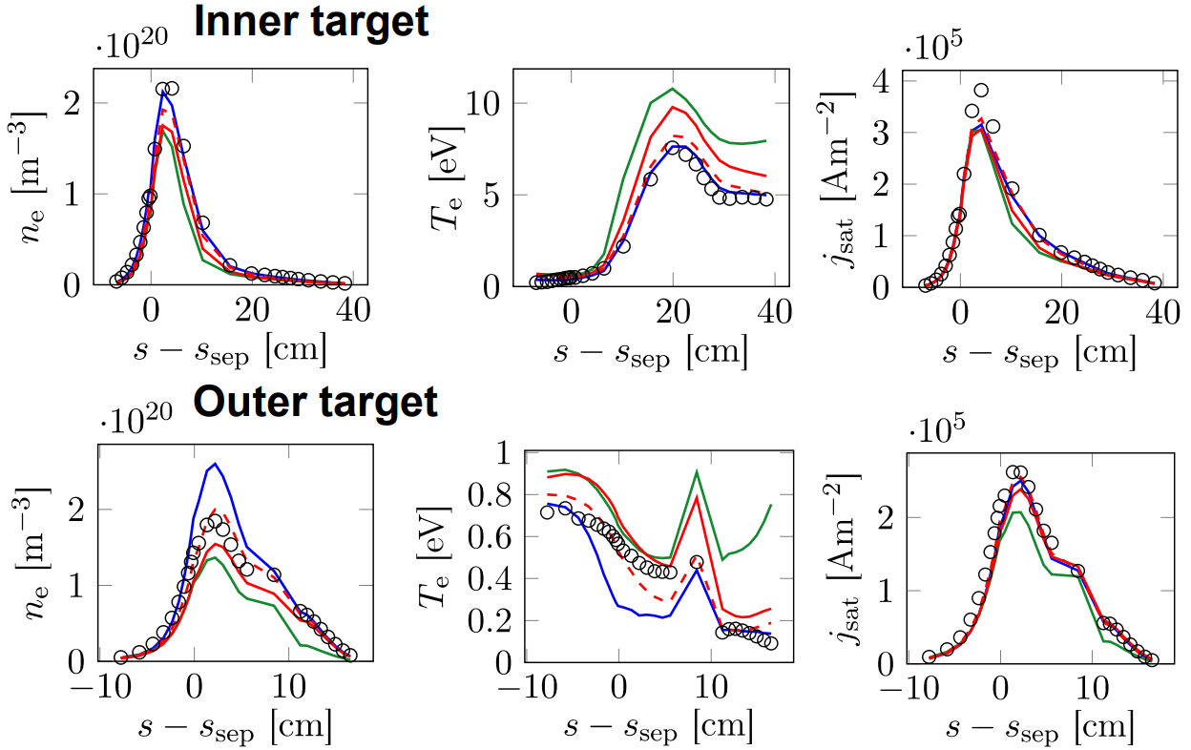
Recent progress with FKH (JET L-mode case)
N.Horsten et al., PET-2021, CPP-2022
Purely micro-macro (mM) approach for rectangular slab geometry with fixed background plasma
2021
Micro-macro approach combined with spatially hybrid approach (Sp-mM)
• Realistic geometry with void regions
• Coupling to kinetic molecules
• Coupled plasma-neutral simulations

Slide 7
FKH Progress 2022 summary
The fluid, (SpH) hybrid and kinetic neutral models were validated with a realistic JET ILW L-mode plasmas cases [2]
This not a slab, but a realistic tokamak configuration, incl. voids, molecules, …
Large fluid-kinetic discrepancies at low density (factor 2), but smaller discrepancies at higher density (50%)
Fluid-kinetic discrepancies in both density regimes successfully corrected by hybrid approach
Drift and n-n effects are successfully introduced
Alternative hybrid approach that avoids cancellation errors by construction under development. Hilbert expansion based fluid model derived; both diffusive & hydrodynamic scaling investigated [V. Maes, paper in preparation]
Release of fluid and hybrid approaches in extended grids version of SOLPS-ITER to the community during dedicated workshop hosted in KU Leuven, November 14-18

Slide 8
Code development – version merging
The main focus with regard to development of the EIRENE code in 2022 was on reuniting the various diverging versions of the code used in FZJ and at ITER.
Roughly 20 different code versions have been analysed and merged together. Thereby taking advantage of developments provided by FZJ external developers.
These developments include
Charge state bundling
Parallelization of the code using shared memory techniques (OpenMP)
Extensions of the existing parallelization of the code with message passing techniques (MPI) by implementation of different parallelization schemes.
Introduction of radiation tallies
Implementation of species resolved volume averaged tallies and their use with species specific rescaling of calculation results in order to improve the particle balances.

Slide 9
Code development - priorities
Initially version-specific code has been generalized in a way it can be used by all the interested parties (RU or specific architecture related code removed).
All changes to the code are carefully tested (still ongoing!..).
Code modifications affecting simulation results were tracked down to their origin and the reasonability investigated.
Updated reference outputs are provided for the testcases in the continuous integration chain (CI).
We are approaching the 1st milestone release of the code, which should be a basis for further joint development

Slide 10
EIRENE licencing - User Agreement (UA)
Old UA
acknowledgement of FZJ origin of EIRENE, non-military use, non-commercial use, no cost/liability for FZJ, etc.
www.eirene.de/new_eirene
New UA “EPL (EIRENE public license)”
Based on copyleft licence (however GPL3.0 occurs to be not suitable).
Similar declarative statements as in the old UA.
More clear statement about the EIRENE-based publications.
Developers and users are divided into “basic” and “associated” ones (AD).
NEW: commercial use of executable for any AD group.
➔ ADs get more rights on decision-making, direct access to the repository, etc.
ADs must keep to the “Developer Code of Conduct” (see at INDICO).
Current status: License is generally ready… and is now part of the source

Slide 11
CRM solvers available
CRM (technically) = reaction data + SOLVER
$$\frac{dN_{i}}{dt}=0$$
Most solvers solve algebraic stationary system of equations
in such cases the solver is much less valuable as the A&M data collection
this statement is underlined even by the developers of the very well established and mostly up-to-date YACORA model
CRM containing molecular species is even more complex, e.g. one needs to track more processes and more states (vibrational, rotational).
Tracking all the states as separate species demands enormous CPU and memory resources.
EIRENE pre-calculates rates for each volume cell. It also allows to pre-calculate values for various T_{i}/T_{e} ratios.
D.Wünderlich and U.Fantz,
Atoms 2016, 4(4), 26

Slide 12
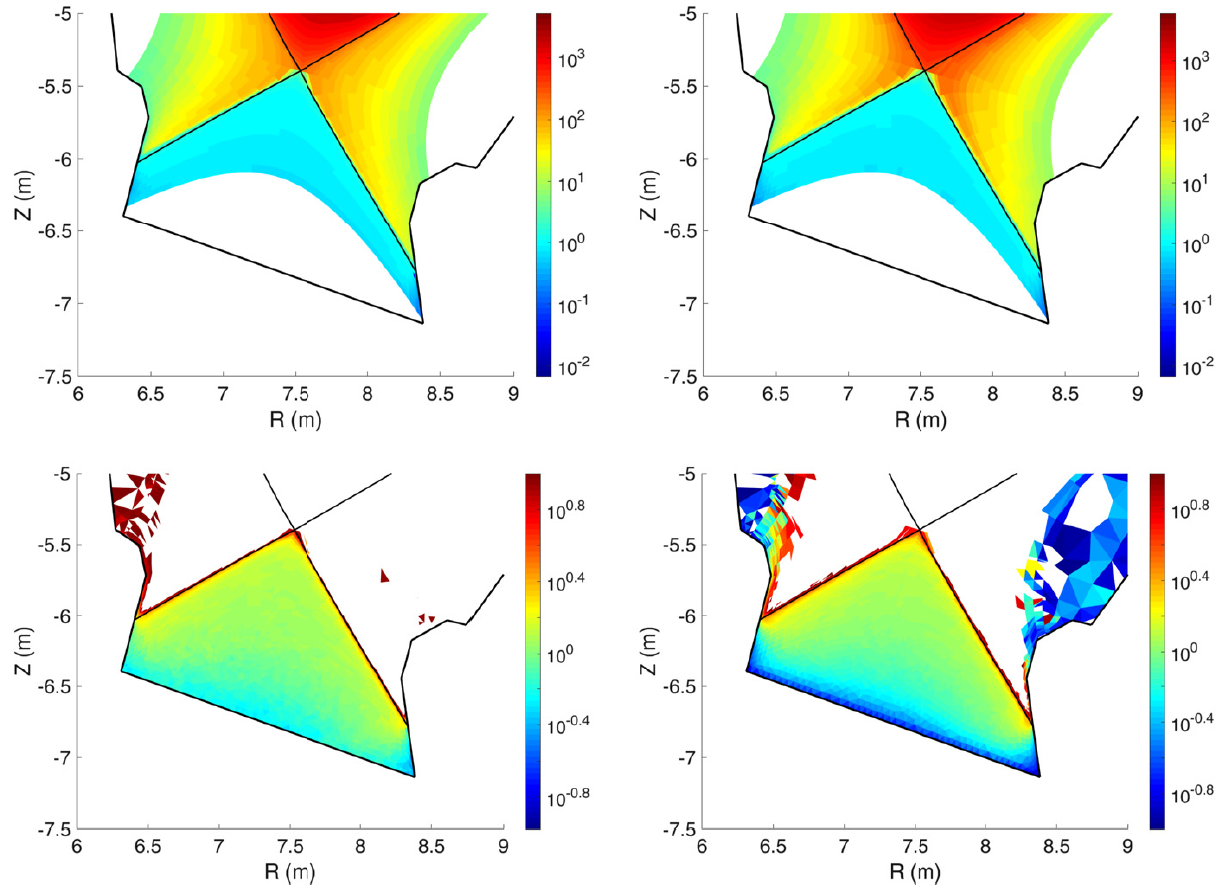
SOLPS-ITER basic simulation case for EU-DEMO
F.Subba et al.,
NF 61 (2021) 106013
Below X-point:
T_{e}=T_{i}=10eV
T(H)=T(H₂) =10eV
N_{e} ~ 10e18 m⁻³
N(H)=10e20 m⁻³
T_{e}
T_{i}=T_{H+}
T_{H}
T_{H2}

Slide 13
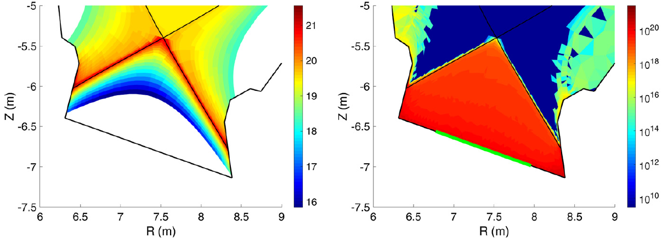
SOLPS-ITER basic simulation case for EU-DEMO
F.Subba et al.,
NF 61 (2021) 106013
Below X-point:
T_{e}=T_{i}=10eV
T(H)=T(H₂) =10eV
N_{e} ~ 10e18 m⁻³
N(H)=10e20 m⁻³
n_{e}
N_{H}
These are semi-detached conditions (1 point)
Attached vs. detached + 2-3 semidetached cases would be wishful to have!
We use EIRENE or standalone CRM to identify spectral features useful for the degree of detachment control for this plasma conditions
We can run (and mean to in future!) full EIRENE: SOLPS with a “frozen” fluid side (B2.5)
This option is not mature enough for meaningful physics results
We use standalone CRM and vary consrtant plsma conditions around

Slide 14
COLLISIONAL-RADIATIVE MODEL
Particle species
H⁺, H, H₂⁺,H₂
Reaction | Type | Source
H₂ + e → H₂⁺ + e + e | molecular ionization | H2vibr
H₂ + e → H₂(b_{triplet}) → H + H + e | neutral dissociation | H2vibr
H₂ + e → H + H⁺ + e + e | dissociative ionization | Amjuel
H₂ + H⁺ → H₂⁺ + H | charge exchange (CX) | H2vibr
H + e → H⁺ + e + e | ionization | Amjuel
H₂⁺ + e → H + H⁺ + e | neutral dissociation (MAD) | Amjuel
H₂⁺ + e → H⁺ + H⁺ + e + e | dissociative ionization (MAI) | Amjuel
H₂⁺ + e → H + H | dissociative recomb (MAR) | Amjuel
H⁺, e sinks (reservoirs)
Molecular source:
Reference value
Plasma parameters:
Fixed electron and ion densities:
n_{e} = n_{i} = 10¹⁹m⁻³ for [1]
n_{e} = n_{i} = 10²¹m⁻³ for [2]
Temperature: T_{e} = T_{i} = 0.2÷30eV.
JET
EU-DEMO
[1] M Groth et al. NF 2013 [2] F Subba et al. NF 2020

Slide 15
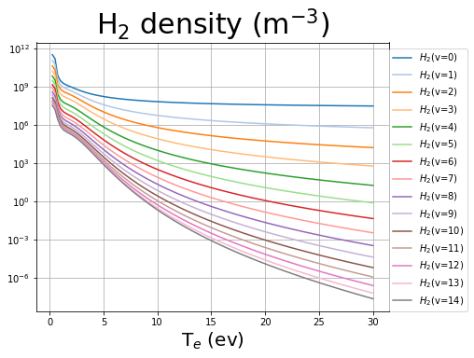
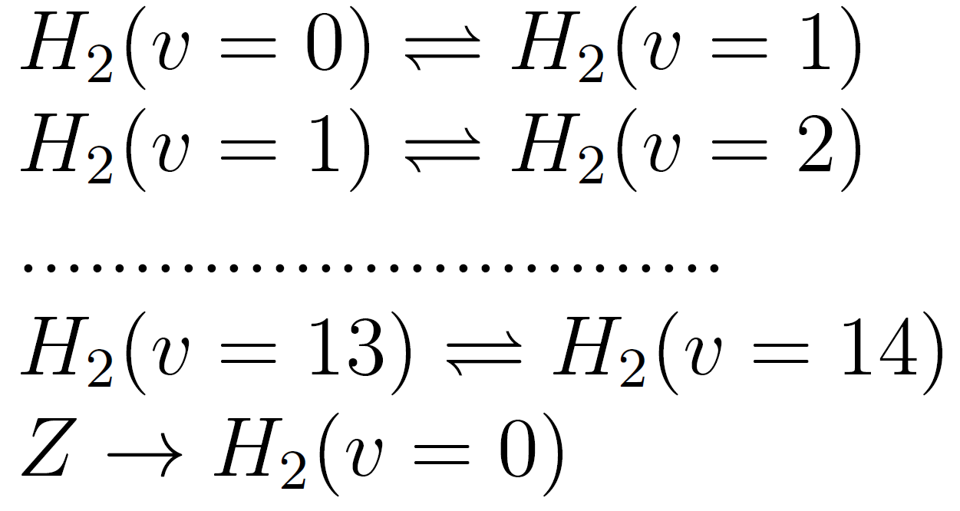
YACORA: inclusion molecular source term
Stationary run vibrationally resolved:
YACORA + Source term
adjustable to the Edge2D-EIRENE
Particle species
F.Cianfrani,
EPS-2022
Reactions
electron impact
proton impact
electron impact
vibrational transitions
H₂ source term

Slide 16
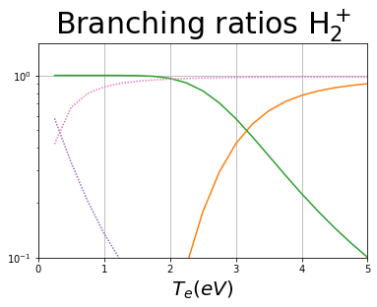
СRM simulations (standalone): branching ratios
EU-DEMO
low temperature (T < 2eV) leading reaction chains:
MAD
MAR/MAD competition at very low temperature
H₂+H⁺→ H₂⁺+H H₂⁺+e → H+H⁺+e
H₂+H⁺→ H₂⁺+H H₂⁺+e → H+H
MAR

Slide 17
CRM: effect of vibrationally resolved states
F.Cianfrani et al.,
EPS-2022
vibrationally resolved molecular states H₂(v) (v=0 ..14) with electron-induced ladder-like trans H₂(v) + e → H₂(v±1) + e rates H2vibr
EU-DEMO
vibrational transitions are the main reaction channels at low temperatures

Slide 18
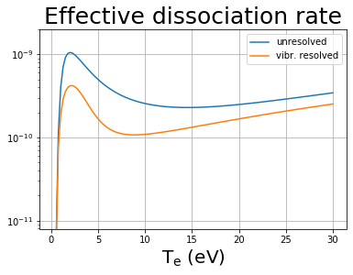
EU-DEMO – effect of resolution by vibrostates
F.Cianfrani et al.,
EPS-2022
Fully in line with the EIRENE and other CRMs:
“Up to 40% reduction in effective dissociation rate due to transport of vibrational states”
A.Holm, M.Groth, et al.,
PET, CPP 2021

Slide 19
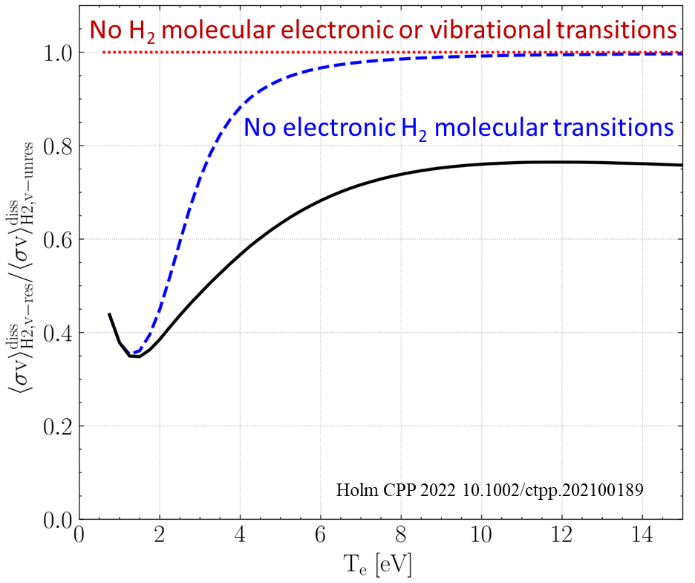
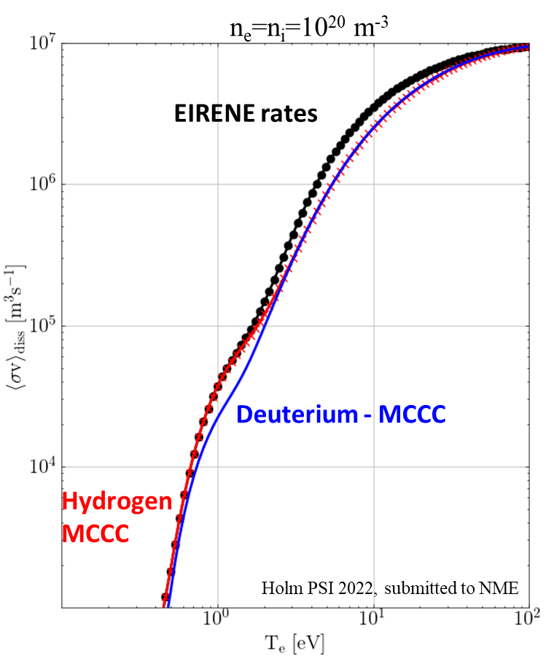
CRUMPET, YACORA simulations (standalone CRM)
Predicted isotope effect strongest for temperatures associated with detachment onset and detached conditions
MCCC data indicates weaker dissociation of both H₂ and D₂ for T_{e} > 3 eV compared to EIRENE data (AMJUEL, HYDHEL, H2VIBR)
Different CR processes cause up to 60% difference in dissociation rates
Impact strongest in the T_{e} = 0.5–4 eV range, where molecular processes strongest
Electronic transitions affect T_{e} > 4 eV
Vibrational transitions affect T_{e} < 4 eV

Slide 20
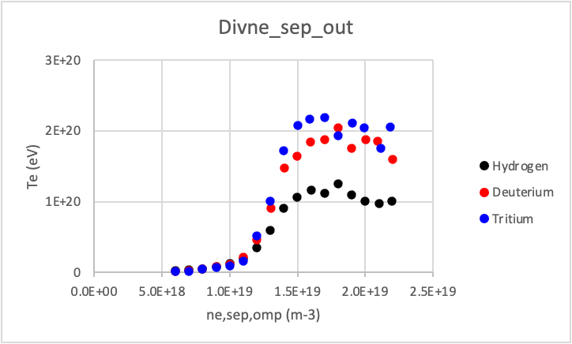
Isotop effect in „full-scale“ EIRENE (M.Groth)
Generic density scan with identical transport coeffs., models
Strong reduction in ion current to outer plate not yet reproduced ⇒ likely to require changes to transport coefficients
T_{e,OT} least affected by isotope species
Higher div. densities for T than for H plasmas observed in
JET-ILW L-mode plasmas, both exp. and in EDGE2D-EIRENE

Slide 21
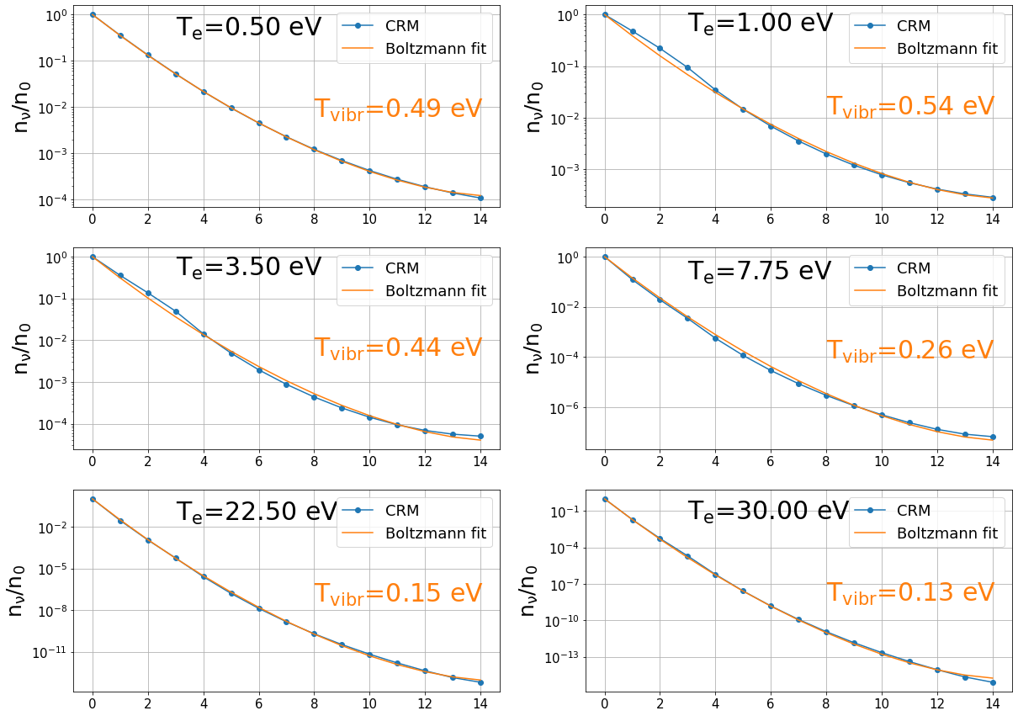
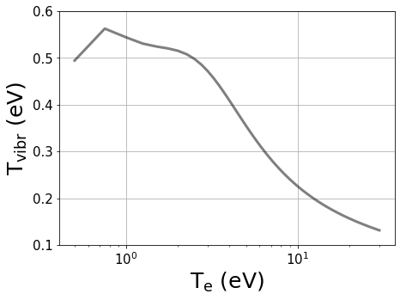
CRM: effect of T_{e} on vibrational populations
X
ground state: Boltzmann distribution
ν = 5
ν = 4
ν = 3
diss./ ion.
ν = 2
ν = 1
SOURCE
ν = 0
T_{vibr} increases with decreasing T_{e}
peak at low T_{e}

Slide 22
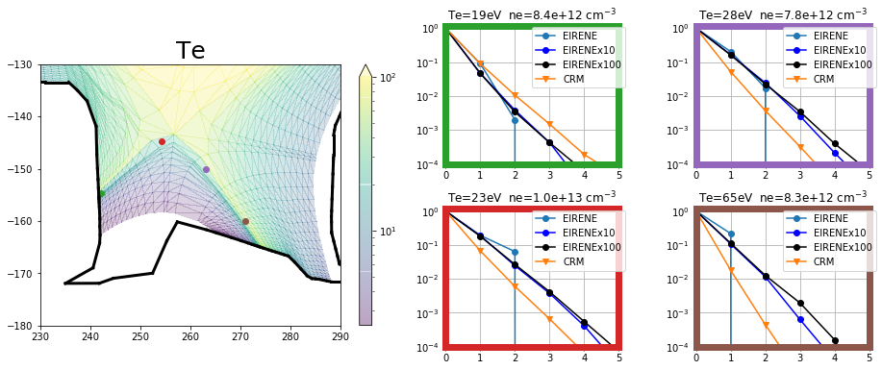
CRM vs EIRENE: vibr. Resolved – statistics issue
Simulations: molecular source
EIRENE: 793’300 histories
EIRENEx10: 7’933’000 histories
EIRENEx100: 79’330’000 histories
Gas puffing v=0
Reflection model (wall as a catalyst surface) v=0
$$\text{n}\text{ν}\text{/}\text{n}\text{0}$$
$$\text{n}\text{ν}\text{/}\text{n}\text{0}$$
disagreement for the population of vibr. excited states
$$\text{n}\text{ν}\text{/}\text{n}\text{0}$$
$$\text{n}\text{ν}\text{/}\text{n}\text{0}$$
JET shot 81472
ν
ν
One needs to

Slide 23
HYDKIN (web-based A&M data tool):
toolbox for plotting and manipulation of A&M data with a user-friendly graphical interface.
includes EIRENE databases: AMJUEL, HYDHEL, H2VIBR, METHANE, .. .
available at http://www.eirene.de/hydkin/
Password-protected (for access contact the authors).
D.Reiter et al.,
Phys. Scr. 2009
F.Cianfrani et al.,
ICAMDATA-2022

Slide 24
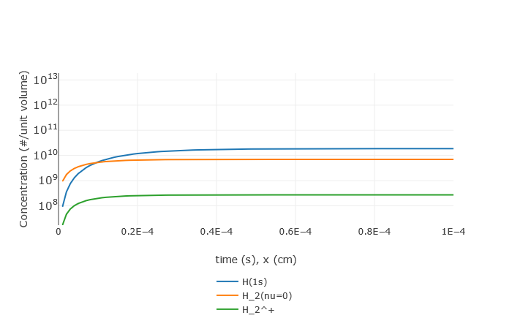
HYDKIN: particle solver (non-stationary)
“infinite reserve” of particles at fixed temperature and density
Default case (see next slides)
reservoir
Development of stationary equilibrium

Slide 25
HYDKIN: what is inside?..
CRM solver (transport excluded, pure A&M side of the problem) with extensive features
Stationary and non-stationary solution (assuming velocity and plasma pars)
Any specie can be treated as “Reservoir”
“Spectral analysis” based on eigenvalue approach (which reactions are most important?)
Sensitivity analysis – vary the plasma parameters, solver settings, reactions, etc.
Plotting, solver results visualisation
Useful for fast consistency checks and trivial analysis while constructing the CRMs
Good for physics analysis in case one follows established routines
Flexible reaction tables interconnected with the solver and plotting
Useful for fast consistency checks and trivial analysis while constructing the CRMs
Good for physics analysis in case one follows established routines
Input/output in various formats (new: JSON) including directly for EIRENE

Slide 26
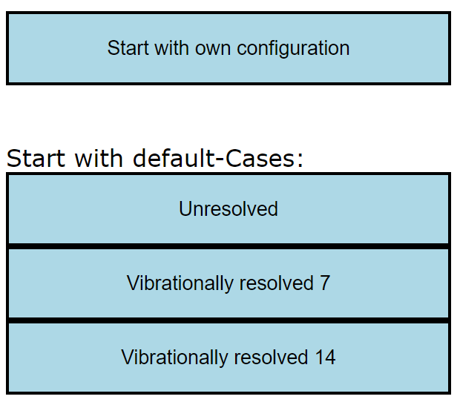
HYDKIN: using the power of the web-interface
The basis table is highly customisable:
Deselected reaction can be excluded from the view
User easily selects the level of info for each reaction to be shown
Basic, solver, plotting etc. tables are interlinked
All is optimised for checking high amounts of similar data
Critical things are highlighted
Data is grouped by the reactions (even if comes from various sources)
One can start with initial configuration (standard or custom) and do only essential (e.g. from physics) changes
For H₂ case (example):

Slide 27
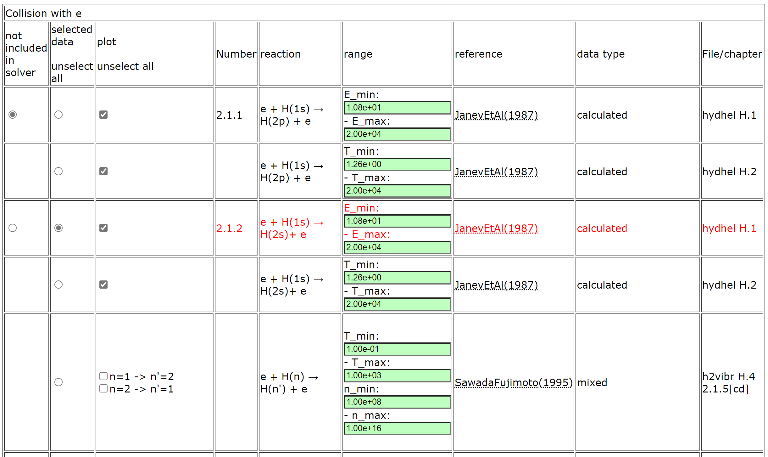
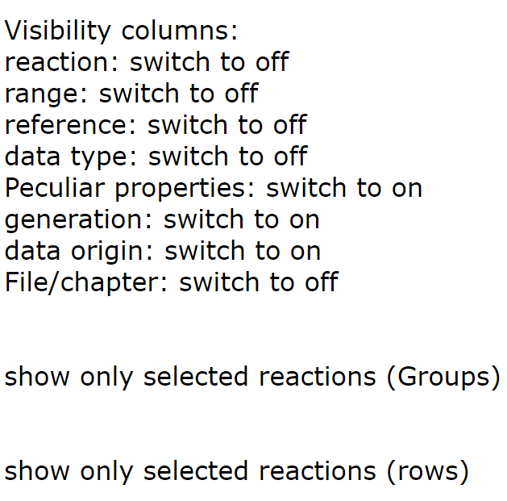
HYDKIN – new mode (H₂ case)
Buttons to adjust table content

Slide 28
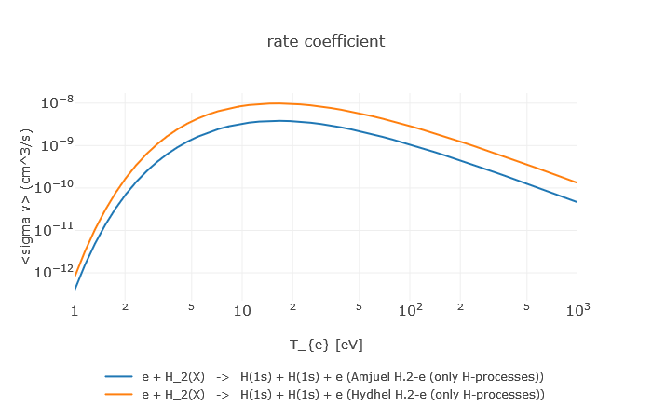
HYDKIN: comparison dissociation rates
e + H₂ → H + H + e
HYDHEL
AMJUEL
Factor 3 wrong

Slide 29
new HYDKIN:
New HYDKIN:
Activities:
grouping of reactions: easier comparison btw data from different sources
new column/features: sparse information now available
default cases: testing purposes and model for molecular decay
json output: reusability for new solver runs and other codes (EIRENE)
Conclusions Eirene Code Camp 22
we want to promote .. [HYDKIN] .. as a standard pre-processing tool for Eirene:
continue improving readability and usability.
write code for generating EIRENE input file (block 4) from json output (also good for consistency check).

Slide 30
New HYDKIN can be used to
to import/export data (JSON, tabular and other formats)
to produce input data for EIRENE and for other codes
to check data for consistency, abnormal features, etc.
to check and improve the results of the simulation
to understand A&M side of the problem and identify the most significant processes (among the selected ones)
to load/improve/save the developed configuration (selected reactions and parameters) including starting from the standard “default” pre-sets
EIRENE Code Camp 2022: we want HYDKIN to substitute certain EIRENE routines in data preparation (JSON) with consistency checks.
Reactions are grouped in the tables optimised for this kind of work

Slide 31
Summary for CRMs
CRM improvement is very significant part of the EIRENE development
It is key to identify useful spectroscopic features for RT control of detachment.
HydKin is largely updated and foreseen to be the main A&M pre-processing tool
All the development is ongoing in a view of future massive data extension
It is meant to provide flexible adjustment of CRMs and auto generation of EIRENE input
Application to the EU-DEMO case (P.Subba) shows that
Even standalone model is useful to understand the critical branching ratios
Tracking of vibrational states is essential
We have agreed with P.Subba on the basic degree of detachment scan, but this for now an elaborate

Slide 32
Thanks for the attention!

Slide 33
New CRM Solver for EIRENE concepted
This CRM is aimed to precompute rate coefficients accounting for all parametric dependences (n_{e}, T_{e}, but also T_{i}, …) in contrast with currently used polynomial fits (AMJUEL, …) + add a number of levels/processes not accounted for at this time
The internal states (e.g. rovibrational states in molecular species) are to be tracked with a flexible a flexible control over this resolution (as separate specie or variable).
The nonstationary solution for balance equations should be the default one
(with the stationary only as a useful option).
The solver should be modular, thus usable standalone or even in other codes.
The improved A&M data input should be readable and structured (for starters JSON, potentially also HDF5). It should be pre-processed mostly automatic and easily exchanged with other codes and tools. We need tools for visualisation and testing.
The only way to meet the exploding amounts of data from RMPS and CCC for molecules (with resolution by rovibrational states)
IAEA GNAMPP assists, but also reveals the challenges AMD Unit: GNAMPP
Not only performance and reliability to be improved, however including additional physics can be provided!
$$Ti≠Te ,$$
$$etc.$$
$$\frac{dN_{i}}{dt}≠0$$

