Slide 1
Permeation reduction factor of Chromia on Cr films on Eurofer¶
Vincenc Nemanič
vincenc.nemanic@ijs.si
“Jožef Stefan” Institute (JSI), Dept. of Gaseous Electronics, F6
Jamova cesta 39, Ljubljana, SLOVENIA

Slide 2
Introduction
Over the last years, several „fusion-related materials“ have been investigated in our lab *
by the gas-driven permeation method
Construction materials: AISI316 ITER grade (ITER), Eurofer (DEMO)
First wall metals: Be, W and BeW
Hydrogen permeation barriers (HPBs): TiAlN, SiN_{x}, WN, CrWN, CrN, Cr₂N, AlCrN, ZrN which were deposited by various sophisticated techniques
In the present campaign, we investigated the ability to prepare an efficient HPB in situ by controlled oxidation
* Original results presented in ~ 20 peer-reviewed papers.

Slide 3
Introduction
We determined the HPB efficiency of CrO_{x}
in situ grown on Cr bulk membrane at 400°C, 1 bar O₂
in situ grown on Cr film sputtered on Eurofer substrate
sputtered CrO_{x} on Cr film sputtered on Eurofer substrate
CrO_{x} has been frequently studied as a passivation layer on steels but rarely as an HPB. By oxidation, chromia (Cr₂O₃) is not always achieved but CrO_{x}.
Unfortunately, even pure Cr membrane has been rarely studied in permeation experiments, and data might be erroneous.*
Our first task was thus testing 1 mm thick Cr membranes.
*Stöver, D. et. al.; Hydrogen and deuterium permeation through metallic and surface-oxidised chromium, Surf. Coatings Technol. 28, 281–290 (1986).

Slide 4
Permeation rate (j) measurements
Permeation cell design (sample φ40 mm, A = 8.5 cm²) with Au sealing sets specific limitation:
temperature 200°C to 400°C,
upstream pressure 50 – 1000 mbar
downstream pressure 10⁻¹⁰ – 0.05 mbar
detection limit of j ~10¹¹H₂/cm²/s and j ~10⁶ D₂/cm²/s
Permeation rate determined by:
dynamic method applying calibrated QMS
or
gas accumulation method: calibrated capacitance manometers + QMS

Slide 5
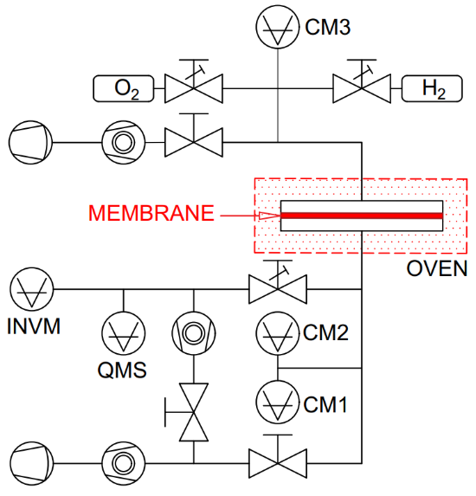
Experiment: All-metal UHV system for permeation
upstream section,
hydrogen pressure:
10 – 1000 mbar
oxygen pressure:
10 – 1000 mbar
downstream section,
hydrogen pressure
0 – 5.10⁻² mbar
analytical
section
Three sections: upstream, downstream and analytical. Deuterium is used for a higher discrimination ratio at highly impermeable membranes.

Slide 6
The formalism for simple bulk membranes
Task 1: Determination of Cr permeability and diffusivity
A solid 1 mm thick Cr membrane, termed „referential membrane“ with no Cr oxides, was prepared by well know approach by coating with Pd (100 nm).
Pd has a very high bulk permeability, but due to low thickness, it does not interfere with Cr data but mainly prevents unavoidable Cr oxidation by residual gases in high vacuum.
Pd withstands moderate thermal cycling up to 400°C, but the diffusion of Pd into bulk Cr limits long-term experiments and higher temperatures even in the UHV.

Slide 7
The formalism for simple bulk membranes
Results on Task 1:
Permeability: P₀ = 3.23x10⁻⁷ mol H₂/s/m/Pa^{0.5} and E_{a} = 0.68 eV
Diffusivity: D₀ = 9.0x10⁻⁵ m²/s and E_{a} = 0.59 eV.
The only published data on diffusivity in Cr is most probably erroneous.[Ref.5]
Ref 5 Stöver, D. et. al.; Hydrogen and deuterium permeation through metallic and surface-oxidised chromium, Surf. Coatings Technol. 28, 281–290 (1986).

Slide 8
The formalism of simple and double-layered membranes
Only AISI316 ITER grade and Eurofer could be measured as solid bulk membranes being strong enough to withstand gas load and sealing force!
**
Since most „fusion materials“ exhibit low bulk permeability, a concept of a „double-layered“ membrane enables the permeation tests.
1st layer: thick substrate (0.3 - 1 mm) made of a highly permeable material.
2nd layer: a dense, defect-free and well-matched film (0.5 – 10 µm) capable
of withstanding thermal cycling and long-term operation at high temperatures.
d₂ >> d₁,
membrane diameter >> d₁,d₂

Slide 9
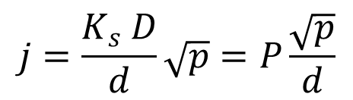
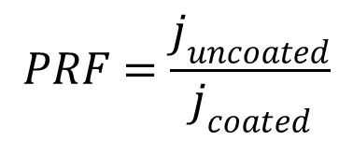
The formalism of double-layered membranes
Definition: the ratio of the steady permeation rate through the uncoated membrane j_{uncoated} versus the permeation rate through the coated membrane j_{coated}, is termed “the permeation reduction factor” (PRF):
$$PRF=\frac{j_{uncoated}}{j_{coated}}$$
(1)
The value of the PRF in the case of a double-layered membrane can be derived from the permeability P_{i} of each layer. The permeation rate j through a single layer of thickness d, having diffusivity D and solubility K_{s} is:
$$j=\frac{K_{s} D}{d}\sqrt{p}=P\frac{\sqrt{p}}{d}$$
(2)

Slide 10
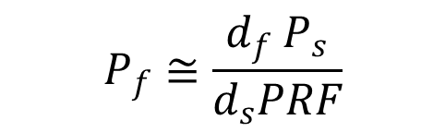
The formalism of double-layered membranes
The effective or apparent permeability P_{e} for the double-layered, (index _{f} for the film and index _{s} for substrate) is:
(3)
where each of the two layers is specified by its thickness and permeability P. The resulting PRF is:
(4)
For a thin film barrier, where d_{f} << d_{s}, and P_{f}<<P_{s}, eq. 4 may be applied to extract the most relevant barrier property, i.e. permeability P_{f}:
(5)

Slide 11
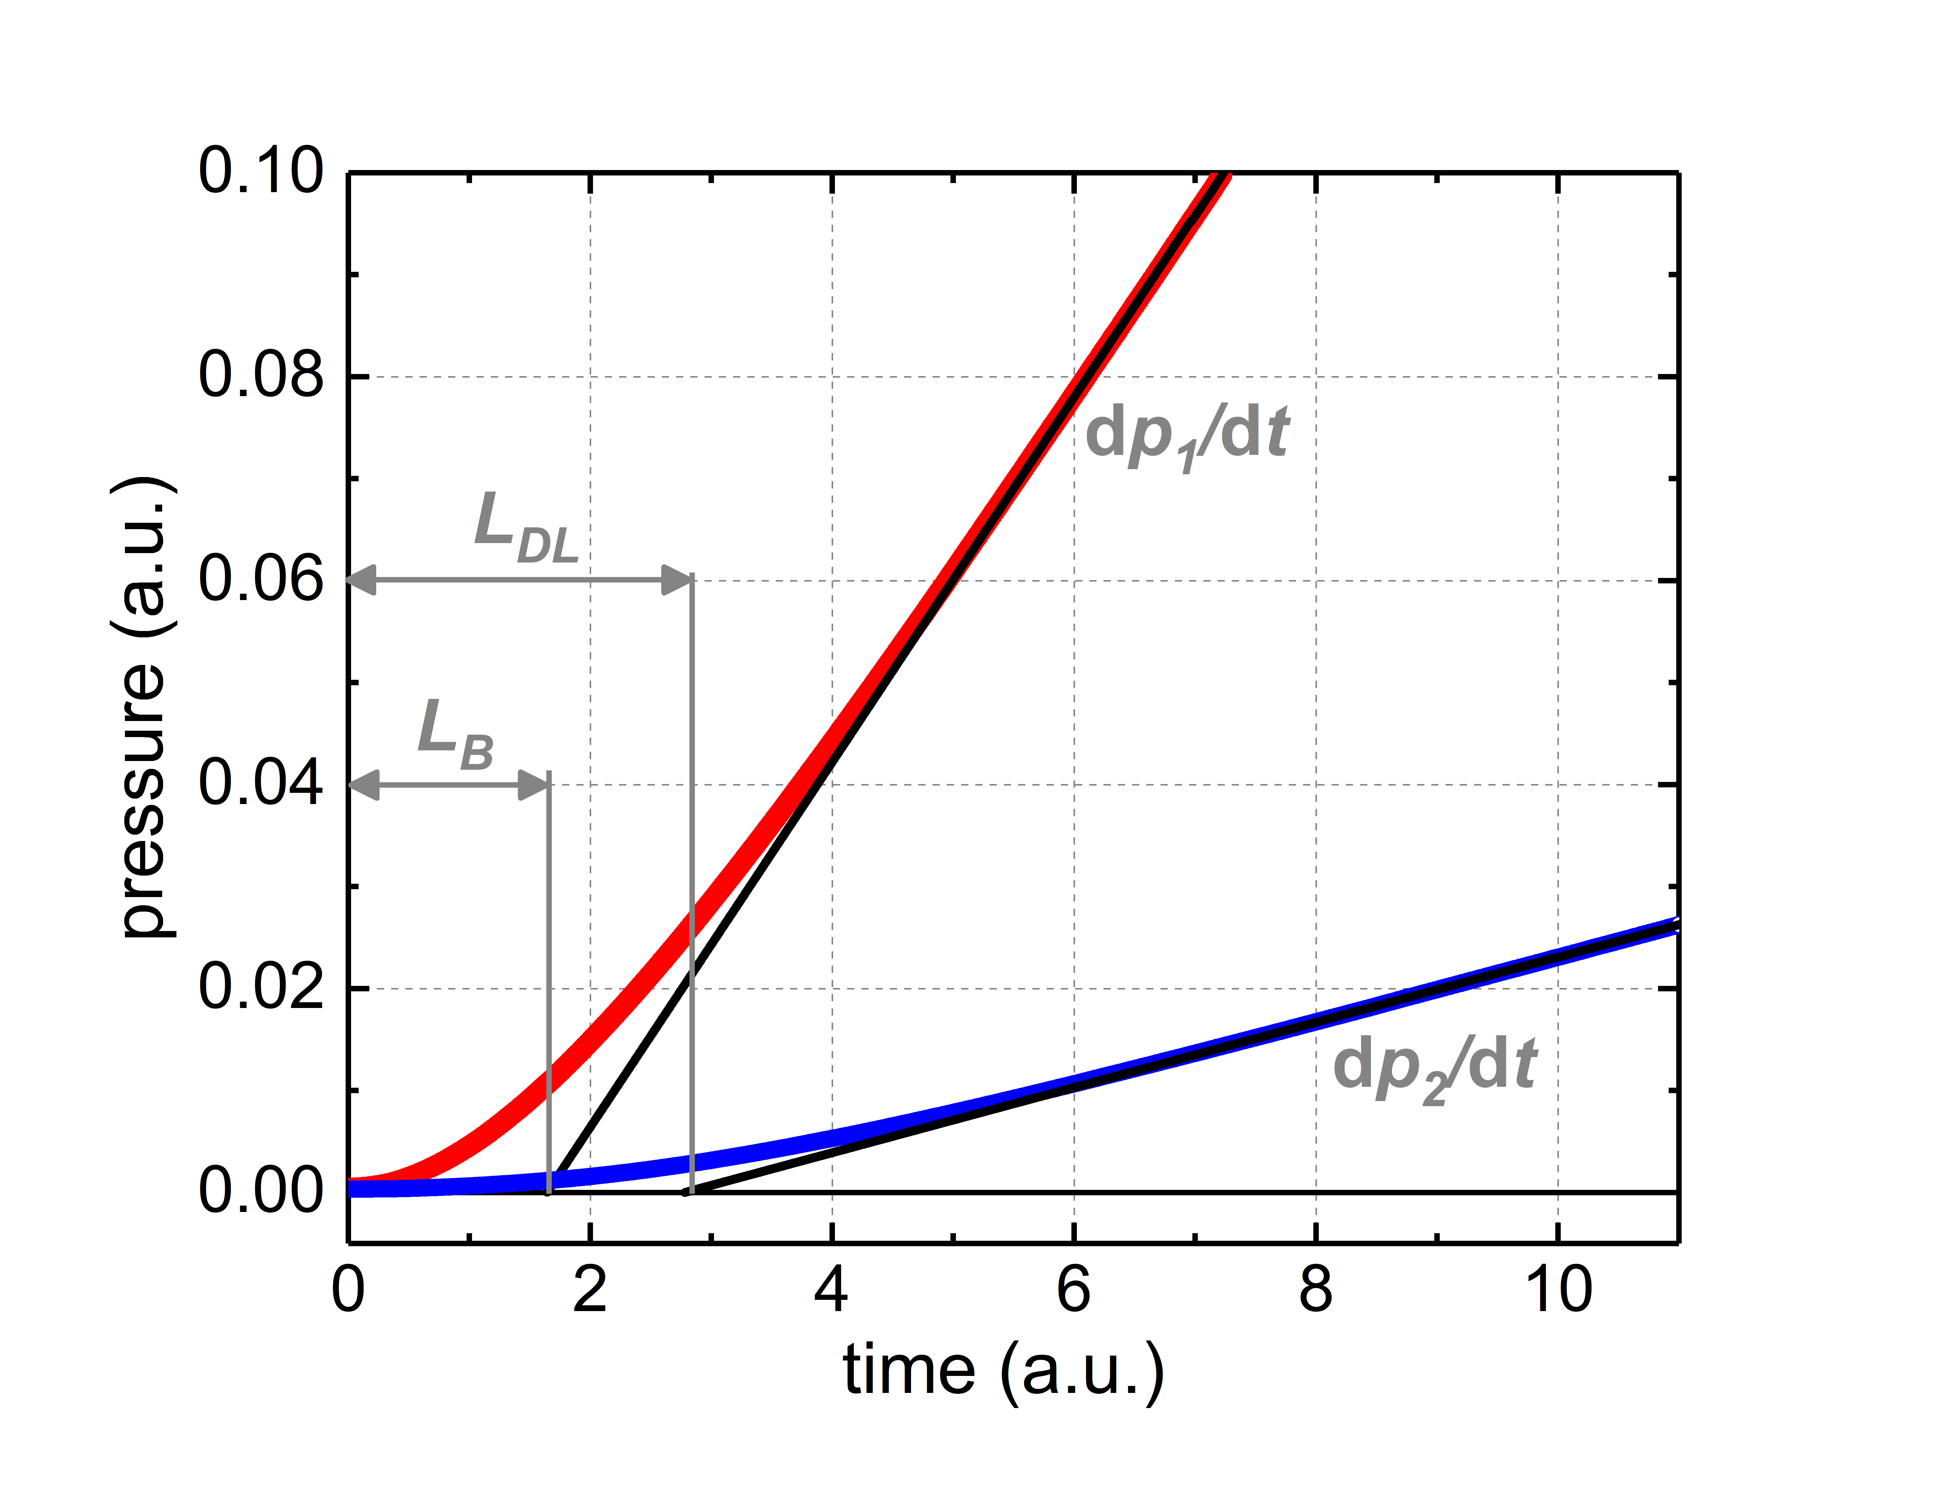
Experiment: Procedure on double-layered membranes
Measuring procedure: after admittance of hydrogen to the upstream side,
steady hydrogen permeation rate through the bulk substrate is established
within a characteristic time-lag L (gas accumulation method displayed)
bulk membrane double-layered membrane
Double-layered membrane exhibits lower permeation rate and longer L, L_{DL}>L_{B}

Slide 12
Review of hydrogen permeation barrier (HPB) efficiency achieved from double-layered membrane experiments
The true mechanism of efficient hydrogen permeation rate suppression (PRF>1000) by a dense dielectric film has rarely been analysed theoretically (=ab initio calculations)*. We do not have a general model of proton migration in the lattice. All data in Table 1 are related only to „thin films“ <10 µm.
Experimental data with a lower PRF (than predicted) were mostly explained by film cracks and defects, which are difficult to confirm by SEM or other methods.**
*Sun, P. Z. et al. Limits on gas impermeability of graphene. Nature 579, 229–232 (2020)
**B. Zajec, Int. J. Hydr. Energy 36 (2011) 7353–7361

Slide 13
In situ grown hydrogen permeation barriers
* data on bulk Cr permeability and Cr₂O₃ is rare; thickness of Cr₂O₃ was estimated, not measured.
Table 1 from V Nemanič, Nuclear Materials and Energy 19 (2019) 451–457
Motivation

Slide 14
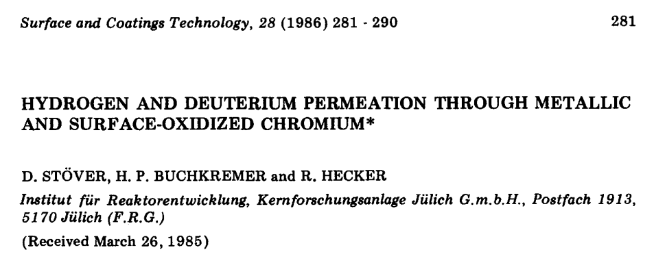
In-situ grown hydrogen permeation barriers
Motivation for our work: The attractive property of an ad-layer grown in situ in (Ar + D₂ + D₂O) at 700°C and 800°C, was claimed; no data on characterisation of Cr oxide properties was reported.

Slide 15
In-situ grown hydrogen permeation barriers
For highly impermeable materials, the effect of in situ grown ad-layer on hydrogen permeation rate is difficult to evaluate. Cr exhibits low bulk hydrogen permeability, so an ad-layers effect can hardly be detected even when the ad-layer is grown in situ.
An old publication on CrO_{x}* and an only recent one **.
An approach that simplifies the task is to prepare first a double-layered membrane:
highly permeable substrate + less permeable film Cr.
three-stage testing follows
* D. Stover, et. al, Surf. Coat. Technol. 28 (1986) 281–290
** V Nemanič, M Žumer, J Zavašnik, J Kovač, Intern. J of Hydrogen Energy, in press

Slide 16
The formalism of double-layered membrane testing
Task 2:
1) Permeation rate evaluation of a double-layered membrane at selected T.
2) The Cr surface is exposed to oxygen (p, T, t), (1 bar O₂, 400°C, 2-20h)
3) Repeated permeation rate evaluation by hydrogen at 400°C
The effective PRF exhibits the role of the Cr₂O_{x} ad-layer.
The highest PRF = 3800 at 400°C was achieved after 2h oxidation in O₂ and corresponded to ~28 nm thick Cr₂O_{x}. ** This value could not be repeated!
Cr₂O_{x} seems to be the most effective barrier material ever reported:
P_{Cr}(400°C) = 7.0x10⁻²⁰ mol H₂/s/m/Pa^{0.5}
* V Nemanič, M Žumer, J Zavašnik, J Kovač, Intern. J of Hydrogen Energy, in press

Slide 17
Advantage of double-layered membrane: Cr film on Eurofer
Task 3:
Cr is brittle – testing of our 40 mm diameter membranes thinner than 1 mm was not feasible. Sealing by golden gaskets exerted high and not uniform pressure which caused cracking.
Using 3.3 µm Cr film sputtered on 0.5 mm Eurofer, a strong double-layered membrane with PRF = 1.03 was prepared. Cr film has thus a negligible impact on permeation rate.
Testing of the influence of various gases on hydrogen permeation rate through modified Cr surface became substantially easier, as at 400°C,
P_{Cr}/P_{Eurofer} = 0.2 shorter evaluation period
D_{Cr}/D_{Eurofer} = 0.004 lower detection limit
This double-layered membrane in oxidation experiments is „analogue“ to
~0.1 mm thick bulk Cr.

Slide 18
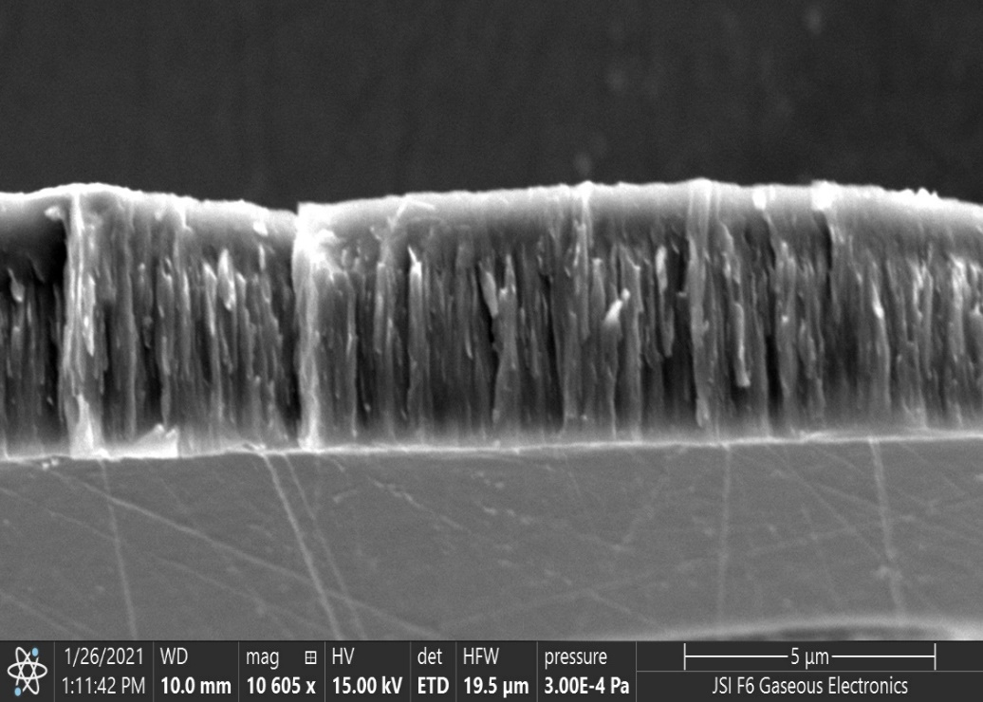
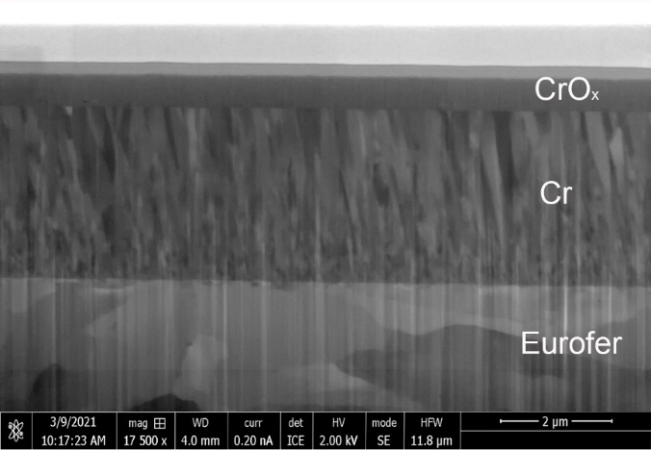
Layered membranes (Eurofer + Cr film and Cr + CrO_{x} film)
Substrate: 40 mm O.D., 0.5 mm thick Eurofer+Cr film, 3.3 µm thick, deposited by the magnetron sputtering technique
Substrate: 40 mm O.D., 0.5 mm thick Eurofer
Cr film, 3.3 µm thick, deposited by the magnetron sputtering technique
Cr film additionally coated by 0.7 µm thick CrO_{x} film, (magn. sputt.)

Slide 19
Oxidation of layered membranes - results
As a thin CrO_{x} on Cr film was formed during unavoidable thermal treatment in a high vacuum on bulk Cr, two referential membranes with 100 nm Pd on Cr film were first prepared and tested. The permeation rate for both samples was almost identical and claimed to have a PRF=1.
Surprisingly, the equal preparation stage resulted in a rather large scattering of PRF values on Cr film coated samples.
CrO_{x} thickness was d ~1.5 nm, as revealed by XPS on a special sample not tested by permeation. Stoichiometry could hardly be determined.
Further oxidation in pure O₂ was to be far less efficient than at bulk Cr.
Sputtered CrO_{x} had a very low impact on the permeation rate!?

Slide 20
Oxidation of layered membranes - results
Key data of 5 selected Cr samples (out of 10) vs. referential Pd coated samples are presented.
Unavoidable residual vacuum exposure during the preparation stage resulted in a PRF from 4 to 30.

Slide 21
Oxidation of layered membranes - results
Further oxidation in pure O₂ was far less efficient than at bulk Cr where
the highest PRF=3800 has been achieved. We could not repeat this high PRF in similar exposures to oxygen.
At present, we do not have a better explanation than that smooth Cr surface prevented CrO_{x} growth much more efficiently than on bulk Cr.
PRF ~10 at ~1.5 nm thickness is a good value.
Another unexpected fact was that 0.7 μm thick sputtered CrO_{x} had a very low impact on the permeation rate!?
The answer is that the atmosphere in the deposition chamber was not optimised for achieving stoichiometric chromia.

Slide 22
Oxidation of layered membranes – results
New phenomena by 5%O₂/95%H₂ mixture at 400°C were observed:
catalytic reaction at hot surface was recorded at the upstream side of Pd and CrO_{x} surface, but kinetics was substantially higher on Pd, but:
no impact of oxygen on permeation rate through referential membranes
permeation blocking by reaction on CrO_{x} surface.
Repeated measurement in pure H₂ restored initial low PRF

Slide 23
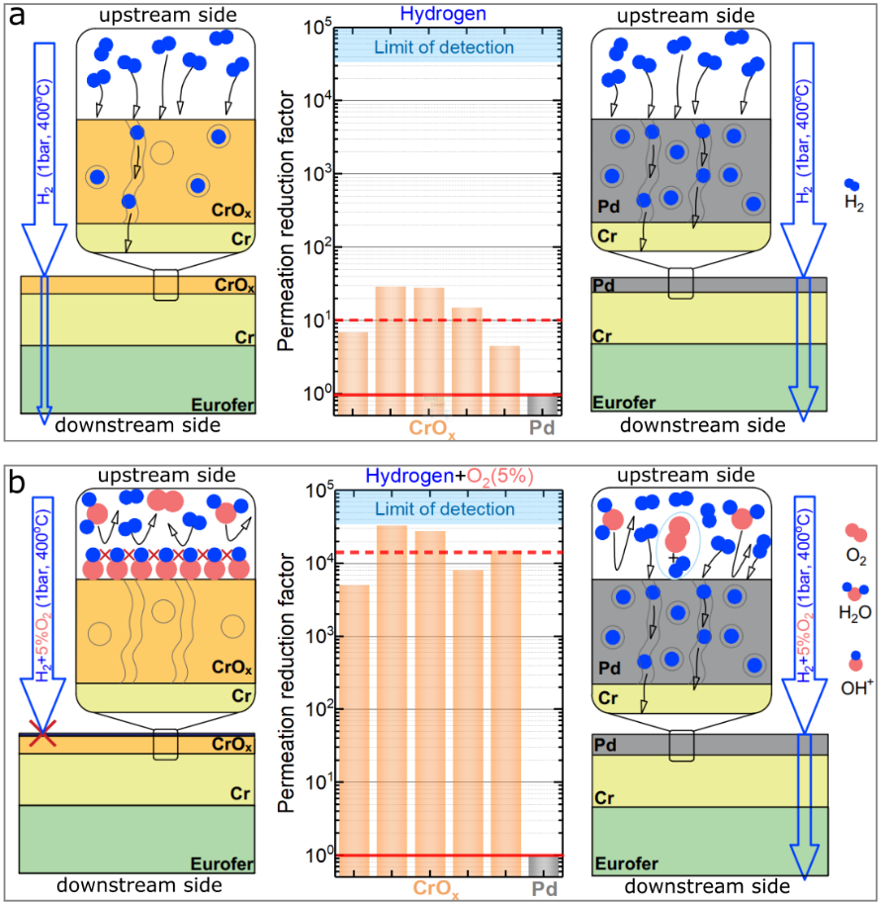
Oxidation of layered membranes - results
Referential Pd coated membrane
Selected CrO_{x} coated membrane

Slide 24
Summary and outlook for next experiments
Double-layered membranes used as a „substrate“ represent a simplification in studying the effect of fusion-related metals, Be and W, as well as oxide ad-layers grown in situ when the bulk membrane material is highly impermeable.
Our data on bulk Cr match reports on permeability but differ greatly in diffusivity. Arguments for errors in the single published paper are given.
High PRF=3900 of CrO_{x} was only confirmed for the in situ grown ad-layer~28 nm CrO_{x}. Sputtered 0.7 μm CrO_{x} had no impact on the permeation rate

Slide 25
Summary and outlook for next experiments
Original results reveal an ultra-thin layer (2D) formed at the topmost CrO_{x} layer at specific testing conditions as being an extremely efficient HPB: PRF >5000. Ab initio calculations and complementary methods needed to confirm this.
In pure hydrogen, the HPB decomposes, and the initial state is restored.

Slide 26
Outlook for 2023 - next experiments
In 2023, we want to further study the role of oxygen in hydrogen at forming an HPB at Fe, as hydrogen permeation rate blocking was observed on Eurofer. Is Cr involved in HPB formation? Is oxygen in the mixture sufficient to form HPB?

