Slide 1
WallDYN3D modeling of fuel retention in ITER
K. Schmid

Slide 2
Contents
ITER background plasmas
Steve‘s far SOL plasmas
Example: variations of SolPS case 1514
Comparison to input data provided to ERO2.0
Issues with the 3D shaped main wall
Predictions of fuel retention based on ITER background plasmas
Influence of 3D shaped Be wall on Be layer formation
Comparison to ERO2.0
Summary
TODO

Slide 3
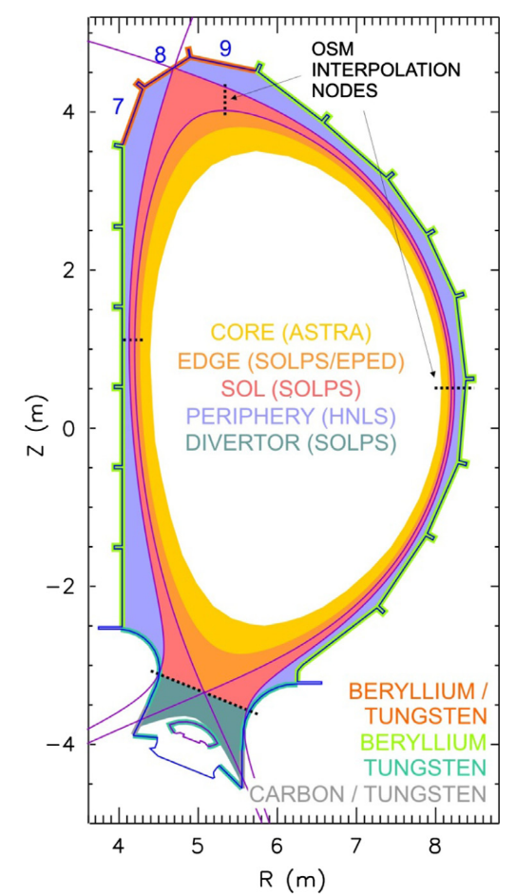
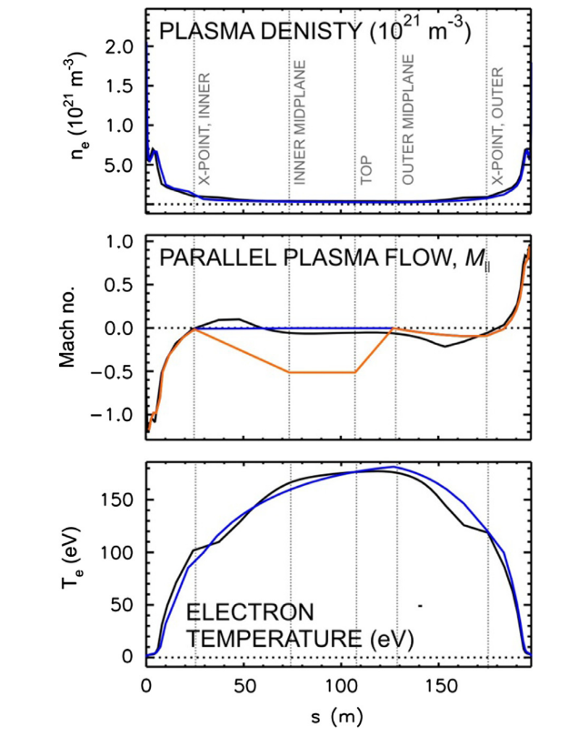

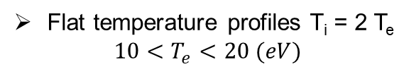
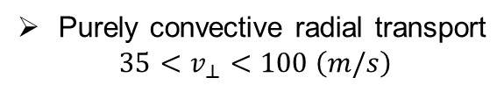

Steve‘s far SOL plasmas
SolPS vs OSM
S along field line just outside separatrix
Black: SolPS
Blue, orange: OSM
Periphery (far SOL):
$0.5<n_{e}<1.5×{10}^{19} \left(m^{−3}\right)$
Purely convective radial transport
$$35<v_{⊥}<100 \left(m/s\right)$$
Flat temperature profiles T_{i} = 2 T_{e}
$$10<T_{e}<20 (eV)$$
Parallel flow towards inner target
$$−0.5<M<0$$
CX fluxes and energies from EIRENE
Inner
target
Outer
target
Taken from S.W. Lisgo et al. / Journal of Nuclear Materials 438 (2013) S580
Notes:
Field line just outside the separtrix

Slide 4
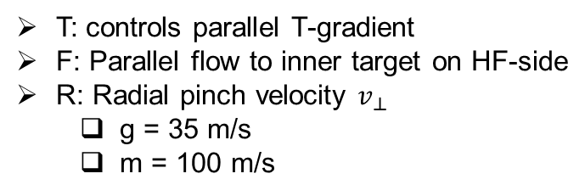
Steve‘s far SOL plasmas
SolPS vs OSM
S along field line just outside separatrix
Black: SolPS
Blue, orange: OSM
Case name nomenclature „E|SSSS|TFR“.
e.g.: 4|1514|00m
E = 4
SSSS = 1514
  T = 0, F = 0, R = m → far SOL
SSSS = 1514 is the SolPS case
E is the equilibrium
  E = 3: 10 cm separatrix distance
  E = 4: 4 cm separatrix distance
T: controls parallel T-gradient
F: Parallel flow to inner target on HF-side
R: Radial pinch velocity $v_{⊥}$
  g = 35 m/s
  m = 100 m/s
Inner
target
Outer
target
Taken from S.W. Lisgo et al. / Journal of Nuclear Materials 438 (2013) S580
Notes:
Field line just outside the separtrix

Slide 5
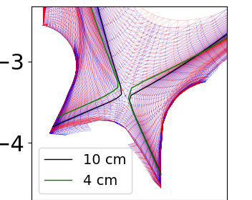
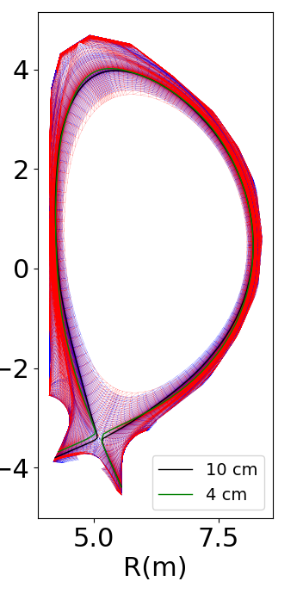
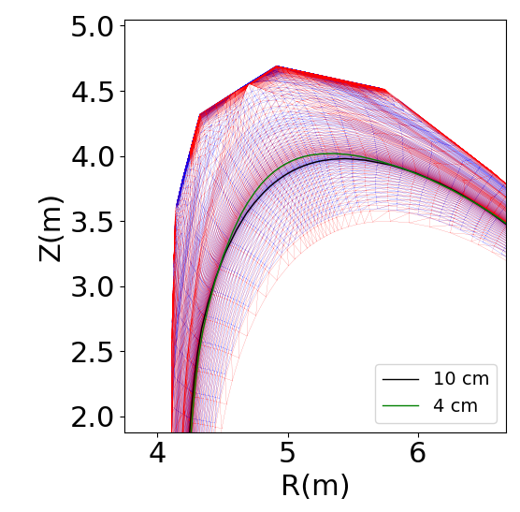
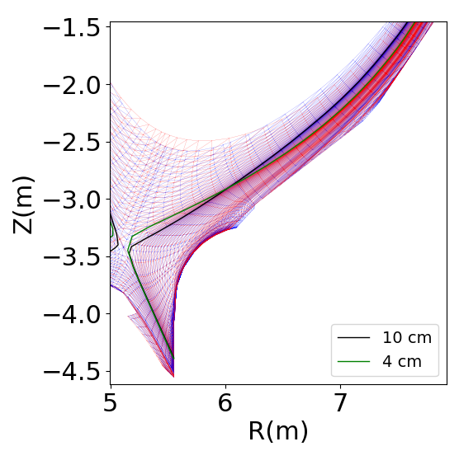
Steve‘s far SOL plasmas
Two different equilibria were used, differing in the distance between primary and seconary separatrix
E is the equilibrium
  E = 3: 10 cm separatrix distance
  E = 4: 4 cm separatrix distance
Increased load for E = 4
Enhanced Be erosion

Slide 6
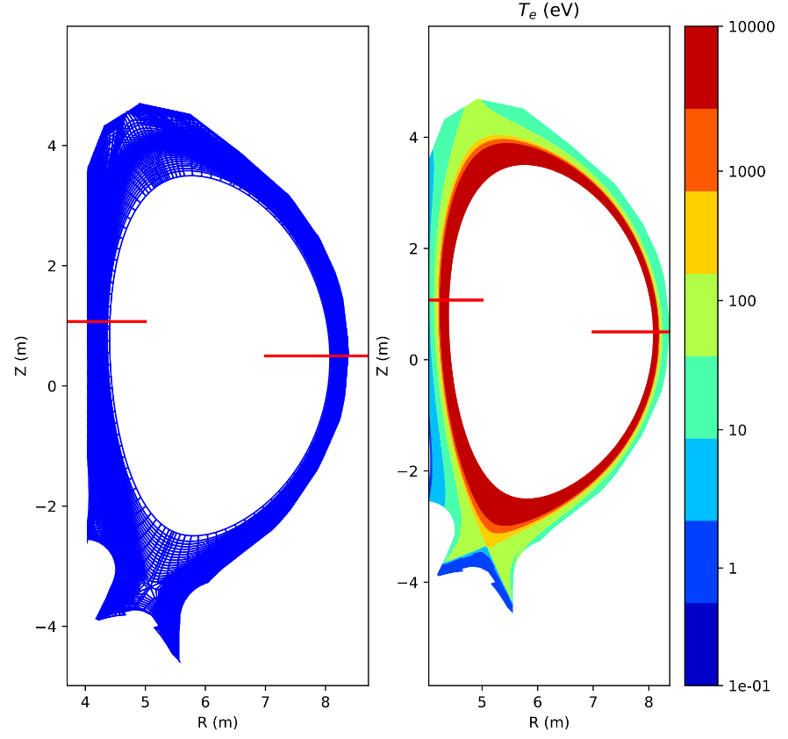
Steve‘s far SOL plasmas
From background plasma & first wall flux files as received from IO
Extract plasma paramters along two lines of sight on the high and low field sides respectively
Z = 1.0
HF-side
Z = 0.5
LF-side
Plot plasma parameters vs location on these lines

Slide 7
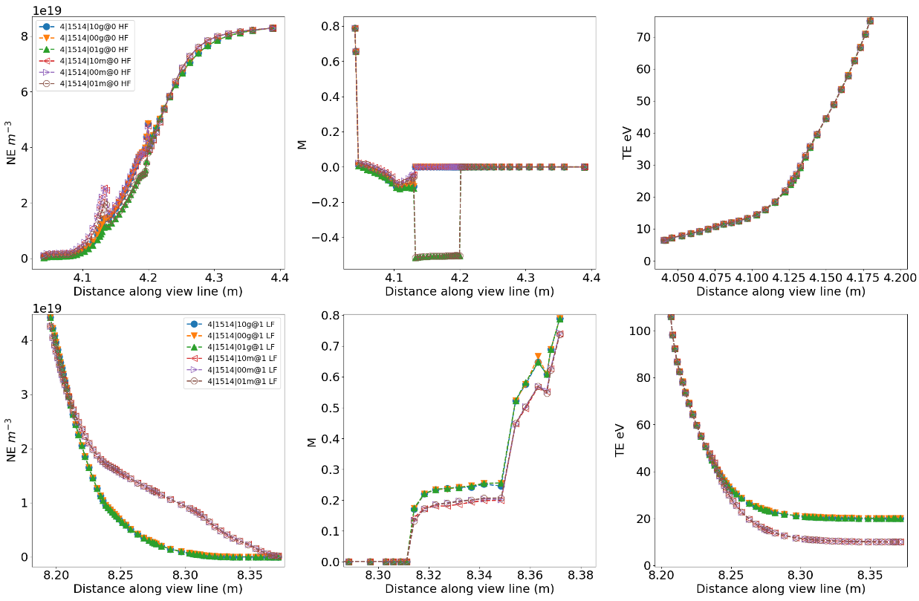
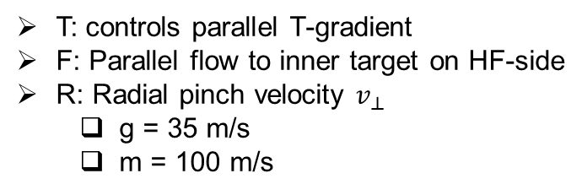
Example: variations of SolPS case 1514: for different T,F,R settings
Ne
M
Te
„Medium density SolPS case“
  E = 4
  SSSS = 1514
HF-Side
T: controls parallel T-gradient
F: Parallel flow to inner target on HF-side
R: Radial pinch velocity $v_{⊥}$
  g = 35 m/s
  m = 100 m/s
Ne
M
Te
LF-Side
„m“-cases: H-mode, v_perp = 100 m/s, Te = 10, Ti = 20 eV
Strong pinch velocity leads to „density shoulder“ formation

Slide 8
Example: variations of SolPS case 1514: for different T,F,R settings
Ne
M
Te
„Medium density SolPS case“
  E = 4
  SSSS = 1514
HF-Side
T: controls parallel T-gradient
F: Parallel flow to inner target on HF-side
R: Radial pinch velocity $v_{⊥}$
  g = 35 m/s
  m = 100 m/s
Ne
M
Te
LF-Side
Discontinuities in some HF side $n_{e}$ values?!?
F = 1: Parallel flow to inner target on HF-side
Parallel flow from top of machine towards inner divertor

Slide 9
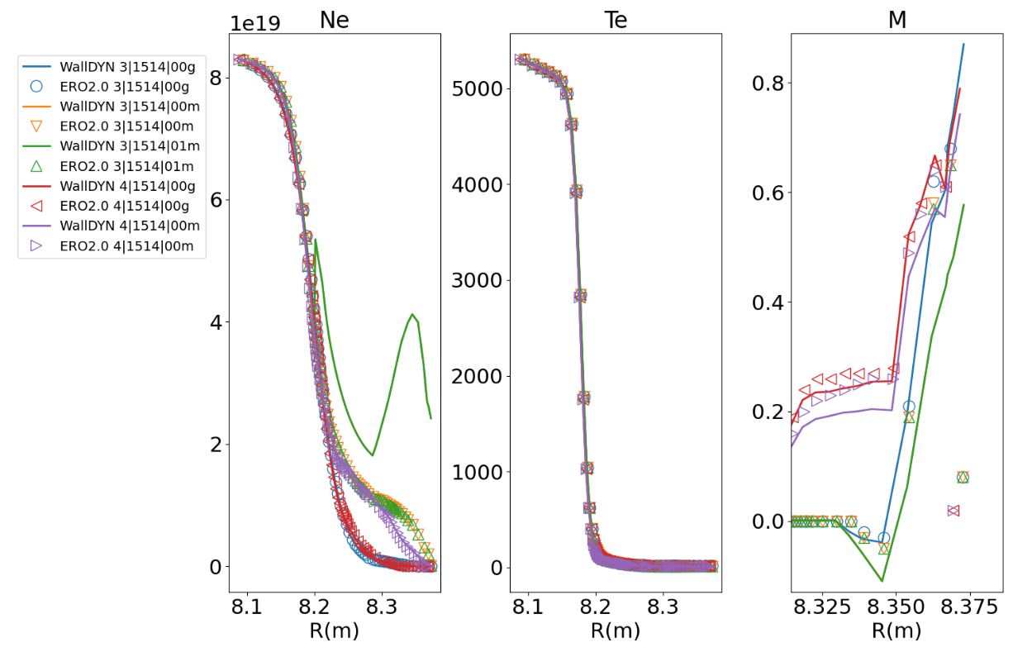
Comparison to input data provided to ERO2.0
Compare input data at outer-mid-plane (OMP)
ERO2.0 input data provided in 2019
Eledgidly generated from previous DIVIMP input...
Ne
M
Te
Almost same view line (Z = 0.5 vs 0.72)
OMP values essentially identical
Except for 3|1514|00m and 3|1514|01m!
→ Discontinuities in „m-cases“ are probably artefacts of the early OSM results from 2012/13
→ 2019 data for ERO2.0 was more „evolved“
→ WallDYN and ERO2.0 did not always receive the same plasma data for the same case number...

Slide 10
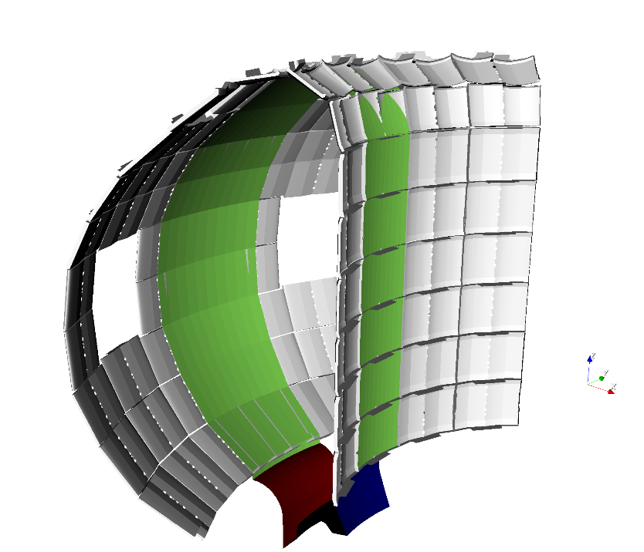
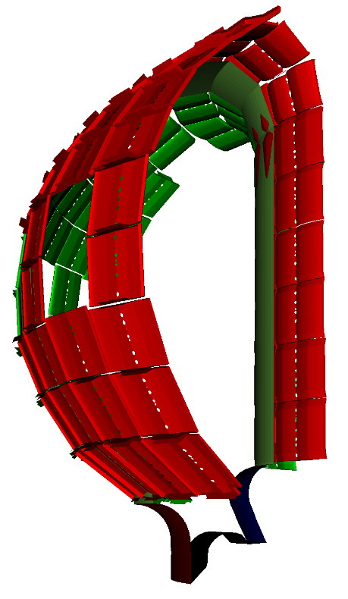
Issues with the 3D shaped main wall
Generate a more accurate wall for EMC3
WallDYN approach: adjust wall
In R, Z, Phi-space scaled wall elements with
R < 4.92 m to move wall inward
Green:
OLD 2D ITER wall
→ Apex of 3D wall limiting elements now matches 2D DIVIMP wall
Grey:
Current 3D shaped wall
HF-side wall is different than it was for DIVIMP/SolPS cases
→ This wall is incompatible with existing plasma solutions/grids

Slide 11
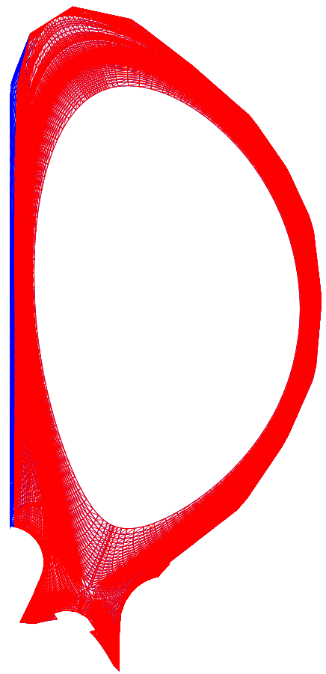
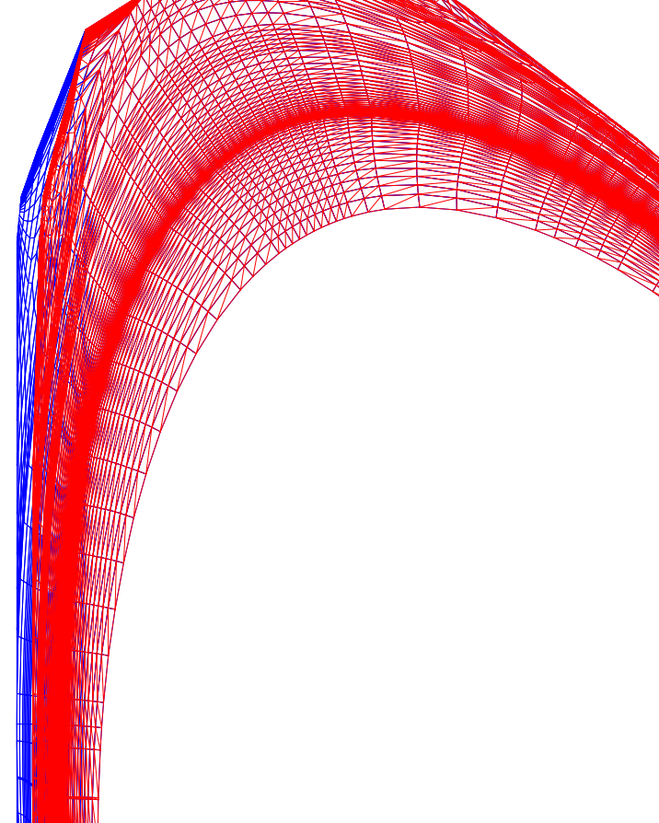
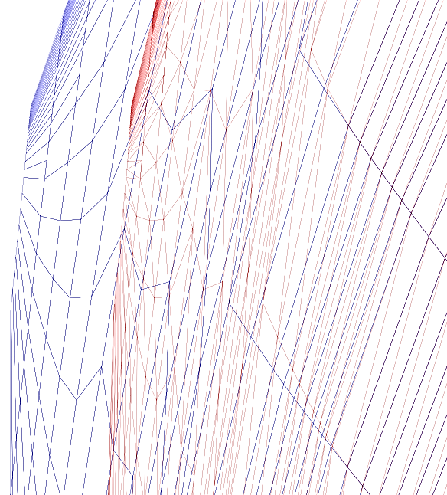
Issues with the 3D shaped main wall
Generate a more accurate wall for EMC3
ERO2.0 approach: adjust GRID
Grid morphing:
  „Compress“ HF-side grid
  Flux convervation?!?
ERO2.0
ERO2.0
WallDYN
WallDYN
HF-side wall is different than it was for DIVIMP/SolPS cases
→ This wall is incompatible with existing plasma solutions/grids

Slide 12
Predictions of fuel retention based on ITER background plasmas
Case 3|1514|00g was used for WallDYN-3D
Is identical in ERO2.0 plasma in all parameters!
No discontinuities in n_{e}

Slide 13
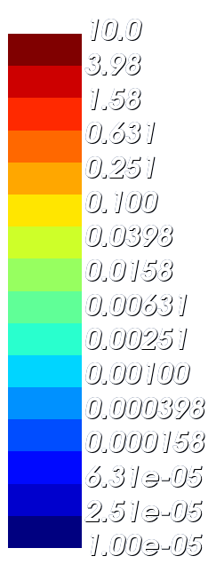
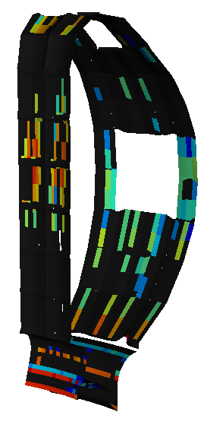
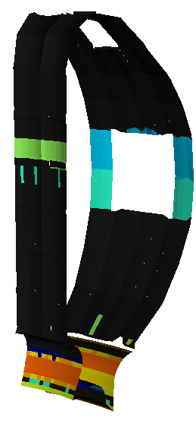

Influence of 3D shaped Be wall on Be layer formation
Look for differences that solely stem from the 3D shaped main wall
Create an artificial 2D WallDYN case by mapping migration matrices and plasma parameters from the 3D case to 2D
→ This mapped case should be least affected by differences in wall plasma and impurity transport calculations
Compare 2D mapped case with full 3D case with shaped Be first wall
Be-layer growth rate (${10}^{20}m^{−2}s^{−1}$)
WallDYN-3D
WallDYN-2D
mapped to 3D
Be deposition in main chamber higher in 3D case
→ Effect of shadowed regions in between shaped Be tiles
2D: 8% on first wall
3D: 43% on first wall
Factor 5!
(Depends on wall-plasma)
Total Be erosion:
2D: 1.3E20 (Be/sec)
3D: 1.6E20 (Be/sec)
→ Total Be source similar
BUT the layer distribution is different

Slide 14
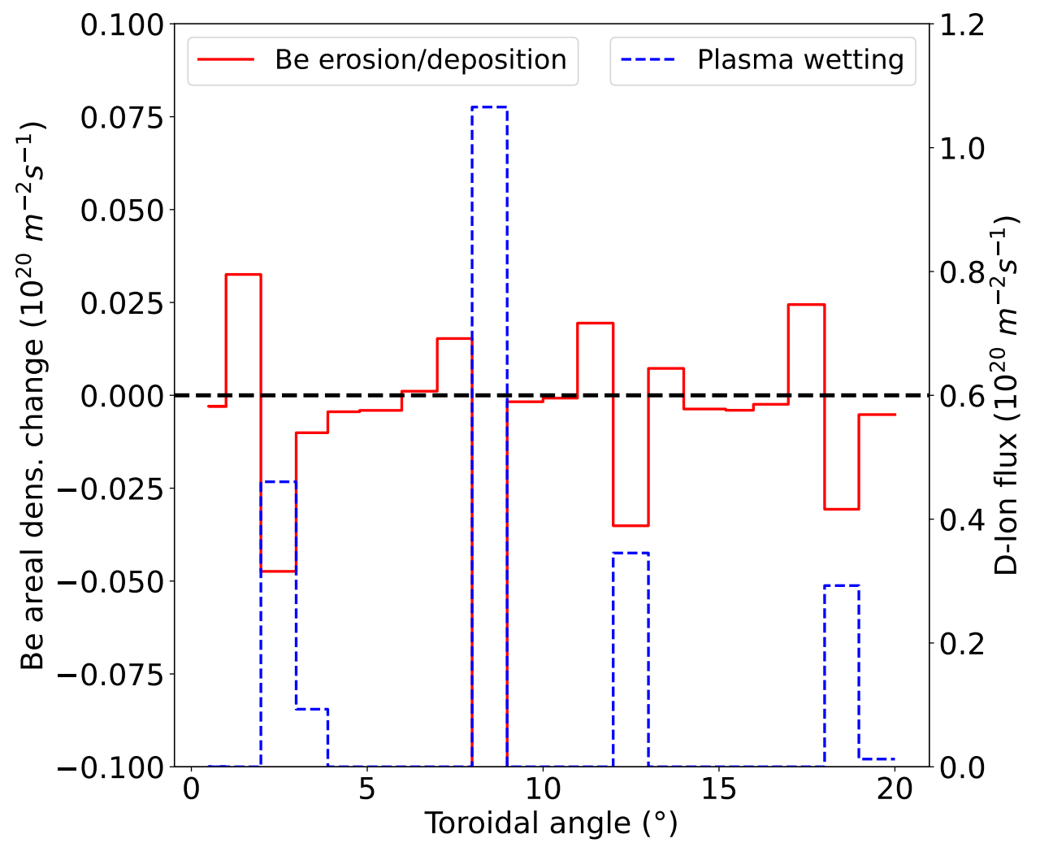
Influence of 3D shaped Be wall on Be layer formation
Look for differences that solely stem from the 3D shaped main wall
Create an artificial 2D WallDYN case by mapping migration matrices and plasma parameters from the 3D case to 2D
→ This mapped case should be least affected by differences in wall plasma and impurity transport calculations
Compare 2D mapped case with full 3D case with shaped Be first wall
Be deposition in main chamber higher in 3D case
→ Effect of shadowed regions in between shaped Be tiles
2D: 8% on first wall
3D: 43% on first wall
Factor 5!
(Depends on wall-plasma)
Total Be erosion:
2D: 1.3E20 (Be/sec)
3D: 1.6E20 (Be/sec)
→ Total Be source similar
BUT the layer distribution is different

Slide 15
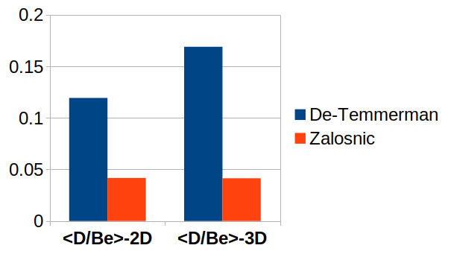
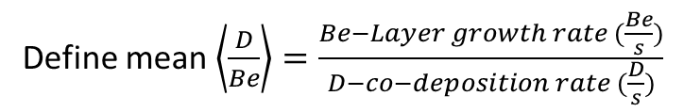


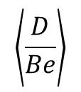
Influence of 3D shaped Be wall on Be layer formation
Resulting difference 2D vs 3D w.r.t co-deposition
Define mean $\left\langle \frac{D}{Be}\right\rangle =\frac{Be−Layer growth rate (\frac{Be}{s})}{D−co−deposition rate (\frac{D}{s})}$
$$\frac{D}{Be}\sim E^{1.34±0.15}$$
$$\left\langle \frac{D}{Be}\right\rangle$$
$$\frac{D}{Be}\sim E^{0.79±0.18}$$
Depending on scaling law shaped wall increase retention slightly (x1.5) or has little effect
Scaling law fit parameters have large error bars:
  → Uncertainty quantification?

Slide 16
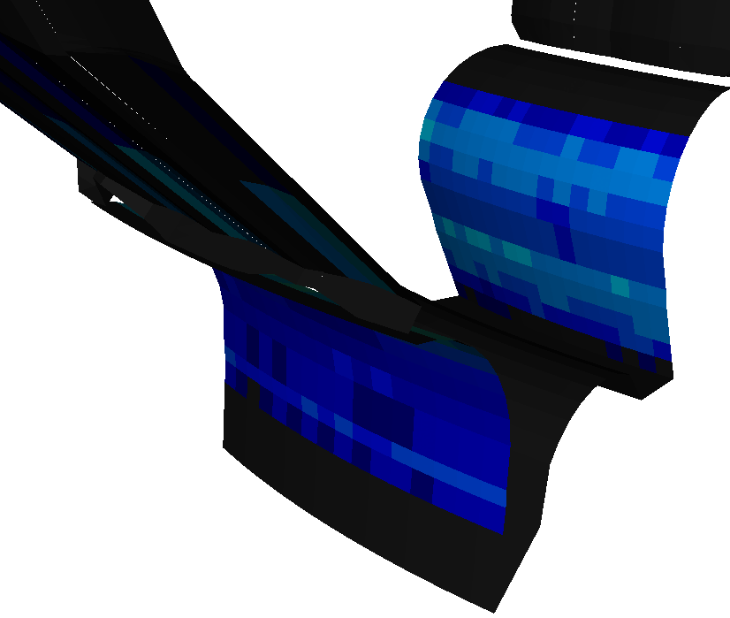
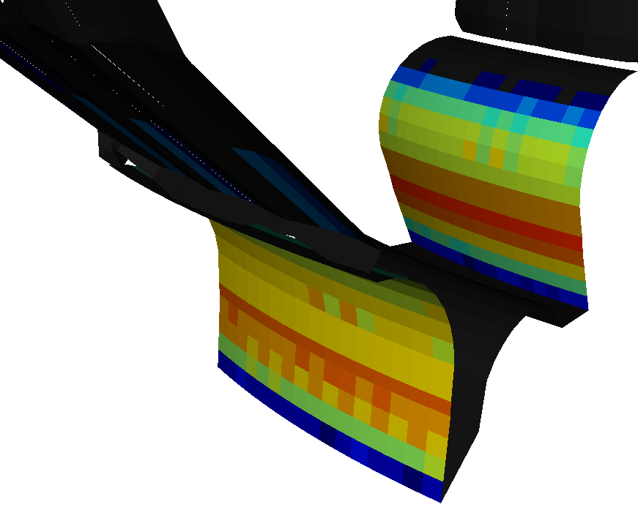
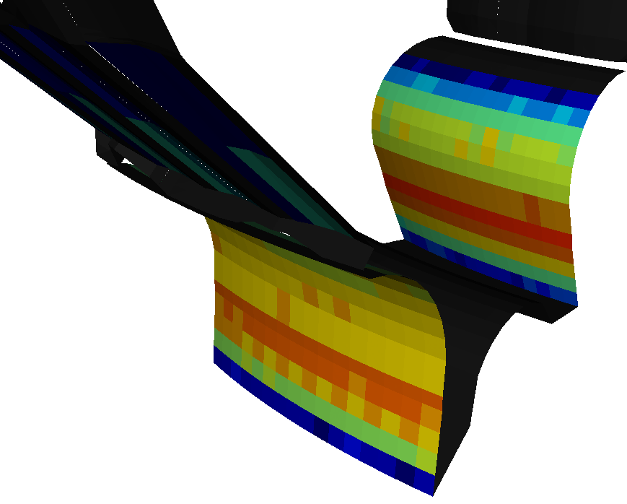
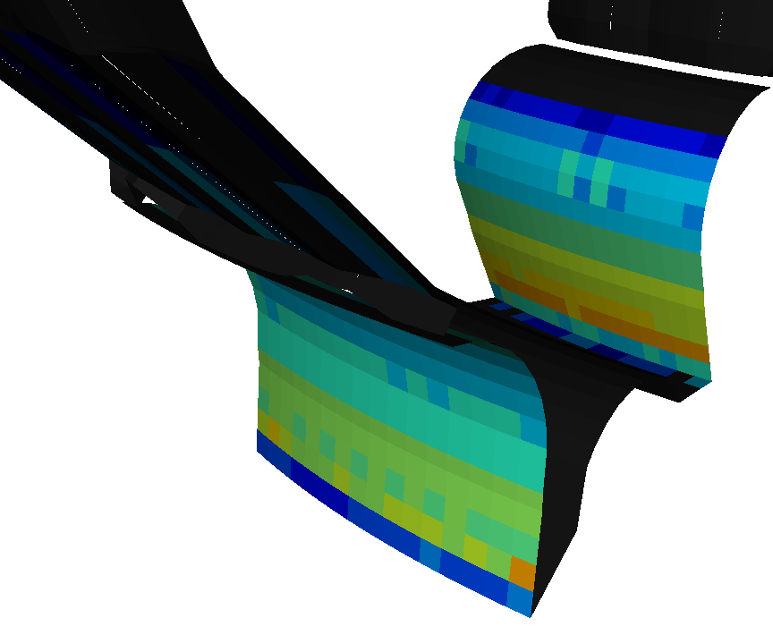
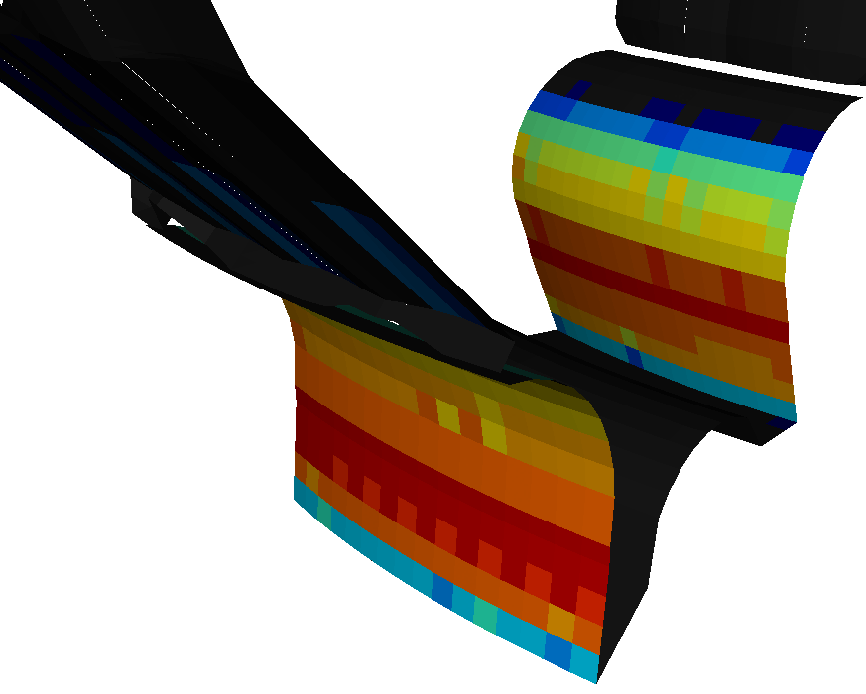
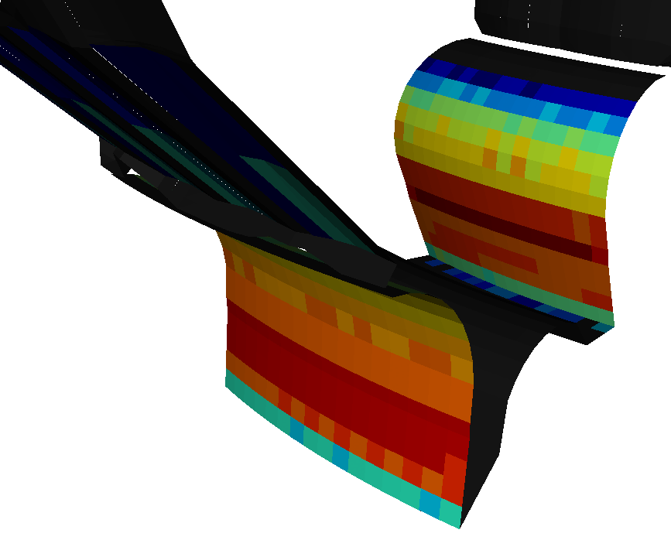
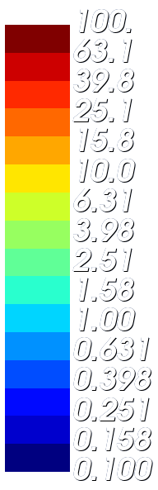

Comparison to ERO2.0
Why do we use WallDYN3D if we have ERO2.0?
Be erosion for the 3D shaped wall was investigated with ERO2.0 in: J. Romazanov et al 2022 Nucl. Fusion 62 036011
So far ERO2.0 without re-erosion, reflection is the only loss of channel for impinging Be
No time dependence in Be sources / sinks in ERO2.0
WallDYN-3D: Time evolution of Be wall in-flux due to different sources
Be influx in divertor has pronounced time evolution
Be recycling at targets
Be plasma concentration build up
Be deposition in divertor
T=0 sec.
Be influx from re-erosion
Be influx from reflection
Total Be influx
Surface dynamics model needed
T=400 sec.
→ Can only compare WallDYN-3D to ERO2.0 w.r.t primary Be erosion
$$\left({10}^{20} m^{−2}s^{−1}\right)$$

Slide 17
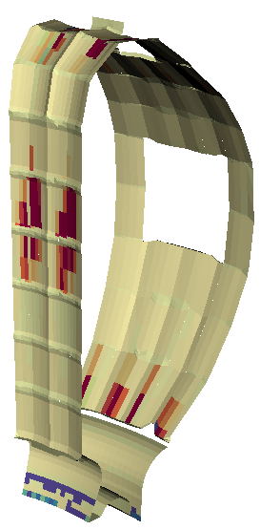
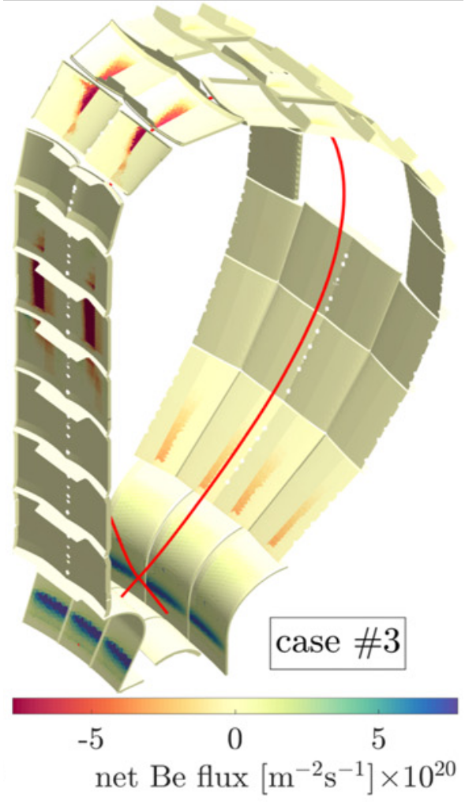


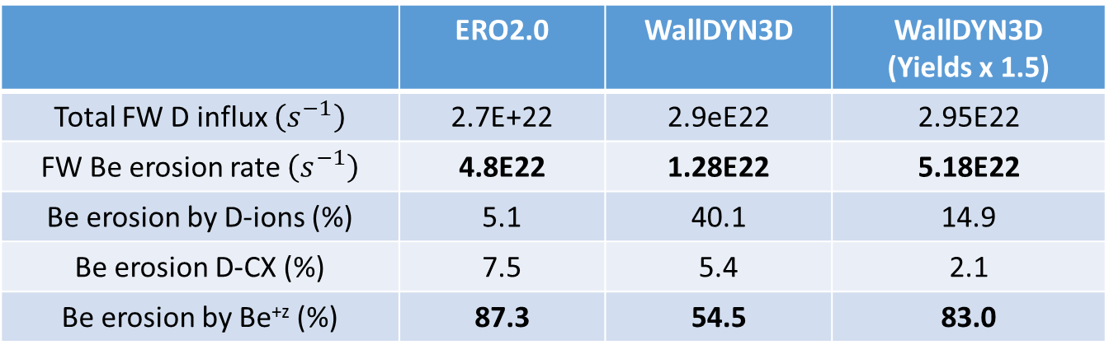


Comparison to ERO2.0
Be erosion for the 3D shaped wall was investigated with ERO2.0 in: J. Romazanov et al 2022 Nucl. Fusion 62 036011
Compare Be first wall (FW) erosion to WallDYN3D for same plasma scenario at t=0
Same erosion/deposition pattern, EXCEPT no Be deposition on outer target in WallDYN3D due to strong re-erosion of Be from W
 | ERO2.0 | WallDYN3D | WallDYN3D (Yields x 1.5)
Total FW D influx $\left(s^{−1}\right)$ | 2.7E+22 | 2.9eE22 | 2.95E22
FW Be erosion rate $\left(s^{−1}\right)$ | 4.8E22 | 1.28E22 | 5.18E22
Be erosion by D-ions (%) | 5.1 | 40.1 | 14.9
Be erosion D-CX (%) | 7.5 | 5.4 | 2.1
Be erosion by Be^{+z} (%) | 87.3 | 54.5 | 83.0
$$Y_{Be}→Y^{MOD}×Y_{Be}$$
-6 0 +6
NET areal density change
Factor 1.5 increase in sputter yields results in factor ~5 in total Be erosion?
$$\left({10}^{20} m^{−2}s^{−1}\right)$$
→ Why the factor $Y^{MOD}$= 1.5

Slide 18


Comparison to ERO2.0
Be erosion for the 3D shaped wall was investigated with ERO2.0 in: J. Romazanov et al 2022 Nucl. Fusion 62 036011
Compare Be first wall (FW) erosion to WallDYN3D for same plasma scenario
→ Need a factor ~1.5 higher yields to match WallDYN3D to ERO2.0
ERO2.0 and WallDYN use different sputter yield data bases
WallDYN interpolates tables generated by SDTrim.SP
$Y_{WallDYN}=Y\left(\left\langle C_{ei}\right\rangle , E_{Prj},α_{Projectile}\right)$
No significant D-accumulation in Be (only considers Be/W mixtures)
ERO2.0 uses different SDTrim.SP generated yield data base with different assumptions
$Y_{ERO2.0}=Y\left(E_{Prj},α_{Projectile}\right)$
Assumes 50:50 Be:D in the surface with „unusual choice“ for material density
→ affects Be sputter yield
→ ERO2.0 calculations are now re-done with refined yield calculations

Slide 19
Summary
ITER background plasma solutions span a large range of experimentally observed features
Density shoulders
Strong parallel flows to inner divertor
They evolved over time but some early versions have „imperfections“
Discontinuities in n_{e}
Unreasonable CX data
Getting a reasonable wall 3D plasma solution for the shaped ITER wall from 2D plasmas is „difficult“
There are always „hacks“ involved
WallDYN3D predicts a shift of the main deposition locations from divertor to shaped 3D main chamber wall
Effect depends a lot on main chamber wall plasma „extrapolation“
Recycling of impurities changes Be influx → Dynamic wall model needed
Effect on retention depends on D/Be scaling law version
→ Need for uncertainty quantification w.r.t to D/Be scaling laws
WallDYN3D and ERO2.0 yield same total erosion when yield data is „matchted“
→ Need for uncertainty quantification w.r.t to yield data
Uncertainties are at least 100%
Generally current modeling input/assumption probably overestimate Be erosion in ITER
→ A physics based 3D first wall plasma & divertor solution is needed

Slide 20
TODO
JET-ILW verification is needed
→ A 3D EMC3-EIRENE JET-ILW plasma solution to test influence of shaped 3D first walls is needed
Continue comparison of ERO2.0 and WallDYN-3D
using the available EMC3 equilibrium E = 3 (10 cm separatrix distance)
Try to use input data generated for ERO2.0 and NOT the old DIVIMP data
Calculate CX data using EIRENE from within EMC3 after mapping the plasma parameters
Or maybe forget about Be and look at influence of boronization that might be needed for a full W-wall
Deformed grid in ERO2.0 is not usable
Use the CX data from S. Wiesen‘s recent efforts
At most two cases
Ideally wait for proper EMC3 based plasma solution:
Proper wall plasma paramters on shaped wall
For the new equilibrium (match new central column)
A plasma solution for (at) the 3D shaped wall is needed
Or at least SolPS ITER calculation with extended grids
Not ideal because this does not yield proper wall plasma wetting

Slide 21
Discussion slides

Slide 22
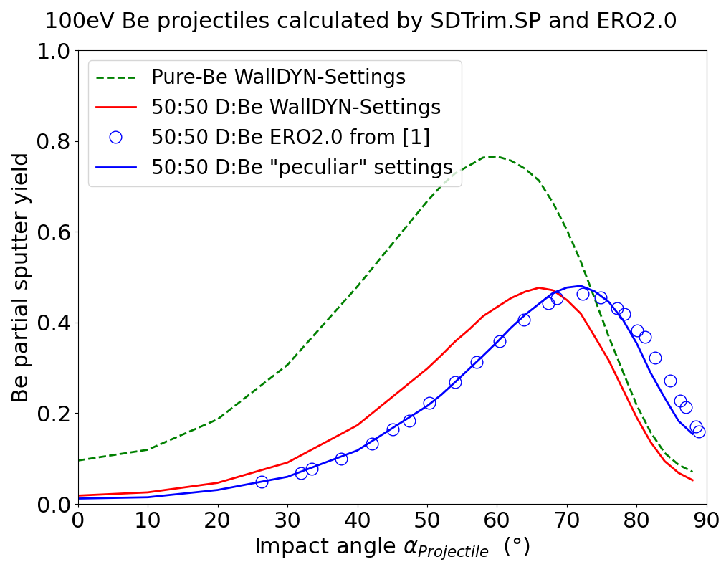
Yield vs Angle using “wrong” D-atomic volume
Summary: comparison of yield models in WallDYN and ERO2.0
Shift in sputter yield maximum w.r.t to angle when using “wrong” D-atomic volume
ERO-min probably over-esitmates erosion at oblique angles
[1] J. Romanzanov et al, Nucl. Fusion 62 (2022) 036011

