Slide 1
E-TASC / TSVV Task #13 Stellarator Turbulence Simulation 11th meeting
J. M. García-Regaña

Slide 2
Agenda
# | Title of contribution | Related M or D | Speaker
1 | TSVV13 status: useful info and updates | - | J. M. García Regaña (CIEMAT)
2 | Full-flux-surface effects on electrostatic turbulence in Wendelstein 7-X-like plasmas (paper rehearsal). | D-TURB-DOMAIN & D-TURB-BULKTRANSP | Felix Wilms (IPP-Garching)
Regular meetings on second Monday of every month at 15:00 (CET)
Next meeting: 13th of March at 15:00.

Slide 3
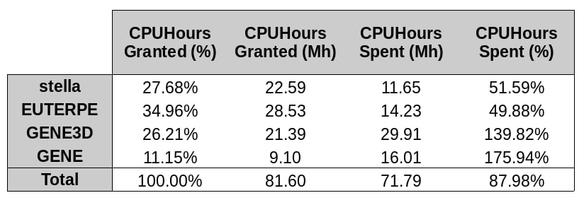
HPC resources
The usage of the TSVV/Marconi project: 88 %
$∼$9 Mhrs to be spent before March.
No feedback about the next Marconi cycle.
Courtesy of H. Thienpondt

