Slide 1

Summary of Sprint on:
Internal Boundaries and Hyperdiffusion
Thomas Jonsson
Tech-dev, 23 September 2020

Slide 2
Brief summary
Goal: Implement internal boundary condition and hyperdiffusion
Main result: Both implemented; the internal boundary is well tested, while hyperdiffusion need more testing.
Started preparing for core-edge coupling with finite edge region.
  Note: solpsz1 sets BCs at rho=1, while PENN fill a finite edge e.g. rho in (0.95 , 1]

Slide 3
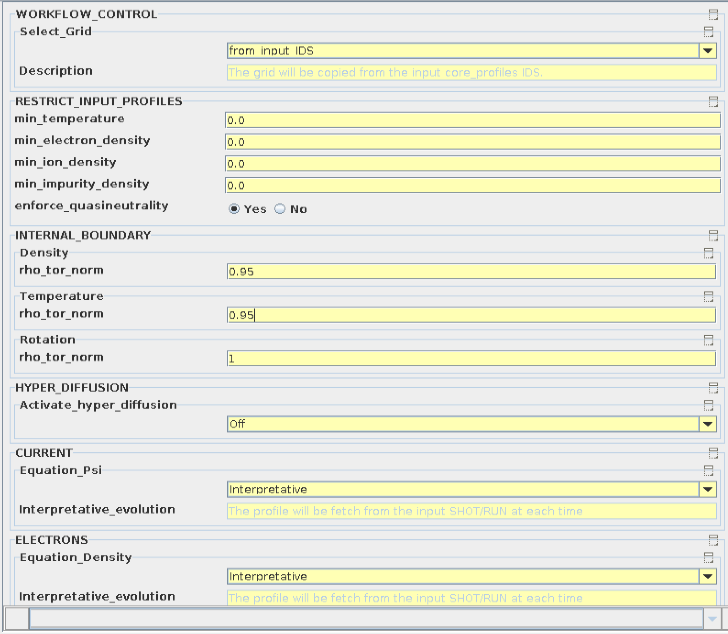
Codeparams ETS-Init
Internal boundary
Hyper-diffusion = OFF

Slide 4
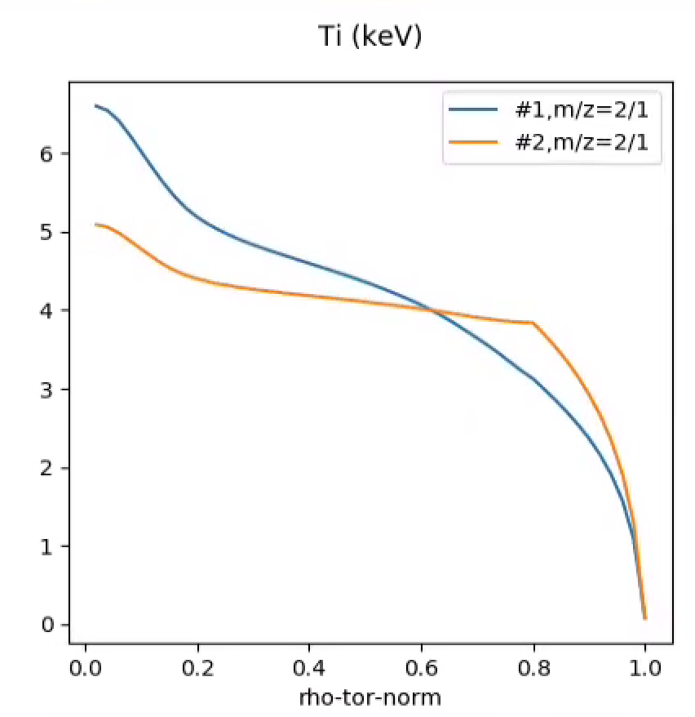
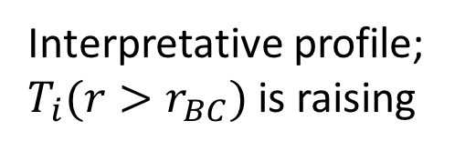
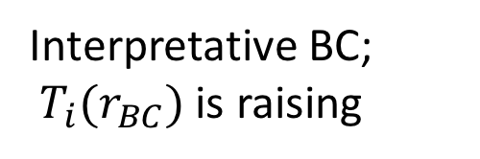
Example with internal boundary
Data source:g2tjohns/jet_reference/92436/84929
Time = 49.02 s
Time = 49.04 s
Interpretative BC;
$T_{i}{(r}_{BC})$ is raising
49.02 s
49.04 s
Interpretative profile; $T_{i}{(r>r}_{BC})$ is raising
Predictive profile, no sources; temperature is going down

Slide 5
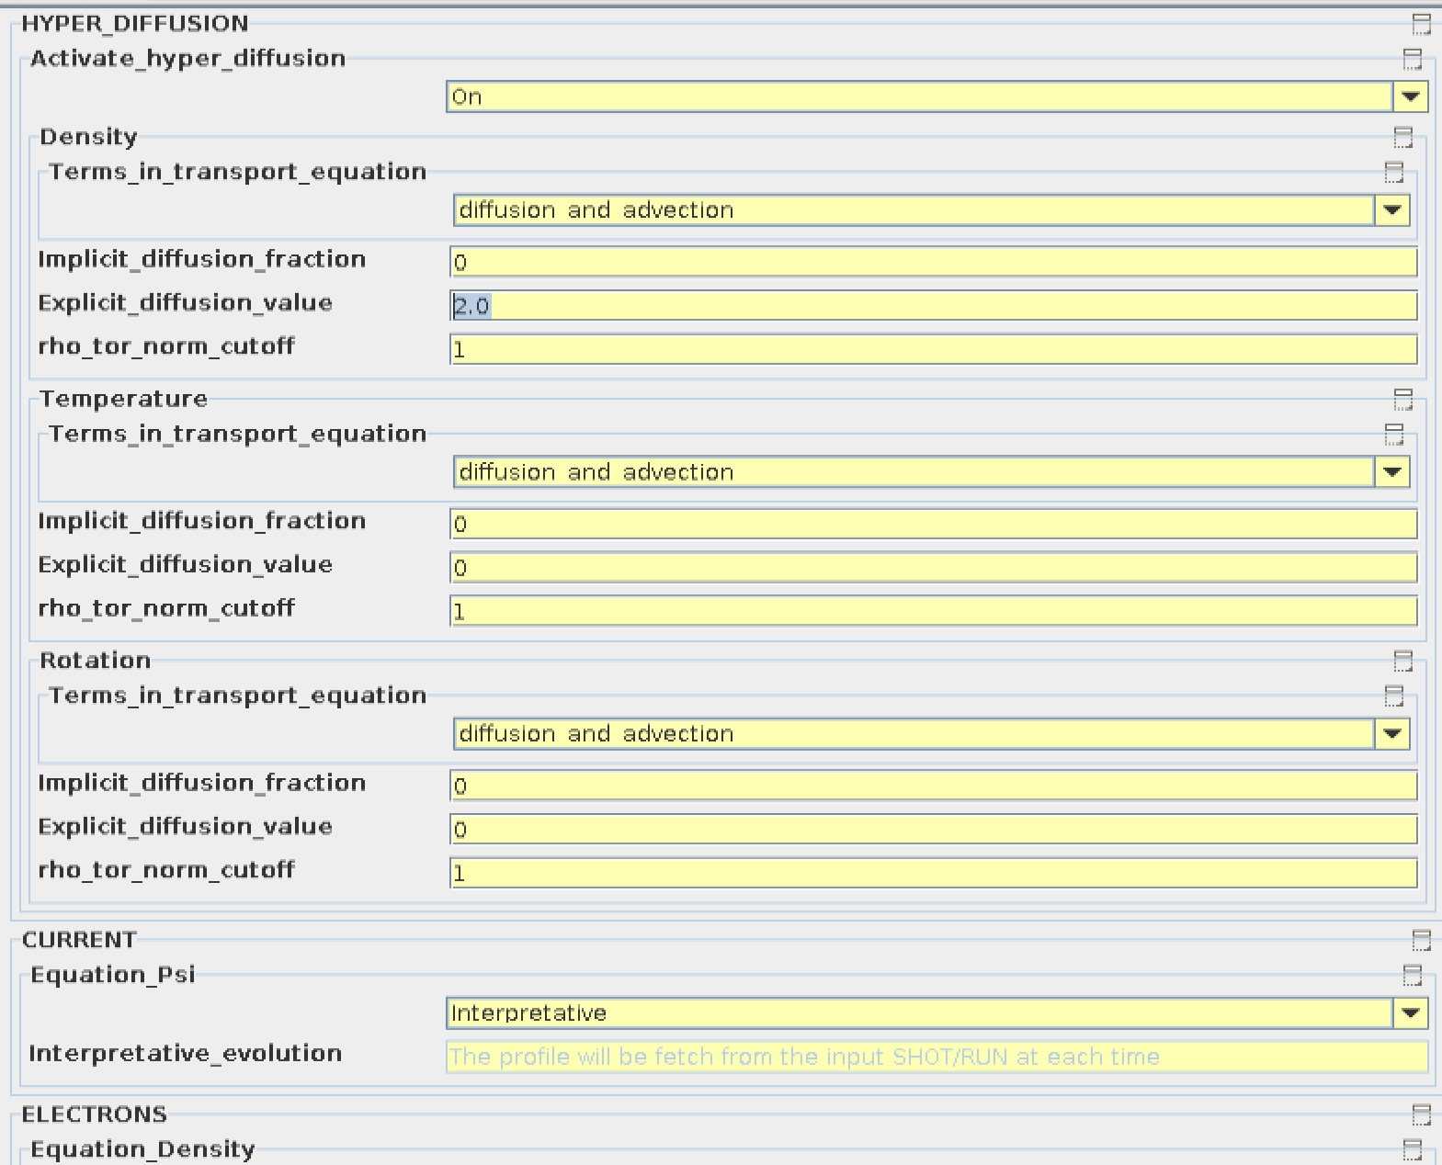
Codeparams ETS-Init
Hyper-diffusion = ON

