Slide 1
TSVV-5 „Neutral gas dynamics in the edge“
20 January 2022
FZJ progress report 2022
CRM and A&M data, code development, etc.
D. Borodin, F.Cianfrani

Slide 2
FZJ personal (including potential positions)
TSVV-5 (and other EUROfusion support):
D.Borodin (0.75PPY + 0.1PPY WPDC + 0.2PPY JET1)
F.Cianfrani (0.75PPY + 0.25PPY WPDC)
P.Börner (0.2PPY in 2022)
B.Küppers (0.3 PPY in 2022)
Third-party resources (highly unprovable…):
CSC: postdoc or sandwich PhD on EIRENE data (proposal submitted for 2022, 2033?..)
Indirect contribution:
D.Harting (TSVV-6: kinetic ions, EMC3-EIRENE)
S.Wiesen (SOLPS-ITER = B2.5-EIRENE)

Slide 3
Outline
EIRENE general development (P.Börner)
Collisional-radiative models (CRM) and A&M data
TSVV-5 management
Meetings, reports, code camp, etc.
New EIRENE license und new webpages
http://www.eirene.de/new_eirene/
Interaction with other TSVVs and ACHs

Slide 4
Code development – version merging
The main focus with regard to development of the EIRENE code in 2022 was on reuniting the various diverging versions of the code used in FZJ and at ITER.
Roughly 20 different code versions have been analysed and merged together. Thereby taking advantage of developments provided by FZJ external developers.
These developments include
Charge state bundling
Parallelization of the code using shared memory techniques (OpenMP)
Extensions of the existing parallelization of the code with message passing techniques (MPI) by implementation of different parallelization schemes.
Introduction of radiation tallies
Implementation of species resolved volume averaged tallies and their use with species specific rescaling of calculation results in order to improve the particle balances.

Slide 5
Code development - priorities
Initially version-specific code has been generalized in a way it can be used by all the interested parties (RU or specific architecture related code removed).
All changes to the code are carefully tested (still ongoing!..).
Code modifications affecting simulation results were tracked down to their origin and the reasonability investigated.
Updated reference outputs are provided for the testcases in the continuous integration chain (CI).
We are approaching the 1st milestone release of the code, which should be a basis for further joint development

Slide 6
CRM solvers available
CRM (technically) = reaction data + SOLVER
$$\frac{dN_{i}}{dt}=0$$
Most solvers solve algebraic stationary system of equations
in such cases the solver is much less valuable as the A&M data collection
this statement is underlined even by the developers of the very well established and mostly up-to-date YACORA model
CRM containing molecular species is even more complex, e.g. one needs to track more processes and more states (vibrational, rotational).
Tracking all the states as separate species demands enormous CPU and memory resources.
EIRENE pre-calculates rates for each volume cell. It also allows to pre-calculate values for various T_{i}/T_{e} ratios.
D.Wünderlich and U.Fantz,
Atoms 2016, 4(4), 26

Slide 7
New CRM Solver for EIRENE concepted
This CRM is aimed to precompute rate coefficients accounting for all parametric dependences (n_{e}, T_{e}, but also T_{i}, …) in contrast with currently used polynomial fits (AMJUEL, …) + add a number of levels/processes not accounted for at this time
The internal states (e.g. rovibrational states in molecular species) are to be tracked with a flexible a flexible control over this resolution (as separate specie or variable).
The nonstationary solution for balance equations should be the default one
(with the stationary only as a useful option).
The solver should be modular, thus usable standalone or even in other codes.
The improved A&M data input should be readable and structured (for starters JSON, potentially also HDF5). It should be pre-processed mostly automatic and easily exchanged with other codes and tools. We need tools for visualisation and testing.
The only way to meet the exploding amounts of data from RMPS and CCC for molecules (with resolution by rovibrational states)
IAEA GNAMPP assists, but also reveals the challenges AMD Unit: GNAMPP
Not only performance and reliability to be improved, however including additional physics can be provided!
$$Ti≠Te ,$$
$$etc.$$
$$\frac{dN_{i}}{dt}≠0$$

Slide 8
COLLISIONAL-RADIATIVE MODEL
Particle species
H⁺, H, H₂⁺,H₂
Reaction | Type | Source
H₂ + e → H₂⁺ + e + e | molecular ionization | H2vibr
H₂ + e → H₂(b_{triplet}) → H + H + e | neutral dissociation | H2vibr
H₂ + e → H + H⁺ + e + e | dissociative ionization | Amjuel
H₂ + H⁺ → H₂⁺ + H | charge exchange (CX) | H2vibr
H + e → H⁺ + e + e | ionization | Amjuel
H₂⁺ + e → H + H⁺ + e | neutral dissociation (MAD) | Amjuel
H₂⁺ + e → H⁺ + H⁺ + e + e | dissociative ionization (MAI) | Amjuel
H₂⁺ + e → H + H | dissociative recomb (MAR) | Amjuel
H⁺, e sinks (reservoirs)
Molecular source:
Reference value
Plasma parameters:
Fixed electron and ion densities:
n_{e} = n_{i} = 10¹⁹m⁻³ for [1]
n_{e} = n_{i} = 10²¹m⁻³ for [2]
Temperature: T_{e} = T_{i} = 0.2÷30eV.
JET
EU-DEMO
[1] M Groth et al. NF 2013 [2] F Subba et al. NF 2020

Slide 9
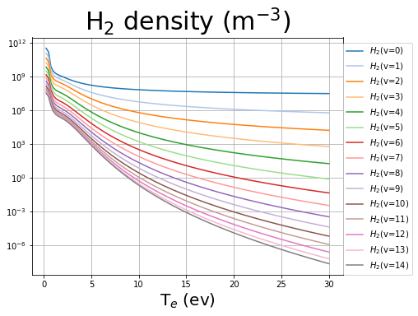
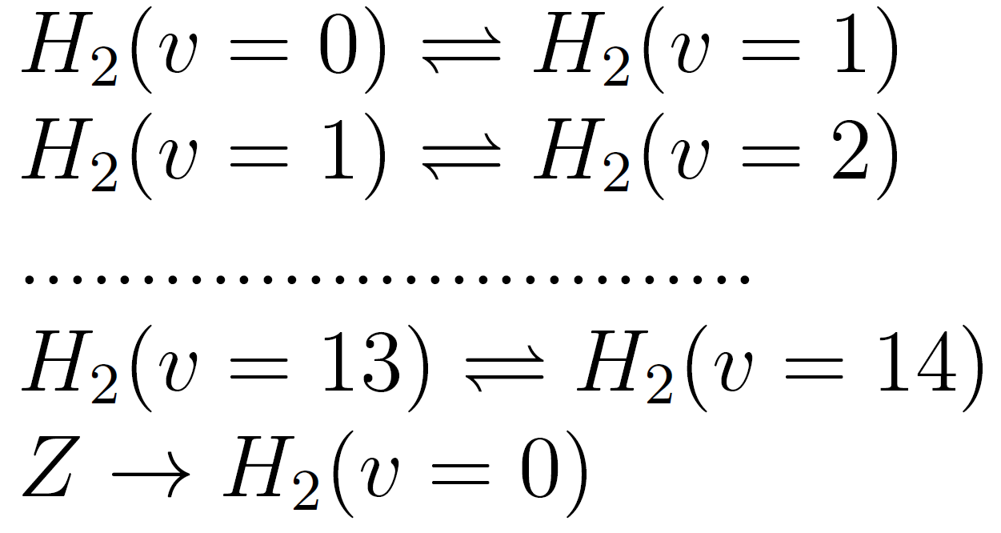
YACORA: inclusion molecular source term
Stationary run vibrationally resolved:
YACORA + Source term
adjustable to the Edge2D-EIRENE
Particle species
F.Cianfrani,
EPS-2022
Reactions
electron impact
proton impact
electron impact
vibrational transitions
H₂ source term

Slide 10
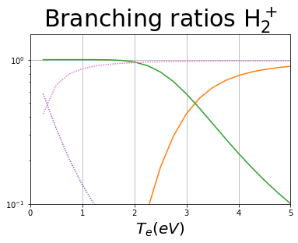
СRM simulations (standalone): branching ratios
EU-DEMO
low temperature (T < 2eV) leading reaction chains:
MAD
MAR/MAD competition at very low temperature
H₂+H⁺→ H₂⁺+H H₂⁺+e → H+H⁺+e
H₂+H⁺→ H₂⁺+H H₂⁺+e → H+H
MAR

Slide 11
CRM: effect of vibrationally resolved states
F.Cianfrani et al.,
EPS-2022
vibrationally resolved molecular states H₂(v) (v=0 ..14) with electron-induced ladder-like trans H₂(v) + e → H₂(v±1) + e rates H2vibr
EU-DEMO
vibrational transitions are the main reaction channels at low temperatures

Slide 12
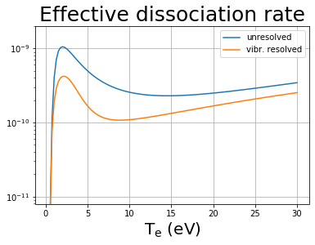
EU-DEMO – effect of resolution by vibrostates
F.Cianfrani et al.,
EPS-2022
Fully in line with the EIRENE and other CRMs:
“Up to 40% reduction in effective dissociation rate due to transport of vibrational states”
A.Holm, M.Groth, et al.,
PET, CPP 2021

Slide 13
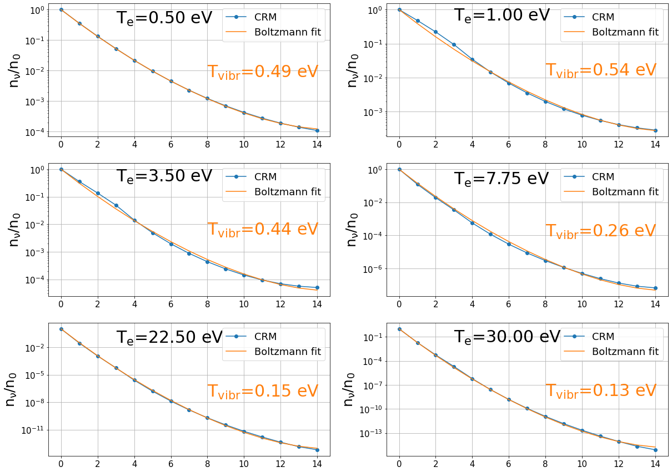
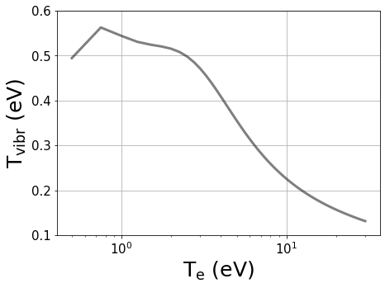
CRM: effect of T_{e} on vibrational populations
X
ground state: Boltzmann distribution
ν = 5
ν = 4
ν = 3
diss./ ion.
ν = 2
ν = 1
SOURCE
ν = 0
T_{vibr} increases with decreasing T_{e}
peak at low T_{e}

Slide 14
HYDKIN (web-based A&M data tool):
toolbox for plotting and manipulation of A&M data with a user-friendly graphical interface.
includes EIRENE databases: AMJUEL, HYDHEL, H2VIBR, METHANE, .. .
available at http://www.eirene.de/hydkin/
Password-protected (for access contact the authors).
D.Reiter et al.,
Phys. Scr. 2009
F.Cianfrani et al.,
ICAMDATA-2022

Slide 15
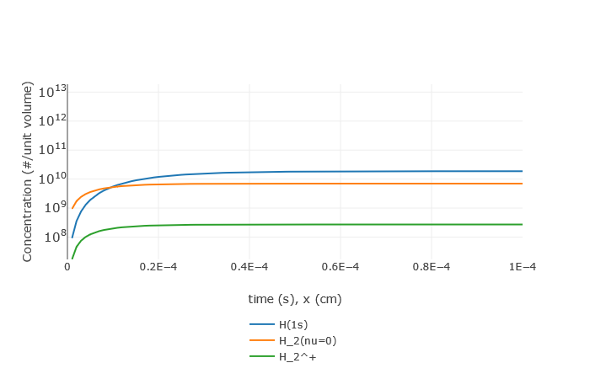
HYDKIN: particle solver (non-stationary)
“infinite reserve” of particles at fixed temperature and density
Default case (see next slides)
reservoir
Development of stationary equilibrium

Slide 16
HYDKIN: what is inside?..
CRM solver (transport excluded, pure A&M side of the problem) with extensive features
Stationary and non-stationary solution (assuming velocity and plasma pars)
Any specie can be treated as “Reservoir”
“Spectral analysis” based on eigenvalue approach (which reactions are most important?)
Sensitivity analysis – vary the plasma parameters, solver settings, reactions, etc.
Plotting, solver results visualisation
Useful for fast consistency checks and trivial analysis while constructing the CRMs
Good for physics analysis in case one follows established routines
Flexible reaction tables interconnected with the solver and plotting
Useful for fast consistency checks and trivial analysis while constructing the CRMs
Good for physics analysis in case one follows established routines
Input/output in various formats (new: JSON) including directly for EIRENE

Slide 17
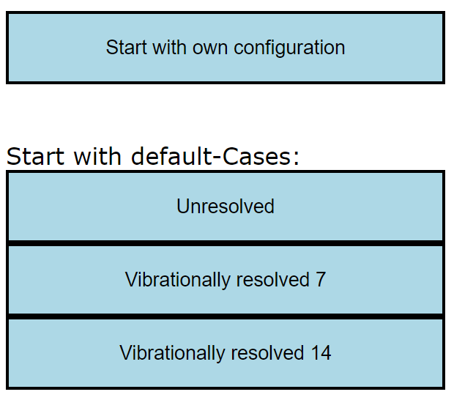
HYDKIN: using the power of the web-interface
The basis table is highly customisable:
Deselected reaction can be excluded from the view
User easily selects the level of info for each reaction to be shown
Basic, solver, plotting etc. tables are interlinked
All is optimised for checking high amounts of similar data
Critical things are highlighted
Data is grouped by the reactions (even if comes from various sources)
One can start with initial configuration (standard or custom) and do only essential (e.g. from physics) changes
For H₂ case (example):

Slide 18
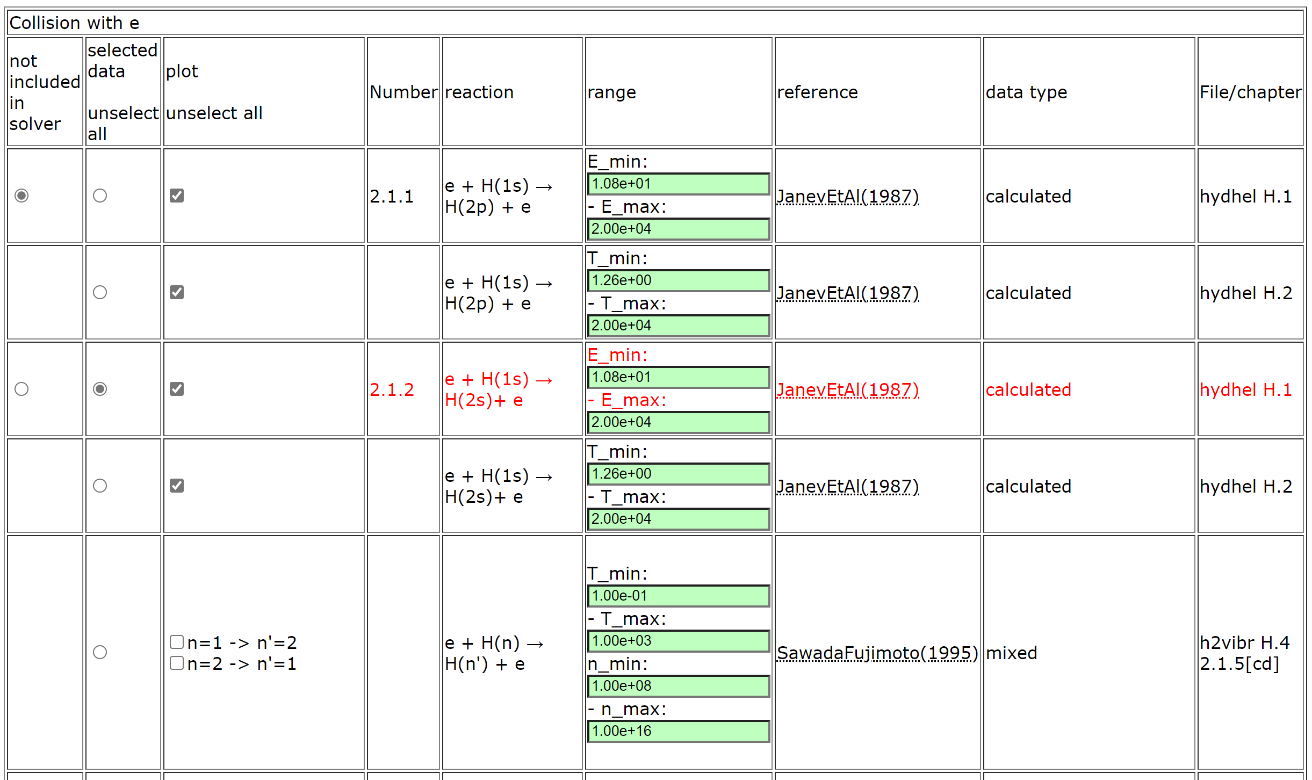
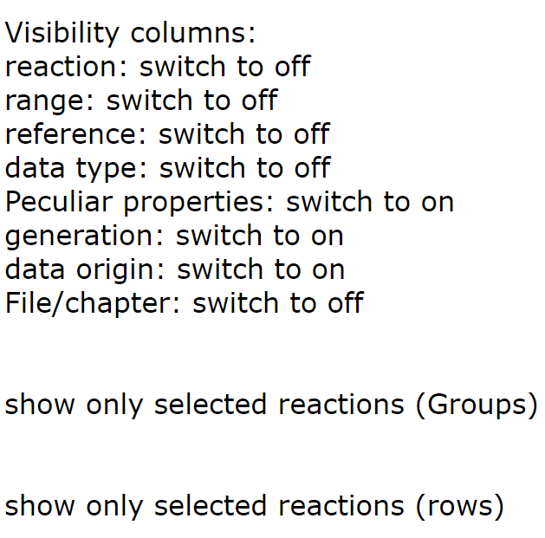
HYDKIN – new mode (H₂ case)
Buttons to adjust table content

Slide 19
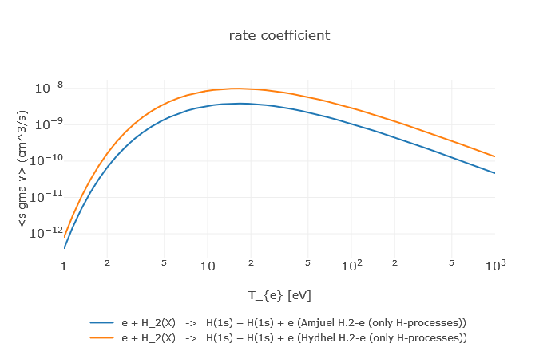
HYDKIN: comparison dissociation rates
e + H₂ → H + H + e
HYDHEL
AMJUEL
Factor 3 wrong

Slide 20
New HYDKIN can be used to
to import/export data (JSON, tabular and other formats)
to produce input data for EIRENE and for other codes
to check data for consistency, abnormal features, etc.
to check and improve the results of the simulation
to understand A&M side of the problem and identify the most significant processes (among the selected ones)
to load/improve/save the developed configuration (selected reactions and parameters) including starting from the standard “default” pre-sets
EIRENE Code Camp 2022: we want HYDKIN to substitute certain EIRENE routines in data preparation (JSON) with consistency checks.
Reactions are grouped in the tables optimised for this kind of work

Slide 21
TSVV-5 WP for 2023 (IMS)
Begin with development of the universal framework for the CFD-EIRENE and other interfaces (e.g. with codes inside TSVV-3, 4, 7). Demonstrate workable schemes on particular examples.
Provide adjoint (AD) approach in Eirene through interfacing with Tapenade in for-/back- ward AD mode. Assess bottlenecks for use of AD with EIRENE, focusing on the context of SOLPS-ITER.
Demonstrate time-dependent simulations for the new modular code including the new features (FKH, CRMs). Consider algorithmic improvements (including theory work if needed) to optimise the performance for the time-dependent runs.
Apply modular EIRENE-NGM with the new version FEM for the FW to MAGNUM-PSI: simulate MAGMUM-PSI plasmas with various degree of detachment as independent snap shots. Validate those with spectroscopy and other diagnostics. Assess performance and other requirements for related time-dependent runs.
Remaining from 2022:
Execute SOLPS-ITER with vibrationally excited hydrogen molecules for and assess their impact on the state of the divertor plasma (JET L-mode). Assess impact of hydrogen isotopes on state of divertor plasma. Utilise CRM post-processors to predict spectroscopic signature of molecules (Fulcher band), for hydrogen, deuterium and tritium.
Assess state of photon tracing model in current EIRENE version, reactivate photon tracing model in standalone EIRENE simulations, execute simple test runs (slab) and actual tokamak geometries (JET).

Slide 22
Summary
Code development is successfully ongoing
Participation in code restructuring
Version merging, preparing milestone release
New CRM is concepted and under development
It should be used both in EIRENE and standalone
We use YACORA (with additional source introduced) to gain useful experience
HydKin is largely updated and about to become the main A&M pre-processing tool
All the development is ongoing in a view of future massive data extension
It is meant to provide flexible adjustment of CRMs and auto generation of EIRENE input
Strong cooperation with WPDC (detachment control)
TSVV-5 organisation and management:
We have appropriate level of meetings. Documentation (INDICO) acceptable, but more will come with the new webpages.
We have mostly very successful cooperation with the ACHs (EIRON, IMASification) and ITER
We need to strengthen cooperation with other TSVVs

Slide 23
Priorities for 2023
Finalise code development in the frame of P.Börner contract
(for details see the related plan and Code Camps…)
Large focus on the CRM development (F.Cianfrani, D.Borodin)
The flexible CRM (both internal and standalone) with tracking of internal stated is to be developed and tested by first applications
Isotope effects to be introduced
Rovibrational temperature tracking
Photon tracing to be introduced
HydKin should become the main pre-processing tool for the CRMs (B.Küppers, F.Cianfrani, D.Borodin)
Organisational work for TSVV-5 (D.Borodin)
Interaction within and outside TSVV-5: TSVVs, ACH, experiments, DEMO, ITER, …
Webpages, licensing, developer forum / issue tracking, CI, …
Publications
Code Camp 2023

Slide 24
Publications/conferences in 2023
IEAE FEC + NF – joint TSVV-5 paper with a focus on CRMs (D.Borodin et al.)
PFMC oral (?..) – HydKin, Yacora, H2 CRM with vibrostates (F.Cianfrani et al.)
PET?.. (F.Cianfrani et al.)
IAEA event “Atomic processes in plasma”, May 2023 - metastable tracking (Be, W, He) in transport codes (D.Borodin et al.)
We would seek to have more joint papers (e.g. on EIRON, on JET applications etc.)

Slide 25
Thanks for the attention!

