Slide 1
An extended 2 point-model for the parallel fluxes in the SOL in sheath and conduction limited regimes:
model description and current status
Notes:
Thank you for having me

Slide 2
Outline
Motivation for studying CLR/HRR
Description of the model
Aim and ansatz
Equations for the connection zone
Equations for the ionization zone
Status of the model:
Implementation
Future improvements & work
Questions (and suggestions)

Slide 3
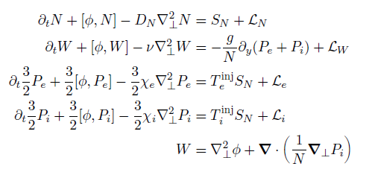
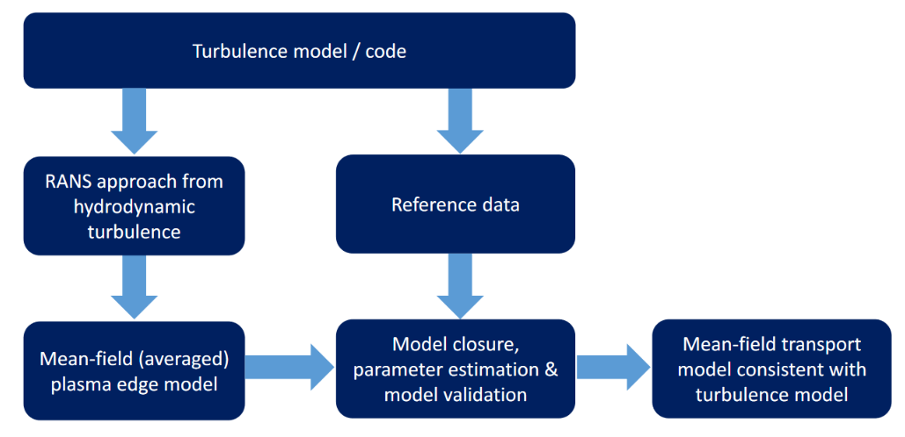
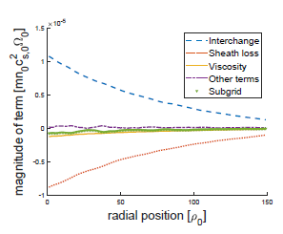
Motivation for studying CLR/HRR
KUL approach:
W. Dekeyser, internal document & R. Coosemans, PhD text.
Notes:
Start from model describing plasma in the simulation

Slide 4
Motivation for studying CLR/HRR
KUL approach:
W. Dekeyser, internal document & R. Coosemans, PhD text.

Slide 5
Motivation for studying CLR/HRR
KUL approach:
W. Dekeyser, internal document & R. Coosemans, PhD text.
Notes:
Get to a mean field eq, with closure terms popping up. In order to identify which are important, we will evaluate them using the ref data provided by the code

Slide 6
Motivation for studying CLR/HRR
KUL approach:
W. Dekeyser, internal document & R. Coosemans, PhD text.
Notes:
Balance between interchange and transport

Slide 7
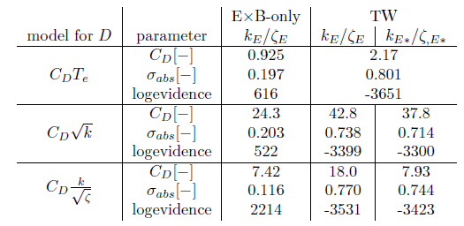
Motivation for studying CLR/HRR
KUL approach:
W. Dekeyser, internal document & R. Coosemans, PhD text.
Notes:
Provide closure forms based on the literature on instabilities/earlier modeling atempts/intuition,,, to come up with those relations
Contain free paramters => tuned bayesian framework
Outputs logevidence to rank models. (depending on nr of unkowns it is more difficult to do this)

Slide 8
Motivation for studying CLR/HRR
KUL approach:
W. Dekeyser, internal document & R. Coosemans, PhD text.
Notes:
Once provided a model for all closure terms (i.e. small ones are approximated as zero) => model to be implemented in MF-codes like SOLPS and SOLEDGE
Use of RANS for predictive studies once it is sufficiently develloped/mature

Slide 9
Motivation:
Current RANS-model:
2D at OMP
No neutrals
Sheath-limited regime
Required improvements:
3D
Interactions with neutrals
Reactor relevant regimes
Goal: extend the validity of the current RANS-model to reactor-relevant regimes
Notes:
Therefore cornerstone is model used
We only looked at 2D -> 3D : this project
My project: is about doing transition to other regimes

Slide 10
Motivation:
Current RANS-model:
2D at OMP
No neutrals
Sheath-limited regime
Required improvements:
3D
Interactions with neutrals
Reactor relevant regimes
Goal: extend the validity of the current RANS-model to reactor-relevant regimes
Notes:
Where I started was with going to first look at the SLR/CLR

Slide 11
Beyond the simple SOL-regime: varying density regimes

Slide 12
Aim & Ansatz
Aim of the model:
Implementable in 2D-codes
Provide expressions for parallel fluxes which are consistent with each other
Incorporate both SL and CL(/HR)-regime
Ansatz:
Since in 2D-models $∇_{∥}Γ≈\frac{Γ^{SE}}{L_{∥}}$, take $Γ\left(s_{∥}\right)=Γ^{CZE}$ $\frac{s_{∥}}{L_{∥}}$, $Γ:Γ_{i};Γ_{e},q_{e},q_{i}$
Allows to calculate ${State}_{CZE}=\left(T_{e},T_{i},φ,n,u_{∥}\right)$
Ref: Phys. Plasmas 18, 012305 (2011); https://doi.org/10.1063/1.3526676
Notes:
2D more affordable to run and larger parameter scans

Slide 13
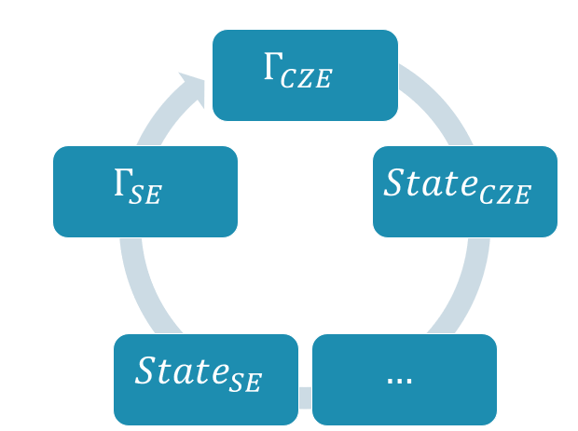
Aim & Ansatz
Aim of the model:
Implementable in 2D-codes
Provide expressions for parallel fluxes which are consistent with each other
Incorporate both SL and CL(/HR)-regime
Ansatz:
Since in 2D-models $∇_{∥}Γ≈\frac{Γ^{SE}}{L_{∥}}$, take $Γ\left(s_{∥}\right)=Γ^{CZE}$ $\frac{s_{∥}}{L_{∥}}$, $Γ:Γ_{i};Γ_{e},q_{e},q_{i}$
Allows to calculate ${State}_{CZE}=(T_{e},T_{i},φ,n,u_{∥})$ => $Γ^{SE}$
CZ-model inspired by the one used in (n)SOLT
Ref: Phys. Plasmas 18, 012305 (2011); https://doi.org/10.1063/1.3526676

Slide 14
Aim & Ansatz
Aim of the model:
Implementable in 2D-codes
Provide expressions for parallel fluxes which are consistent with each other
Incorporate both SL and CL(/HR)-regime
Ansatz:
Since in 2D-models $∇_{∥}Γ≈\frac{Γ^{SE}}{L_{∥}}$, take $Γ\left(s_{∥}\right)=Γ^{CZE}$ $\frac{s_{∥}}{L_{∥}}$, $Γ:Γ_{i};Γ_{e},q_{e},q_{i}$
Allows to calculate ${State}_{CZE}=(T_{e},T_{i},φ,n,u_{∥})$ => $Γ^{SE}$
CZ-model inspired by the one used in (n)SOLT
Ref: Phys. Plasmas 18, 012305 (2011); https://doi.org/10.1063/1.3526676

Slide 15
Aim & Ansatz
Aim of the model:
Implementable in 2D-codes
Provide expressions for parallel fluxes which are consistent with each other
Incorporate both SL and CL(/HR)-regime
Ansatz:
But HRR: allow for ionization zone (& charge-exchange zone in future)
Previous step: fields and fluxes at IZE (CZE)
IZ will adjust them: ${State}_{SE}=f\left(State_{CZE},Γ_{CZE}\right)$
Ref: Phys. Plasmas 18, 012305 (2011); https://doi.org/10.1063/1.3526676
Notes:
Dont forget to say ‘hence’ ...
Due to the iz-zone these aren’t anymore the ones at the target

Slide 16
Equations for Connection Zone
Obtaining $T_{e/i,CZE}$
Using :
Results:
$q_{∥,e/i}=\frac{\frac{4}{7}κ_{0,e}\left(T_{e/i,u}^{\frac{7}{2}}−T_{e/i,CZE}^{\frac{7}{2}}\right)}{L_{∥}}$
Obtaining $n_{CZE},u_{∥,CZE}$
Using:
Results:
Ref: PC Stangeby. The plasma boundary of magnetic
fusion devices. CRC Press, 2000
Notes:
With the anzats clear, let’s look into the equations and the problems

Slide 17
Equations for Connection Zone
$Obtaining ϕ_{CZE}:$
Starting from Ohm’s law:
Using linear increase, $T_{e}(x_{∥})$ and integrating:
Hence 1 ‘problem’: no analytical expression
Could pose different approximations
$∫\{∇_{∥} \left(T_{e}\right)+T_{e}∇_{∥}\ln\left(n\right)\} dx_{∥}⇒SLR:≈\ln\left(\frac{n_{CZE}}{n_{u}}\right)T_{e}\sim 0,71T_{e}$, but in general?
$\underset{→}{?}\left(T_{e,CZE}−T_{eu}\right)+\frac{\left(T_{e,IZE}+T_{eu}\right)}{2}\ln\left(\frac{n_{CZE}}{n_{u}}\right)$
Ref: PC Stangeby. The plasma boundary of magnetic
fusion devices. CRC Press, 2000
Notes:
With the anzats clear, let’s look into the equations and the problems

Slide 18
Equations for Connection Zone
$Obtaining ϕ_{CZE}:$
First approximation:
$\left(T_{e,IZE}−T_{eu}\right)+\frac{\left(T_{e,IZE}+T_{eu}\right)}{2}\ln\left(\frac{n_{IZE}}{n_{u}}\right)$
Brida et al. used expression from Chankin et al.:
This leads to:
Checking simplistic SLR:$α=\frac{\log\left(\frac{p_{e,SE}}{p_{e,u}}\right)}{\log\left(\frac{T_{e,SE}}{T_{e,u}}\right)}=$ $\frac{\log\left(0,5\right)}{\log\left(1−δT_{e}\right)}=\frac{\log\left(0,5\right)}{−δT_{e}−\frac{{\left(δT_{e}\right)}^{2}}{2}−…}⇒αδT_{e}≈−log⁡(0,5)$
$∫\frac{1}{n}\frac{∂p_{e}}{∂x_{∥}}dx_{∥}$ = $log(2)T_{e}$
Last alternative: neglect ...
A. Chankin, et al., J. Nucl. Mater. 290 (2001) 518–524. &
D .Brida, et al. doi: https://doi.org/10.1016/j.nme.2022.101262
Notes:
I really like this new insight (as it still motivates the use of the chankin relation)... Insight was wrong, and luckily it was not needed.

Slide 19
Own Model: Equations for Connection Zone
$Obtaining ϕ_{CZE}:$
First approximation:
$\left(T_{e,IZE}−T_{eu}\right)+\frac{\left(T_{e,IZE}+T_{eu}\right)}{2}\ln\left(\frac{n_{IZE}}{n_{u}}\right)$
Brida et al. used expression from Chankin et al.:
This leads to:
Checking simplistic SLR: 0,5 = ${\left(1−δT_{e}\right)}^{α}≈1−αδT_{e}$
so: = $0,5T_{e}$
-> While currently used in the implementation
-> Foreseen: adapt relationship to be:
! Not rigorous as when $δT_{e}≈0$, $α→∞$, h.o.t. not negligible per sé ... I was wrong ...
Last alternative: neglect ...
A. Chankin, et al., J. Nucl. Mater. 290 (2001) 518–524. &
D .Brida, et al. doi: https://doi.org/10.1016/j.nme.2022.101262
Notes:
I really like this new insight (as it still motivates the use of the chankin relation)

Slide 20
Equations for Connection Zone
Note:
Momentum conservation only between OMP and CZE, not along flux tube
Approximation used for $∫\frac{1}{n}\frac{∂p_{e}}{∂x_{∥}}dx_{∥}$ determines $n(x_{∥})$
$T_{e/i}\left(x\right),u_{∥}(x_{∥})$ are determined by fluxes
Since for $u_{∥,CZE}$ 2 solutions possible => use the low velocity branch
(Numerically: we chose to limit $Γ_{CZE}$ to sound-speed flux, similar limit $q_{e/i}$)
Notes:
With the anzats clear, let’s look into the equations and the problems

Slide 21
Idea behind Ionization Zone
Reminder: a model realizing the transition low recycling -> high recycling
=> model for particle source close to target
Current implementation:
Fixed width from viewpoint neutrals
$≈0$ width from viewpoint plasma
Treat $T_{e},T_{i}$ as constant in IZ
Only consider volumetric sources due to the ionizations

Slide 22
Equations for the Ionization Zone
Apply conservation equations across the zone:
Additional relations:
$$γ_{e}=4$$
$$γ_{i}=2,5$$
Phys. Plasmas 28, 092305 (2021); doi: 10.1063/5.0060524
Notes:
Note for ions the internal energy equation is used as a basis and not the total energy equation. (One of the reasons): electric potential should accelerate the ions partly. But not all ions undergo same potential drop,...

Slide 23
Equations for the Ionization Zone
Model ionization source:
Greenwood, J. (2002) The correct and incorrect generation of a cosine distribution of scattered particles for Monte-Carlo modelling of vacuum systems. Vacuum. [Online] 67 (2), 217–222. & W. Cielen (2021), Master thesis KU Leuven
Notes:
Note about angle of incendence

Slide 24
Conclusion about the model description
=> Consistent, implicit, approximate, set of equations to infer $Γ_{∥}^{′}s$ based on OMP quantities
Approximate:
No pressure conservation implied by $φ_{CZE}=f(φ_{u},α,…)$
$∫a\left(s_{∥}\right)∇_{∥}b\left(s_{∥}\right)ds_{∥}≠0$ for conservation equations applied to IZ (i.e. technical work neglected)
No equilibration in IZ
Internal energy equation for ions (potential drop will help acceleration)
Required cross-field transport is implicitly included
Notes:
Note for ions the internal energy equation is used as a basis and not the total energy equation. (One of the reasons): electric potential should accelerate the ions partly. But not all ions undergo same potential drop,...
If pressure conservation: no real $n,u$ are necc. implied by the model (To be checked again) => if we impose pressure conservation then the model would look differently and we would need to deal with that integral exactly. If we would use pressure conservation then the ‘convergence region’ would be differently. Maar dit gaat over een ander model. Eg ons model zou lage Te_SE kunnen realiseren met een lage Ti langsheen de veldlijn als we geen ionizaties beschouwen, maar die lage Te_SE kan dan wss niet bekomen worden als we het model oplossen met exact drukbehoud omdat het verloop langsheen de veldlijn niet meer reeel blijft.

Slide 25
Status of the model
Done:
Elaborated version (technically) implemented in TOKAM2D
Incorporated in the workflow of TOKAM2D:
Adjusted the boundary condition for the potential:
$φ_{East}=ΛT_{e}→J_{∥, East}=0$
Including potential adjustment to limit charge build-up in iterative way
Guarantee consistency between OMP-fields and $Γ_{∥}$
Notes:
Is this potential adjustment also done in 3D codes?

Slide 26
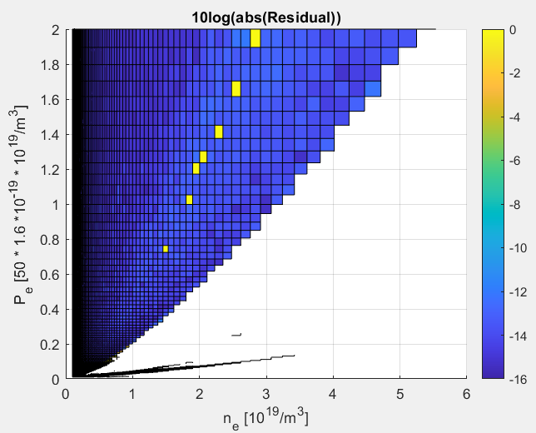
Status of the model
Doing:
debugging simulations:
Convergence pModel: ~10^(-12)
NaN’s during longer simulations
Better ‘understand’ convergence region
Notes:
Make solver robust to initial conditions, as when I checked a point with conditions from a converged one, it also converged. => Not necc problematic for simulation, but good if it would work all the time.
I.e. originally I first ran without current and then with current for setting up these maps, this map is all together from first time.

Slide 27
Status of the model
To do:
Investigate CXZ
Consistency update: $γ_{e}→2+Λ or 2+φ_{SE}$
Go through development notes document
Verification of the implementation! (allocation and initialization issues)
Make database of simulations
Diagnose simulations + evaluate mean-field balances
Check current closures and propose adaptions where needed
Notes:
Database: Core + SOL, Possibly without and with
As illustrated by work done previous week: the convergence was not great due to not having initialized a certain matrix as in original way of working it was not needed ... (i.e. used dF_dX(:,15) whilst i only filled in the dF_dX(2,15) as that one was needed for calc of Jacobian ... But dF_dX(:,15) was needed for calculating accurate derivatives. Hence compromise between: ‘wanting to code downstream routines flexible’ or more hard coded: A = zeros(4,1); A(2) = dF_dX(2,15) ...
ionisation zonde depending on what stepwise approach we will follow.

Slide 28
Questions (and/or advice)

Slide 29
Back-up

Slide 30
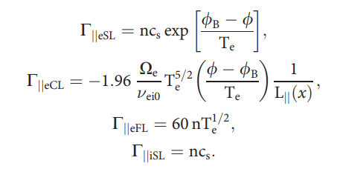
Model formulation: (n)SOLT
Original plan: use model of (n)SOLT
Ref: Phys. Plasmas 28, 092305 (2021); https://doi.org/10.1063/5.0060524
Notes:
Calculate the fluxes based on: ions always n*cs, electrons via the current: where they take some harmonic avergage between 3 current limits and do this similarly for the conductive heat flux
We will now look into these limit expressions: SL-fluxes are as expected (the boundary conditions which we apply in usual 2D or 3D codes)
But what about the CL-fluxes?

Slide 31
(n)SOLT-model
Parallel electron flux:
Start from ohm’s law:
Assume:
Linear increase of $j_{∥}$ and of $q_{e}$
In Limit of CLR: $T_{e,ize}=0$ =>
+ $σ_{∥}{\left.​\right|}_{OMP}$
Notes:
Dont forget that they are providing limiting expressions => Te_ize = 0 => can cancel out => obtain this

Slide 32
(n)SOLT-model
As a result, questions arose:
1)What about the following integral?
$n_{e}=C^{te}?$

Slide 33
(n)SOLT-model
=> Own Model
As a result, questions arose:
1)What about the following integral?
2)Did they assume = 3 ?
3) Neglected 0,71$T_{eu}$?
Additional questions:
n$c_{s}$: which $n,c_{s}$?
Seems CL-expression for q is used in calculating j => ?
Notes:
Did they neglect 0,71 * Teu, or do they let it compensate the first term?

Slide 34
Note
Conceptually:
When $Δ_{iz}=0$, $E_{disso}=0$ eV, the model will give: $T_{i}=!$
Further when not using $α$-relation, and accounting $Δφ=…+0,71ΔT_{e}+…$
=> Model can be interpreted as an extension of the (n)SOLT-model:
- implicit model
+ consistent interpolation of fluxes
- only for transition SLR->CLR, as doesn’t incorporate Flux limiters (require $n(s_{∥})$)
... But to what extend are flux limiters based on upstream conditions useful, when you use the same upstream quantities to infer the Sheath-fluxes and the latter are smaller than the limit (To be read again)
I.e. we impose qe = qe_sheath => the flux can’t get higher than the value imposed by the boundary condition and this value was (normally) lower then the FL at the SE (i.e. its $α_{χ_{e}}^{sh}\sim 0,072$, whilst $α_{χ_{e}}^{FS}\sim 0,8$ and $α_{χ_{e}}^{SOLPS}\sim 0,2$. (pg R174-Fundamenski 2005)
W Fundamenski 2005 Plasma Phys. Control. Fusion 47 R163

