Slide 1
Introduction to the discharge simulator
E. Joffrin, CEA, IRFM (France)

Slide 2
Purpose of the discharge simulator
Tool for EU scientists or operators to develop their experimental/operation scenario before they propose or implement an experiment on the machine (JT-60SA).
Light tool: accessible and « reasonable » CPU time.
Friendly interface
Capable of simulating a discharge from begining start of ramp-up to end of ramp-down, including X-point formation, heating, etc …
Include the machine operational constraints (current limits, controller, etc …)

Slide 3
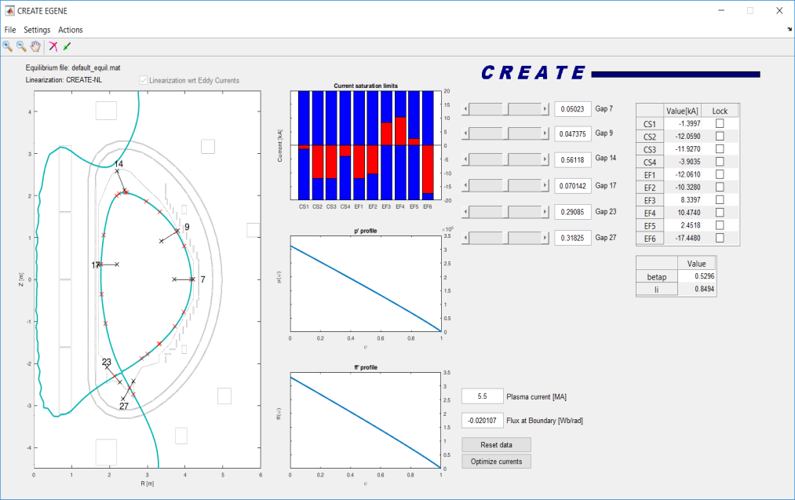
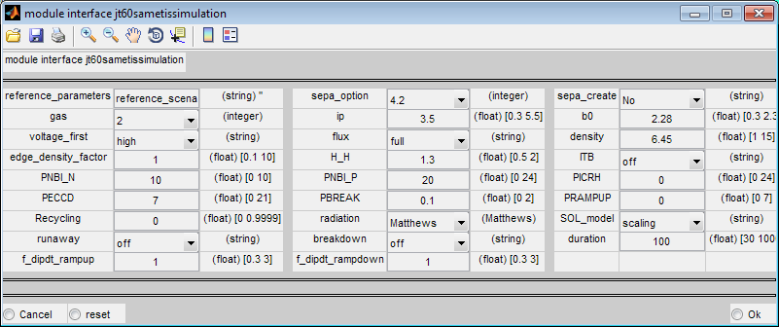
Codes involved in the simulator
CREATE-EGENE code
(CREATE Develoment)
First order FEM solving the free boundary dynamic plasma equilibrium problem for ITER, JT-60SA: validated on JET
METIS (FEEQS) code
(CEA develoment)
Time evolution of the global plasma quantities for given control parameters. Solves the current diffusion with an approximate equilibrium evolution. And simplified treatment of the sources
Team: M. Mattei, J.F. Artaud, L. Di Grazia, A. Mele, D. Abate, T. Bolzonella, V. Ostuni, D. Abate, N. Cruz, M. Lennholm

Slide 4
Plan overview
CREATE activities
Step 1 – Scenario Definition
CEA activities
Shape Generator and Optimizer (GUI developed under F4E contract)
METIS Scenario preparation and optimization. Discharge analysis and flux consumption estimation (target: ramp-up in scenario 2)
Step 2 – Limit Assessment and Waveforms optimization
Tools for nominal feedforward currents optimization in view of closed loop simulations
FREEBIE Poynting mode (no fixed boundary). Poloidal currents, voltage and force limits assessment
Step 3 – non-linear closed loop dynamic simulations
CREATE-NL
Closed loop dynamic simulation including vertical stabilization
METIS
Light transport simulator

Slide 5
Notes
This is a working session
Practical examples of EGENE and METIS run will be given together with first tutorials
This session will be recorded
Agenda
Discharge simulator: status and results (J.F. Artaud) (20’+10’)
METIS-FEEQS tutorial and simulations (V. Ostuni)(15’+10’)
EGENE tutorial and simulations of scenario 2 (A. Mele) (15’+10’)
EGENE simulations of scenario 4.2 (D. Abate) (15’+10’)

Slide 6
Session summary

