Slide 1
Integrated commissioning organization
(including device status, work breakdown, schedule)
E. Joffrin (CEA, France),
G. Giruzzi, E. Belonohy, G. de Tommasi

Slide 2
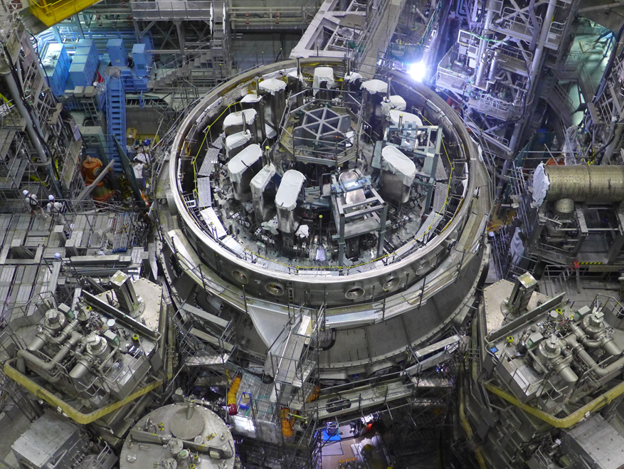














Outline
Project status and results 2019
JT-60SA status & assembly
WPSA news 2019
IC commissioning & exploitation
Integrated commissioning
Commissioning team organization
References

Slide 3
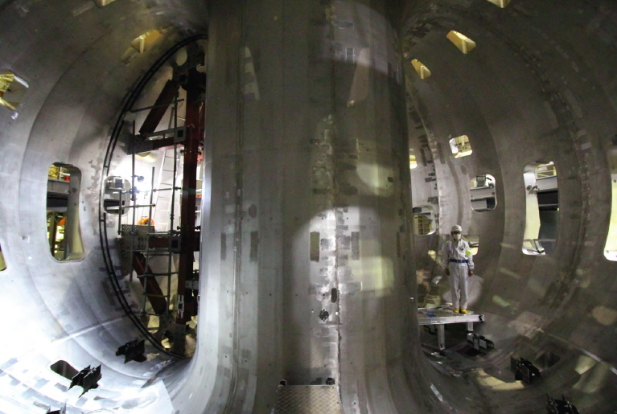
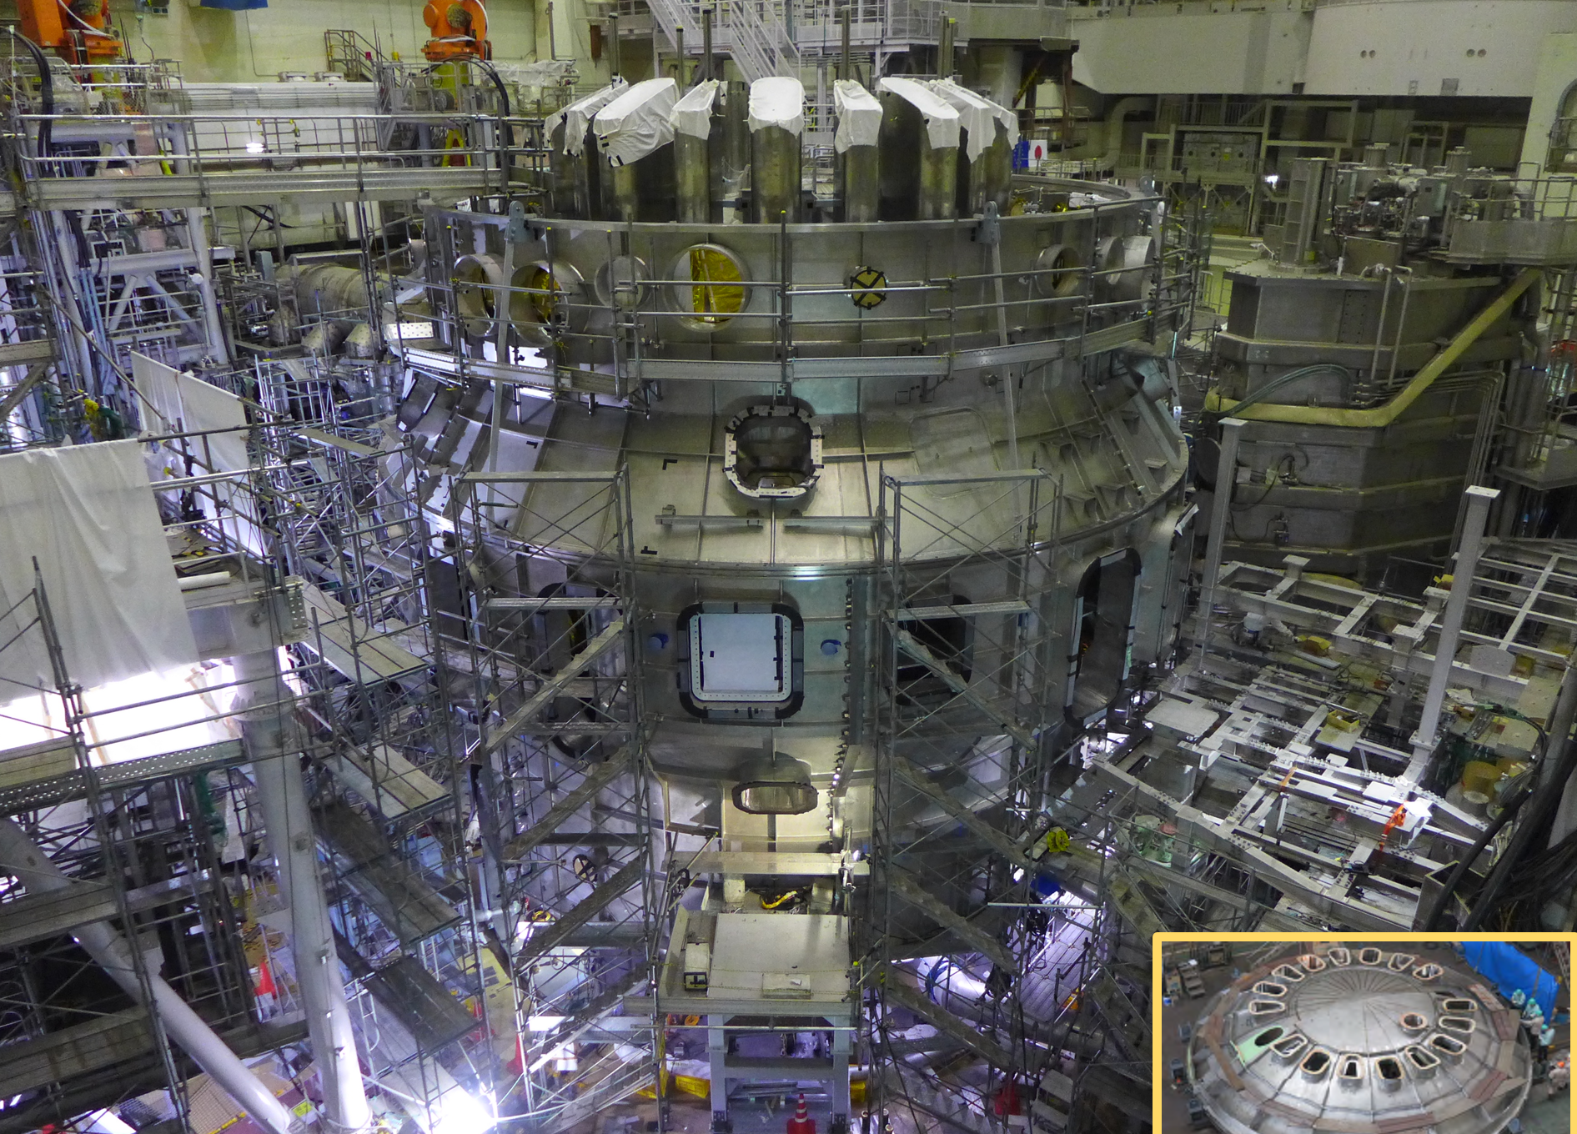
The JT-60SA tokamak
Designed and built jointly by Japan and EU at the Naka site
Largest tokamak before ITER. Fully superconducting, highly shaped
Due to start operation in Sept. 2020
Exploitation by joint EU-Japan team
B_{t} | 2.25 T
I_{p} | 5.5 MA
R / a (A = 2.5) | 2.96 / 1.18 m
κ / δ | 1.93 / 0.5
t (flat-top) | 100 s
N-NBI (500 keV) | 10 MW
P-NBI (85 keV) | 24 MW
ECRH (82, 110, 138 GHz) | 7 MW

Slide 4
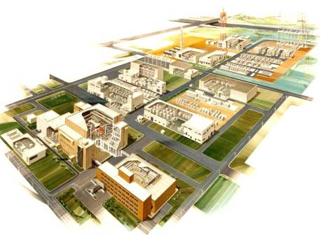
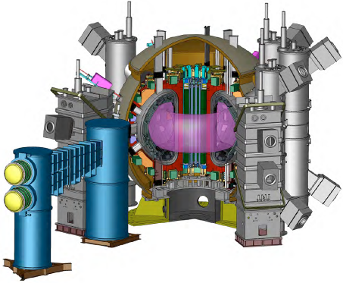
Procurement sharing
Japan and EU implement in-kind contributions for components.
Existing JT-60U facilities are also utilized.
Power Supplies
Compressor Building
TF coils&Testing
CS, EF coils
Water Cooling
System
NBI
Cryogenic System
Cryostat
ECRF
Diagnostics
Vacuum Vessel
In-vessel Components
Assembly
Remote Handling

Slide 5
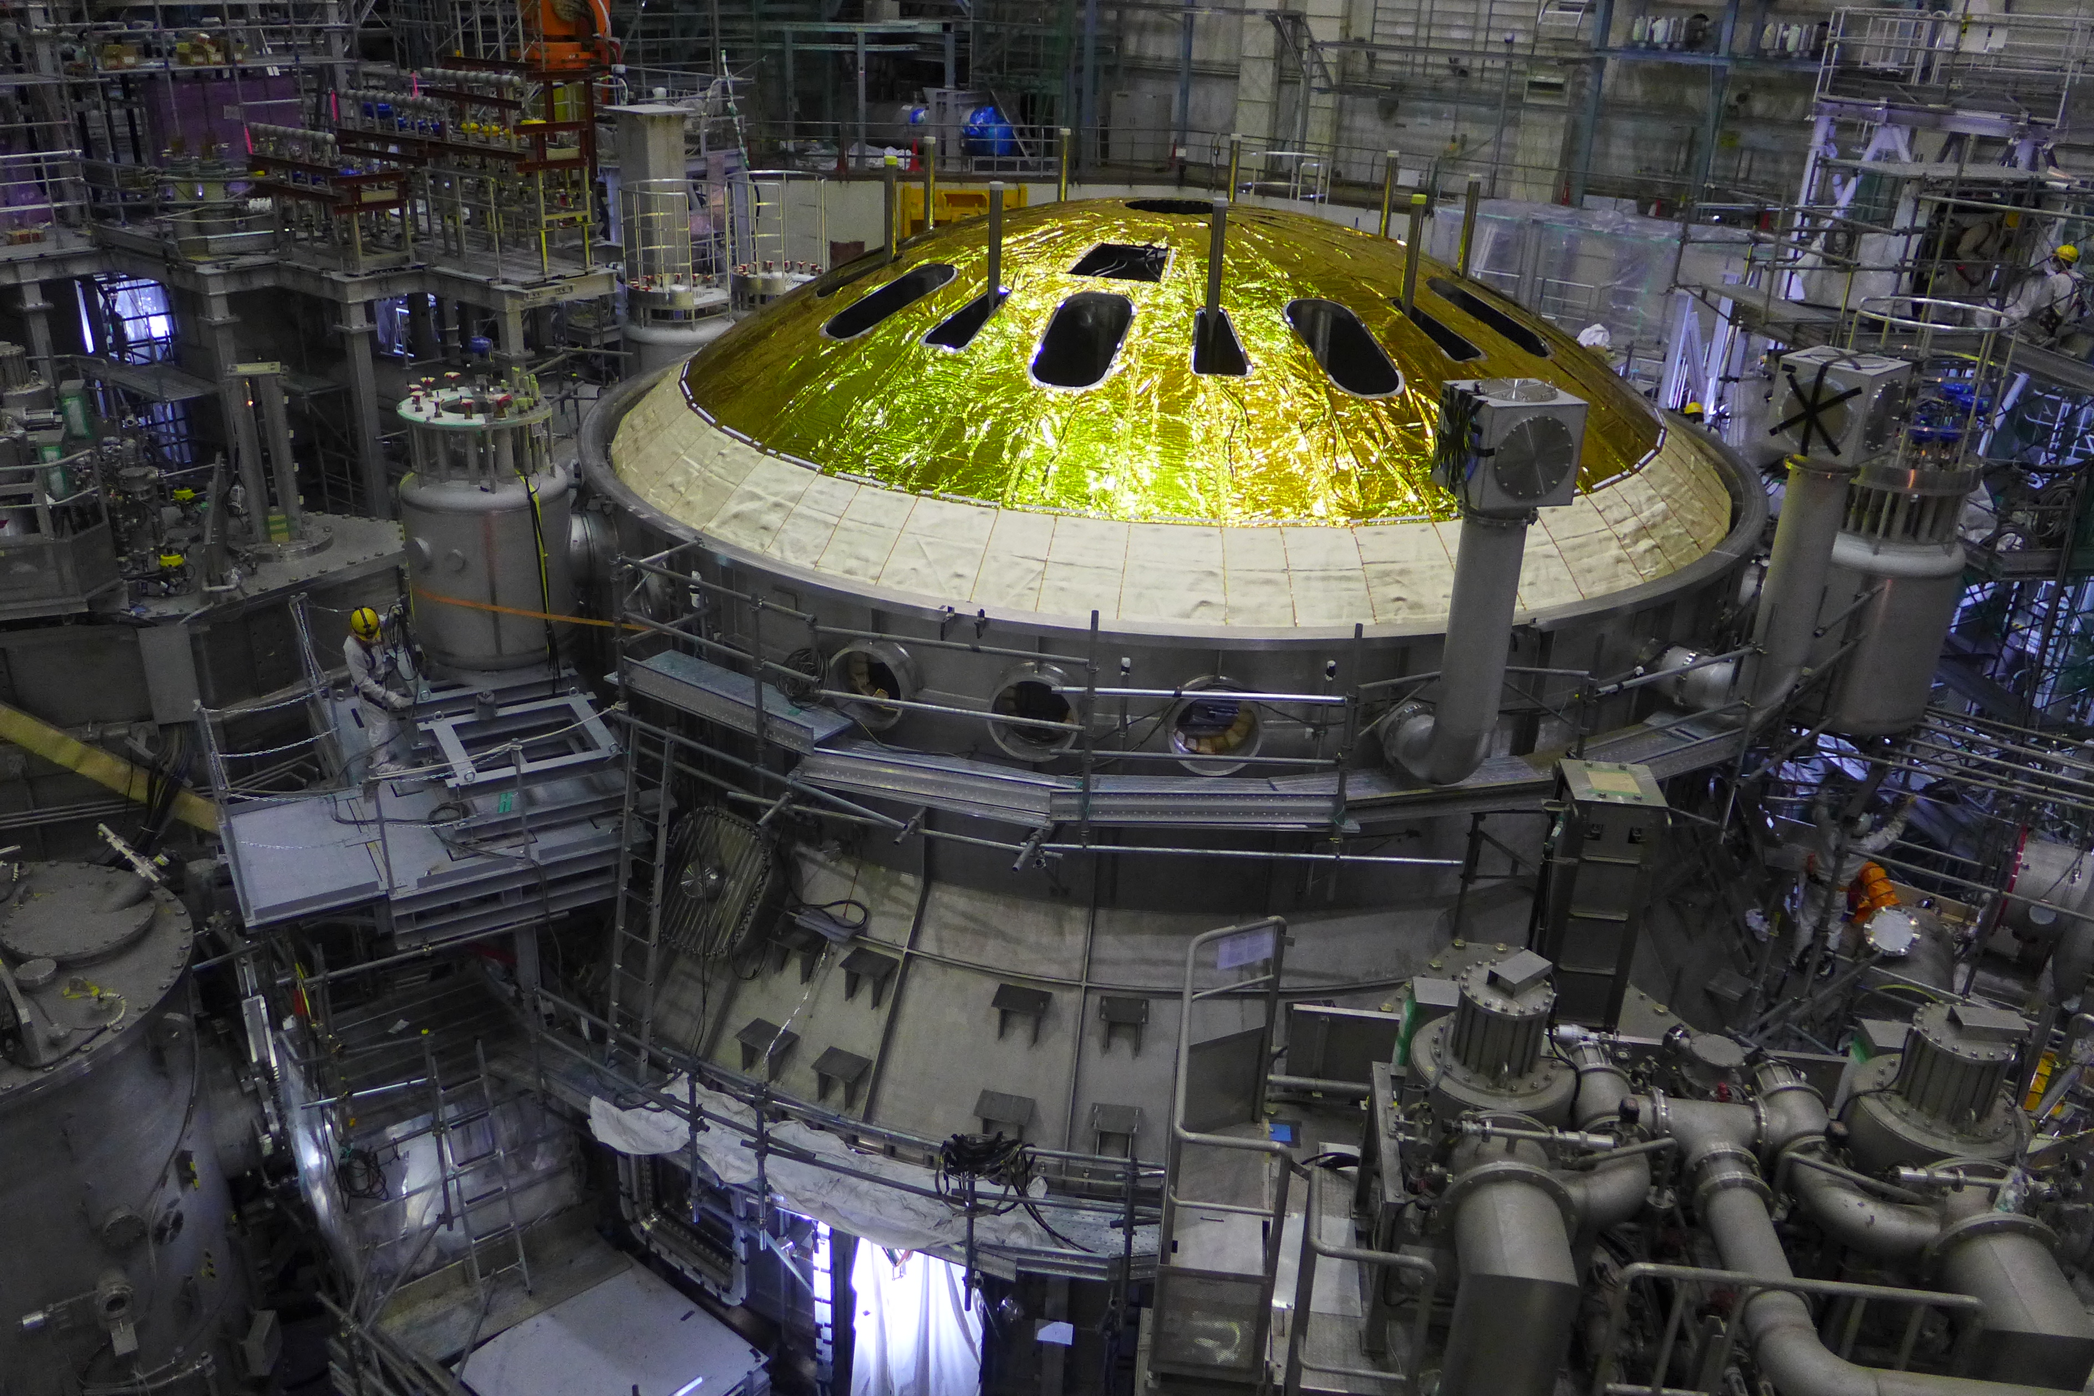
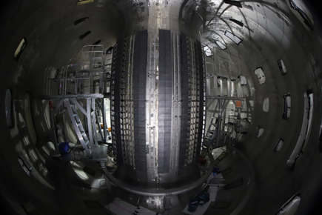
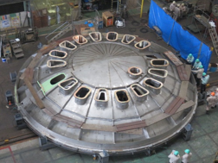
Status of the JT-60SA assembly
  Central solenoid re-inserted on the 26th Dec
  Gravity supports and thermal shields installed
  First wall carbon tiles installed
  Cryostat body assembled top thermal shield installed and top lid ready for installation
  End of assembly (March 2020) and 1st plasma dates (Sept. 2020) maintained

Slide 6
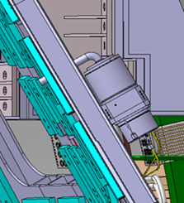

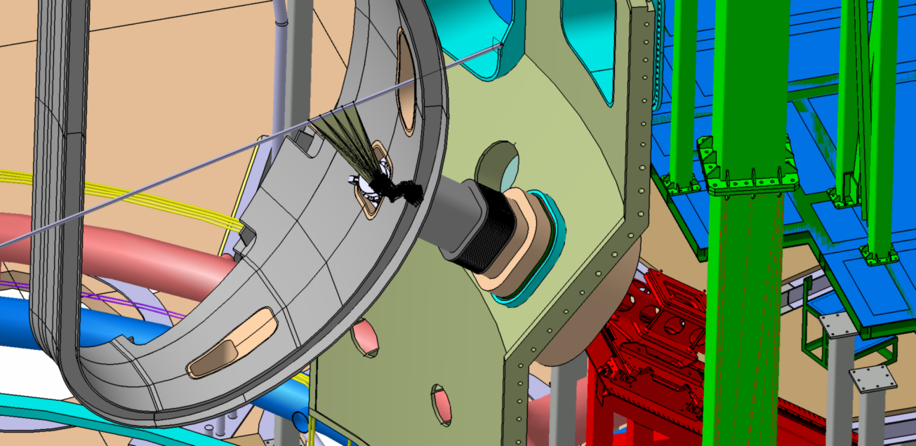
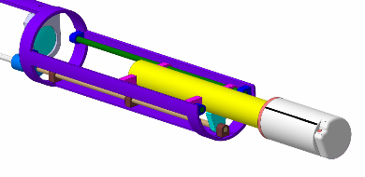
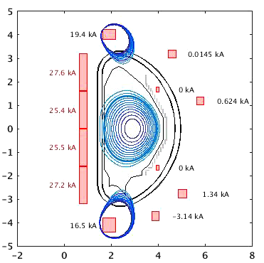
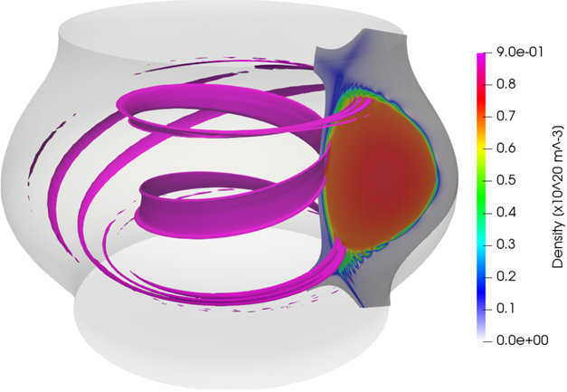
WPSA: EU scientific/operational participation
WPSA is broken down in three tasks:
I- Enhancements (see sessions E1 &E2):
  EDICAM – being installed
  Edge Thomson scattering
  Divertor VUV spectrometer
  Cryopump system
  Pellet injection system
  Massive Gas Injection system
  Fast Ion Loss Detection system
TS
FILD
II- Operation (sessions O1 to O5):
  Discharge simulator
  Position and shape control
  ECRH-assisted breakdown
  ECWC
  Disruption studies
III- Modelling (session M1):
  MHD studies
  Scenario integrated modelling
  Energetic particles

Slide 7
Work Package SA: latest news
6th WPSA Project Planning meeting, Sevilla (March 2019)
  3 days plenary meeting + 1.5 days specific parallel meetings
  68 participants on site + ≈15 remotely (participation steadily growing)
8th Research Coordination Meeting (Naka, June 2019) - 24 EU participants:
First EU diagnostic (EDICAM) delivered to Naka in July 2019
6 new Enhancement Projects launched with F4E
Naka-site EUROfusion team coordinator and deputies appointed → E. Joffrin (coordinator), E. Belonohy and G. De Tommasi (deputies)
Call for EUROfusion Integrated Commissioning team issued on the 2nd of Dec
Results of the call after selection issued on the 16th of March
7th WPSA Project Planning Meeting: Budapest, 30 March – 3 April 2020
Postpotned to September (7th -11th) following the virus crisis.
Replaced by VC working sessions organized by the three tasks

Slide 8
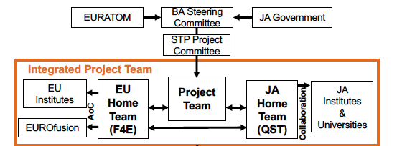
Organization within BA phase II for JT-60SA
EURATOM – JA Gov. Joint Declaration for BA phase 2021-2025 phase II (2nd March 2020)
Preparation of Procurement Arrangements (March-April 2020)
Project Plan of the Satellite Tokamak Programme for BA Phase II (March2020)
(WPSA)
EUROfusion – F4E MOU, Multi-year Project Plan, assignment Agreement (Feb 2020)
Common Quality Management System (CQMS) documents on Integrated Commissioning, Operation and scientific exploitation (agreed with QST, Feb 2020)
The EU has a share of 40% of the Programme ➔ It is expected that about 150 to 200 EU individuals are involved at any time in the JT-60SA Programme

Slide 9
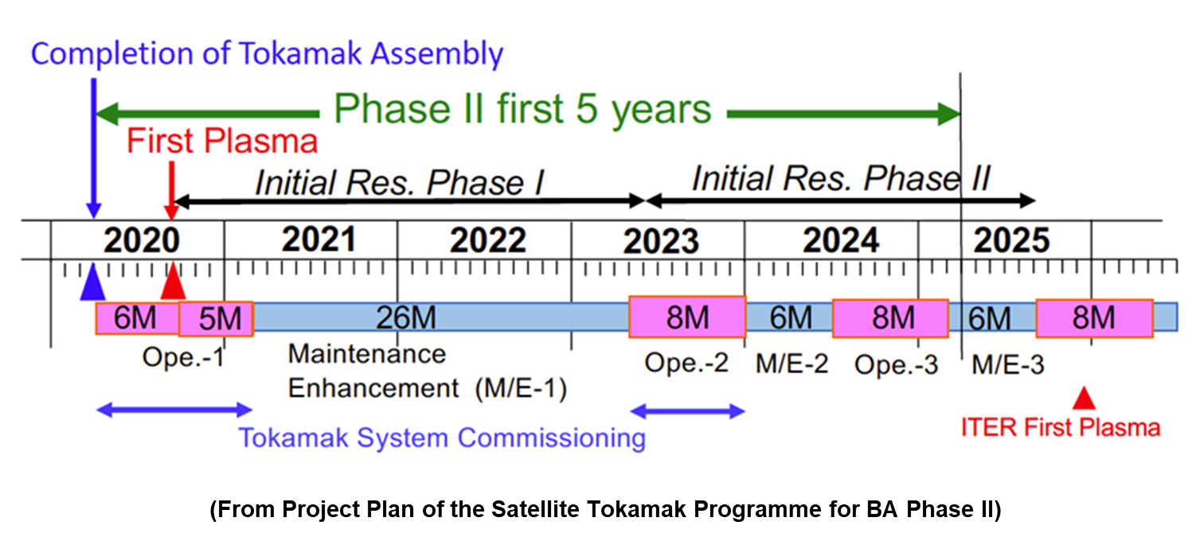
Multi-year JT-60SA Schedule

Slide 10
Commissioning all the items at right timing
2020 |  |  |  |  |  |  |  |  | 2021
Apr | May | Jun | Jul | Aug | Sep | Oct | Nov | Dec | Jan | Feb | Mar
Pump-down + Leak Check
as of 2019.6.27
SC coil LC + Cryo purification
SC coil Cool-down
quality of vacuum
VV & cryostat
diagnostics
…
Baking + LC
Coil Energizing test (TF:100%, CS:50%)
ECWC
Plasma operation
1st Pl.
Coil Energizing test (CS:100%)
coil temperature
status of cryosystem
coil displacement
cryostat vacuum
frost
…
Plasma operation
AC loss test, He flow measu.
SC coil warm-up
Cryo annual inspection
power supply
coil displacement
magnetic sensors commissioning
…
Vac. Break
plasma development
equilibrium controllability=control
diagnostics commissioning
coil displacement
heat load on cryosystem
…
status of wall condition
heat load on cryosystem
…

Slide 11
Status of the machine for IC phase
The nominal toroidal field of 2.25T is ready.
The maximum plasma current allowable for machine safety is 2.5MA.
Upper divertor plates (Carbon, inertial cooling),
No stabilizing plates
Partial (50%) coverage of the inner (high field side) first wall,
Two Gyrotrons (0.75MW x 100s and 0.75MW x 5s) with waveguide launchers,
Power supply system for the full-operation of the superconducting coil
The set of plasma diagnostics available during IC & FP:
Section | Port | Diagnostics
P-1 | Horizontal | CO2 Laser interferometer (tangential) Zeff monitor (visible spectrometer)
P-8 | Horizontal | CO2 Laser interferometer (tangential) Zeff monitor (visible spectrometer)
P-14 | Horizontal | Soft X-ray detector arrays
P-15 | Horizontal | Visible TV cameras
P-18 | Horizontal | EDICAM
P-2,8,14 |  | Langmuir probes on upper divertor

Slide 12
Integrated Commissioning objectives
Main aims of the IC phase (April 2020 – March 2021):
  Obtain stable discharges from plasma breakdown to current ramp-down
  Confirm plasma controllability: current, shape, equilibrium
  Develop 2.5 MA-class divertor discharge scenario
Objective for EUROfusion:
➔ gain the maximum hands-on experience of JT-60SA for the future experimental campaigns
➔ develop the expertise of the ITER generation on a super-conducting device
EUROfusion Call on the participation to the integrated commissioning of JT-60SA prepared in October/November by EU coordination

Slide 13
EUROfusion organisation for the IC phase:
➔ ensure maximum return
7 topics selected in agreement with QST and consistent with WPSA work
1- Wall conditioning (ECWC) and gas analysis
2- Plasma control and equilibrium reconstruction
3- Magnetic diagnostics validation and MHD/Disruption analysis
4- Plasma breakdown (with ECRH)
5- Cryogenic and magnet operation analysis
6- Plasma discharge preparation and development
7- Camera (EDICAM) and image analysis
E. B.
G. De T.
G. De T.
G. DeT.
E. J.
E. B.
E. B.
« Back-office » organisation managed by the EUROfusion coordinators
Framework for the integrated commissioning:
EU people participating to the IC are integrated into the QST structure
shift work is expected on-site (5 experiment days per week, 2 shifts operation)
~3 montths & shorter stays for back-office people with specific support task
The “back office” has a support function for people in the front line in Naka. Home EU support on analysis, computations, personal assistance, etc.
Each “back office” is managed by one of the 3 coordinators.

Slide 14
EU selection for participation in JT-60SA IC/OP1
Call prepared and issued: Dec. 2, deadline Jan. 31, extended to Feb. 7.
Great interest in Europe for the IC activities:
  49 proposals from 13 Institutes – 7 countries
  all competences (as agreed at TCM-34) covered (at different levels)
  broad spectrum of ages, from PhD students to senior scientists
  Offers typically exceeding the budget by x2.
Selection: issued on the 16th of March
Selection done on the basis of CVs + application form
Interviews for people applying for more than 12 weeks
Results (16th March): Good team players focused on the commissioning tasks:
11 people part of the integrated commissioning (IC) team in Japan for duration of ~12 weeks
12 Support/ on-call visiting expert (2-4 weeks)
13 Home support expert (not visiting)

Slide 15
EUROfusion participation to the integrated commisionning
Competence | IC team on site | weeks on-site/off-site | Supporting / on-call visiting expert | weeks on-site/off site | Home support experts | Weeks (off-site)
Breakdown | D. Ricci (ENEA) W. Bin (ENEA) | 12/6 8/4 | A.Lunt (IPP) B. C. Sozzi (ENEA) | 4/1 2/2 | A.Moro (ENEA) | 4
ECWC + gas | T. Wauters (ERM) | 13/4 | C. Sozzi (ENEA) | 2/2 | J. Buermans (ERM) | 10
Control and equilibrium | D. Abate (ENEA) M. Bonotto (ENEA) | 12/12 12/12 | M. Mattei (ENEA) A. Pironti (ENEA) | 2/4 2/2 | M. Ariola (ENEA) L. Di Grazia (ENEA) M. Adriano (ENEA) G. Tartaglione (ENEA) | 2 16 4 4
Cryo and magnets | A.Louzguiti (EEG, CEA) F. Michel (CEA) | 16/20 14/2 | L. Zani (CEA), C. Hoa (CEA) | 6/10 4/3 | B. Lacroix (CEA) A.Torre (CEA) S. Nicollet (CEA) P. Roussel (CEA) R. Bonifetto (ENEA) | 4 4 8 4 4
EDICAM | T. Szepesi (Wigner) G. Kocsis (Wigner) | 12/4 12/5 | S. Zoletnik (Wigner) O. Asztalos (Wigner) T. Szabolics (Wigner) A. Kovacsik (Wigner) | 4/2 6/0 4/2 4/0 | Possible support within WPSA
Magnetic and MHD | L. Pigatto (EEG, ENEA) | 16/8 | T. Bolzonella (ENEA) F. Villone (ENEA) | 6/4 2/4 | G. Rubinacci (ENEA) C. Reux (CEA) V. Scalera (ENEA) N. Isernia | 4 3 6 6
Scenario development | M. Iafrati (ENEA) | 20/10 | S. Hall (CCFE), P. Moreau (CEA) | 4/1 4/0 | Possible support from WPSA
 |  | 147/87 |  | 48/37 |  | 73
Under QST management
Visits managed by EJ/ EB/GdeT
Aligned with available budget.

Slide 16
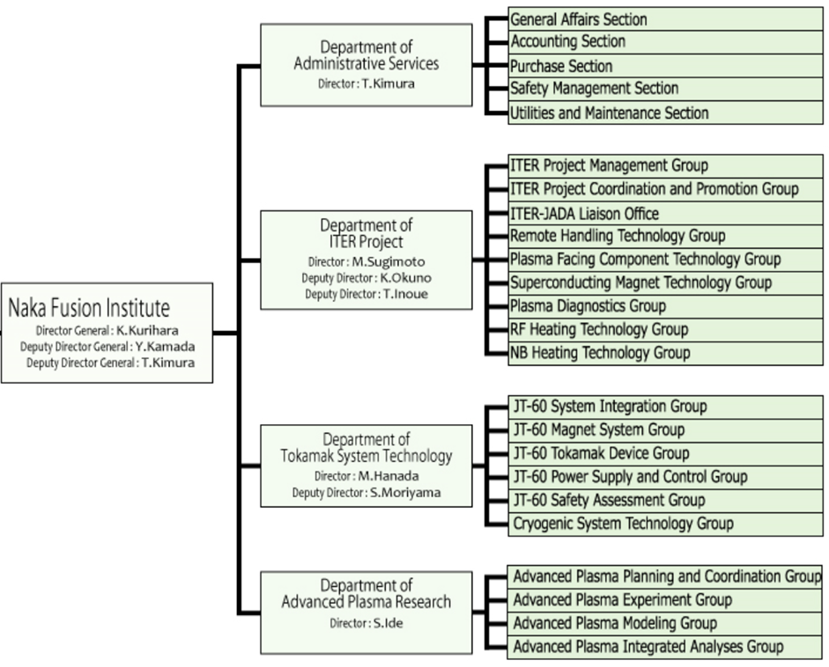
QST organization in Naka
Groups involved in the integrated commissioning
The integrated commissioning implementation team coordinates the IC accross all functional areas according to the procedures in place.

Slide 17
Integration of EUROfusion participants in QST
Topics | EU contact person | QST contact persons
1- Wall conditioning (ECWC) and gas analysis | E. B. | T. Nakano (M. Fukumoto)
2- Plasma control and equilibrium reconstruction | G. De T. | S. Inoue (T. Wakatsuki)
3- Magnetic diagnostics validation and MHD/Disruption analysis | G. De T. | M. Takechi (H. Tojo)
4- Plasma breakdown (with ECRH) | G. De T. | H. Urano (T. Wakatsuki)
6- Plasma discharge preparation and development (to be discussed separately) | E. B. | M. Yoshida (H. Urano)
7- Camera (EDICAM) and image analysis | E. B. | K. Kamiya
5- Cryogenic and magnet operation analysis (to be discussed separately) | M. Wanner & V. Tomarchio (F4E) | K. Hamada
Advanced plasma experiment group: N. Oyama (M. Yoshida)
JT-60SA Magnet System group and cryogenic system Tecolhogy group: K. Hamada
Plasma Operation Team: M. Yoshida
➔ The EU contact person to QST has the role of administration manager of EU participants in each QST group
➔ You will be contacted soon by the EUROfusion coordination for the back office work

Slide 18
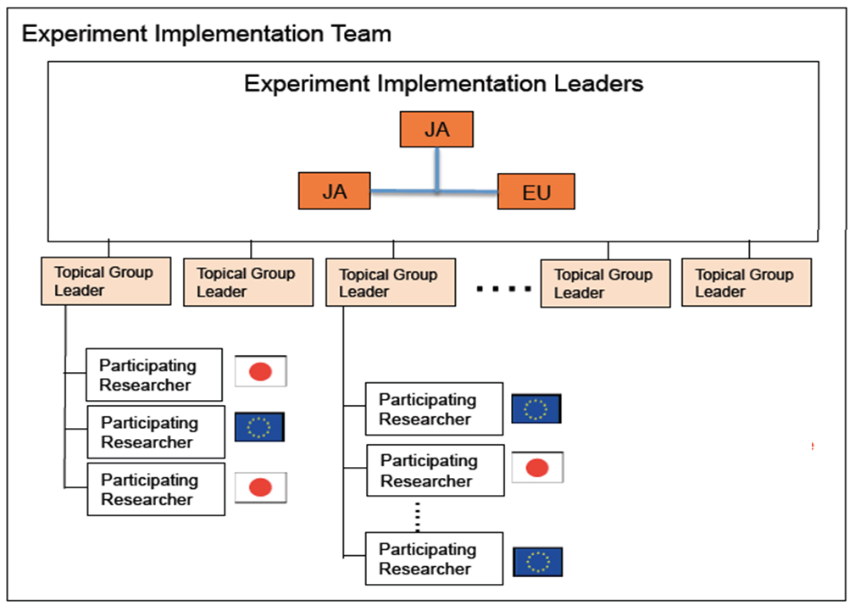
Future scientific exploitation: an integrated Programme
The EU will have a share of ~40% of the Programme
EU Scientific Priorities derived from the Research Plan SARP4.0:
Development and investigation of high performance scenarios compatible with future W-PFCs.
Avoidance and mitigation of disruptions and runaways,
Fast ion physics,
Development and validation of high level real-time control strategies.
Nominated in 2021 by BA-SC
Nominated by EU&JA PMs
Priorities endorsed by STAC F4E and discussed with QST.
The preparation for Experiment Implementation Organization led by:
E. Joffrin (E. Belonohy / G. de Tommasi) ←→ S. Ide (T. Suzuki / M. Yoshida)

Slide 19
EUROfusion commissioning team work breakdown
EUROfusion on-site coordination
Management
Future campaigns
Commissioning
On-site participants management
Experiment implementation organization
MHD & disruption
Equil. & control
Reporting & Pub
RCA & RDA set-up
Plasma BD + ECH
Visitors handbook
Scenarios Develpt
ECWC + gas
E. Belonohy
G. De Tommasi
EDICAM
E. Joffrin
Cryo & Magnets

Slide 20
Summary
The exploitation of JT-60SA is starting
Do not hesitate to ask question to the EU-IC team: myself, Eva, Gianmaria or Gerardo for more details.
More information can be found on the WPSA webpage with information for working with JT-60SA in 2020.
Main objectives for 2020 for WPSA:
Efficient EU participation to the JT-60SA commisioning (see session O2 & O4)
Successful operation and exploitation of EDICAM (see session O3)
Design and launch manufacturing of enhancement projects (see session E1 & E2)
Complete development of discharge simulator in view of the future experiment preparation (see session O5 on Thursday)
Continue and expand background modelling activities (see session M1 this p.m.)
Research plan: http://www.jt60sa.org/pdfs/JT-60SA_Res_Plan.pdf

Slide 21
Some references
Web pages: - Public Broader Approach web site: www.ba-fusion.org
- Public JT-60SA web site: www.jt60sa.org/b/index.htm
- Public EUROfusion web site: www.euro-fusion.org/eurofusion
- WPSA wiki:
http://users.eurofusion.org/iterphysicswiki/index.php/WPSA:_
Preparation_of_Exploitation_of_JT-60SA
Research Plan: - JT-60SA Research Plan, v4.0 (Sept. 2018):
www.jt60sa.org/pdfs/JT-60SA_Res_Plan.pdf
Articles: - Y. Kamada et al., Nucl. Fus. 53 (2013) 104010
- P. Barabaschi et al., Nucl. Fusion 59 (2019) 112005
- G. Giruzzi et al., Nucl. Fusion 57 (2017) 085001
- G. Giruzzi et al., Plasma Phys. Contr. Fusion 62 (2020) 014009

