Slide 1
ITER Research Plan priorities forJT-60SA first operational phases
R. A. Pitts, Y. Gribov, S. Jachmich, M. Lehnen, A. Loarte,
S. D. Pinches, G. De Temmerman, P. de Vries
Science Division
ITER Organization, Route de Vinon-sur-Verdon, CS 90 046, 13067 St. Paul Lez Durance Cedex, France
The views and opinions expressed herein do not necessarily reflect those of the ITER Organization.

Slide 2
Content
Agreements in place for collaboration IO-JT-60SA
  Brief overview of areas identified
Specific areas of interest to ITER for first JT-60SA campaigns
  First wall alignment, start-up, conditioning
  Disruption loads and mitigation
  H-modes, ELM control, plasma magnetic control, NBI shine-through, IMAS

Slide 3
Preamble: Cooperation Agreement IO/BA activities
An IO/F4E/QST Cooperation Agreement was signed on
20/11/2019 at the Nov. 2019 ITER Council Meeting
  Sets out framework for cooperation in all academic, scientific and engineering fields of mutual interest
    “Cooperation of IO with Implementing Agencies of the BA Activities considered an essential element in support of the future joint exploitation of the ITER facilities under the ITER Agreement”
  10 year initial duration, may be renewed upon mutual consent before 19/11/2029

Slide 4
Previous relevant talks
“ITER Research Plan and physics R&D priorities for JT-60SA”, R. A. Pitts et al.
  6th JT-60SA Research Coordination Meeting, Naka, 23/5/2017
  Larger scope, covering all of the IRP, but some aspects repeated here
“Proposal of collaboration between ITER and JT-60SA”, T. G. Luce et al.,
  JT-60SA TCM-33, Naka, 26/6/2019
  Overview of a proposed collaboration

Slide 5
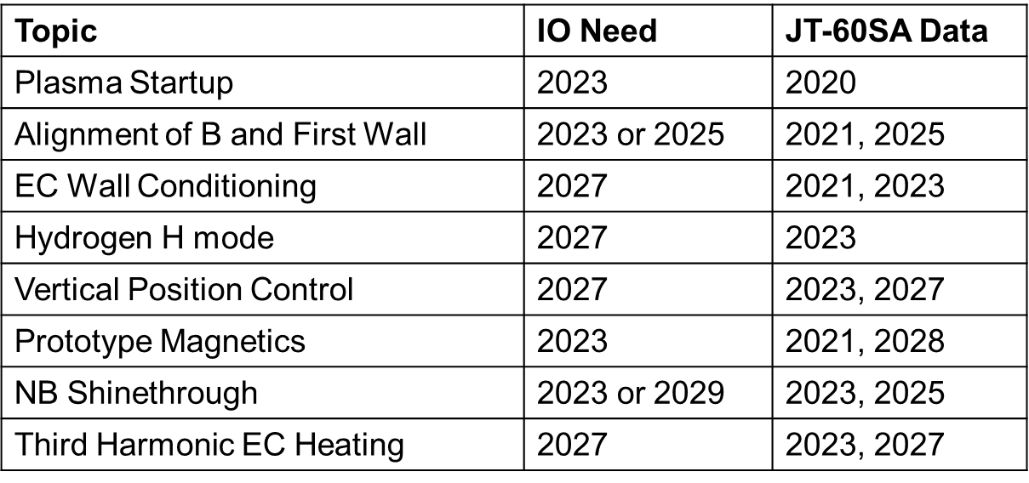
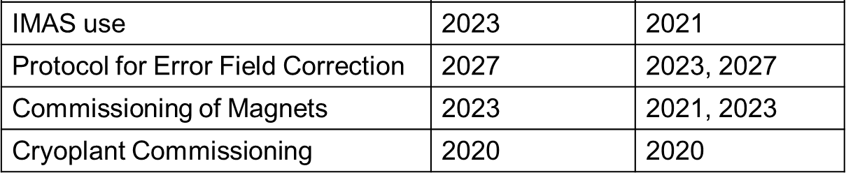
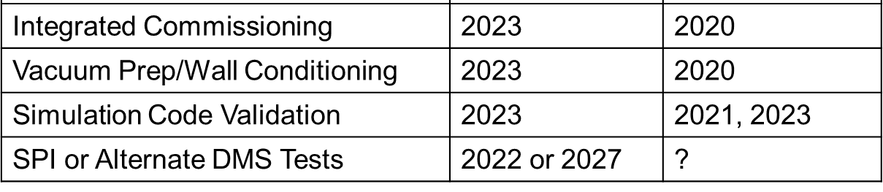
Quick overview of IO/JT-60SA collaboration
Extracted from talk by T. G. Luce at JT-60SA TCM-33:
Programme
Data
Collaboration

Slide 6
First wall alignment, start-up and conditioning

Slide 7
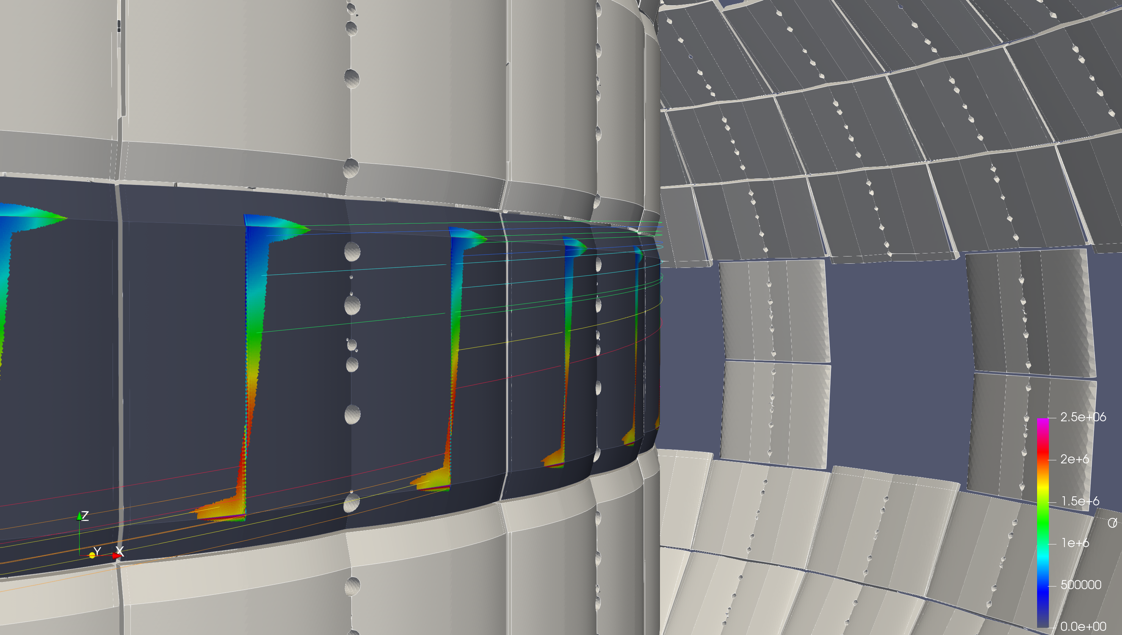
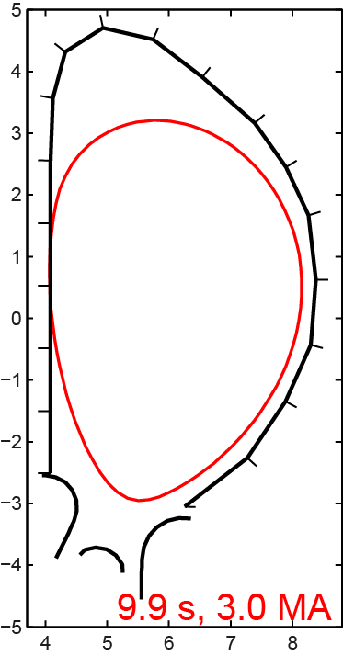
Importance of first wall alignment
Recent multi-machine observations of narrow SOL heat flux features for inner wall limiter plasmas mean that ITER is concerned about longwave misalignments between the toroidal field structure and the central column PFCs
  A significant effort is underway to prepare an array of NMR sensors to measure the toroidal field structure at First Plasma
Our understanding is that JT-60SA will not make this measurement
  But we are very interested to learn anything about plans for metrology to locate PFCs
  And for JT-60SA to make heat flux measurements on inner FW PFCs to characterize the alignment

Slide 8
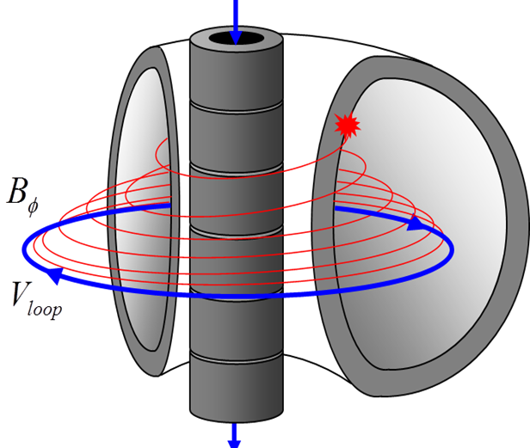
Ohmic plasma initiation
Reasonably well understood
  Several models can be used to make predictions for ITER
But low loop voltage, plasma size and a conductive vessel can affect breakdown¹
  JT-60SA can provide valuable input to test the currently assumed models for these effects
ITER would like to learn more on:
  Determination and optimization of magnetic stray field topology at breakdown and following vertical field rise
¹P.C. de Vries, Y. Gribov, NF 59 (2019) 096043
  Comparison of ohmic breakdown with standard Townsend avalanche model in a large device¹
  Plasma size in the early breakdown phase, i.e. before and at close flux surface formation

Slide 9
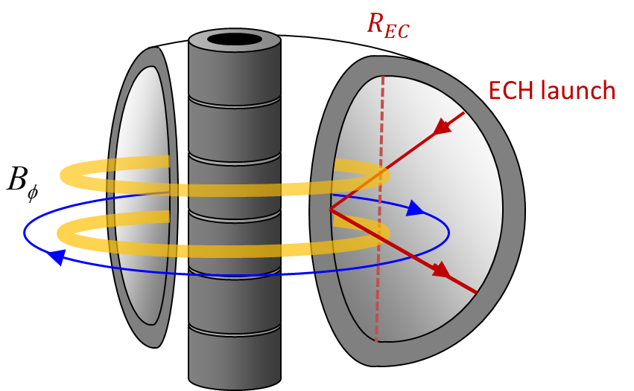
ECH-assisted plasma initiation (1)
Well established technique on many devices
Can assist in 2 specific ways:
  Ionize neutrals (pre-ionization)
  Then power absorption to assist burn-through
Burn-through assist well understood and can be modelled and predictions made for ITER
But knowledge still too limited to make predictions for ECH pre-ionization
Concept of ECH pre-ionization process: If the ECH beam has sufficient power density, it is able to increase the electron energy above the ionization energy¹. Free electrons with sufficient energy, travel along the toroidal field lines, ionizing further neutrals via collisions, creating a toroidal ring of plasma intersecting with the ECH beam at the (R_{ec}) resonance². The plasma may expand from these rings further into the vessel.
[1] D. Farina, Nucl. Fusion 58 (2018) 066012.
[2] J. Stober, et al., Nuclear Fusion 2011 51 083031
Notes:
The use of ECH pre-ionization may aid the timing of breakdown. At ITER, 20 MW of 170 GHz ECH is foreseen [28], that can, either as 1st harmonic O-mode for Bφ = 5.3 T or 2nd harmonic X-mode for Bφ = 2.65 T, be used to pre-ionize the prefill gas, and assist with the heating of the plasma during the burn-through. ECH power can be launched equatorially or via the ECH upper-launcher reflected into the plasma via the high-field-side blanket.

Slide 10
ECH-assisted plasma initiation (2)
We need to better understand the ECH pre-ionization process and how to extrapolate to ITER
What parameters affect the process and in what way?
  No. of ECH beams, power per beam, ECH beam width, ECH injection angle
  Prefill pressure, magnetic field topology
How to characterize the pre-ionization?
  n_{e,} T_{e,} size of pre-ionized plasma?
What characteristics should the pre-ionization have in order to be able to affect the burn-through?
  Will require sufficient measurements
Concept of ECH pre-ionization process: If the ECH beam has sufficient power density, it is able to increase the electron energy above the ionization energy¹. Free electrons with sufficient energy, travel along the toroidal field lines, ionizing further neutrals via collisions, creating a toroidal ring of plasma intersecting with the ECH beam at the (R_{ec}) resonance². The plasma may expand from these rings further into the vessel.
[1] D. Farina, Nucl. Fusion 58 (2018) 066012.
[2] J. Stober, et al., Nuclear Fusion 2011 51 083031
Notes:
The use of ECH pre-ionization may aid the timing of breakdown. At ITER, 20 MW of 170 GHz ECH is foreseen [28], that can, either as 1st harmonic O-mode for Bφ = 5.3 T or 2nd harmonic X-mode for Bφ = 2.65 T, be used to pre-ionize the prefill gas, and assist with the heating of the plasma during the burn-through. ECH power can be launched equatorially or via the ECH upper-launcher reflected into the plasma via the high-field-side blanket.

Slide 11
Electron Cyclotron Wall Conditioning
Closely linked to ECH breakdown assist
The only active cleaning method on ITER until PFPO-2, but large uncertainty on required ECH power levels
Need scalings for power and transport coefficients based on multi-machine analysis supported by 1D modeling (new ITPA DivSOL multi-machine activity)
ITER looks to JT-60SA to provide extensive study of ECWC capability and efficiency on a large device
~100 GHz
TORE SUPRA
KSTAR
EC power (kW)
2-3 GHz
Area (m²)
  e.g. ECH mirror scanning, pulsed operation mode, optimum combination of radial and vertical fields, minimization of onset time for ECWC plasma to limit damage to in-vessel components, compare removal efficiency to that achieved on smaller devices

Slide 12
Disruption loads and mitigation

Slide 13
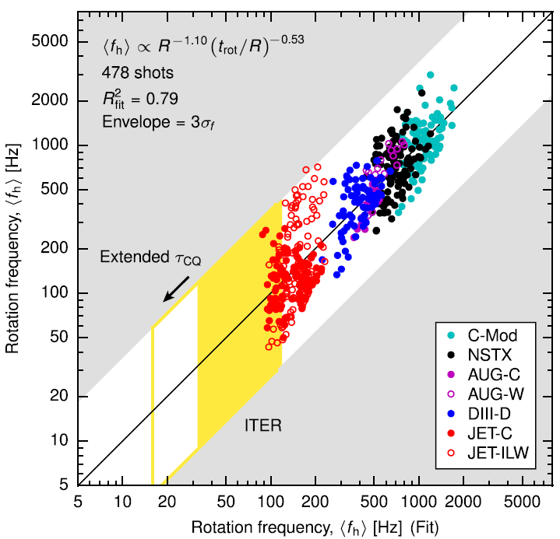
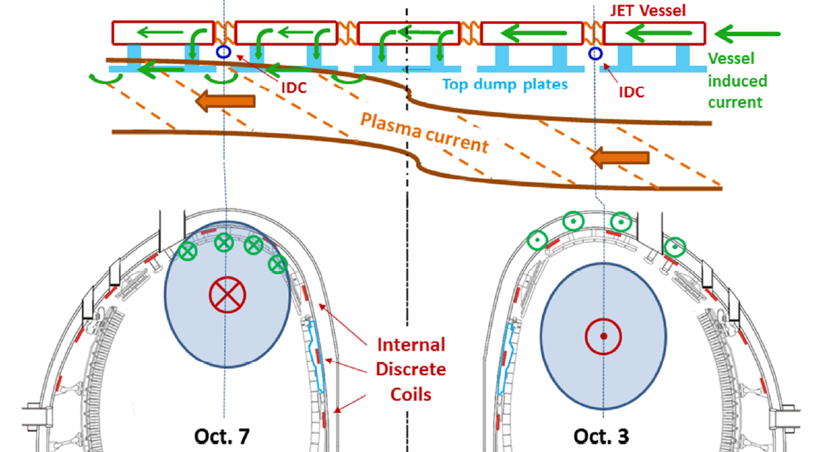
Characterization of disruption loads
Poor understanding of asymmetric, rotating VDEs
  Large uncertainties in forces on the ITER VV and blanket (potential dynamic load amplification)
  Depends on halo current path between FW components and through components to VV
R. Roccella et al., NF 56 (2016) 106010
JT-60SA has a highly conductive, continuous VV as in ITER (≠ JET) + very good halo current sensor set (20-48 probes)
  Information required on halo current distribution, sideways impulse and displacement
Runaway electrons a major issue
As much information as possible required on:
  RE footprint characterisation: wetted area, toroidal distribution (C wall more resilient than metal wall)

Slide 14
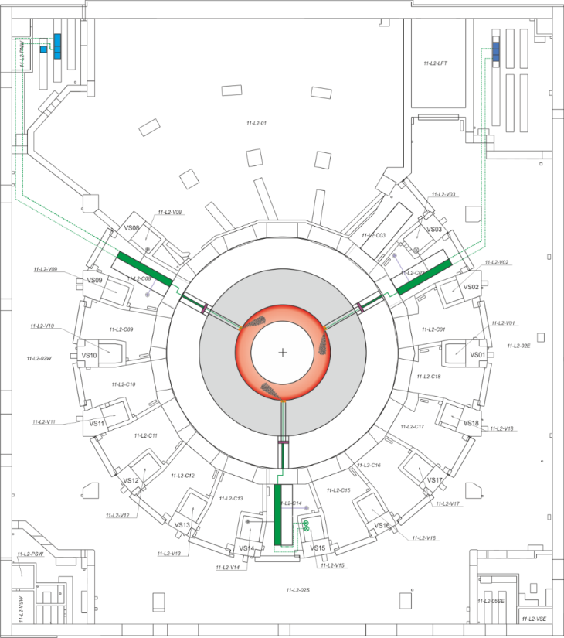
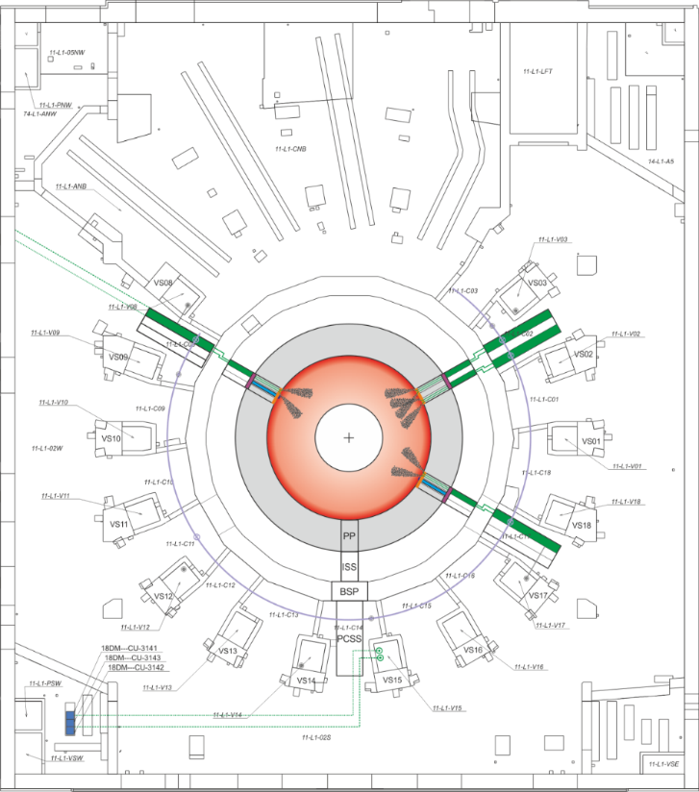
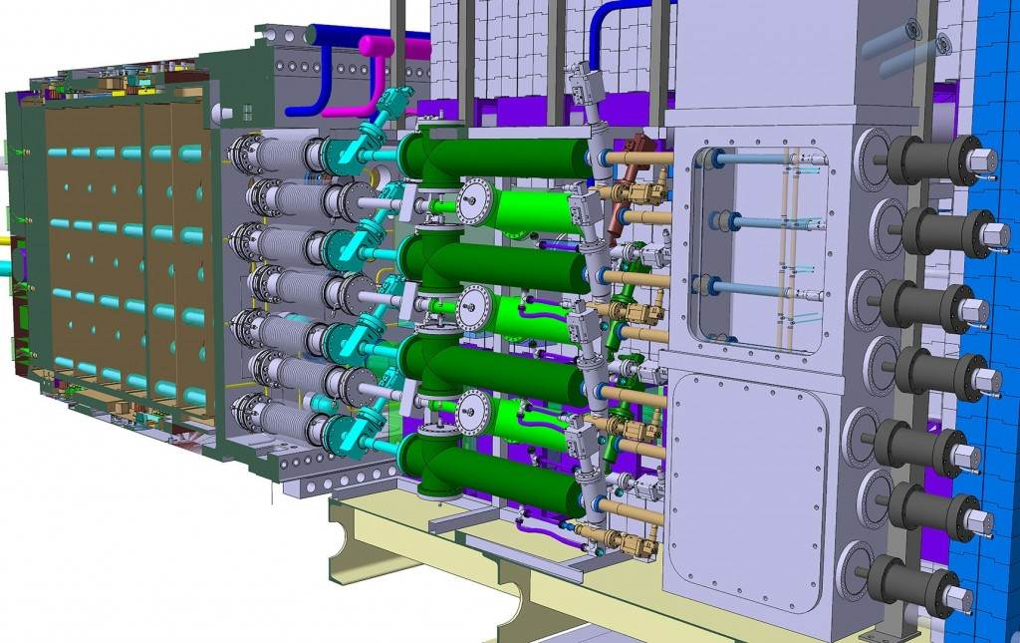
Disruption mitigation: ITER DMS Design
Massive programme on ITER and in ITER Party institutions to design and test a reliable and robust “Disruption Mitigation System” (DMS)
  Multiple cryogenic (D, Ne, Ar) Shattered Pellet Injection to dissipate thermal and current quench energies and to prevent the formation of, or kill runaway electron beams
  24 flight tubes in 3 equatorial ports + 3 barrels in 3 upper ports; each pellet: D = 28.5 mm and L = 57 mm
Upper ports
Equatorial ports
1 barrel
6 barrels
12 barrels
PC08
1 barrel
PC08
PC08
PC02
PC17
6 barrels
PC14
1 barrel

Slide 15
DMS testing
ITER SPI prototype testing → one of the major elements identified for IO/JT-60SA collaboration
  Preparation of the extensive ITER DMS commissioning in PFPO-1
  (possible staged approach with first injector available in OPE3?)
  Determine operational space for ITER DMS at high plasma currents and energies (especially important to test the robustness of RE avoidance)
  Experience with closed-loop operation using ITER disruption predictor

Slide 16
H-modes, ELM control, plasma magnetic control, NBI shine-through, IMAS

Slide 17
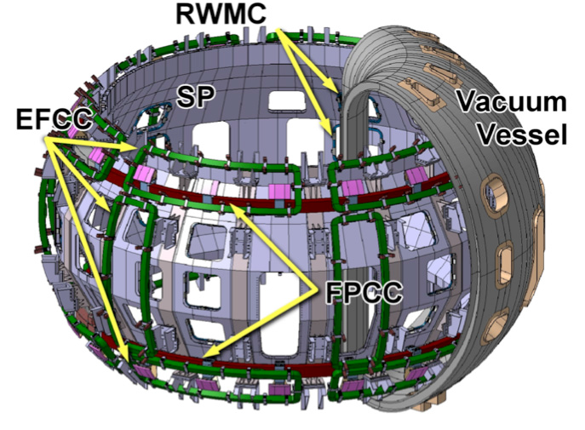
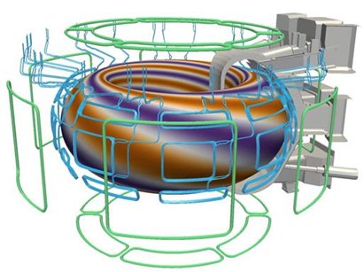
Vertical stability, error field identification/control
ITER relies on external superconducting coils (VS1) and in-vessel copper coils (VS3) for Vertical Stability control → similar scheme in JT-60SA
Also strong similarity between ITER and JT-60SA machine and error field correction coil systems
JT-60SA will start operation with knowledge of the position of the “as manufactured” and “as positioned” PF coils, CS, etc.
JT-60SA
ITER
Y. Gribov et al., NF 55 (2015) 073021

Slide 18
Magnetic control: some key issues
Error fields:
  Determine schemes for optimization of error field identification and correction in a range of plasma scenarios
  Development of criteria for allowable n = 1 and n = 2 error fields (locked mode threshold, increased disruptivity in H-L transitions, etc.)
  Input for development of scaling of critical n =1 and n = 2 resonant (“overlap”) error fields and impact of non-resonant components on plasma performance
Vertical stability:
  Optimization of VS1 + VS3 for minimum use of VS3 → important for ITER since VS3 coils cannot be replaced (redundancy included in design)
  Determine the source of low frequency [0, 200Hz] noise in the dZ/dt signal (plasma, diagnostics, power supplies) used for plasma vertical stabilization (VS) and develop schemes for its minimization that can be used in ITER
Notes:
Required for:
Reduction of number of VDEs at operation with low stability margin (e.g. with increased outboard plasma-wall gap)
Minimization of AC losses in the superconducting coils driven by reaction of PF coil system on noise in dZ/dt to keep plasma vertical stability
Reduction of heating of the VS in-vessel coils and busbars, and, possibly, for reduction of thermal fatigue of the divertor due to strike point oscillations

Slide 19
H-mode plasmas for PFPO-1
Only H&CD installed in PFPO-1 is ECH
  H-mode operation in PFPO-1 will be restricted to 5 MA/1.8 T → 3rd harmonic ECH
Modelling shows that ECH first pass absorption increases rapidly with T_{e} far above T_{i} reaching full absorption in less than 1 s (Ok for FW loads) → validation of 3rd harmonic absorption and transport required
M. Schneider et al., NF 59 (2019) 126014

Slide 20
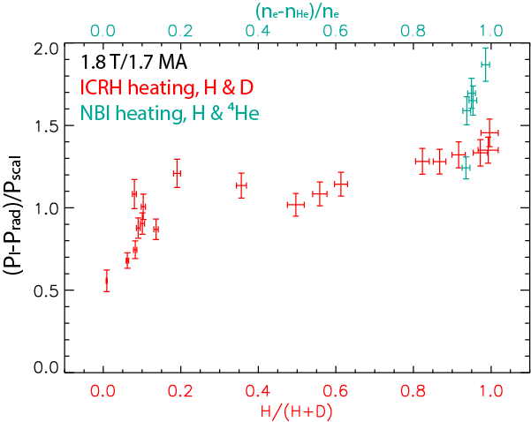
H + x% He H-mode plasmas in PFPO
J. C. Hillesheim et al., 2018 IAEA FEC, paper EX/4-1
Hydrogen H-modes very restricted with 33 MW NBI + 20(-30) MW ECH (poor ICH Single pass absorption scheme and large NBI shine-through loads)
  Helium ensures more robust H-mode access (P_{aux} = 73 MW), but uncertainties regarding extrapolability to DT (fuelling, PWI, pedestal and ELMs, …)
Options for H-dominant H-modes exist (H + 10% He) if JET findings are confirmed → wider operational space (also relevant for Q = 10 ~ 5 % He)

Slide 21
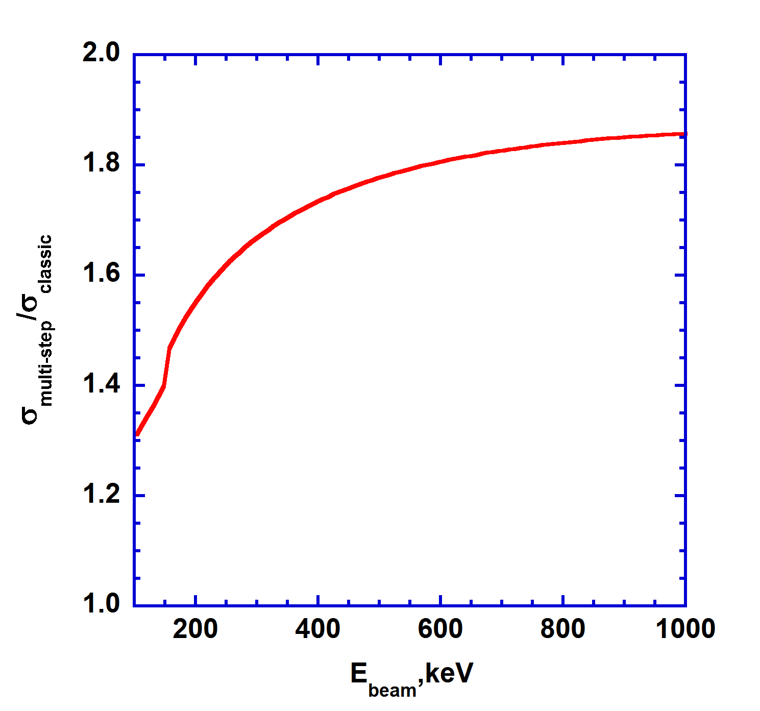
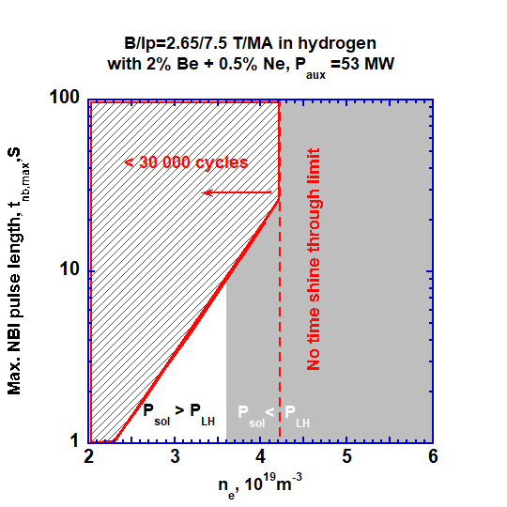
Validation of NBI shine-through loads
ITER’s NBIs have ~ 1 MeV energy → validation of multi-step ionization essential to predict shine-through loads
These loads considerably restrict ITER operation in PFPO-2 (particularly for H-plasmas) → JT-60SA E_{NBI} = 0.5 MeV shine-through validation could have large impact on IRP
  At high energies, multi-step ionizations ~ single step → JT-60SA data with 0.5 MeV beams very important for ITER
  (from A. Polevoi using data from S. Suzuki et al., PPCF 40 (1998) 2097)
  Approx. saturation

Slide 22
H-mode and ELM control
JT-60SA can provide complete assessment of issues of interest to ITER for H-modes due to flexible H&CD mix and ELM control schemes (already in hydrogen):
  P_{aux}^{max} /P_{LH} ≥ 2 up to 5.5 MA/2.25 T
  13 MW PNBI, 10 MW NNBI + 3 MW ECRH
  Electron heated H-modes (10 MW NNBI + 3 MW ECRH) and with strong fast particle/CD (PFPO-2 ITER H-modes)
  Torque input control (Normal and Tangential Co-/Counter PNBI)
  ELM control using 3-D fields
  ELM control using pellet pacing (~20 Hz)

Slide 23
Integrated Modelling and Analysis Suite (IMAS)
All ITER data (experimental, processed, analysed and simulated) will be stored in a representation following the IMAS Data Dictionary
Preparation for ITER First Plasma requires development of data processing pipelines, analysis tools, and many predictive simulations
Effective execution of ITER Integrated Commissioning and First Plasma requires IMAS to be fully functional and extensively validated
EU has invested significantly in IMAS compatibility and the IO has supported the installation of IMAS at the JT-60SA Naka site
Request that JT-60SA go as far as reasonable in translating to or adopting IMAS to provide ‘real-world’ testing for ITER
IO need date: 2023; JT-60SA data: 2021-2023

Slide 24
Conclusions
Early JT-60SA operations will be an excellent model for early ITER operations
  The machine is similar in many respects to ITER
  The facility and the research program must progress through many of the same steps as ITER
  Experiments on JT-60SA from start-up to end of
Experiments on JT-60SA from start-up to end of BA Phase II can make a major contribution to the R&D identified as key in the early phases of the ITER Research Plan

Slide 25
Reserve

Slide 26
Tokamak start-up
First Plasma is an important milestone for JT-60SA and ITER
  But preparation for first tokamak operation involves much more than just plasma breakdown
First Plasma operation is intimately linked to a whole series of integrated commissioning activities that are required to start up tokamak operation
  Usually strongly linked to integrated coil/power supply and magnetic diagnostic commissioning
Careful preparation required to ensure that the organization of the start-up of tokamak operation is optimized, and done such that sufficient information is obtained, without wasting operation time
ITER is interested to obtain information on:
  Schemes to be used to validate models of passive components, diagnostics (magnetics) and coil/power supplies.
  Schemes which optimize First Plasma operation
  The experimental approach to validate plasma initiation models on JT-60SA

