Slide 1
Modelling of scenarios of initial research phase I and II
L. Garzotti (with contributions from F. Casson and F. Koechl)

Slide 2
Introduction
Simulations of the phase I and II of the research plan.
Limited to scenario 2 (low density ELMy H-mode).
Improved degree of complexity with respect to JINTRAC simulations published in Nucl. Fusion 2018 (impurities and self-consistent pedestal).
Demonstration of modelling capabilities that could be deployed in preparation of experiments.

Slide 3
Machine status considered

Slide 4
Simulation plan
Scenario 2 half field half current (2.75 MA / 1.13 T).
n_{G} constant.
Three NBI power levels (19, 26.5 and 33 MW PNBI+NNBI).
3 MW ECRH (profile prescribed).
Bohm/gyro-Bohm transport model.
Continuous ELM model.
Equilibrium recalculated every second.
Sawtooth (Kadomtsev model, partial reconnection)
Fully predictive simulations (deuterium density, ion and electron temperature and impurities). 5 s simulations (to relax kinetic profiles).
C main impurity (SANCO).
Pedestal height determined self consistently by MHD stability.

Slide 5
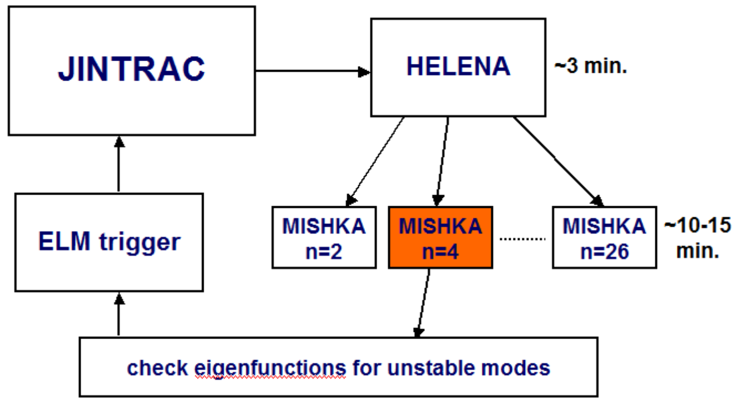
Brief description of MHD stability scheme
Or adjust continuous ELM model

Slide 6
Previous JT-60SA scenarios modelling
Initial simulations of the full blown scenarios performed in the past and published in Nucl. Fusion (L. Garzotti 2018).
One of the points of the analysis that could be improved was the estimate of the pedestal height (Cordey scaling + neoclassical particle diffusivity in ETB).
With the new scheme the density at the top of the pedestal still has to be guessed in some way, but the temperature is determined automatically on the basis of ideal MHD peeling-ballooning stability criteria.

Slide 7
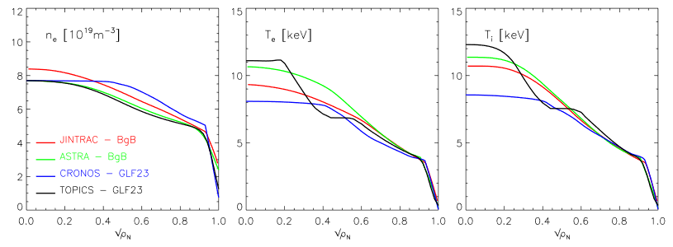
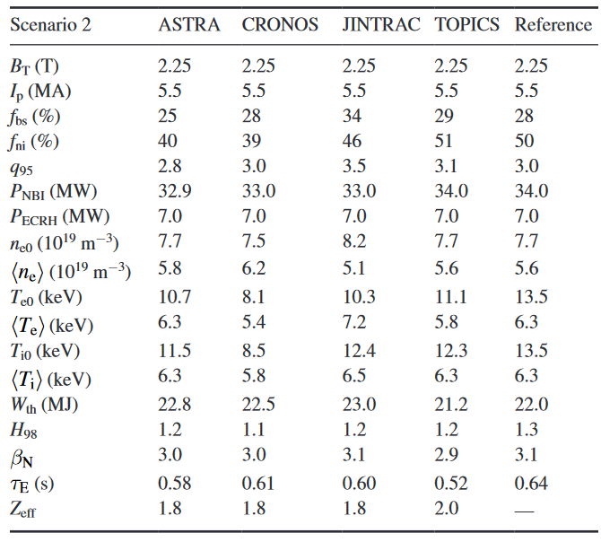
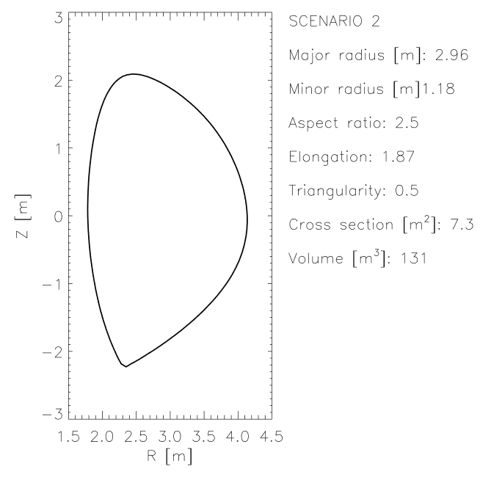
JT-60SA scenario 2 full current

Slide 8
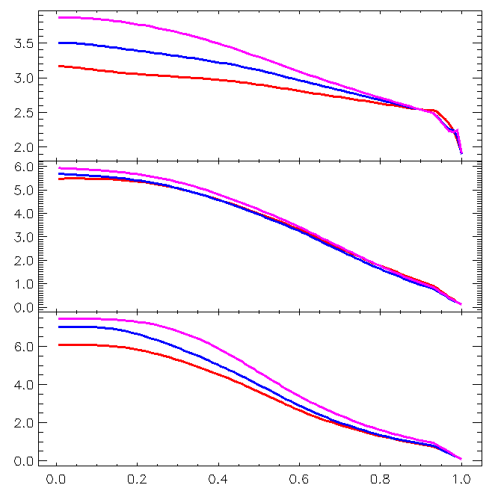
Power scan kinetic profiles
Density peeking most likely because of the beam source.
Electron temperature largely unchanged.
Ion temperature increasing in the core, less so at the top of the ITB (MHD stability clamping it?).
n_{e} [10¹⁹ m⁻³]
19 MW
26.5 MW
33 MW
T_{e} [keV]
T_{i} [keV]

Slide 9
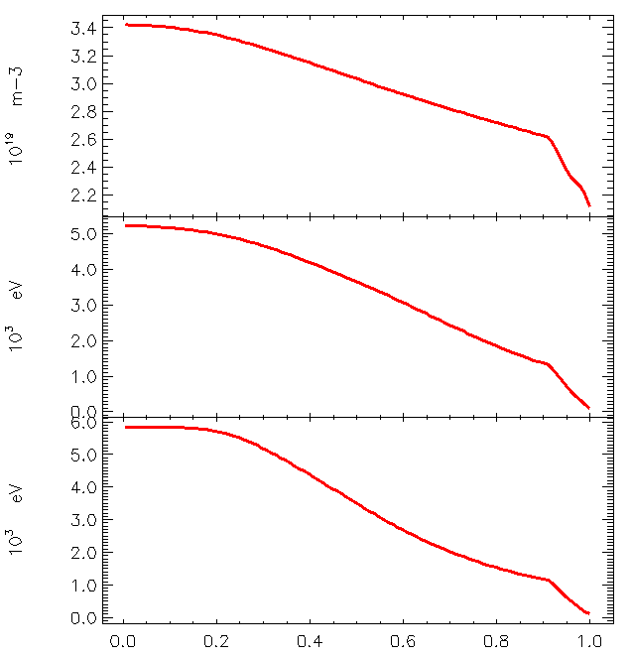
Zero dimensional parameter for 19 MW case
q_{min} = 1.0
q₀ = 1.0
q₉₅ = 3.2
n_{e,ax} = 3.4 10¹⁹ m⁻³
n_{e,av} = 2.9 10¹⁹ m⁻³
T_{e,ax} = 5.2 keV
T_{e,av} = 2.8 keV
T_{i,ax} = 5.8 keV
T_{i,av}== 2.8 keV
W_{th} =5.0 MJ
τ_{E} = 0.23 s
H_{98,Y} = 0.85
n_{e}
T_{e}
T_{i}

Slide 10
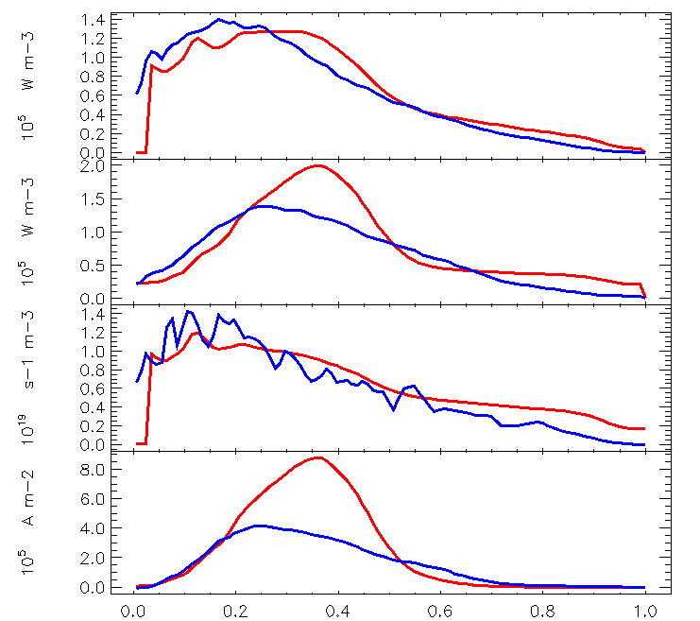
NBI deposition
P_{NBI,i}
PENCIL
ASCOT
Reason(s) for disagreement under investigation
P_{NBI,e}
S_{NBI}
j_{NBI}

Slide 11
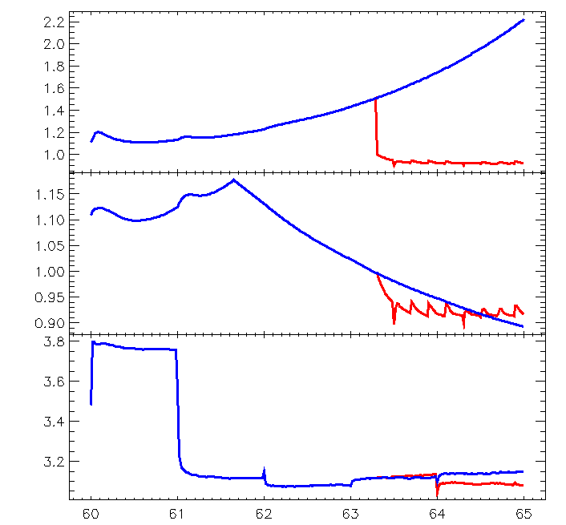
Effect of the sawtooth
q₀
with ST
without ST
(without sawtooth q profile tends to reverse probably du to the significant amount of NBI driven off-axis current)
q_{min}
q₉₅

Slide 12
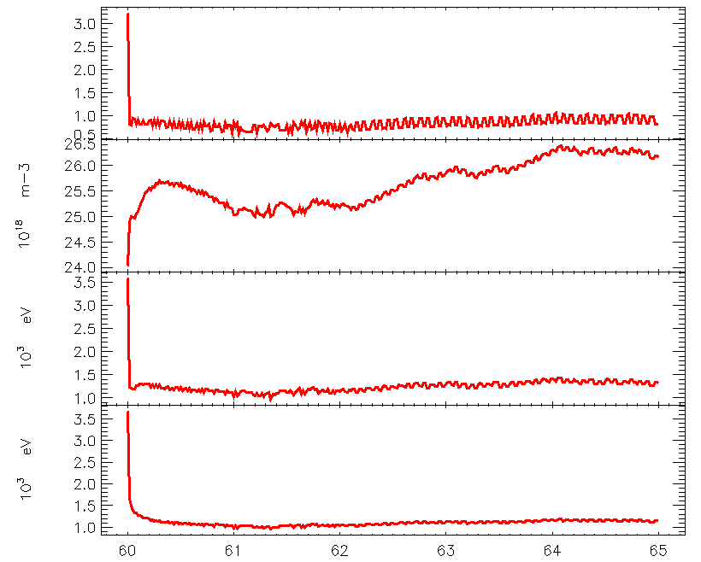
MHD stability analysis in action
Pedestal oscillates between no unstable modes and a few unstable modes.
Reflected in the steps in α_{max}.
α_{max}
n_{e,ped}
T_{e,ped}
T_{i,ped}

Slide 13
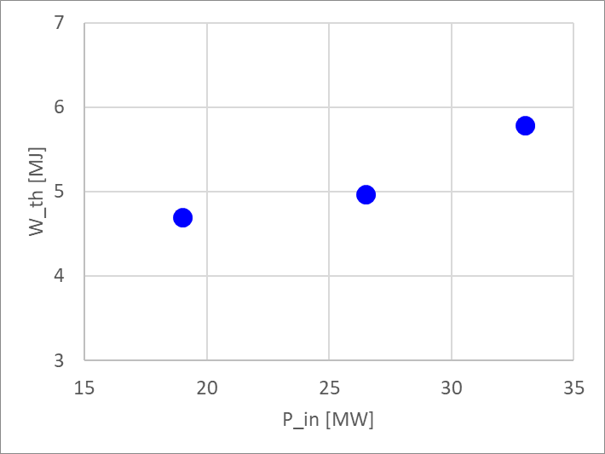
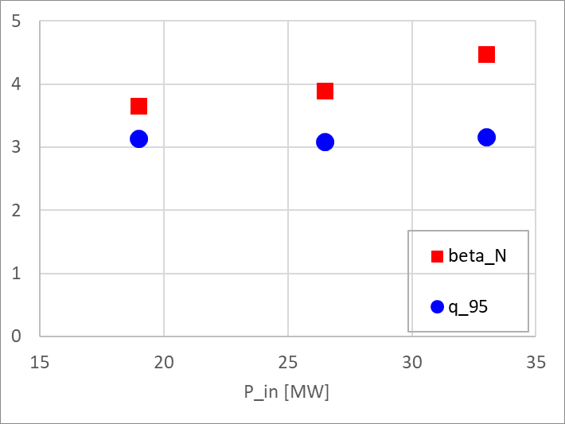
Power scan: core plasma
W_{th} increases according to power.
q₉₅ almost unaffected.
β_{N} increases perhaps beyond realistic values at highest power.

Slide 14
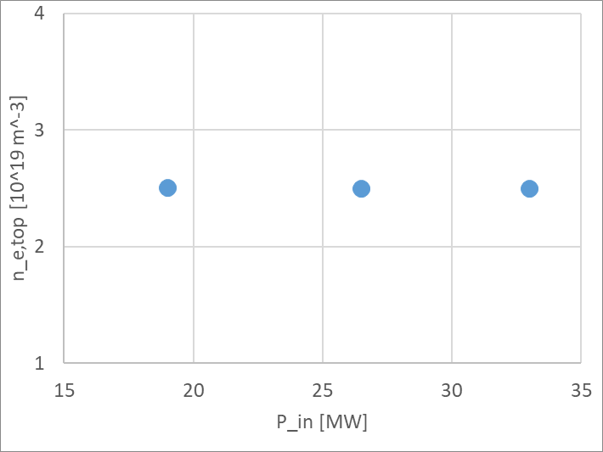
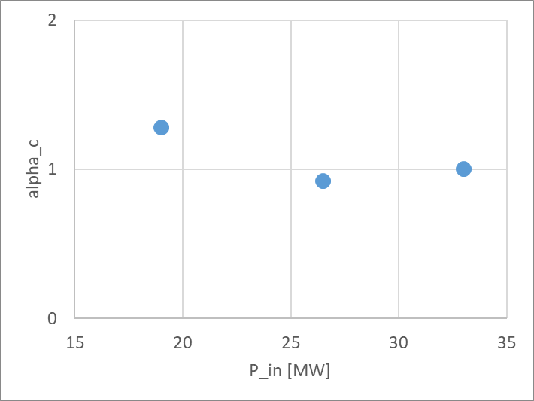
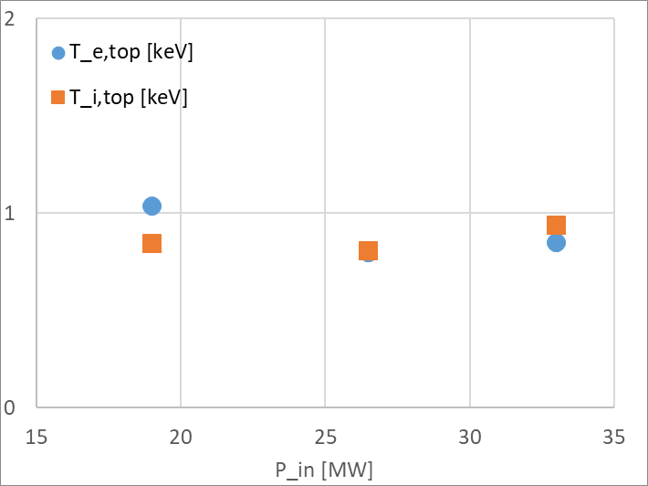
Power scan: pedestal
Density at the top of the ETB kept constant by choice.
α_{max} inside ETB initially decreasing and then increasing slightly. Details of the equilibrium to be investigated.
T_{e} and T_{i} very close and following α_{max}.

Slide 15
Conclusions and future work
Proof of principle simulations of the JT-60SA ELMy H-mode scenario in research phase I and II have been performed by modelling a power scan at half field and half current.
Consistency of the simulations still to be investigated fully.
Modelling capability have been expanded by incorporating a scheme that can adjust the pedestal pressure according to ideal MHD stability criteria.
The modelling of impurities has been incorporated in the simulations.
So far a semi-empirical Bohm/gyro-Bohm transport model has been used but the modelling framework is mature for the use of more complex (and computationally more expensive) first principle models such as QuaLiKiZ or TGLF.
Other scenarios and more detailed proposed experiment will be simulated (discussion within the JT-60SA modelling group).
A Year in Industry student will be joining Culham in June/July to help expand the simulation database along the agreed lines.

