Slide 1
Disruption modelling w/wo stabilizing plates
G. Rubinacci, F. Villone & CREATE team

Slide 2
Outline
Disruption simulations
Activities carried out
Planned activities
Possible manning and support to IC
AVDEs
Simplified modelling
Estimate for JT-60SA

Slide 3
Planned activities & status
Planned activities on disruption modelling in support of IC (Jan 2020)
Task 1. Assessment of the available 3D geometrical description of JT-60SA
Task 2. Derivation of an updated 3D finite elements mesh
Task 3. Disruption simulations and post-processing (force & halo calculations)
Task 4. Definition of set of tests to calibrate the model with the available halo and magnetic sensors
Current status (March 2020)
Task 1. Completed
Task 2. Completed
Task 3. Ongoing
Task 4. Scheduled

Slide 4
Disruption simulation approach
If some of the operational limits are exceeded, a rapid growth of a MHD instability makes the plasma lose most of its thermal energy
Thermal Quench (TQ)
A current density profile flattening takes place
The plasma current increases, experiencing a spike
Immediately after, the plasma cools down and its resistivity increases, so that the plasma current drops to zero
Current Quench (CQ)
Supposed linear in time on a time scale following empirical scaling laws
This may cause the vertical position feedback to lose control of plasma, giving rise to a Vertical Displacement Event (VDE)
The plasma eventually hits the wall, injecting currents directly in the structures (halo currents)
This event has been modelled using the CarMa0NL code
Axisymmetric plasma under the evolutionary equilibrium assumption, in presence of 3D conducting structures

Slide 5
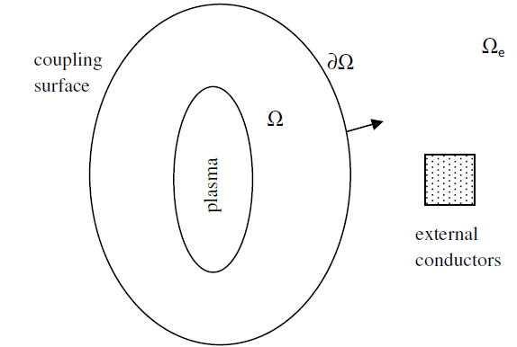
Computational tool
CarMa0NL: able to describe the evolutionary equilibrium of axisymmetric plasmas, in presence of three-dimensional volumetric conducting structures
Time scale of interest is supposed much longer than Alfvèn time
Plasma mass can be neglected
Plasma moves through equilibrium states
The formulation uses a coupling surface to describe the electromagnetic interaction between the plasma and the conductors
The most convenient formulation can be used in each domain
Inside Ω: plasma evolutionary equilibrium
Outside Ω: eddy currents in 3D structures
On ∂Ω: suitable coupling conditions

Slide 6
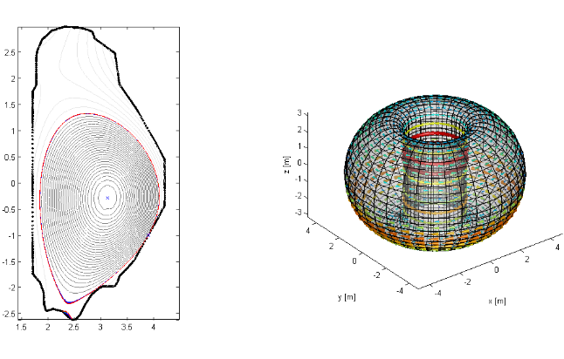
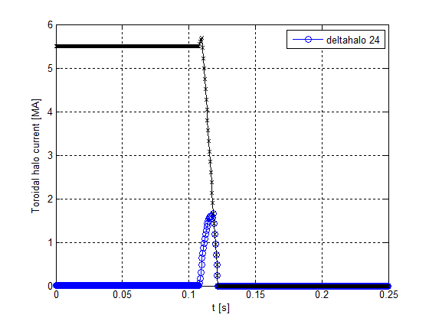
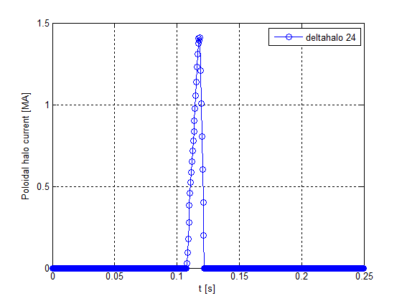
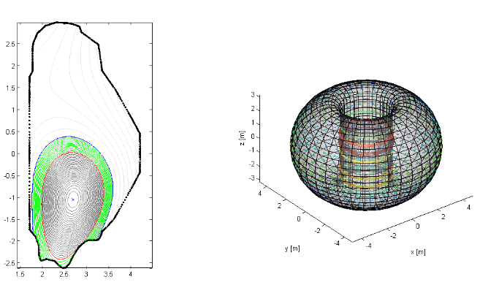
2019 activities
Prior to 2019, several disruption simulations in presence of stabilizing plate have been carried out
Not reported here
In 2019, a case with no stabilizing plates has been considered [G Giruzzi et al 2020 Plasma Phys. Control. Fusion 62 014009]
Same equilibrium and wall configurations, only stabilizing plate removed
The plasma is forced to move downwards with a current step in PF coils until it hits the wall
TQ in 3 ms, linear CQ in 12 ms

Slide 7
3D meshing
A detailed 3D mesh of the vacuum vessel has been produced
Removing the passive plate, the main stabilizing effect is provided by vessel, so a rather detailed mesh is needed
This is also needed for breakdown modelling activities (see Mattei’s presentation – Thursday)
Problem: the vessel is not periodically symmetric
Ports do not replicate with an exactly periodic geometry
Approach used
One mesh covering 60° toroidally and fictitiously replicated with rotational symmetry
One mesh covering 360°, reproducing the actual situation

Slide 8
3D meshing
Time constant [ms] | Harm. | Notes
88.6 ms | n=0, m=0 | Toroidally directed current
80.7 ms | n=0, m=0 | Poloidally directed current
53.9 ms | n=0, m=1 | Up-down antisymmetric (vertical plasma motion)
35.6 ms | n=0, m=1 | Inboard outboard antisymmetric (radial plasma motion)

Slide 9
3D meshing

Slide 10
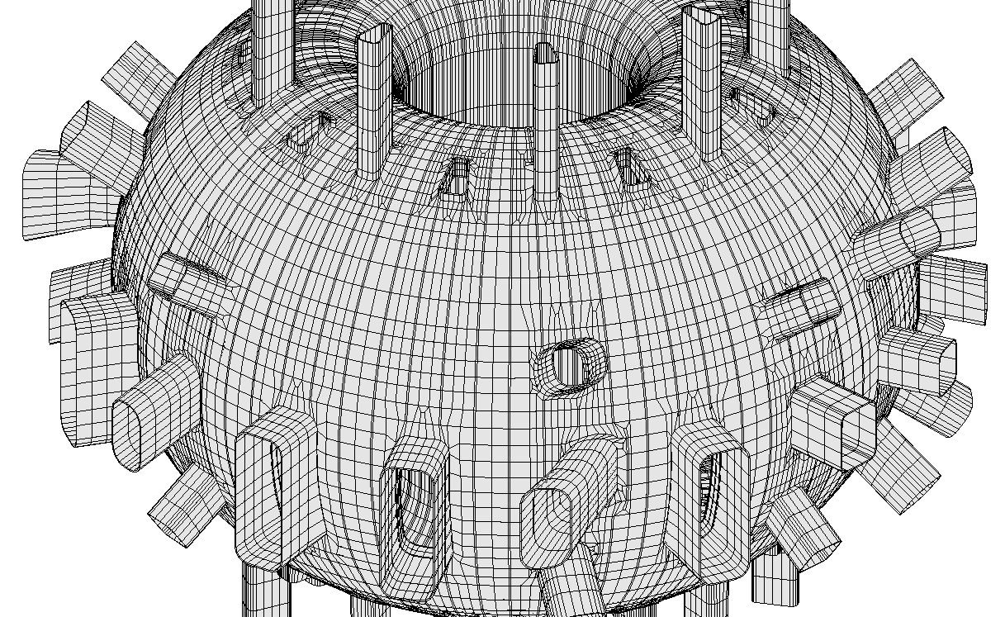
3D mesh

Slide 11
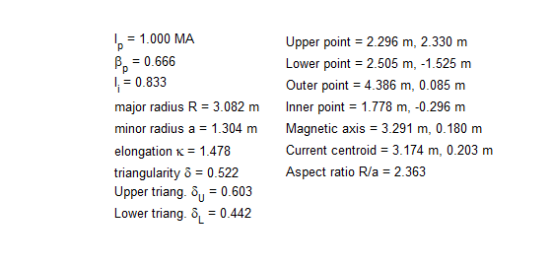
Disruption simulation
Starting equilibrium configuration: Upper Single Null, high beta

Slide 12
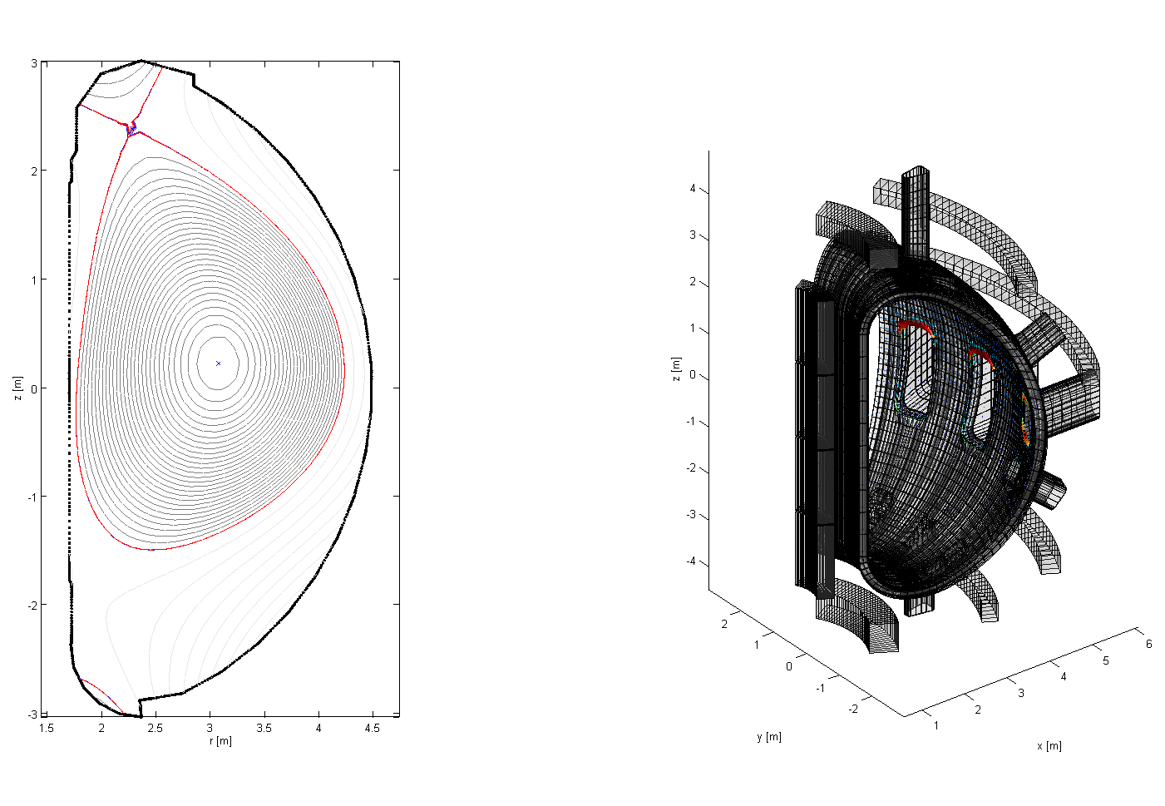
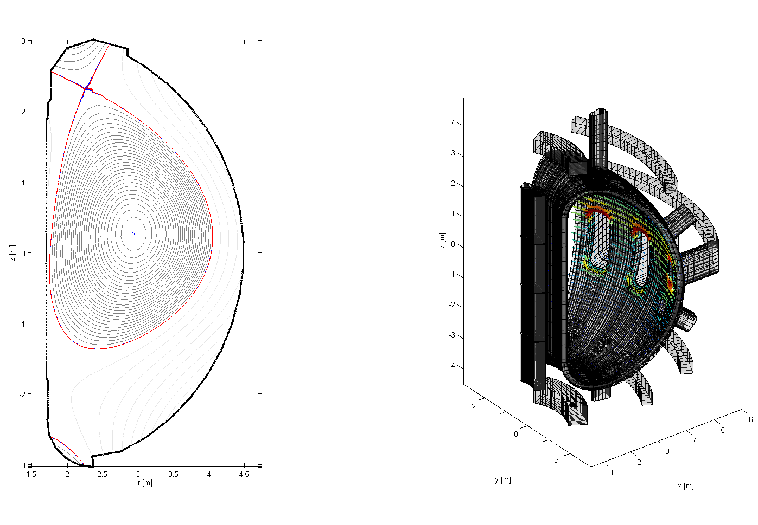
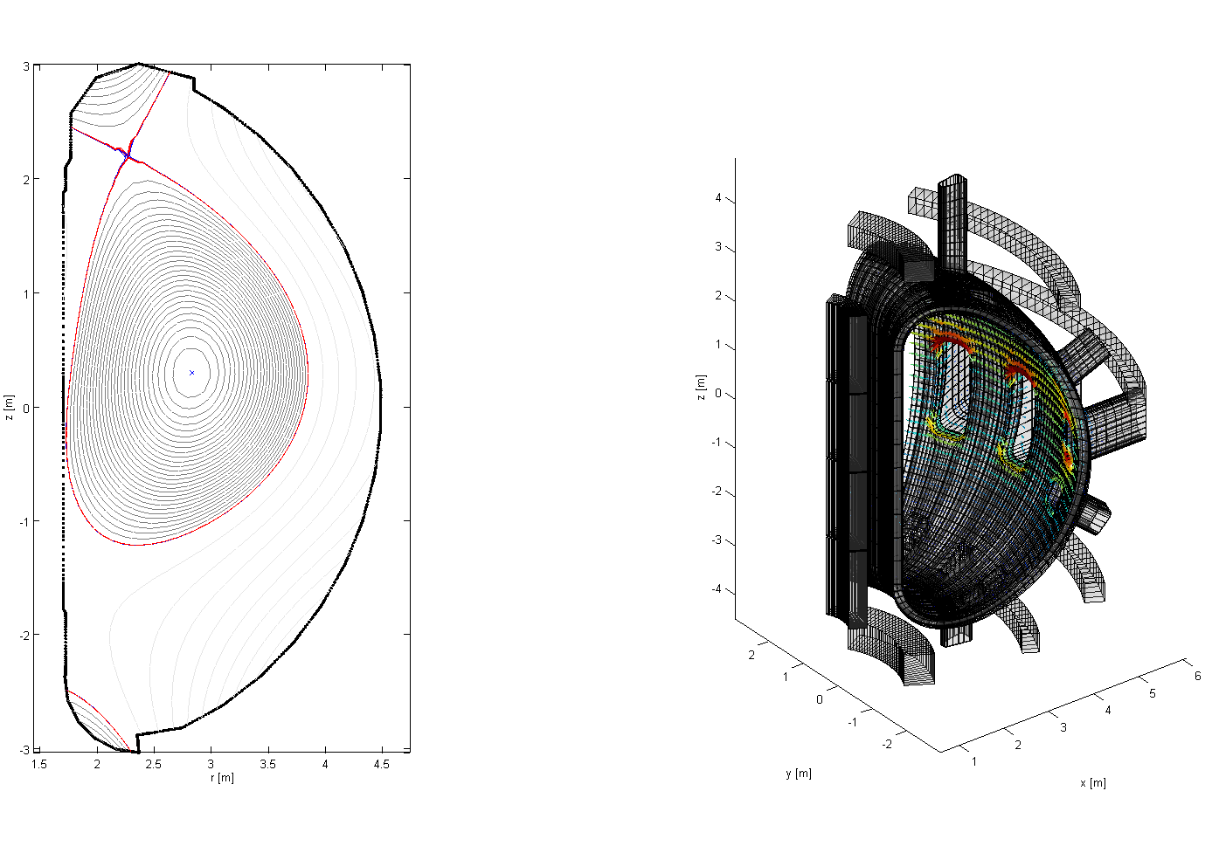
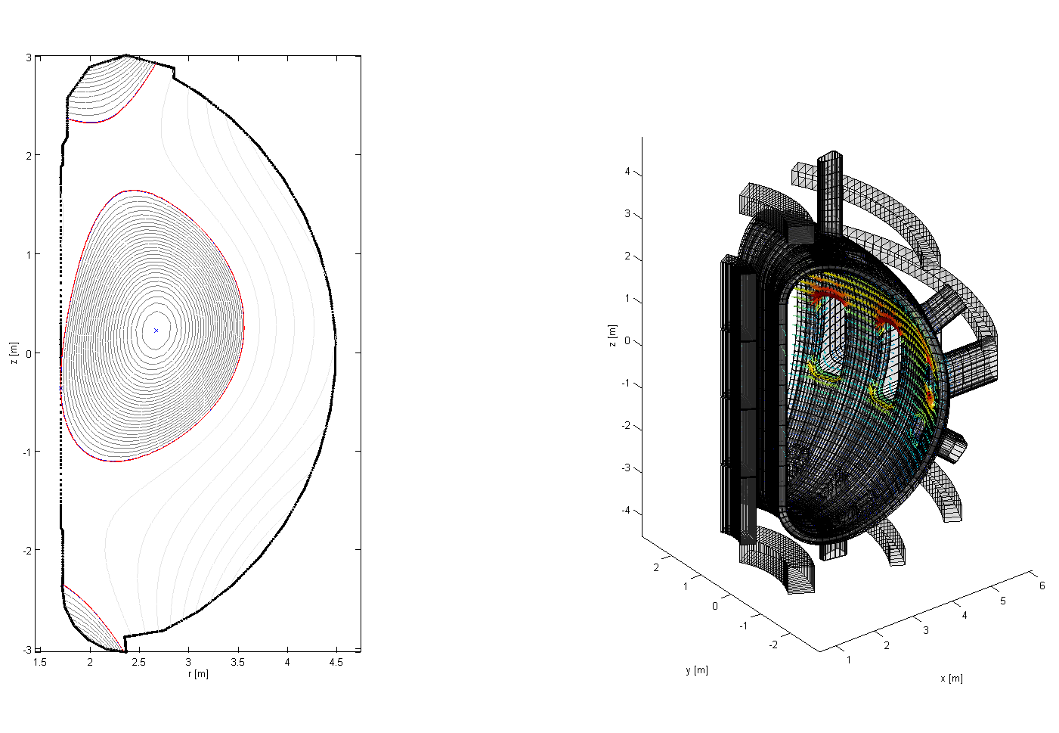
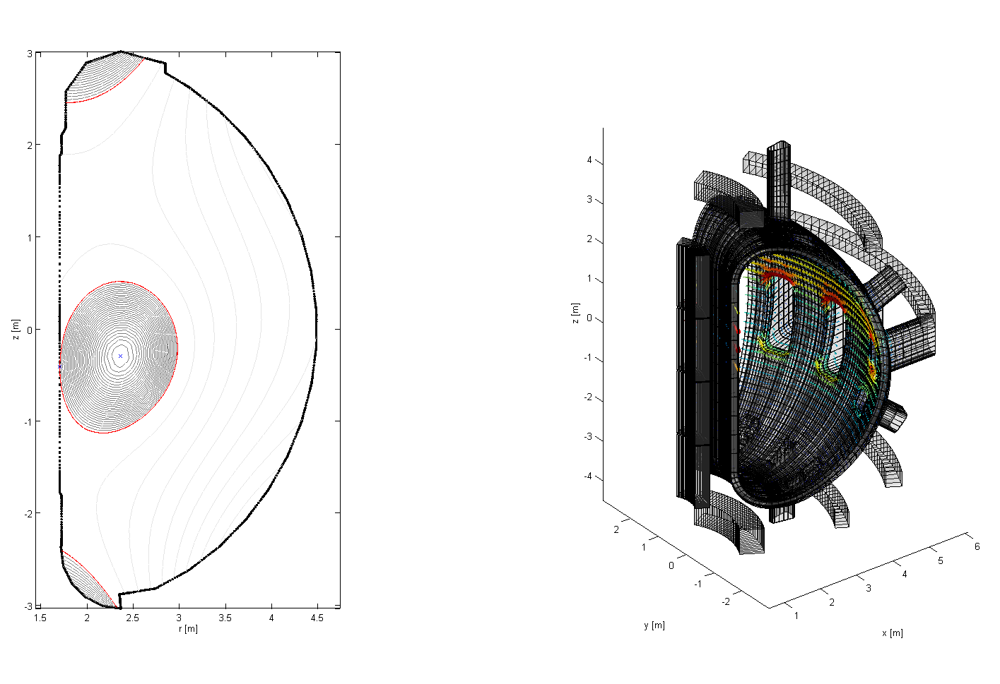
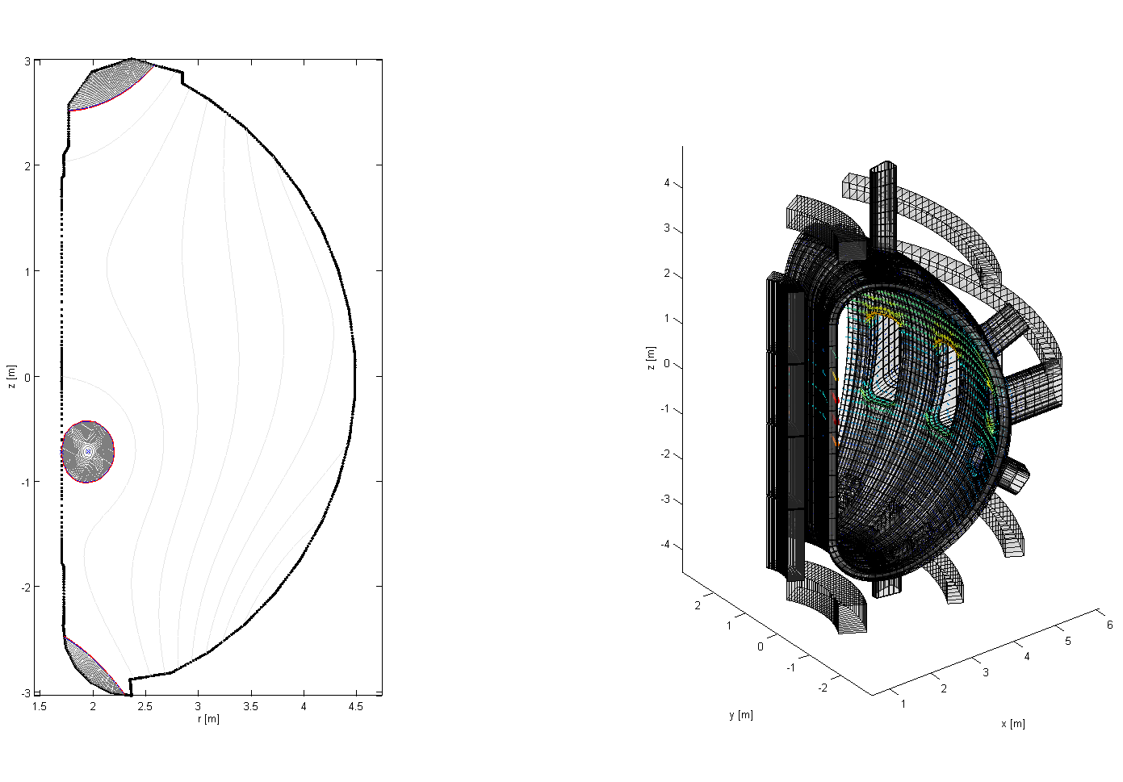
Disruption simulation

Slide 13
Disruption simulation
Next steps
Include halo currents
First wall geometry?
Use 360° mesh
Necessary? It is computationally demanding
Computation of forces on structures
Post processing of existing simulations
Inclusion of simulated magnetic measurements
3D positions needed

Slide 14
Manning
Accepted manning on 3D electromagnetic modelling in support of IC
Disruption modelling + 3D breakdown activities (see Mattei’s presentation on Thursday)
Current status
Around 40-50% off site time used up to now for
3D model production, 3D model assessment, simulation set up, simulation execution
Remaining 50-60% off site time needed for
Refinement of simulations, post-processing, magnetic measurements (see above)
Specific modelling activities in support of IC (see below)
Name | PM on site 2020 | PM off site 2020 | PM on site 2021 | PM off site 2021
F. Villone | 0 | 0.5 | 0.5 | 0.5
V. Scalera | 0 | 1 | 0 | 0.5
N. Isernia | 0 | 1 | 0 | 0.5
G. Rubinacci | 0 | 1 | 0 | 0

Slide 15
Manning
No on-site activity approved for 2020 for the members of the team
Specific modelling activities to be carried out on site will be postponed
A direct link is missing with the experimental facility: we need someone on site taking care of this!
Understand experimental needs and priorities
Receive specific modelling requests in support of IC
Examples of 3D electromagnetic modelling activities in support of IC
TF ripple studies
Estimate of the effects of coil misalignement
Prediction of performance of magnetic sensors in nominal conditions (e.g. misalignement of pick-up coils; effect of 3D path of flux sensors; etc.)
Prediction of performance of magnetic sensor in off-normal conditions (e.g. Rogowski coils measurements during disruptions; halo currents measurements; etc.)
Modelling support to the planning of dedicated experimental campaigns for magnetic sensor commissioning

Slide 16
AVDE modelling tool
Surface Kink Source (SKS) model
Simplified modelling tool to evaluate maximum sideway force due to external kink perturbation
An «engineering-oriented» model
Based on very basic assumptions (see the following)
Focus on the «external» effects of AVDEs (maximum sideway force)
NOT a «physical» model of disruption
No attempt to reproduce the actual plasma evolution
No attempt to understand what is happening inside the plasma
Only basic assumptions are made
Maxwell equations
Quasi-static plasma evolution
No plasma rotation
No plasma-wall contact
No halo: force due to external plasma kink only

Slide 17
Surface Kink Source (SKS) model
We start from a reference plasma axisymmetric equilibrium configuration, surrounded by a conducting vessel with arbitrary geometry
We introduce an axisymmetric shell located inside the vessel in the proximity of the plasma; a finite elements mesh of this shell is considered
Axisymmetric currents on this shell are computed so as to provide the same magnetic field as the axisymmetric plasma outside.
Two kink perturbations are applied to this shell, with the nodes of the mesh of the shell displaced as follows:
θ, ϕ: poloidal and toroidal angles
nnodes: number of nodes of the shell mesh

Slide 18
Surface Kink Source (SKS) model
We assume that the kink perturbations vary exponentially in time:
This induces non axisymmetric currents in the vessel (see figure)
Note that γ and ξ_{0r} are «parameters» of SKS (see the following)
The total magnetic field is
Coils (TF, PF)
Plasma
Eddy currents (due to plasma perturbation)
The interaction of non axisymmetric currents in the vessel with magnetic field gives rise to sideway forces acting on the vessel

Slide 19
Surface Kink Source (SKS) model
The relative amplitude K_{γ} of the two modes is found by imposing that the plasma is in equilibrium at each time instant, i.e. the global force acting on the plasma is zero
This is true on a time scale >> Alfvén time, so that plasma inertia can be neglected ⇒ very good approximation for disruption modelling
We numerically impose that the integral of the Maxwell stress tensor over a surface circumventing the plasma is zero
$$0=F_{p}∙\hat{u}=\iiint_{V_{p}}{\left(J×B\right)∙\hat{u} dV}=\iint_{S_{m}}{\left[\left(B∙\hat{u}\right)B−\frac{\left(B∙B\right)}{2}\hat{u}\right]∙\hat{n}}dS$$

Slide 20
Application to JT-60SA
Different surfaces needed in the model
the reference position of the shell
the surfaces used for the integration of the Maxwell stress tensor
inside and outside the wall, to compute separately the force acting on the plasma and on the wall
the wall and the equivalent surface
Also considered a simplified description of the vessel, by assuming a single shell
The actual meshes cover 360° in the toroidal direction; only a portion is shown for clarity

Slide 21
Application to JT-60SA
Linear relation between displacement and magnetic field perturbation
Rich poloidal spectrum of the radial magnetic field perturbation

Slide 22
Application to JT-60SA
Sideways force for a displacement of 5 mm, i.e. a kink magnetic perturbation of ≈ 1.8 mT
One shell (top) and two shells (bottom)
Maximum sideway force of the order of ≈ 2 kN/mT
This force DOES NOT take into account asymmetric halo currents
A single mode calculation (i.e. not imposing the equilibrium constraint) results in forces higher of one order of magnitude
Preliminary results - further activities needed
Assessment of results obtained so far
Quantification of expected magnetic field perturbation
Definition of reference equilibrium (USN?)
Definition of structures of interest (stabilizing plate?)
Estimate of the effects of halo currents

Slide 23
Conclusions
Symmetric disruption simulations
Detailed 3D mesh of the vessel available and running
Disruption simulation of USN configuration already available and currently under refinement
Electromagnetic modelling tools ready to support IC
Possible modelling activities in support of IC identified
Possible manning planned
AVDEs (asymmetric disruptions) simulation
Sideways force estimated with simplified engineering-oriented SKS model
Estimate of such force provided in absence of halo currents
Further activities needed

