Slide 1
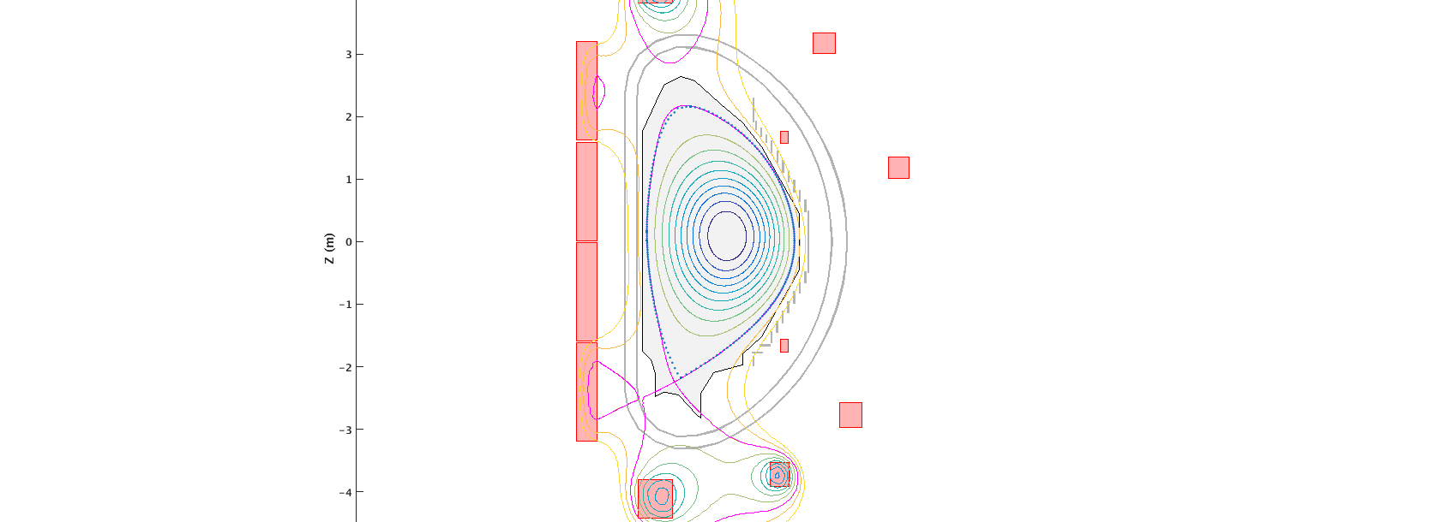
WPSA
JT-60SA
Discharge simulator
Status and progress
Pour insérer une image :
Menu « Insertion / Image »
ou
Cliquer sur l’icône de la zone image
Jean-François Artaud on the behalf of discharge simulator team
04/02/2020

Slide 2
Discharge Simulator: Contributors
Coordination :
Emmanuel Joffrin
Code testers :
Gianmaria De Tommasi
Nuno Cruz
Bolzonella Tommaso
Chiara Piron
Morten Lennholm
Discharge Simulator
Massimiliano Mattei, Adriano Mele, Luigi di Grazia (CREATE), Domenico Abate (RFX)
Holger Heumann, Cedric Boulbe, Blaise Faugeras (Nice University/CNRS/Inria)
Jean-François Artaud, Gerardo Giruzzi, Frédéric Imbreaux, Valeria Ostuni (CEA)
Funding and support :
  F4E (Mario Cavinato, Filippo Sartori)
  EUROfusion (WPSA & WPCD)

Slide 3
Discharge Simulator: Goals
  Discharge simulator:
      Prepare JT-60SA experiments
      Assess feasibility of the scenario
      Optimize scenario
      Analyze JT-60SA experiment (when data will be available)
  Input:
      Targeted plasma parameters (from research plan, …)
      JT-60SA measurements (when data will be available)
  Output:
      Plasma reference waveforms (Ip, nbar, P_NBI, …)
      Plasma shape snapshots
      Coil currents feedforwards
      Models for the position and current controller

Slide 4
Discharge Simulator: Codes
Discharge Simulator
PLASHAPE
(LCFS design tool)
METIS
(plasma scenario simulator)
CREATE-EGENE (equilibrium design tool and linearized model computation)
FEEQS.M
(free boundary equilibrium used in various inverse modes)
CREATE-NL
(free boundary equilibrium used in time dependent simulation)
Shape and plasma current controller (Simulink library)
NICE
(used for equilibrium reconstruction)
Matlab / Simulink framework
In blue: code interfaced with IMAS

Slide 5

DISCHARGE simulator:
FULL discharge workflow
METIS simulator
(plasma scenario)
Feedforwards
Simulink
Powers, density, …
Kinetic controller
Plasma shape, …
Shape controller
Plasma current
Vertical controller
Plasma current controller
CREATE-NL
(free boundary equilibrium)
Observer: RAPTOR
NICE
Equilibrium identification
(formerly EQUINOX)
Synthetic diagnostics:
Magnetics, polarimetry, …
(ToFu based)

Slide 6
Discharge Simulator: HowTO in 4 steps
GUI
GUI
GUI
Plasma shapes
Initial equilibrium
Linearized model
Scenario optimisation
Coils current feedforwards
Shape update
Plasma scenario development
PLASHAPE
METIS
CREATE-EGENE
FEEQS.M
(FBE inverse mode)
1st equilibrium
Linearized model
METIS
Simulink
Shape controller
Vertical controller
Coil current
feedforwards
Plasma current controller
CREATE-NL
(free boundary equilibrium)
METIS simulator
(plasma scenario)
Reference
Waveforms (Ip,…)

Slide 7
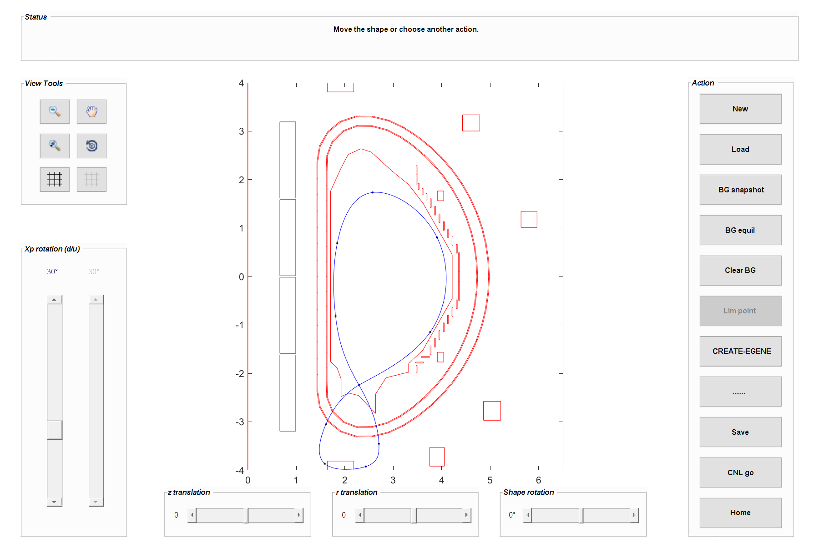
Plasma shape design with Plashape tool
View manager
Insert new shape by points
Load a previuos built shape
Interactive shape plot
Change the X point angle
Run Fixed Buondary Equilibrium
Shape traslation and rotation
Tool to prepare or import shape sequences and compute freeboundary equilibria in view of equilibrium current calculation

Slide 8
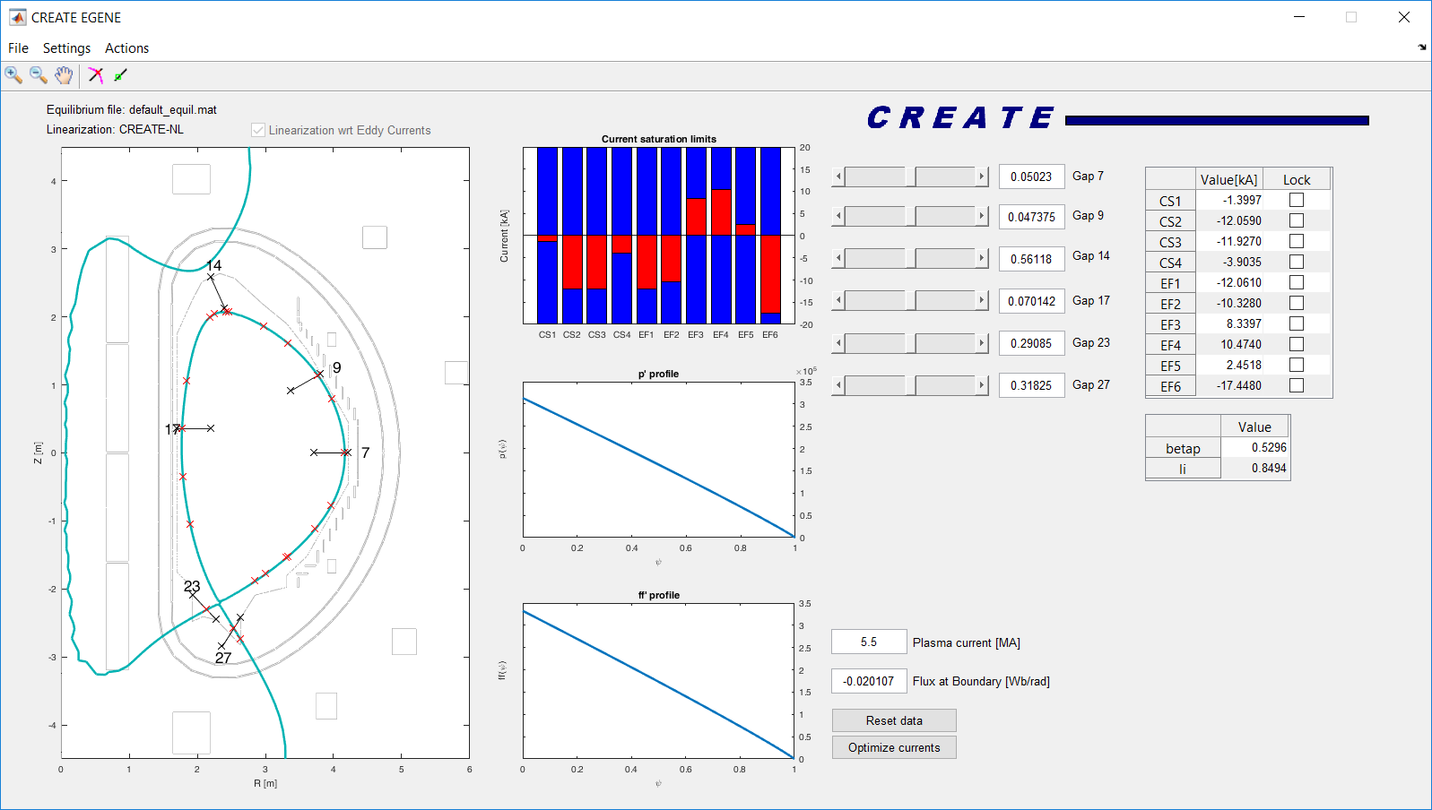
Main GUI CREATE-EGENE

Slide 9
PLASHAPE & CREATE-EGENE
  2 next presentations :
      CREATE-EGENE tutorial and simulations of scenario 2
      by Adriano Mele
      CREATE-EGENE simulations of scenario 4.2
      by Domenico Abate

Slide 10
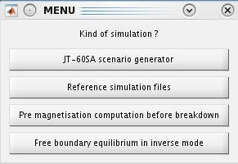
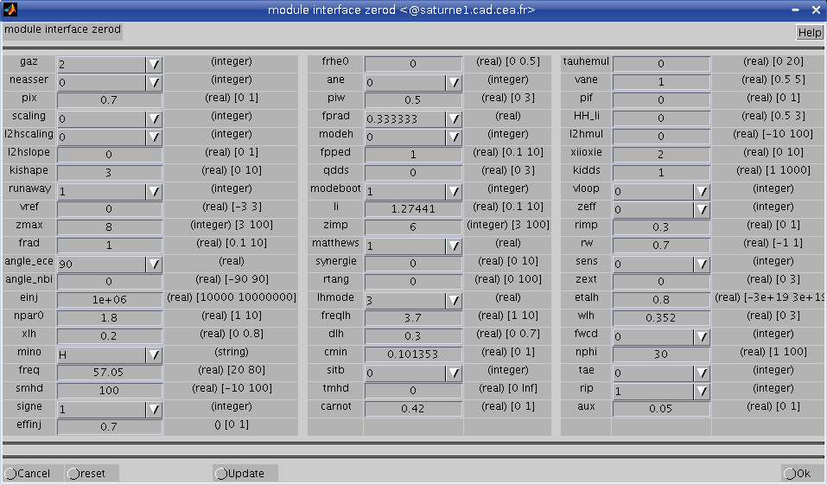
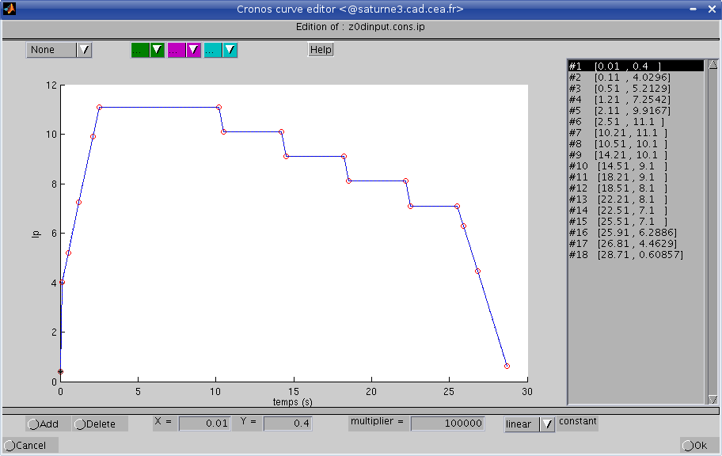
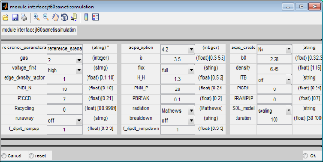
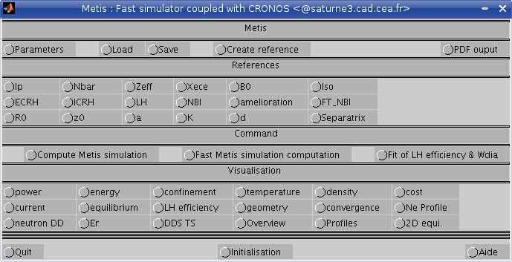
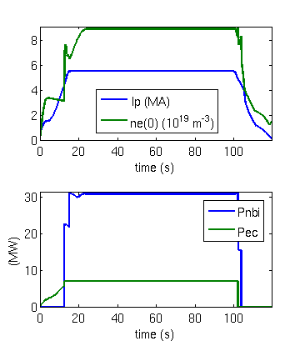
PLASMA SCENARIO design with METIS
Data source
Parameters
References
Scenario choice
METIS : main interface
Run
(~ 1mn)
Visualisation
Export to database
Results

Slide 11
SCENARIO OptimiSAtion tools
Plasma shape
Waveforms
FEEQS.M parameters
FEEQS.M
Inverse magneto-static
METIS LCFS generator
Parameters
CREATE-EGENE LCFS
METIS simulator
METIS simulation
Initial coil currents
FEEQS.M LCFS
FEEQS.M
Inverse static
(full shot computation)
FEEQS.M
Inverse evolving
(transient phases computation)
Constraints checking, scenario waveforms and LCFS update
(handmade)
FEEQS.M results
(time dependent)
Updated LCFS
Full simulator:
CREATE-NL + METIS + Simulink controller
Coils currents
Power supply voltages
Passive structure currents
Forces on coils
maximum magnetic field

Slide 12
METIS + FEEQS.M :
BENCHMARKs & scenario optimization
  METIS +FEEQS tool has been validated & benchmarked
      a bug in the coupling between codes has been solved
      optimization method has been improved to prevent
      non optimal solutions (current dipole).
  The tool is now user friendly and available for any user
      FEEQS.M is now under GPL v3 license
  Next presentation :
      JT-60SA tokamak scenario optimization with METIS & FEEQS by Valeria Ostuni.

Slide 13
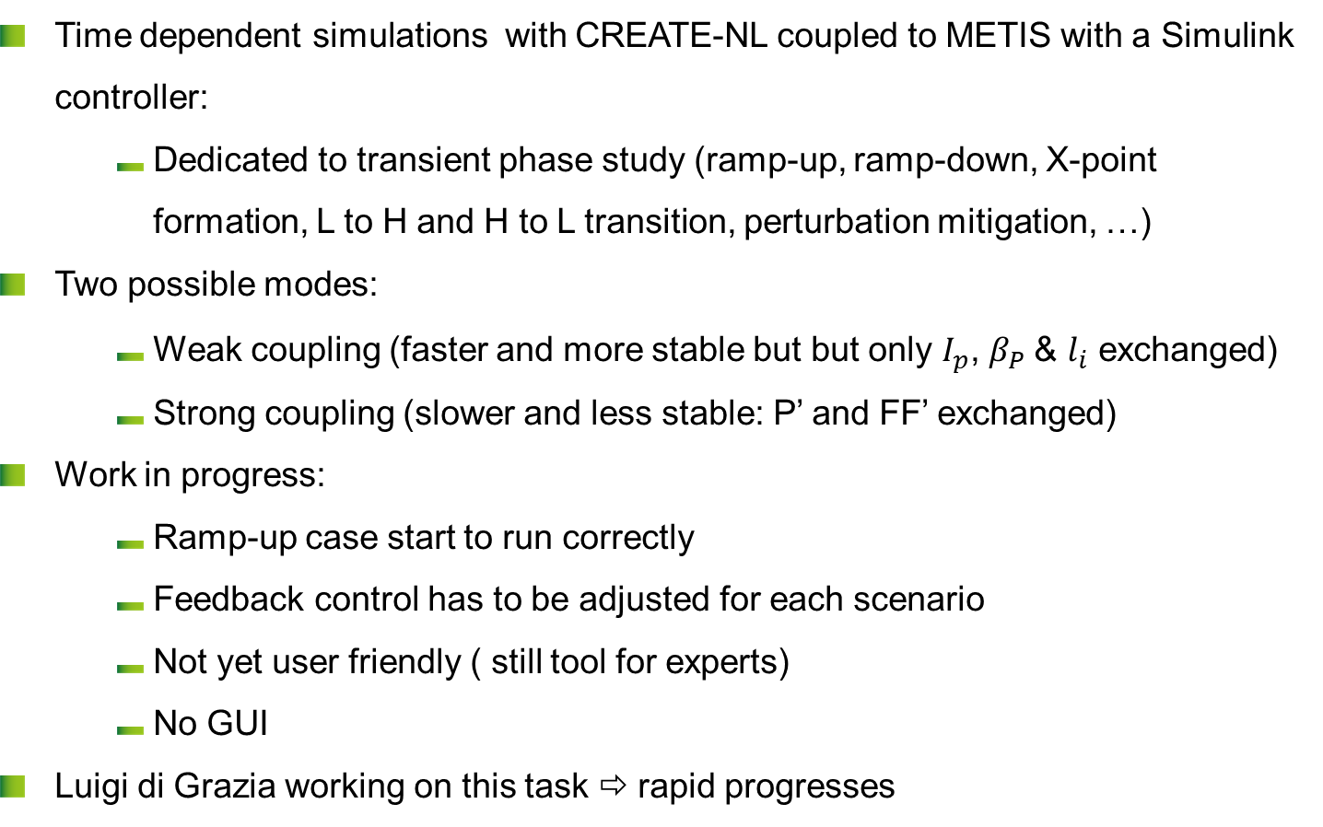
close loop simulationS
  Time dependent simulations with CREATE-NL coupled to METIS with a Simulink controller:
      Dedicated to transient phase study (ramp-up, ramp-down, X-point formation, L to H and H to L transition, perturbation mitigation, …)
  Two possible modes:
      Weak coupling (faster and more stable but but only $I_{p}$, $β_{P}$& $l_{i}$ exchanged)
      Strong coupling (slower and less stable: P’ and FF’ exchanged)
  Work in progress:
      Ramp-up case start to run correctly
      Feedback control has to be adjusted for each scenario
      Not yet user friendly ( still tool for experts)
      No GUI
  Luigi di Grazia working on this task ⇨ rapid progresses

Slide 14
Latest developments
Shape Tool (Plashape)
  Algorithm based on splines to produce a sequence of plasma shapes to be used for scenario simulations
  User interface to produce diverted, limited, double null plasma shapes
Equilibrium currents calculation
  Set of functions to acquire shape sequences from Plashape and waveforms of Ip, profile parameters (ff’ and p’ or poloidal beta and li), flux consumption and compute equilibrium currents and voltages for free boundary equilibria
Strong coupling METIS-CREATENL
  Coupling still diverging after a while.
  Review of the interaction scheme (definition of the interaction variables, numerical integration scheme,…)
  Test of new scenarios. Now ohmic Scenario is under testing

Slide 15



Strong and Weak Coupled simulations comparison for Ohmic Scenario
Red line: Weak Coupled simulation
Cyan line: Strong Coupled simulation
2.7 MA
4.0 MA
5.5 MA

Slide 16
NICE : ADAPTATION to JT-60SA
  NICE code as been adapted to JT-60SA :
      JT-60SA machine description has been added
      optimized 2D mesh has been created
      Magnetic probes and flux loops description has been added
  NICE code can be used for equilibrium identification / reconstruction
      Full domain mode
      Inside magnetic probes contour (not sensitive to error in coil current measurements and not sensitive to currents in passive structures outside magnetic probes contour)
      Already widely used for JET and WEST equilibrium reconstruction
  Reconstruction test:
      use of synthetic data generated from NICE/FEEQS equilibrium

Slide 17
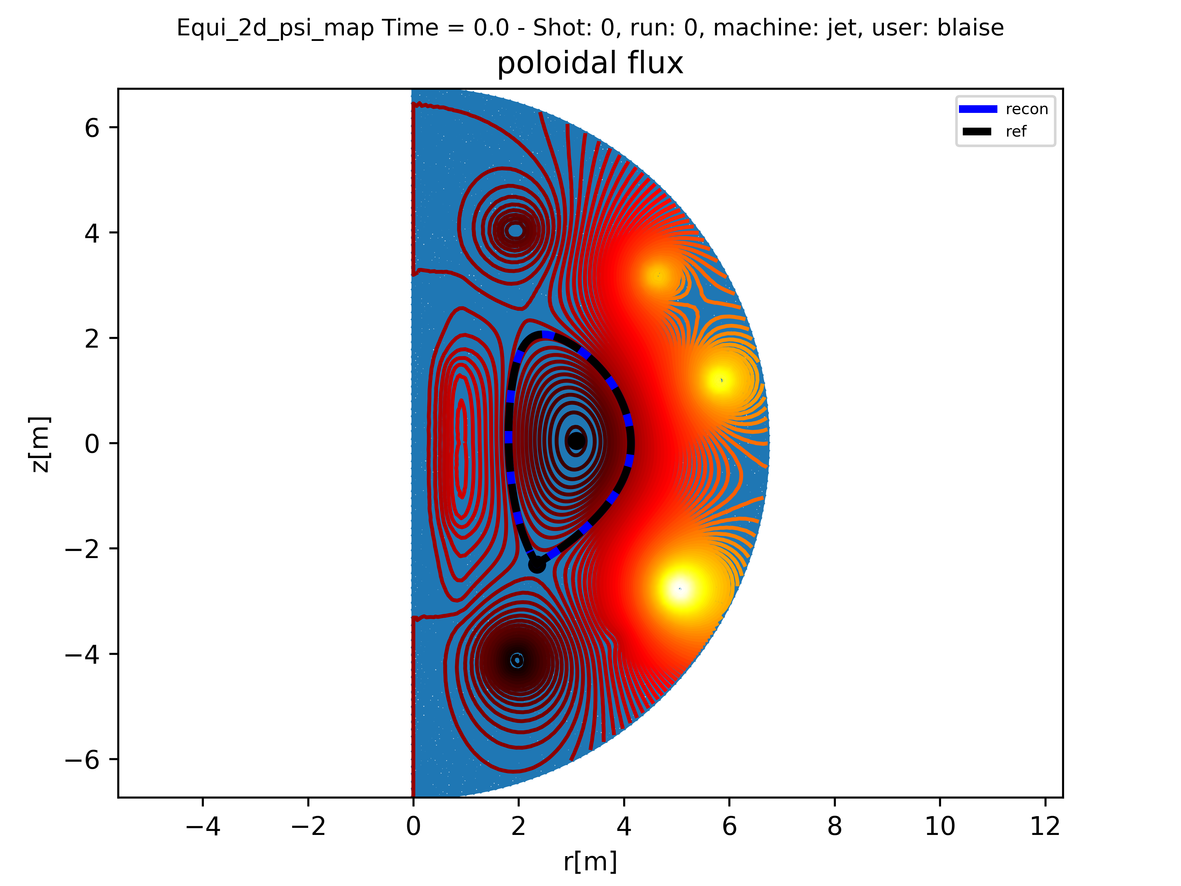
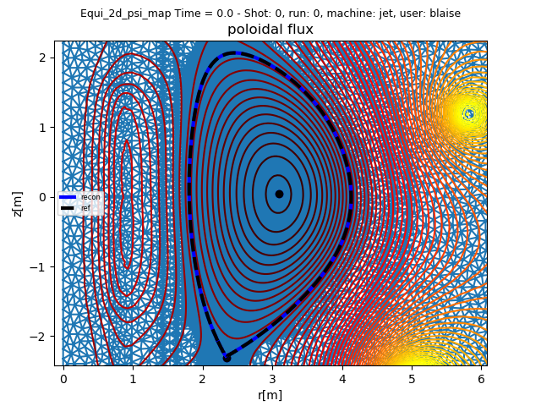
NICE : EQUIlibrium identification TEST (1/3)
equilibrium reconstruction with comparison of initial and identified LCFS

Slide 18
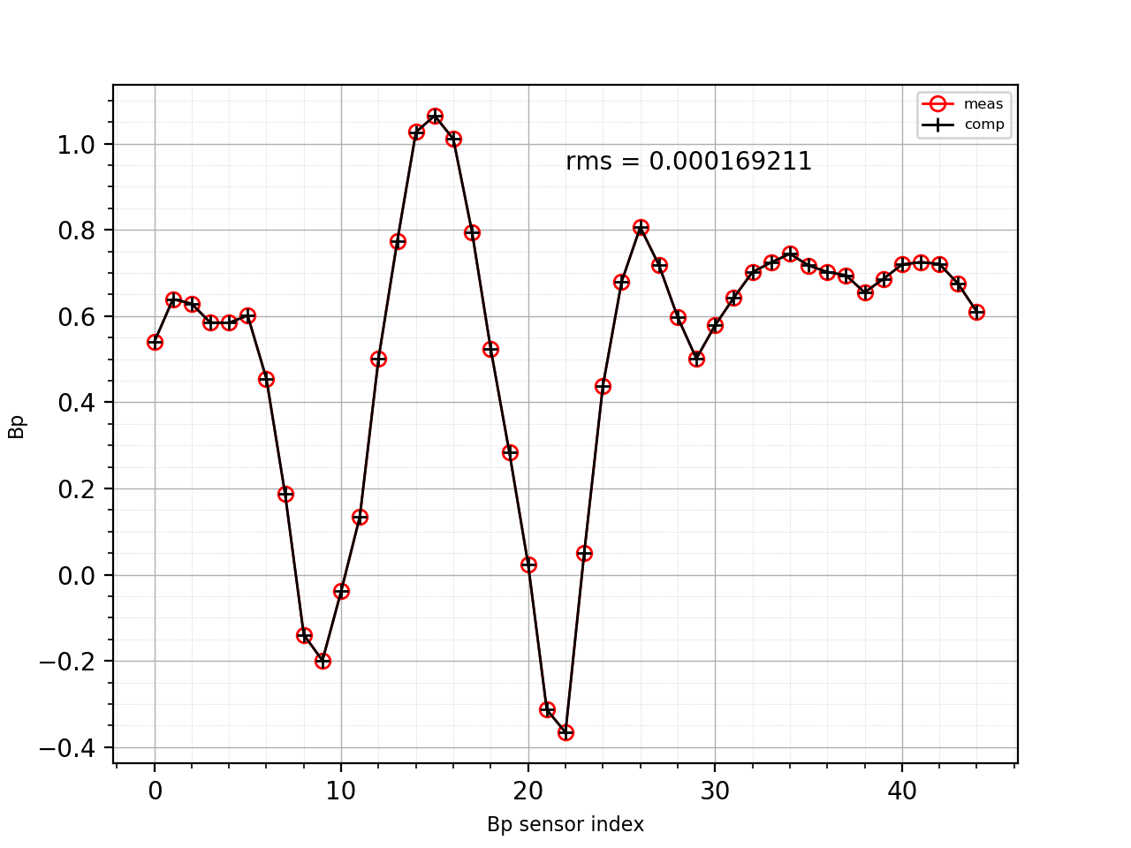
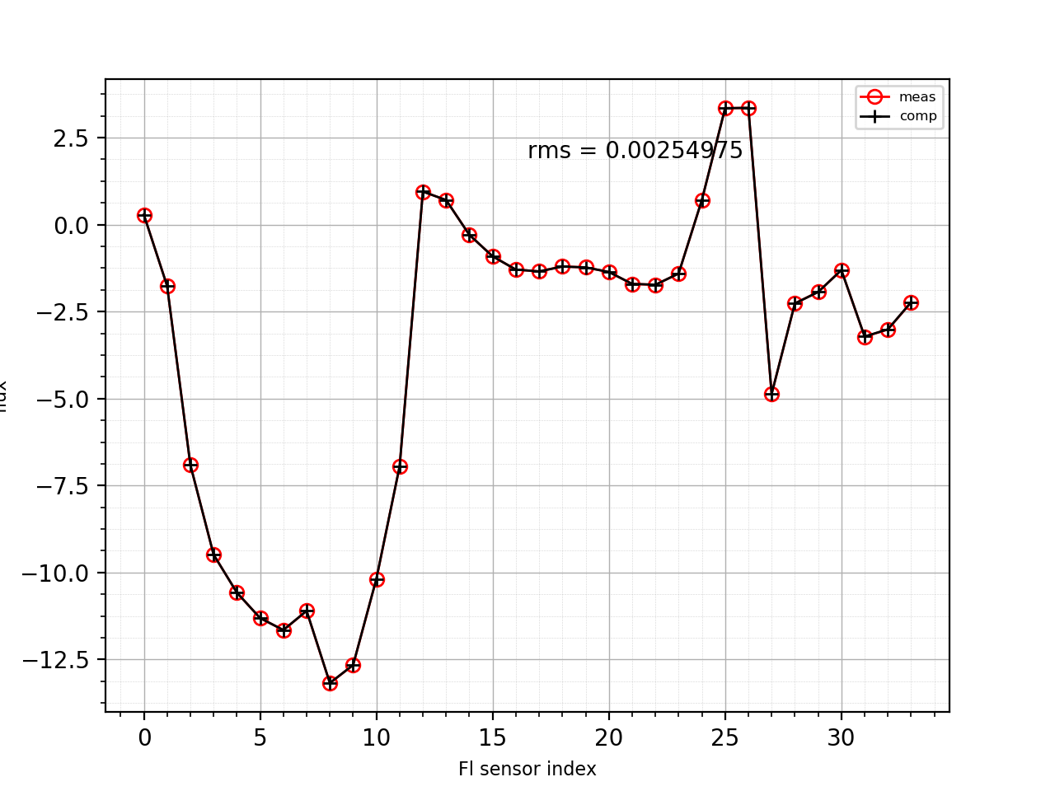
NICE : EQUIlibrium identification TEST (2/3)
Measurements matching (without noise):
Magnetic probes
Flux loop

Slide 19
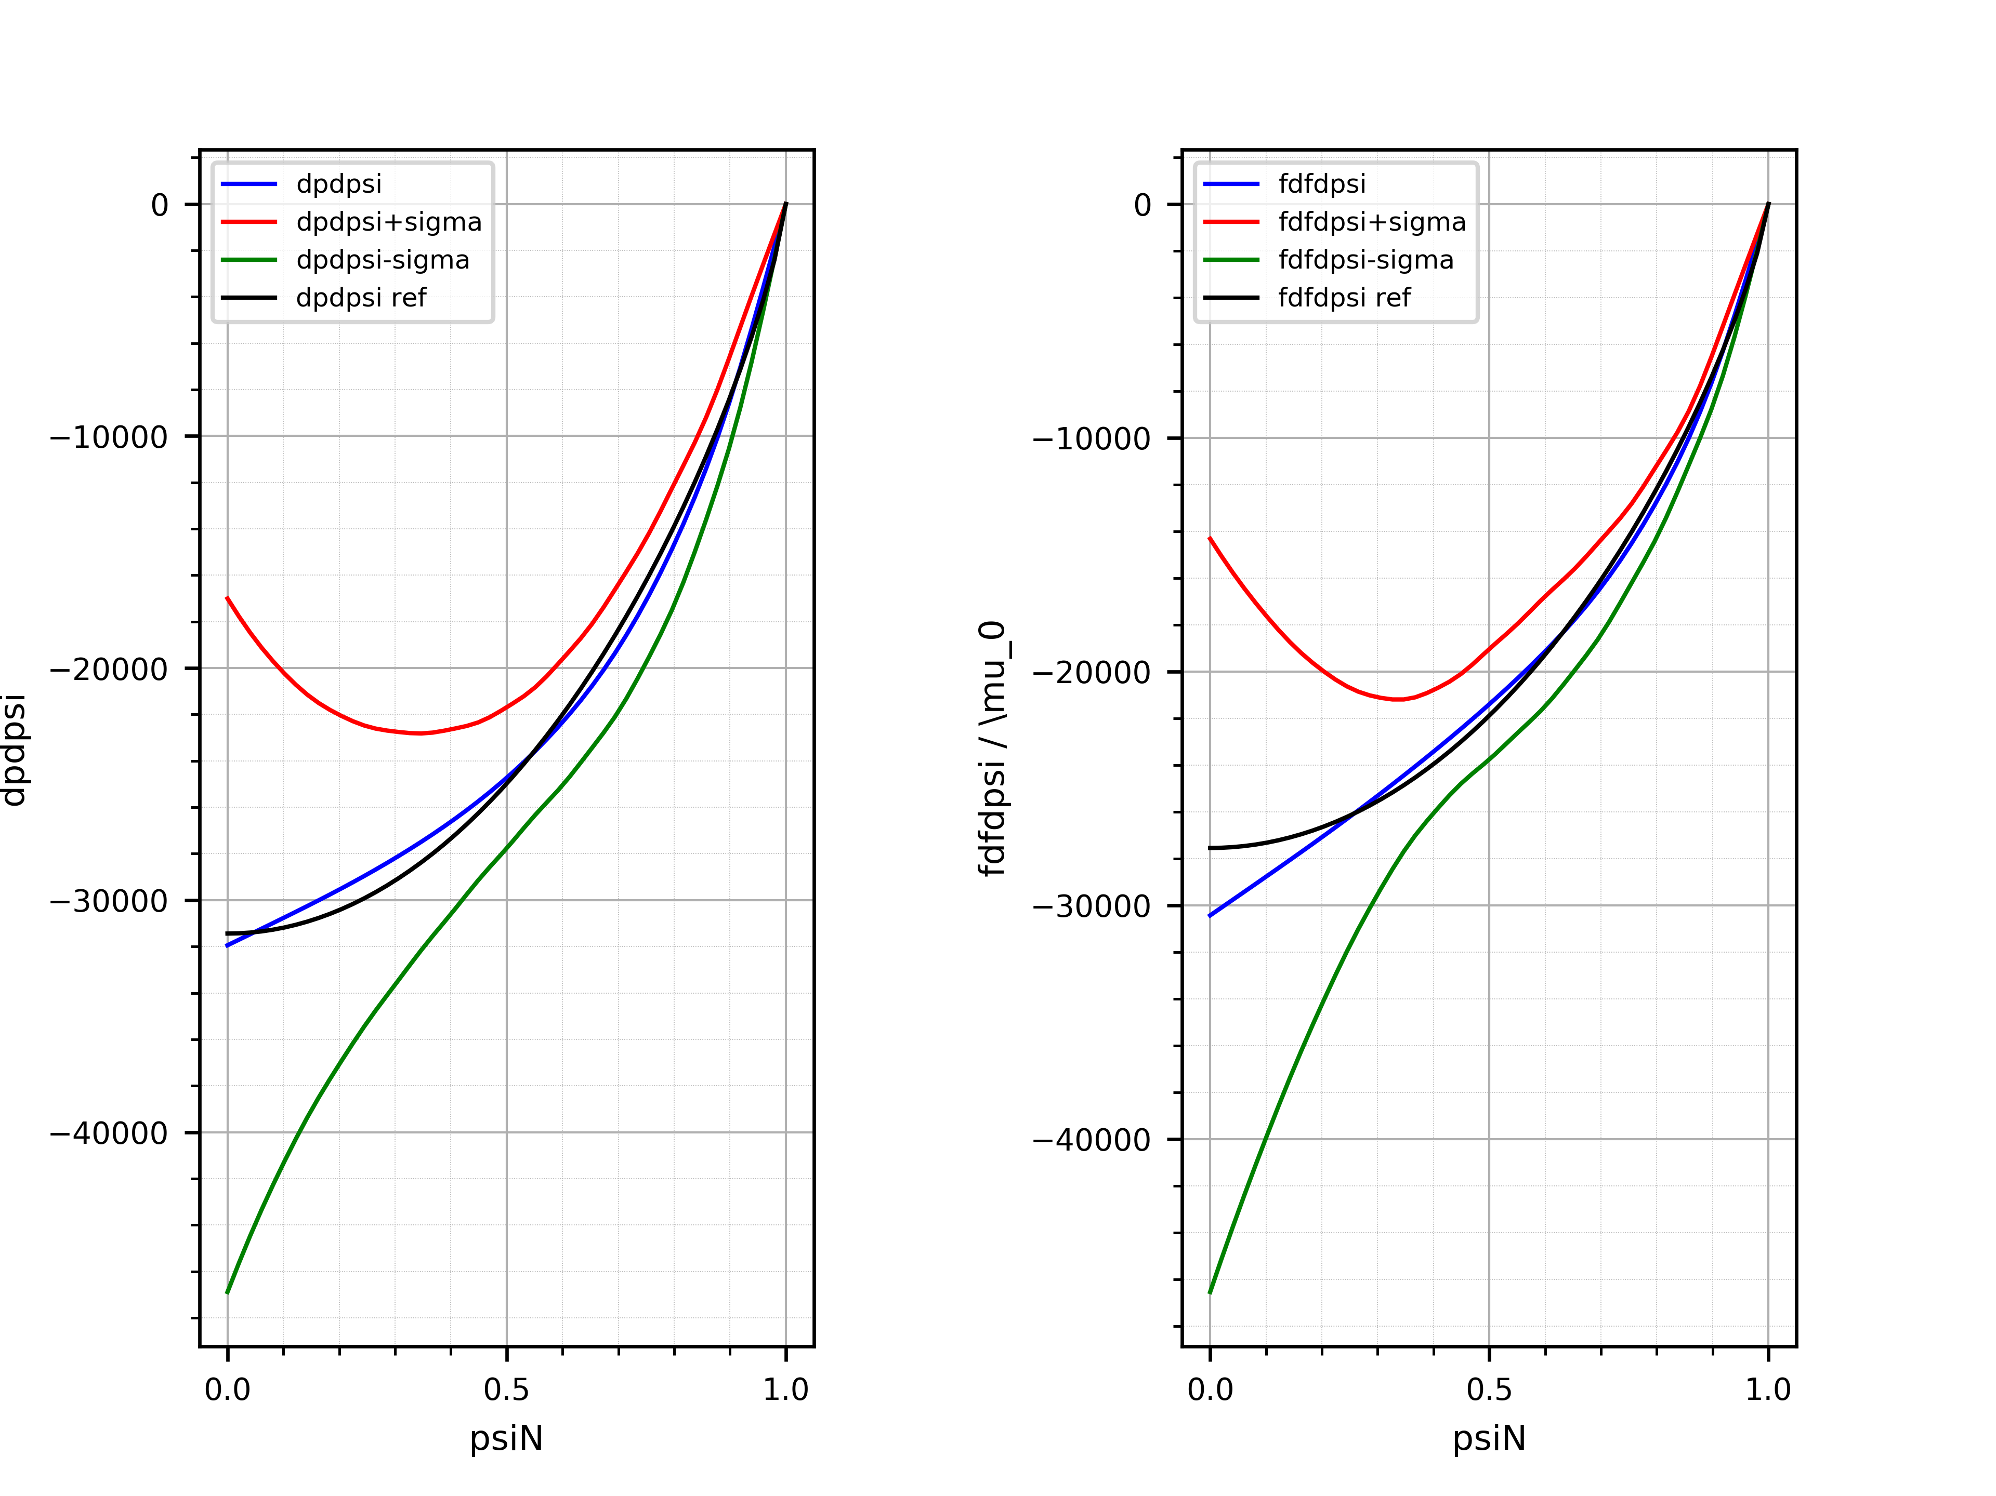
NICE : EQUIlibrium identification TEST (3/3)
Profiles identification (magnetic measurements alone):

Slide 20
Summary of
DISCHARGE Simulator development
  Scenario development tools (PLASHAPE/CREATE-EGENE & METIS) are available → users are welcome to used it
  (One year later, there is still some concerns to install it on IM gateway …)
  Scenario optimization tool (based on METIS and FEEQS.M) is available for all users:
        Integration with METIS has been finished
        Use of FEEQS.M has been made user friendly
        Codes coupling has been validated and benchmarked
        FEEQS.M has been released under GPL v3 license
  Full simulator (CREATE-NL + METIS + Simulink controller)
        Large progresses have been done
        Ramp-up simulation start to work fine
        Work will continue

Slide 21
What come next ?
  Documentation of optimization tools
  Preparation of JT-60SA early scenarios (reduce field, current, power, density, …) → planed but not done
  Tests by users of the tools → problems on IM gateway have still to be solved
  Work to develop the full simulator (CREATE-NL + METIS + Simulink controller) continue.
  Try to improved computation time of full simulator
  Benchmark of passive structure model between CREATE-NL and FEEQS.M/NICE
  Complete the workflow: add synthetic diagnostics (magnetic, polarimetry, …) and identification equilibrium code NICE in the workflow
  Later: training of future session leaders and scientific coordinators
  JT-60SA data access to compare experiments and simulations
Jean-François Artaud | CEA/DRF/IRFM | 02/04/2020

Slide 22
Backup slides

Slide 23
CREATE Tools for Scenario Preparation/Simulation
Shape Tool
(Plashape)
Linear Simulations in Simulink
METIS
Fixed Boundary Equilibrium
Feedback Control Design
EGENE
(Equilibrium fine tuning)
Compute Currents
Free Boundary Equilibrium (snapshots)
METIS+CREATE-NL Weak Coupling or Strong Coupling
METIS

Slide 24
Who will use These tools ?
﻿FEEQS est sous licence GPL 3.0
  METIS and CREATE-EGENE:
      Easy and fast to run (user friendly GUI)
      Available for EU physicists
      Well documented
  FEEQS.M code in inverse evolution mode:
      Now quite user friendly
      More expert tool, but can be used by any with some training
  Coupled simulation with CREATE-NL + METIS:
      Not yet a user friendly tool
      → requests more development for :
      GUI, configuration set, pre-tune controller, documentation, …
      Need some expertise level (in particular for controller tuning)

Slide 25
References
  Metis: a fast integrated tokamak modelling tool for scenario design, J.F. Artaud et al 2018 Nucl. Fusion 58 105001.
  Quasi-static free-boundary equilibrium of toroidal plasma with CEDRES++: Computational methods and applications, H. Heumann et al, J. Plasma Physics (2015), vol. 81, 905810301 , doi:10.1017/S0022377814001251.
  Equilibrium reconstruction at JET using Stokes model for polarimetry, Blaise Faugeras et al 2018 Nucl. Fusion 58 106032 .
  JT-60SA Research Plan, Research Objectives and Strategy, Version 3.3, 2016, March: JT-60SA Research Unit (http://www.jt60sa.org/pdfs/JT-60SA_Res_Plan.pdf)
  https://idm.f4e.europa.eu/Portal/Pages/ContentView.aspx?uid=2AAZGM
  H. Urano et al, Fusion Engineering and Design 100 (2015) 345–356
  T Wakatsuki et al, Plasma Phys. Control. Fusion 57 (2015) 065005 (12pp)

Slide 26
DRF
IRFM
SPPF
Commissariat à l’énergie atomique et aux énergies alternatives
Centre de Cadarache | 13108 Saint Paul Lez Durance Cedex
T. +33 (0)4 42 25 46 59 | F. +33 (0)4 42 25 64 21
  Etablissement public à caractère industriel et commercial | RCS Paris B 775 685 019

