Slide 1
Integrated modelling of fusion plasma discharges with application to the JT-60SA tokamak
V. Ostuni
Institut de Recherche sur la Fusion
par confinement Magnétique
Commissariat à l’Energie Atomique
CEA/Cadarache (FRANCE)
valeria.ostuni@cea.fr
CEA | 10 AVRIL 2012
| PAGE 1

Slide 2
Outline
Introduction
Codes for integrated tokamak modelling
Benchmark of FEEQS.M
Coupling of METIS and FEEQS.M
Application to scenario optimization
Conclusions

Slide 3
Introduction

Slide 4
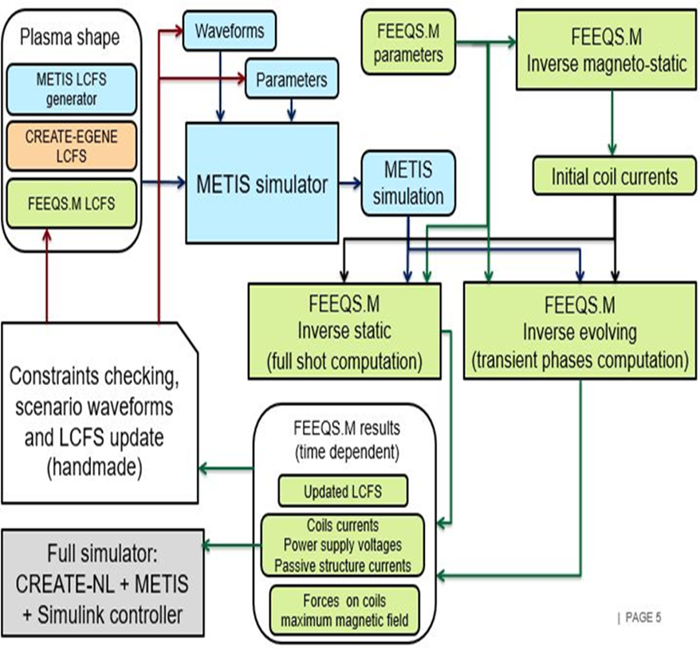
Introduction
For the first time, a fast integrated tokamak modelling tool for scenario design (METIS) is coupled with a quasi-static free-boundary equilibrium code (FEEQS) in order to reproduce a full tokamak discharge simulation.

Slide 5
Introduction - goals
Since the validation of models and codes is one of the mains milestones for ITER realization, this work has three goals:
Perform the benchmark between FEEQS.M and TOSCA to check if the results of the code are consistent;
Run the coupling codes to stress the effect of calculating $β_{p}$ and li(3) instead of just assuming them;
Use the two codes in order to optimize one of the JT-60SA scenario.

Slide 6
Codes for integrated tokamak modelling

Slide 7
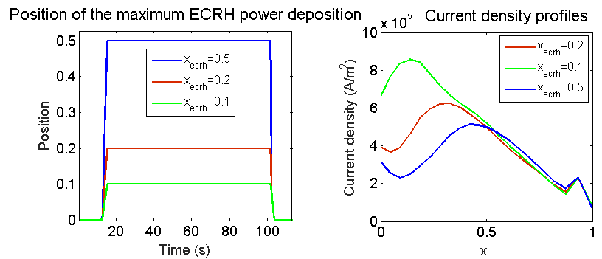
Codes for integrated tokamak modelling - METIS
Input given as waveform:
Plasma current;
line-average electron density;
Line-averaged effective charge;
ECRH power deposition position;
Toroidal field;
Tritium and deuterium density ratio;
ECRH, ICRH, NBI and LH power injection;
H factor;
Plasma geometry.
METIS is a fast integrated transport code that combines 0D scaling-law normalized heat and particle transport with 1D current diffusion modelling and 2D equilibria.
Output:
Time dependent profile data;
Time dependent scalar data;
Plasma equilibrium.

Slide 8
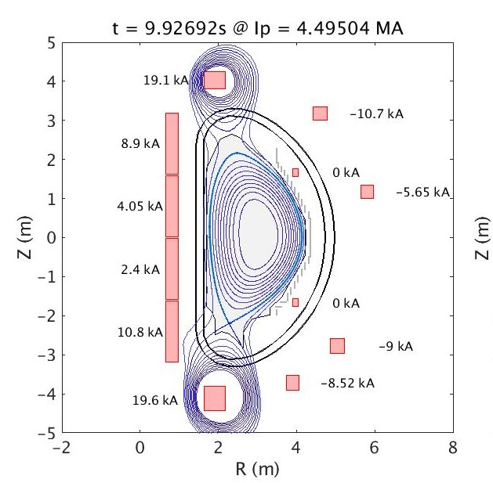
Codes for integrated tokamak modelling – FEEQS inverse Poynting mode
FEEQS is a quasi-static free-boundary equilibrium code that computes the coils currents necessary to produce a given magnetic equilibrium.
Inputs:
P’ and FF’ profiles from METIS;
Plasma shape from METIS;
Plasma current;
LCFS poloidal flux;
Coils limits.
Outputs:
Updated LCFS shape as real solution of free-boundary equilibrium equation;
Waveforms of time dependent coil currents;
Forces and maximum magnetic field on coils;
Estimation of voltage on coils;
Estimation of current in passive structures.

Slide 9
Benchmark of FEEQS.M

Slide 10
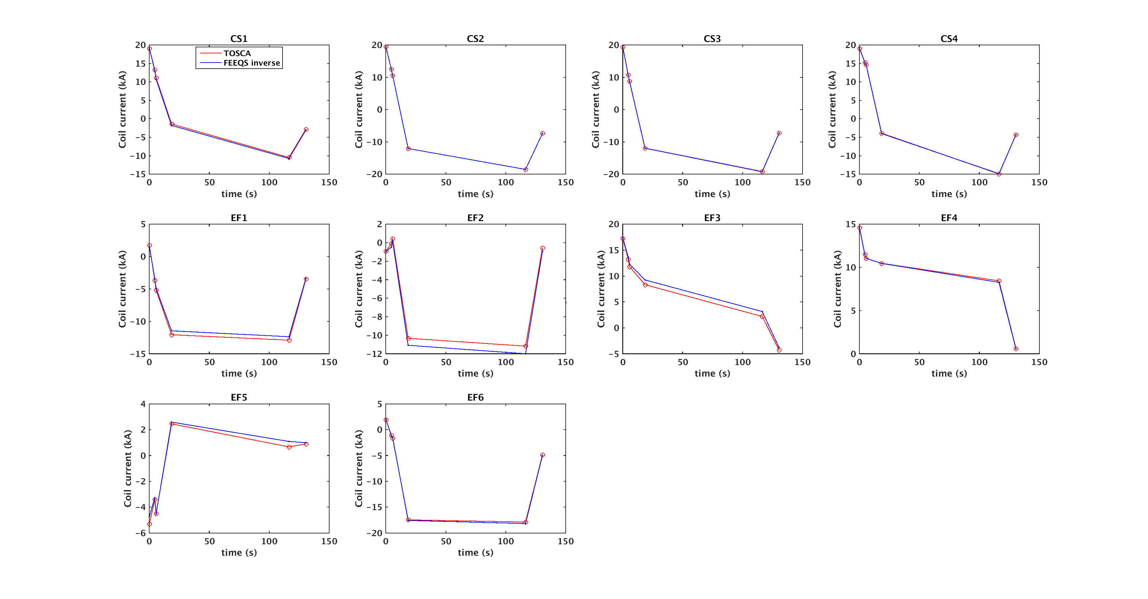
Benchmark of FEEQS.M
A direct benchmark between TOSCA and FEEQS has been made without METIS in the loop. It consists of setting CS2 current to the values taken from TOSCA and computing all of the other currents using FEEQS.
FEEQS results match well TOSCA data. The two codes use the same equations and assumptions.
The small differences come from the currents in passive structures set to be 0.

Slide 11
Coupling of METIS and FEEQS.M

Slide 12
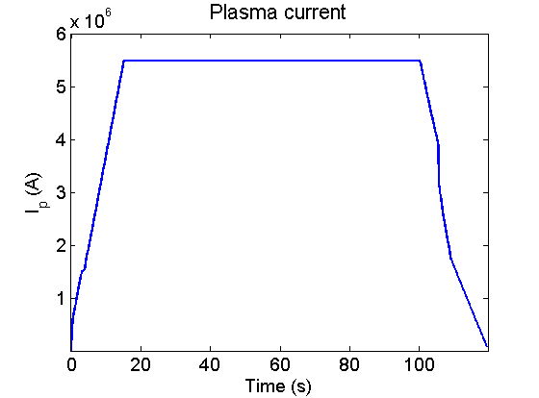
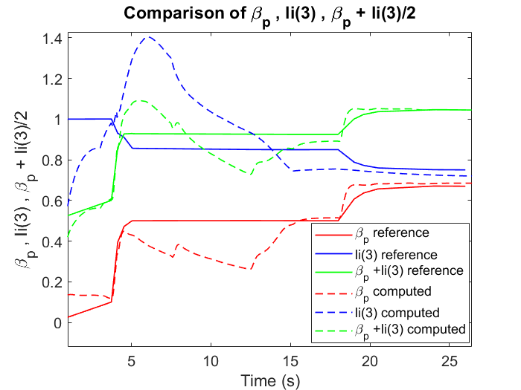
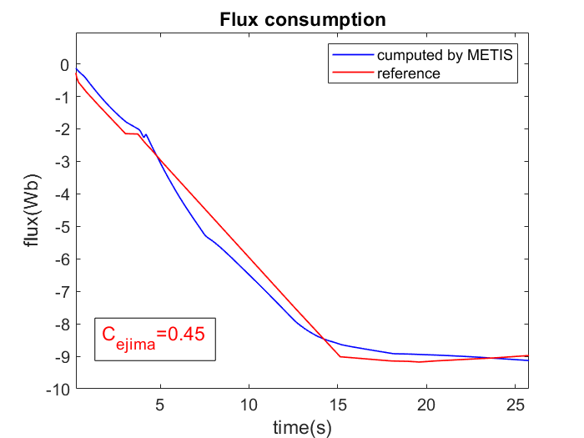
Coupling of METIS and FEEQS.M
The aim of the study is to compute the same coils current using FEEQS.M with and without METIS.
The first step is to change the input METIS parameters starting from scenario #2 of JT-60SA in order to obtain similar behavior of flux consumption, l_{i}(3), β_{p} and C_{Ejima} factor used as inputs in the benchmark.
The waveform of the plasma current is considered a fixed value and it is left unchanged.

Slide 13
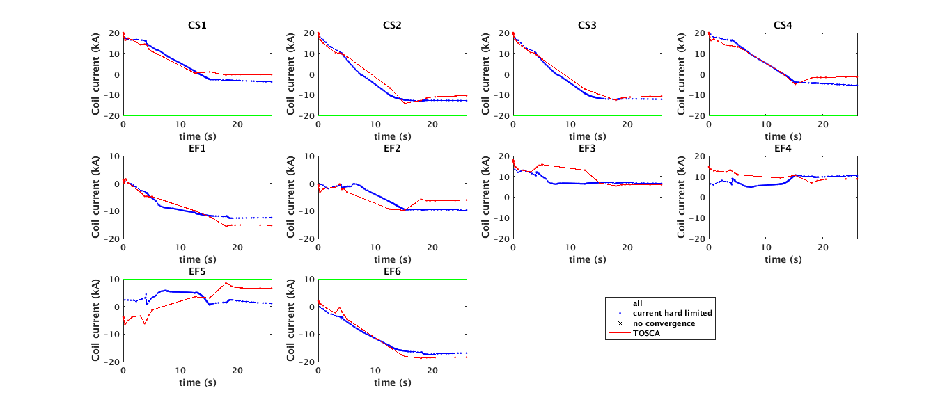
Coupling of METIS and FEEQS.M
The next step consists of using this configuration as input for FEEQS.M in order to compute coils currents and to compare them to reference one. Constraint forces on coils and constraint forces between coils are not taken into account. The flux offset is set to 17Wb and the regularization weight to 10⁻¹⁷.
The penalization of EF5 = 10³ (its weight is 10⁻¹⁴)

Slide 14
Application to scenario optimization

Slide 15
Application to scenario optimization - optimization process
The optimization process consists of:
launching a large number of simulations and varying a large number of parameters;
Using FEEQS in order to compute coil currents, power supply voltages, forces on coils and to update the LCFS;
Uploading the new LCFS in the same simulation and running again METIS and FEEQS in order to obtain a better convergence.
The aims are:
Respect the physical limits;
Respect the technological limits;
achieve a shot as long as possible.

Slide 16
Application to scenario optimization – inputs parameters
The following parameters are set to start the optimization of the scenario #2
Plasma current (MA) | Toroidal magnetic field (T) | Major radius (m) | Minor radius (m) | ECR/N-NBI/P-NBI powers (MW))
5.5 | 2.25 | 2.96 | 1.18 | 7/10/24
Gas species | Flattop duration (s) | ECRH Assisted breakdown (MW) | H factor | Breakdown
Deuterium | 100 | 0.1 | 1.3 | on
Line-averaged electron density (10E20/m³) | ITB formation, recycling and runaway | ECRH maximum power at the end of the ramp-up (MW) | Voltage | Density peaking factor
0.63 | off | 6.7 | low | 1.3

Slide 17
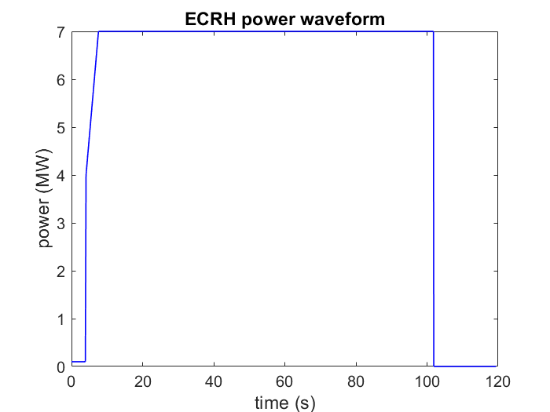
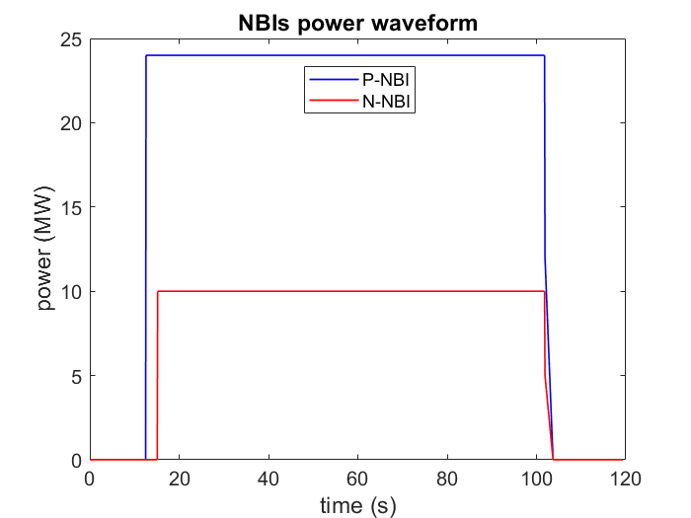
Application to scenario optimization – importance of externals heating
The ECRH power waveform is modelled to help the x-point formation (at 4.09 s). Its radial deposition position is equal to 0.5 with the deposition width to 0.2, and it is directed toward the high flux surface. P-NBI power is used to assist the transition to H-mode (at 12.89 s). They vertical shift at the center of the plasma is set to 0.35 with the tangency radius of 2.85.

Slide 18
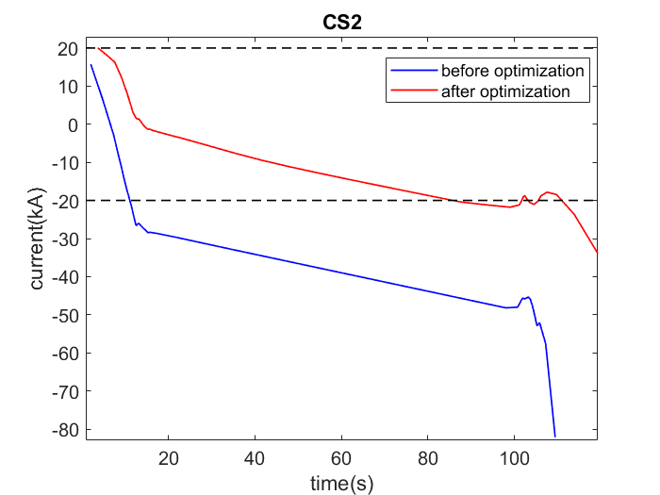
Application to scenario optimization – check of the technological limits
FEEQS.M is run with the flux offset set to 20 Wb and the regulation weight set to 10⁻¹⁵

Slide 19
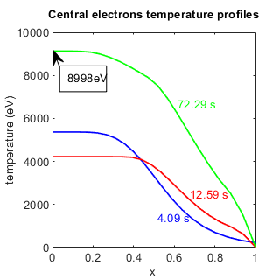
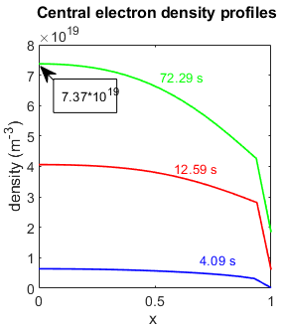
Application to scenario optimization – check of the physical limits
The central electron temperature and the central electron density are checked in order to verify if they respect the typical values expected for the scenario #2.

Slide 20
conclusions

Slide 21
Conclusions
From the simulation results obtained, it is possible to conclude that:
FEEQS results match well TOSCA ones, this means that the two codes have the same contents and similar accurancy;
the effect of calculate 𝛃_𝐩 and li(3) is larger in the coils dedicated to the formation and the position of the x-point;
the scenario analyzed is possible to obtain;
the power and the position of the externals heating are the most relevant parameters affecting the behaviour of the plasma discharge.
Future upgrades:
More efforts are needed to better analyze the ramp-down phase;
The only way to match the starting upper limit coils current is to shift manually the computed coil current. Therefore, a code improvement is need to find model to make this part automatic;
couple CREATE-NL and METIS in order to simulate a full tokamak discharge.

Slide 22
Back up slides

Slide 23
FEEQS inverse Poynting mode equations
FEEQS combines:
the Grad-Shafranov equation for the magnetohydrodynamic equilibrium in axisymmetric systems
$$−∆ψ(t)=rP^{′}\left(ψ\left(t\right)\right)+\frac{1}{μ_{0}r} FF′(ψ(t))$$
Where P' and F' refer to the derivatives respect to $ψ$of P($ψ$) and F($ψ$) that are the kinetic pressure and the diamagnetic function constant on $ψ$.
circuit and induction equations for the poloidal field coils
$$j\left(r,ψ\left(t\right),t\right)=\frac{I_{i}}{\left|C_{i}\right|} in C_{i} and j\left(r,ψ\left(t\right),t\right)=−\frac{σ}{r}\frac{∂ψ\left(t\right)}{∂t} in S$$
Where I is the total current for each coil (C) and $σ$ is the conductivity of the passive structure S.

Slide 24
Flux offset
The flux offset is used to match METIS current diffusion LCFS poloidal flux with FEEQS LCFS poloidal flux.
The automatic mode means that the offset is automatically computed taking into account the flux consumption estimated for the breakdown and the flux leakage between the end of the breakdown and the first time of ramp-up.
The manual mode means that the value of the offset is manually set to match better the two LCFS poloidal flux. It consists in a precise number that it is added to the LCFS poloidal flux computed by METIS.

Slide 25
Regulation weights
The aim is to find a vector x such that:
$$Ax=b$$
Where the matrix A and the vector b are known. If no x satisfies the equation or more than one x does, the problem is said to be ill-posed. In solving the inverse-problem, in order to give preference to a particular solution with desirable properties, a regularization term can be included in the minimization:
$${\left\|Ax−b\right\|}_{2}^{2}+{\left\|Γx\right\|}_{2}^{2}$$
The matrix is chosen as a multiple of the identify matrix ($Γ=αI$). The effect of regularization may be varied by the scale of matrix $Γ$. The optimal regularization parameter $α$ is usually unknown and often in practical problems is determined by an ad hoc method.

