Slide 1
Status of the JT-60SA Massive Gas Injection system
M. Dibon, S. Nakamura, G. Matsunaga, S. Davis, C. Sozzi
Acknowledgement: G. Giruzzi, Y. Kamada

Slide 2
Outline
Current valve design
Gas preparation system
Vacuum feedthrough
Summary

Slide 3
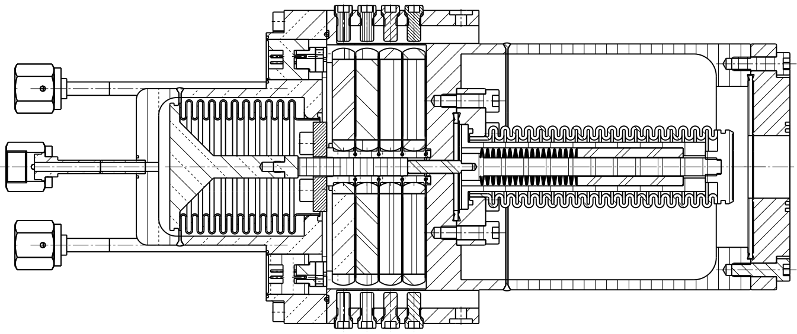
Current valve design
Kalrez seal
Ceramic valve stem
Injection volume
120V supply
Gas supply
Air supply
Closure volume
Nozzle
120V supply
Piezostacks
Copper seal
Disc springs

Slide 4
Current valve design
Valve properties
 | Valve Type 5
Gas reservoir [cm³] | 815
Max. gas pressure [MPa] | 7.2
Max. gas amount [Pam³] | 5868
Max. inj. Particles | 1.4*10²⁴
Opening time [ms] | < 2
Valve plate lift [mm] | 7
Nozzle diameter [mm] | 28
Size l [mm] x b[mm] x h[mm] | 140 x 110 x 292
Piezoelectric stacks | 8
Required air pressure [MPa] | 1.5
Closure volume [cm³] | 53

Slide 5
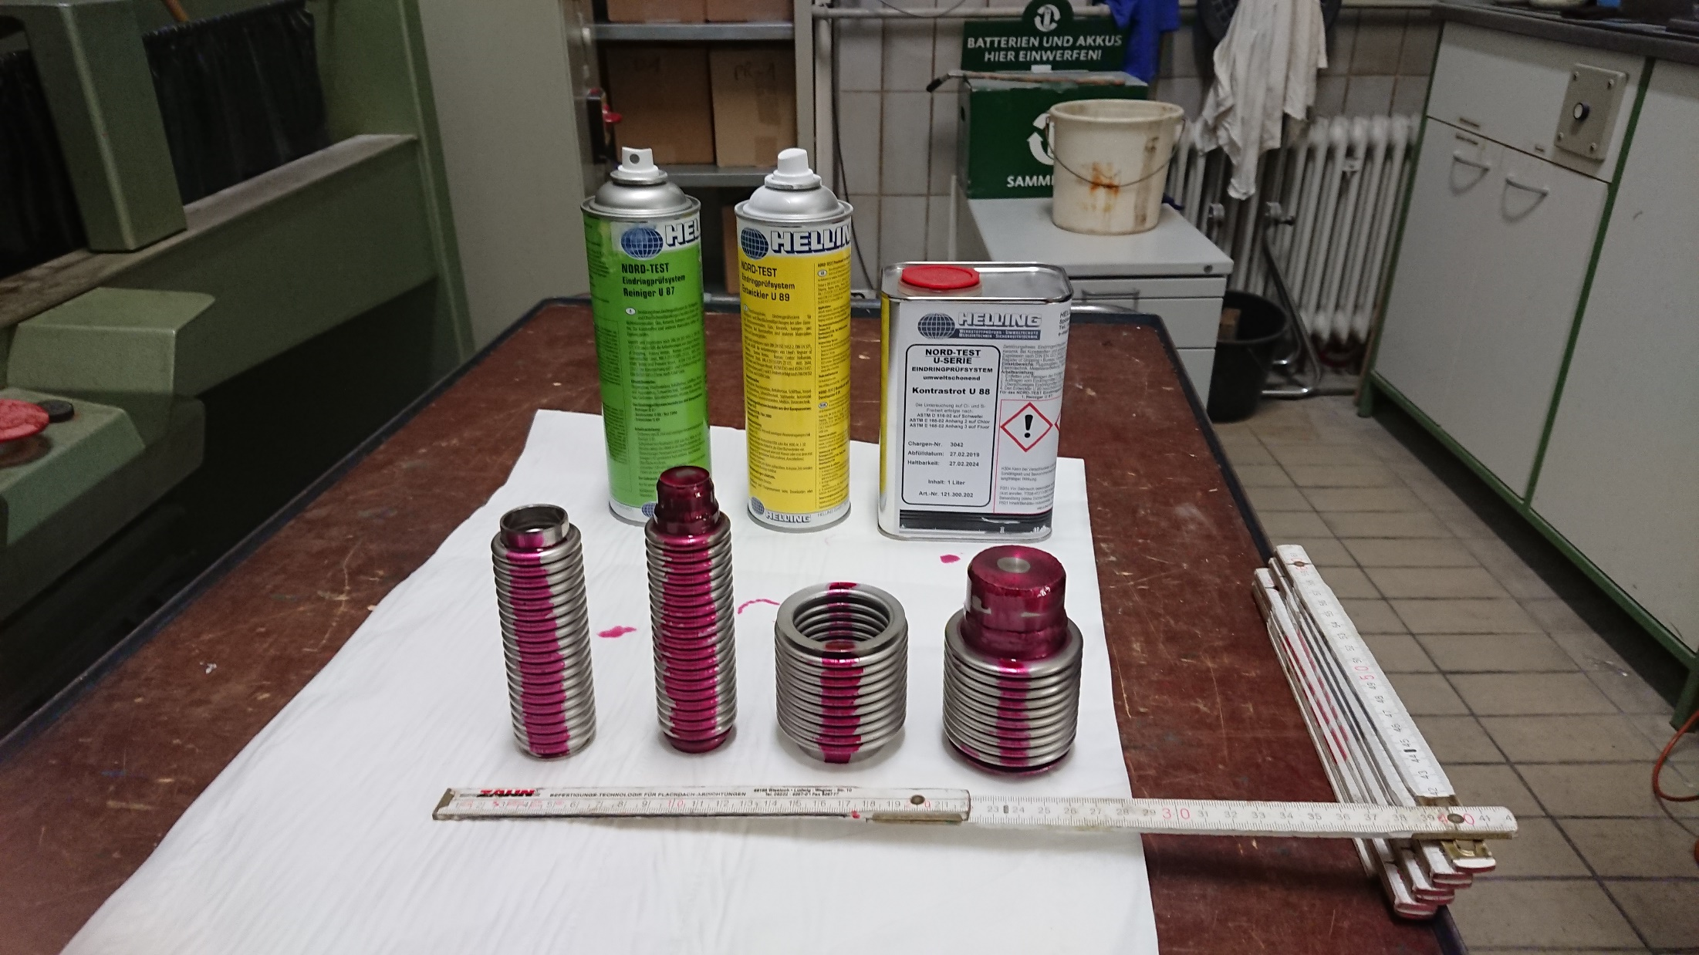
Current valve design
Dye penetration test for bellows and pressure test samples at TÜV
No cracks found in welds

Slide 6
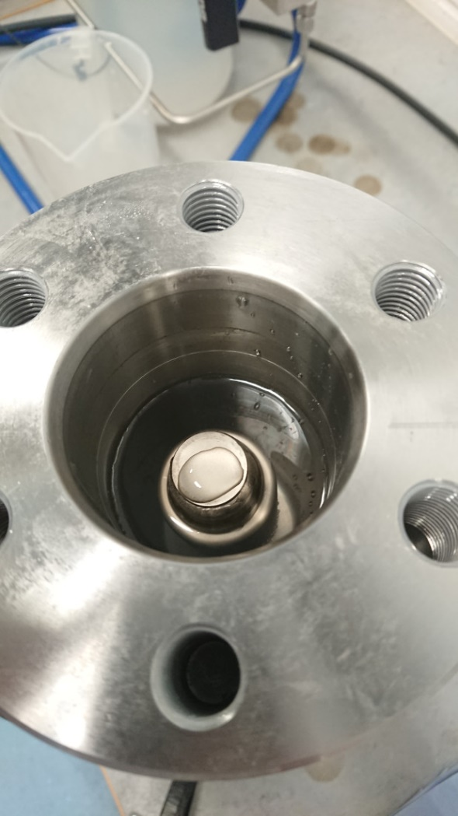
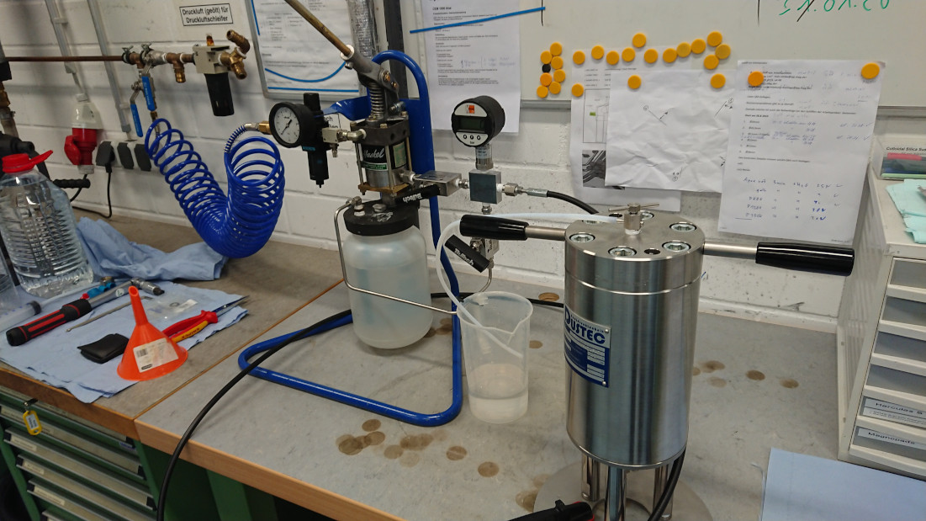
Current valve design
4 times pressure test of bellows performed in Greifswald:
Front bellows: P_{test} = 32.2 Mpa
Rear bellows: P_{test} = 6.05 MPa
No damage found after pressure test

Slide 7
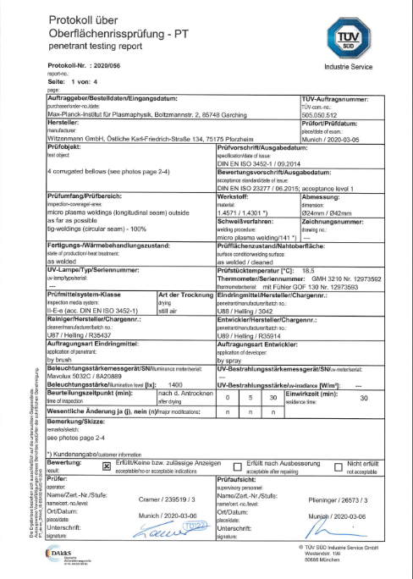
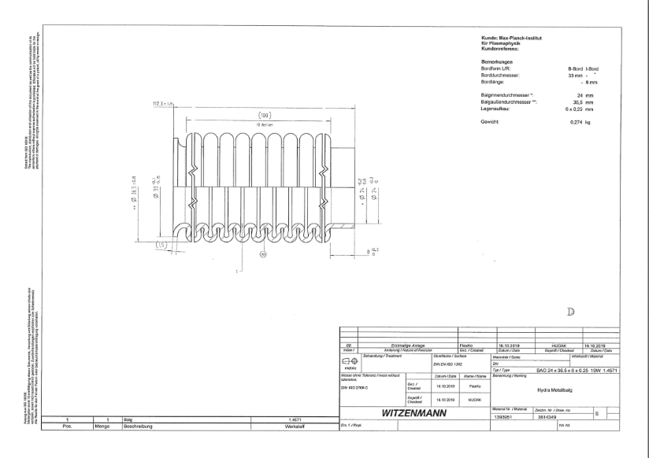
Current valve design
Documents for application of the bellows to Ibaraki Prefecture sent to QST
Structural drawing of each bellows
Structural drawings of each test sample
Visual inspection certificate of the bellows and test samples before the test
IPP welder certificate
Material certificates for every bellows
Material certificates for each attachment of the test samples
Qualification of the welding procedure of the bellows
manufacturer
Test protocol of dye penetration test
Test protocol of the 4 times pressure test

Slide 8
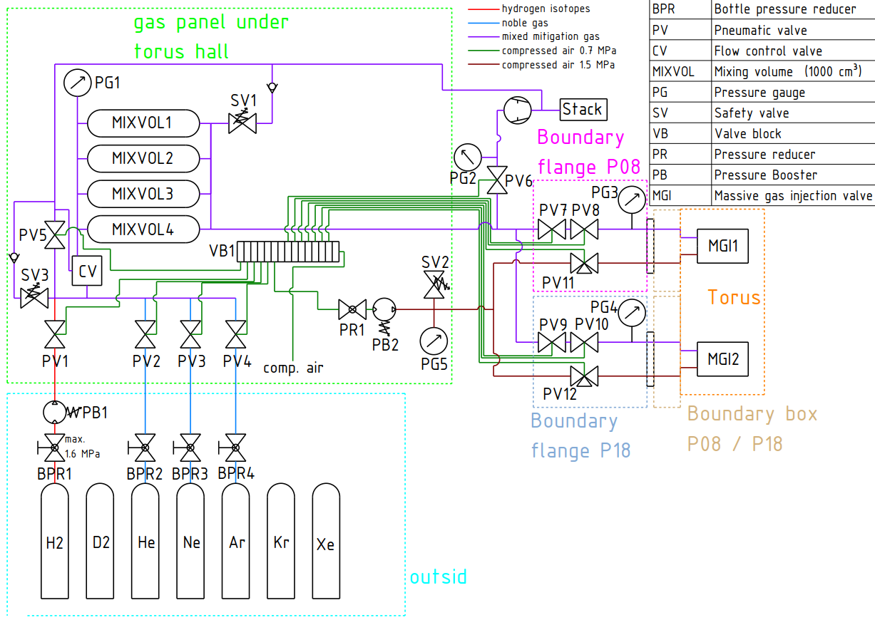
Gas preparation system

Slide 9
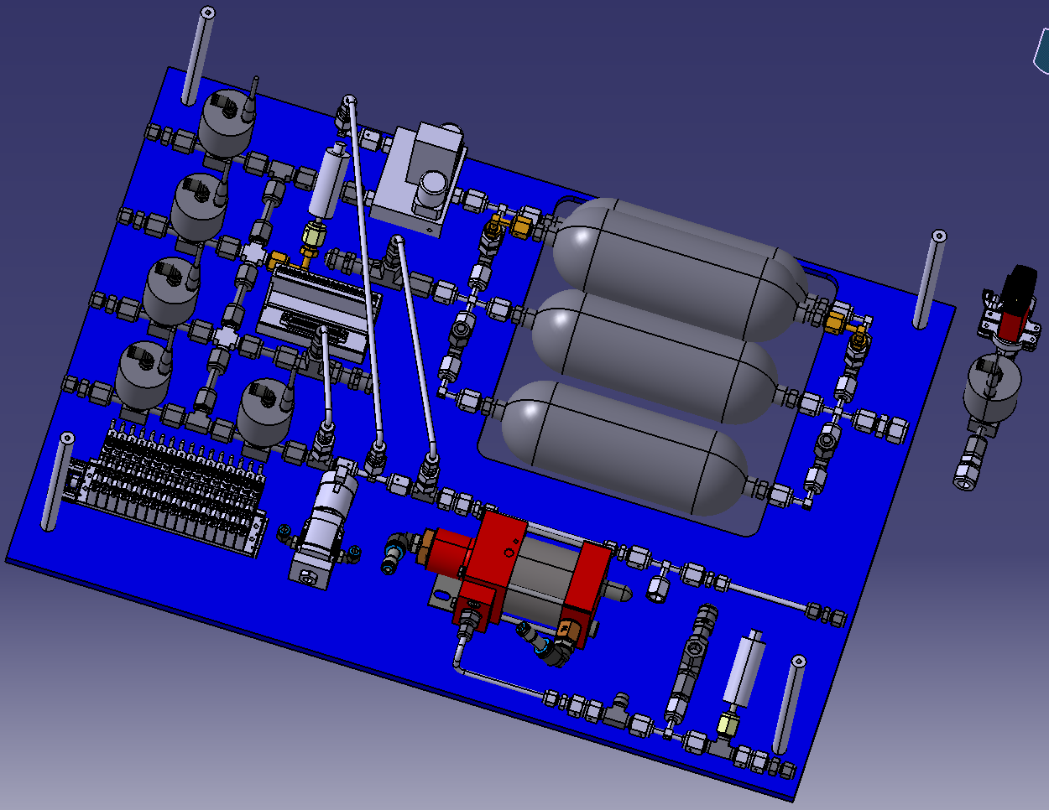
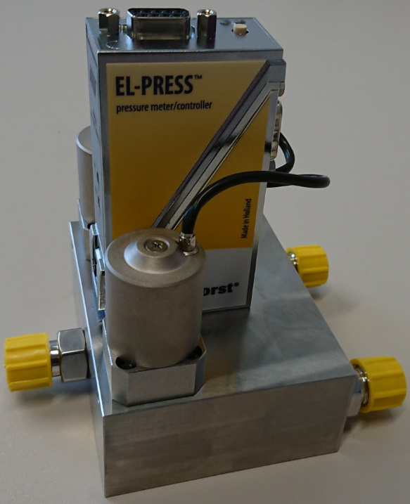
Gas preparation system
Introducing the EPC (Electronic pressure controller) for automated gas mixing
Check valves behind safety valves
Increased mixing volume due to shorter supply lines
Changed pressure gauges (original ones died at AUG)
Compressed air safety valve blows directly into pumping room
Pumping room radiation monitored
Air blow off into exhaust line not allowed (H2 in exhaust line)

Slide 10
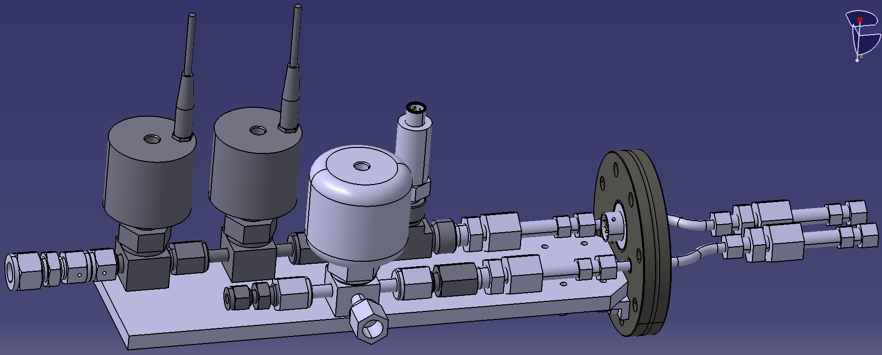
Vacuum feedthrough
3 way valve in compressed air line for blow off into torus hall
Changed pressure gauge
PVC support to relieve stress from fittings

Slide 11
Summary
MGI valve design finished, manufacturing drawings ready and checked by F4E
Pressure test and dye penetration tests of bellows successful
Gas preparation system modified for better automation and safety
Feedthrough flange modified for better structural integrity
MGI valve now under investigation by Ibaraki Prefecture
New gas panel and feedthrough flange under consideration by QST

