Slide 1
JT-60SA Enhancement Projects –
Cryopumps (CRP) Project Update
Sam Davis,
Nandor Hajnal,
Kazuya Hamada,
Volker Hauer,
Go Matsunaga,
Shigetoshi Nakamura,
Kyohei Natsume,
Carla Piccinni,
Santiago Ochoa,
Carlo Sozzi,
Holger Strobel,
Manfred Wanner
Chr. Day, for the CRP Team
WPSA Annual Meeting, 31 Mar 2020

Slide 2
Four party scope sharing
KIT under EUROfusion WPSA delivers the engineering design of the system, validation and according documentation.
F4E does the procurement and delivers the cryopump system hardware, utilizes KIT under EUROfusion for tight project monitoring.
  3.7 K coated cryopanels equipped with heaters fully cabled to the cable interface at the even-numbered lower vertical ports
  80 K base plate and thermal shield plates
  80 K chevron baffle, blackened (absorptive) where needed
  Temperature sensors attached and with cabling to reach the even-numbered lower vertical ports
  All parts required to mount the pumps and connecting to in-vessel cryopiping at the odd-numbered lower vertical ports
QST provides:
  the electric feedthroughs
  the recording of the signals, conversion and control.
  Isolation of the cryopumps from the cryostat by potential breaks in the supply pipes
  The power supplies of the heaters
  The cable trays for the heater and sensor cables to guide them from the odd to the even numbered lower ports
New items

Slide 3
Cryopump environment
Contract: 9 identical cryopump units + 1 spare
40° sector

Slide 4
CAD model - Full assembly

Slide 5
CAD model – Chevrons removed

Slide 6
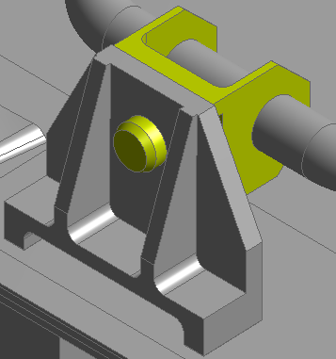
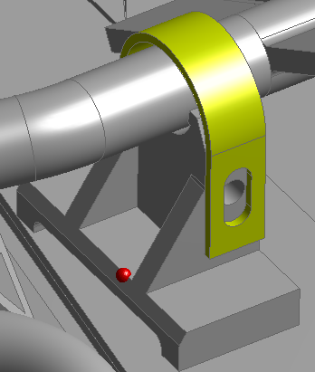
CAD model - 4K-supports
Sliding supports allow the contraction/expansion/rotation of the 4K panel

Slide 7
CAD model – 80K-supports to vessel
must be adapted to the actual curves of the vessel
Free movement in direction of the yellow arrows.

Slide 8
FEM simulations – schedule and status

Slide 9
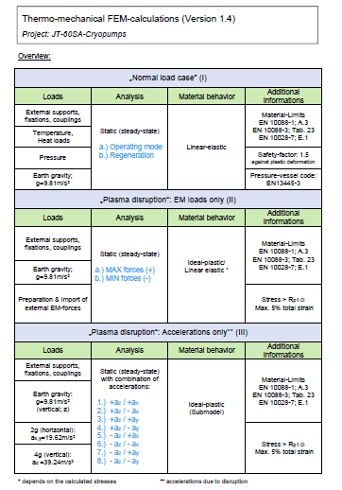
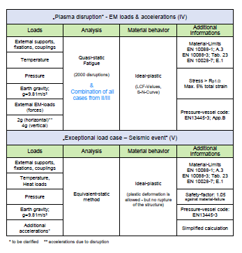
FEM simulations – Load cases

Slide 10
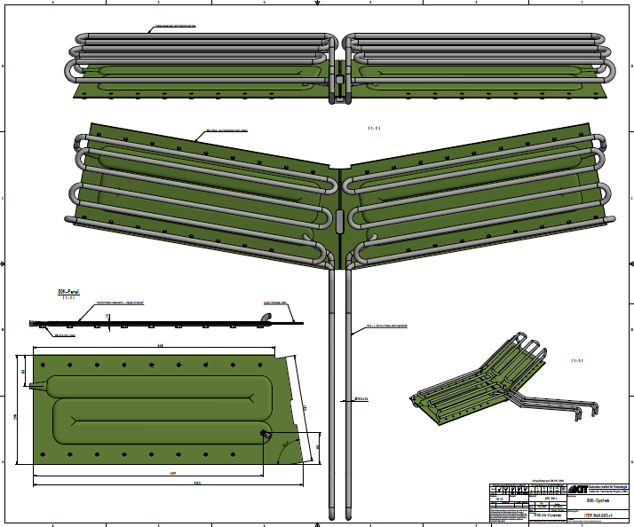
2D drawing for CfT – 80 K system

Slide 11
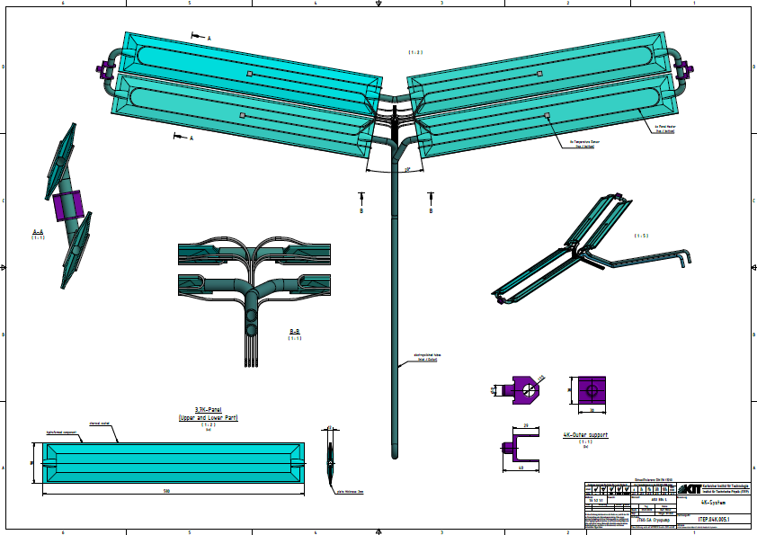
2D drawing for CfT – 4 K system

Slide 12
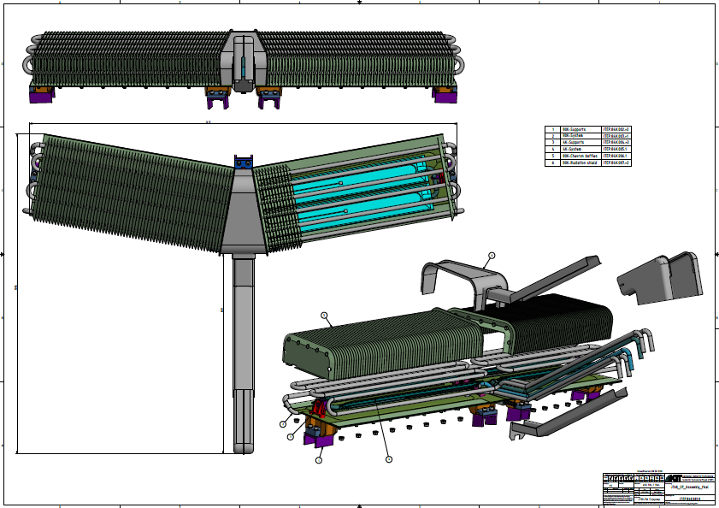
2D drawing for CfT – Full assembly

Slide 13
Present detailed design status
Critical thermomechanical analyses are closed, no further issue remaining.
Remaining analysis to be done is seismic (started).
Then, final report will be compiled (200 pages +).
Interfaces with QST have been clarified (connection with cryopiping, feedhrough ratings for heater and sensor cables, cable trays even/odd numbered lower ports).
CAD model has been re-integrated and clash check performed, found 6 clashes which were resolved in a meeting with QST. Design amendment actions partly still ongoing (minor changes).
Current CAD model is considered as sufficiently final to be used for Call for tender.
Re-import from ANSYS to CATIA ongoing.
2D drawings for call for tender under final iteration.
BA_D_255UTZ

Slide 14
Present management status
Call for tender policy changed: Now, only one contract for everything, one main supplier + sub-contractors.
Elaboration of Call for Tender Annex B (Technical Spec) has seen various iteration loops, is now in a very close to final status.
Elaboration of Call for Tender Annex A (Management Spec) is in a close to final status.
PA Annex B Tech Spec with QST still not approved, to be finalised (recent points Matsunaga-san, Natsume-san, Hamada-san), solutions have been agreed. The next version v1.2 to come very soon will then be the final one.
IMPORTANT: Make sure that the CfT Annex B is well in line with the PA Annex B, to have no surprises in the end.
PA and PA Annex A is on IDM for signature.
PA Annex B [T.R.72.] and Article 4.2 Annex A - Drawings and technical specifications sent to suppliers defining the design for manufacture shall be approved by QST.
This meeting / design review has not yet taken place, but will take place the latest when we have the manufacturing drawings.
BA_D_29VESF
BA_D_28GA8M

Slide 15
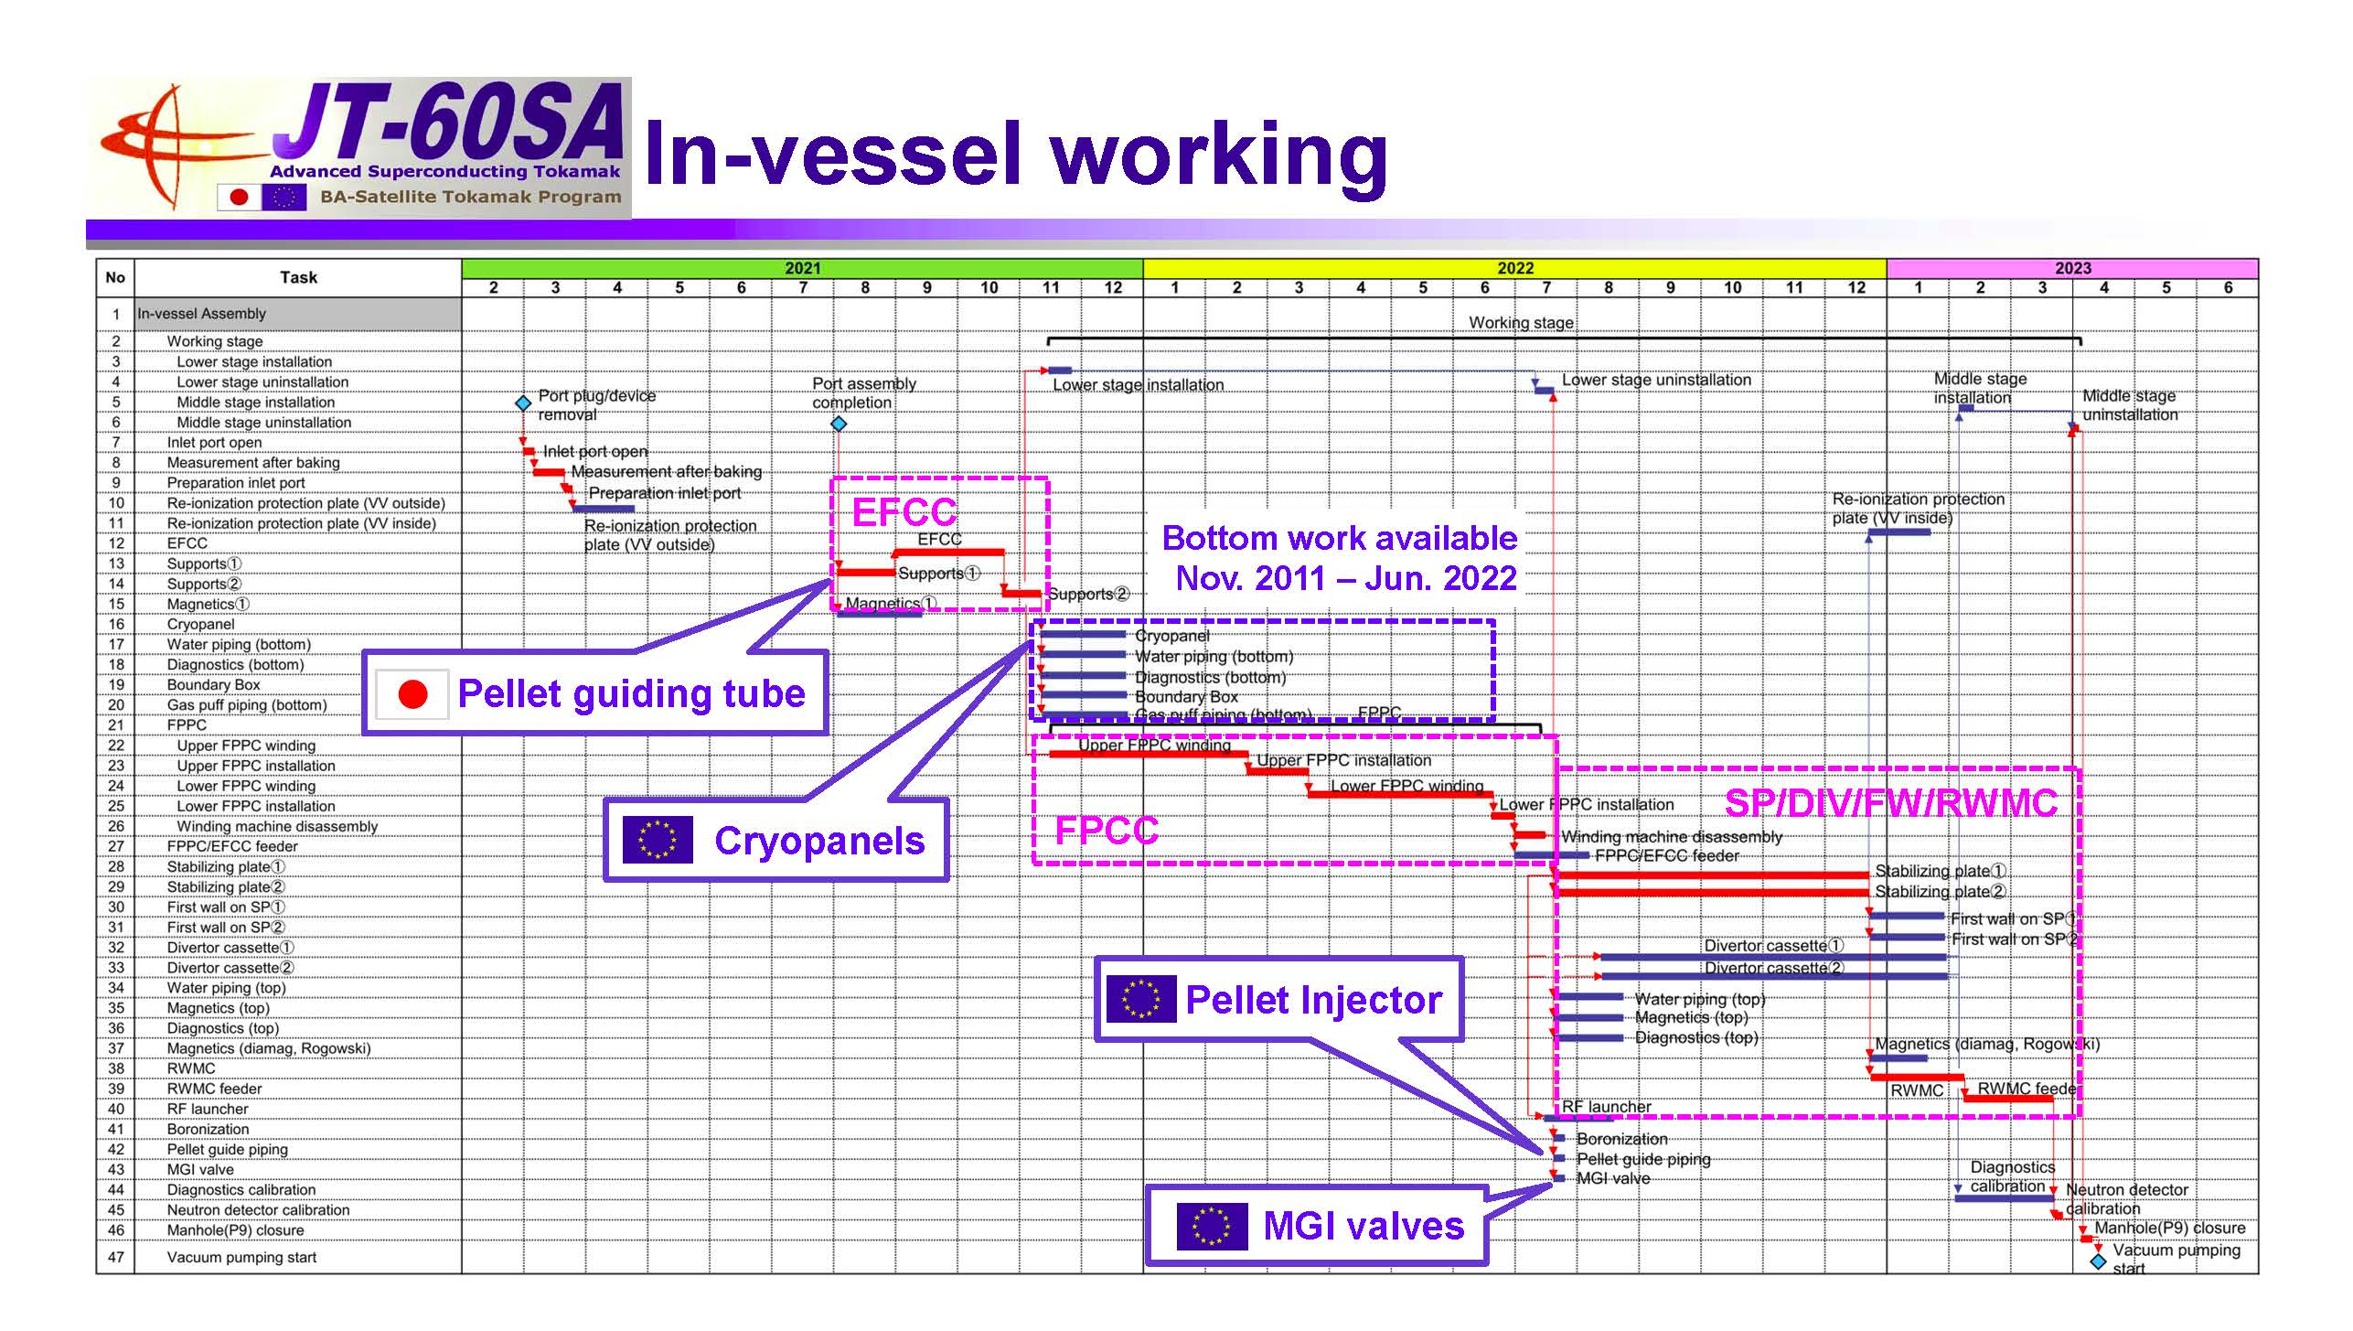
QST timeline (from 2019, assumed to still hold)

Slide 16
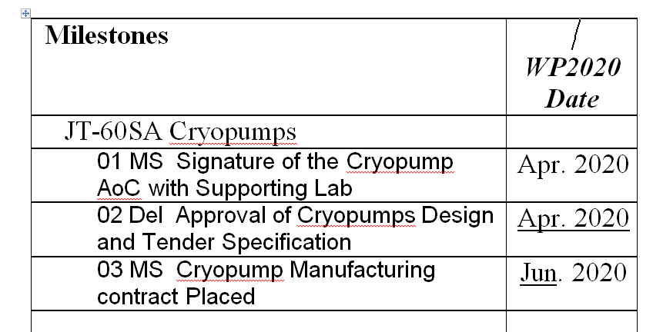
Work Plan
High level milestones as per updated BA II work plan 2020
Stage | Activity | Initial Plan 10/18 | Updated 1/19
1 | Set-up of contract documents F4E | Q1/2019 | Q1/2019
2 | Detailed design | Q2-Q4/2019 | Q4 /2019
3 | Drawings and call for tender | Q1-Q3/2020 | Q1/2020-Q2/2020
4 | Manufacturing, FAT, delivery, project control and monitoring | Q4/2020-Q1/2022 | Q3/2020 – Q3/2021
5 | Installation | Q2/2022 | Q4/2021
6 | Commissioning | 2023 | 2022
~ Still holds
(delivery 10/2021)

