Slide 1
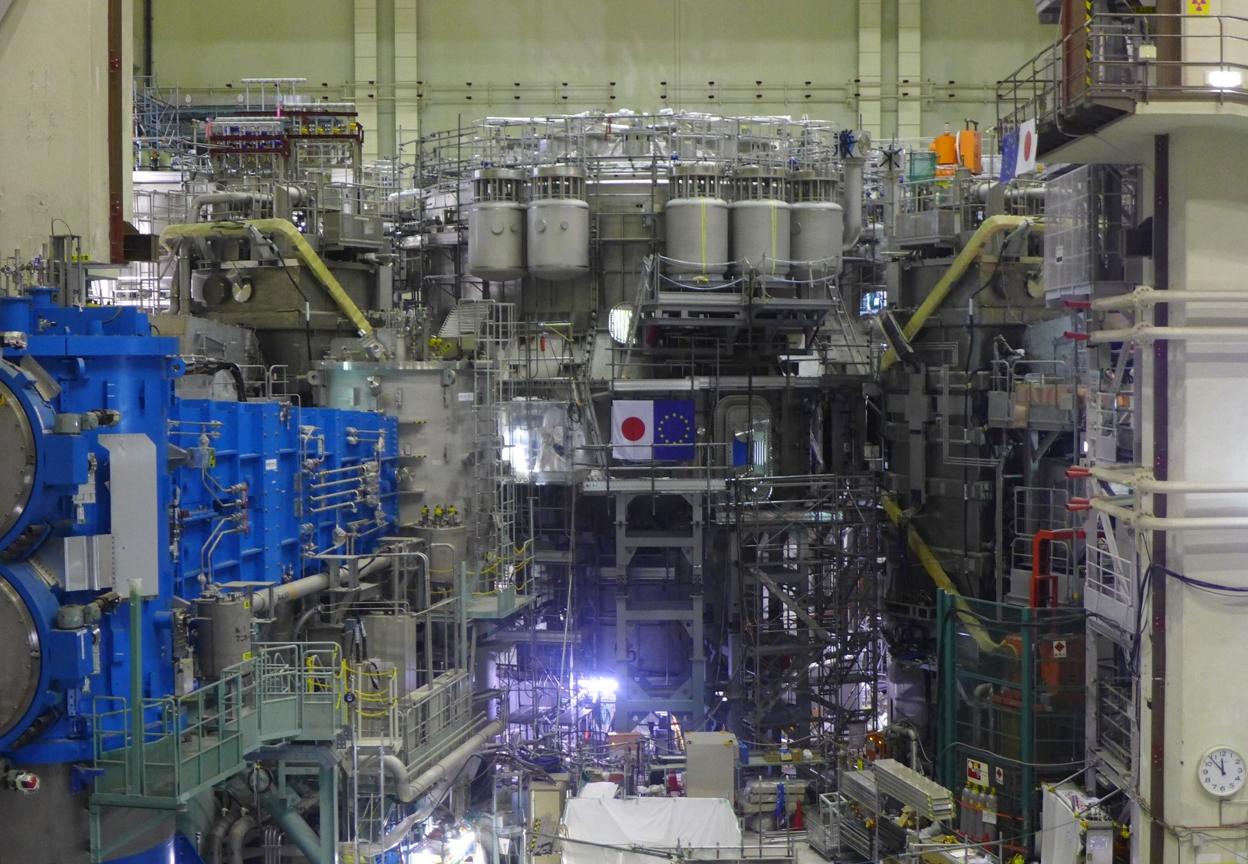
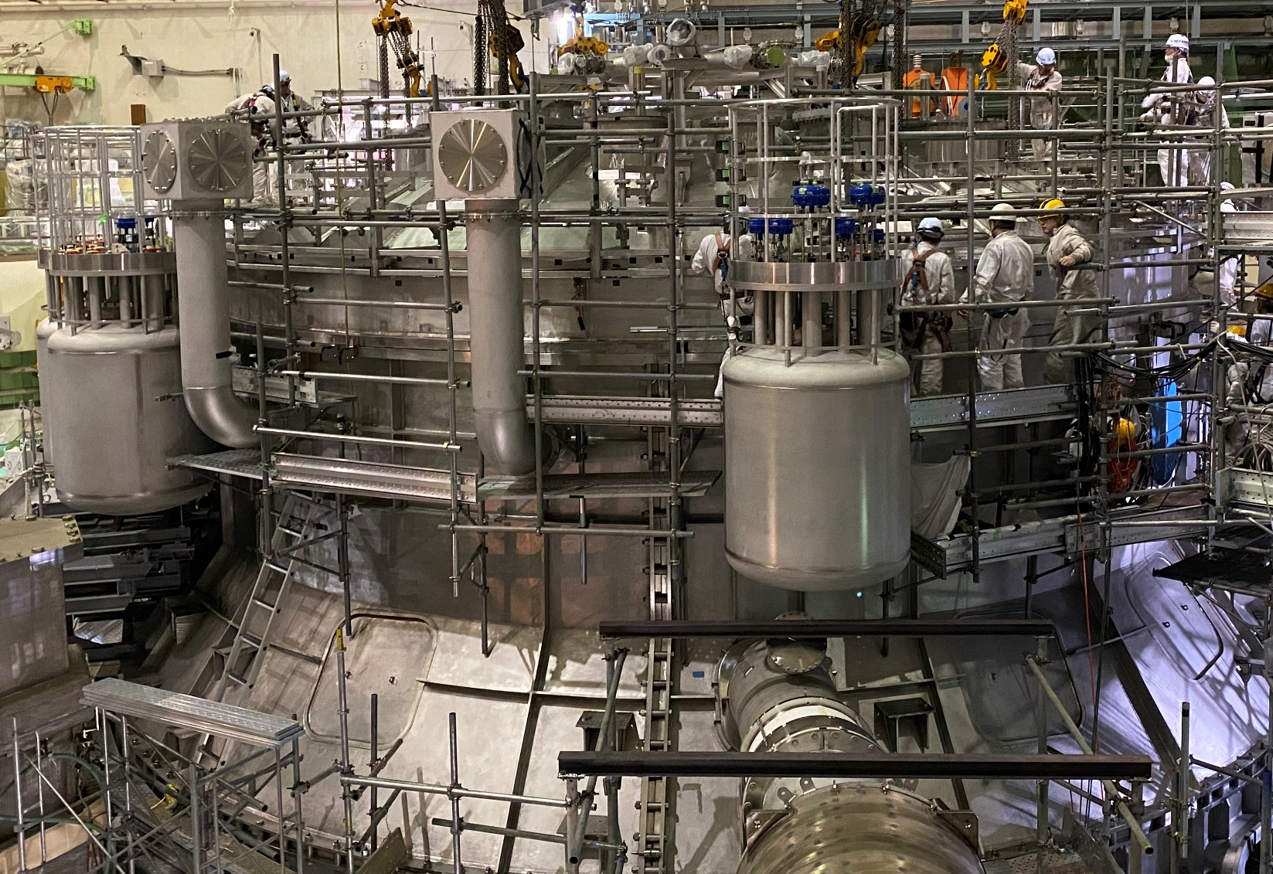
F4E enhancement plans
Sam Davis WPSA Project Planning Meeting 31 March 2020

Slide 2
Phase II formally released
Joint Declaration by the Government of Japan and EURATOM on 02 Mach has formally released BA phase II
No fixed end point; resources released annually
JT-60SA project plan has changed quite a lot in the last year, primarily due to budget constraints
Aim is to maximise achievement of research goals with the available money

Slide 3
EU enhancements in current project plan
EDICAM | Installed; operational summer 2020
Massive gas injection Divertor cryopumps Pellet launching system Thomson Scattering VUV divertor spectrometer Error field correction coils power supply ECRH waveguides & power supply Fast Ion Loss Detector (2024) | Live projects Delivered alongside major enhancements to heating systems, diagnostics and in-vessel components by QST for operation in 2023
Phase contrast imaging Doppler reflectometry | Concept design (not explicitly in project plan yet – under “advanced diagnostics”)
Actively cooled divertor | F4E concept; see TCM 35 Implementation strategy TBD Installation after 2025

Slide 4
Other news
03 Feb | Welcome Carla Piccinni to Garching
23 Mar | Contract for TS fibres awarded by F4E
31 Mar | EDICAM port plug installation underway
01 Apr | Sam Davis relocated to Naka
08 Apr | New time for enhancements co-ordination meeting: Wed 08:30 CEST / 15:30 JST

Slide 5
Challenges for EUROfusion enhancements
Part time work and conflicting priorities
Lack of project management culture and engineering capacity
EUROfusion rules not clearly understood by all project leaders – most often regarding reimbursement but also regarding accessing resources
Underestimation of resources required and lead times for activities
Delay to the Joint Declaration by the government of Japan and EURATOM on BA phase II (achieved 02 March 2020)
Simultaneous changes to framework conditions (e.g. MoU, JA-EU-IO Trilateral Agreement)
“Enhancing” a machine under assembly
Japanese High Pressure Gas Law
Critical to deliver hardware on time!

Slide 6
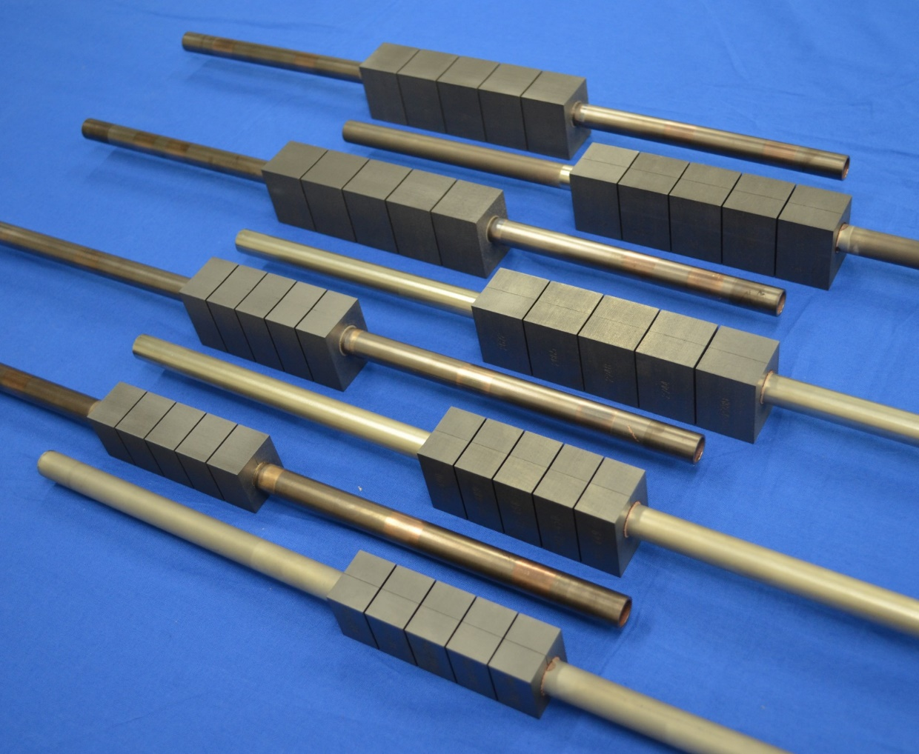
Divertor
Lower divertor operating in 2023 will have graphite tiles and intershot cooling, limiting duration of high power pulses
Tungsten plasma facing components are planned after 2030
CFC monoblock in between is risky, very expensive and considered bad value

Slide 7
New actively cooled divertor concept
Hence F4E intends to develop and build a new non-monoblock concept which allows the plasma facing material to be changed
preserving the original scientific requirements
introducing aspects of maintenance relevant for DEMO and power plant scenarios.
Requirements:
Remain within available budget
Withstand steady state operation at 10MW/m2
Withstand a limited number of short pulses at 15MW/m2
Ease of maintenance by avoiding in-vessel cutting and welding of pipes
Ease of PFC material upgrade by removable target assemblies
As a new concept, rapid proof of principle testing will be essential
Further details of some of the concepts being considered may be discussed during TCM 35
(illustration shows one possibility only)

