Slide 1
JT60-SA
Thomson scattering status
01-04-2020
Roberto Pasqualotto
for the EU-TS team

Slide 2
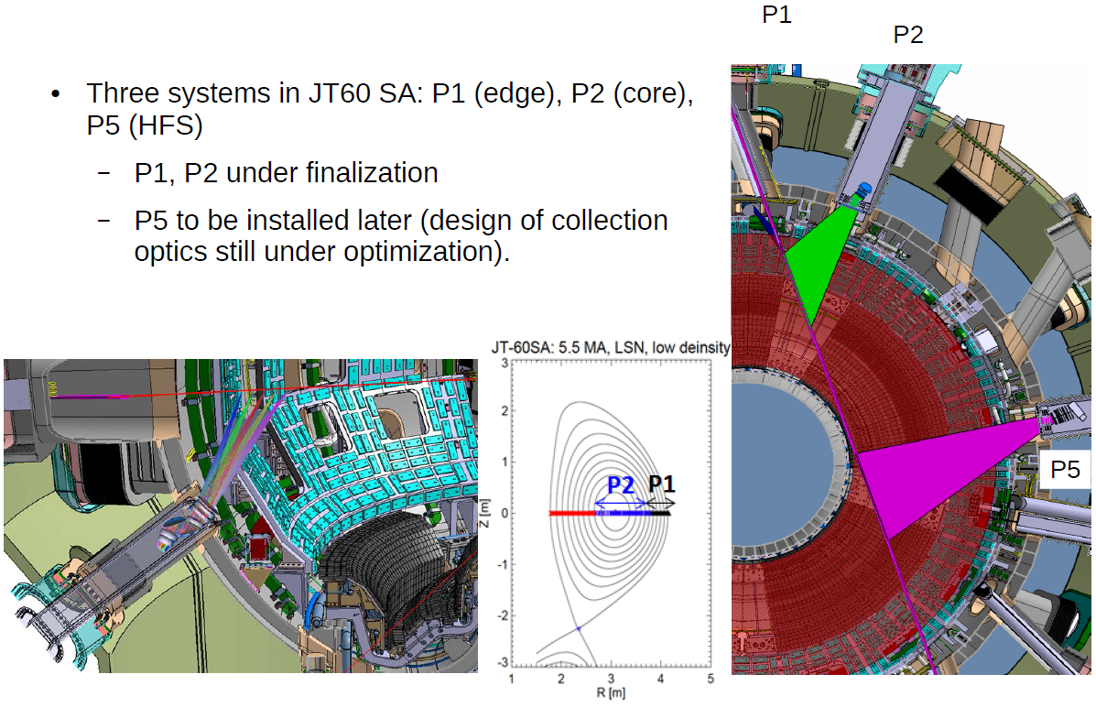
Thomson Scattering in JT-60SA
- Divertor TS (not shown) in the wish list

Slide 3


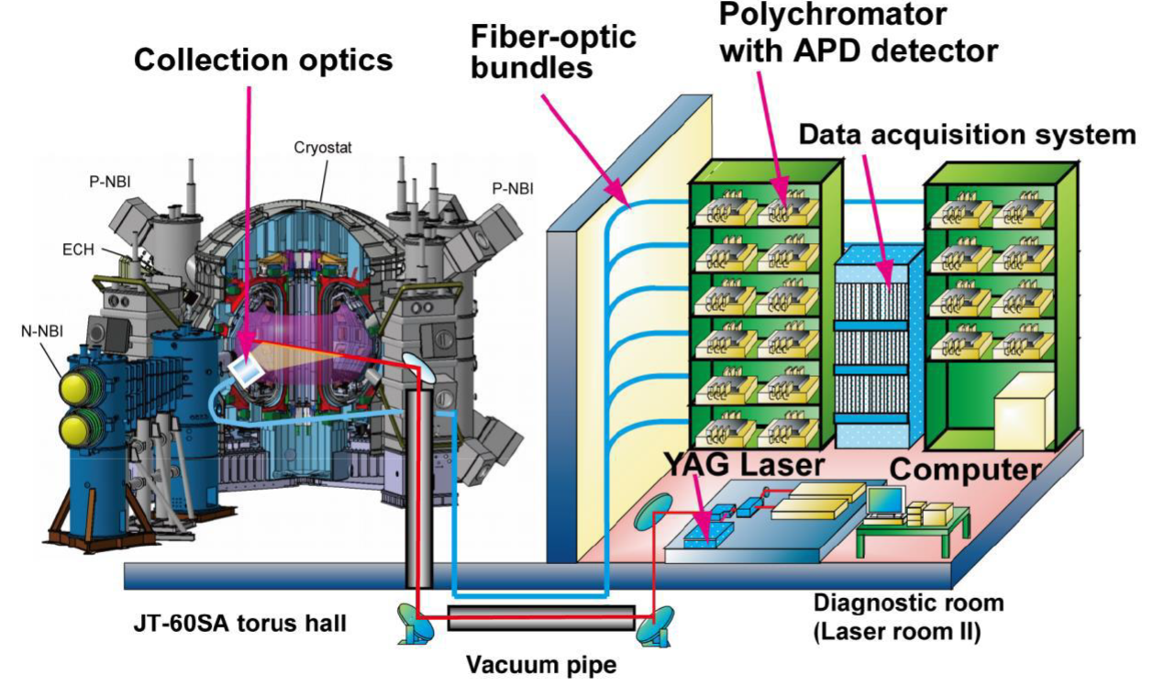
TS diagnostics layout in JT60-SA
CORE&EDGE
EDGE
CORE
CORE&EDGE
CORE&EDGE
installation
EDGE
CORE&EDGE
CORE&EDGE
CORE

Slide 4
Performance requirements
The core TS system (P2) shall measure electron temperature Te and density ne profiles
46 positions from R=2.6m to R=3.725m,
scattering volume length 15 mm ; nominal value from fiber bundle magnification
radial spatial resolution (points distance) 25 mm
dynamic range 0.1-30 keV
Laser pulse repetition rate will be 50 Hz.
The edge TS system (P1) shall measure electron temperature Te and density ne profiles
50 positions from R=3.7m to R=4.17m,
scattering volume length 5mm; nominal value → < 10 mm required incl. optics blur
radial spatial resolution (points distance)
25 mm at R<3.9 m, 5.5 mm at R>3.99 and 10 mm in between
dynamic range 0.01-10 keV.
Laser pulse repetition rate will be 100 Hz.
For both systems:
The accuracy is expected to be better than 10% for T_{e} and 5% for n_{e}, at n_{e} = 1 x 10¹⁹ m⁻³ (from simulation) → Best Effort

Slide 5
Status design & procurement prep.
Annex B for PA
Signed in Jan 2020 to allow Fiber procurement
Fibers
Fiber path reduced
F4E tender launched 17 October, contract awarded on 23 March to Polymicro-Molex
Polychromators
Specifications for F4E tender in Feb 2020: P1 spectral range from 660 nm
F4E tender (negotiated procedure) Feb-Jun 2020
Optics edge TS (P1)
Specifications for EF procurement in Dec 2019
Two stage contract: competitive design + manufacturing
On hold since February: issue on EF reimbursement rules
Mechanics edge TS (P1)
CAD design and FEM analyses nearly completed,
preliminary negotiations with one manufacturer started

Slide 6
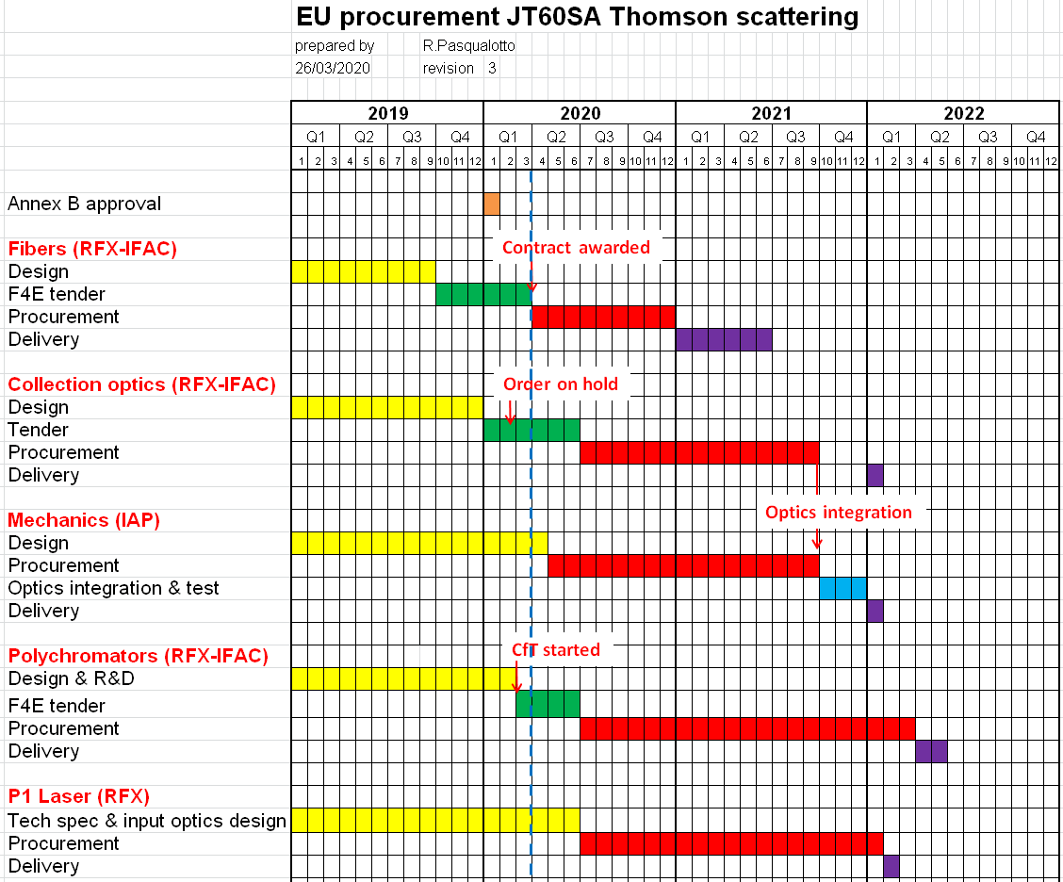
PLANNING
Impact of COVID-19 on manufacturing ?

Slide 7
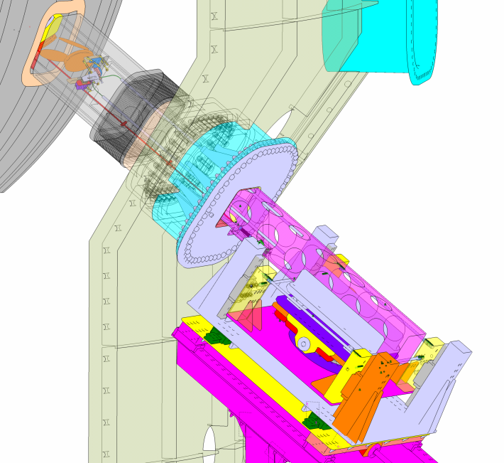
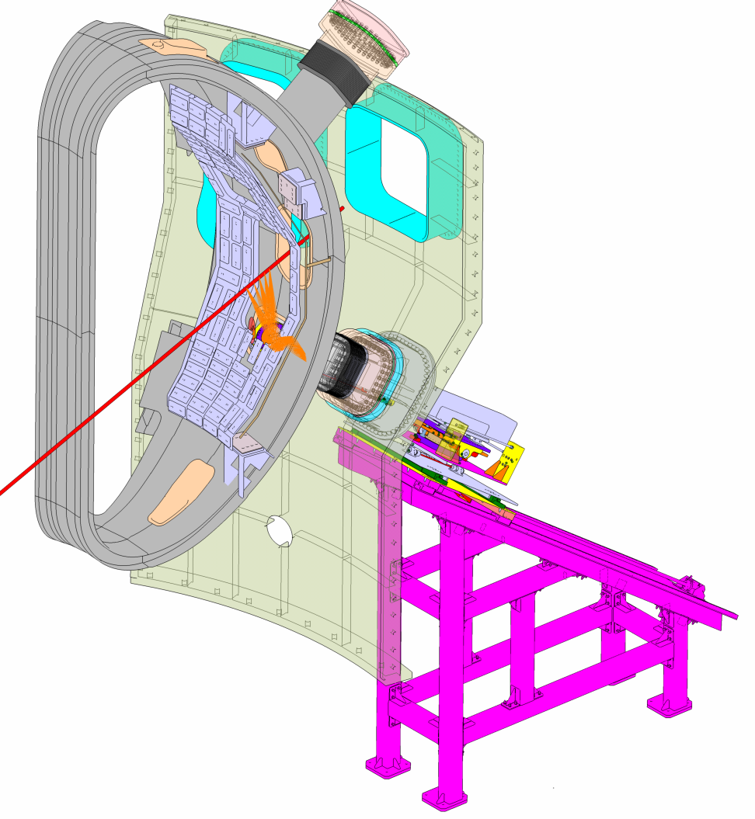
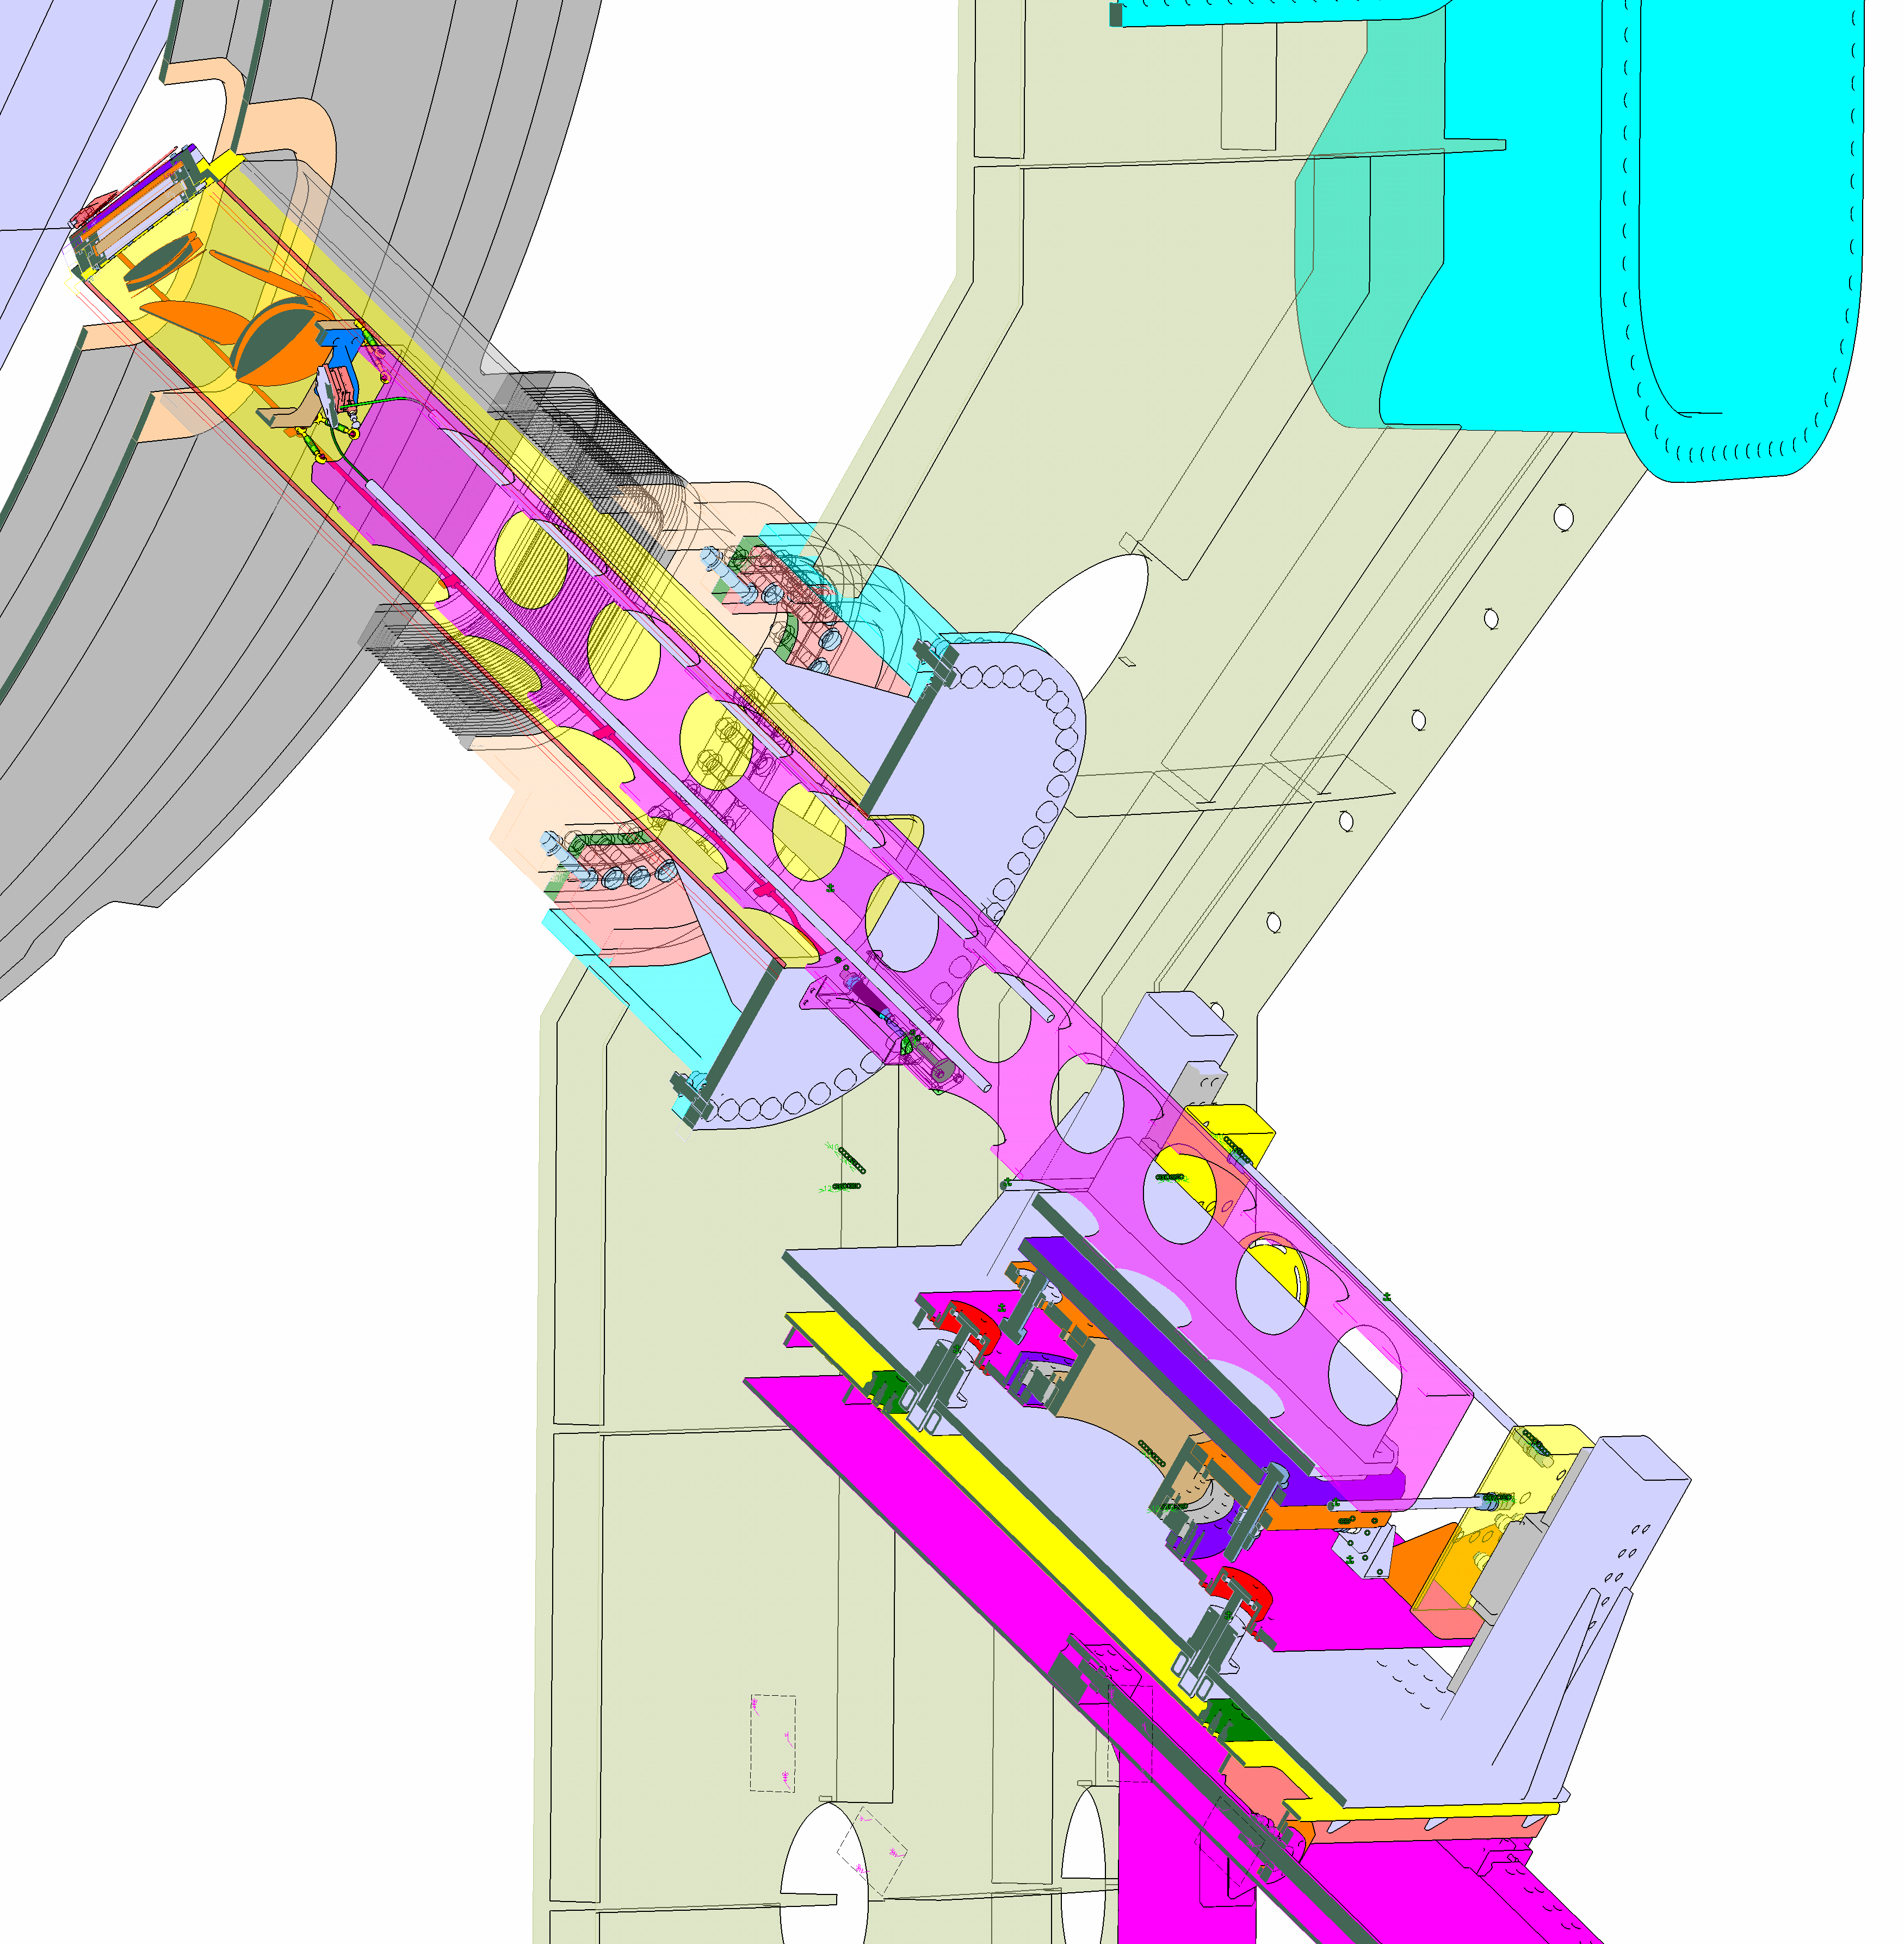
Edge TS – mechanical structure
Collection optics on a retractable arm
Decoupled from cryostat
On supporting structure standing on floor
Same structure to install port plug
Vacuum window & shutter
Collection optics
Supporting structure
Retractable arm

Slide 8
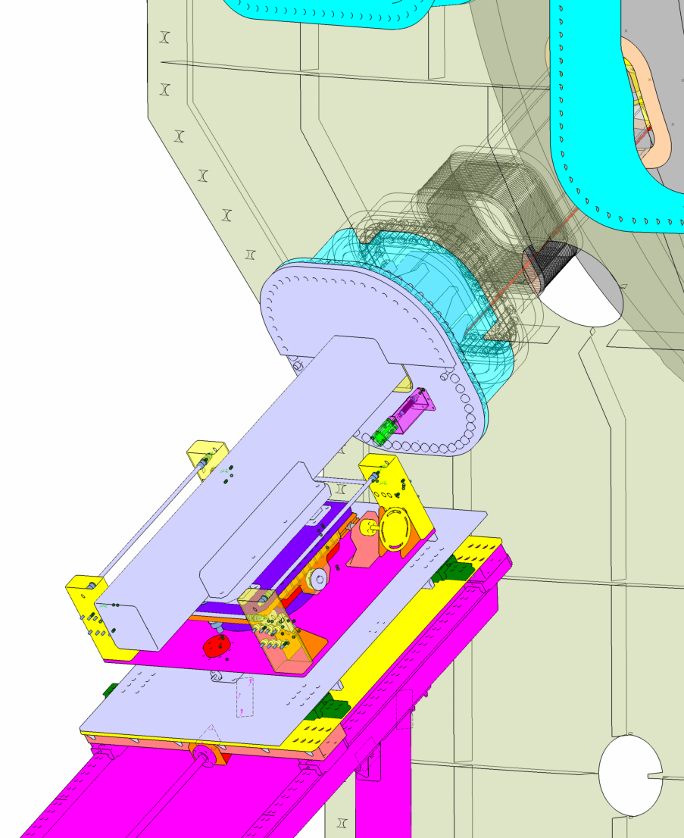
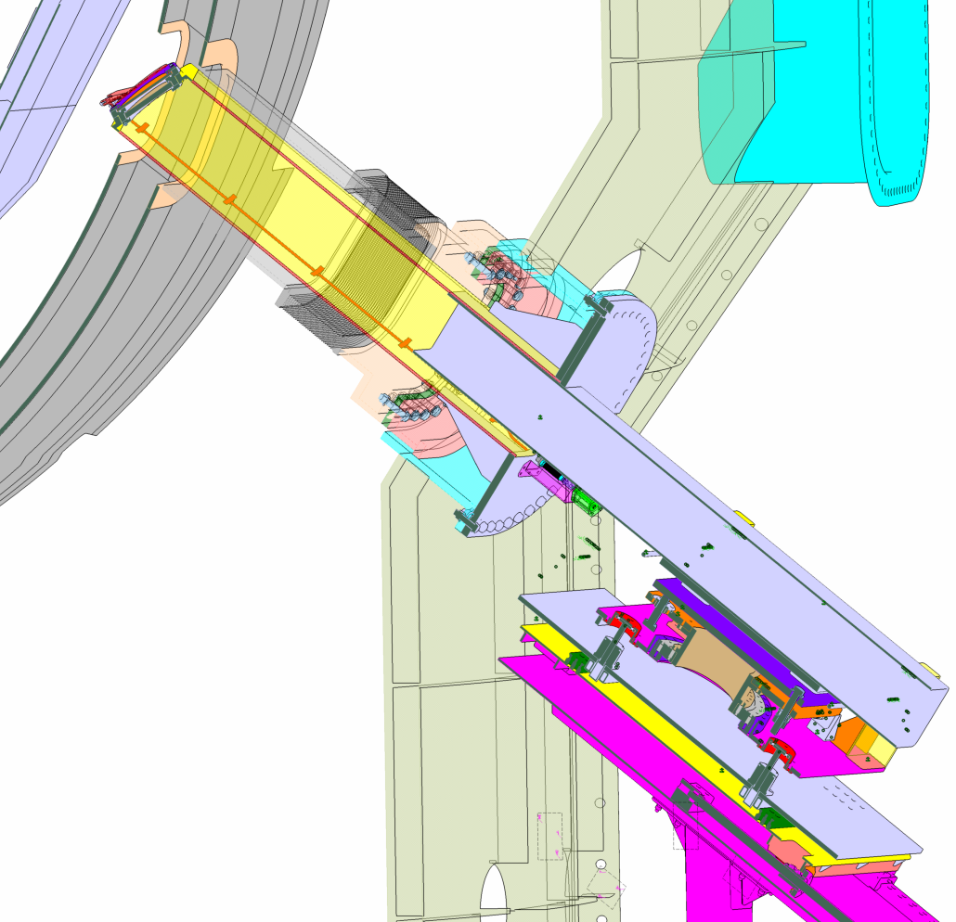
Edge TS – mechanical structure
Port plug fixed to insertion tube held by same trolley

Slide 9
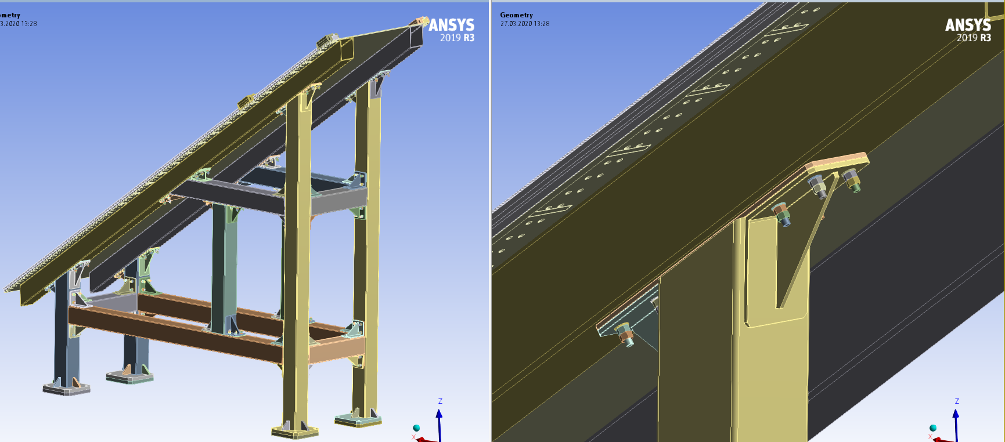
Edge TS – mechanical structure
Supporting structure assembled by bolted components
to fit in the tight space
Installation procedure in progress

Slide 10
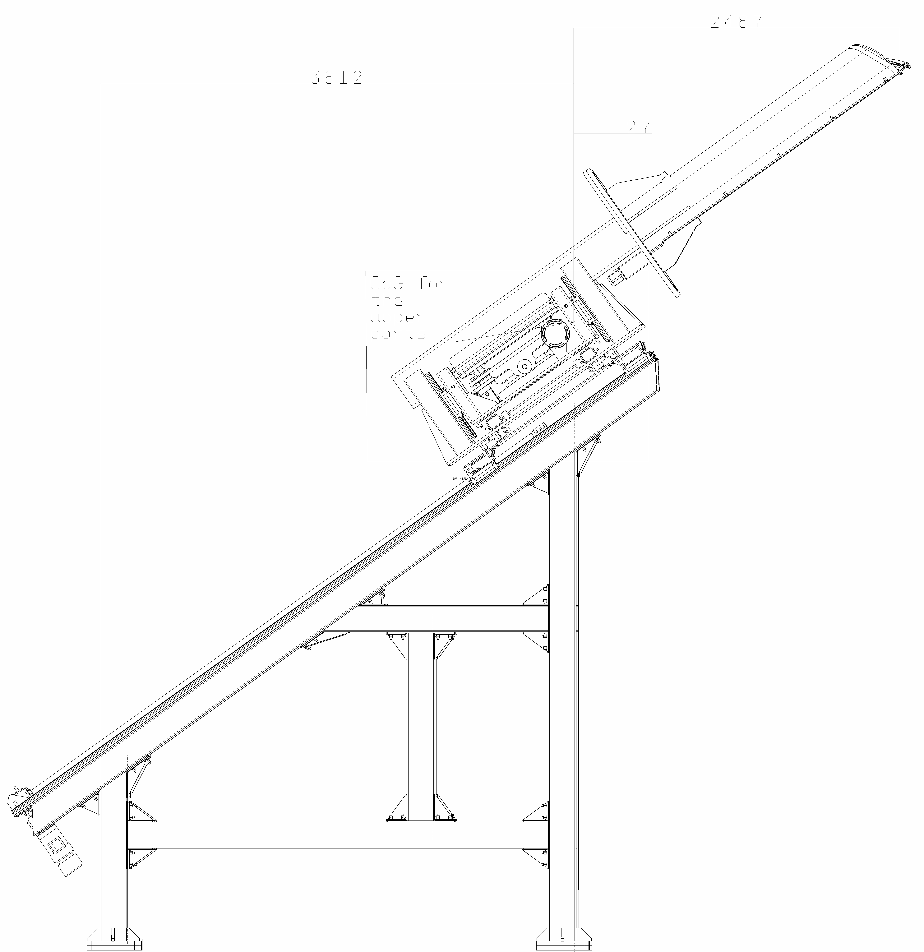
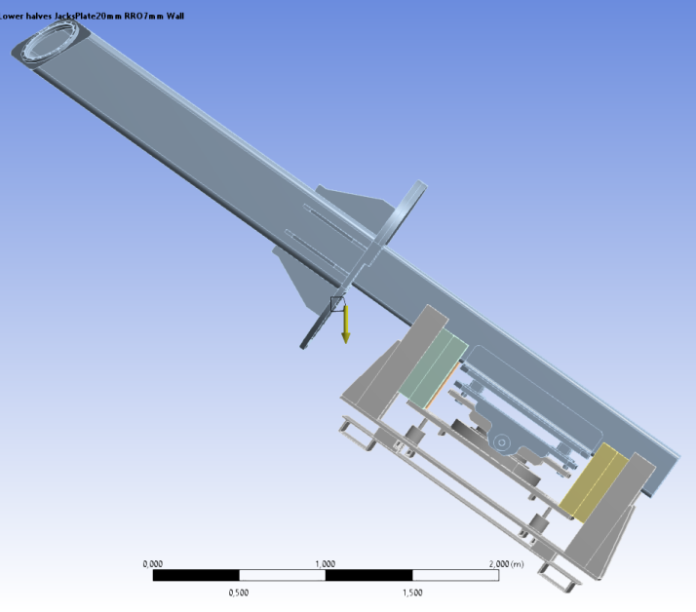
Edge TS – mech. structure weight
Weight
  Port Plug: 650 Kg
  Insertion Arm: 405 Kg
  Trolley*: 2000 Kg
  Support structure: 2250 Kg
  * so heavy to carry the port plug
CoGravity
P.Plug+
inser.tube+
trolley
CoGravity
P.Plug+
inser.tube

Slide 11
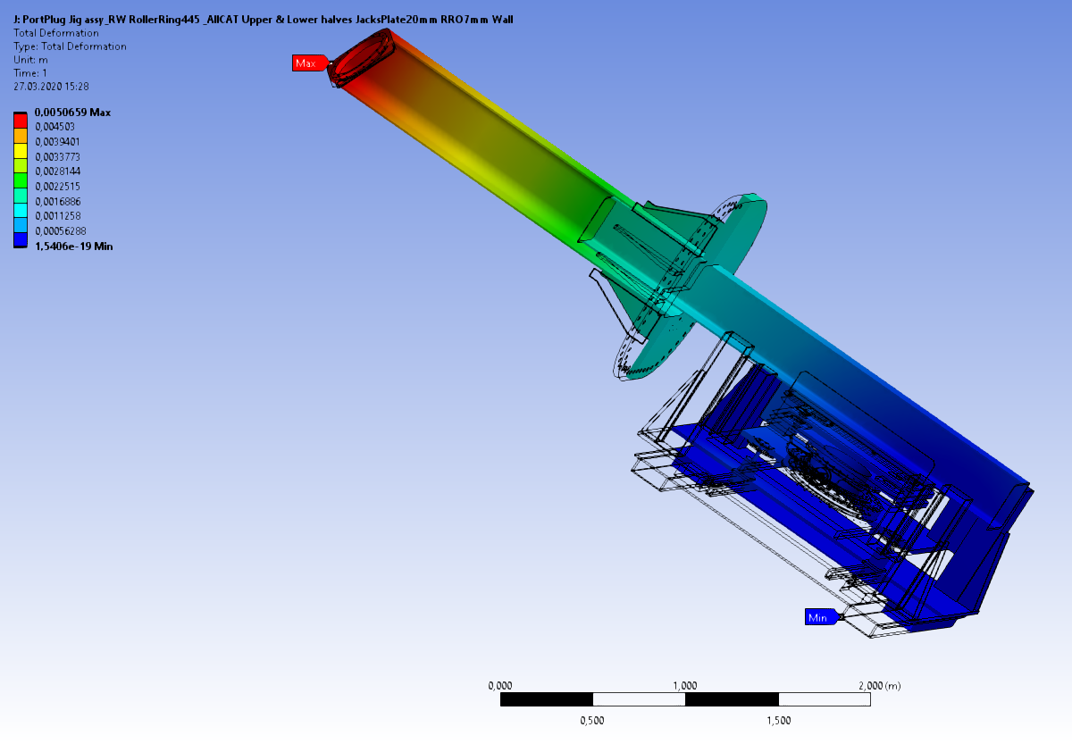
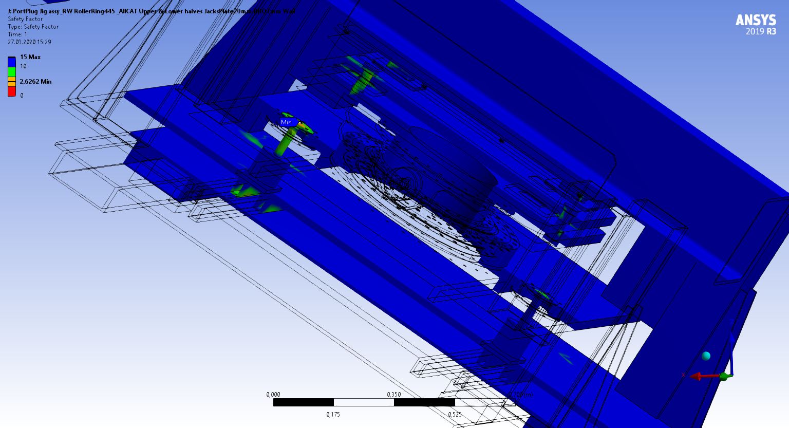
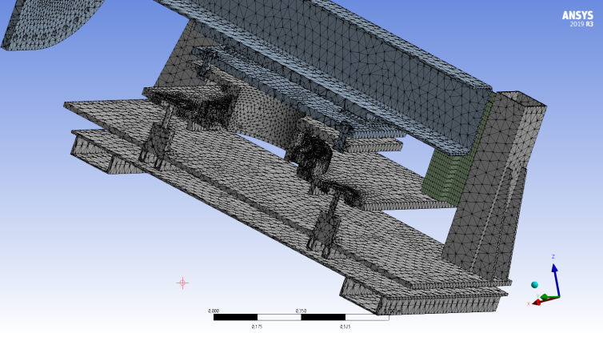
Edge TS – mech. structure FEM analysis
Acceptable port plug bending and safety factor before plastic deformation,
but significant weight increase
Total deformation(tip)
max 5mm
Safety Factor min 2.6

Slide 12
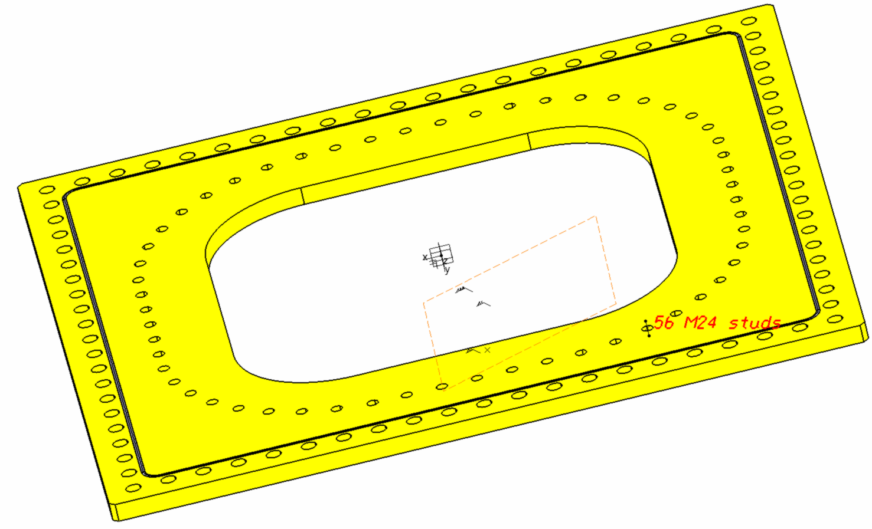
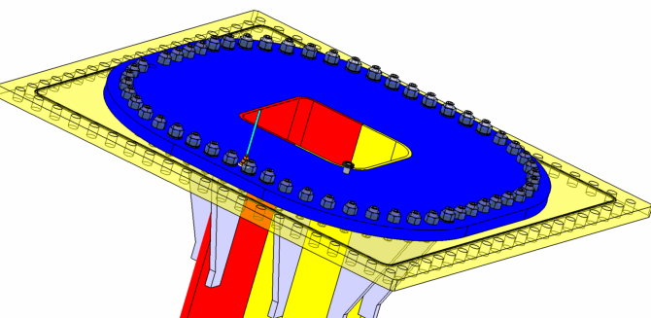
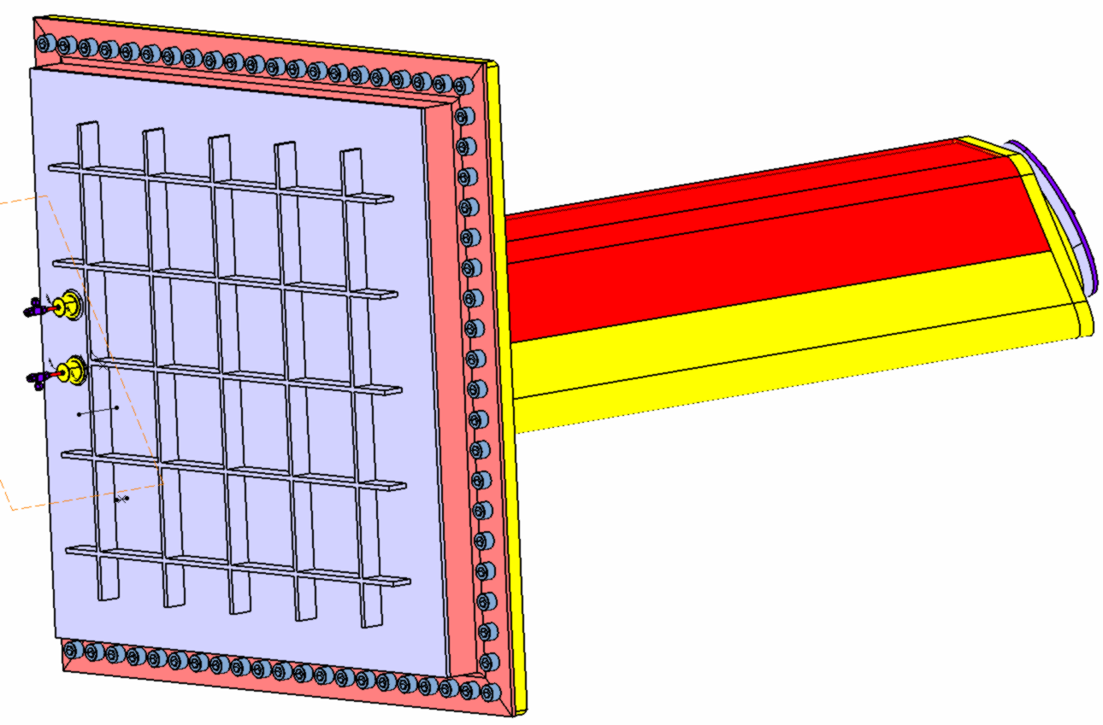
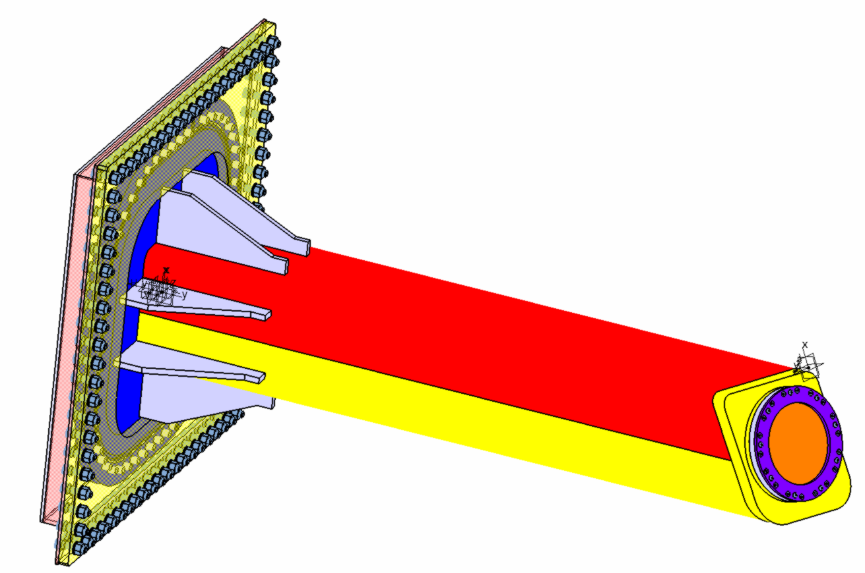
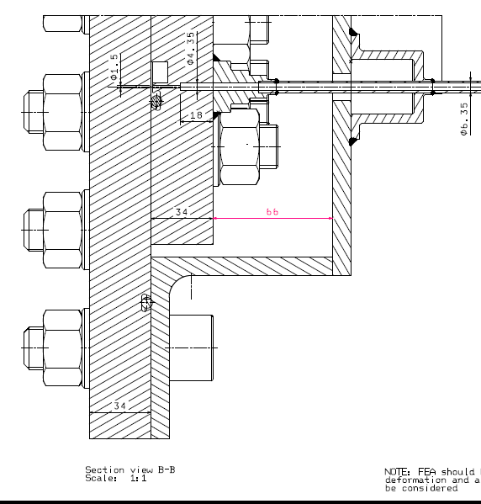
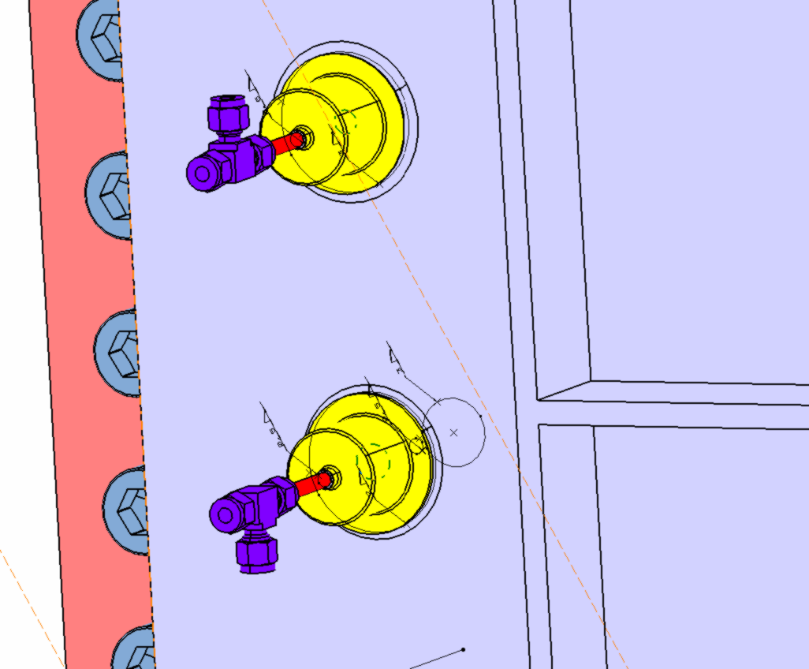
Edge TS – port plug vacuum leak test
Check port plug vacuum tightness without a large vacuum chamber
Port Plug He leak tested by “tent procedure”
Port Plug with Lid filled with He, 1.2 bar over-pressure
Also O-rings interspace is monitored
Pressure gauge
He inlet
For inter-groove He leaks

Slide 13
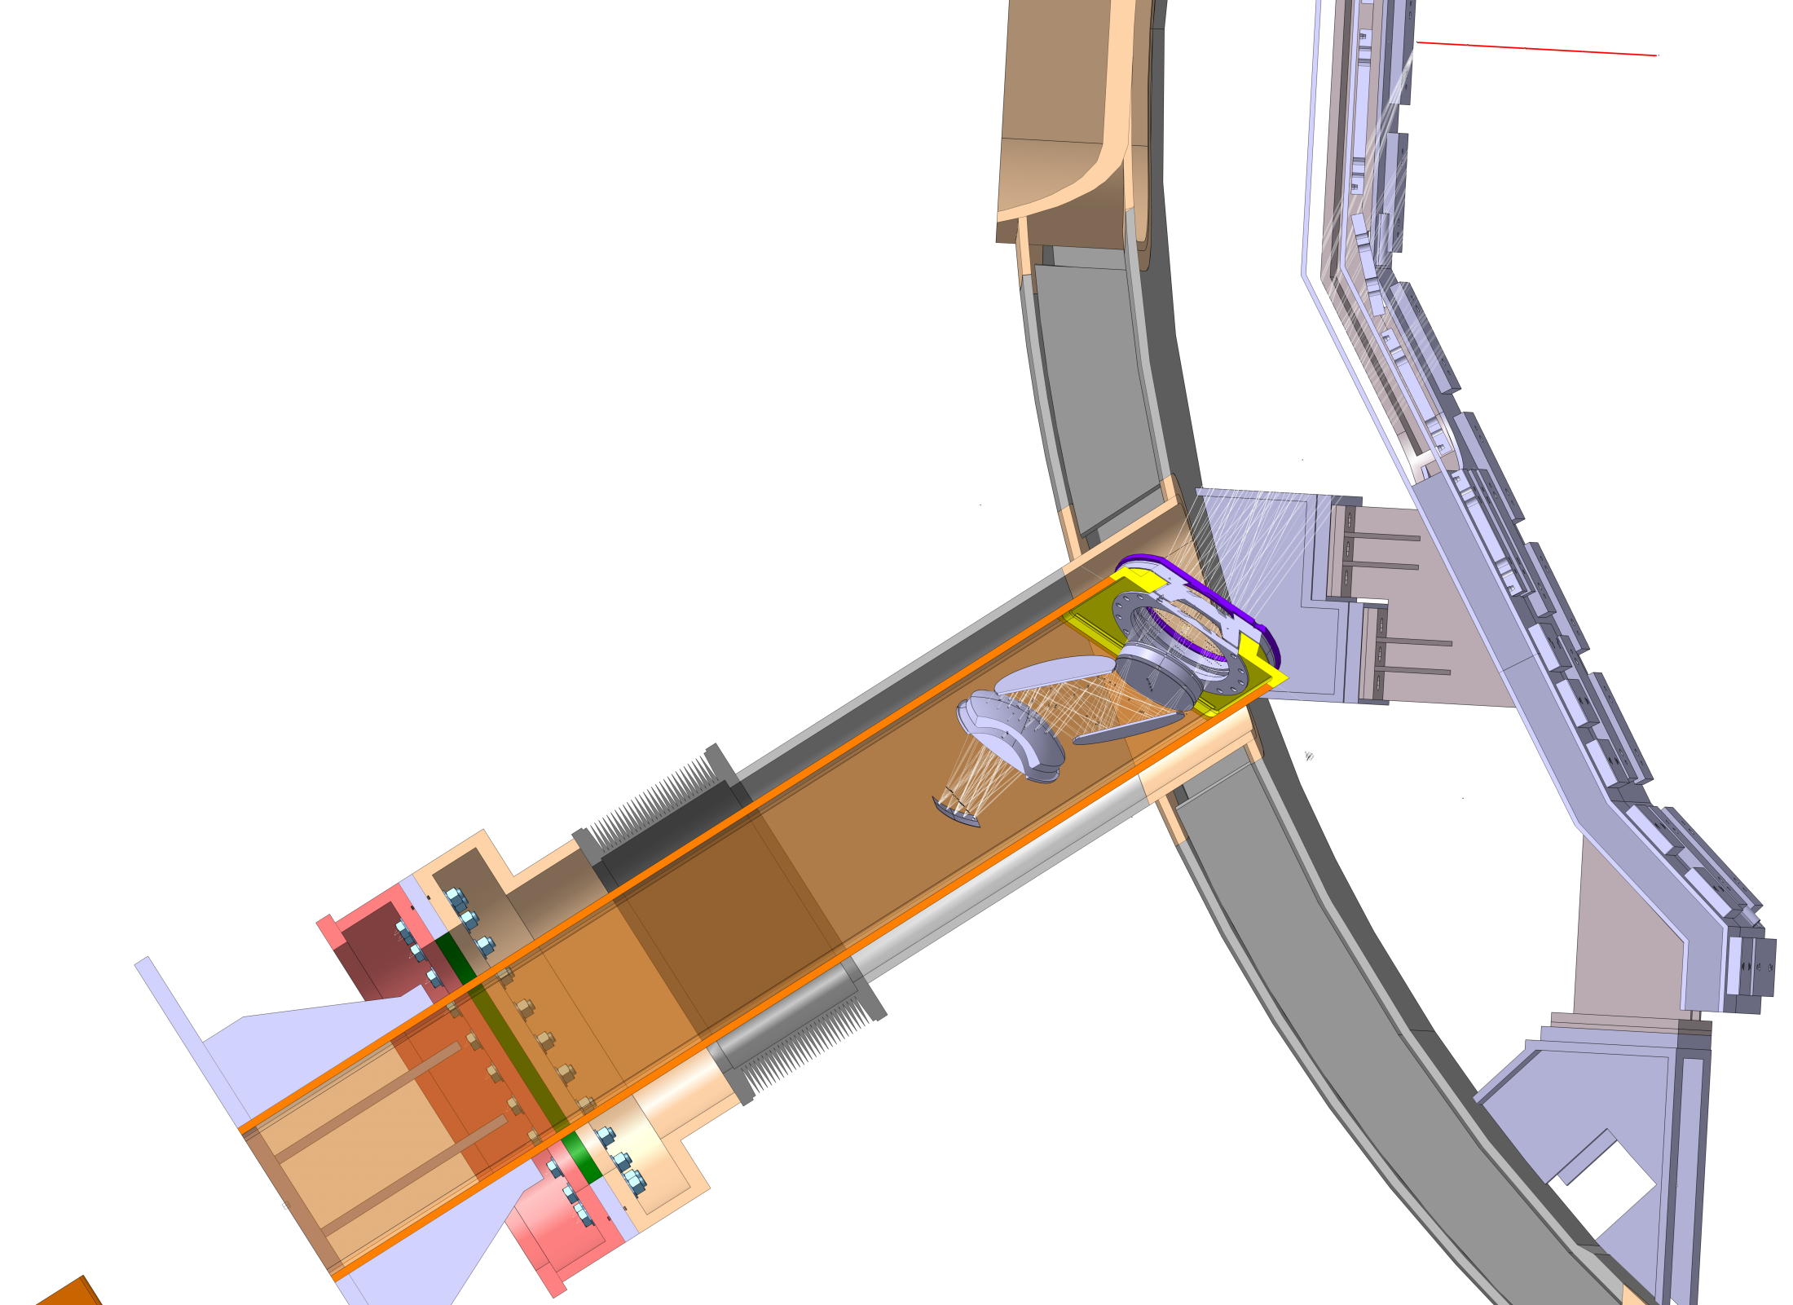
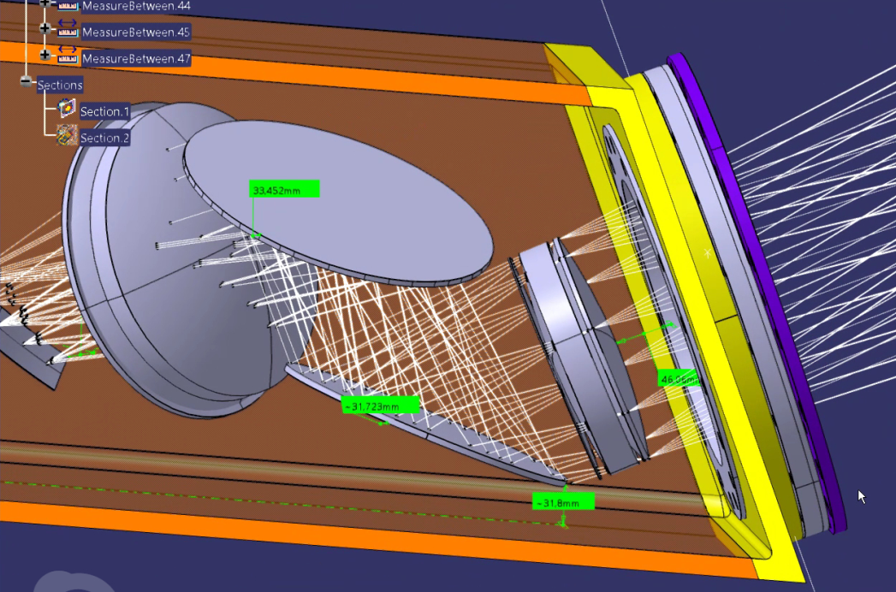
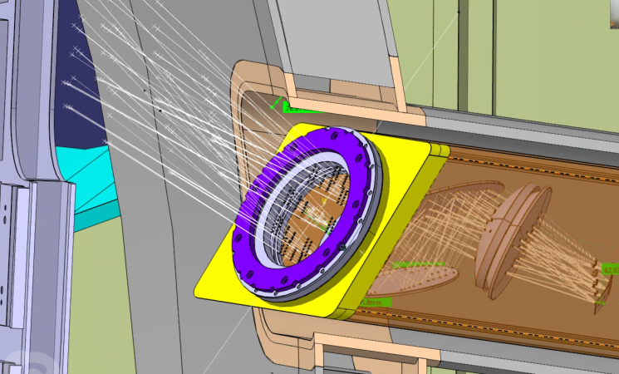
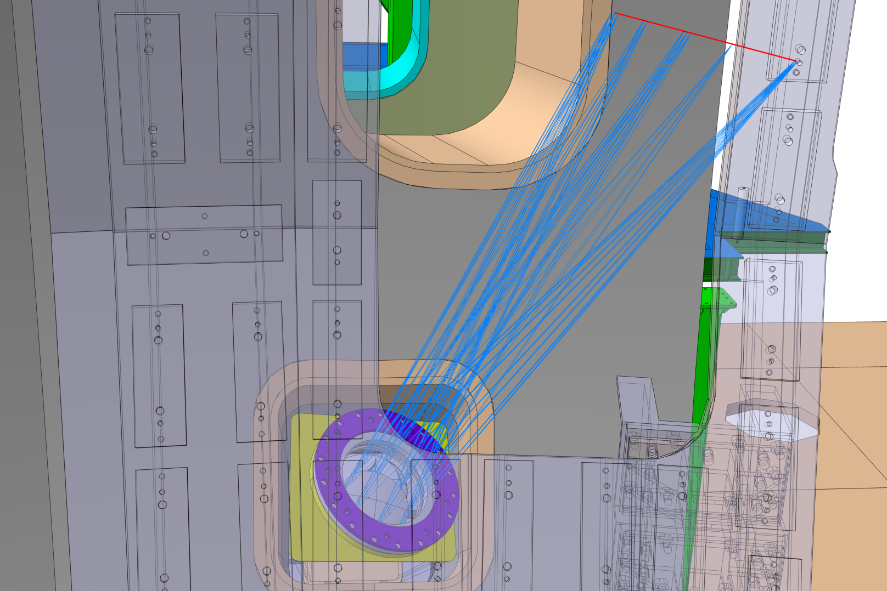
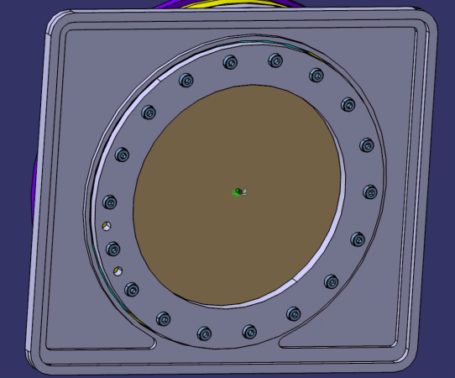
P1 port plug & window flange
Max use of available space
Port plug extends into vacuum vessel
Window screened by stabilizing plate
Front plate
water cooling
T<80°C

Slide 14
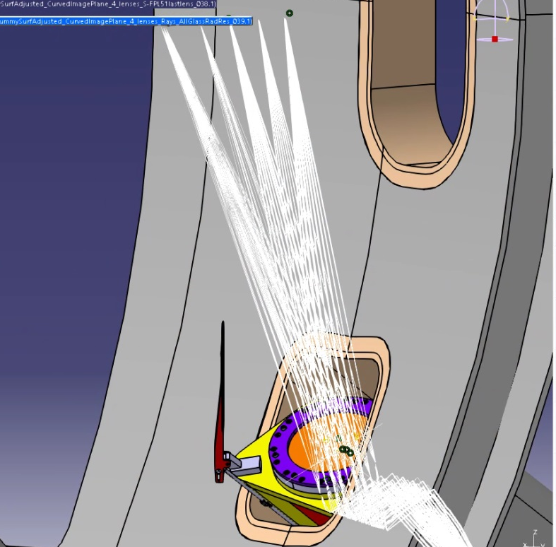
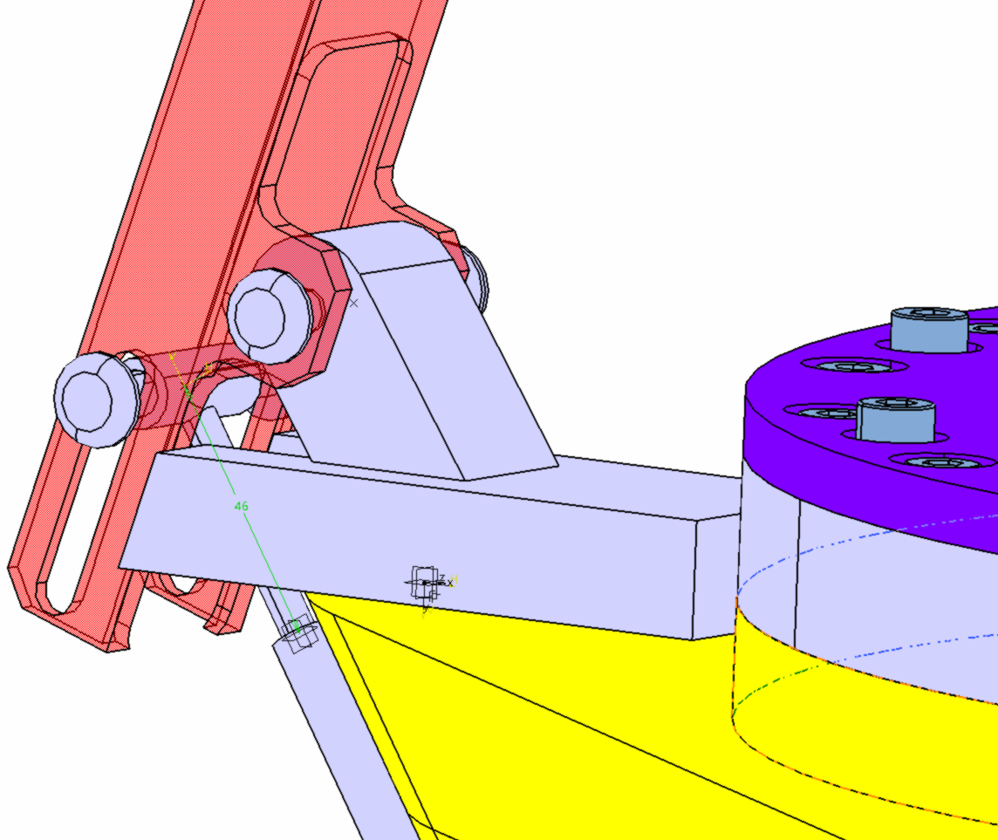
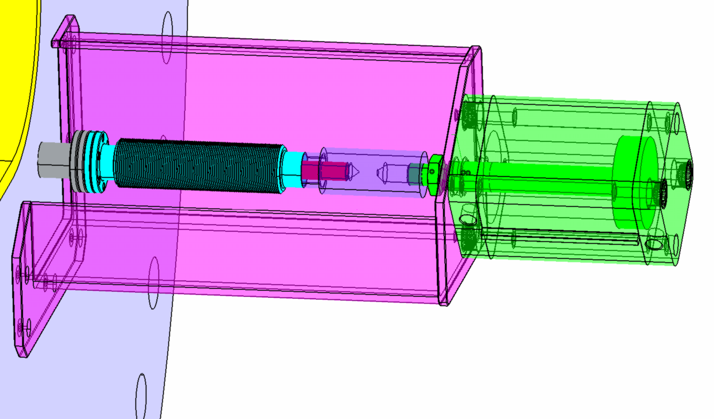
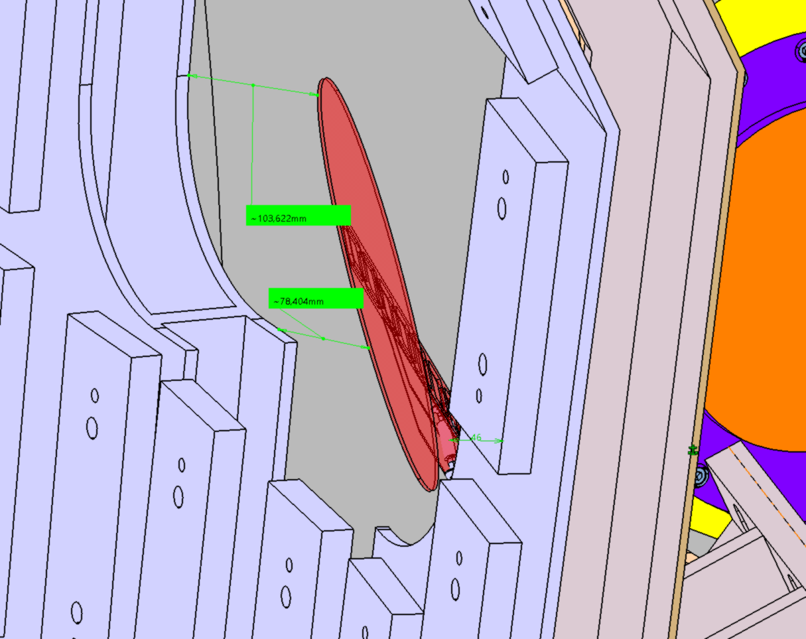
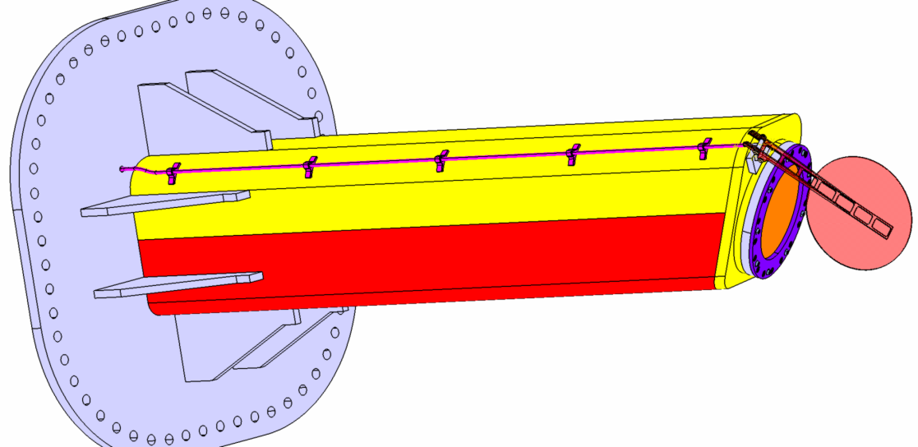
P1 port plug: vacuum window shutter
Shutter components:
  Actuator
  Shaft and supports
  Threaded connection
  Pins
  Shutter
  Shutter support
10 cm
8 cm

Slide 15
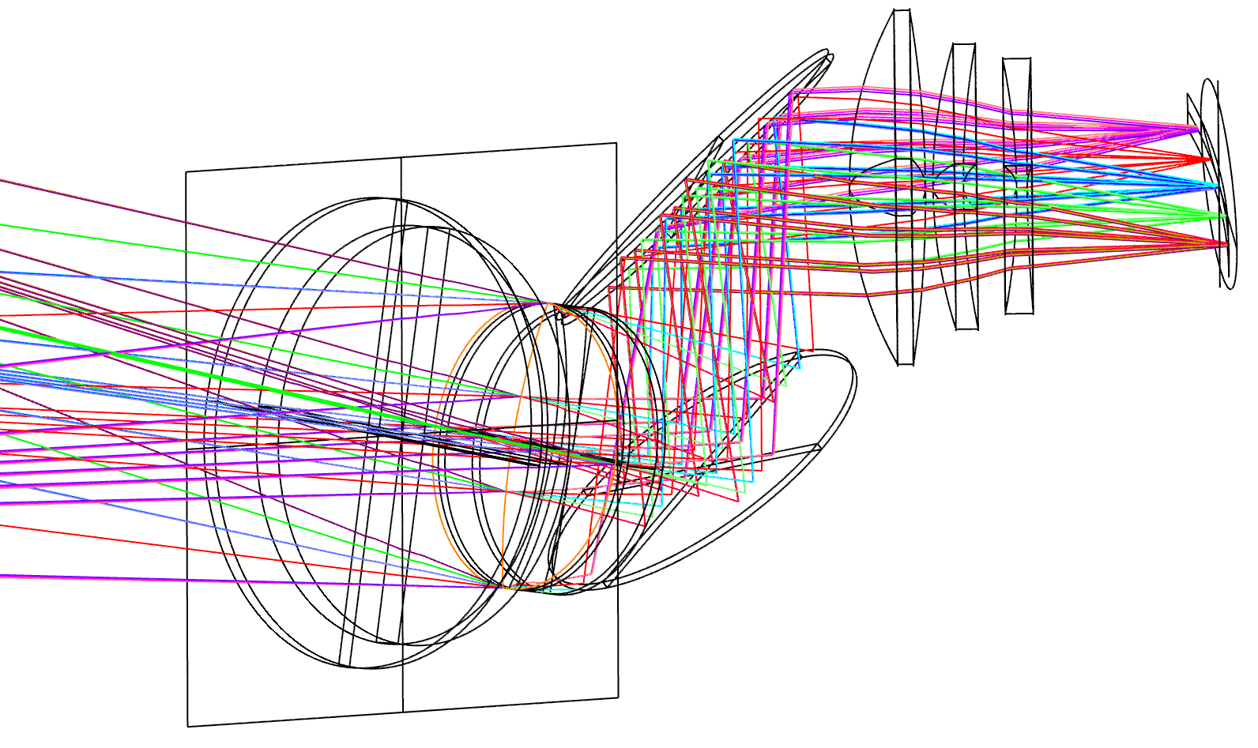
P1 collection optics – not rad hard
Specification for CfT:
Av. Transmission in 660-1070nm >0.7
Spatial resolution (90% energy) < 250 μm
NA on fibers < 0.22
Magnification: 3.6
Chief ray as normal as possible to image surface
Throughput shall be maximised (F/# ~ 2.3)
Preliminary design
4/5 lenses + 2 mirrors
Curved & tilted image surface
Discussion with suppliers
Two contracts for
competitive design (April?)
Manufacturer selection (July?)
+/- 0.5mm focus tolerance
0.13 mm optical resolution
fiber bundle ~3x1.5 mm

Slide 16
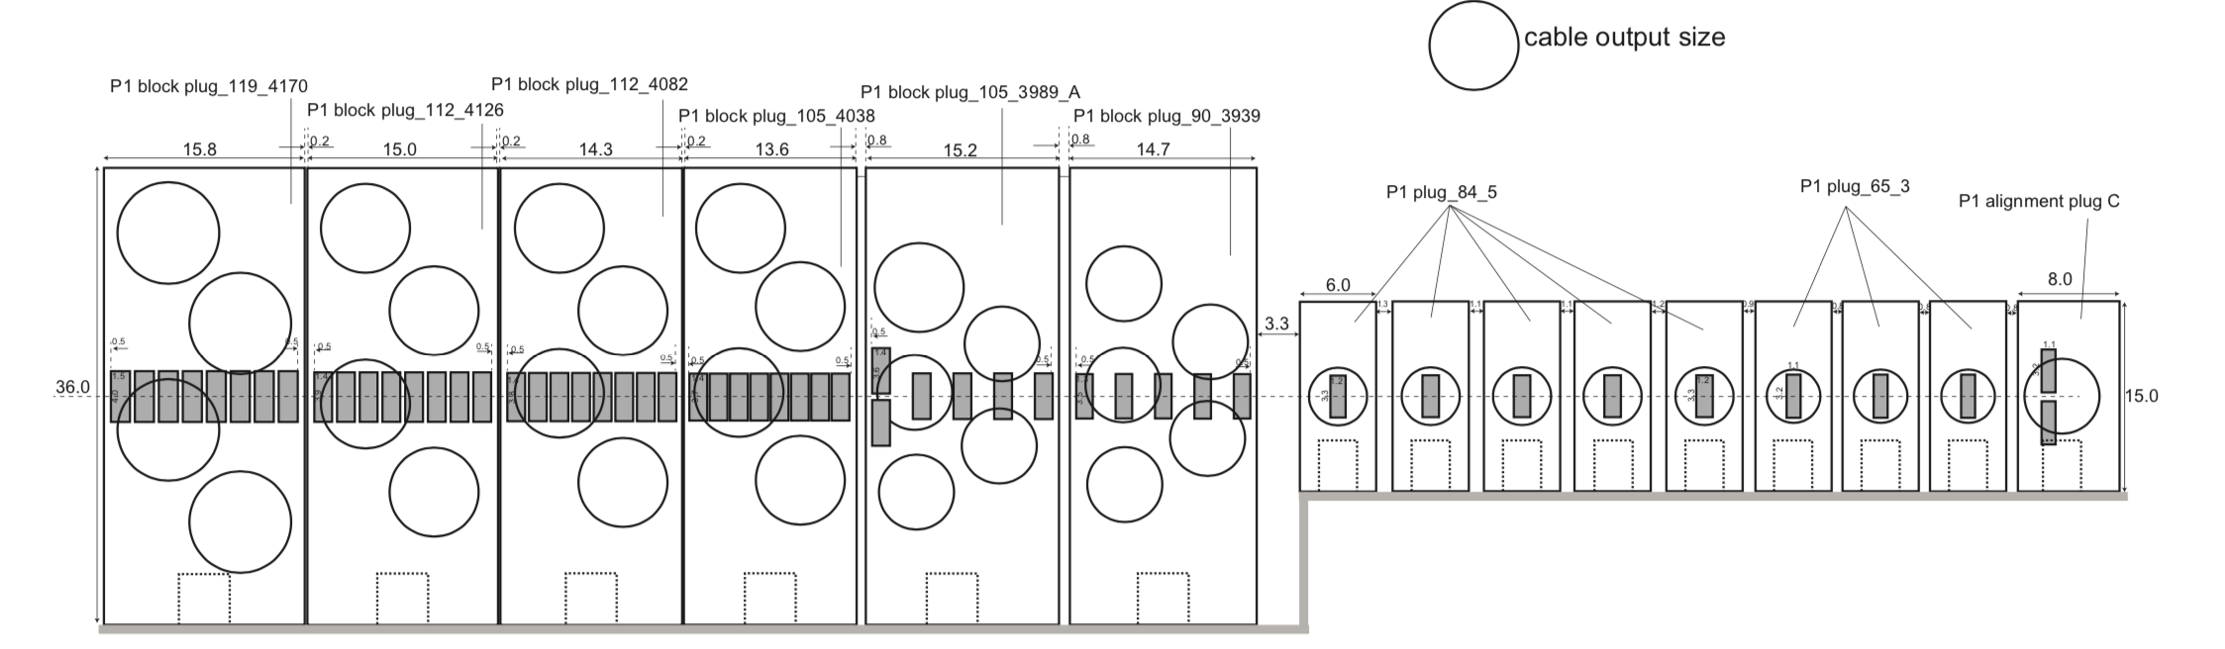
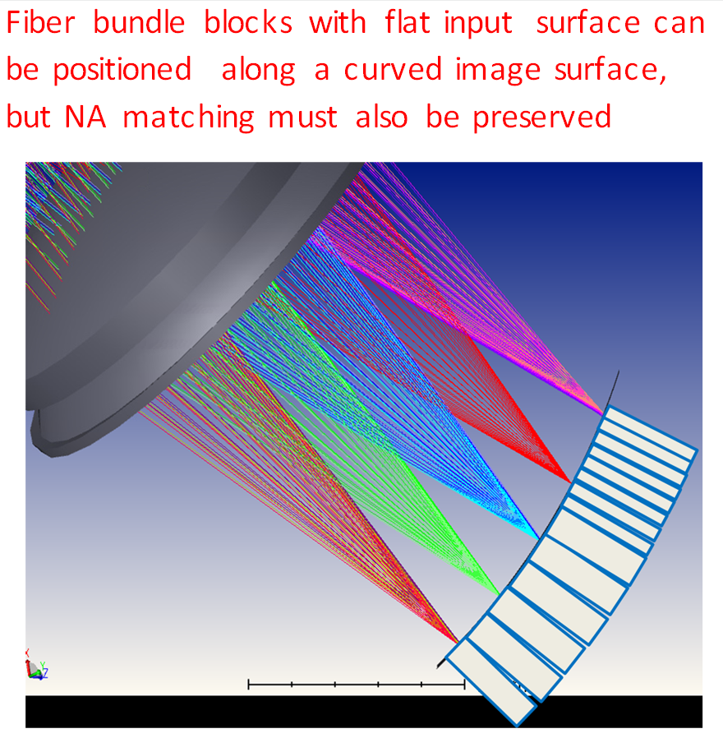
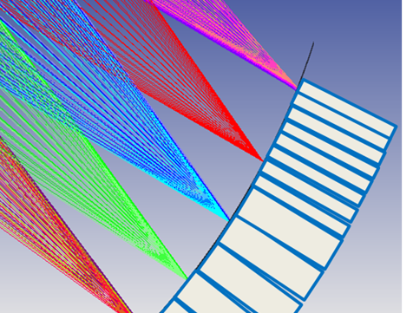
P1 collection optics – fiber bundles
Fiber bundles
Compromise required between NA mismatch and defocusing

Slide 17
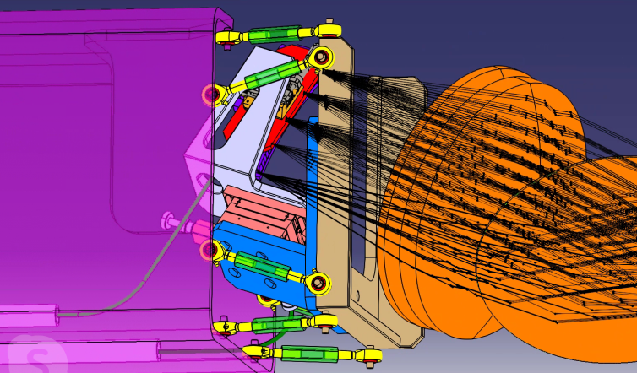
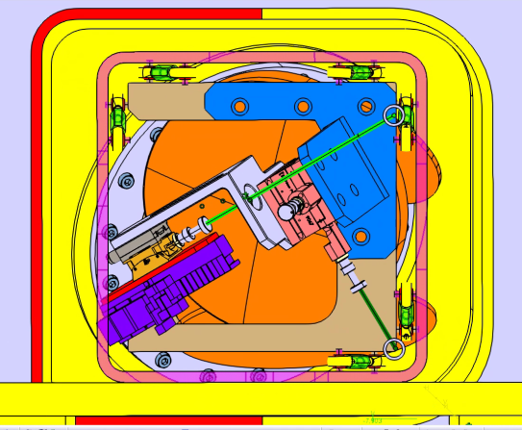
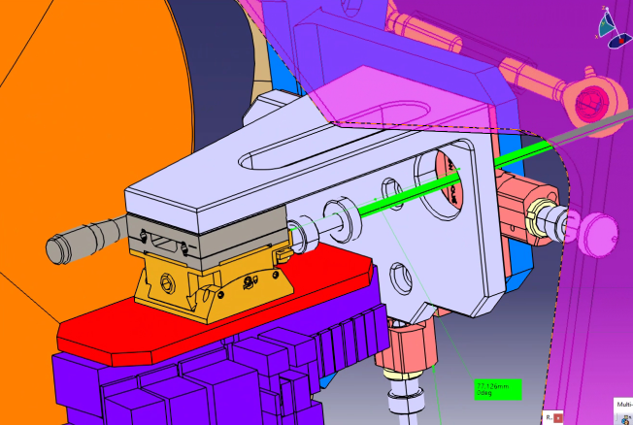
P1 collection optics & fiber holder
Optics block & fibers on same frame
Connected to retractable arm
with hexapod system
Fiber holder adjustments:
- Manual focusing & along laser beam
- remote actuator for translation and rotation across laser beam for alignment
>30mm clearance to port plug walls
Retractable
arm
Fiber bundles
array
3cm
5cm
Fiber holder

Slide 18
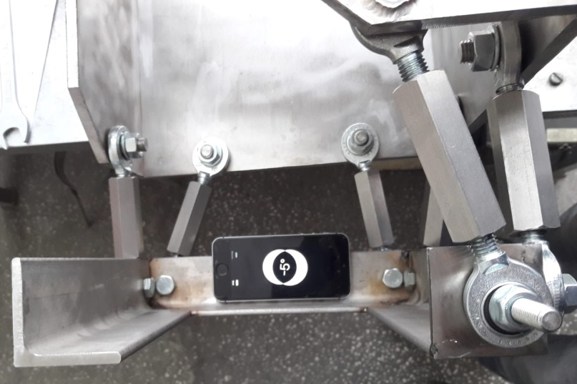
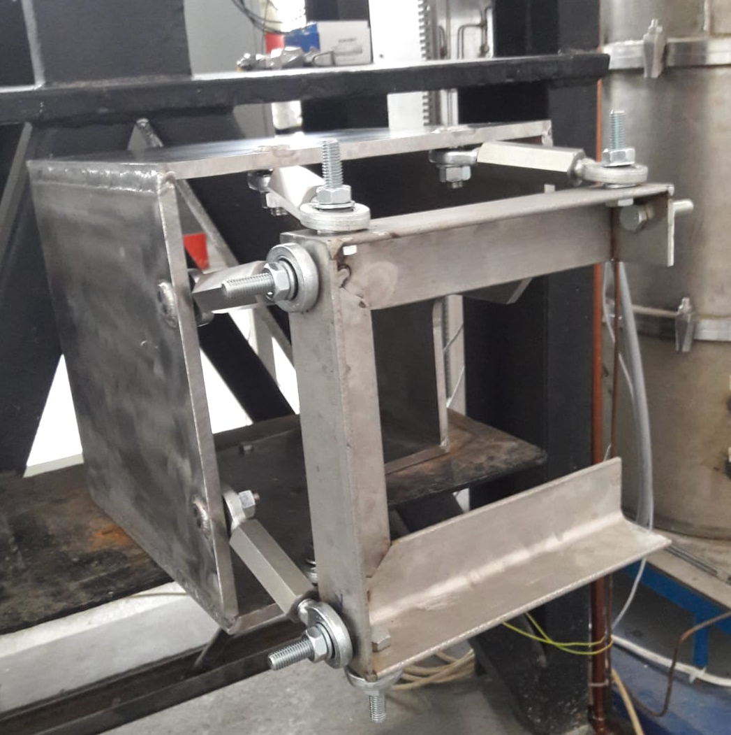
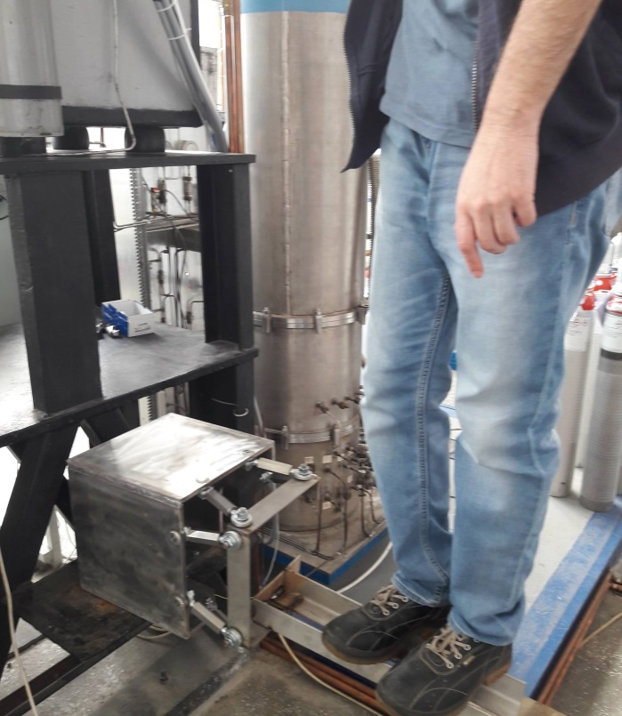
P1 collection optics & fiber holder
Mock-up to test robustness & adjustment of hexapod connections

Slide 19
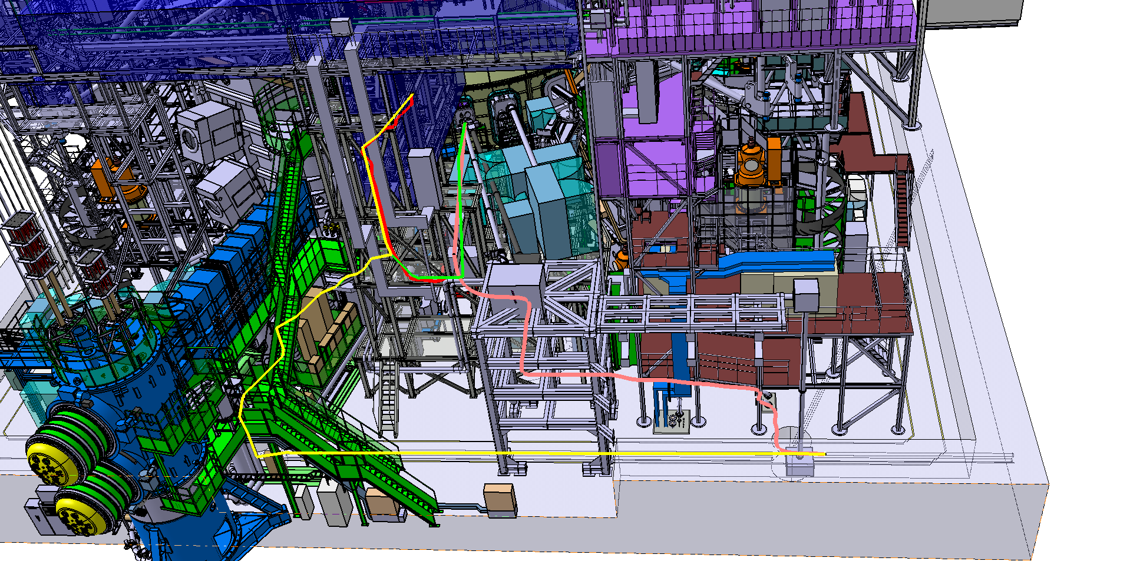
Optical Fibers: shorter path in torus hall
P2
P1
New
Old
laser room
Second pit
First pit
P1 oblique: -27m
P2 horizontal: -19m
P1 oblique: 83 m
P2 horizontal: 91 m
Extra length 10 m in the torus hall is included.

Slide 20
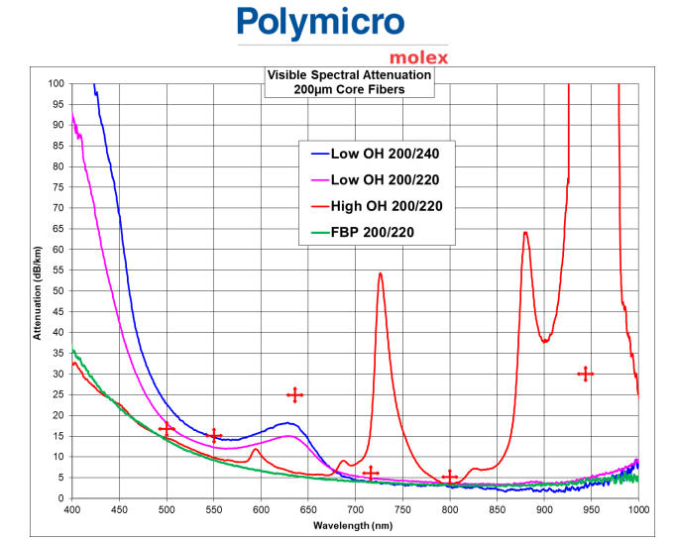
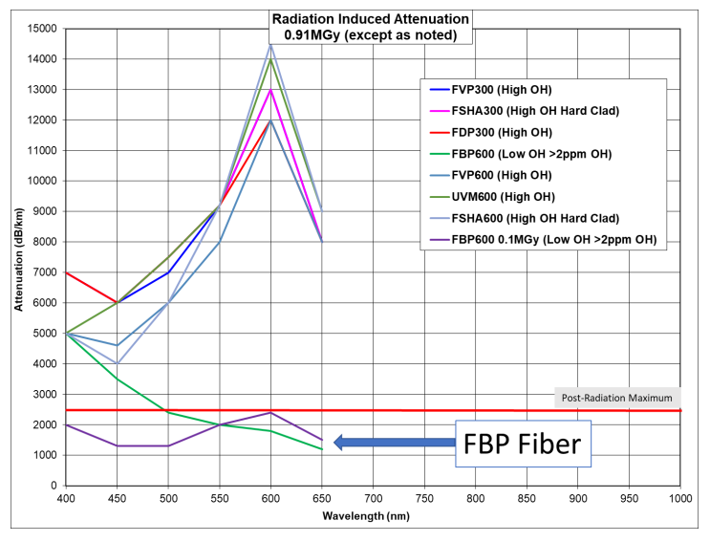
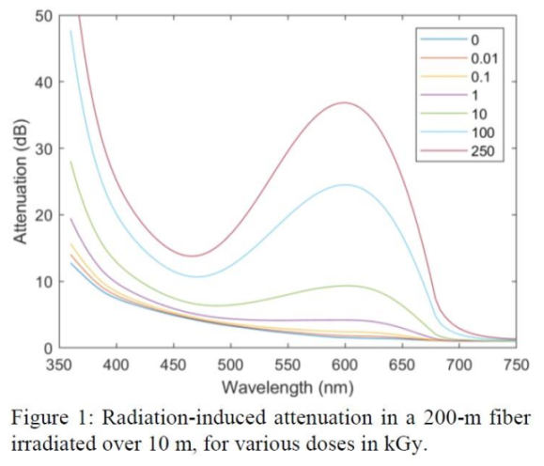
Optical Fibers: F4E procurement
SPECIFICATION
Silica core / fluorine silica cladding
/ polyimide coating (max T=150°C)
200/220/250 micron
0.22 NA
1100 km
Delivery: Jan-Jun 2021
Neutron dose: 0.13 MGy (10¹⁶ n/cm²)
wide market survey of rad hard fibers
incl. cost of mid OH & H₂ loaded
FBP low OH content: 2ppm
dB/m@600nm
kGy FBP
0.1 0.2
1 0.4
10 0.9
100 2.4
specification
0.9 MGy
0.1 MGy

Slide 21
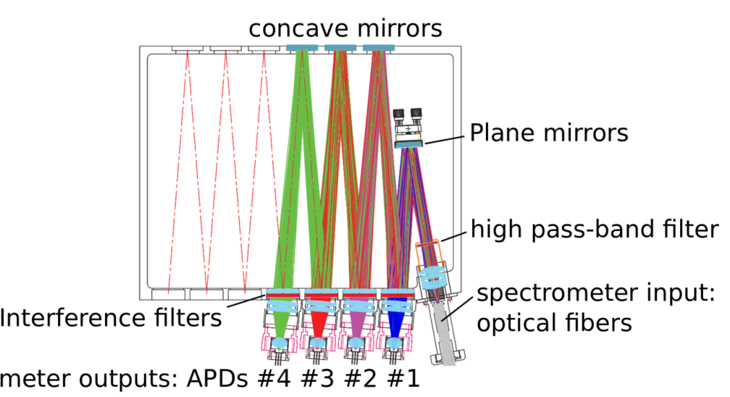
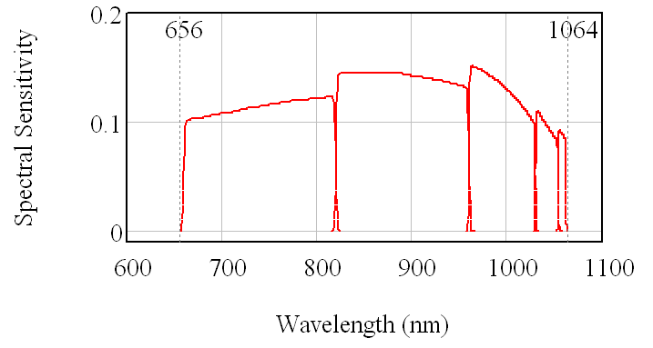
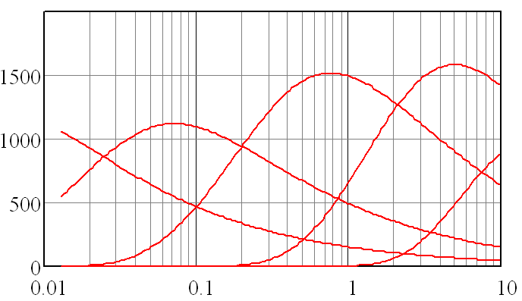
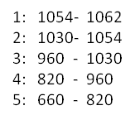
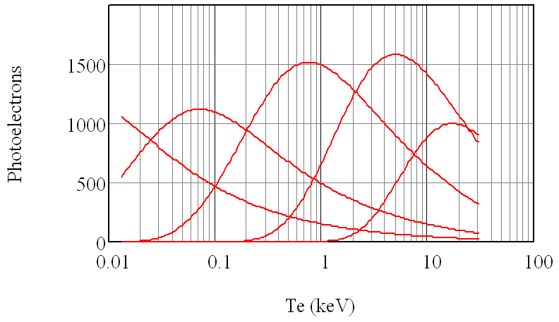
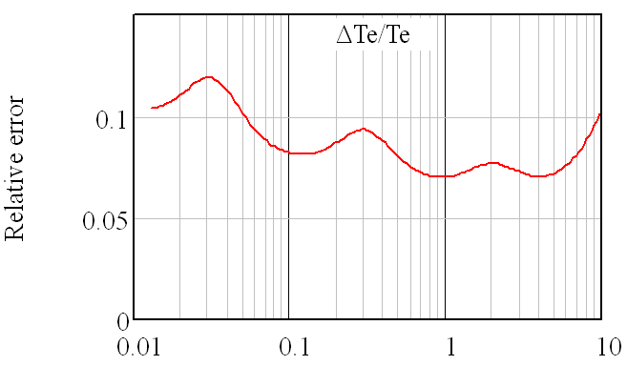

Filter polychromators
Same interf. filters + APD polychromator design for both core & edge systems:
filter bandpass only difference;
well mature design (dark noise 80 → 15 pe in 20 y)
6 cubicles, 16 polychromators each
Tech specs based on performance,
no constraint of optical components,
detector model and electronic design.
Both systems: 6 channels (5+Rayleigh);
filters defined by TS signal simulations.
Acquisition system (QST):
12 bit, 1GHz,
1024 points/pulse (1 μs)
1 GB local memory:
data read out
after 100s plasma discharge
3
4
1
1
2
5
5
4
3
2
Edge TS
Filters transmission
including polychromator transmission
& APD QE

Slide 22


Polychromators F4E CfT
CfT 27 Feb 2020
INFO-DAY 3 March
F4E tender: Negotiated procedure:
- Step 1: Request to Participate
Selection
- Step 2: Invitation to Tender
Negotiation

Slide 23







Polychromators F4E CfT

Slide 24


Polychromators F4E CfT
8 alignment fibers will be detected by modules
similar to the polychromator channels
Installation and calibration on site
will be performed by the supplier
Digital polychromator control only an option

Slide 25


Edge TS simulation
Solid angle, scattering angle & length of each scattering volume vs R
Plasma light background adds to TS signal and contributes to noise:
calculated for specific plasma profiles
2D T_{e}(R,Z), n_{e}(R,Z) and Z_{eff}(R,Z) maps
from 2D maps of poloidal flux and 1D T_{e} and n_{e} profiles
Plasma bremsstrahlung spectral emissivity
integrated along each line of sight & wavelength integrated.
x2 enhancement factor to include line radiation and wall reflection
The plasma light signal was included
as a noise source in T_{e} and n_{e} errors,
in addition to shot noise
and detector noise
mostly due to preamplifier noise
(dark rms noise ~30 pe).
Profiles prepared from CRONOS by J.Garcia and used by S. Fututani for JOREK input (pedestal profile shifted outwards)

Slide 26

Edge TS simulation
n_{e} (10¹⁹ m⁻³) | 0.87 | 0.6 | 0.37 | 0.18
dT_{e}/T_{e} (%) | 12 | 15 | 23 | 45

Slide 27
Project challenges
Ref. to Sam presentation yesterday: my view of this project
Project team built on purpose from different labs: more effort but also opportunity
Negotiations with QST (Annex B): solution is a single central reference (F4E)
Lack of Engineering resources: support from F4E engineering team
PL has little knowledge of the subtleties and rigidity of Eurofusion rules,
e.g. for reimbursement
PL has little knowledge and no control of own lab – Eurofusion relationship
PL has no knowledge and no control of partner lab – Eurofusion relationship
Weakness of initial budget estimate: best guess in haste at project kick off;
cost increase also due to scope and constraints evolution
Lead time risk: mainly on testing / acceptance phase, to be well planned.

