Slide 1
Doppler reflectometer in the JT-60SA tokamak
Status Report
D. Carralero¹, T. Happel², T. Estrada¹, J. Martínez, J. García³, E. de la Luna¹, T. Tokuzawa⁴
¹Laboratorio Nacional de Fusión Ciemat, Av. Complutense 40, 28040 Madrid, Spain
²Max-Planck-Institut für Plasmaphysik, Boltzmannstr. 2, D-85748 Garching, Germany
³CEA, IRFM, 13108 Saint-Paul-lez-Durance, France
⁴ National Institute for Fusion Science 322-6 Oroshi, Toki-city, 509-5292, Japan

Slide 2
Intro: why a Doppler reflec in JT-60SA?
JT-60SA research strategy states that:
  “The validation of theoretical models and simulation codes with the aim of establishing a solid basis for the design of ITER and DEMO scenarios is one of the main objectives of the JT-60SA scientific program.”
JT-60SA Research Plan, v3.3 (2016)
Turbulent transport of heat, momentum and particles is a major uncertainty:
JT-60SA will provide not only an increased range of parameters (β, ν*, ρ*, etc), but also qualitatively different situations, closer to ITER/DEMO operational scenarios.
Transport-related extrapolations used by current codes must be validated.
The main messages of this proposal are:
A DR is a particularly useful diagnostic for this job. Our proposal covers the diagnostic design, implementation, and scientific operation and exploitation.
It is being developed by an interdisciplinary, multinational team including members from both the EU (CIEMAT, IPP, Oxford) and Japan (NIFS/SOKENDAI).
1 / 7
Notes:
2
2
2
2
2
2
2
2
2

Slide 3
Main Features of a Doppler diagnostic
Turbulence measurements
Good for quantitative analysis: k⊥-selective, radial scans of the amplitude of local density fluctuations. By correlation studies, average size and tilt of turbulent structures can be measured.
Good coverage: by using an steerable mirror, a range of k⊥ values can be probed. Typical values are in the k⊥ρ_{s} ~ 1-10, appropriated to observe ITG and TEM turbulence.
Good temporal, spatial, spectral resolution: typical values are Δt_{turbulence} < 1 μs, Δr ~ 1 cm, Δ k⊥ ~ 1 cm⁻¹. Typical radial range covers SOL, edge and core (ρ > 0.5, see later).
Good comparison to gyrokinetic models: by implementing GK model output in a full-wave code, a direct comparison between simulation and experiment is posible.
Flow measurements
Besides turbulence measurements, DR provides radial scans of the u⊥ of turbulent structures. By estimating v_{phase} using simulations or assuming v_{phase} << v_{ExB} , E_{r} profiles can be obtained. This allows for direct comparison between turbulence amplitude and E_{r} shear.
Calculating neoclassical flow contributions in a tokamak, u_{toroidal} can be obtained from u⊥. By this, a DR system can be used to carry out studies in rotation and neoclassical viscosity (regardless of NBI penetration).
2 / 7

Slide 4
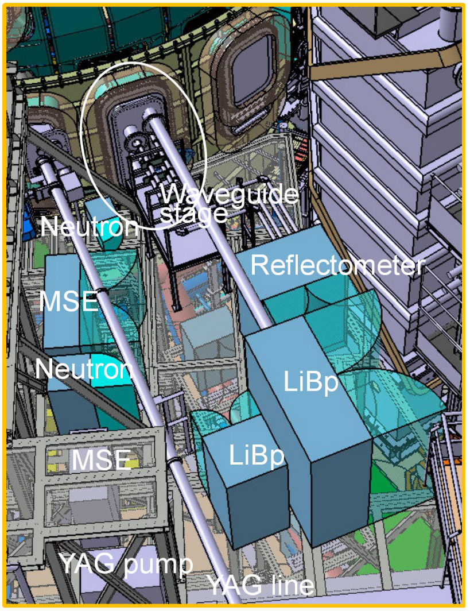
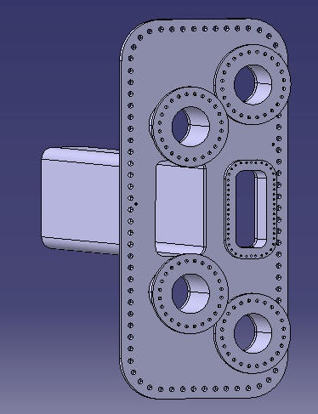
Basic system description
The most likely position for the DR system would be the P18-Horizontal diagnostic flange.
The bottom third of the port is used for light guides which might be removed after 2023.
Details remain TBD.
P18-Horizontal
EDICAM
Visible TV
Neutron monitor
Bolometer
Light guide
N.Oyama, PID U2JYv4.0, 2018
3 / 7
Notes:
Recent meeting, we found the question of what could be the access point. This remains to be decided. Other than that, there seems to be sufficient space for the diagnostic and no further problems have been identified. The experimental team will begin discussing this by 2021.
Final decissions regarding light guides will come after 2023.

Slide 5
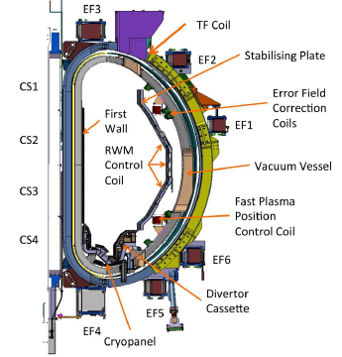
Feasibility study in JT-60SA
A first feasibility study was conducted in order to determine the existence of a geometric solution (launching angles, position) for the DR to probe a likely JT-60SA scenario in the region and range of k⊥ values of interest.
As a working hypothesis, a launching position at one of the lower ports of the P18 diagnostic flange has been considered, between the vacuum vessel and the stabilising plate. Final launching position still TBD.
  Selected launching position coordinates :
  R = 4500 mm, z = -640 mm
  Results do not depend strongly on the precise position of the antenna.
  Other potential launching positions could be evaluated
R = 4216 mm
P18 port
+
R = 4954 mm
Launching position
N.Oyama, PID U2JYv4.0, 2018
4 / 7

Slide 6
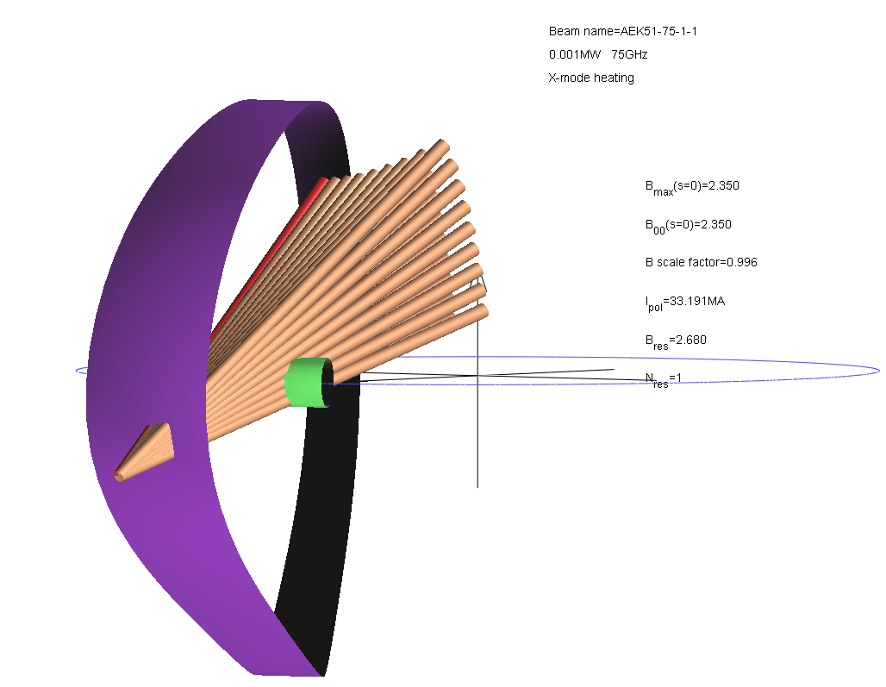
Feasibility study: Ray tracing
A first feasibility study was conducted in order to determine the existence of a geometric solution (launching angles, position) for the DR to probe a likely JT-60SA scenario in the proposed region and range of k⊥ values.
Ray tracing code TRAVIS has been used to determine optimal launching angles for the proposed frequency bands.
  The criteria were:
  Minimize k|| to at most, k||/k⊥ < 0.1 (required for acceptable S/N ratio)
  Reflection layers close to the OMP (ballooning character of turbulence suggest optimum S/N levels)
  Single-axis rotation in steering mirror (minimize complexity of mechanical system)
  k⊥ρ_{s} in the 1-10 range (ITG/TEM turbulence)
4 / 7

Slide 7
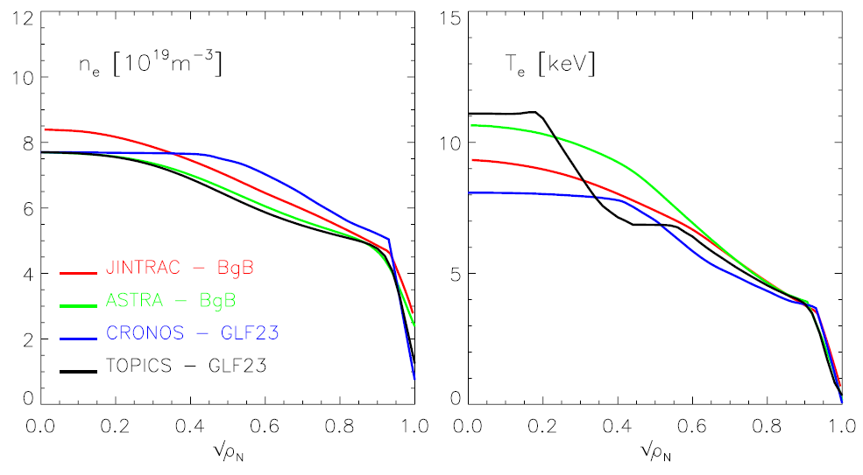
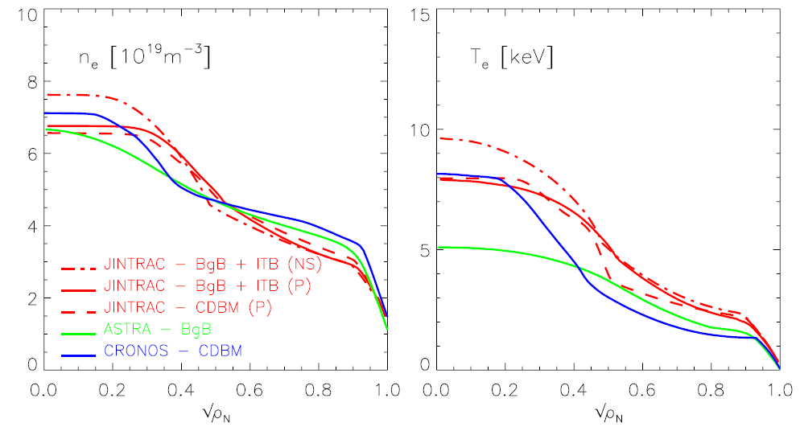
Regions of interest
Standard H-mode scenario
Taking into account recent scenario predictions, three distinct regions of interest are foreseen:
- Observation of core turbulence
ρ < 0.8, n_{e} ~ 4-7.5 10¹⁹ m⁻³
Examples: TEM turbulence, ITB formation.
- Observation of pedestal region:
ρ > 0.8, n_{e} ~ 2-5 10¹⁹ m⁻³
Example: L-H transition, ETB formation.
- Observation of SOL region:
ρ > 1, n_{e} < 2 10¹⁹ m⁻³
Example: SOL E_{r}, filamentary activity.
This presentation covers the first two regions. The SOL observations are being developed by T. Tokuzawa (R.O.).
Advanced steady state, high power scenario
L. Garzotti et al., NF 2018
5 / 7

Slide 8

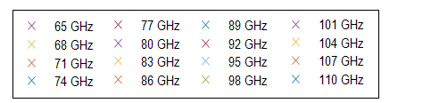
Results: High density scenario
Freqs at equatorial plane
W-band
θ = 43.9º
θ = 39º
θ = 34.1º
θ = 29.1º
θ = 24.3º
E-band
  Central region can be completely covered by W-band in O-mode.
  Edge (up to LCFS) can be covered by E-band in X-mode.
  This way, k_{⊥, core} = 5-30 cm⁻¹ and k_{⊥, edge}= 3-20 cm⁻¹ can be obtained with k||/k⊥< 0.1
6 / 7

Slide 9
Results: Hybrid scenario
Freqs at equatorial plane
W-band
θ = 43.9º
θ = 39º
θ = 34.1º
2xf_{ec} absorption
θ = 29.1º
θ = 24.3º
E-band
  Central region can be completely covered by E-band in O-mode.
  Edge (up to LCFS) can be covered by E-band in X-mode.
  This way, k_{⊥, core} = 5-25 cm⁻¹ and k_{⊥, edge}= 5-25 cm⁻¹ can be obtained with k||/k⊥< 0.1.
  W-band is strongly absorbed by the 2nd EC harmonic in X-mode.
6 / 7

Slide 10
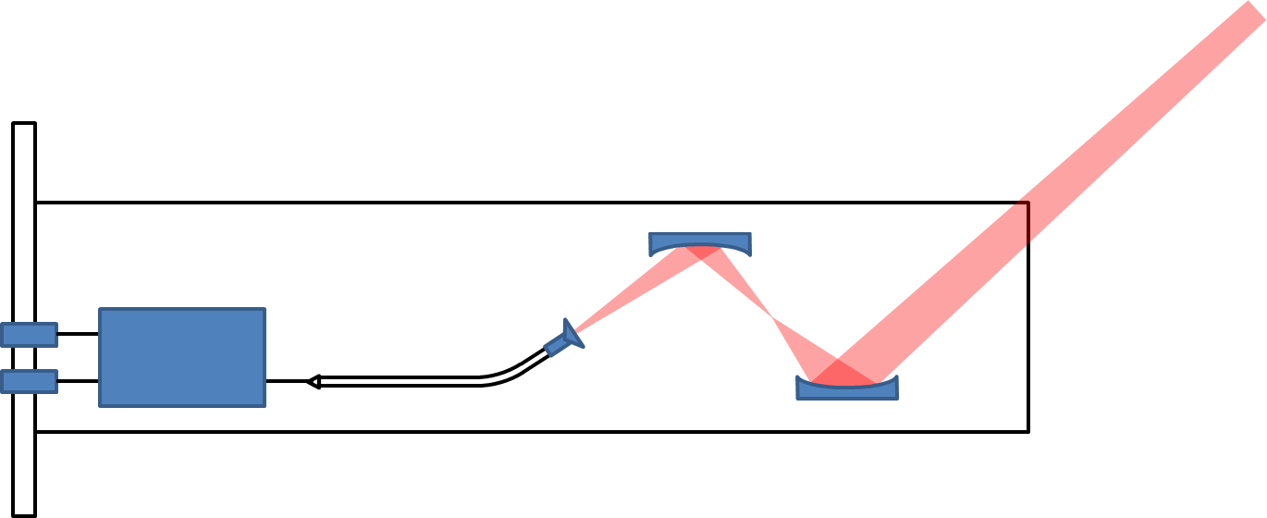
Current status of conceptual design
  Elliptic
  mirrors
  RF windows
  RX
  TX
  Ø 200 mm
  Directional coupler (E-band)
  Optimized antenna
  Port plug
A viable conceptual design has been found for a V/W band DR:
Monostatic system. 30 mm beam waist @ cut off position for 90 GHz (1.4 m distance).
The whole system is contained in a 200 mm diameter port plug.
Q-band might be fitted in the second circular port (T. Tokuzawa)
Space limitations impose a number of critical restrictions:
Only one band at a time can be used (only core/edge observation).
The system only admits one polarization mode (O/X).
There is not enough space for antenna steering (no spectrum measurements).
7 / 7
Notes:
E-band for V/W operation. Q-band would go in the other port?
Chocked-corrugated antenna can be designed to fit in the space for the V-W bands.
Exact beam waist/distance to be optimized. Gaussian telescope design makes this result theoretically independent of frequency.
Mirrors still need optimization. Now, f= 100, 400 mm, diameter ca. 100 mm, z=+-50, horizontal distance 500 mm.
Strong angle may depart beam from gaussianity.

Slide 11
Current status of conceptual design
  Elliptic
  mirrors
  RF windows
  RX
  TX
  Ø 200 mm
  Directional coupler (E-band)
  Optimized antenna
  Port plug
A viable conceptual design has been found for a V/W band DR:
Monostatic system. 30 mm beam waist @ cut off position for 90 GHz (1.4 m distance).
The whole system is contained in a 200 mm diameter port plug.
Q-band might be fitted in the second circular port (T. Tokuzawa).
A better scenario involves access to the whole 700-400 mm space:
All features could be implemented (SOL/core/edge, steerable mirror,…).
Probably, the whole space wouldn´t be needed. Flexible solutions, involving aditional diagnostics, continuation of light guides would be possible.
7 / 7

Slide 12
Current status of conceptual design
  Elliptic
  mirrors
  RF windows
  RX
  TX
  Ø 200 mm
  Directional coupler (E-band)
  Optimized antenna
  Port plug
A viable conceptual design has been found for a V/W band DR:
Monostatic system. 30 mm beam waist @ cut off position for 90 GHz (1.4 m distance).
The whole system is contained in a 200 mm diameter port plug.
K-band might be fitted in the second circular port (T. Tokuzawa).
A better scenario involves access to the whole 700-400 mm space:
All features could be implemented (SOL/core/edge, steerable mirror,…).
Probably, the whole space wouldn´t be needed. Flexible solutions, involving aditional diagnostics, continuation of light guides would be possible.
A Doppler reflectometer in JT60-SA is possible: Our analysis has identified several working solutions which could address the physics program.
In order to go into further detail, we need more detailed information regarding available space.
7 / 7

Slide 13
Additional Slides
Notes:
13
13
13
13
13
13
13
13
13

Slide 14
Feasibility study in JT-60SA
A first feasibility study has been conducted in order to determine the existence of a geometric solution (launching angles, position) for the DR to probe a likely JT-60SA scenario in the proposed region and range of k⊥ values.
As a working hypothesis, a launching position at one of the lower ports of the P18 diagnostic flange has been considered. Final launching position still TBD. Two scenarios from the scientific plan have been considered:
High density
Hybrid
8 / 14

Slide 15
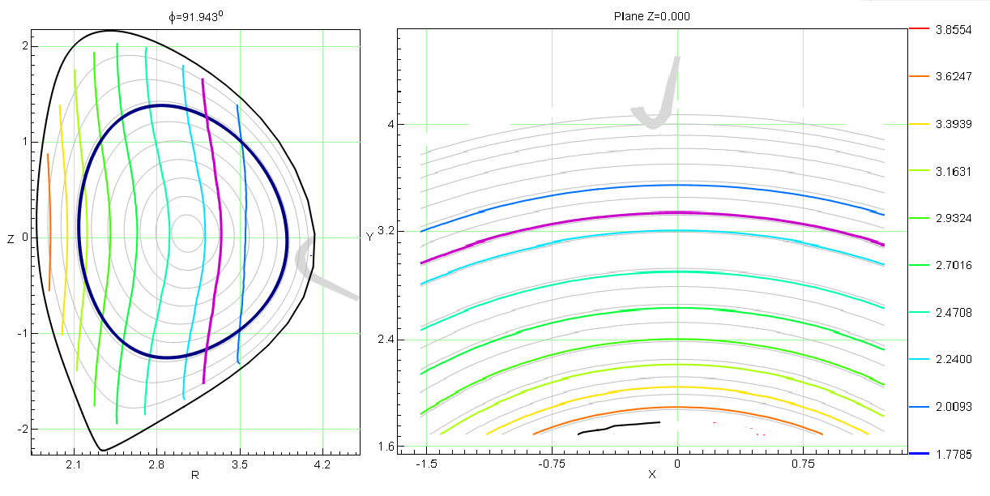
Feasibility study: Ray tracing
A first feasibility study has been conducted in order to determine the existence of a geometric solution (launching angles, position) for the DR to probe a likely JT-60SA scenario in the proposed region and range of k⊥ values.
Ray tracing code TRAVIS has been used to determine optimal launching angles for the proposed frequency bands.
poloidal view
top view
＋
＋
9 / 14

Slide 16
Turbulence-GK simulation comparison
In AUG, the turbulence field has been calculated using flux-tube, non-linear GENE simulations.
Using said field as an input for 2DFW code, a synthetic DR output is obtained.
This allows for a direct comparison of DR output and GK turbulence predictions.
T. Happel et al., 13th Int. Reflect. Workshop, 2017 & T. Happel et al., PPCF 2017
3 / 14

Slide 17
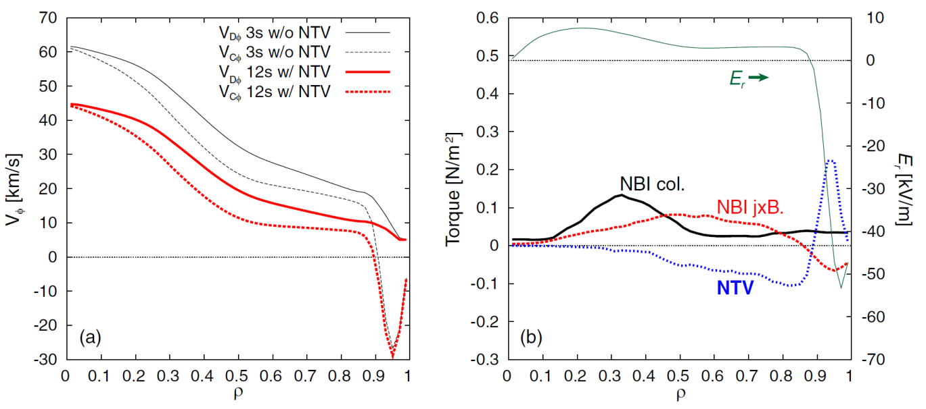
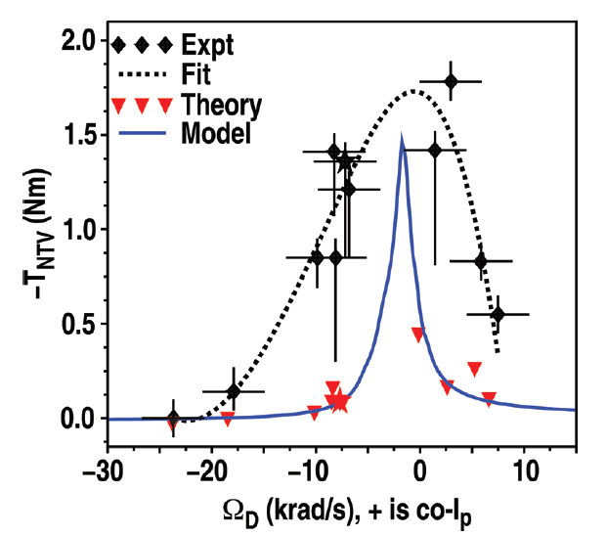
Rotation and NTV
Suficient rotation is required for high-β MHD stability.
Predictive simulations show that NTV torque may be equivalent to that of NBI drive when axisymmetry is lost.
Strong impact in rotation, which will be substantially reduced.
Simulation-experiment comparisons are required to validate models.
E_{r} may also be relevant for impurity transport
For large enough deviation of axisymmetry, impurity transport might become driven by E_{r}, as typically in stellarators.
JT-60SA (AI scenario), TOPICS simulation
M. Honda et al, NF, 2014
DIII-D
A. J. Cole et al, NF, 2011
5 / 14

Slide 18
Main Features of a Doppler diagnostic
Turbulence measurements
Good for quantitative analysis: k⊥-selective, radial scans of the amplitude of local density fluctuations. By correlation studies, average size and tilt of turbulent structures can be measured.
Good coverage: by using an steerable mirror, a range of k⊥ values can be probed. Typical values are in the k⊥ρ_{s} ~ 1-10, appropriated to observe ITG and TEM turbulence.
Good temporal, spatial, spectral resolution: typical values are Δt_{turbulence} < 1 μs, Δr ~ 1 cm, Δ k⊥ ~ 1 cm⁻¹. Typical radial range covers SOL, edge and core (ρ > 0.5, see later).
Good comparison to gyrokinetic models: by implementing GK model output in a full-wave code, a direct comparison between simulation and experiment is posible.
2 / 14

Slide 19
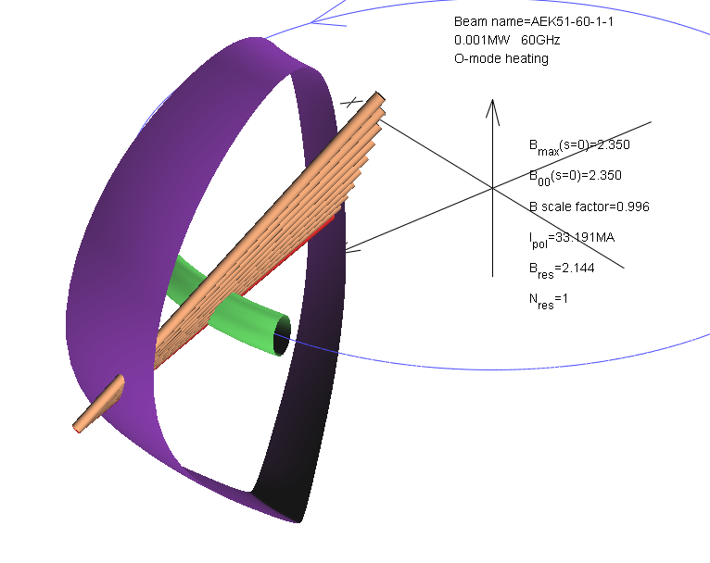
k-spectra characterization
A number of rays are launched on the optimal plane to simulate different launching angles from a steerable mirror.
  O-mode, 60 GHz
  elevation angle
  azimuth angle
  k||/k⊥ = 0.1
  k|| = 0
11 / 14

Slide 20
Results: High density scenario
Freqs at equatorial plane
W-band
θ = 43.9º
θ = 39º
θ = 34.1º
θ = 29.1º
θ = 24.3º
E-band
  Central region can be completely covered by W-band in O-mode.
  Edge (up to LCFS) can be covered by E-band in X-mode.
  This way, k_{⊥, core} = 5-30 cm⁻¹ and k_{⊥, edge}= 3-20 cm⁻¹ can be obtained with k||/k⊥< 0.1
6 / 7

Slide 21
Results: Hybrid scenario
Freqs at equatorial plane
W-band
θ = 43.9º
θ = 39º
θ = 34.1º
2xf_{ec} absorption
θ = 29.1º
θ = 24.3º
E-band
  Central region can be completely covered by E-band in O-mode.
  Edge (up to LCFS) can be covered by E-band in X-mode.
  This way, k_{⊥, core} = 5-25 cm⁻¹ and k_{⊥, edge}= 5-25 cm⁻¹ can be obtained with k||/k⊥< 0.1.
  W-band is strongly absorbed by the 2nd EC harmonic in X-mode.
6 / 7

