Slide 1

EDICAM: from commissioning to routine use – Part I
Status
EDICAM overview
EDICAM capabilities
  Slow framing
  Fast framing
Tamás Szepesi
Á. Kovácsik*,
G. Kocsis, T. Szabolics, S. Zoletnik,
Centre for Energy Research
*Institute for Nuclear Techniques
Budapest, Hungary

Slide 2
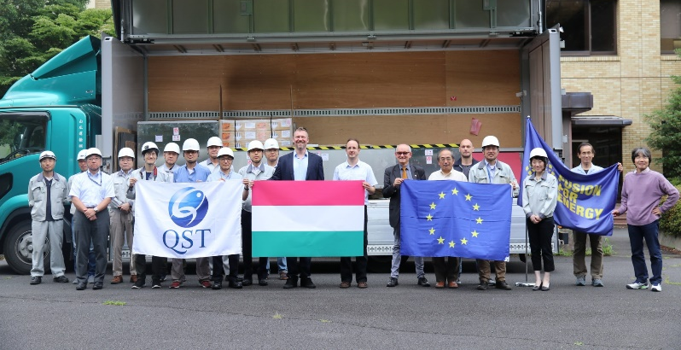


Status of installation and commissioning
EDICAM delivered to Naka on 22 July 2019
On-site works before installation
  Unboxing, first tests
  Training of local staff
  Individual linkage test
    → communication with DCS, data transfer to server
  Integrated linkage test (all systems together)
    → partly failed due to COVID-19 (travel restrictions)
  SW/HW updates
    → SW update failed due to COVID-19 (travel restrictions)
Port plug and diagnostic installation
  Vacuum leak of P18 port → significant delays, repair finished at 27/03
  Installation foreseen for 10 April
T. Szepesi | PPM-7 | 2020.04.01. | Page 2

Slide 3
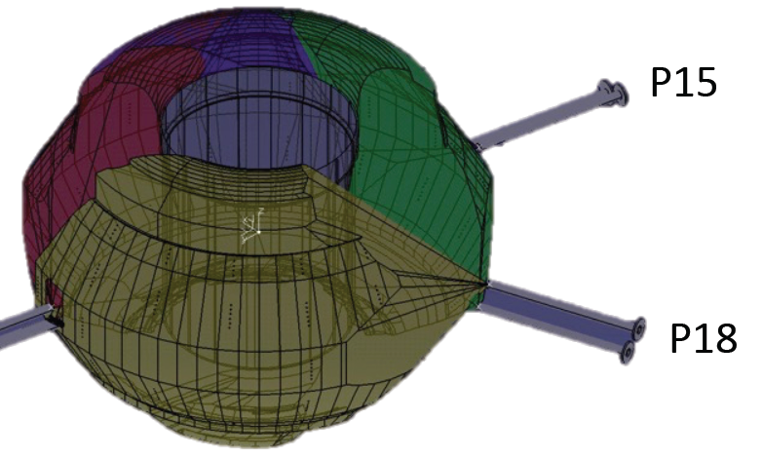
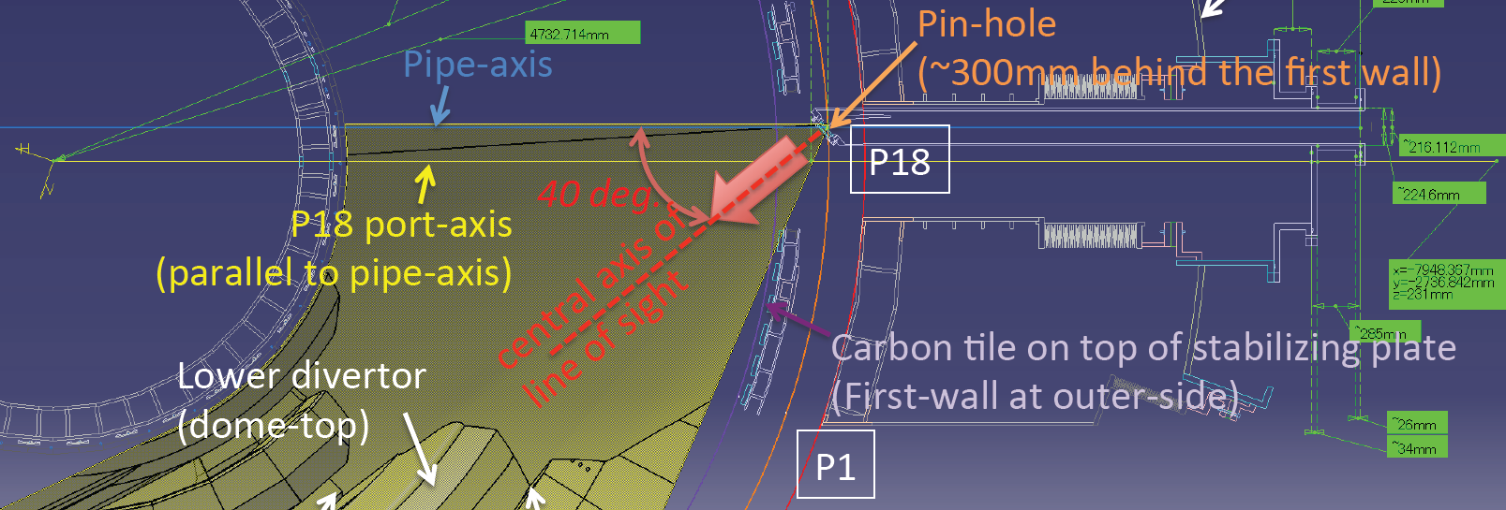
EDICAM overview – Design parameters
Single channel wide-angle fast video diagnostics
Features
  Field-of-view: 80° (wide-angle)
  Tangential view
  Temporal resolution: 100 Hz
    → max. 400 Hz full frame, up to 20 kHz for ROIs
  Spatial resolution: better than 13 mm (over 3-8 m distance)
T. Szepesi | PPM-7 | 2020.04.01. | Page 3

Slide 4
EDICAM capabilites – Multi-ROI features
Advanced camera control: multiple ROIs, non-destructive readout
Define several regions to be observed (max. 6)
  different size and position
  independent timing
  NDR = sensor content is not erased
ROI 1
ROI 2
CMOS chip
ROI 1
ROI 2
pixel brightness
time
Exposure cycle
Exposure
Reset
T. Szepesi | PPM-7 | 2020.04.01. | Page 4

Slide 5




EDICAM capabilites – Multi-ROI features
Advanced camera control: multiple ROIs, non-destructive readout
Stationary objects:
NDR readouts
reset & readout
pixel brightness
time
Exposure
Reset
T. Szepesi | PPM-7 | 2020.04.01. | Page 5

Slide 6
EDICAM capabilites – Multi-ROI features
Advanced camera control: multiple ROIs, non-destructive readout
Moving objects:
NDR readouts
reset & readout
pixel brightness
time
Exposure
Reset
T. Szepesi | PPM-7 | 2020.04.01. | Page 6

Slide 7
EDICAM capabilites – Multi-ROI features
Advanced camera control: multiple ROIs, non-destructive readout
Moving objects:
Recover fast movements. Limitation: overexposure.
T. Szepesi | PPM-7 | 2020.04.01. | Page 7

Slide 8
EDICAM capabilites – Event detection
Camera is controlled by FPGA
All data is flowing through the FPGA
  offers real-time image processing
Events
  → intensity threshold on image
  → time
  → external input (TTL)
Actions
  de/activate ROI
  start/stop data archiving
  external trigger (TTL)
Modular design:
camera head + FPGA card
Small
Durable
Image processing
Events
cam.head
FPGA
10 Gbit/s fiber link
T. Szepesi | PPM-7 | 2020.04.01. | Page 8

Slide 9
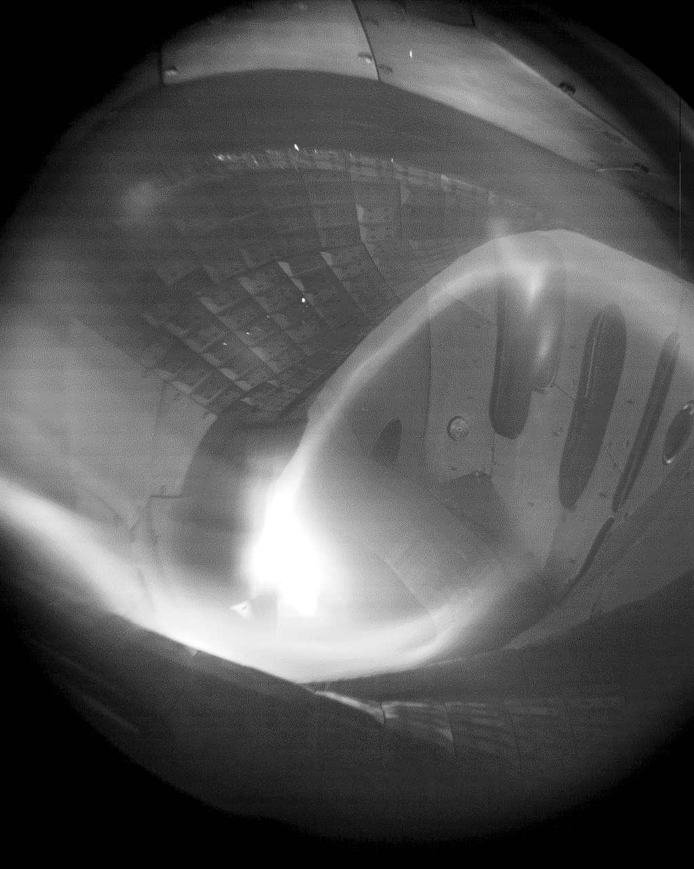
EDICAM capabilites – W7-X experience
z
R
Plasma boundary
Inner heat shield
Outboard
Vertical divertor
Horizontal divertor
T. Szepesi | PPM-7 | 2020.04.01. | Page 9

Slide 10

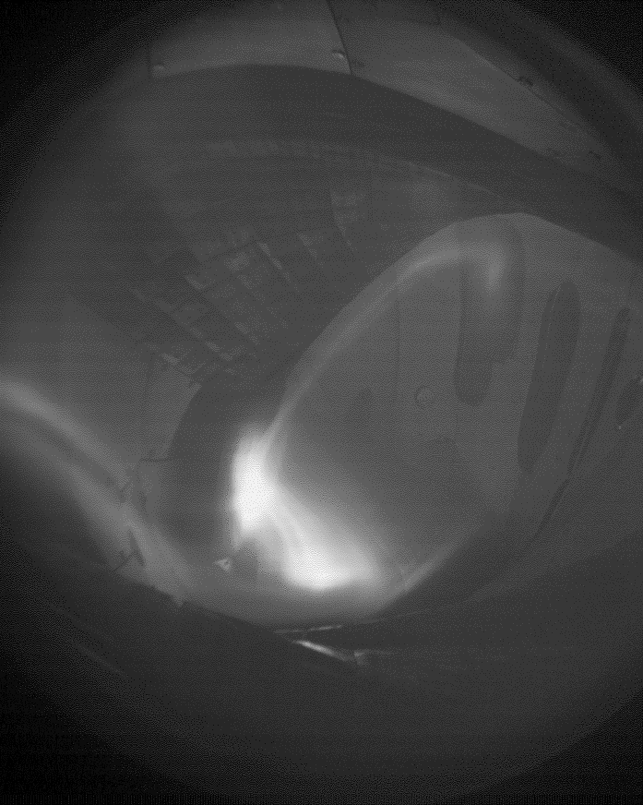
EDICAM capabilites – Slow framing
Plasma monitoring: size, position
Full frame, 50-200 Hz → ROI 1 (convention)
  Plasma and machine overview.
  Plasma size: is the plasma large enough? Is it touching the limiter/divertor?
200 Hz
Fully developed
W7-X plasma
Divertor strike lines are visible.
W7-X plasma grows to full size (limiter version)
T. Szepesi | PPM-7 | 2020.04.01. | Page 10

Slide 11

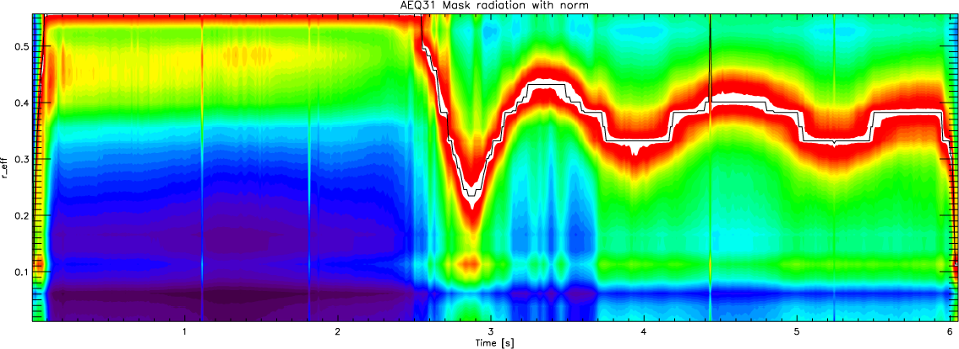
EDICAM capabilites – Slow framing
Plasma monitoring: size, position
100 Hz
W7-X plasma
Density-radiation limit reached, plasma size is not stable.
T. Szepesi | PPM-7 | 2020.04.01. | Page 11

Slide 12
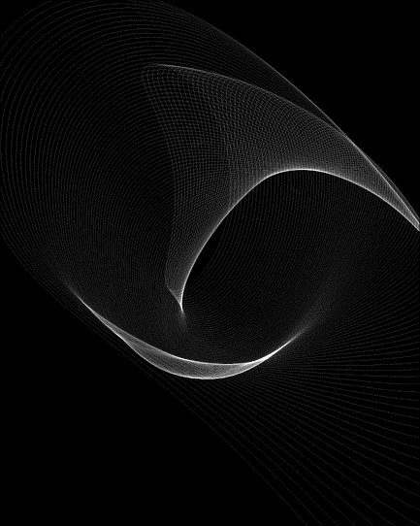
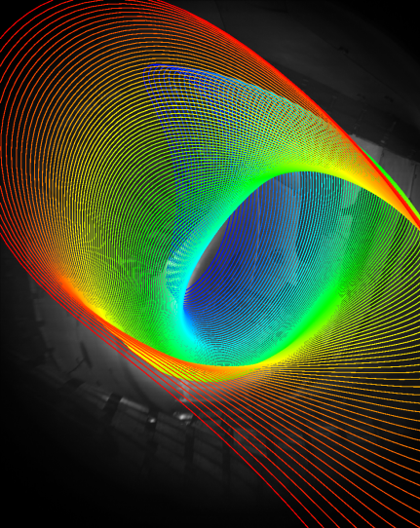



EDICAM capabilites – Slow framing
Plasma monitoring: size, position
Sophisticated plasma boundary analysis: synthetic diagnostic
  Very basic modelling of visible radiation: assume uniform light source
synthetic image
Add offset (R,z)
measurement
Projection of flux surface onto image
Color = toroidal position
Plasma position can be determined as well.
T. Szepesi | PPM-7 | 2020.04.01. | Page 12

Slide 13
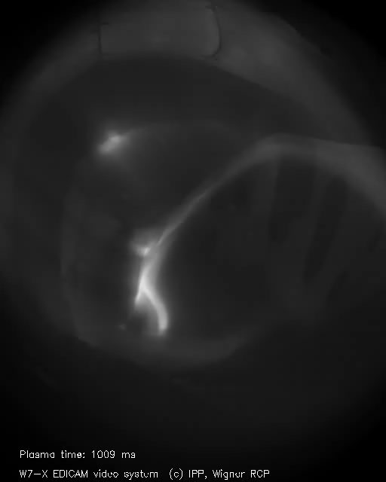
EDICAM capabilites – Slow framing
Hot-spot detection – machine protection
(Unwanted) plasma-wall interaction: visible light emission
  Heat load cannot be determined!
  But (after)glow can be seen (T > 6-800°C)
  → important to record few sec after plasma
Universal hot-spot detection
  Location can be anywhere
  → Needs full frame ROI
  Present method: manual inspection
100 Hz
W7-X plasma
Hot-spot on shielding house
T. Szepesi | PPM-7 | 2020.04.01. | Page 13

Slide 14
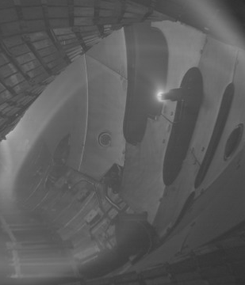
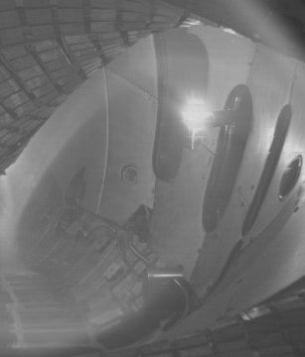
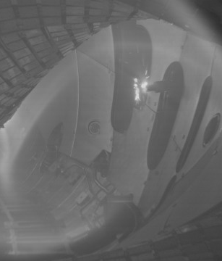
EDICAM capabilites – Slow framing
Hot-spot detection – machine protection
Dedicated hot-spot detection
  Location is known before discharge (e.g. reciprocating probe)
  → full frame ROI can be OK, but smaller/faster ROI possible
  Detection can be automated
T. Szepesi | PPM-7 | 2020.04.01. | Page 14

Slide 15
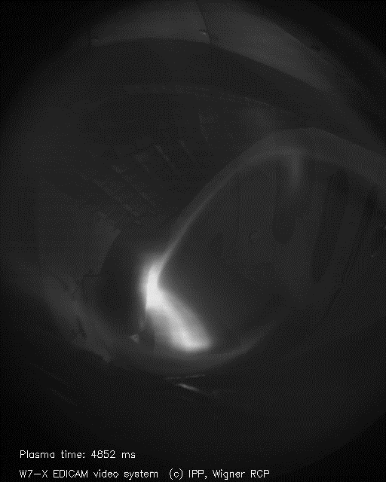
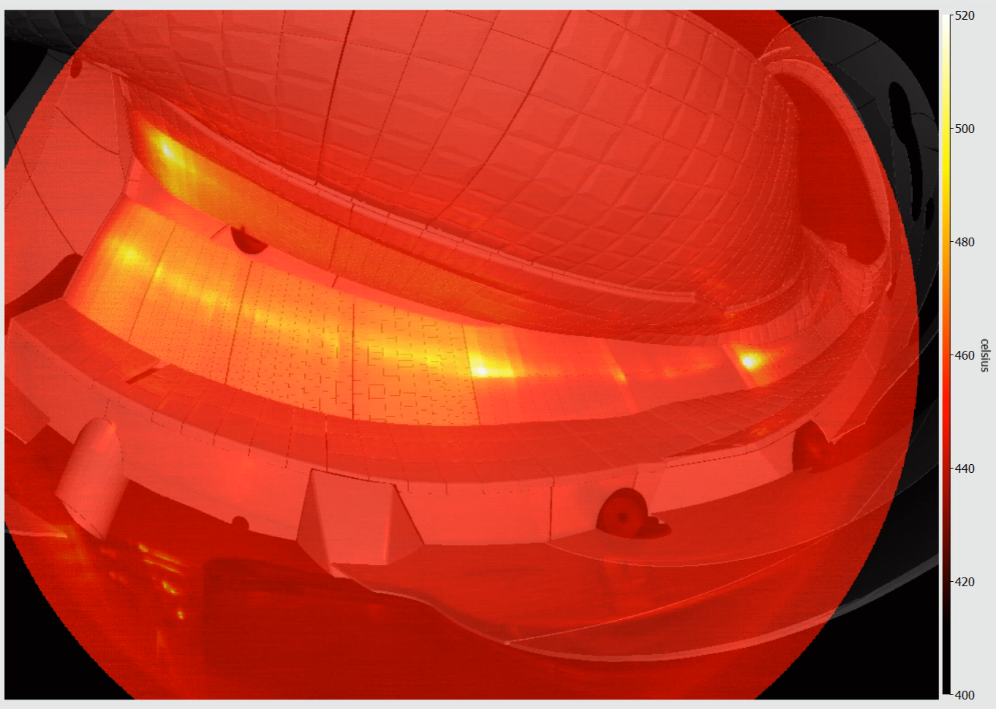
EDICAM capabilites – Slow framing
UFO detection
UFO = hot-spot with changing location
  Difficult to detect and follow
  → can move toroidally (in/out) of view
  Manual inspection required
T. Szepesi | PPM-7 | 2020.04.01. | Page 15

Slide 16
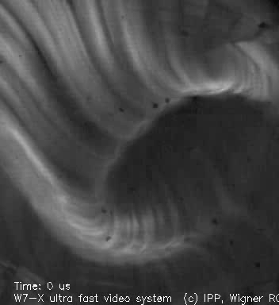
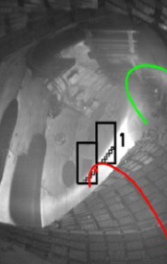
EDICAM capabilites – Fast framing
Observing edge turbulence – filaments in W7-X
Structures elongated along magnetic field lines → visible with exp. times < 50 µs
→ intense edge radiation due to unconditioned first wall
No direct observation of filaments
use correlation methods
calculate phase and coherence between two EDICAM cameras
→ high coherence (> 0.8)
→ linear phase
We observe the filaments
[G. Kocsis et al, EPS 2017]
[S. Zoletnik et al, RSI 89 (2018) 013502]
T. Szepesi | PPM-7 | 2020.04.01. | Page 16

Slide 17
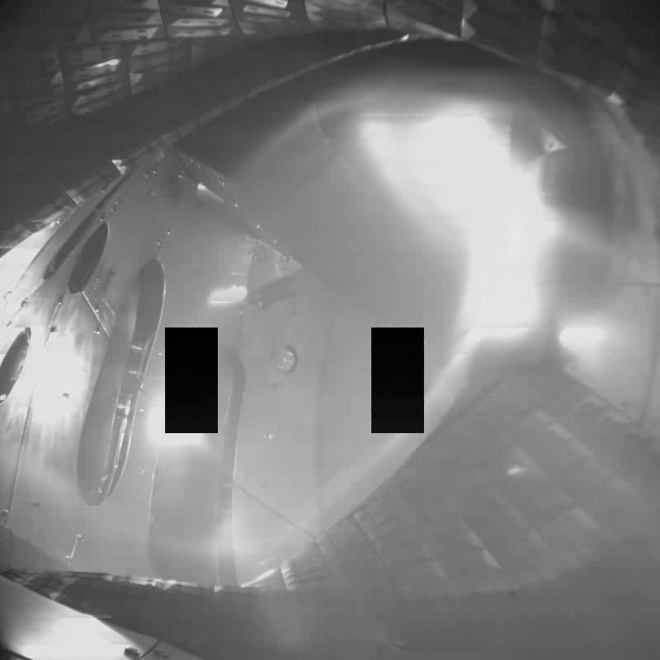
EDICAM capabilites – Fast framing
Utilization of multiple ROIs in the non-destructive readout mode
the EDICAM system can handle upto 6 ROIs simultaneously ≡ 6 cameras
20171115.039
Helium plasma
Pellet injection
ROI #1: full frame, 100 Hz
Here: still image
ROI #2 and #3:
Small area (160x100), 10 kHz
Pellet penetration is temporally resolved!
Event → only during pellets
expo
reset
NDR readouts
NDR readouts
pixel brightness
time
T. Szepesi | PPM-7 | 2020.04.01. | Page 17

