Slide 1
EDICAM: from commissioning to routine use – Part II
Set-up for 1st campaign
Planned applications
EDICAM for ECWC
Available software tools
Commissining, work plan
Plan B
Tamás Szepesi
Á. Kovácsik*,
G. Kocsis, T. Szabolics, S. Zoletnik,
Centre for Energy Research
*Institute for Nuclear Techniques
Budapest, Hungary

Slide 2
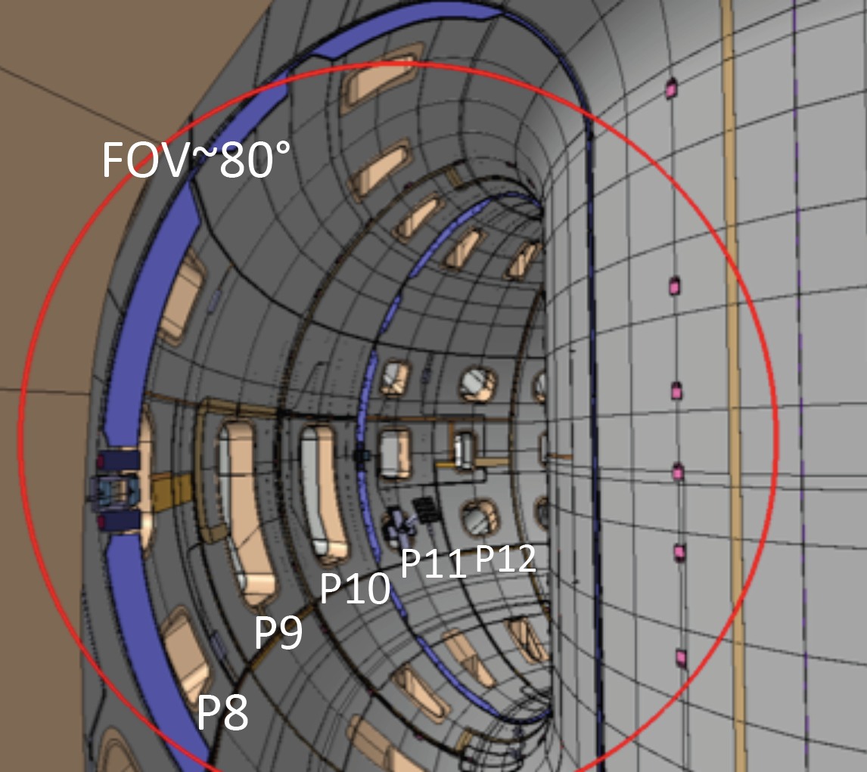
EDICAM for the first campaign
Set-up
Wide-angle view: ca. 1/5 of torus
ROI 1: full frame overview
→ 1280x1024 @ 100 Hz
ROI 2, 3, …
→ fast observations
Aim: make calibration image
with illuminated torus
→ refine ROIs using real image
ROI 1
Full frame 100 Hz
FOV~80°
ROI 2 (e.g. breakdown)
10,000 Hz
ROI 3 (e.g. limiter)
1000 Hz
T. Szepesi | PPM-7 | 2020.04.01. | Page 2

Slide 3
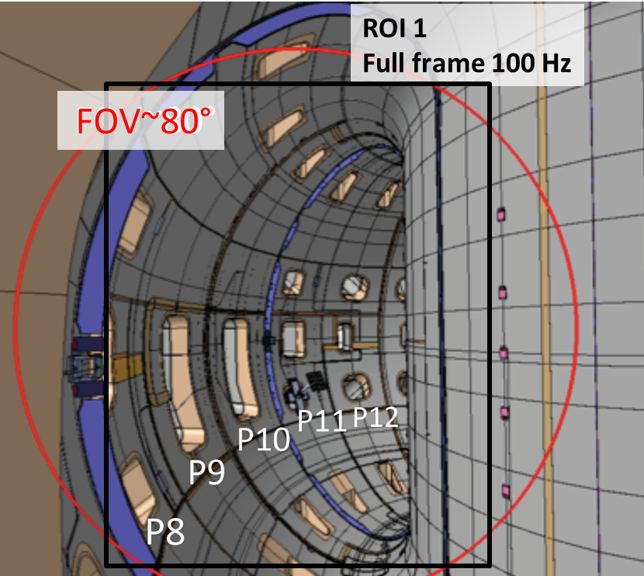
EDICAM for the first campaign
Plasma size and position
ROI 1: 1024x1280 @ 100 Hz
→ control-related issues can be resolved
ECRH shinethrough
radiation collapse
detachment
asymmetries (poloidal)
T. Szepesi | PPM-7 | 2020.04.01. | Page 3

Slide 4
EDICAM for the first campaign
Plasma size and position
ROI 1: 1024x1280 @ 100 Hz
→ control-related issues
ECRH shinethrough
Observed pattern for JT-60SA: more like a toroidal belt
W7-X plasma
Loss of ECRH absorption
T. Szepesi | PPM-7 | 2020.04.01. | Page 4

Slide 5
EDICAM for the first campaign
Plasma size and position
ROI 1: 1024x1280 @ 100 Hz
→ control-related issues
radiation collapse
Source of impurities may be identified as well – if within the view.
W7-X plasma
Radiation collapse
T. Szepesi | PPM-7 | 2020.04.01. | Page 5

Slide 6
EDICAM for the first campaign
Plasma size and position
ROI 1: 1024x1280 @ 100 Hz
→ control-related issues
detachment
Clear change is plasma size and divertor radiation pattern.
Similar behavior is expected at JT-60SA.
W7-X plasma
Transition to detachment
T. Szepesi | PPM-7 | 2020.04.01. | Page 6

Slide 7
EDICAM for the first campaign
Plasma size and position
ROI 1: 1024x1280 @ 100 Hz
→ control-related issues
poloidal asymmetries
Asymmetries, as well as possible sources can be identified.
W7-X plasma
MARFE-like event
T. Szepesi | PPM-7 | 2020.04.01. | Page 7

Slide 8
EDICAM for the first campaign
Safety-related issues
ROI 1: 1024x1280 @ 100 Hz
→ hot-spots
→ UFOs
T. Szepesi | PPM-7 | 2020.04.01. | Page 8

Slide 9
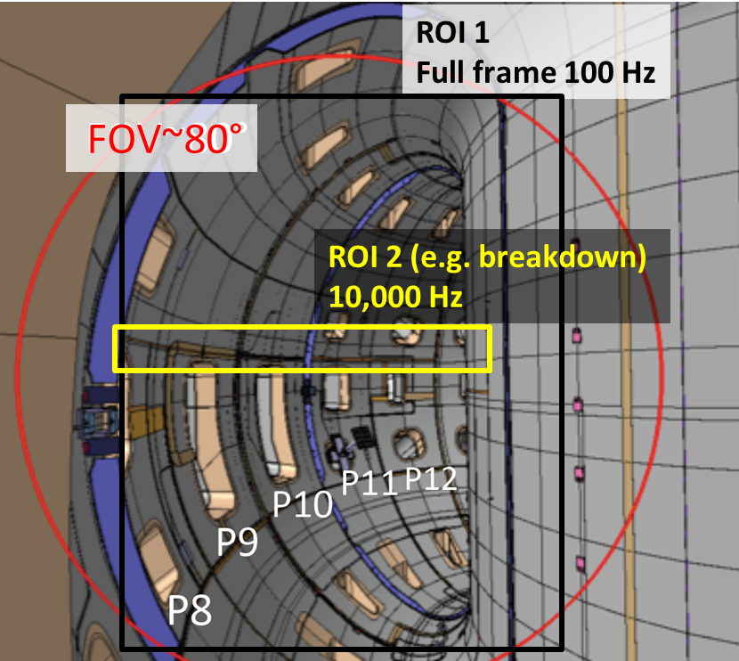
EDICAM for the first campaign
Breakdown studies
ROI 2: 640x64 @ 10 kHz
→ plasma blow-up can be resolved
W7-X breakdown
Compound movie
ROI 1: 100 Hz
ROI 2, 3: 5 kHz
T. Szepesi | PPM-7 | 2020.04.01. | Page 9

Slide 10
EDICAM for the first campaign
Other fast measurements
ROI 2, 3, …
We need experience with the new machine!
T. Szepesi | PPM-7 | 2020.04.01. | Page 10

Slide 11
EDICAM for the first campaign
Use for ECWC: in W7-X it could be observed
ROI 1: 1024x1280 @ 100 Hz
→ similar to other plasmas
→ faint radiation
→ lower frame rate?
T. Szepesi | PPM-7 | 2020.04.01. | Page 11

Slide 12
Available software tools
JVIDACS-JEDIDAQ
camera set-up and control
live view
playback (from PC storage)
IDL movie viewer
playback (from PC storage)
display total image intensity for whole movie
zoom, flip/rotate, false color, gamma, brightness
background correction, median filter (despeckle)
export single images (with corrections)
Specific investigations
IDL
T. Szepesi | PPM-7 | 2020.04.01. | Page 12

Slide 13
Available software tools
EDVIS (EDICAM visualization software)
based on Python
can display and playback 10 movies simultaneously, time sync-ed
display total image intensity for all movies
supports multi-ROI format of EDICAM (HDF5 file)
supports many external formats (mpeg, avi)
zoom, flip, rotate, false color, gamma, brightness
background correction
generate time traces from movies (e.g. software ROI total intensity)
display plasma discharge data (t.b.d.)
export images and movies
T. Szepesi | PPM-7 | 2020.04.01. | Page 13

Slide 14
Commissioning, work plan
No missions foreseen to Naka before campaign
The ”start-up team” shall arrive 1-2 weeks before first plasma
Blow off the dust and wake up the system (6 months)
Test spare power supply kit
Make an additional linkage test if possible
→ in any case: test the data acquisition
Establish working environment
→ check available software (IDL), data access
In-campaign commissioning
Gain experience with JT-60SA plasmas and how machine looks like
Set up additional ROIs
Develop events – if needed
T. Szepesi | PPM-7 | 2020.04.01. | Page 14

Slide 15
Plan B
In case we cannot travel to Naka (e.g. virus crisis)
Send spare components by post
QST personnel not trained for installing/testing
Close supervision of on-site camera operator team is necessary
VC connection for camera setup and operation
→ to find good camera settings
Remote access to EDICAM computers (at least PC1)
EDICAM commissioning only in late shift!
So that we can VC from Europe
T. Szepesi | PPM-7 | 2020.04.01. | Page 15

