Slide 1
TSVV3 – Regular advancement meeting 08/03/2023 – Task 4: code optimization Project news
P. Tamain

Slide 2
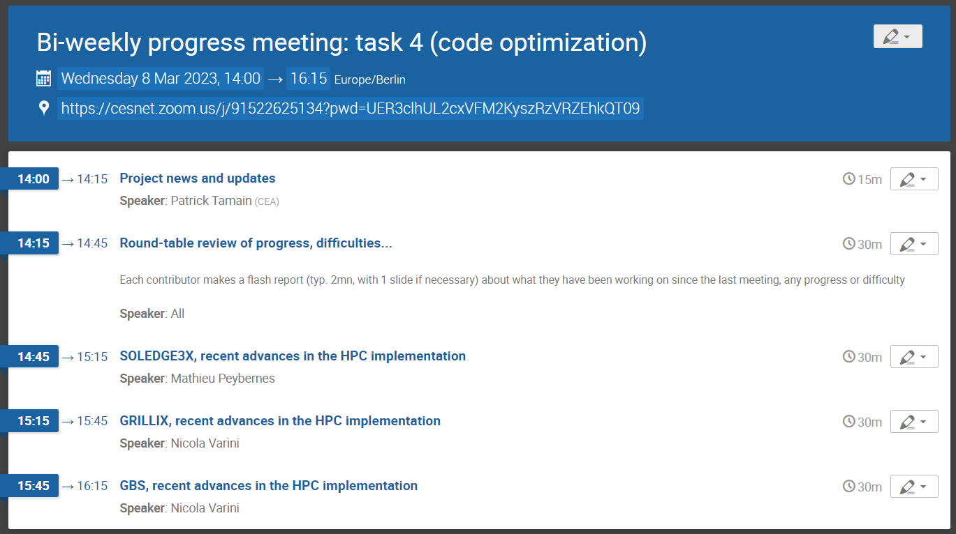
Today’s meeting agenda

Slide 3
Marconi computing time cycle 7
New projects are FUA37_TSVV3 (Skylake) and FUAC7_TSVV3 (GPU)
Officially started on March 1st
$WORK directories moved to new projects, check your paths!
Users not automatically moved to new projects
Doing it on request in order to keep list of users clean and up-to-date
Please contact me if you want access to the projects resources, specifying which project
Reminder of allocations ventilated by team (kh.node):
 | EBC | BIT1 | FELTOR | GBS | GRILLIX | S3X | ACH | TOTAL
Skylake (A3) | 25 | 450 |  | 180 | 400 | 320 | 20 | 1395
GPU (C1) |  |  | 40 |  | 5 |  | 50 | 95

Slide 4
On-going actions
EUROFusion standard software review:
Document circulated last week by e-mail
Please send me updated table by Friday last limit (or simply say no change)
Project’s in-person Workshop:
Location: IPP Garching
Duration: 5 days (project review, “code training”)
Time: circa June, dooldle poll: https://doodle.com/meeting/organize/id/dRl31OVa
Set-up of TCV experiment simulations?

Slide 5
Today’s meeting agenda
Upload presentations on https://indico.euro-fusion.org/event/2500/ or send to me please.

