Slide 1
TSVV3 – Regular advancement meeting 22/03/2023 – Task 5: neutrals physics Project news
P. Tamain

Slide 2
Today’s meeting agenda

Slide 3
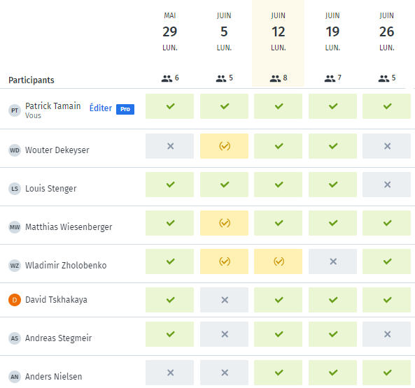
Project in-person workshop
Best date so far:
June 12th – June 16th
Not everyone replied => please do so by Friday
Considering cancelling our bi-weekly meeting until then to avoid redundancy…
Might organize still dedicated meetings on specific topics (e.g., TCV modelling)

Slide 4
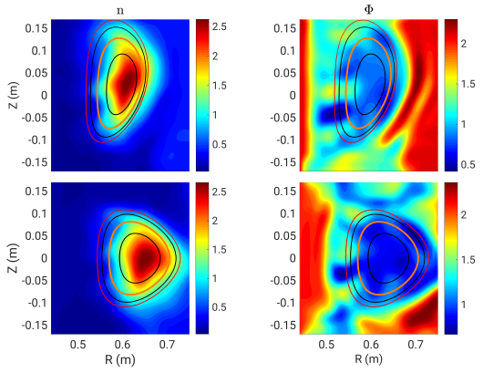
Latest publications
Complex geometries (stellarator)
A.J. Coelho et al : 16th March 2023 | DocumentID : 34872
: Validation of GBS plasma turbulence simulation of the TJ-K stellarator
Journal : Plasma Physics and Controlled Fusion, .

Slide 5
Today’s meeting agenda
Upload presentations on https://indico.euro-fusion.org/event/2501/ or send to me please.

