Slide 1
Status of TCV experiment modelling in soledge3x: 3D turbulence simulations with self-consistent neutrals
V. Quadri, P. Tamain, H. Bufferand, N. Rivals, R. Düll, G. Ciraolo, H. Yang, K. Galazka, G. Falchetto,
and the SOLEDGE3X team all.

Slide 2
3D turbulence + advanced fluid neutrals model for a real case: TCVX21
Demonstration of real scale case with turbulence and neutrals with TCVX21 case.
After discussion with WPTE, move to new experimental equilibrium (“TCVX23”).
H. Bufferand

Slide 3
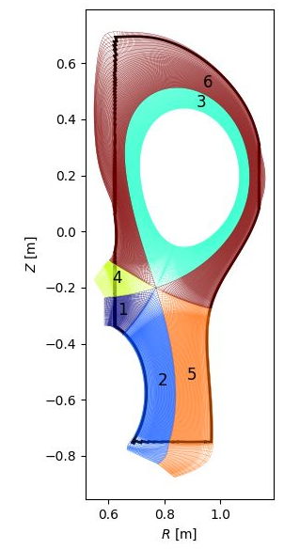
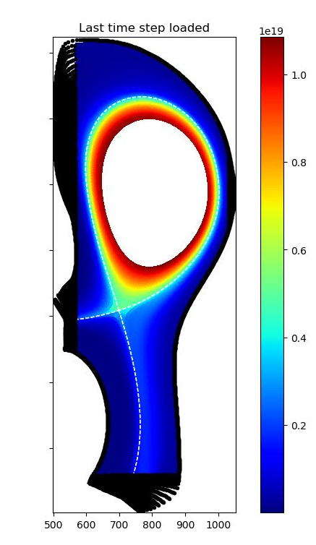
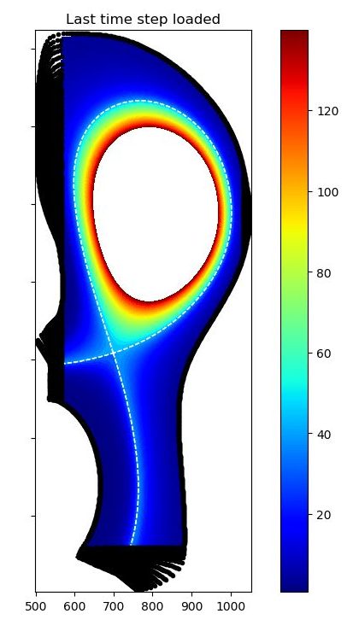
New 3D mesh generated for TCVX23: urgency of accelerating convergence…
$$n_{e} [m^{−3}]$$
$$T_{e} [eV]$$
New mesh with:
TCVX23 equilibrium
Clearance for neutrals in far SOL (avoid artificail gas box behaviour)
1mm resolution at mid-plane and targets
But convergence of particle balance with neutrals costly ~50ms of plasma time
Working on accelerating convergence: reach steady-state in 2D mean-field and then move to 3D turbulence.
P. Tamain

Slide 4
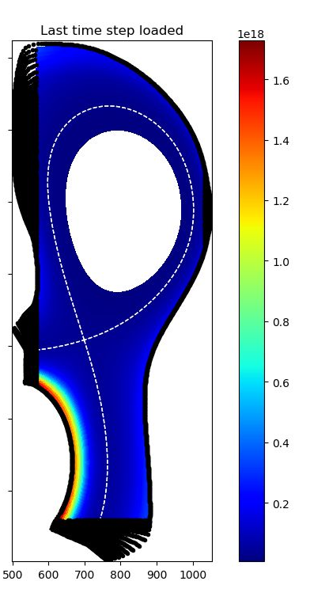
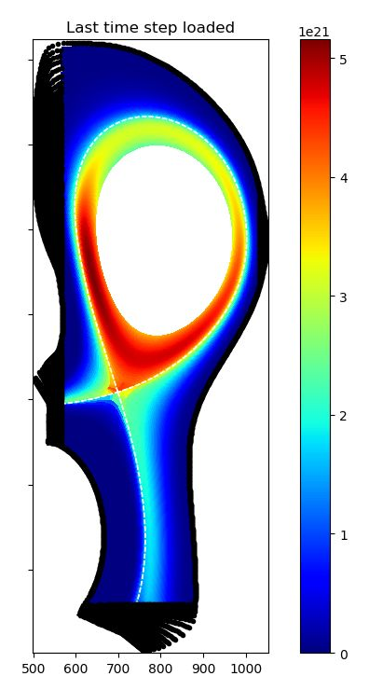
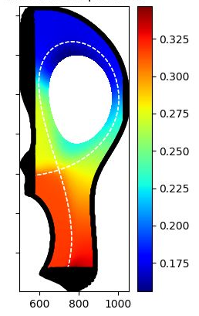
Advanced fluid neutrals (AFN) model in soledge3x leads to high diffusion in diverted geometry
$$n_{N} [m^{−3}]$$
$$p_{N} [Pa]$$
$$S_{n_{N}} [m^{−3}s^{−1}]$$
very low neutral density
no neutral compression in the divertor.
very diffuse ionization map, neutrals concentrating in cold areas.
Is it due to the AFN model or to the parametrization (either not enough puff (${5.5×{10}^{18}m}^{−3}$ ) or not enough recycling ($R_{n}=0.95$)).

Slide 5
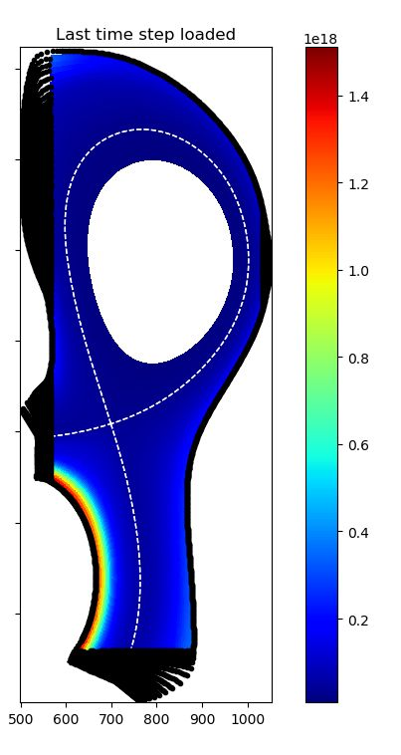
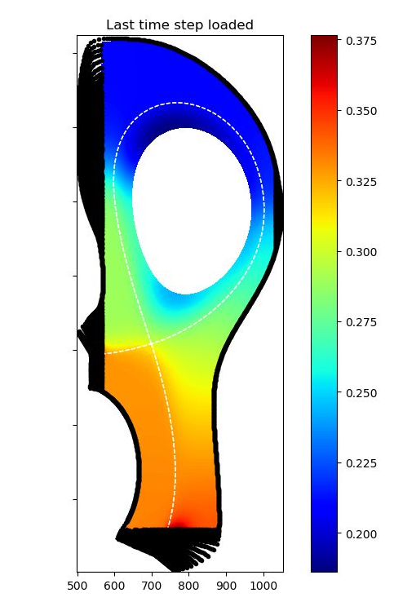
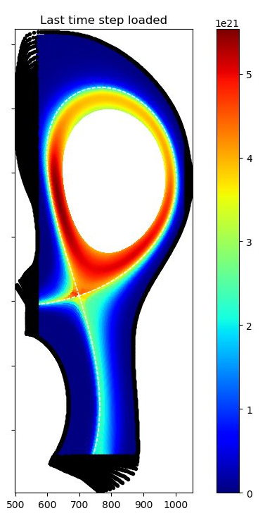
Advanced fluid neutrals (AFN) model in soledge3x leads to high diffusion in diverted geometry
$$n_{N} [m^{−3}]$$
$$p_{N} [Pa]$$
$$S_{n_{N}} [m^{−3}s^{−1}]$$
By doubling the puff $({1×{10}^{19}m}^{−3}$) the value of the density does not increase so much (show?)
Add EIRENE if finished (not yet)

