Slide 1
TSVV3 – Regular advancement meeting 06/09/2023 – TCV validation Project news
P. Tamain

Slide 2
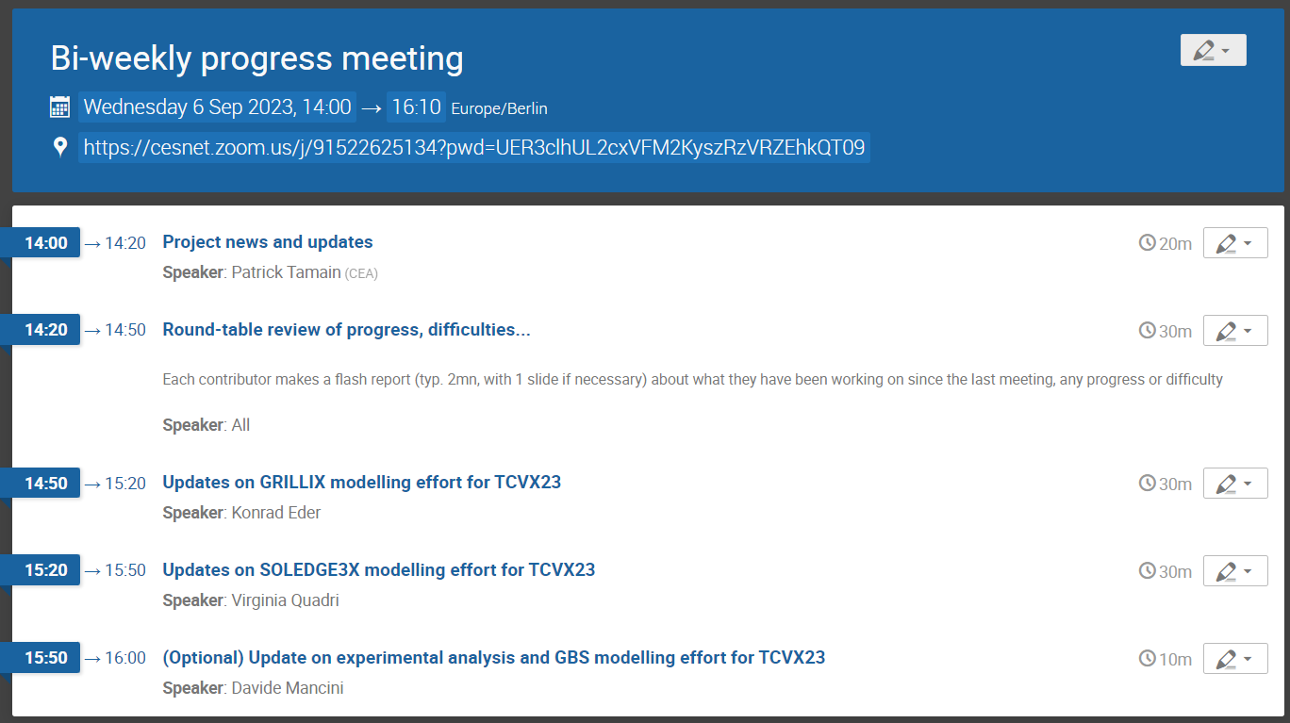
Today’s meeting agenda

Slide 3
EUROfusion code standard survey
Received again a request to update table “Status of the code progress towards the EUROfusion standard software”
Please send back to me before September 15th if any update (still drop an e-mail if no update)

Slide 4
Request for ACH support 2024
Need to submit request for ACH support in 2024
Deadline October 6th
Suggested course of action:
Return to me by Friday 15th individual requests from each group
I will compile all together
Discuss at next bi-weekly meeting on September 20th (with ACH colleagues)
Final iterations after by e-mail if necessary

Slide 5
EUROfusion HPC
MARCONI allocation extended until end of 02/2024
Linear extension of allocated hours
MARCONI100 definitely closed => LEONARDO
Access should have been granted to all of GPU users
Any issue to bring up?
Request from EUROfusion to provide feedback on data storage and analysis needs mid/long term
If you haven’t done so, please feed back to me (see e-mail from 01/09)

Slide 6
Up-coming communications
IAEA 2023: project overview (poster)
Currently writing manuscript
Will submit it simultaneously on pinboard and for your feedback by the end of the week
There will be need for inputs in terms of figures (copyrights!)
Pinboard deadline 04/09, hard deadline 20/09
WPTE Science Meeting / SB presentation for project gate review
Thank you all for providing feedback
Running very late on this
Will try to send slides Friday morning to get rapid feedback

Slide 7
Workplan 2024-2025
Currently writing document summarizing the output of June’s workshop
Will serve as reference for future workplan, in sight of EUROfusion deliverable definitions
I will send it for feedback and approval as soon as it is complete (probably beginning of October)

Slide 8
Proposal for future meetings
TCV-X23 case at the center of effort for mid-term future
Should hold regular dedicated meetings
Suggestion:
Hold it on the time slot of Wednesday’s meetings
Alternate generic task orientated meetings with TCVX23 meetings
Davide, Konrad and Virginia in charge of the agenda

Slide 9
Latest publications
Applied maths / numerics
M Guido et al : 30th August 2023 | DocumentID : 35916
: Subspace Acceleration for a Sequence of Linear Systems Arising from Plasma Simulation
Journal : Journal of Scientific Computing, .
Reduced turbulence models
R. Coosemans et al : 18th August 2023 | DocumentID : 35859
: Mean-field transport equations and energy theorem for plasma edge turbulent transport
Journal : Frontiers in Physics, .
Neutrals and turbulence
K Kvist et al : 15th August 2023 | DocumentID : 35831
: A direct Monte Carlo approach for the modeling of neutrals at the plasma edge and its self-consistent coupling with the 2D fluid plasma edge turbulence model HESEL
Journal : Journal of Computational Physics, .

Slide 10
Today’s meeting agenda
Upload presentations on https://indico.euro-fusion.org/event/2513/ or send to me please.

