Slide 1
TSVV3 – Regular advancement meeting
01/11/2023 – TCV validation
Project news
P. Tamain

Slide 2
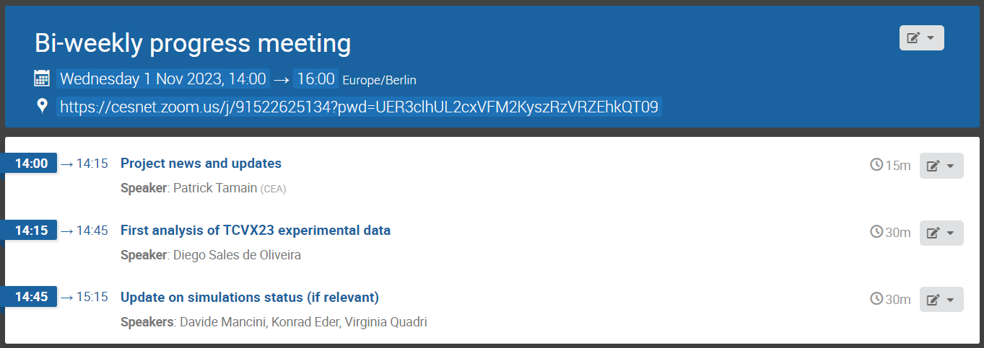
Today’s meeting agenda

Slide 3
Project’s gate review conclusions (1)

Slide 4
Project’s gate review conclusions (2)
TCVX23 

Slide 5
Work-plan 2024-2025
  Document sent this morning
    Please read carefully (especially where there are comments)
    Feedback before middle of next week (November 8th), even if happy with content
  Urgent request from PMU to provide “objectives” and “work description” in IMS
    Requested to be short (2-3 bullets, 10 lines max)
    Proposal:
    FELTOR, GBS, GRILLIX and SOLEDGE3X GPU compatible with demonstration of production run on Leonardo or equivalent machine
    Improved sheath boundary conditions for multi-species collisional plasmas implemented in 1 or several edge turbulence codes, and first evaluation of impact
    Preliminary report on validation exercise between TSVV3 edge turbulence codes and TCVX23 experiment in high density regime

Slide 6
Other on-going actions
  MARCONI call: compiling the requests, will try to send draft by end of week
    If you haven’t done so, still time to send me last minute contribution
  Mission planning 2024:
    My default proposal:
      ~3 days for all projects participants for an in-person project workshop (place tbd) => ~40 people.day
      1 week trip for 1 person in each codes’ team to visit ACH in Lausanne or Barcelona => ~15 people.day
    If incomplete or inaccurate, feedback needed by November 15th
  Budget 2023: all numbers to be frozen November 15th
    Changes in ppy for 2023 need to be made before!

Slide 7
Latest publications
Turbulence with neutrals
V. Quadri et al.: 27th October 2023 | DocumentID : 35107
Self-organization of plasma edge turbulence in interaction with neutrals recycling
Conference : 19th International Workshop on Plasma Edge Theory in Fusion Devices (PET-19), Hefei, Anhui, China.
RANS models
O. Renders et al.: 27th October 2023 | DocumentID : 35100
Formulation and validation of a model for the transport along the magnetic field in varying density regimes for use in 2D drift-fluid turbulence codes
Journal : 19th International Workshop on Plasma Edge Theory in Fusion Devices (PET-19), Hefei, Anhui, China.

Slide 8
Today’s meeting agenda
Upload presentations on https://indico.euro-fusion.org/event/2517/ or send to me please.

