Slide 1
TSVV3 – Regular advancement meeting 29/11/2023 – Project news
P. Tamain

Slide 2
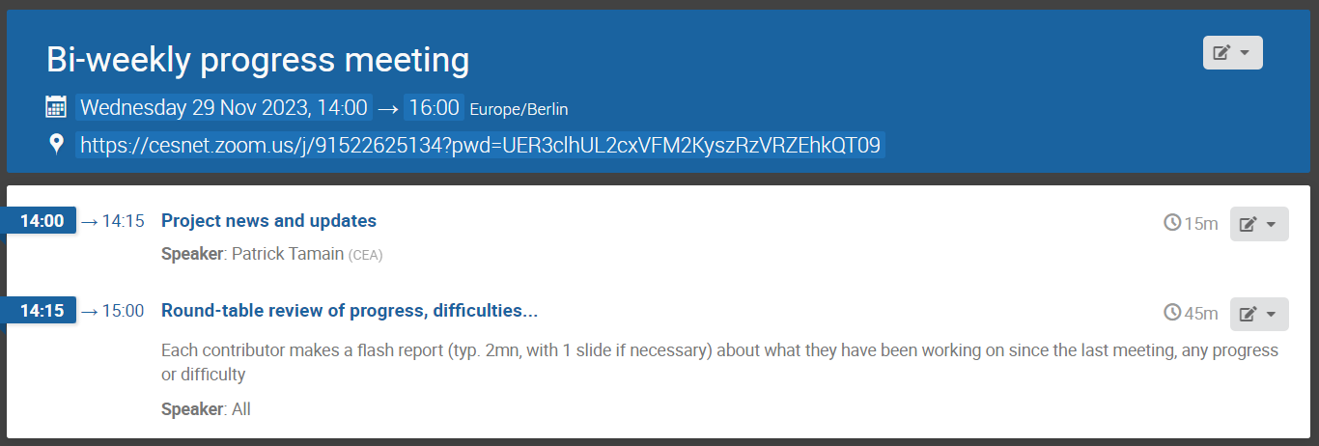
Today’s meeting agenda

Slide 3
Marconi call
Answer to MARCONI call submitted:
Strong increase in request essentially due to merge with GRILLIX project
 | EBC | BIT1 | FELTOR | GBS | GRILLIX | S3X | ACH | TOTAL
Skylake (A3) | 25 (25) | 390 (450) |  | 180 (180) | 1560 (400) | 320 (400) | 20 (20) | 1395 (2575)
GPU (Leonardo) |  |  | 40 (40) |  | (5) |  | 50 (50) | 95 (90)

Slide 4
Work-plan 2024-2025
Document quasi-finalized
No urgency anymore as only 3 deliverables selected for next year (request from PMU):
FELTOR, GBS, GRILLIX and SOLEDGE3X GPU compatible with demonstration of production run on Leonardo or equivalent machine
Improved sheath boundary conditions for multi-species collisional plasmas implemented in 1 or several edge turbulence codes, and first evaluation of impact
Preliminary report on validation exercise between TSVV3 edge turbulence codes and TCVX23 experiment in high density regime
Nevertheless want to complete it shortly, 3 feedbacks missing:
Feedback from DTU on miHESEL and nHESEL activities (Alexander)
Feedback from Anders and Anna on synth. diags (might delay decision on this to January)
New deliverable added after feedback => need validation
D5.5 | Refine fluid neutrals models available in turbulence codes by adding further moment balance equations and reworking recycling boundary conditions | Report on progress of fluid neutrals model in SOLEDGE3X and GRILLIX | CEA, IPP-G, KUL | 12/2024 12/2025

Slide 5
End of year report
Same format as last year (will send template by e-mail, pre-filled with deliverables)
Max 6 pages => 1 or 2 paragraphs per team + a key figure are enough
Please make sure that any communication is posted on the pinboard
Submission deadline: 31/12/2023. Retro-planning:
22/12: submission
20/12: deadline for last comments/suggestions
15/12: first full draft circulated for validation
13/12: discussion of outstanding points at TSVV3 meeting
08/12: feedback from each team following template

Slide 6
Deliverable: attempt at ITER case
One of deliverable for end of 2023: report on attempt at ITER case
Outcome can be anything: impossible / doable but costly / easy
No need necessarily to use ITER equilibrium: ITER-relevant resolution on circular grid enough to feed discussion and satisfy deliverable
If really impossible to run, estimates based on weak scaling can be used

Slide 7
TCVX23 update
Diego is preparing to put new data on Gateway repository (issue with access)
We should all aim at having 1 case at beginning of density ramp, 1 case at end of density ramp
NB: SOLEDGE3X-EIRENE mean-field simulations with no special tuning are beyond detachement at all densities with newly corrected values from Diego
Rather than fine tuning parameters (recycling coefficient…), aiming at lower density cases than suggested by experimental data to have 1 attached and 1 detached case
Please provide feedback during round-table

Slide 8
Latest publications (1)
EM turbulence in SOLEDGE3X
R Düll et al : 9th November 2023 | DocumentID : 36288
: Introducing electromagnetic effects in Soledge3X
Journal : Contributions to Plasma Physics, .
Review of fluid edge plasma turbulence modelling tools
E Serre et al : 22nd November 2023 | DocumentID : 36366
: Global fluid simulations of edge plasma turbulence in tokamaks: a review
Journal : 0 - Please choose a journal, . (Computers and Fluids)

Slide 9
Latest publications (2)
PSI abstracts
D Moiraf et al : 23rd November 2023 | DocumentID : 36370
: Heat and particle flux control in double-null configuration in WEST: Experimental study and modeling with SOLEDGE
Conference : 26th International Conference on Plasma Surface Interaction in Controlled Fusion Devices (PSI-26), Marseille, France, 12th May 2024.
R Düll et al : 28th November 2023 | DocumentID : 36434
: Electromagnetic effects in turbulent structures with Soledge3X
Conference : 26th International Conference on Plasma Surface Interaction in Controlled Fusion Devices (PSI-26), Marseille, France, 12th May 2024.
Co-authors : H.Bufferand, E.Serre, G.Ciraolo, V.Quadri, N.Rivals, P.Tamain
K Eder et al : 28th November 2023 | DocumentID : 36440
: Fluid modeling of plasma-neutral turbulence in detached plasma regimes
Conference : 26th International Conference on Plasma Surface Interaction in Controlled Fusion Devices (PSI-26), Marseille, France, 12th May 2024.
Co-authors : W. Zholobenko, A. Stegmeir, F. Jenko

Slide 10
PSI conference
Other contributions to come:
Edge turbulence in high-density divertor regimes (V. Quadri)
Mean-field modelling of ITER FPO seeded case with SOLEDGE3X,including discussion on simulation convergence acceleration (S. Srikanth)
Any other?
Requested to give review talk on status of fluid edge plasma modelling tools
Title: “The path to high-fidelity numerical modelling of exhaust issues in magnetic fusion devices: challenges, state-of-the-art and perspectives”
Scope: mean-field and turbulence, world-wide (extends IAEA contribution)
TSVV3 = large contribution => will interact with all of you for the preparation

Slide 11
Today’s meeting agenda
Upload presentations on https://indico.euro-fusion.org/event/2519/ or send to me please.

