Slide 1
ACH visit
Mathieu and Emily visited IRFM from 17/11 – 23/11:
review of GPUization actions (changes to be made in the code)
review of communication pattern in SOLEDGE3X => defined strategy to reduce by factor of 2
Miscellaneous: implementation of cmake compilation and improvement of pipelines for non regressions test

Slide 2
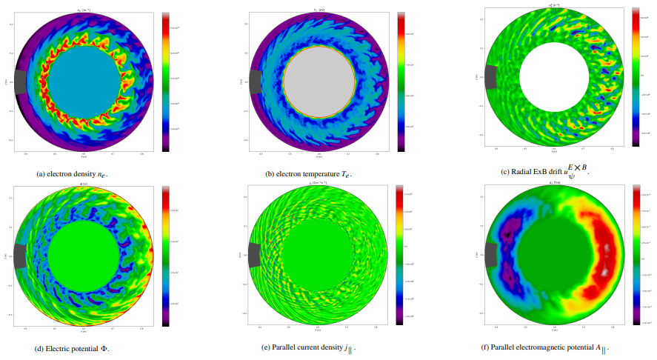
On-going developments (1)
Collisional closure with unified interface: Braginskii, Zhdanov or Raghunathan (M. Raghunathan)
Quasi-complete, under-going unit and non-regression tests
EM turbulence with flutter in all geometries (R. Düll)
Working in circular geometry, discretization issues being solved with X-point
Open way to RMP modelling
[R. Düll, submitted to CPP]

Slide 3
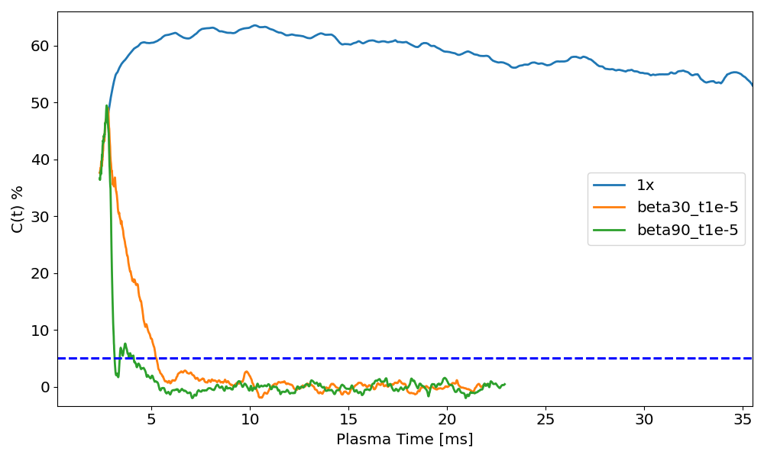
On-going developments (2)
Reflections on neutrals physics for DT cases (S. Suresh)
How to deal with DT molecules?
Acceleration scheme for convergence of simulations with neutrals implemented and under test (S. Suresh)
factor of >10 on ITER mean-field simulations!

Slide 4
On-going developments (3)
Development of generic flexible interface to EIRENE as stand-alone package (N. Rivals)
Basic coupling features implemented (not diagnostics), first tests by mid-december
On-going work to develop an automatic searchable simulations database (D. Midou)

Slide 5
On-going simulations
Mean-field simulations:
WEST X-point radiator and high-fluence scenarios (D. Moiraf, R. Iammarino, N. Rivals)
ITER FPO seeded cases, D+He+Ne without and with drifts (S. Srikanth, N. Rivals)
TCVX23 cases (V. Quadri):
restart from converged 2D mean-field cases finally obtained (many minor technical issues)
running to check if accelerates time (V. Quadri)
TCVX21 cases (H. Bufferand)
Hugo running several cases (ref + power ramp), exploring possibility of multi-grid approach to turbulence modelling (60ms of plasma time simulated!)

