Slide 1
TSVV3 – Regular advancement meeting 13/12/2023 – Task 2: sheath boundary conditions Project news
P. Tamain

Slide 2
Today’s meeting agenda

Slide 3
Work-plan 2024-2025
Feedback still needed from DTU on multi-species and neutrals:
“Use 2D turbulence simulation (nHESEL) to perform basic studies of plasma turbulence – neutrals interaction on the impact of noise and non-linearities”
“Test with mi-HESEL the impact of the approximation made in SOLEDEG3X of dropping the polarization drift (in non-linear turbulence simulation), including a scan through the mass of species. Provide recommendations on implementation in 3D turbulence codes.”

Slide 4
End of year report
Same format as last year (will send template by e-mail, pre-filled with deliverables)
Max 6 pages => 1 or 2 paragraphs per team + a key figure are enough
Please make sure that any communication is posted on the pinboard
Submission deadline: 31/12/2023. Retro-planning:
22/12: submission
20/12: deadline for last comments/suggestions
15/12: first full draft circulated for validation
13/12: discussion of outstanding points at TSVV3 meeting
08/12: feedback from each team following template – missing input from IPP-P

Slide 5
Deliverable: attempt at ITER case
Status of attempts at ITER case?
Please provide feedback during round-table
I will need a micro-report to complete the end of year report by the end of next week (except GRILLIX team, CPC paper sufficient)

Slide 6
Marconi time usage
Possible issue with management of batches of jobs and priorities on Marconi:
Use of job arrays gives higher priority to large bunches making it difficult to run single simulations
Shall we define common policy?
For information, status of CPU time consumption:
Month consumption (cpu.h)
Integrated year consumption (cpu.h)
Month #
Month #

Slide 7
EUROfusion call for AI applications
EUROfusion issue call for: “Project proposals for innovative Artificial Intelligence and Machine Learning Methods used in support of EUROfusion programme objectives.”
Quick brainstorming: any view of applications for TSVV3?
Random ideas:
Acceleration of implicit solvers? (potentials, neutrals…)
Initial plasma conditions?

Slide 8
Review paper by F. Schwander et al.
Some reactions to review paper by F. Schander, E. Serre et al. of which I am co-author (https://users.euro-fusion.org/webapps/pinboard/EFDA-JET/journal/index.html#Document36366)
A bit of context:
Paper put on pinboard and submitted ~20 days ago: submission too rapid without waiting for feedbacks
Almost immediately accepted by editor (no review!?)
E. Serre was hoping to use ping-pong with referees to include possible corrections
This paper is not meant to represent the official position of TSVV3 (if this has any meaning)
To make it clear, asked to be withdrawn from list of authors
Might be an issue as editor a priori refuses it => currently insisting

Slide 9
Latest publications
PSI abstracts
V. Quadri et al : 7th December 2023 | DocumentID : 36554
: Edge plasma turbulence simulations in high density regimes
Conference : 26th International Conference on Plasma Surface Interaction in Controlled Fusion Devices (PSI-26), Marseille, France, 12th May 2024.
K. Eder et al : 28th November 2023 | DocumentID : 36440
: Fluid modeling of plasma-neutrals turbulence in detached regimes
Conference : 26th International Conference on Plasma Surface Interaction in Controlled Fusion Devices (PSI-26), Marseille, France, 12th May 2024.
D Moiraf et al : 23rd November 2023 | DocumentID : 36370
: Heat and particle flux control in double-null configuration in WEST: Experimental study and modeling with SOLEDGE
Conference : 26th International Conference on Plasma Surface Interaction in Controlled Fusion Devices (PSI-26), Marseille, France, 12th May 2024.
R Düll et al : 28th November 2023 | DocumentID : 36434
: Electromagnetic effects in turbulent structures with Soledge3X
Conference : 26th International Conference on Plasma Surface Interaction in Controlled Fusion Devices (PSI-26), Marseille, France, 12th May 2024.

Slide 10
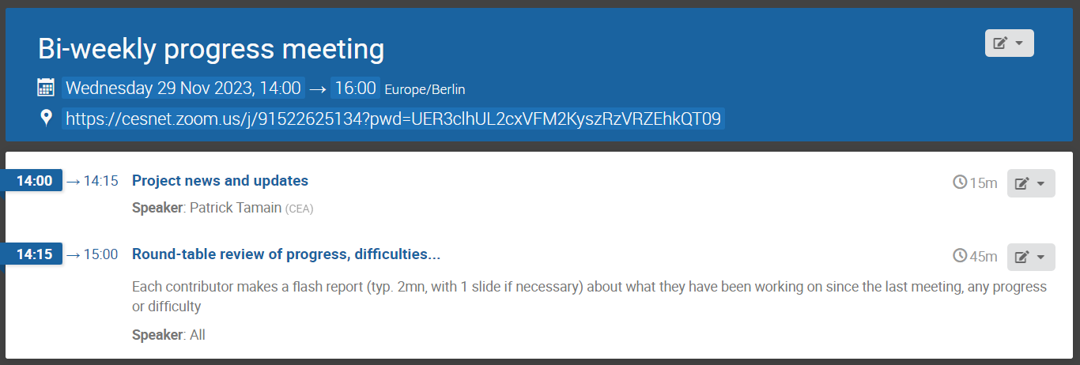
Today’s meeting agenda
Upload presentations on https://indico.euro-fusion.org/event/2520/ or send to me please.

