Slide 1

EIROforum
Who ?
Why ?
How ?
A short introduction
J. Figueiredo / EUROfusion
on behalf of the EIROforum Instrumentation WG

Slide 2
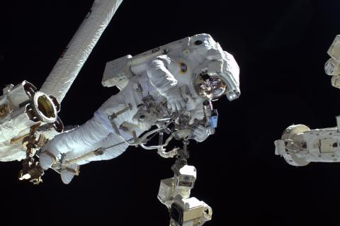
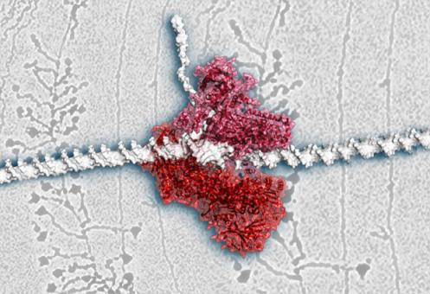
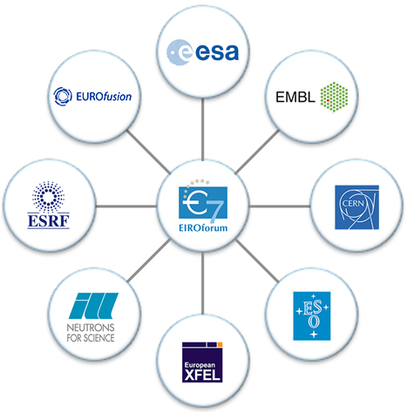
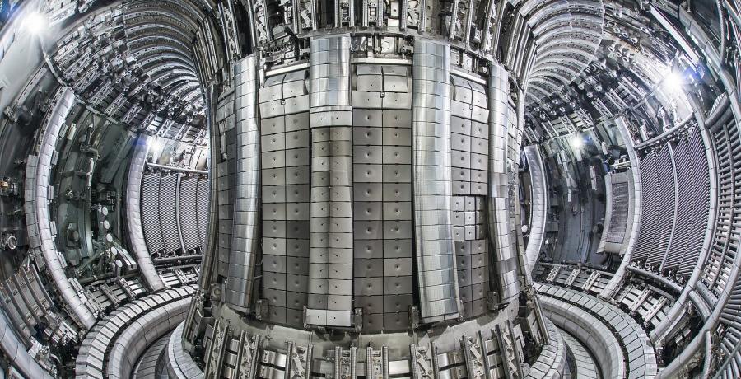
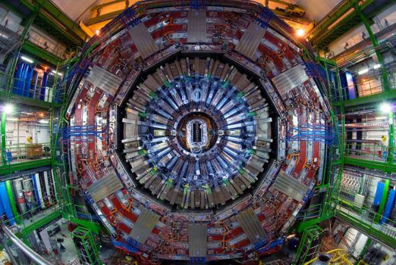
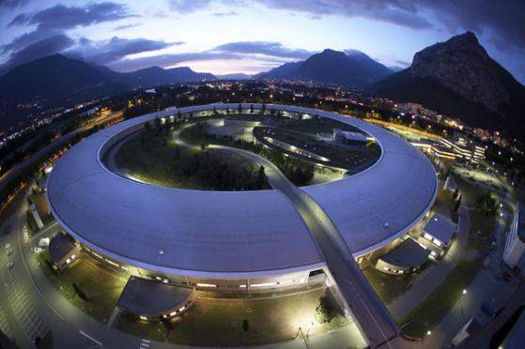
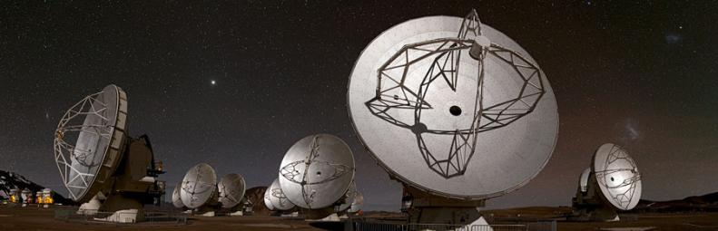
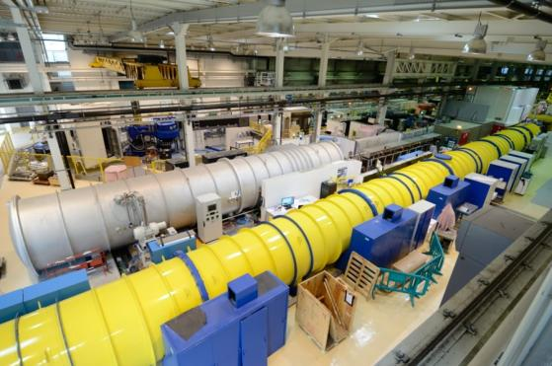
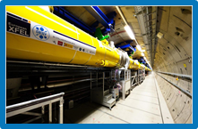
1975
Who ?
1974
Previously EFDA
(1999)
2014
European Intergovernmental Research Organisations
1954
8 Members
= ‘EIROs’
1989
1962
2009
1967

Slide 3


CERN – Conseil Européene pour la Recherche Nucléaire
CERN – European Laboratory for Particle Physics
CERN: founded in 1954:
12 European States
“Science for Peace”
Today: 23 Member States
~ 2600 staff
~ 1800 other paid personnel
~ 14000 scientific users
Budget (2019) ~ 1400 MCHF
Accelerating Science and Innovation
Notes:
3

Slide 4
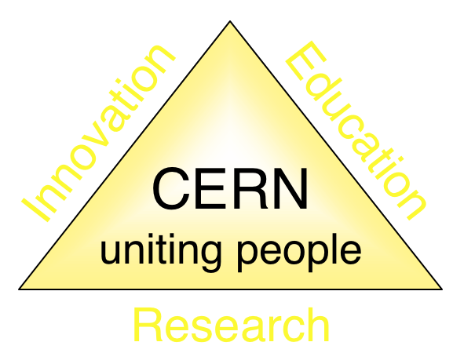
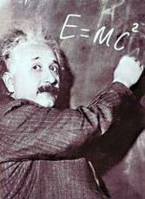
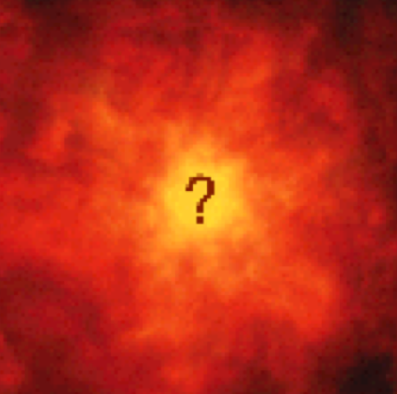
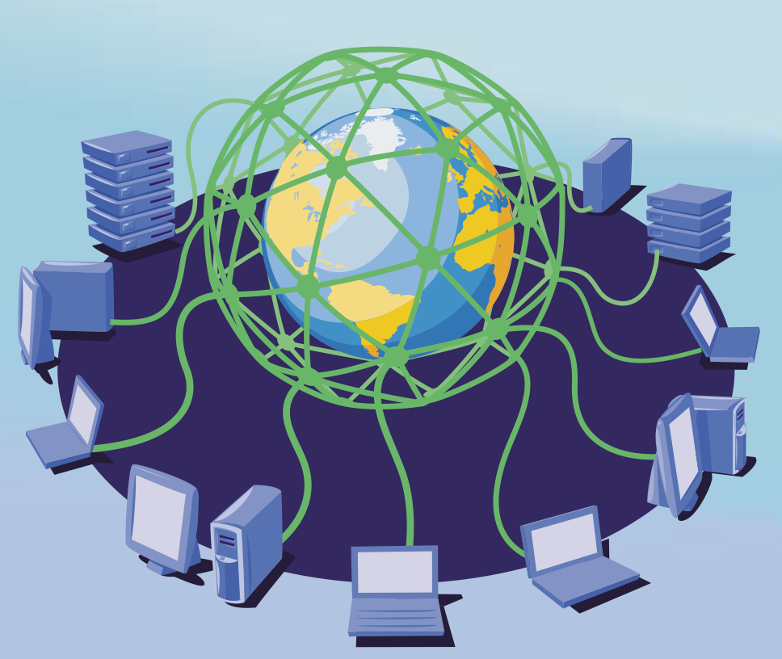
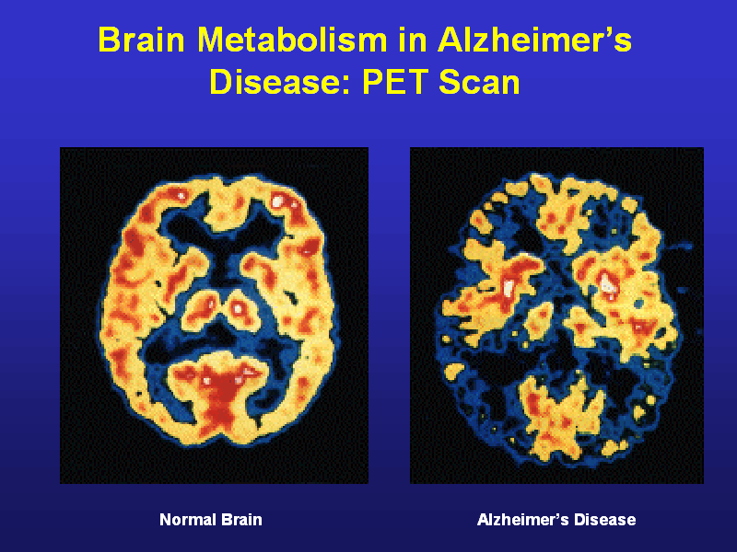
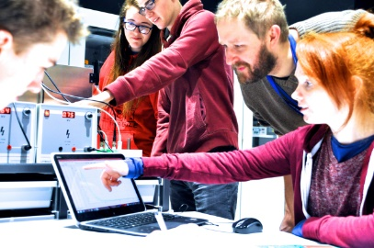
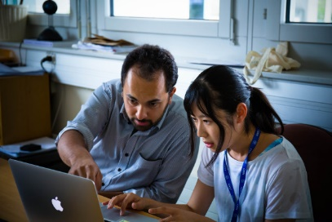
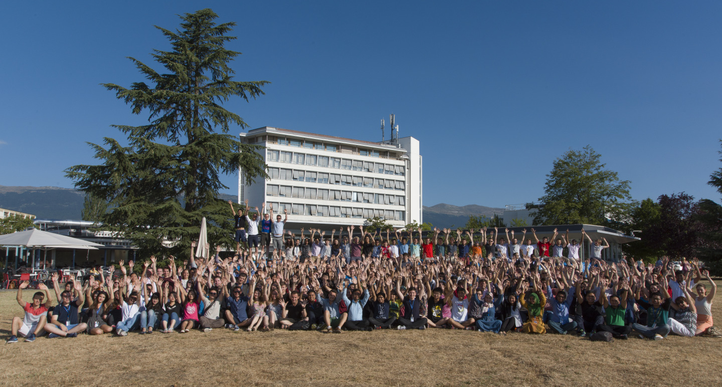
The Mission of CERN
Push back the frontiers of knowledge
E.g. the secrets of the Big Bang …what was the matter like within the first moments of the Universe’s existence?
Develop new technologies for accelerators and detectors
Information technology - the Web and the GRID
Medicine - diagnosis and therapy
Train scientists and engineers of tomorrow
Unite people from different countries
and cultures
ESI
Notes:
4

Slide 5
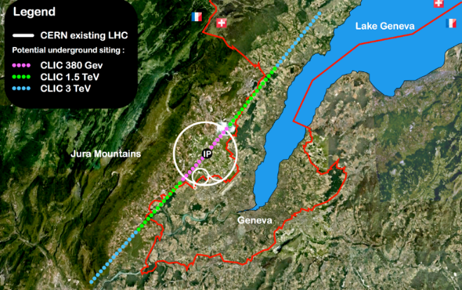


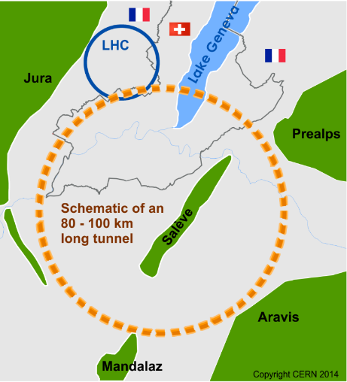
Future of particle physics
High Luminosity LHC until 2035
Ten times more collisions than
the original design
Studies in progress:
Compact Linear Collider (CLIC)
Linear e⁺e⁻ collider √s up to 3 TeV
Future Circular Collider (FCC)
New technology magnets →
100 TeV pp collisions in 100km ring
e⁺e⁻ collider (FCC-ee) as 1st step?
HE-LHC in the present LHC tunnel
with FCC-hh technology?
European Strategy for Particle Physics

Slide 6
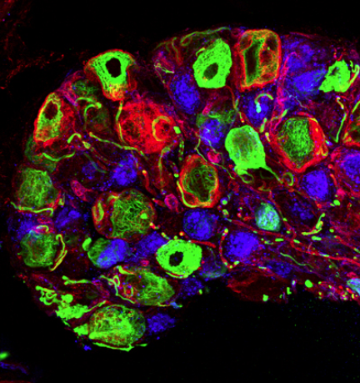
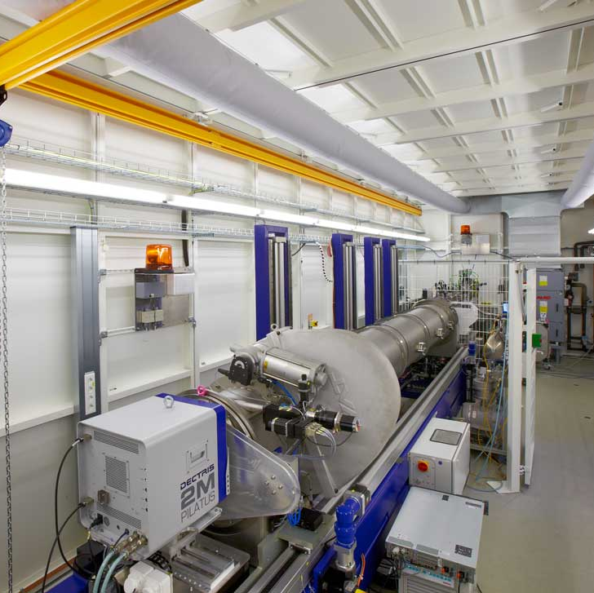
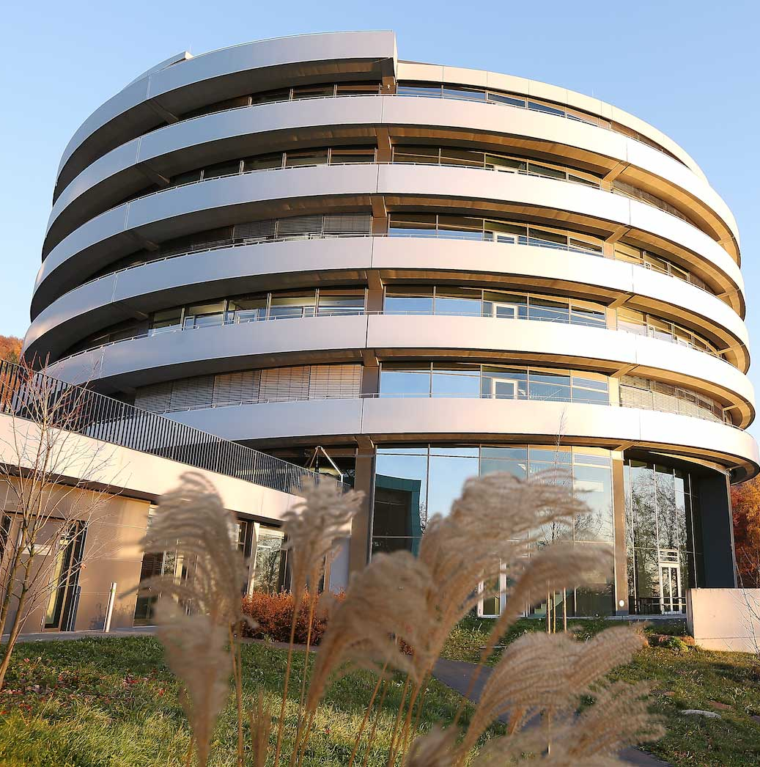
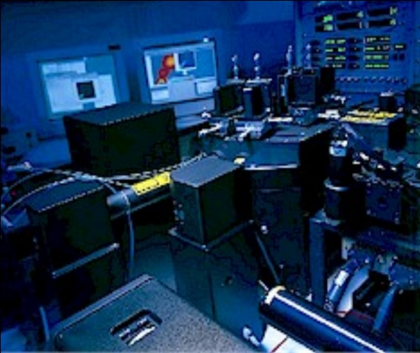
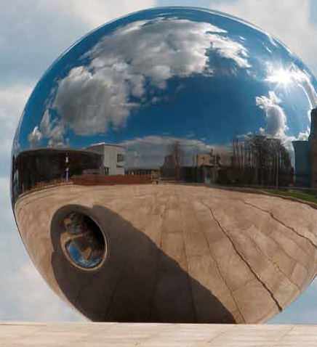
European Molecular Biology Laboratory (EMBL) - Missions
Basic research
Services
Advanced training
Technology development
& transfer
Integration
of life science research
Notes:
EMBL pursues five synergistic missions that, in combination, complement and provide added value to the activities of member state scientific communities.
1. Forefront research: uncovering the molecular basis of life
2. Providing world-class research infrastructure and services
3. Training and inspiring the next generation of leading scientists
4. Driving research, innovation and progress through technology development, interactions with industry and technology transfer
5. Playing a leading role in the integration of life science research in Europe
Images: LCastaldi/EMBL,Udo Ringeisen/EMBL, Marietta Schupp/EMBL, Photolab/EMBL, Photolab/EMBL

Slide 7
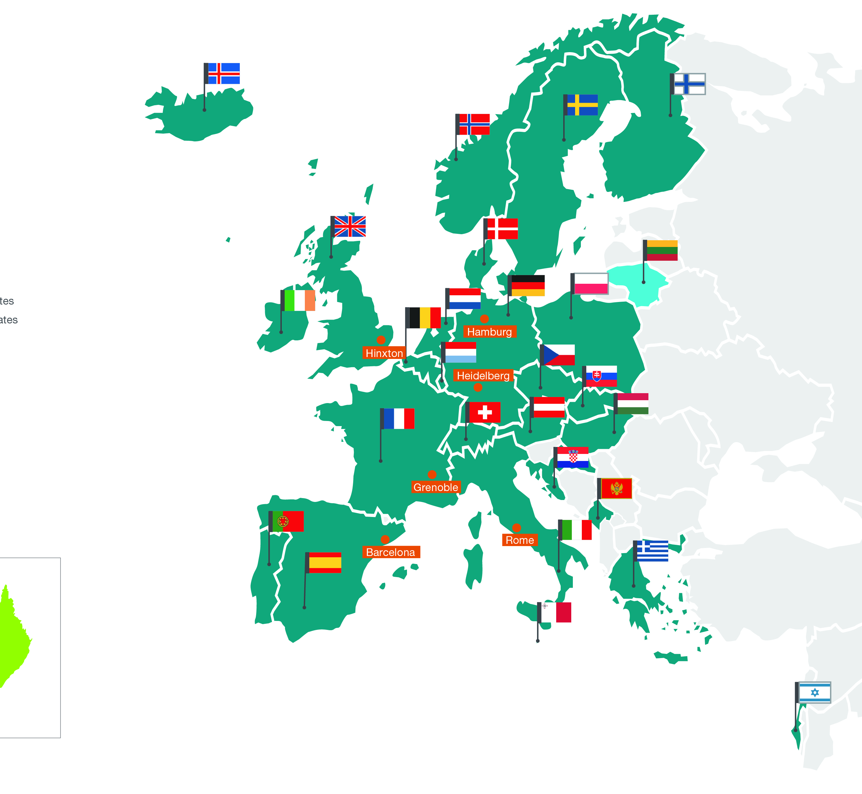
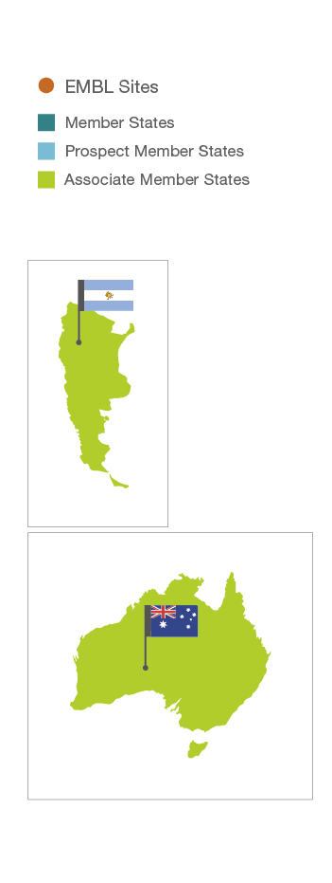
EMBL member states (1974-2019)
Member states (26)
Associate
member states
Austria 1974
Denmark 1974
France 1974
Germany 1974
Israel 1974
Italy 1974
Netherlands1974
Sweden 1974
Switzerland 1974
United Kingdom 1974
Finland 1984
Greece 1984
Norway 1985
Spain 1986
Belgium 1990
Portugal 1998
Ireland 2003
Iceland 2005
Croatia 2006
Luxembourg 2007
Czech Republic 2014
Malta 2016
Hungary 2017
Slovakia 2018
Montenegro 2018
Poland 2019
Australia 2008
Argentina 2014
Prospect member states
Lithuania 2015
Annual Budget ~ 240 m€, ~1700 staff

Slide 8
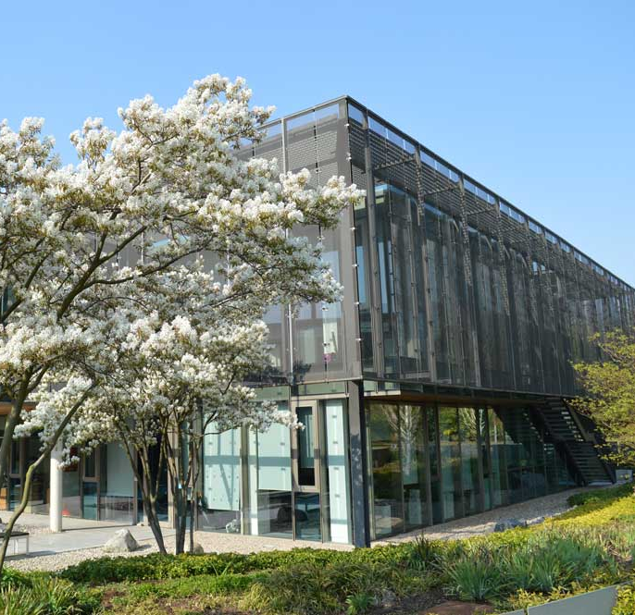
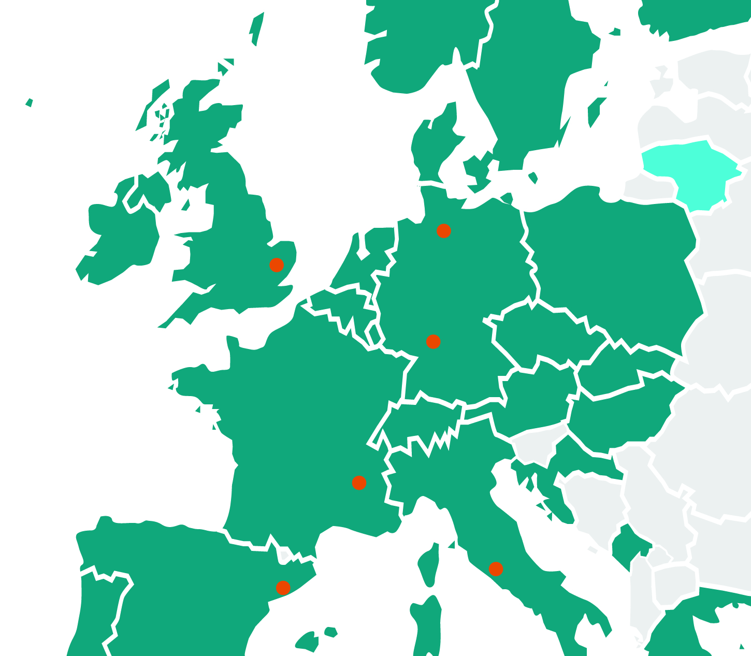
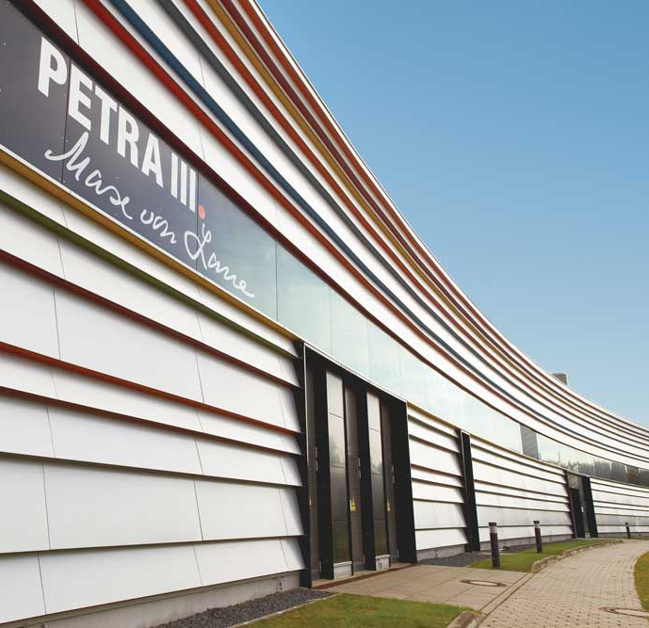
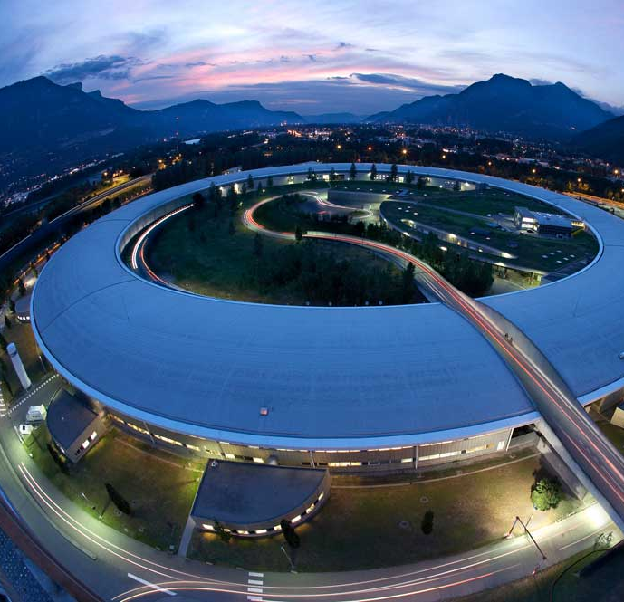
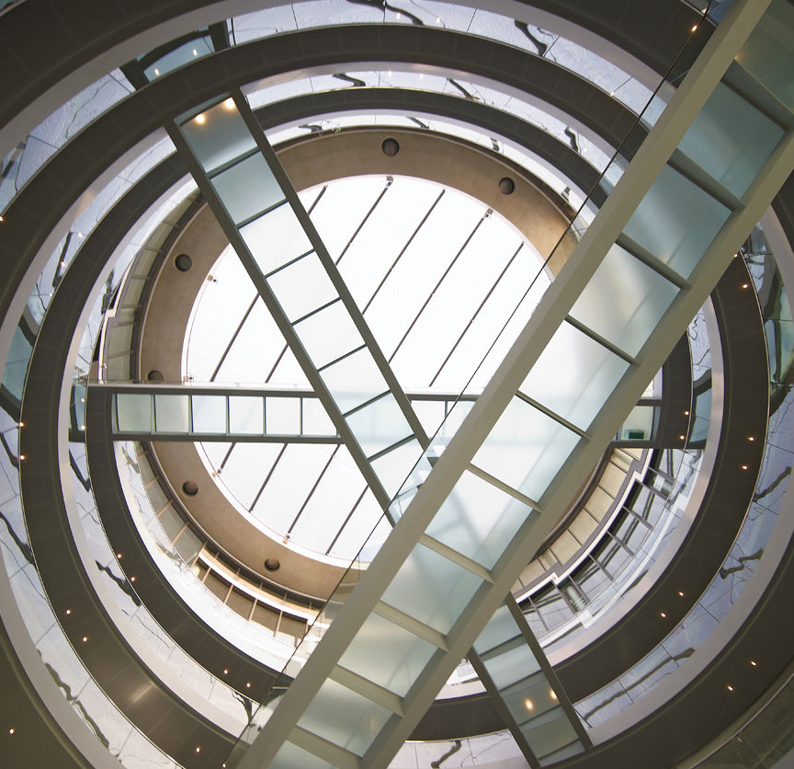
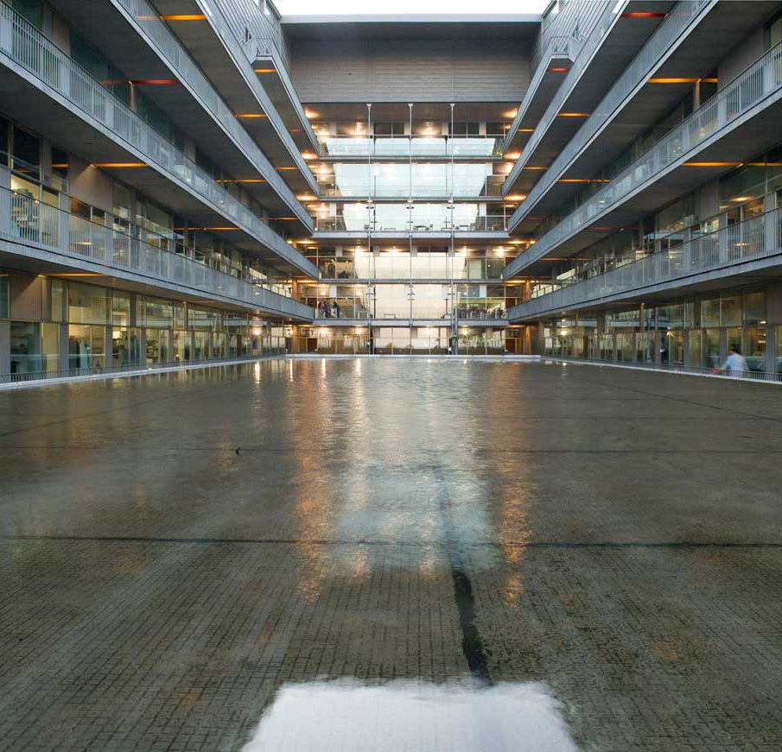
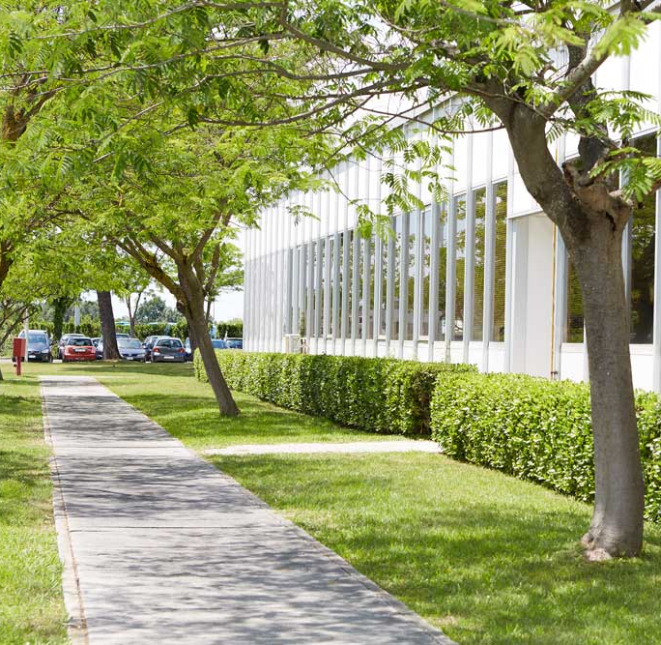
EMBL sites – over 1700 people and more than 80 nationalities
Hinxton
EMBL-EBI
Hamburg
Bioinformatics
Structural biology
Grenoble
Heidelberg
Structural biology
Life sciences
Barcelona
Rome
Tissue biology and disease modelling
Epigenetics
and neurobiology
Notes:
Images:
Photolab/EMBL Photolab/EMBL
Peter Ginter Photolab/EMBL
Ferran Mateo /PRBB Photolab/EMBL

Slide 9
THE EUROPEAN
SPACE AGENCY
UNITED SPACE IN EUROPE

Slide 10
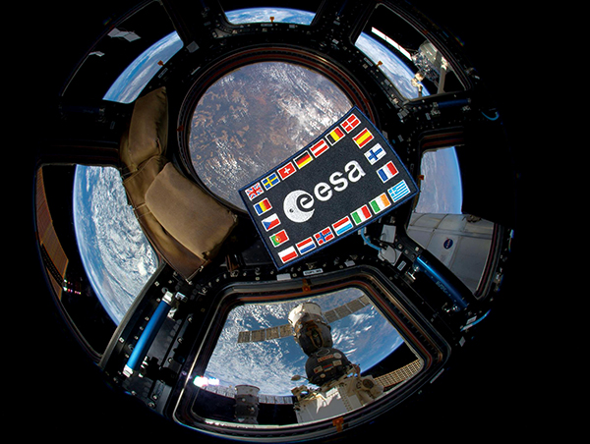
ESA facts and figures
  Over 50 years of experience
  22 Member States
  Eight sites/facilities in Europe, about 2300 staff
  7.8 billion Euro budget (2024)
  Over 80 satellites designed,
  tested and operated in flight

Slide 11
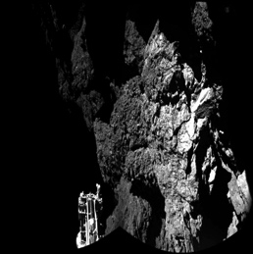
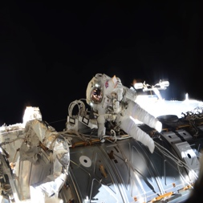
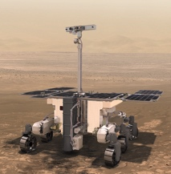
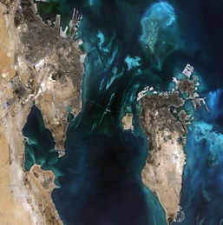
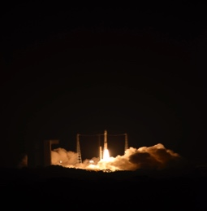
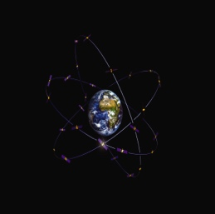
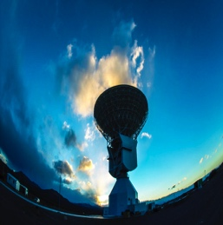
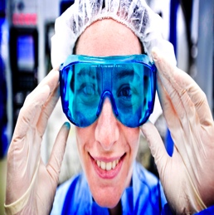
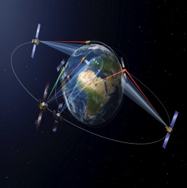
Activities
space science
human spaceflight
exploration
ESA is one of the few space agencies in the world to combine responsibility in nearly all areas of space activity.
earth observation
launchers
navigation
operations
technology
telecommunications

Slide 12

ESO
“European Southern Observatory”
Intergovernmental research organization for ground-based astronomy.
Mission: “Provide state-of-the-art research facilities to astronomers and astrophysicists”.
Founded: 1962
Member States in 2024: 16
Annual budget: ~160 M€
Staff members: ~700

Slide 13
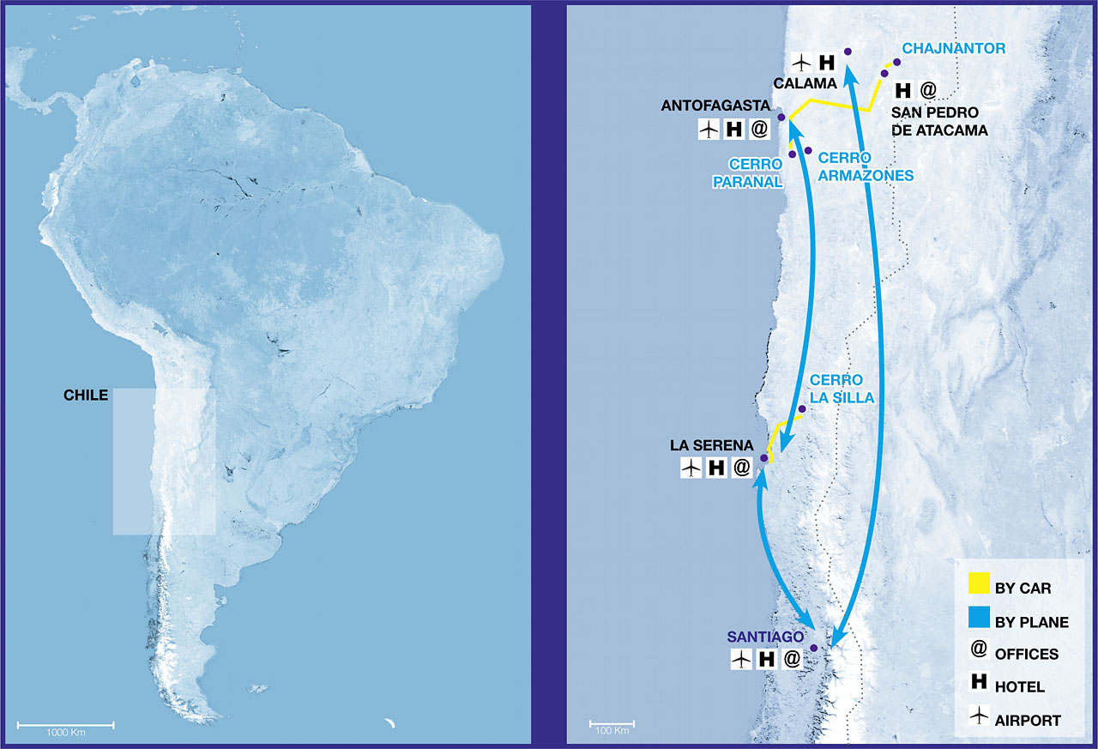
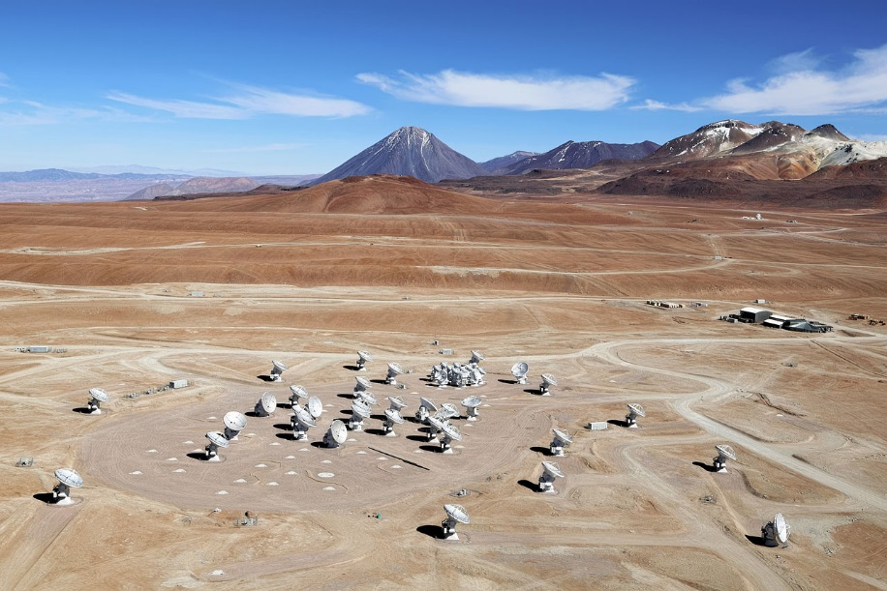
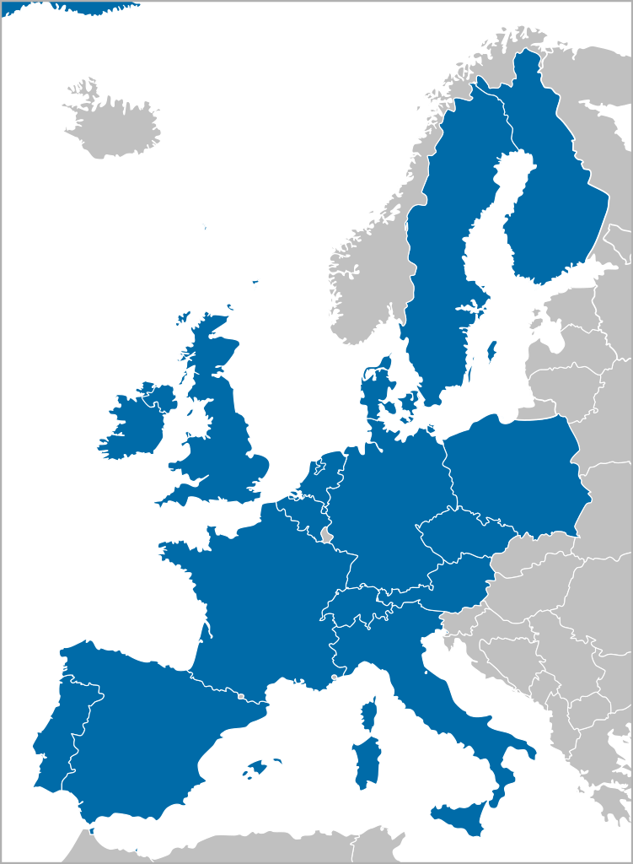
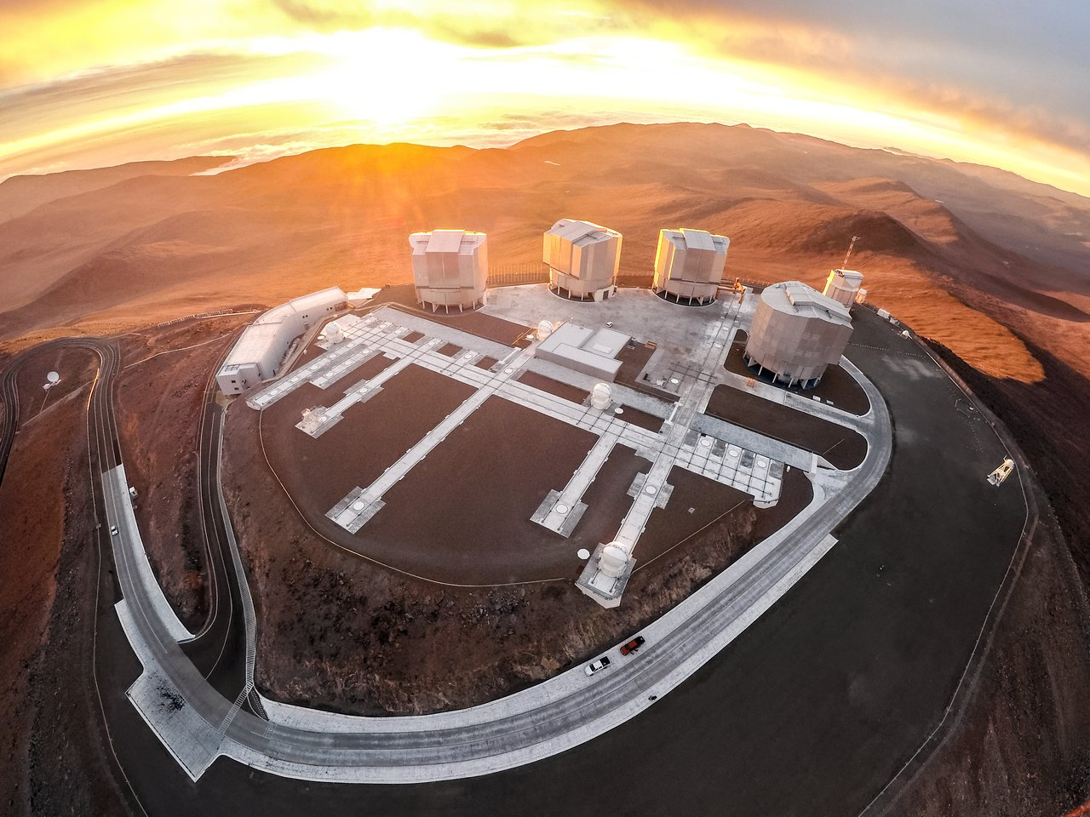
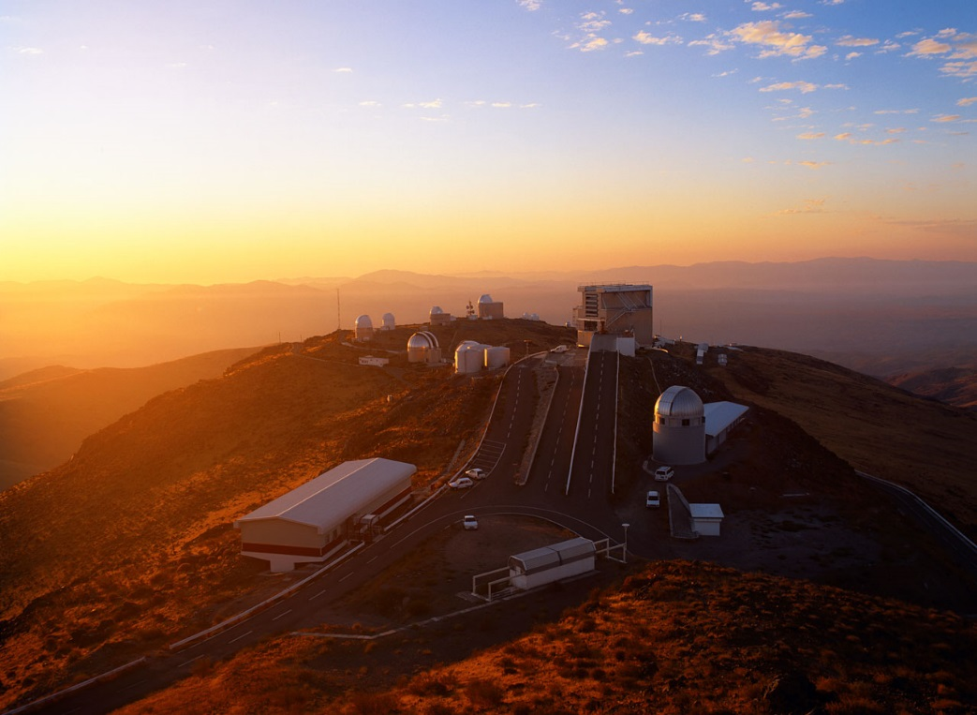
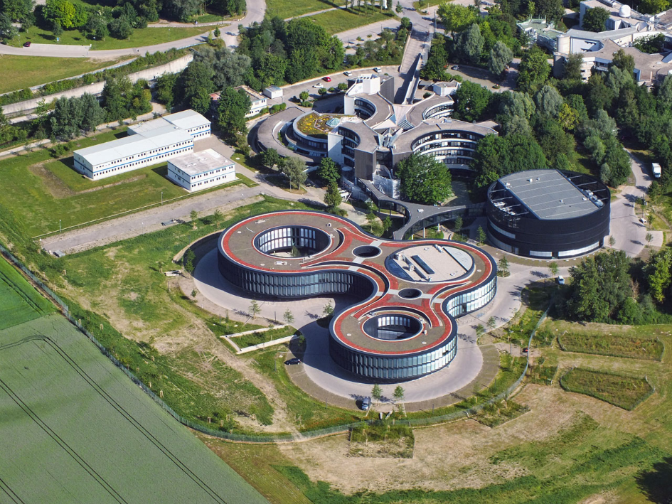
ESO – Sites
ALMA on Chajnantor (5100m)
Garching b. München
VLT on Cerro Paranal (2635m)
La Silla (2400m)
Observatories in Chile
Headquarters (482m)

Slide 14
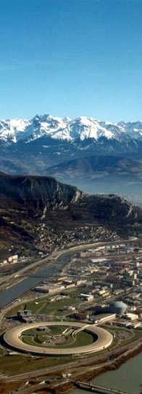
ESRF: European Synchrotron Radiation Facility
A user facility for cutting-edge science with X-rays
Exploration of the structure and dynamics of our
complex world, down to the single atom.
Scientific excellence. Access to experiment time is competitive, and selection of experiments is guided by external review.
Accessibility. The use of the ESRF is free of charge for all academic research. Close to a quarter of the academic research at the ESRF involves industrial partners. Industrial use of our facilities and expertise, including full intellectual property protection, is possible.
Openness. The results of academic research at the ESRF are always published, and the knowledge, skills and technologies developed at the ESRF are shared with the member countries and associates.
Grenoble, EPN campus, founded in 1989, 600 staff, 50 beam lines, 13 member states
Synchrotron with 800 m circumference

Slide 15





ESRF Upgrade Programme: An ambitious programme to prepare the future
Purple Book
January 2008
Orange Book
January 2015
ESRF UPGRADE PHASE I
180 M€ (2009-2015):
ESFRI ROADMAP 2006-2016
IN TIME – WITHIN BUDGET
19 new beamlines,
many specialised on
nano-beam science
Upgrade and renewal of
facilities and support
laboratories
ESRF-EBS
Extremely Brilliant Source
150 M€ (2015-2022)
ESFRI LANDMARK (2016)
a new revolutionary low-emittance storage ring
New beamlines
Data (analysis) as a service
- Instrumentation programme

Slide 16

European XFEL—a leading new research facility
The European XFEL is a new research facility that uses high-intensity X-ray light to study the structure of matter.
  User facility with 400 employees (+250 from DESY)
  Location: Hamburg and Schenefeld, Germany
  September 2017 start of user operation
Schenefeld research campus on 31 May 2018

Slide 17

About European XFEL
Organized as a non-profit corporation in 2009 with the mission of design, construction, operation, and development of the free-electron laser
Supported by 12 partner countries
Germany (federal government, city-state of Hamburg, and state of Schleswig-Holstein) covers 57% of the costs; Russia contributes 26%; each of the other international shareholders 1–3%
Total budget for construction (including commissioning)
  1.25 billion € at 2005 prices, about 118 M€ operating budget
  600 M€ contributed in cash, over 550 M€ as in-kind contributions (mainly manufacture of parts for the facility)

Slide 18

Institut Laue-Langevin – founded in 1967
World leader in neutron science and technology
The neutron is a unique and irreplaceable probe, with characteristics that cannot be supplanted by other methods
Major neutron sources: 10 in Europe, 6 in North America, 5 in Asia and Oceania
The ILL is the most intense neutron source in the world, at the service of international scientists, to carry out scientific research at the frontiers' of modern science
Notes:
18

Slide 19

ILL’s Second Mission is to Help Building Europe
The advent of the scientific members continues the process.
Close to one Billion €
of capital investment
An annual budget
of approximately 90 M€
A highly qualified workforce of about 500 people
Notes:
19

Slide 20







Key figures about the ILL
1400 users from an active community of 12 000 scientists
850 experiments/year
650 publications/year
65 countries
28 instruments + 10 CRGs
(collab. Res. Group instruments)
4 cycles of 50 days/year
Notes:
20

Slide 21


Programme Management Unit
EUROfusion supports and funds fusion research activities on behalf of the European Commission’s Euratom programme.
All EU Member States plus Switzerland have joined the EUROfusion agreement involving 29 fusion laboratories and numerous Third Parties.
Their combined effort will achieve the ultimate goal: fusion electricity by 2050
ITER

Slide 22




Roadmap towards fusion electricity
Fusion is practical, attractive
Power Plant
JT-60SA
ITER
DEMO
Fusion is feasible
Fusion is plausible
Fusion is commercially exploited
~2020
Operation
~2025
~2050
Fusion facilities around the world

Slide 23
Why ?
The eight EIROs have extensive expertise in the areas of basic research and the management of large, international infrastructures, facilities and research programmes.
There is limited thematic overlap, however the EIROs share similar principles and methodologies, use similar methods and tools, face similar challenges and needs.
It therefore makes sense to form a relatively ‘loose’ configuration (forum) in order to combine the resources, facilities and expertise of its member organisations to support European science in reaching its full potential.

Slide 24
How ?
Our DGs meet twice a year and agree on joint actions, statements, policies, best practices …
Within EIROforum, the organisations form joint working groups, e.g. on information technology, instrumentation, outreach, technology transfer, …
→ Expertise within the organisations is identified and shared in common projects and events.
The EIROforum School on Instrumentation (ESI) is one of the main activities of the Instrumentation WG.
Even though the goals and approaches are very different in the 8 EIROs, instrumentation is based on the same principles and often on similar technical solutions.
A school seems like an ideal event to learn from each other and build new relations, between students … and teachers.

