Slide 1
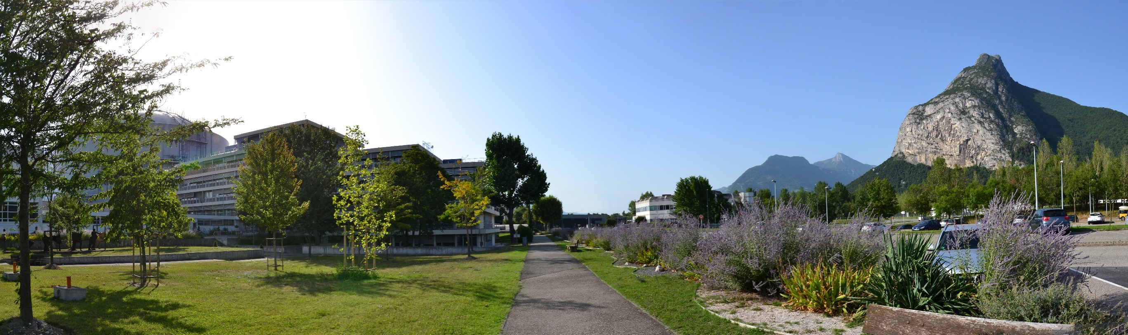
NOMAD More Than A Simple Sequencer

Slide 2
Outline
ILL - 57 years of neutron science
Facts and figures
NOMAD – Experiment control software
Different interfaces and tools
NOMAD Remote
Digital twin
Notes:
2

Slide 3
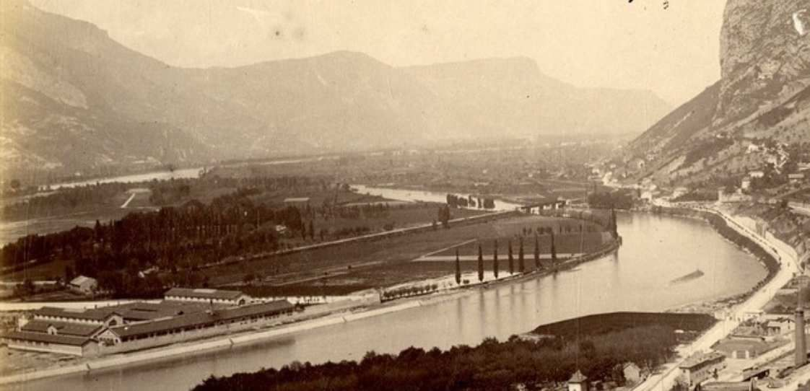
57 Years Ago …
Notes:
3

Slide 4
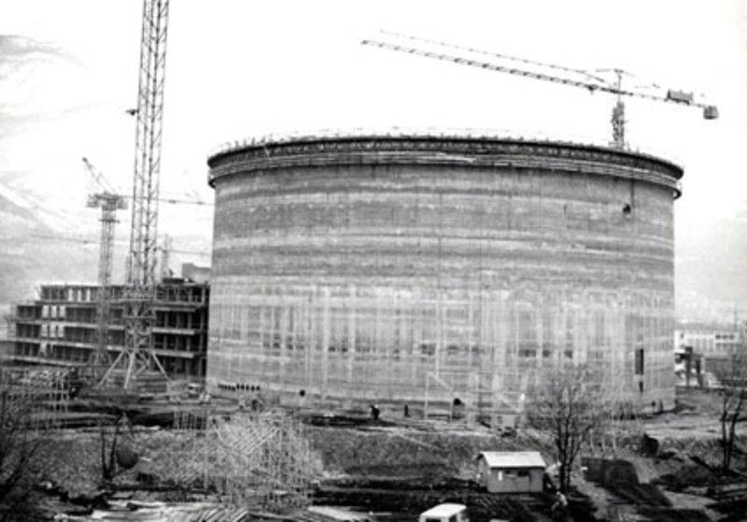
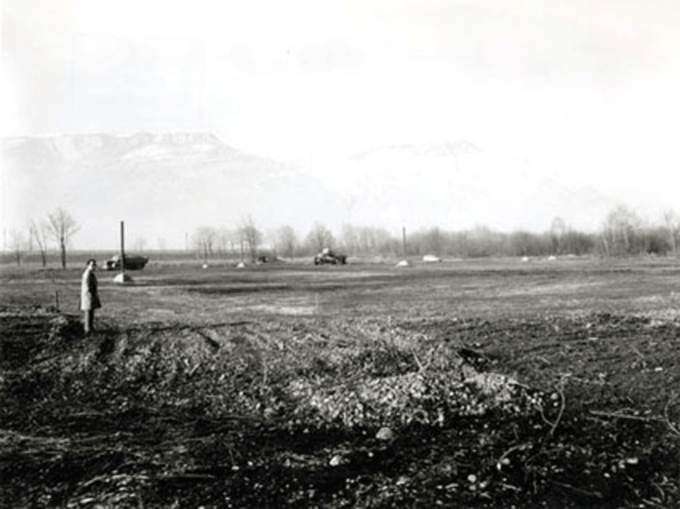
57 Years Ago …
Notes:
4

Slide 5
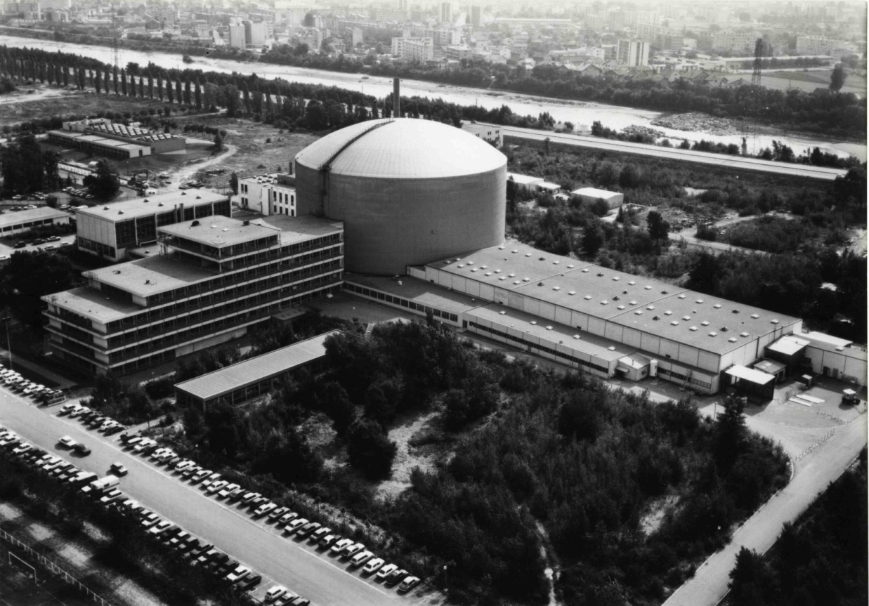
1971 - First Divergence …
Notes:
5

Slide 6
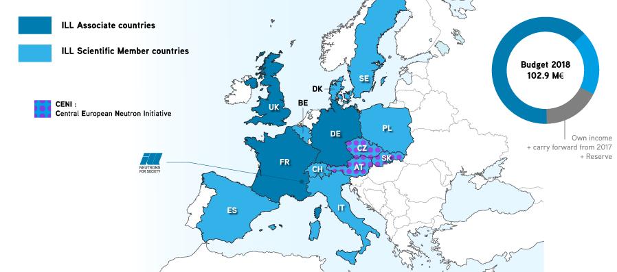
The ILL Stakeholders
The advent of the scientific members continues the process.
Close to one Billion €
of capital investment
An annual budget
of approximately 90 M€
A highly qualified workforce of about 500 people
Notes:
6

Slide 7


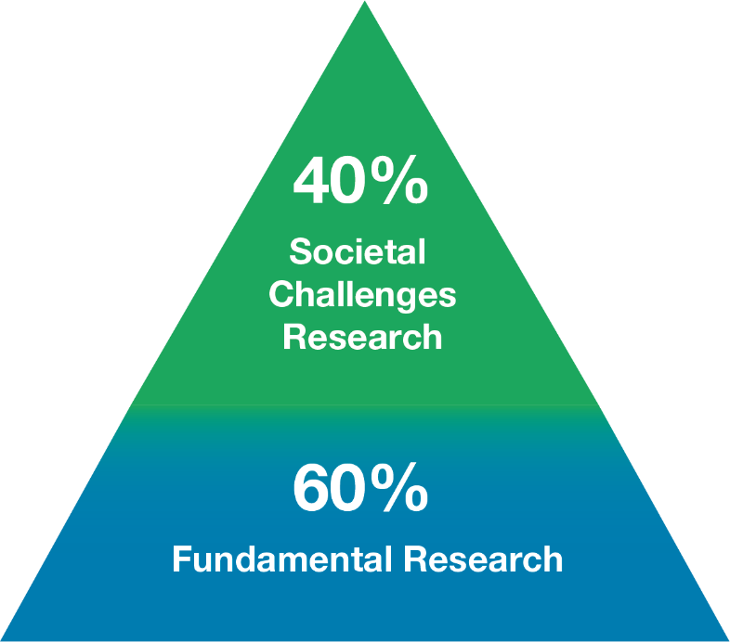




Key Figures
1400 users from an active community of 12 000 scientists
850 experiments/year
650 publications/year
65 countries
28 instruments + 10 CRG
4 cycles of 50 days/year
Notes:
7

Slide 8
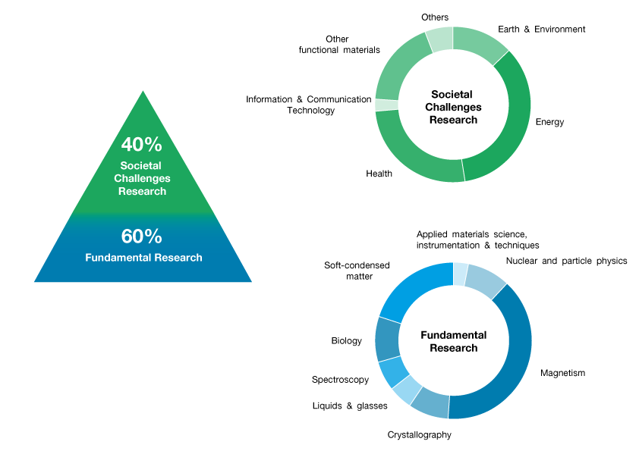
Research Areas
As per accepted proposals
Notes:
8

Slide 9
Students @ ILL
180 month of traineeship from ILL dedicated budget allocated each year
Specific external founding
Erasmus
STFC
EU projects
National balance
Average of about 10 new PhD students/year
Students distribution per division
Notes:
9

Slide 10
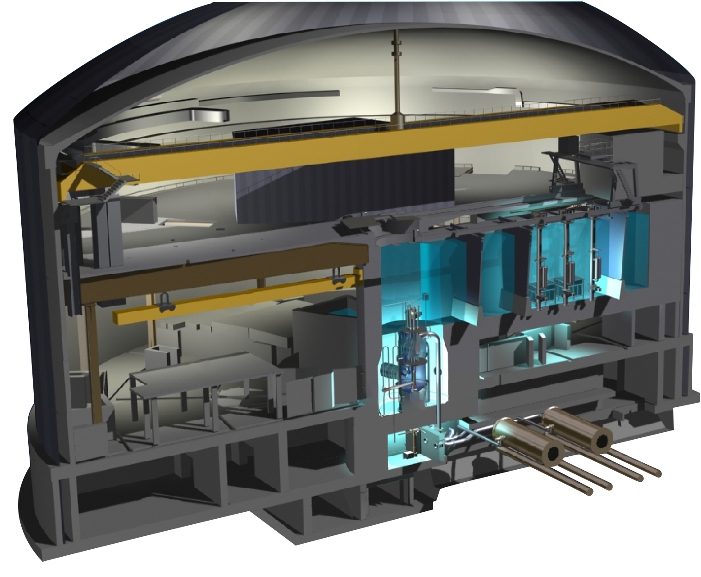
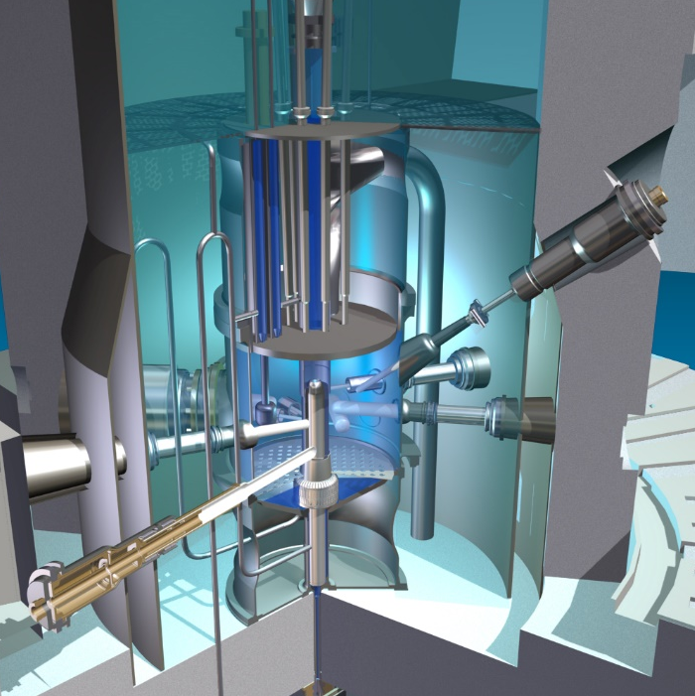
The ILL Reactor
Notes:
10

Slide 11
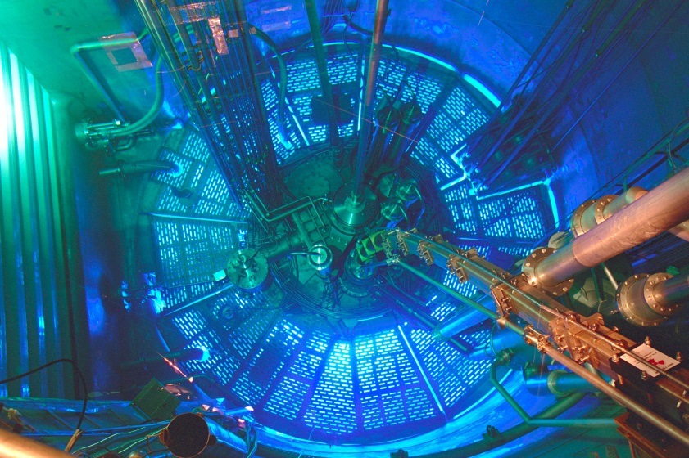
The ILL Reactor
Notes:
11

Slide 12
Neutron Techniques
Notes:
12

Slide 13
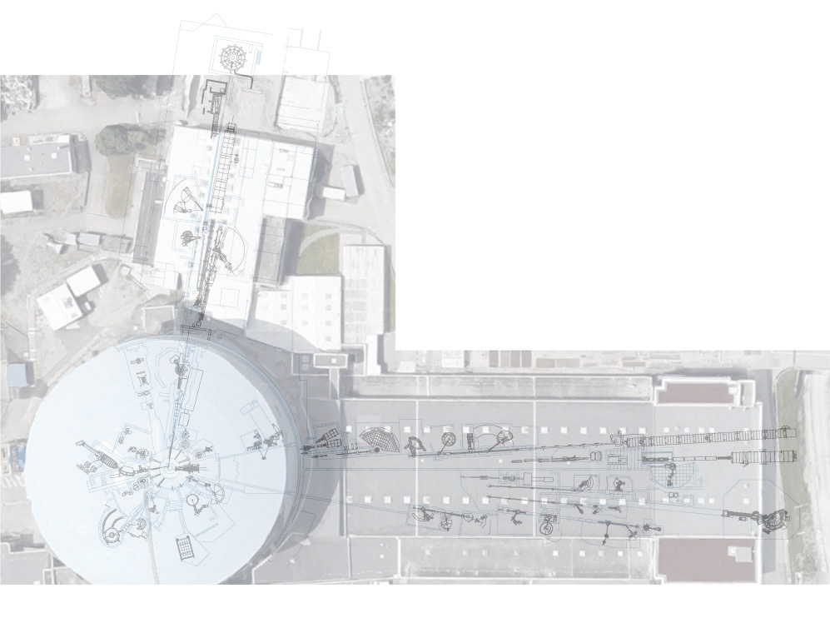
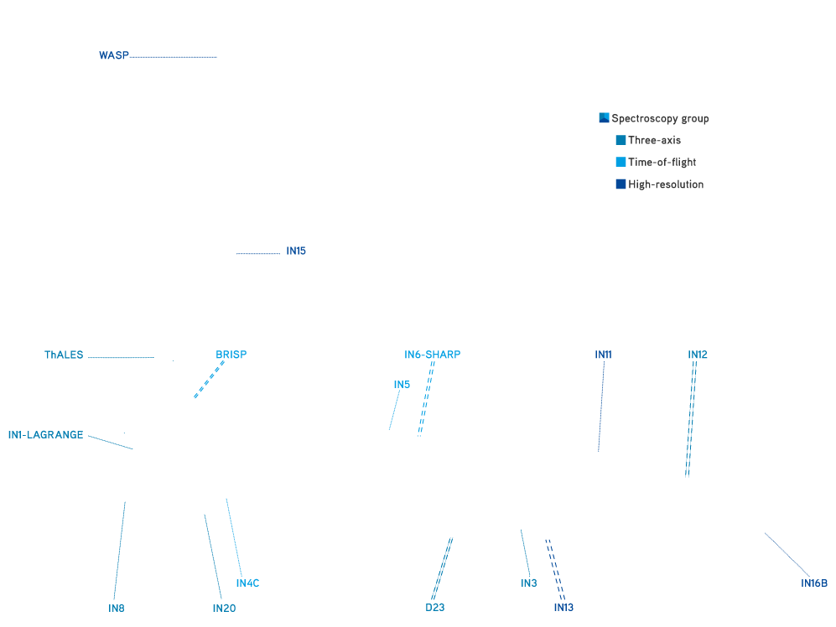
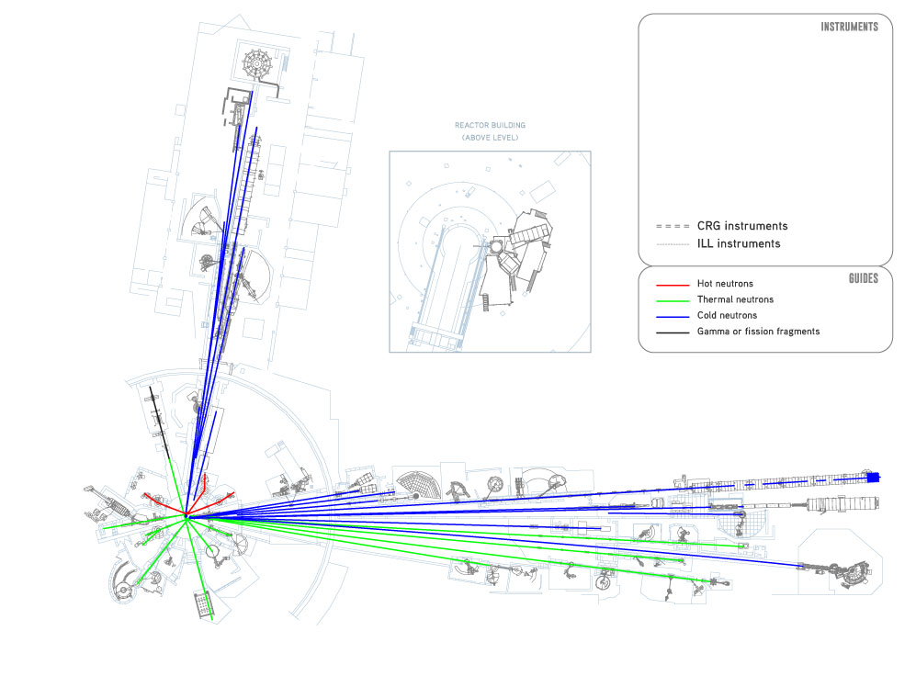

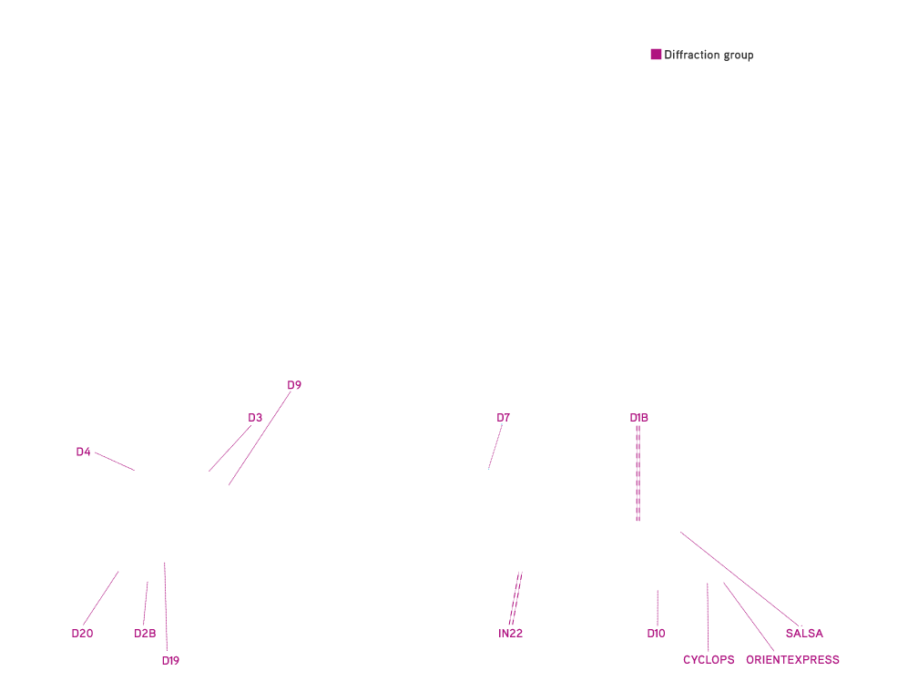
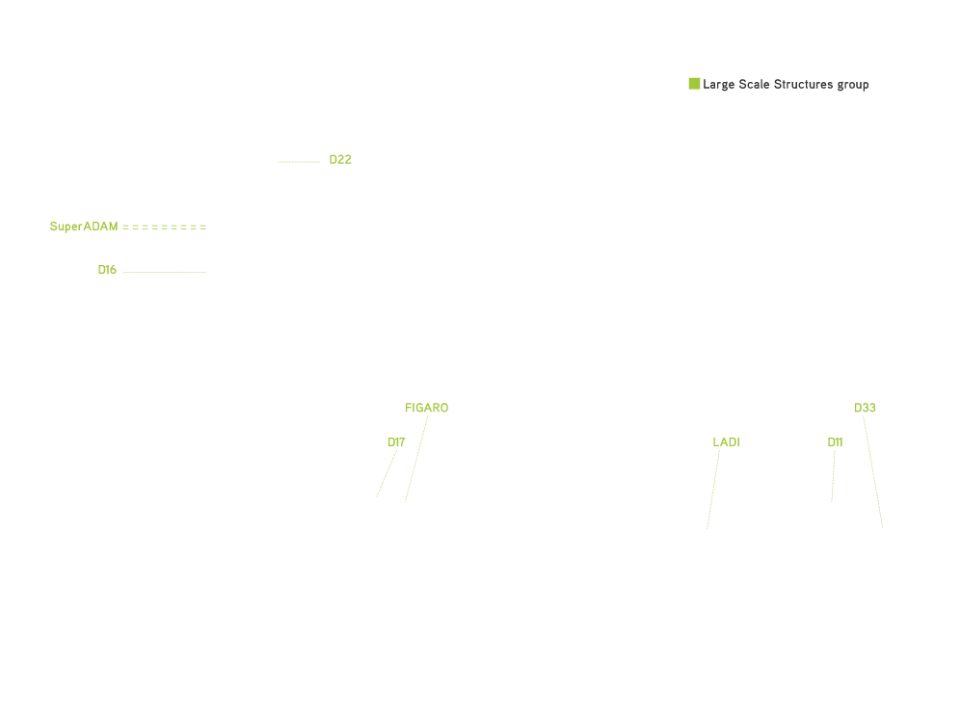
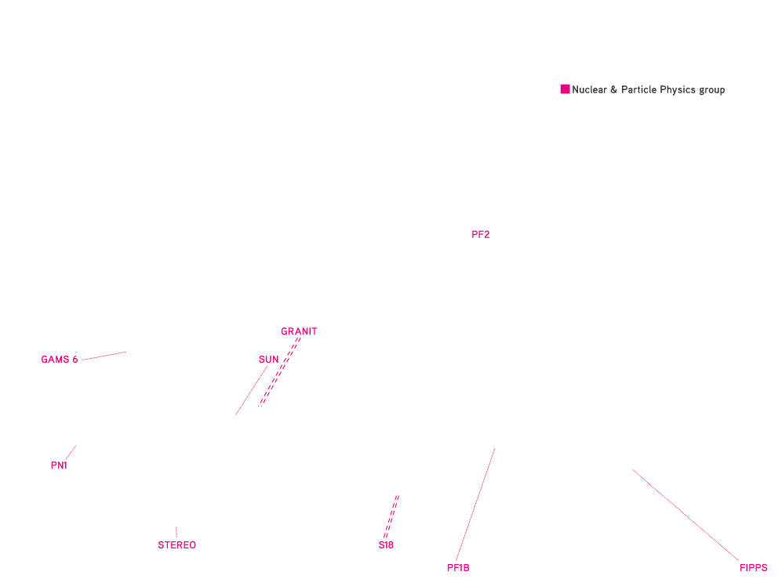
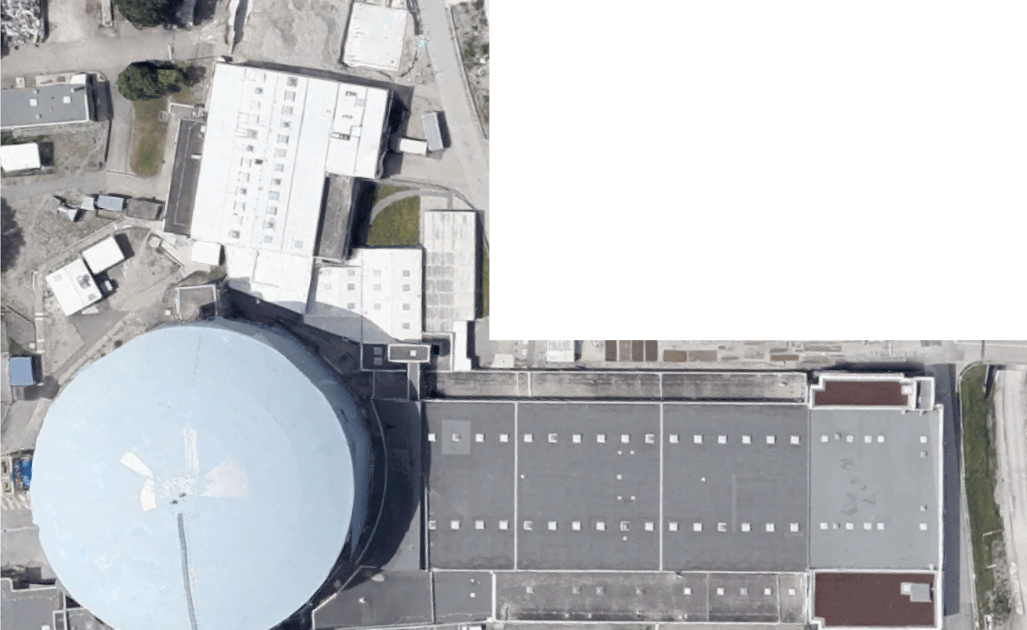
The Instrument Suite
Notes:
13

Slide 14


NOMAD Framework
Team project to optimize resources
Facilitate development and maintenance
Unique interface to facilitate user’s operations
Abstraction to hide technical complexity
Tools to help setting up and evaluating results
Unique for all ILL instruments
Notes:
14

Slide 15
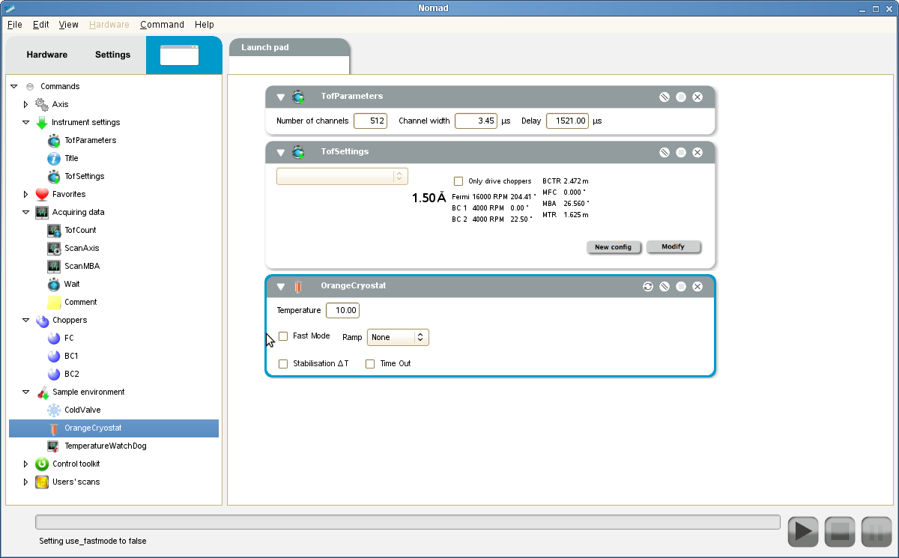
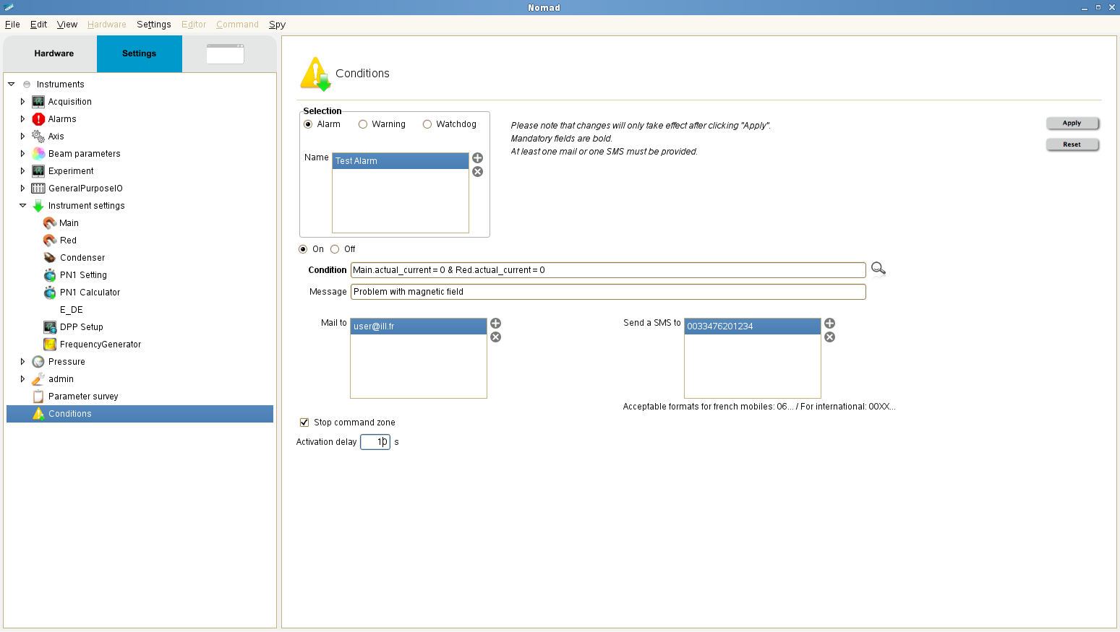
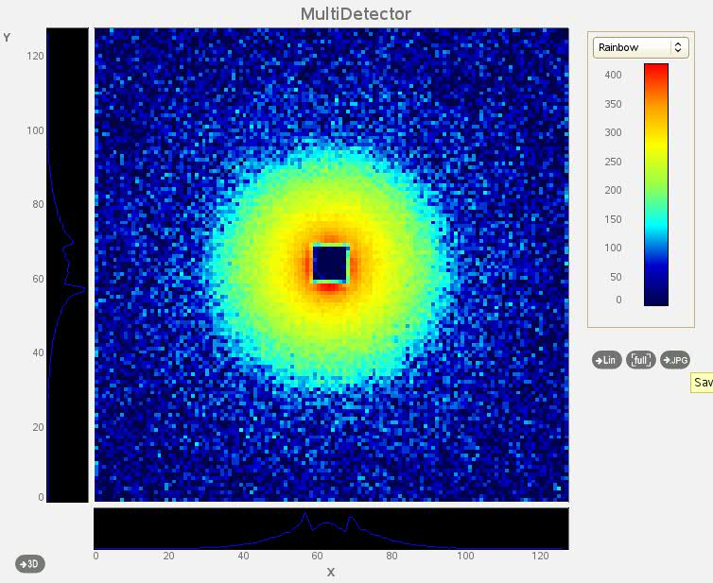
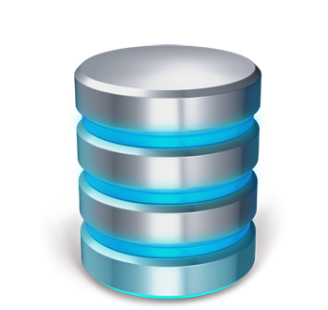

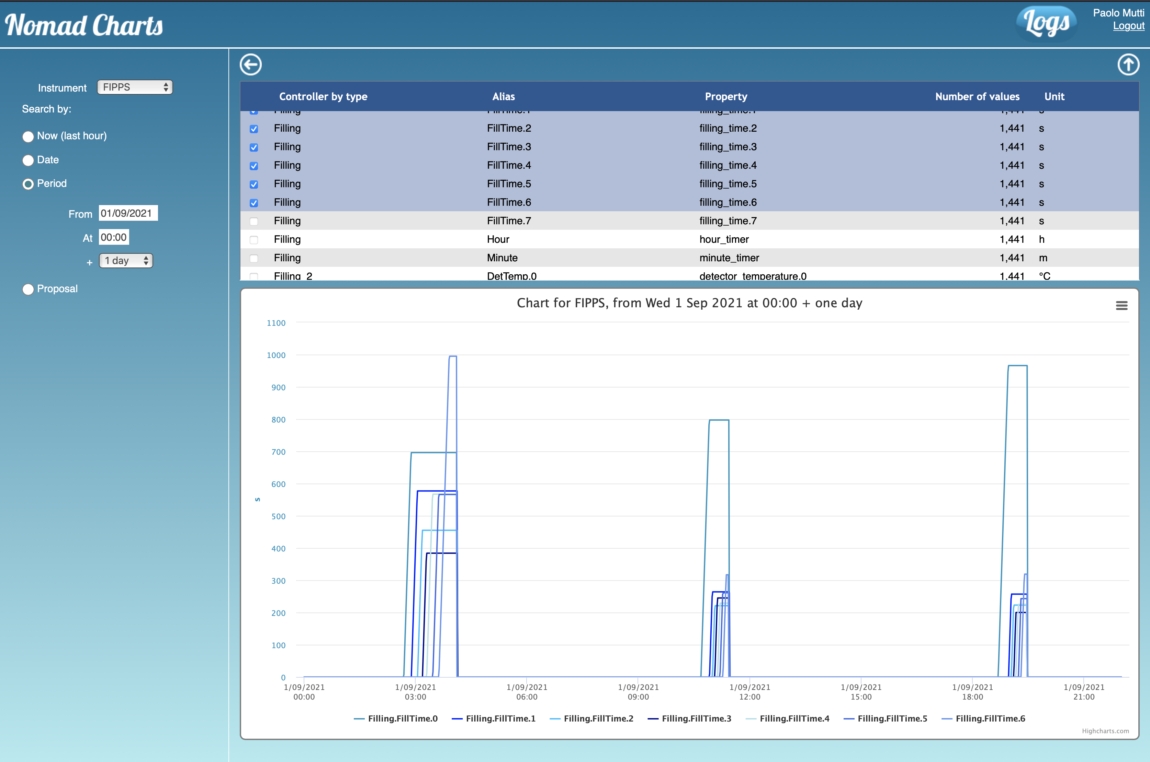
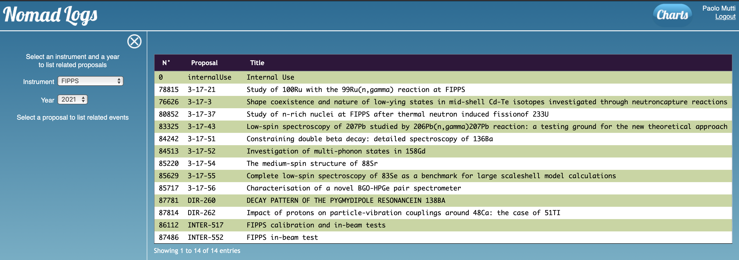
GUI
Alarms
Real-time Plot
Server
Data Storage
Application Manager
User Application
Log
Parameters survey
Notes:
15

Slide 16

CAMEO - Application Manager
Server written in Java to be multiplatform
Handle local and distant applications
APIs in C++, Java, Python
Every node has its own server
Communication layer
ZeroMQ
Provide the flexibility to handle the application duty cycle (start/stop/sync)
Notes:
16

Slide 17



Architecture
Java + SWT
Dynamic interface engine
Real time visualization (OpenGL)
GUI
Transport Layer
C++
Drivers and controllers
Scheduler: sequential and parallel execution
File system: data, logs, rules, etc…
SERVER
Notes:
17

Slide 18
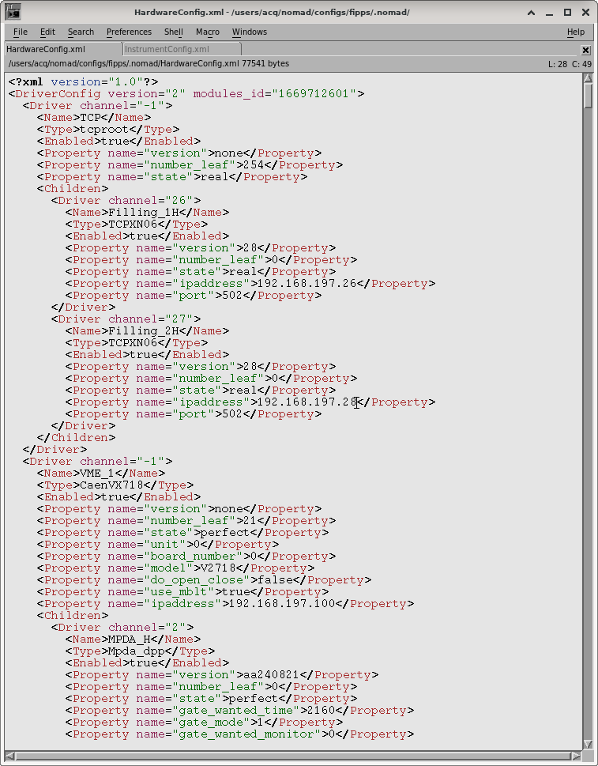


Server Architecture
For every instrument:
One core application
Specific plugins
Flexibility to develop specific plugin without a general impact on the application
Notes:
18

Slide 19
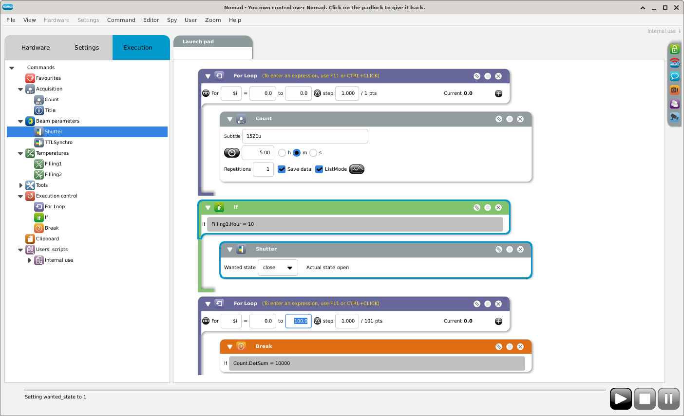
GUI – Dynamic Interface Generation Engine
Notes:
19

Slide 20
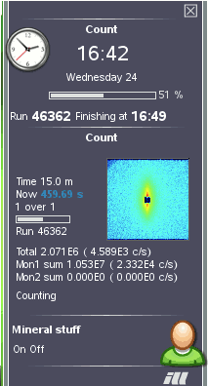
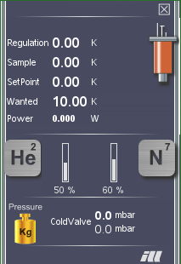
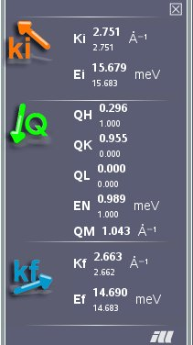
Configurable Interface
Notes:
20

Slide 21
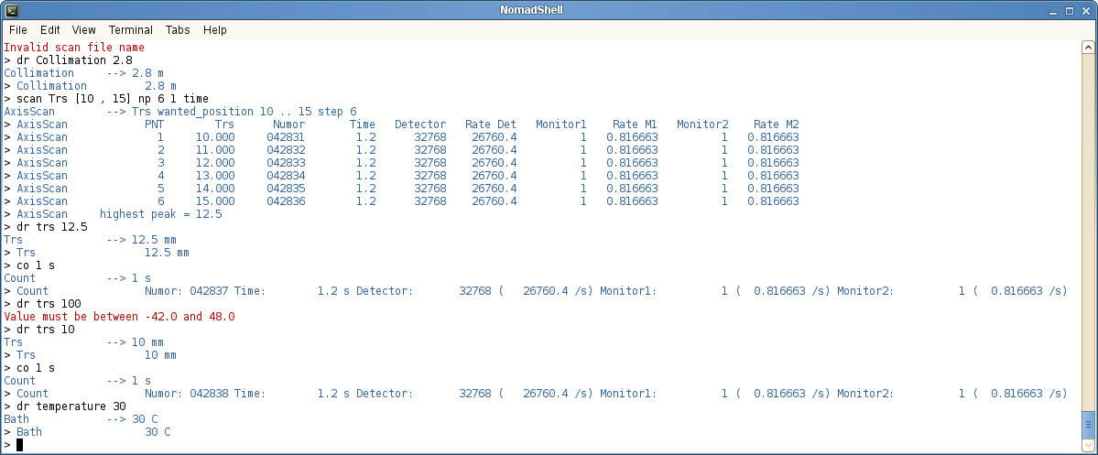
One Server Different Interfaces
A specific command-line
Notes:
21

Slide 22
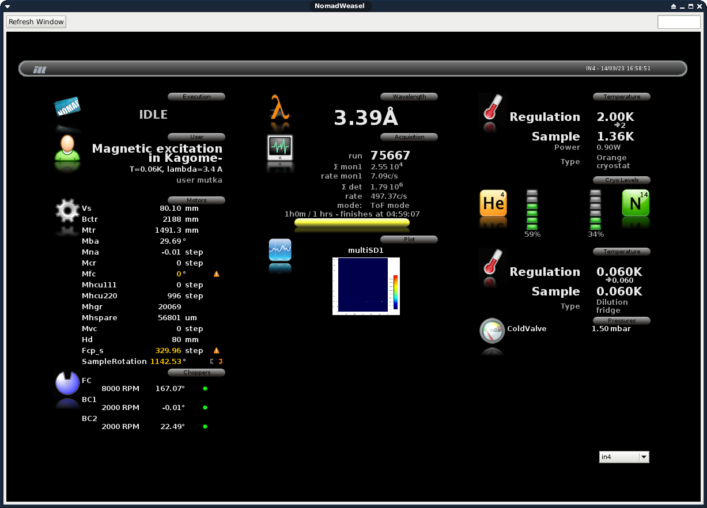
On The WEB
Notes:
22

Slide 23

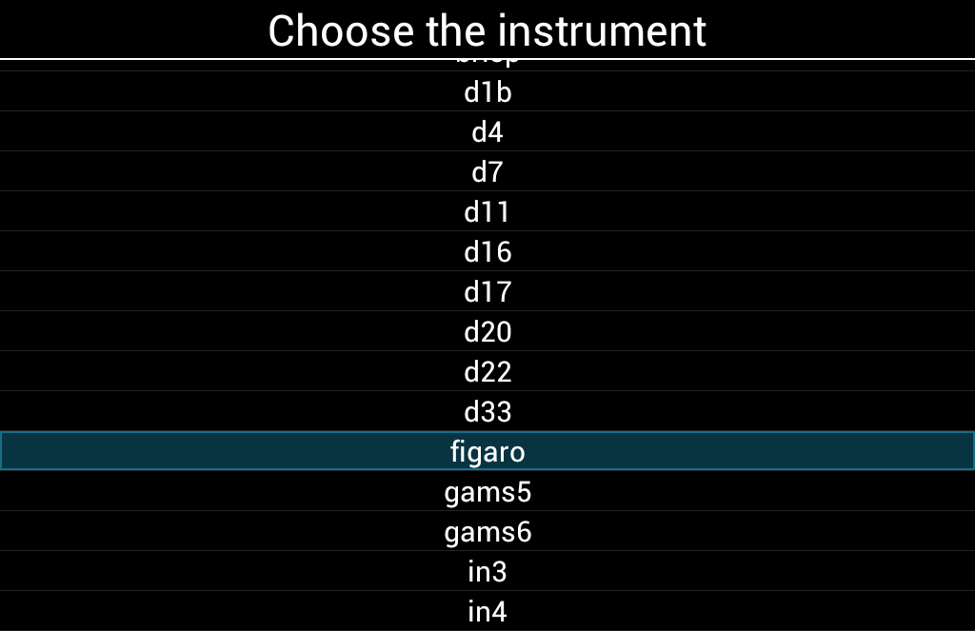
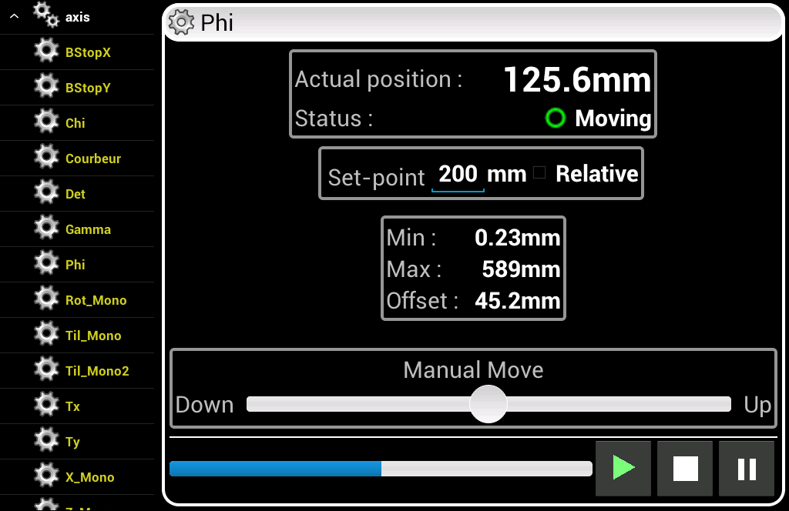
On ANDROID
Notes:
23

Slide 24
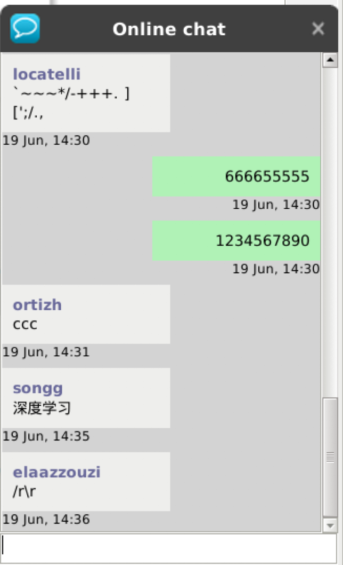
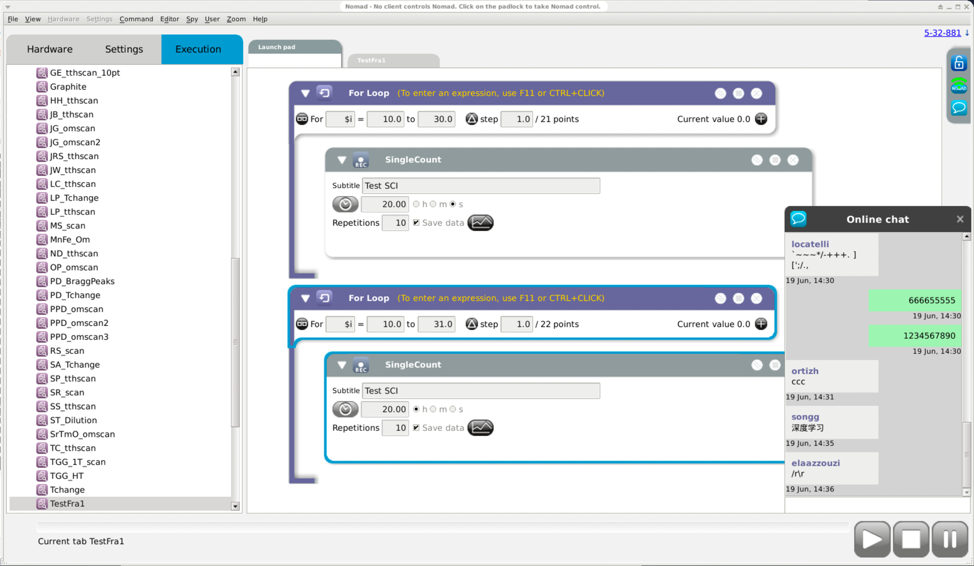



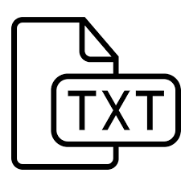

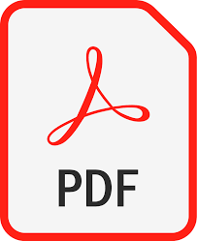
The Chat
Notes:
24

Slide 25
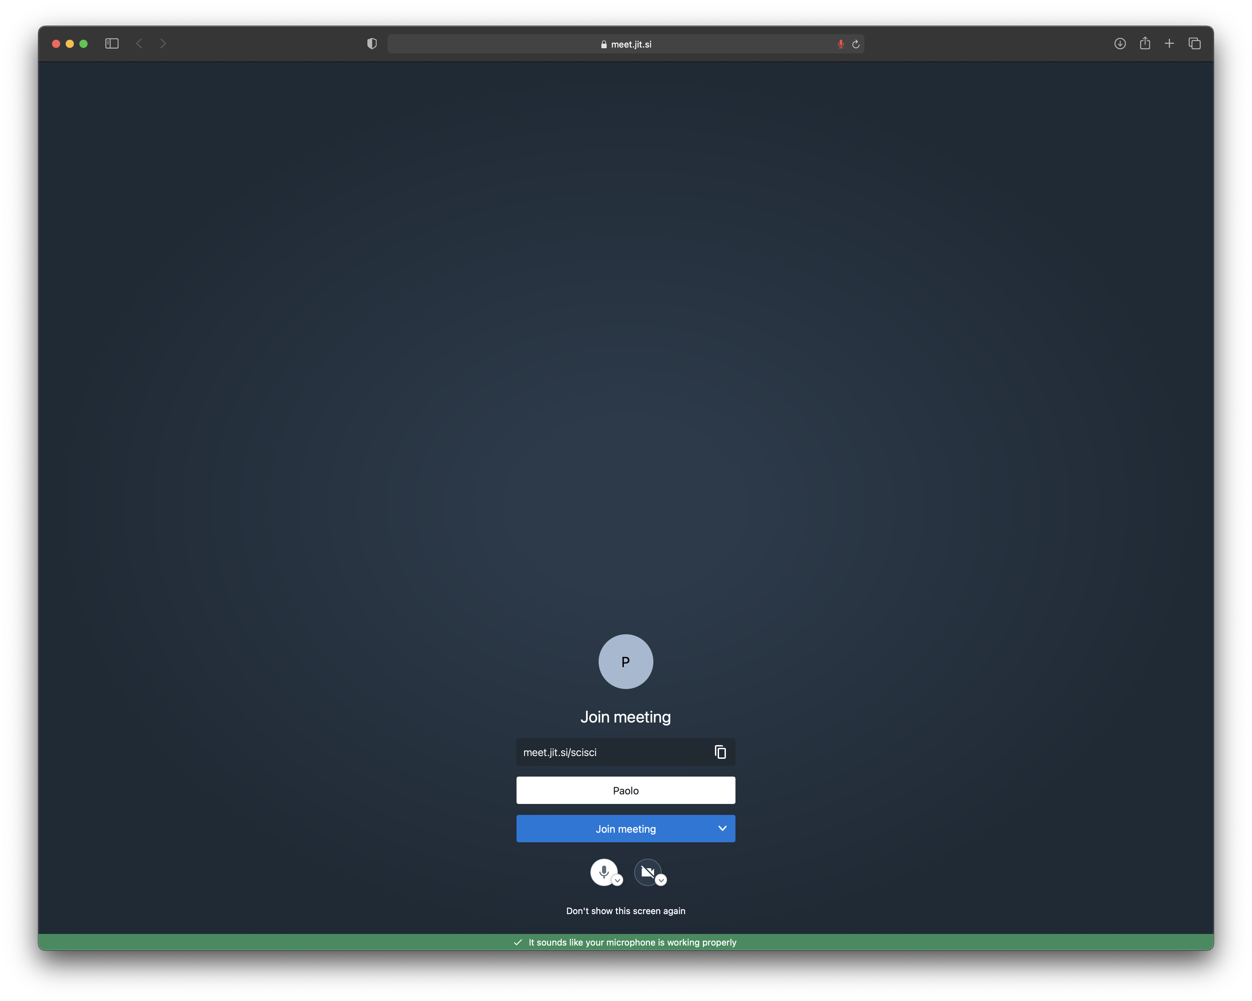
The Video Chat
Based on Jitsi
A dedicated meeting
room per proposal
Meeting room is
created automatically
at first request
On the instrument
Notes:
25

Slide 26
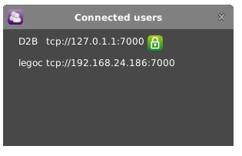
User Connected List
Display owner of the token
Notes:
26

Slide 27
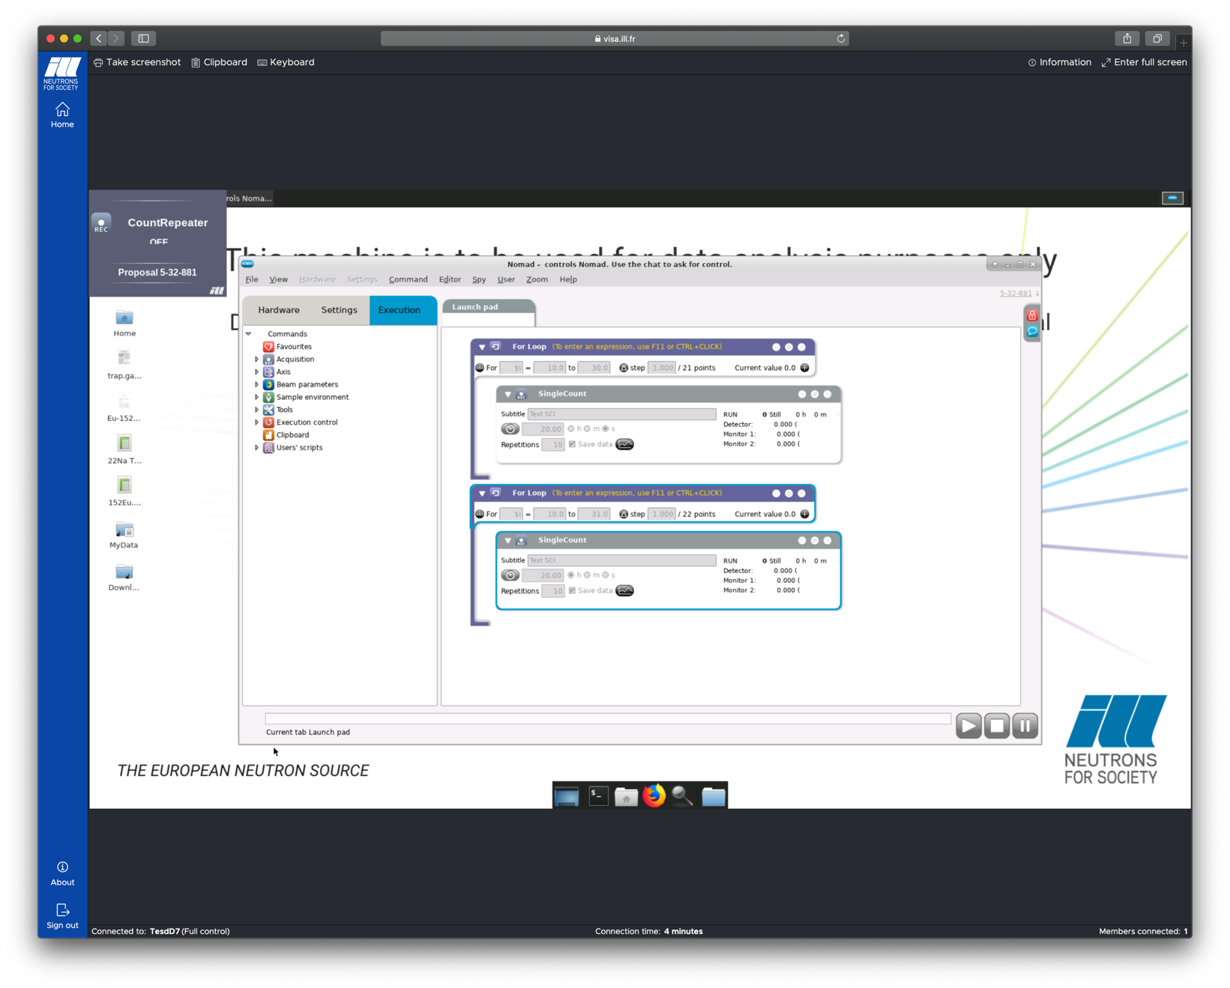
NOMAD REMOTE
Fully independent clients
Customize your interface
Open/close any type of plot
Create user’s workflows which are
then visible and usable by
any other client
Access the log viewer and the
parameter survey
Run simulations
Notes:
27

Slide 28
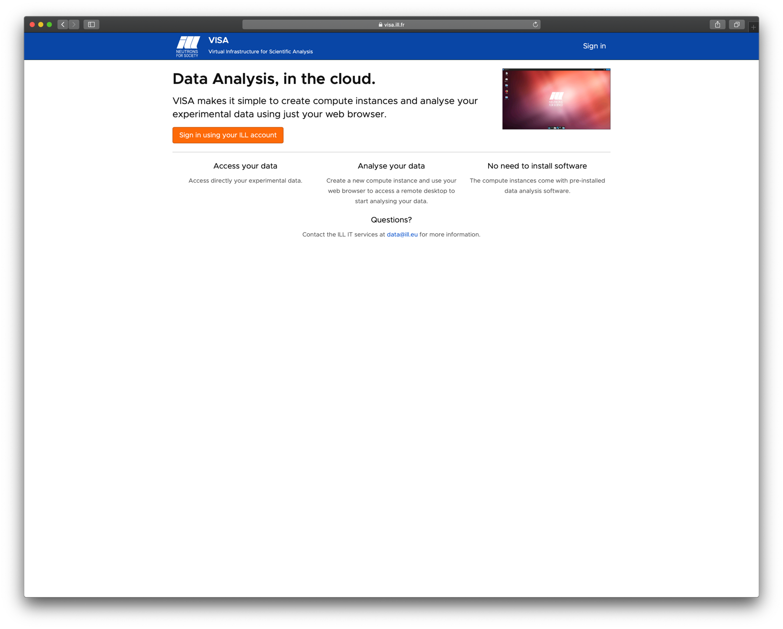
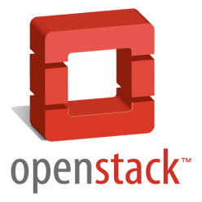


visa.ill.fr
Virtualization infrastructure
Clientless remote desktop gateway
Notes:
28

Slide 29
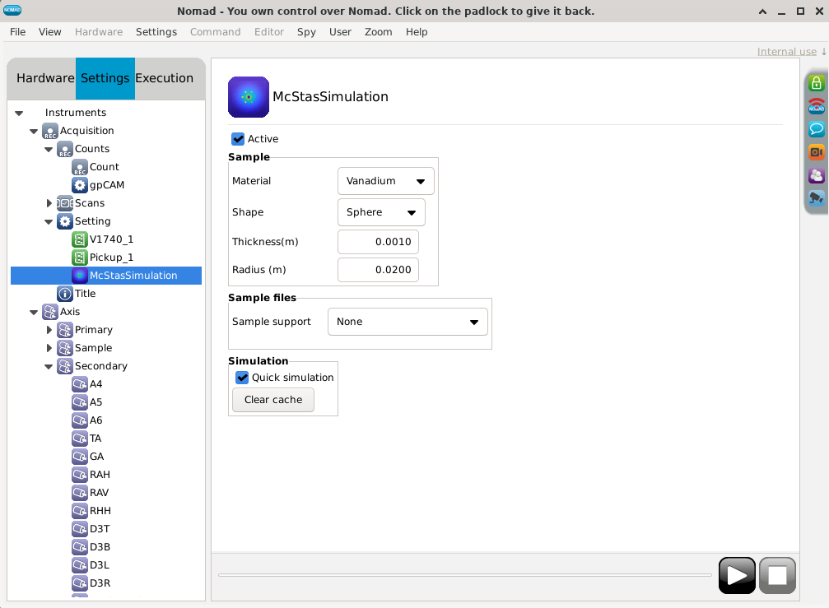
Digital Twin

Slide 30
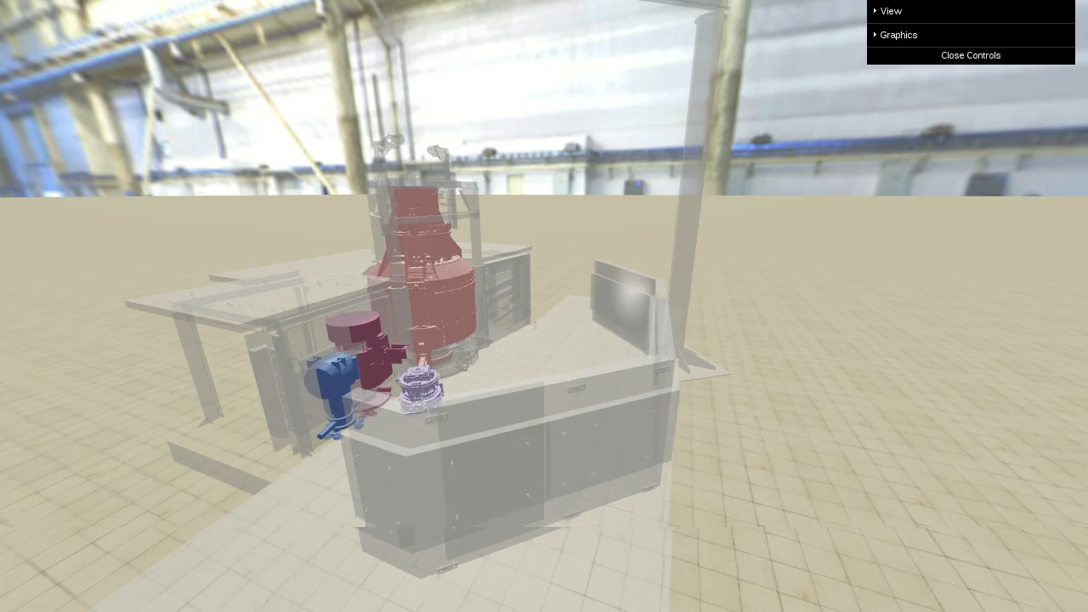
Digital Twin

Slide 31
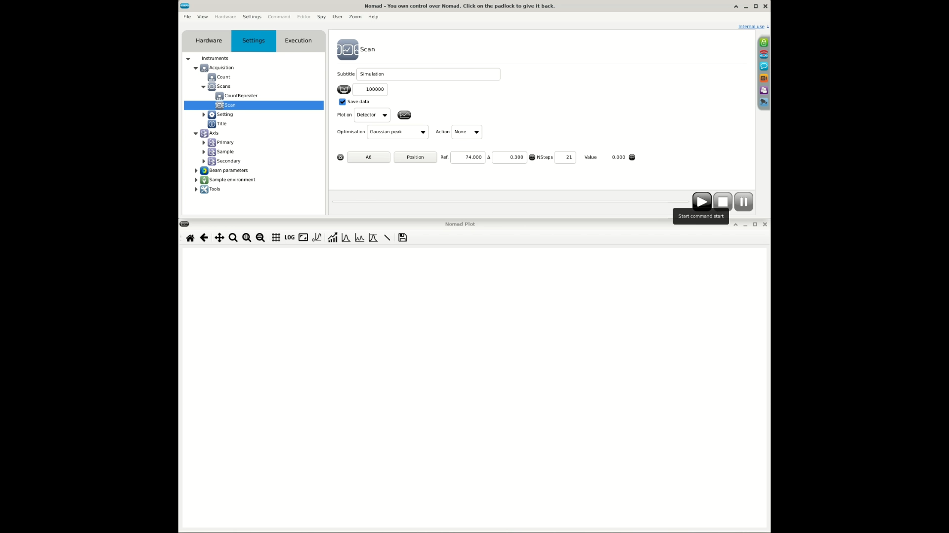
Digital Twin

Slide 32
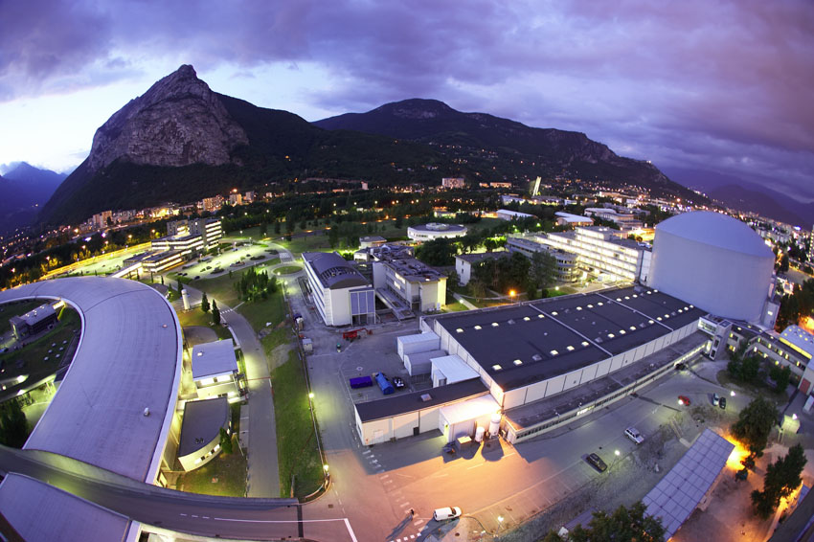

The EPN Science Campus
Notes:
32

