Slide 1
EIROForum
School on Instrumentation 2024
Sebastian Egner

Slide 2
Welcome to ESO!

Slide 3

Logistics
https://indico.euro-fusion.org/event/2559/overview
www.eiroforum.org/esi2024
Lectures & Hands-on Sessions
Poster Sessions
Coffee-Breaks & Lunch

Slide 4
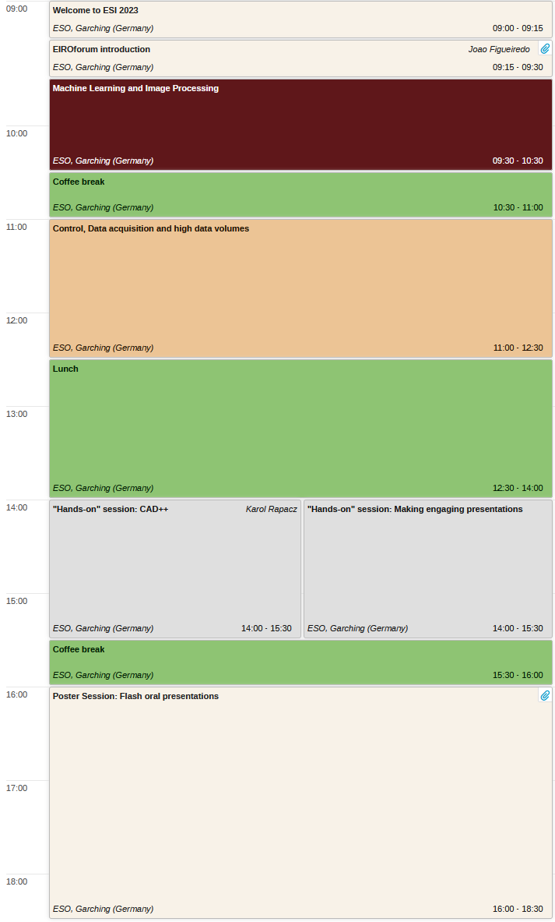
Auditoriums
Lectures will take place here in “Eridanus”

Slide 5
Auditoriums
Hands-on Sessions will take place in
  “Eridanus” – Group 1
  “Telescopium” – Group 2
Group 1 – First name from A to Kateryna
Group 2 – First name from Katrin

Slide 6
Poster Sessions
Posters will be on display in front of Eridanus (upper level) from Monday to Friday.
We will have dedicated “Poster-Sessions” on Tuesday & Thursday,
when the poster authors should be at their poster.
We will also have a “Flash-Presentation-Session” for your posters on Monday afternoon.
One slide – Two minutes
Please send your slide as PDF to Stefanie until today, 11:00 CEST.
There will be prizes for the best posters & flash presentations.

Slide 7
Food
We will have coffee breaks in front of Eridanus (lower level).
Lunch will be at the IPP Canteen on-campus (Mon, Tue, Thu, Fri).

Slide 8
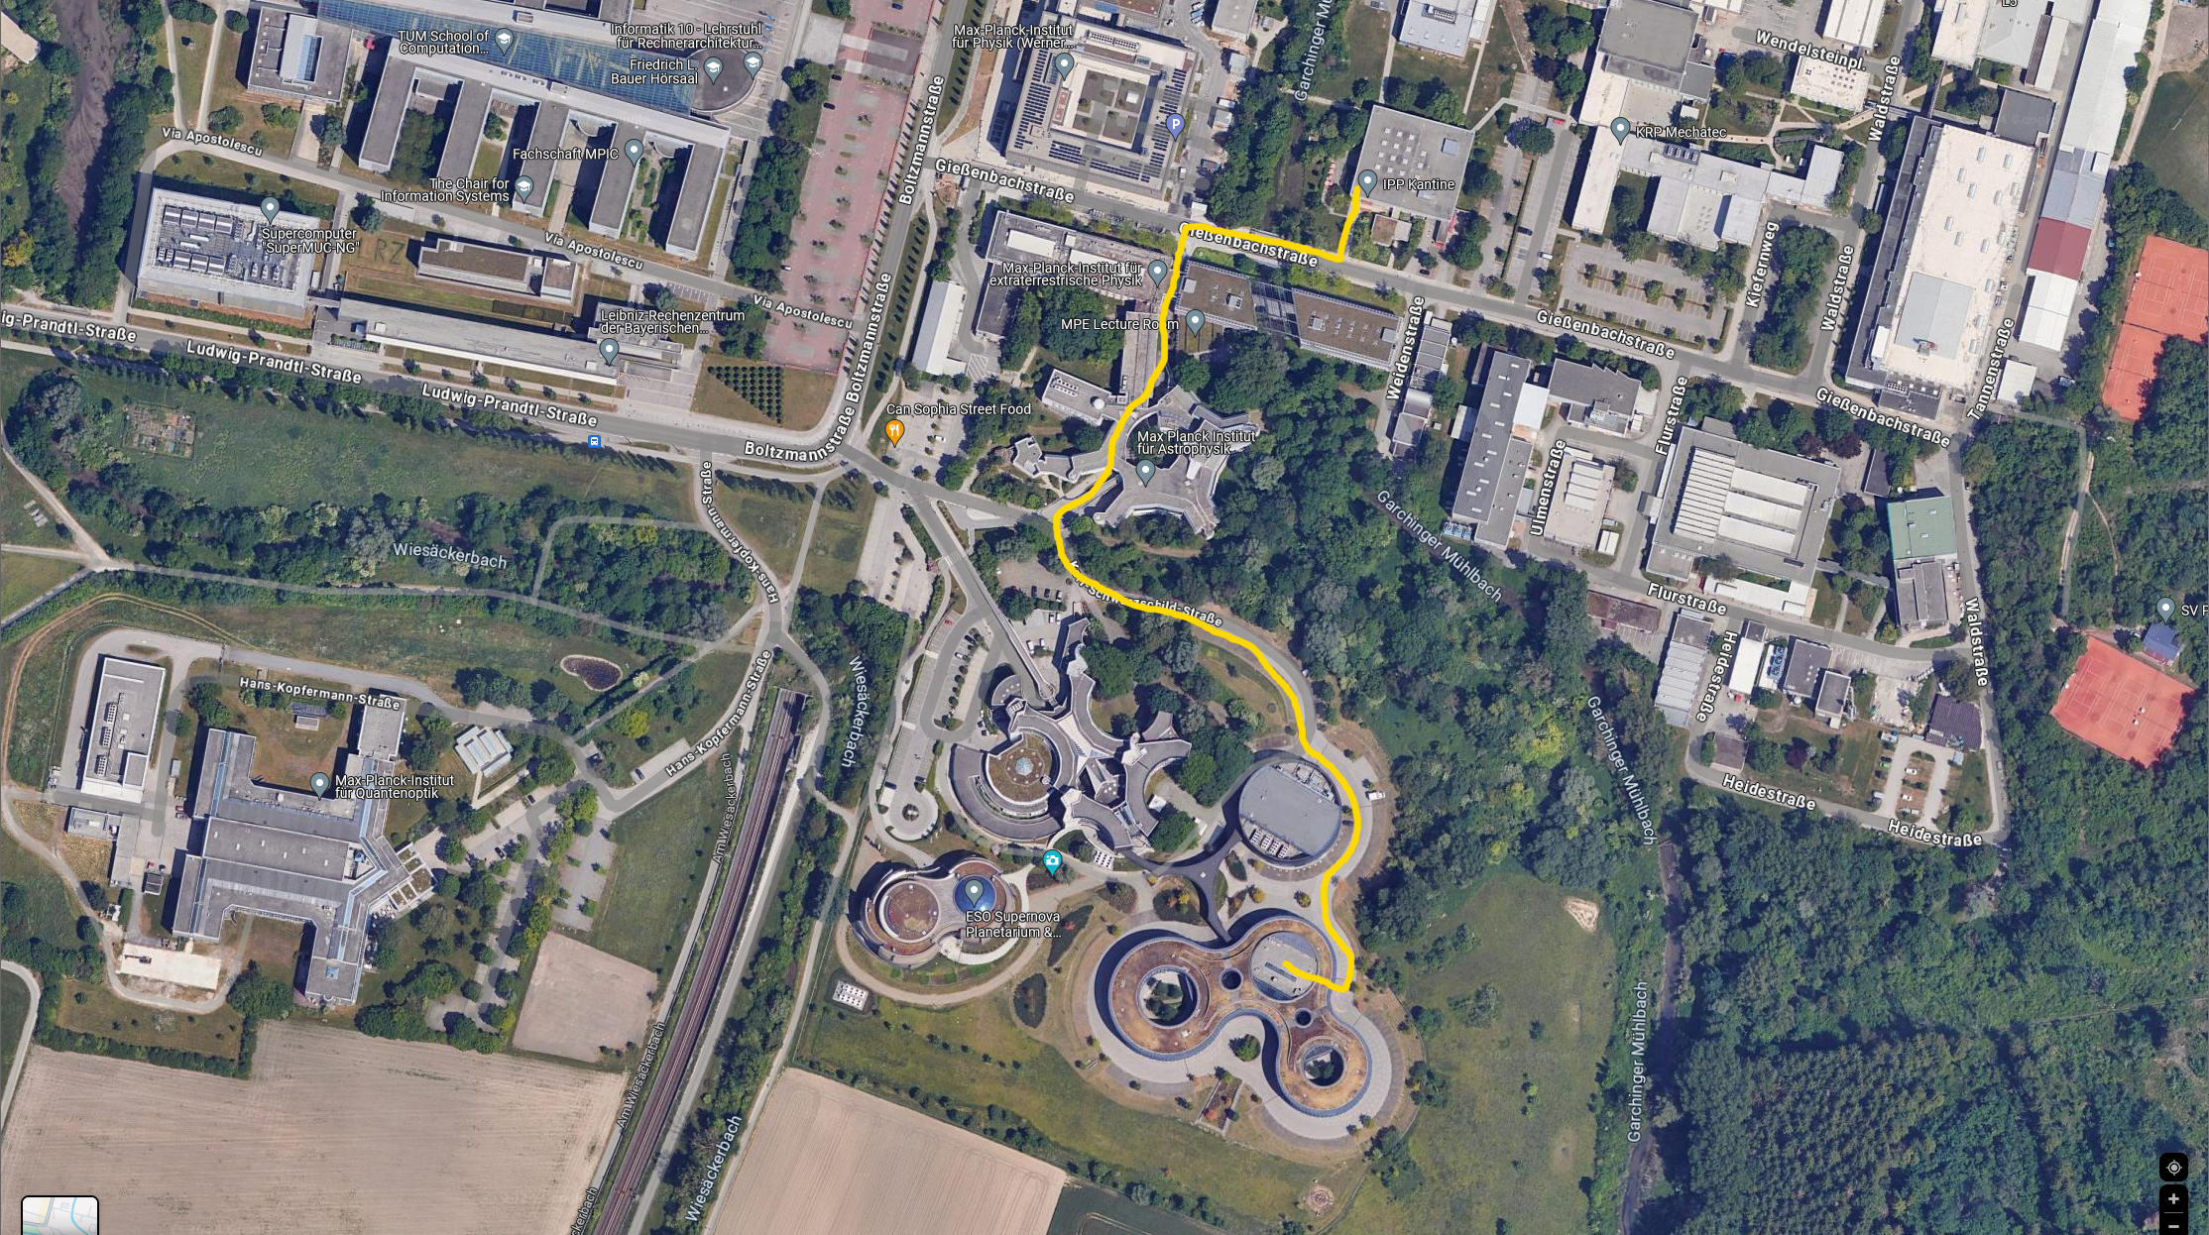
Cantine
Lunch
We are here.

Slide 9
WIFI
WIFI Access during the workshop:
SSID: ESO
Username: eris
Password: ta8fav
Or eduroam, if offered by your home institute.

Slide 10
Hands-on Session Machine Learning
The hands-on session on Thursday / Friday will be via JupyterNotebooks on virtual machines,
hosted by European XFEL.
You will need to sign-in at:
https://visa.xfel.eu/login
by using "Helmholtz AAI“ as authentication code.
Please do so by Wednesday evening - in case of question please reach out to Steffen Hauf (steffen.hauf@xfel.eu).

Slide 11
Problems? Questions?
Contact:
  Stefanie Schlatt Stefanie.Schlatt@euro-fusion.org
  Joao Figueiredo Joao.Figueiredo@euro-fusion.org
  Sebastian Egner segner@eso.org

Slide 12
Enjoy!

Slide 13
Here your name
and your contact details
Final slides include our flag row
@ESOAstronomy
@esoastronomy
@ESO
european-southern-observatory
@ESOobservatory

