Slide 2
BLISS Beamline Control and Data Acquisition
Outline
Instrument Control
Data Acquisition
Data Access
FAIR Data
Conclusion
Jens Meyer on behalf of the ESRF Software Group

Slide 3
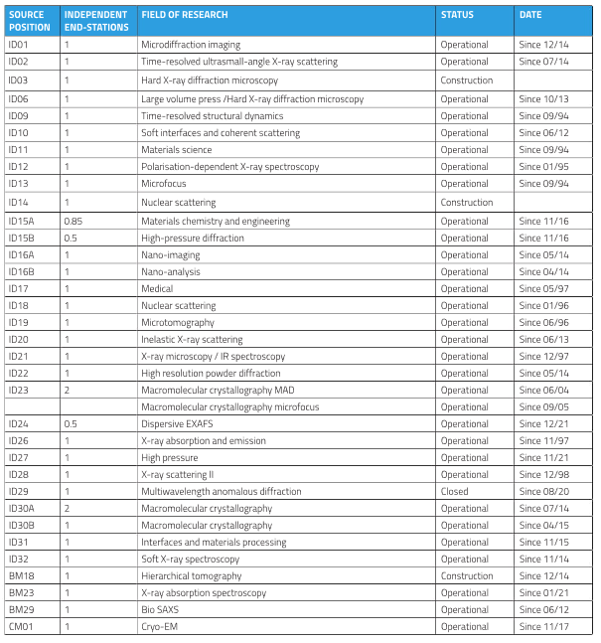
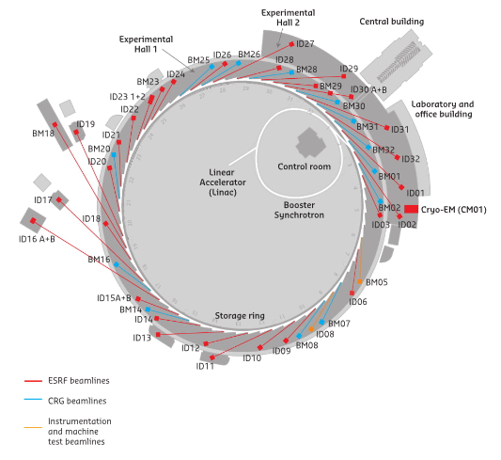
ESRF Beamlines and Experiment Types
33 ESRF beamlines and 13 CRG beamlines
46 Beamlines
More than 100 scientific techniques

Slide 4
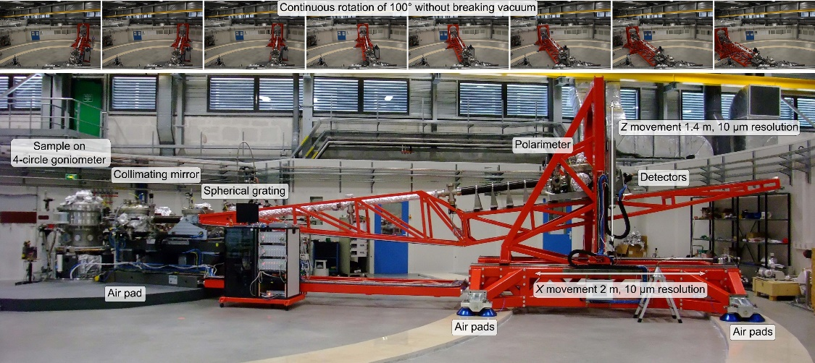
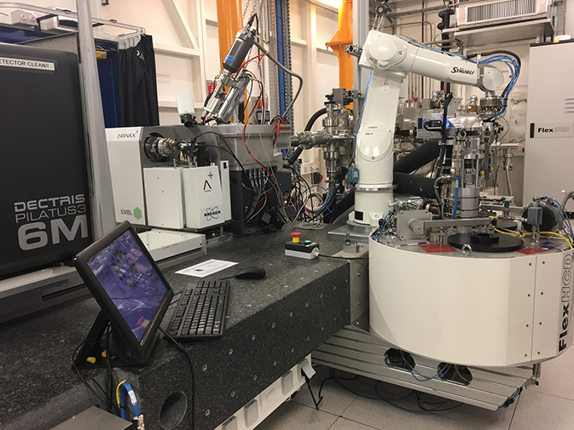
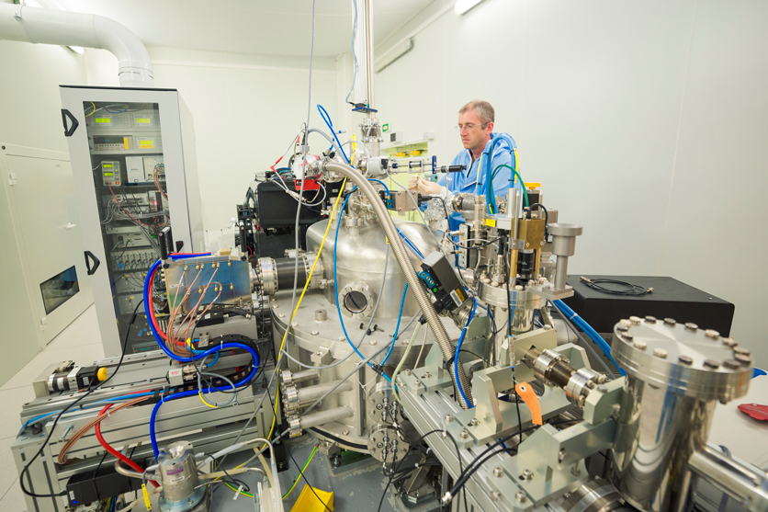
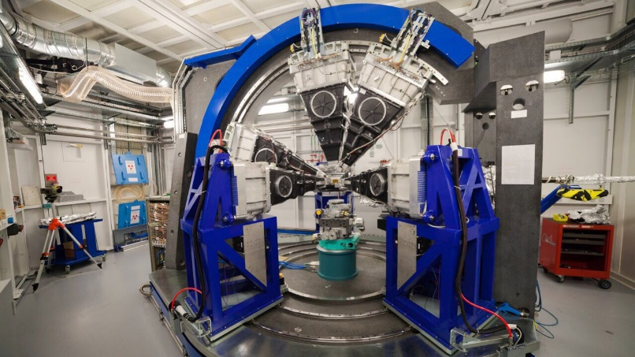
ESRF Experimental setups

Slide 5
Bliss : Instrument control and data acquisition
Command line driven data acquisition sequencer written in Python
Main concepts
Hardware abstraction layer for all instrumentation used during a data acquisition sequence
Motors, counters, monochromators, spectrometers, diffractometers, etc.
A generic scan engine for step and continuous scans
The use of trajectories and HKL space is possible with all scans
Decoupling of data acquisition from data saving and analysis
All data buffered in memory. Allows higher acquisition speed without blocking
Coherent HDF5 storage of all acquired data at high speed and for large data volumes
All data of a proposal, its samples and the produced datasets is saved as a coherent HDF5 data tree
Live data display of all acquired data
Immediate visibility of acquisition results for the user
Easy configuration of hardware and experimental environment
Switch between predefined acquisitions set-ups on the fly
PyTango to interface any device from the Tango world
https://www.tango-controls.org
https://bliss.gitlab-pages.esrf.fr/bliss/master

Slide 6
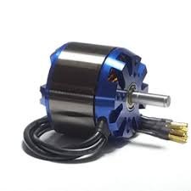
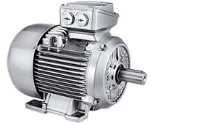
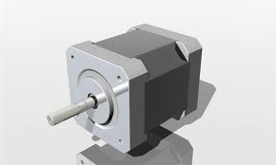
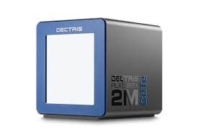
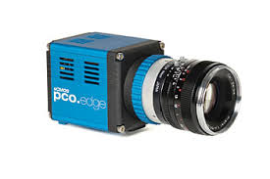
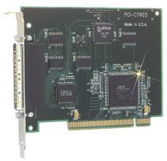
Hardware abstraction
Direct hardware access or underlying control system?
BLISS
Data Acquisition System
Motors
2D Detectors
0D Counters
Galil
Motor Controller
Motors
Tango Controller
2D Detectors
Tango Controller
P201 card
Counter Controller
Tango Software Bus
Galil
Tango Server
ETEL
Tango Server
Eiger
Tango Server
PCO
Tango Server

Slide 7
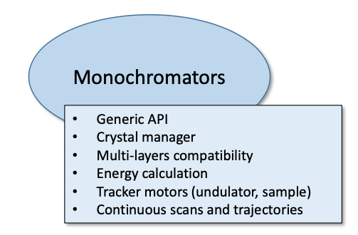
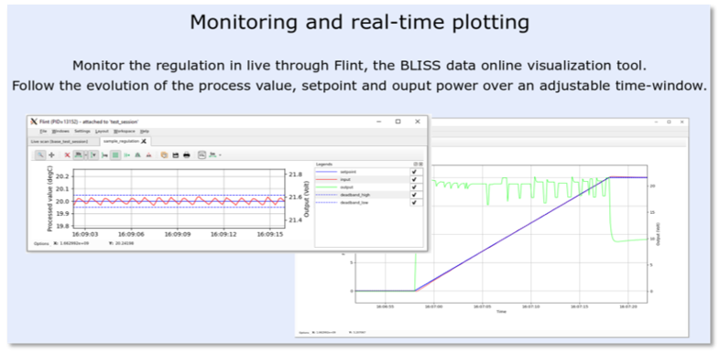
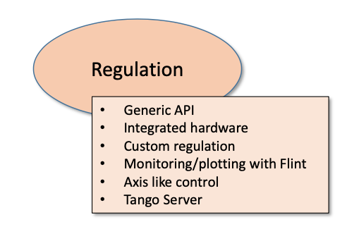
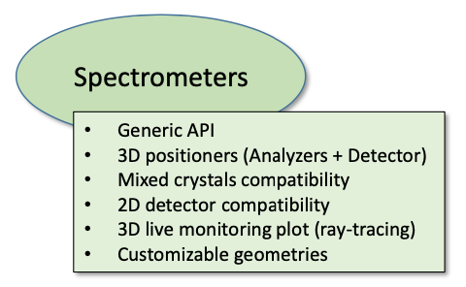
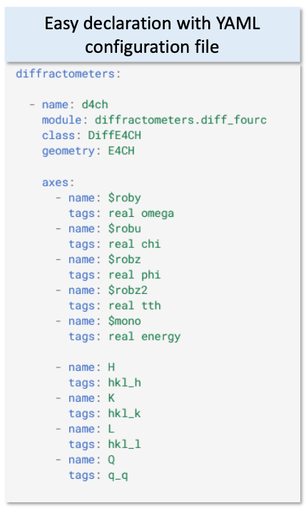
Hardware abstraction
BLISS Hardware Abstraction Frameworks

Slide 8
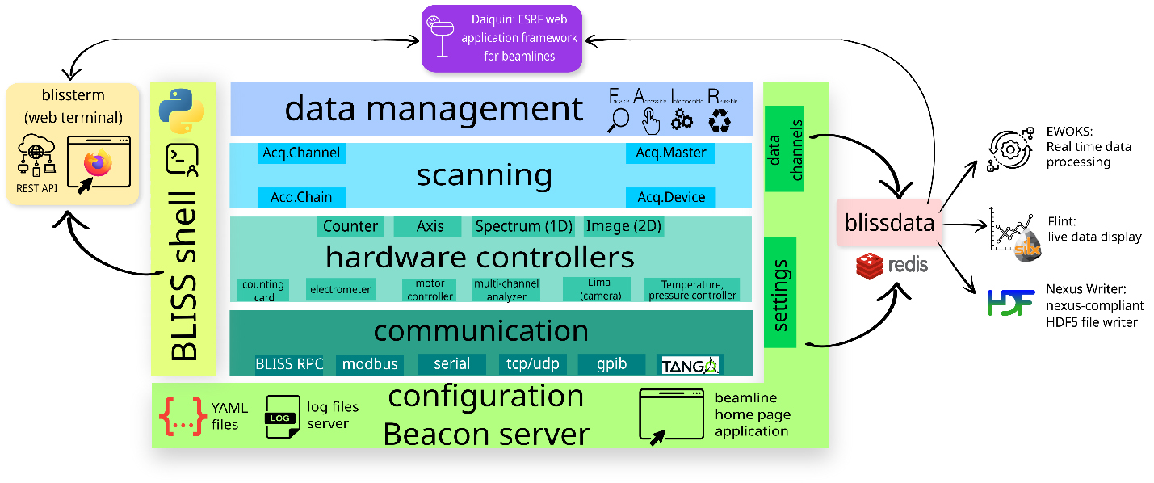
BLISS Software architecture
Schematic view of the BLISS software layers

Slide 9
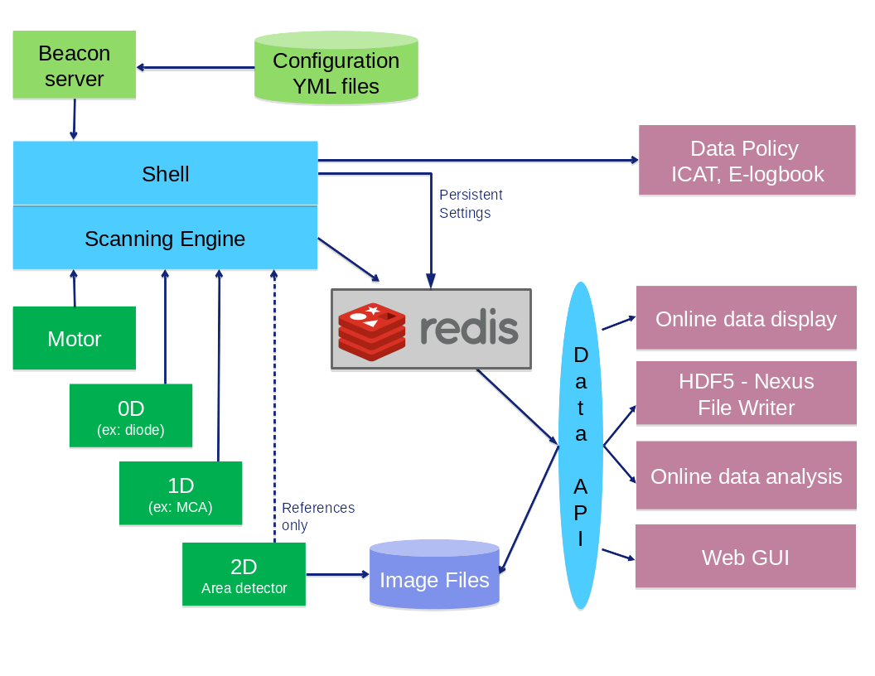
BLISS Software architecture
Decoupling of data acquisition from data saving and analysis

Slide 10
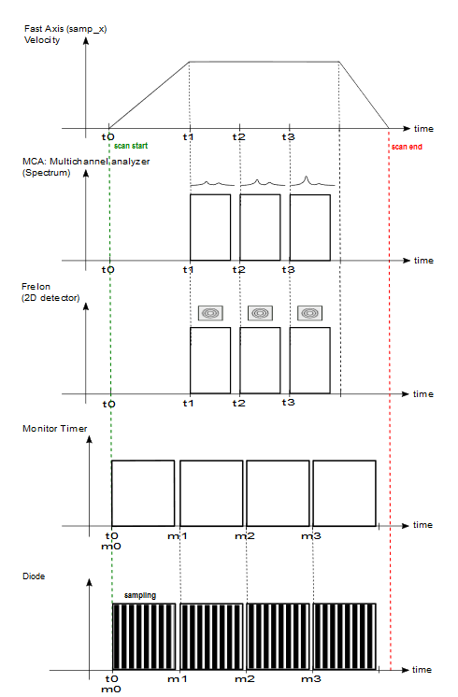
Building A continuous scan
Motor:samp_x
MCA
spectrum
Lima
image
Timer
Keithley
scalar

Slide 11
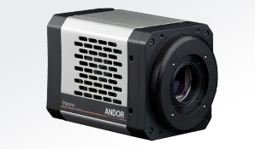
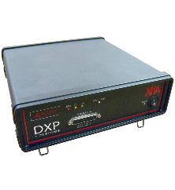
Building A continuous scan
Writing a scan is writing an AcquisitionChain
AcquisitionChain is a tree of AcquisitionObjects with master/slave relations
LIMARoiCounter
MotorMaster
MusstAcqMaster
LIMAAcqMaster
LIMARoiSpectrum
Synchronization electronics
2D detectors
MCAAcqMaster
MCARoiCounter
1D detectors
MCAStatCounter
CounterTimerAcqMaster
0D detectors
Scan specific
Measurement Group

Slide 12
Building A continuous scan
SoftwareAcquisitionMaster : For counters that cannot be synchronized
Epoch counter provided to link the acquisition of the 2 masters
LIMARoiCounter
MotorMaster
MusstAcqMaster
LIMAAcqMaster
LIMARoiSpectrum
Synchronization electronics
2D detectors
MCAAcqMaster
MCARoiCounter
1D detectors
MCAStatCounter
CounterTimerAcqMaster
Hardware
synchro
0D detectors
SoftwareTimerMaster
SamplingCounters
Software
loop
Scan specific
Measurement Group

Slide 13
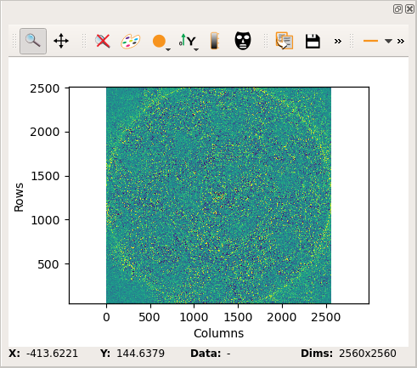
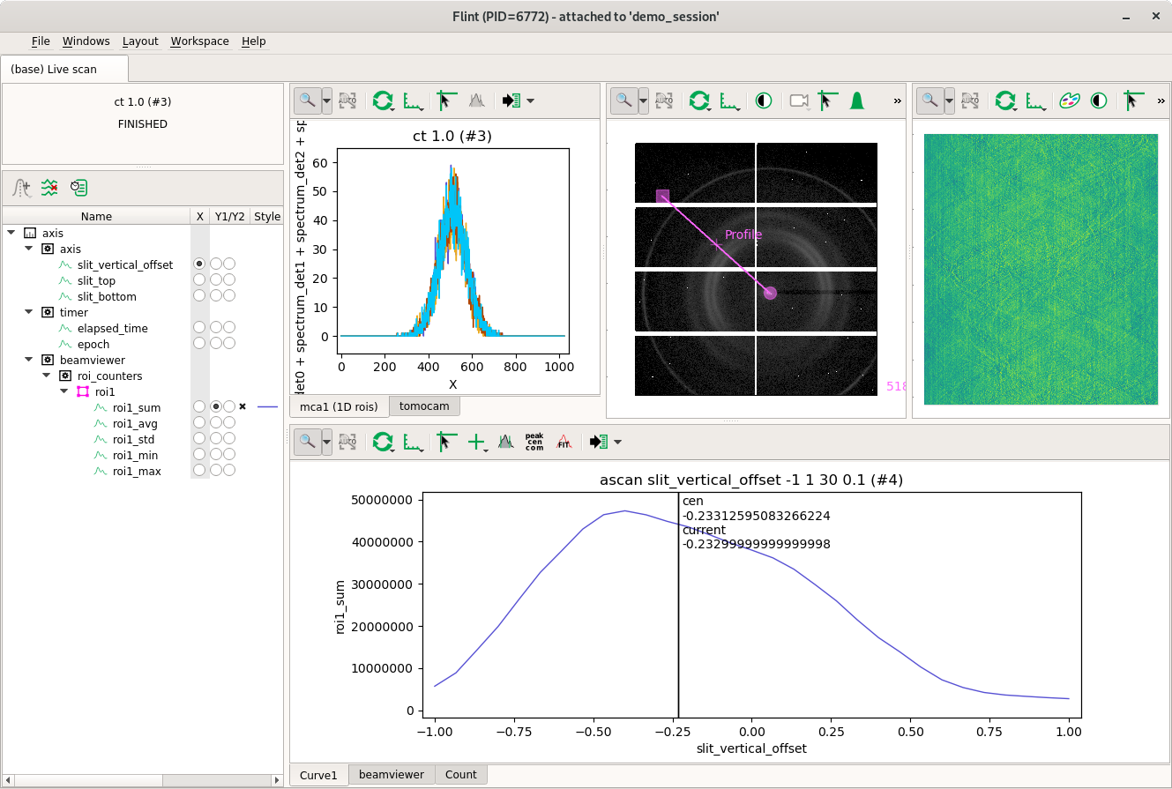
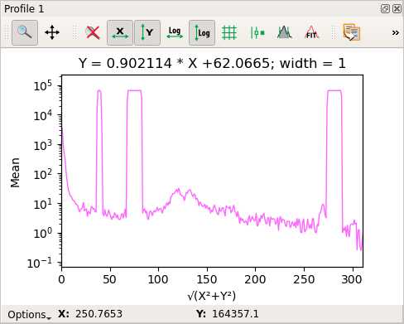
Why Bliss?
Flint - Live Data Display
Live scan data
Calculated data can be pushed to Flint

Slide 14
BLISS Software architecture
Decoupling of data acquisition from data saving and analysis

Slide 15
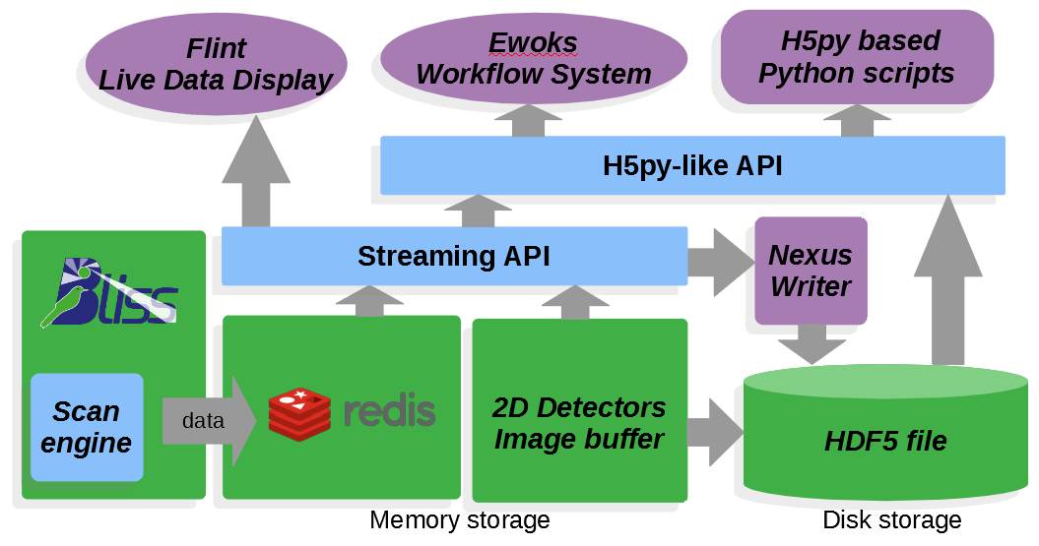
Bliss data access
Streaming API
H5py like API for transparent on- and offline data access
The API switches transparently to file access when data is no longer available online

Slide 16
Online data analysis - EWOKS

Slide 17
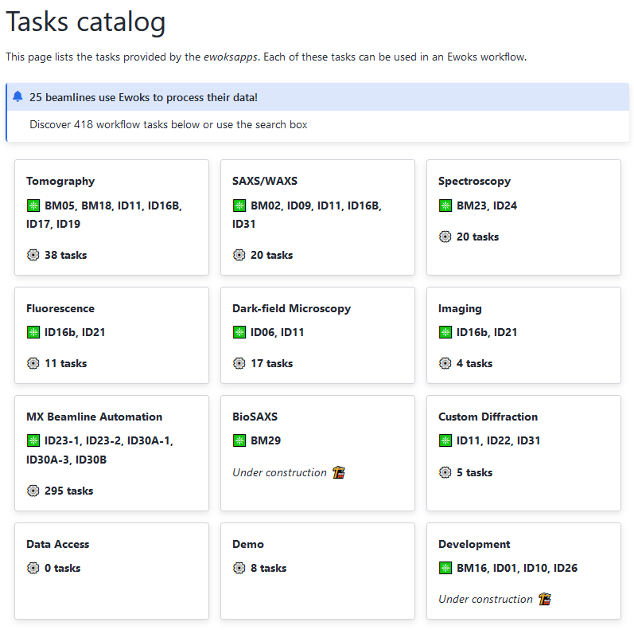
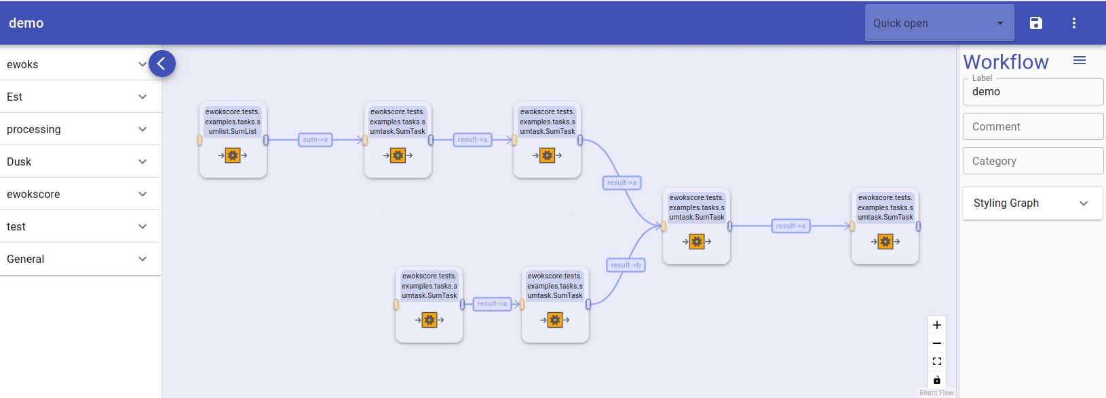
Online data analysis - EWOKS
Workflow System for Online Data Analysis and Reduction
Graphical chaining of predefined processing tasks by the user
Web GUI to build workflows
Specific workflow tasks for every scientific domain
Can run fully automated or manually
Processing by CPU or GPU, locally or batch cluster
Results can be stored or fed back to the acquisition system
EWOKS is running in daily operation on 25 beamlines today!

Slide 18
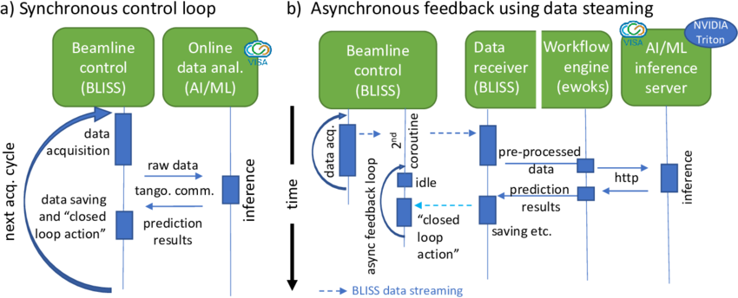
The proof is in the pudding
With BLISS and EWOKS the door is wide open for complex experiments
Example on ID10: Using AI/ML to close the loop with the running experiment
L.Pithan - Closing the loop: Autonomous experiments enabled by machine-learning-based online data analysis in synchrotron beamline environments

Slide 19
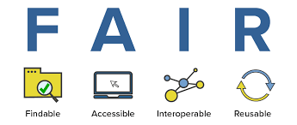
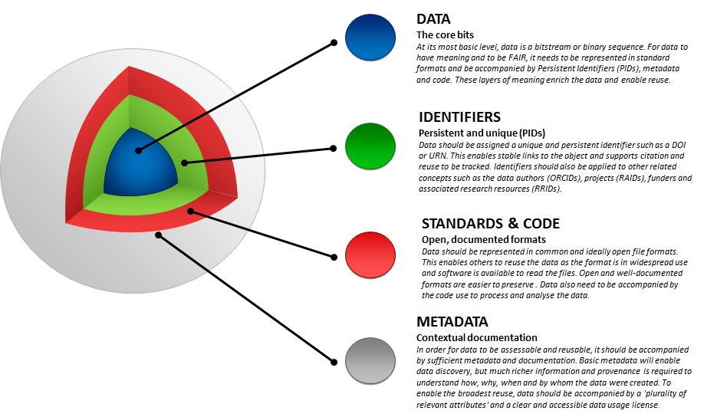
FAIR Data

Slide 20
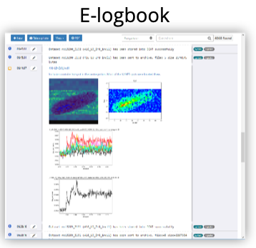
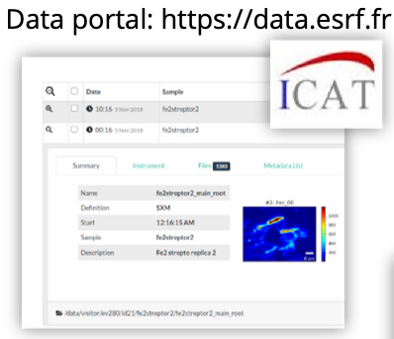
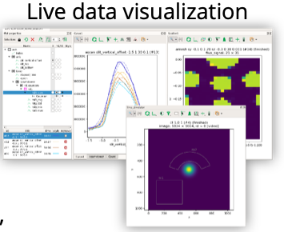
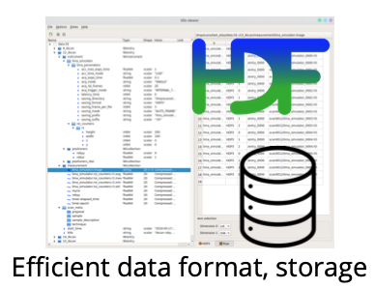
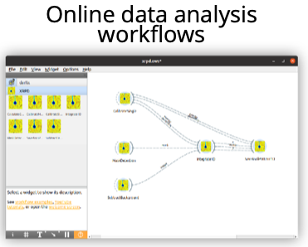
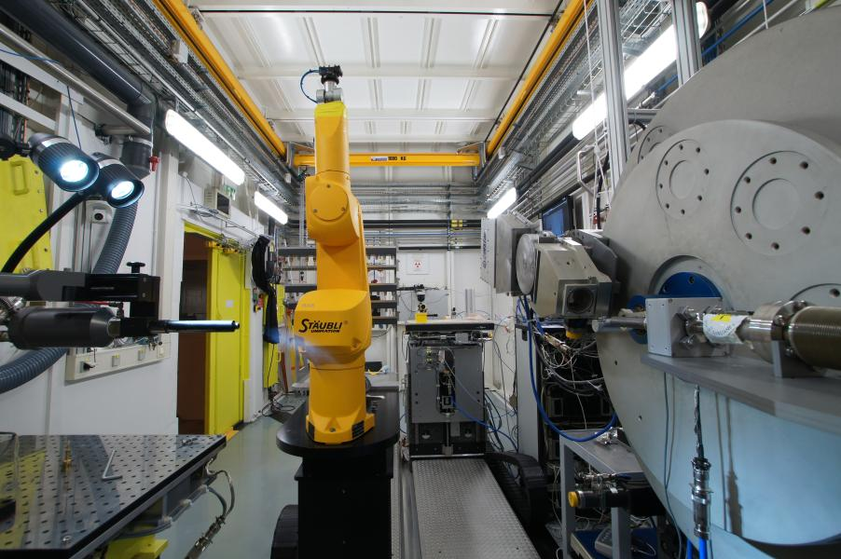
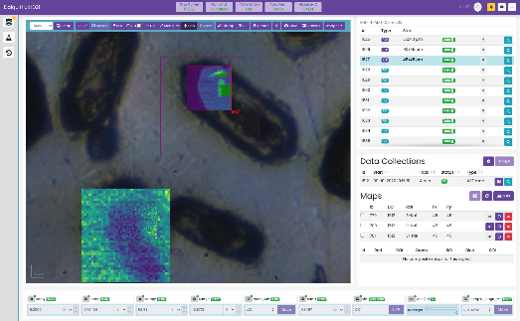
Why Bliss?
Integration within the ESRF Ecosystem
Sample changers, automation
Experiment GUIs

Slide 21
conclusion
BLISS
Ready to push-up the data acquisition frequency
Easy integration of user software
High flexibility to prepare complex experiments
Online data visualization
HDF5 saving structure, following the ESRF data policy, for all experiments
Transparent online and offline data access for data analysis
Decoupled data producers and data consumers. The BLISS data API can easily filled other data producers to use the same data analysis tools
EWOKS
Workflow definitions for different science domains
Easy automation of data reduction and online processing
Result feedback to the running acquisition

Slide 22
Thank You
Acknowledgements to
The members of the software group for the development of all the different software tools
Our colleagues from the Technical Infrastructure Division for their work on the network and data storage infrastructure
All the beamline scientists for their feedback, patience and bug reports since the EBS start-up

