Slide 1

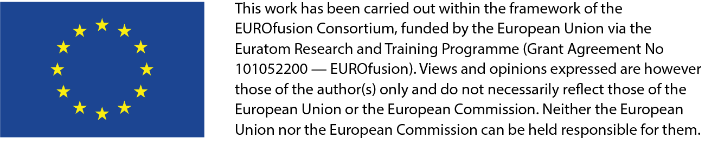
On implementation of non-steady-state sources in BIT1
Jernej Kovačič, Ștefan Costea
Jožef Stefan Institute
Ljubljana, Slovenia

Slide 2
Outline
General BIT1 model
Blob-filaments (no-ELM regimes)
Non-stationary source properties
Cases studied (single, train)
Results
Outlook
Jernej Kovačič, Ștefan Costea (JSI)| TSVV 7 review meeting 2022 | | 8.11.2022 | Page 2

Slide 3
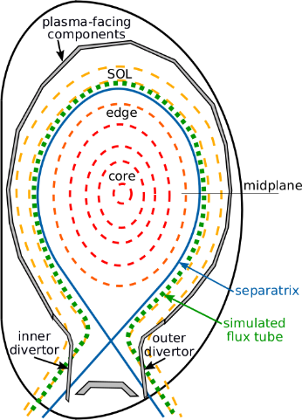
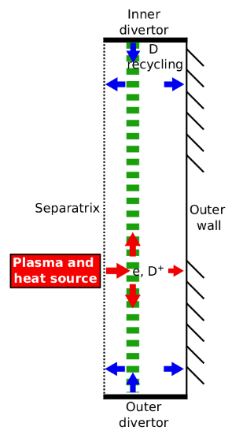
General BIT1 model
Poloidal projection of (any) full flux tube
Self-consistent simulation (source-sink balance)
Fully resolves charged particle motion (1d3v)
Temporal and spatial resolving down to ω_{pe} and λ_{D}
BIT1 code - rich MCC module with exact cross-sections
Fig 1: BIT1 model geometry; poloidal projection of a single flux tube.
Jernej Kovačič, Ștefan Costea (JSI)| TSVV 7 review meeting 2022 | | 8.11.2022 | Page 3

Slide 4
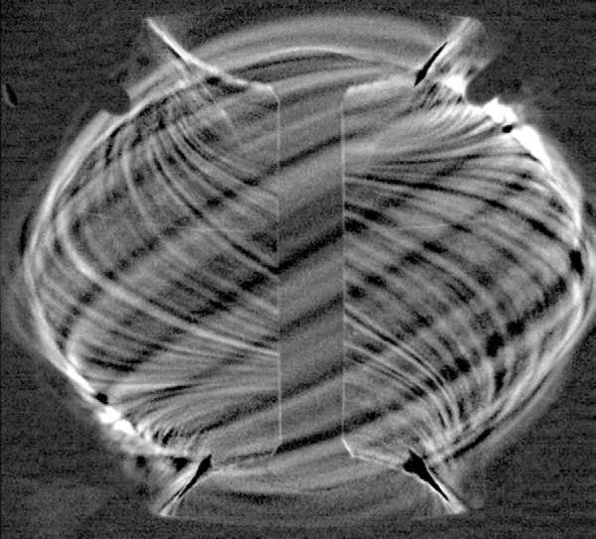
Blob-filaments
Coherent structures of hotter denser plasma entering SOL
Main inter-ELM transport mechanism
Cannot be adequately described by fluid models
Non-Maxwellian EDF/VDF (non-local behaviour)
Need for exact collisional processes (MC)
Transport in no-ELM regimes, ITER and post-ITER plasmas
Fig 2: Filaments in MAST
Courtesy of Nick Walkden
IT OMP OT
Fig 3: Snapshot of EEDF in SOL during blob passing
Jernej Kovačič, Ștefan Costea (JSI)| TSVV 7 review meeting 2022 | | 8.11.2022 | Page 4

Slide 5
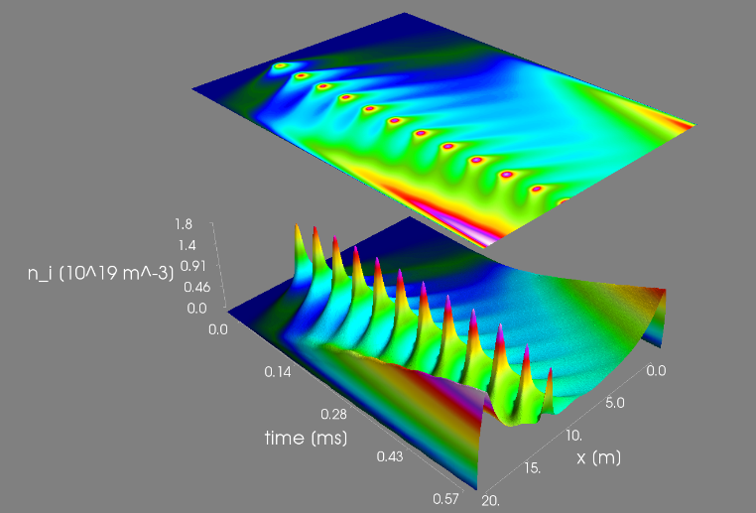
Non-stationary source
Initially empty simulation domain
Experimental blob to background density ratio
Any shape in time – we use Gaussian
Location: around outer midplane
Geometry: Cosine, parallel extension = 1 m
Experimental FWHM, t_{blob}/t_{wait}=1/5
Fig 4: Train of blobs in time and space
Jernej Kovačič, Ștefan Costea (JSI)| TSVV 7 review meeting 2022 | | 8.11.2022 | Page 5

Slide 6
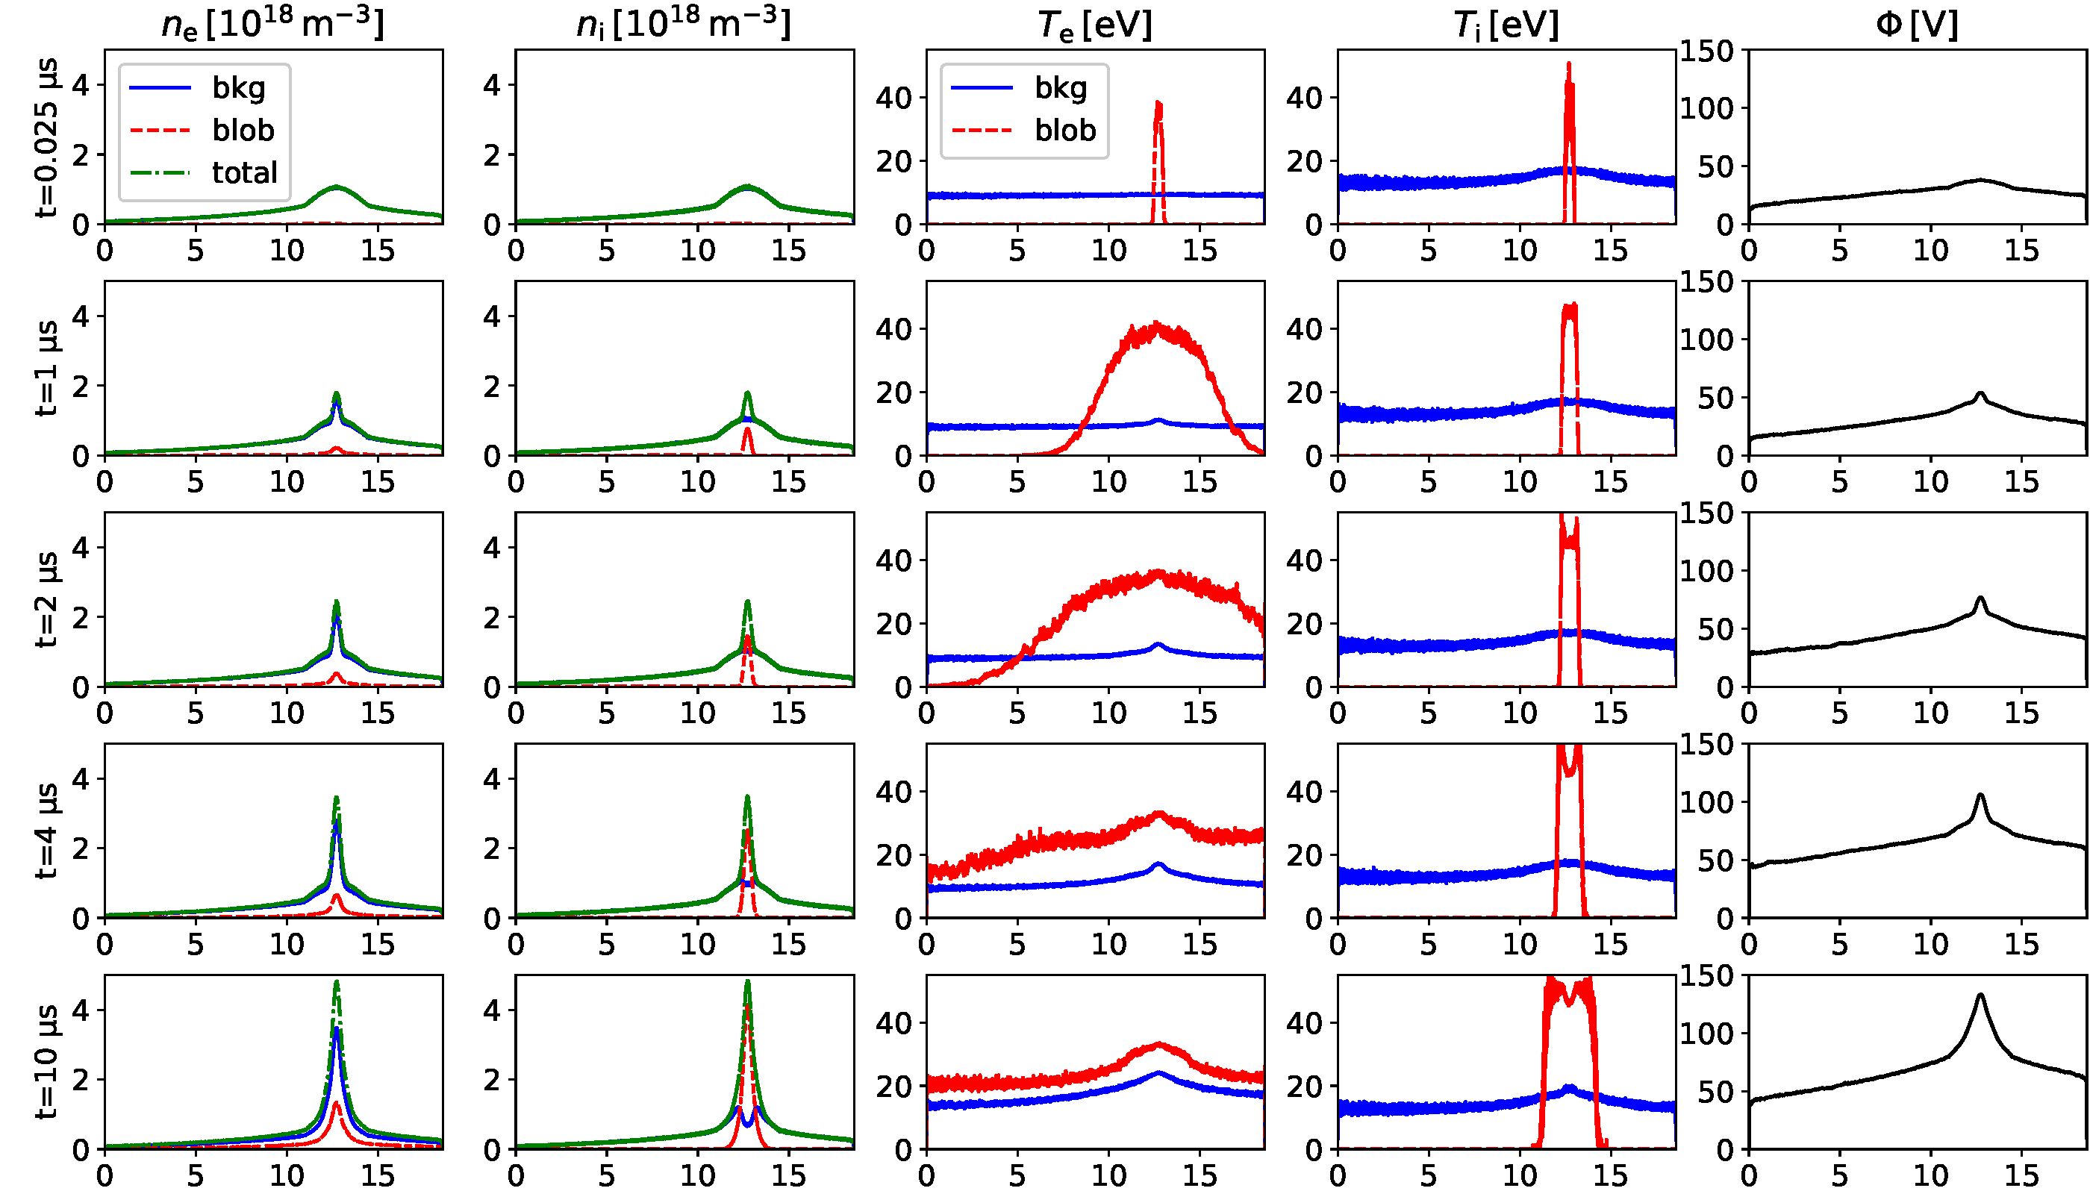
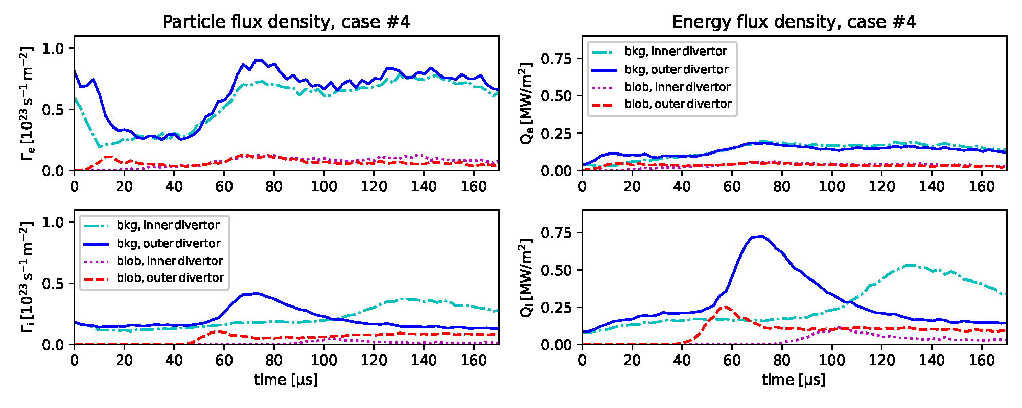
Single blob
Fig 5: Temporal development of fluid observables for a blob-filament injected into background plasma. There is visible decoupling of electron and ion part of the blob-filament.
[S.Costea, J. Kovacic, et al., PPCF 63 (2021), 055016]
Fig 6: Particle (left column) and heat (right column) fluxes of electrons (top row) and ions (bottom row) in time for a blob-filament.

Slide 7
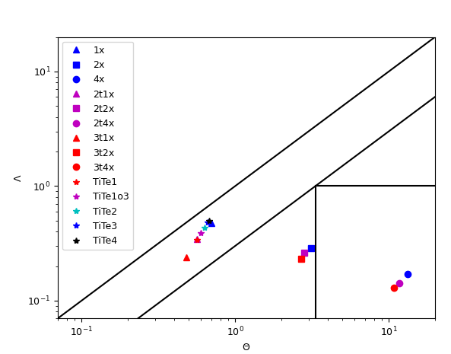
Cases studied
„Train of blobs“
Reference case: T_{i}=50 eV, T_{e}= 50 eV, δ_{b}=1 cm, tblob =10 μs, t_{wait}=50 μs.
Scan over temperatures and temperature ratios:
  Ti=Te=50 eV, 100 eV, 150 eV
  Ti= 100 eV, Ti/Te= 1,2,3,4
Scan over blob sizes, by varying t_{blob,} but keeping t_{blob}/t_{wait} (energy influx the same):
  Reference case = 1; cases 0.1, 0.2, 0.5, 1, 2, 3, 4
Neutrals sources: recycling (divertor, main chamber), fuelling (volumetric)
RB
RX
C_{S}
C_{i}
Fig. 7: Simulated cases of trains of blobs pinned to the Λ-θ scaling plane.
Jernej Kovačič, Ștefan Costea (JSI)| TSVV 7 review meeting 2022 | | 8.11.2022 | Page 7

Slide 8
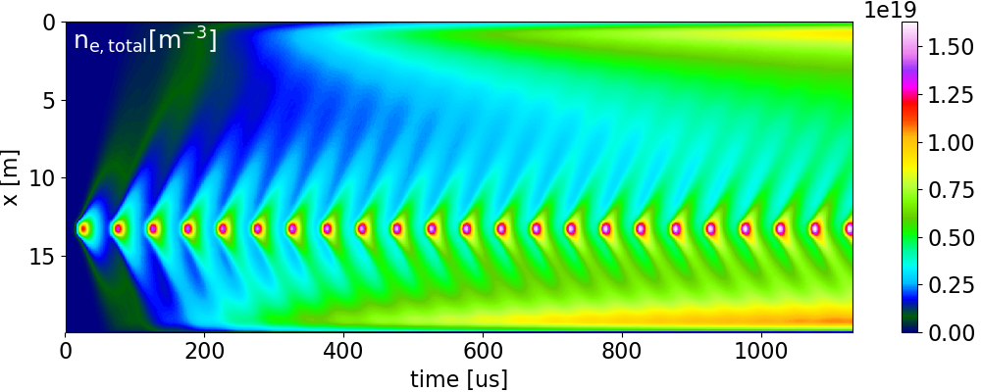
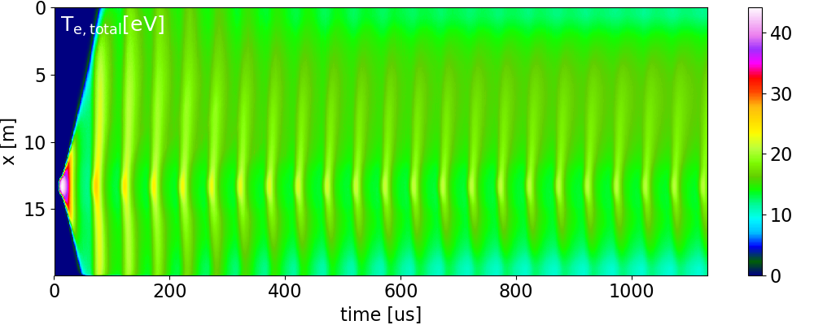
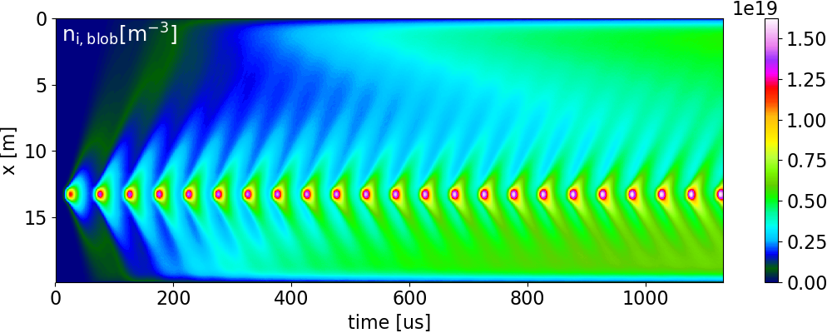
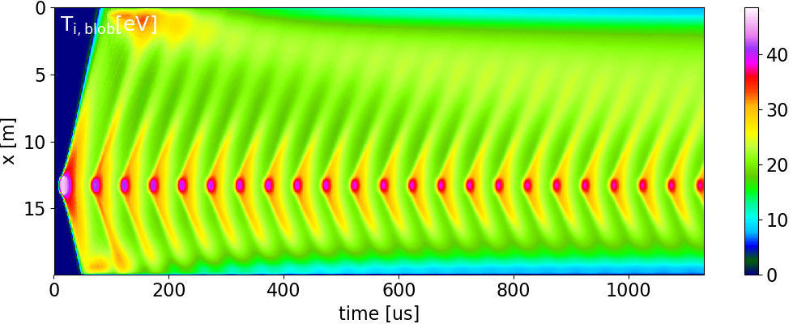
Results – train of blobs
Fig. 8: Temporal evolution of electron and ion densities and temperatures for the reference case.
Jernej Kovačič, Ștefan Costea (JSI)| TSVV 7 review meeting 2022 | | 8.11.2022 | Page 8

Slide 9
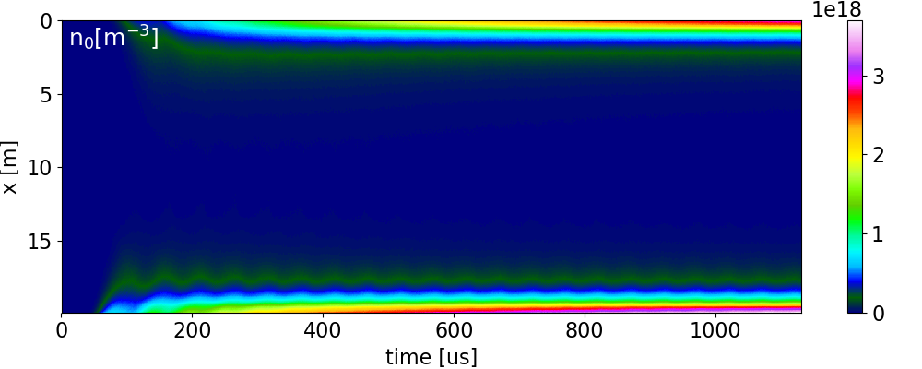
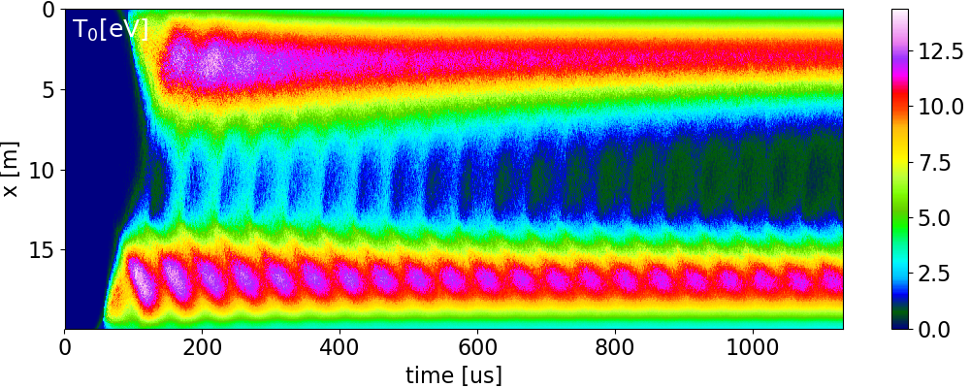
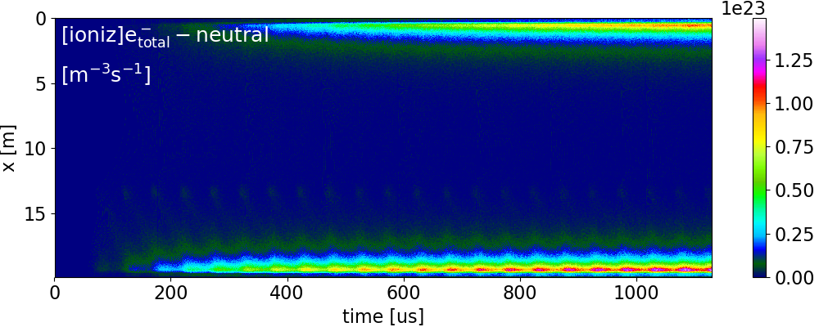

Results – train of blobs
Fig. 9: Temporal evolution of neutral density and temperature + spectroscopy data.
Jernej Kovačič, Ștefan Costea (JSI)| TSVV 7 review meeting 2022 | | 8.11.2022 | Page 9

Slide 10
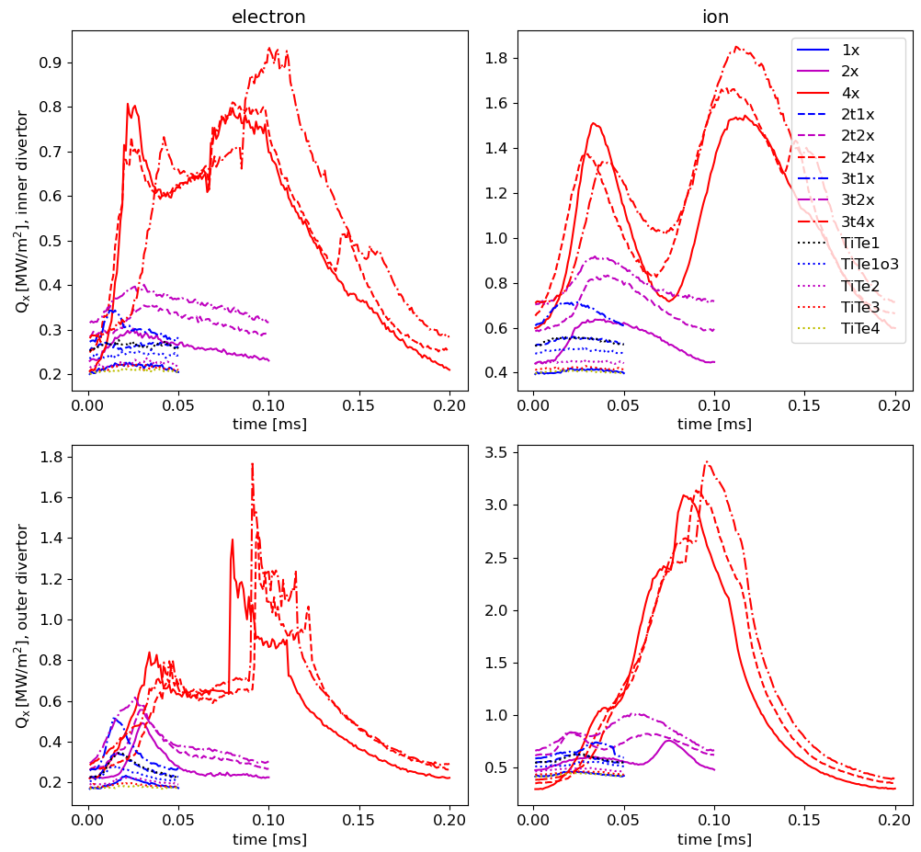
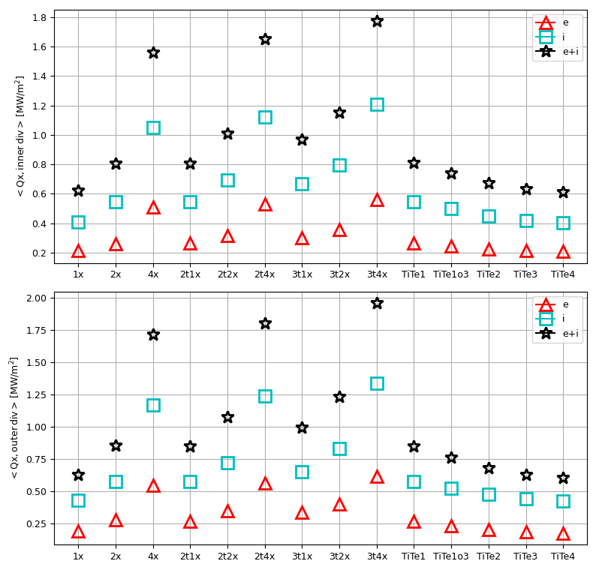
Results – power density
Fig. 10: Temporal evolution of total power density into the divertor for electrons and ions.
Fig. 11: Averaged total power density per case.
Jernej Kovačič, Ștefan Costea (JSI)| TSVV 7 review meeting 2022 | | 8.11.2022 | Page 10

Slide 11
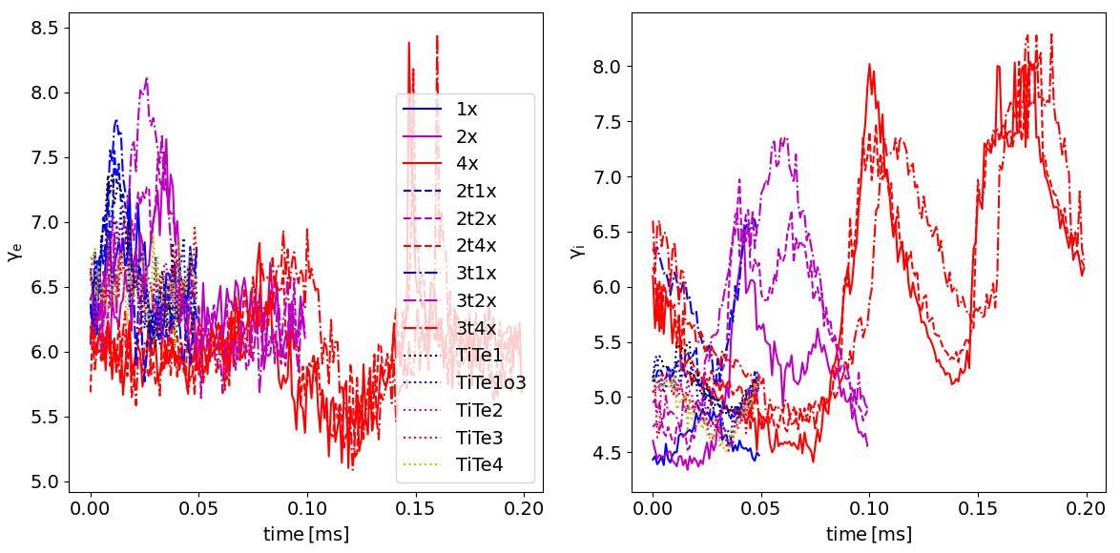
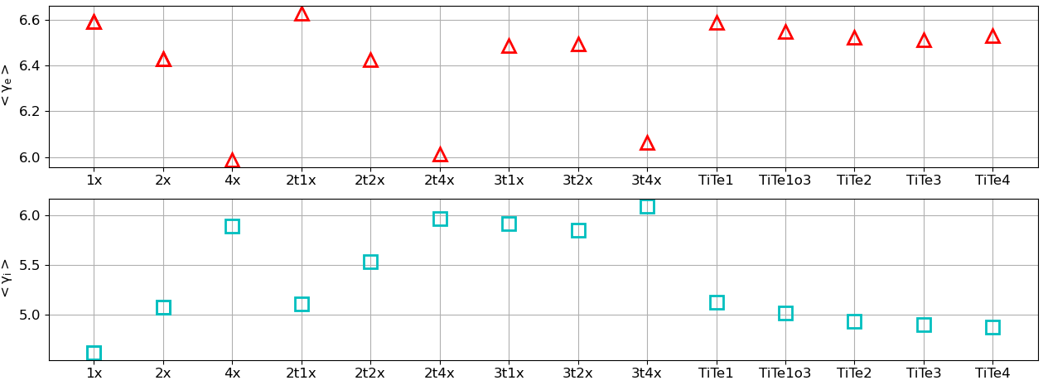
Results – SHTC
Fig. 12: Temporal development of sheath heat transmission coefficient for electrons (left) and ions (right) for different blob cases.
Fig. 13: Averaged values of sheath heat transmission coefficients for electrons (top) and ions (bottom).
Jernej Kovačič, Ștefan Costea (JSI)| TSVV 7 review meeting 2022 | | 8.11.2022 | Page 11

Slide 12
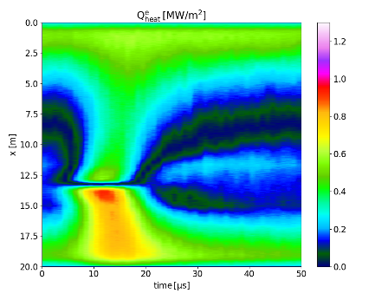
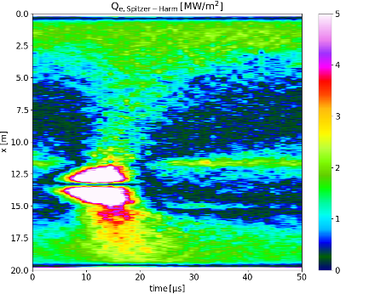
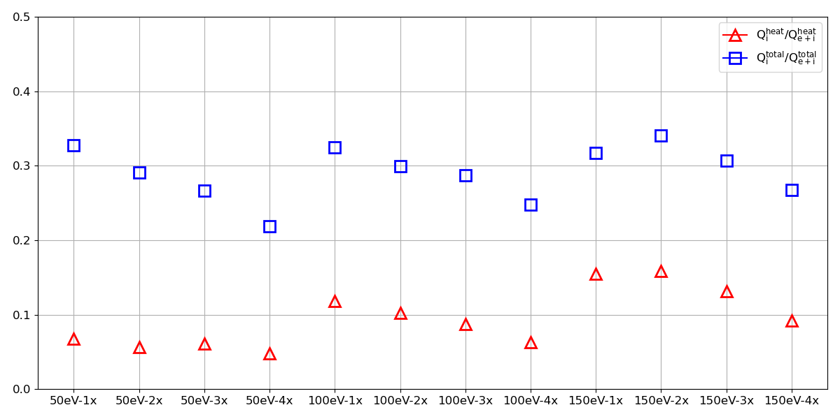
Results – heat and total fluxes
Fig. 15: Simulated (top) and calculated (Spitzer-Härm) heat fluxes from a passing of a single blob
Fig 14: Comparing ion to ion+electron heat (top row) and total power flux (bottom row) for steady state case (left column) and blob-filament (right column)
Fig. 16: Ratio of electron and ion contribution to heat and total flux.
Jernej Kovačič, Ștefan Costea (JSI)| TSVV 7 review meeting 2022 | | 8.11.2022 | Page 12

Slide 13
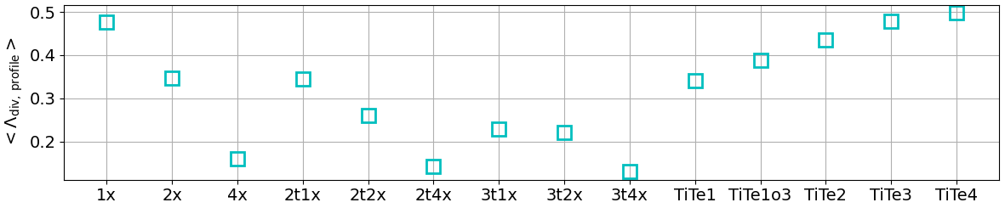
Results – local Λ_{div}
1X
Fig. 18: Collisionality parameter Λ_{div} averaged over passing of 1 blob over the whole simulation domain.
2X
4X
Fig. 17: Local values of collisionality parameter Λ_{div} in time for the cases of different blob sizes (1x, 2x, 4x of the reference blob) at T_{i}=T_{e}=100 eV
Jernej Kovačič, Ștefan Costea (JSI)| TSVV 7 review meeting 2022 | | 8.11.2022 | Page 13

Slide 14
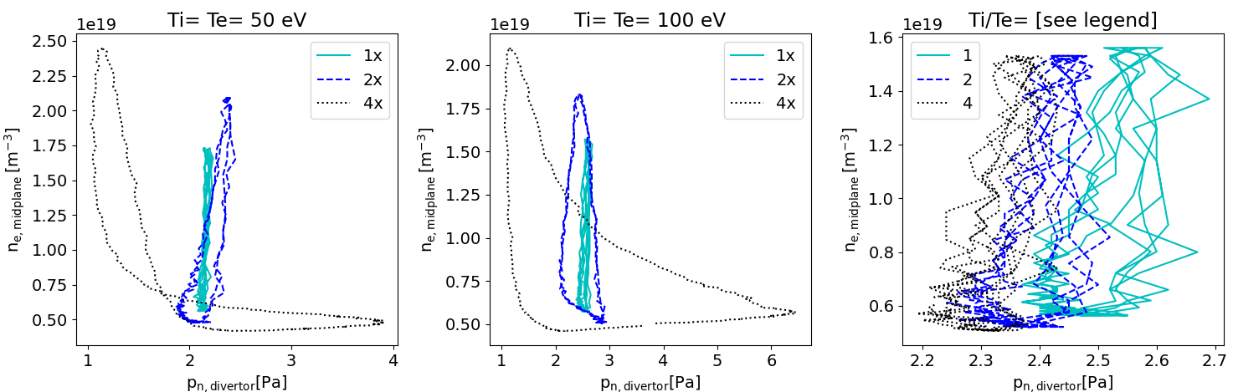
Results – recycling pressure in the divertor
Fig. 19: Divertor neutral pressure due to recycling with respect to midplane electron density.
Jernej Kovačič, Ștefan Costea (JSI)| TSVV 7 review meeting 2022 | | 8.11.2022 | Page 14

Slide 15
Outlook
Increasing neutrals density – higher charged particle density and lower temperatures
Improved radial transport model
Behaviour (detachment) of filaments
No-ELM regimes
Going up in size: ITER and DEMO like divertor densities and temperatures

Slide 16
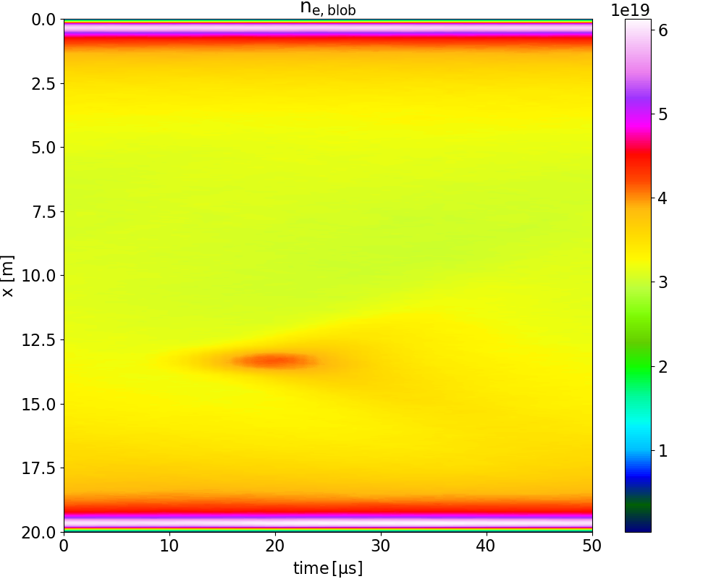
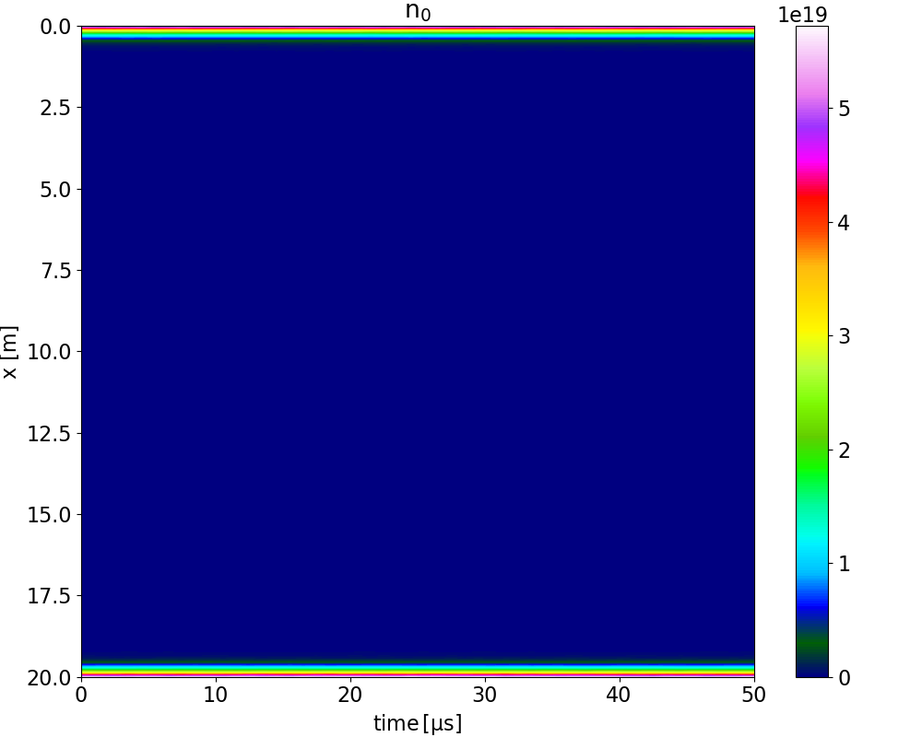
Outlook – increasing density
Additional volumetric neutral source
Fig. 20: Increased density of charged particles and neutrals due to added D fuelling source at the divertor.
Jernej Kovačič, Ștefan Costea (JSI)| TSVV 7 review meeting 2022 | | 8.11.2022 | Page 16

