Slide 1
MD simulations of D supersaturated W and interatomic potential development for W-O and W-O-D
Fredric Granberg
University of Helsinki
(VTT)

Slide 2
Personnel changes
PI: Fredric Granberg (Minor or no official workload)
Ph.D. Researcher: Faith Kporha (~6pm / year)
Maternity leave 9.22 ->
Open position for Ph.D. researcher
Fill in for Faith

Slide 3
OUR TASK
Excerpt from the proposal:
In order to provide ERO simulations with DEMO-relevant W erosion yields, including molecular sputtering yields, an extensive set of MD simulations will be performed for W under D/T super-saturation conditions. Existing W-H interatomic potentials that were proven to work well for PWI with W will be used for this task. Further effort will be put on development of W-O and W-O-H interatomic potentials that will be able to provide necessary input for ERO simulations under DEMO conditions when surfaces have been oxidized, e.g. as a result of off-normal transient events.

Slide 4
TIMELINE Proposal
Y1:
Intermediate results on erosion of H supersaturated W from MD simulations are reported
Y2:
Final results on erosion of D/T supersaturated W from MD simulations are reported.
Y3:
Intermediate results on W-O potential development are reported
Y4:
Final results on W-O potential development are reported
Intermediate results on W-O-H potential development are reported
Y5:
Final results on W-O-H potential development are reported
Task 1
Task 2

Slide 5
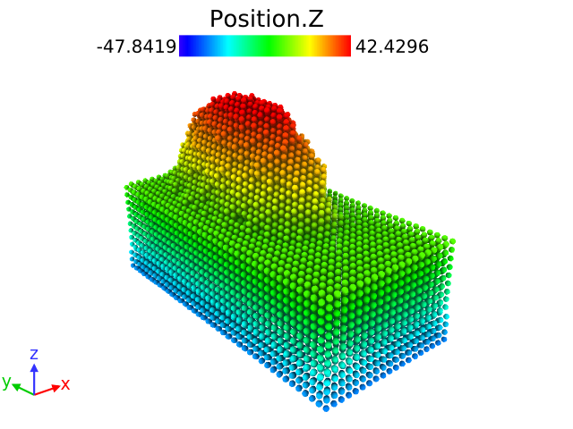
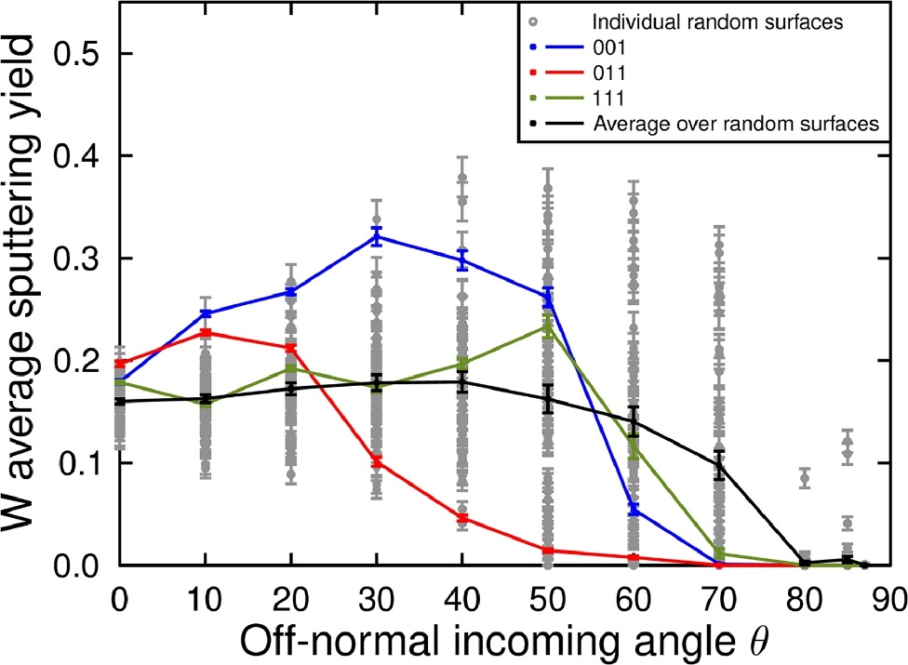
TASK 1 Background
We have studied the
Effect of random surface orientation
Effect of ion element and ion energy
Effect of incoming angle
Effect of surface roughness
Effect of interatomic potential
Effect of amorphous surface
On the
Sputtering and reflection yield [1,2,3,4,5,6]
And identified the mechanisms
However, only pure materials (W, Mo and Pd)

Slide 6
TASK 1
Utilize existing interatomic potentials for W-H(D,T) to simulate supersaturated W surfaces under irradiation with classical Molecular Dynamics
Develop a methodology for obtaining representative supersaturated surfaces
Simulate single impacts from low (10-100eV) to high (1keV +) energy at different incoming angles for different surface orientations and varying supersaturation
Identify the mechanisms behind the sputtering phenomena
Start cumulative impact simulations on selected similar cells as single impacts
Shown to yield comparable results with experiments
Run 10,000,000 - 100,000,000 MD impacts for good statistics

Slide 7
TASK 2
Expected start in 2023 as planned
Develop an interatomic potential for W-O and extend it further to W-O-H
At the moment very few methodologies exist for this
Most likely a Machine Learning potential will be created
Previous effort for ”classical” interatomic potential generation showed to be very hard
Drawback of ML potentials are their CPU-cost, 10-1000x slower than normal ones
Most interesting cases and results from TASK 1 will be validated and further investigated
Maybe GPU enabling will remedy the high demand and more cases can be studied
On the side, run Task 1 like simulations with the new potential

Slide 8
Methods Setup
2 methodologies for the setup:
Good for any surface orientation
Optimized amount of atoms
Good for cumulative setup
Good for supersaturation simulations

Slide 9
Methods Obtaining supersatutation
We inserted 1-10 H/D atoms in various depths of the sample and relaxed
This was repeated x times to achieve experimental relevant levels ( approx 10%)
All escaped H/D was deleted
This cumulative build-up yields representetive cells as ”any” H/D level
First problem came here:
The ”goto” W-potential, with existing W-H impementation failed
H/D strongly binds together or escaped
We obtain gas-exfoliation instead of supersturation

Slide 10
Problem 1
Why is this a problem:
Most previous results on pure W is with this W-potential
All benchmarks and other results needs to be redone in a new potential
(Obviously obtained knowledge will speed-up the benchmark generation)
The other existing potentials are Tersoff-type (vs. EAM)
This is approx. 5 times slower
Solution: Use the much slower not as much validated Tersoff-type potential
Some extra benchmarking is needed & CPU cost is approx 5-fold

Slide 11
Results Supersaturation
We obtained cells with different level of supersaturation
We used 5%, 10% and 20% supersaturation levels (approx 10% found in literature)
We used D and D2 as ions (D2 usually used experimentally)
Mainly focused on 10% & pristine at 0, 30 and 60 degrees @ 1keV/nucleon
Sputtering yield:
Reflection yield:
W Sputtering Yields
Incoming Angle | Pristine |  | 5% Supersaturated |  | 10% Supersaturated |  | 20% Supersaturated
 | D | D2 | D | D2 | D | D2 | D | D2
0 | 0,0007 | 0,0016 | 0,0005 | 0,0012 | 0,0004 | 0,0007 | 0,0004 | 0,0006
30 | 0,0035 | 0,0083 | 0,0027 | 0,0055 | 0,0021 | 0,0035 | 0,0015 | 0,0026
60 | 0,0065 | 0,0162 | 0,0043 | 0,0111 | 0,0035 | 0,0089 | 0,0020 | 0,0058
H Reflection Yields
Incoming Angle | Pristine |  | 5% Supersaturated |  | 10% Supersaturated |  | 20% Supersaturated
 | D | D2 | D | D2 | D | D2 | D | D2
0 | 0,0374 | 0,0771 | 0,0367 | 0,0753 | 0,0348 | 0,0703 | 0,0377 | 0,0828
30 | 0,1541 | 0,3128 | 0,1536 | 0,3244 | 0,1567 | 0,3278 | 0,1691 | 0,3391
60 | 0,2795 | 0,5882 | 0,2827 | 0,5932 | 0,2711 | 0,5903 | 0,3020 | 0,6137

Slide 12
Results
Supersaturation seems to lower the sputtering yield
Refection yield similar for all cases, slighlty higher for 20%
However, sputtering yields are very low, hugh statistics are needed (especially during perpendicular irradiation)
Caveat:
We found that sputtering seems to be happening as a secondary effect @ 0degrees
Preliminary results show is a boxsize effect
-> We need much larger boxes that previously though for light ions (H/He), heavy elements are fine

Slide 13
Conclusions
We have obtained a potential suitable for supersaturation simulation
Unfortunaltely slow and not utilized before (no pre-existing results to use)
We see an effect of supersaturation on the sputtering yield, not as much on reflection yield
D vs D2 is not large (except the 2x due to extra energy)
We found a possible problem, under investigation, with the cell size at perpendicular impact
Would lead to 5-10 times slower simulations
We also have a possible correction factor that could be used, on conceptual level
Mainly for perpendicular or close to irradiation
We have most of the MD results as planned, and a simulation setup that can easily be used to obtained all the needed yields for specific energies and incoming angles.

Slide 14
Outlook
Finalize the investigation of the possible problem at perpendicular impacts
Find a correction factor if needed
Run more energies/incoming angles/surface orientations
Make a manuscript out of all the findings
Start the work on W-H-O interatomic potential

Slide 15
THANK YOU FOR YOUR ATTENTION
References:
[1] Jussila, J., Granberg, F., and Nordlund, K. Nuclear Materials and Energy. 17 (2018) 113-122
[2] Granberg, F., Litnovsky, A., and Nordlund, K. Journal of Nuclear Materials 539 (2020) 152274
[3] Schlueter, K., Nordlund, K., Hobler, G., Balden, M., Granberg, F., Flinck, O., da Silva, T. F. and Neu, R. Physical Review Letters 125 (2020) 225502
[4] Granberg, F. and Byggmästar, J. Computational Materials Science 188 (2021) 110134
[5] Lopez-Cazalilla, A., Cupak, C., Fellinger, M., Granberg, F., Szabo, P. S., Mutzke, A., Nordlund, K., Aumayr, F., and Gonzalez-Arrabal, R. Physical Review Materials 6 (2022) 075402
[6] Lopez-Cazalilla, A., Jussila, J., Nordlund, K., and Granberg, F. Computational Materials Science 216 (2023) 111876

