Slide 1
Retention and permeation modelling for DEMO (2022)
J. Mougenot¹, R. Delaporte-Mathurin^{2,1}, E. Hodille², Y. Charles¹, C. Grisolia²
¹Université Sorbonne Paris Nord, LSPM, CNRS, UPR3407, F-93430, Villetaneuse, France
²CEA, IRFM, F-13108 Saint-Paul-lez-Durance, France

Slide 2
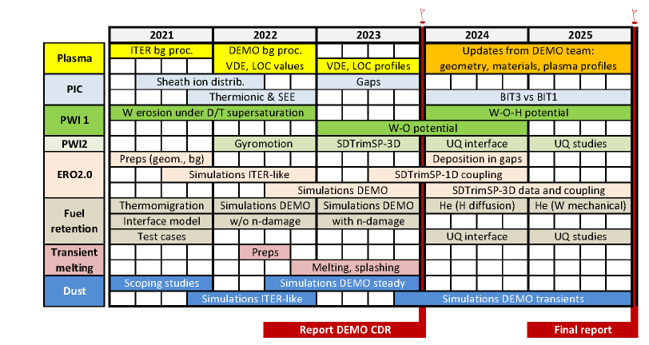
Fuel retention task
One of the TSVV#7 objectives: Assessment of tritium in-vessel inventory (co-deposition, bulk retention with He-induced and neutron damage)

Slide 3
Summary of work done in 2022
(for M2.9) 3D effects on hydrogen transport in ITER-like monoblocks with FESTIM code
Paper to be submitted – on Eurofusion Pinboard (ID: 33309)
(for M4.6) Modelling H-He interactions in W
32nd Symposium on Fusion Technology –September 10-23 2022 –Dubrovnik, Croatia
on Eurofusion Pinboard (ID: 30921)

Slide 4
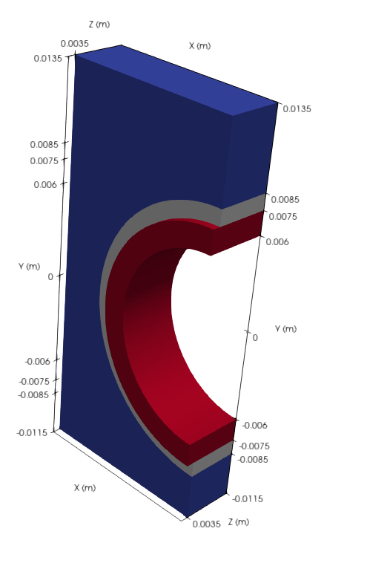
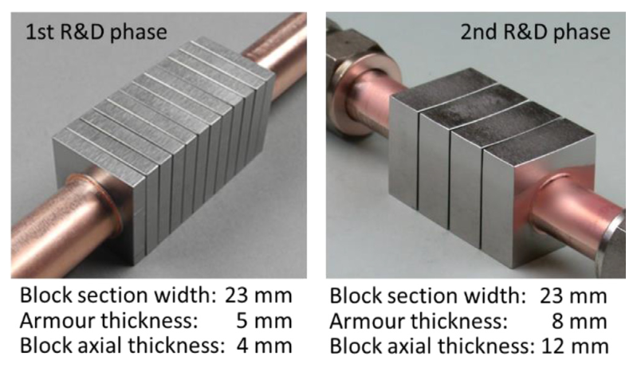
Monoblock for DEMO (ITER-like)
W
e/2
Cu
5 mm
CuCrZr
1 mm
1.5 mm
You et al. Journal of Nuclear Materials 544, 152670 (2021)
Several simulations were run with the monoblock thicknesses (e)
varying from 4mm to 14 mm
¼ of a monoblock
+0.5 mm of CuCrZr over Z (pipe continuity, 1 mm space between the monoblocks)

Slide 5
General model description
Transient heat tranfer
Chemical potential continuity at interfaces
Fick diffusion of solute hydrogen
Kinetic trapping of trapped hydrogen
Trap properties
R. Delaporte-Mathurin – To be submitted

Slide 6
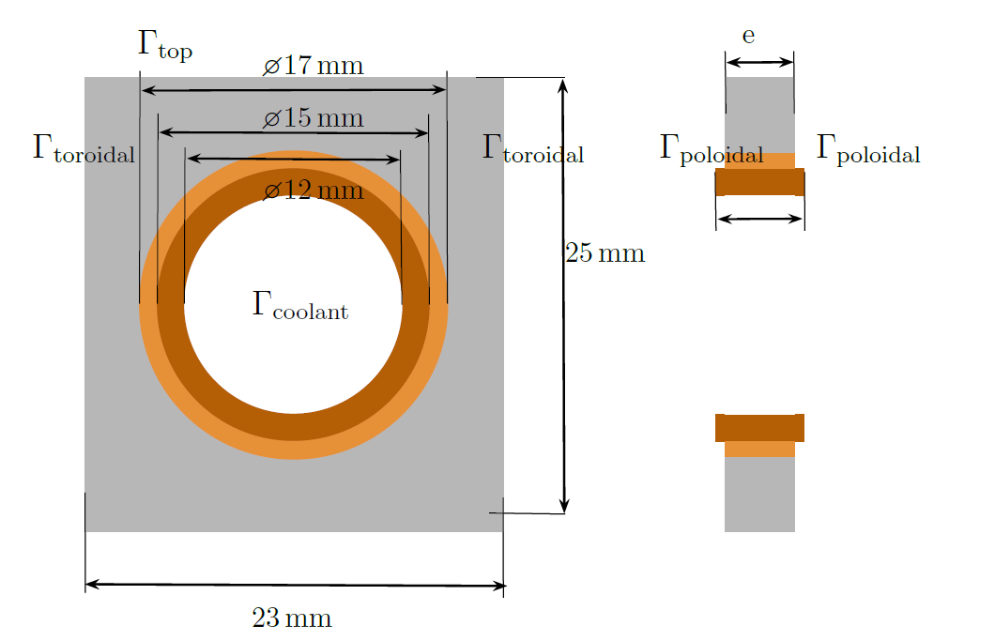
Scenario and boundary conditions
Transient simulations up to 10⁶ s (no cycling for DEMO ?)
Solved with FESTIM code now open-source: https://github.com/RemDelaporteMathurin/FESTIM
2 cases are considerated
R. Delaporte-Mathurin – To be submitted

Slide 7
Temperature and mobile H field
Similar to 2D field
(zero thermal flux on the toroidal face)
Instantaneous recombination
Solubility effect
Stationnary
e=6 mm
After 10⁶ s
e=6 mm
R. Delaporte-Mathurin – To be submitted

Slide 8
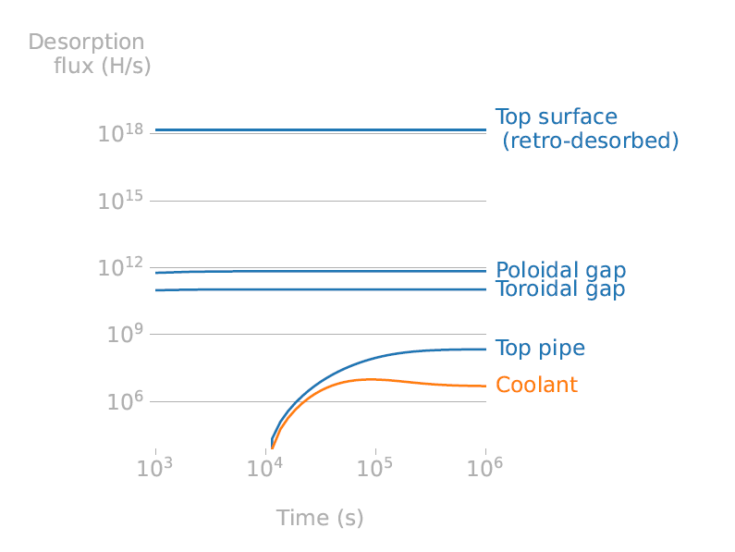
Some temporal evolutions
No recombination = zero flux ≈ 2D case
Flux to coolant is zero before 10⁴ s (H diffusion need time) and decrease 10⁵ s thank to the desorption on the CuCrZr pipe extrusion
Retention is over estimated by 2D simulations
R. Delaporte-Mathurin – To be submitted

Slide 9
Thickness effect
The variation for the no recombination case is due to CuCrZr pipe extrusion
The retention is higher for the thicker, because H is stored futher from a desorption surface
t= 10⁴s
R. Delaporte-Mathurin – To be submitted

Slide 10
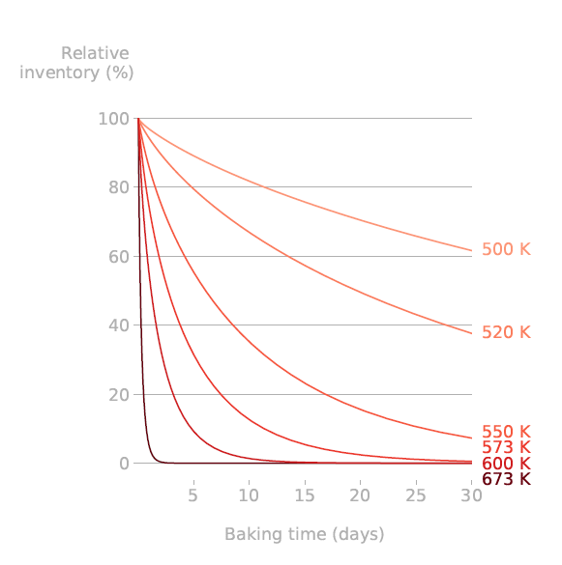
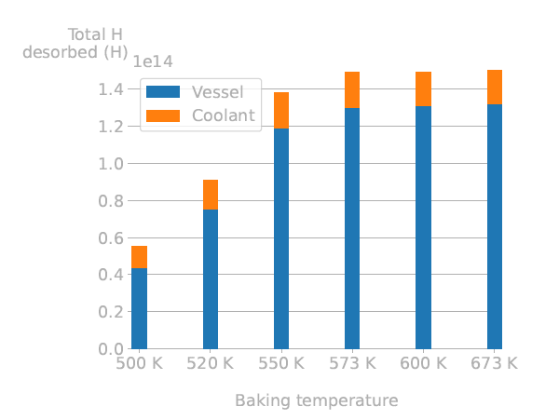
And study of the baking phase
No more plasma, just constant heating during baking phase. Starting point: steady state retention field e=6 mm case
The higher the temperature, the faster the desorption.
The desorption to the coolant represents ≈ 10% of the total desorption
After 30 days
R. Delaporte-Mathurin – To be submitted

Slide 11
Next steps (planned for 2023)
Add new trap induced by neutron damages
3D simulations with the Soret effect (data on the heat of transport will be available, the code is ready)
3D simulations with other parametric study (thickness of the W armor ?) and/or others exposure conditions (given by plasma code) and geometry
Evaluate the possibility of IMASization the FESTIM open source code

Slide 12
Summary of work done in 2022
(for M2.9) 3D effects on hydrogen transport in ITER-like monoblocks with FESTIM code
Paper to be submitted – on Eurofusion Pinboard (ID: 33309)
(for M4.6) Modelling H-He interactions in W
32nd Symposium on Fusion Technology –September 10-23 2022 –Dubrovnik, Croatia
on Eurofusion Pinboard (ID: 30921)

Slide 13
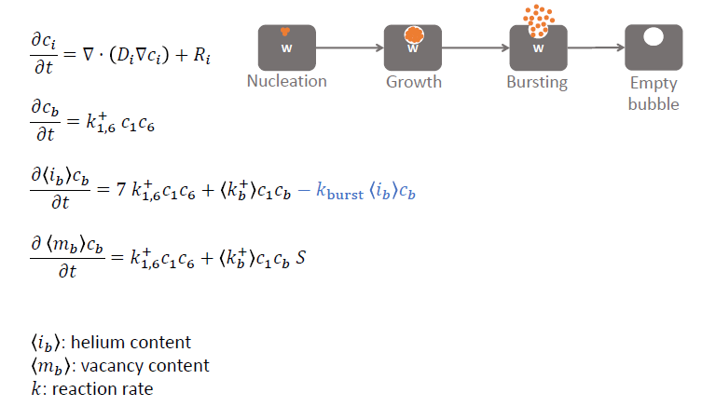
He nanobulles
Adding a bursting effect in our HeFenics code
In collaboration with S. Blondel and cross-check with Xolotl code
S. Blondel . Nuclear Fusion 58, 126034 (2018)
R. Delaporte-Mathurin . Scientific Reports 11, (2021)
R. Delaporte-Mathurin – 32nd SOFT (2022)

Slide 14
He nanobulles
It allows to predict more realistic bubble size close to the surface
But what is the value of $k_{burst}$ ?
R. Delaporte-Mathurin – 32nd SOFT

Slide 15
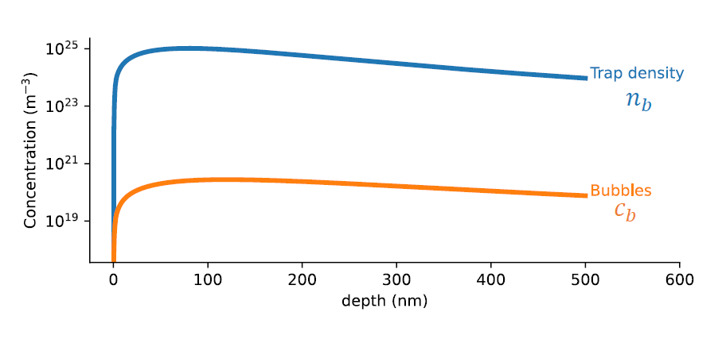
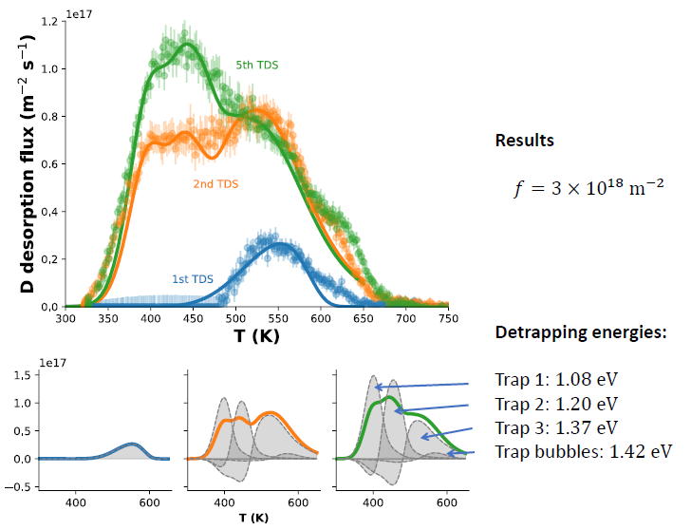
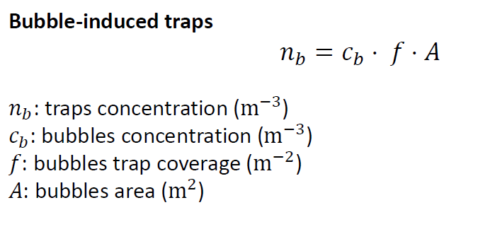
Some proposal to couple with H transport
?
With some TDS analys we can estimate
R. Delaporte-Mathurin – 32nd SOFT (2022)

Slide 16
Next steps
Working on the implementation of different k busting laws
Add new traps induced by helium in the 3D simulation of H transport. It is only a surface effect, the impact will be low on the total inventory
Add other surface effects modelled in the frame of TSVV#7 ?

Slide 17
CEA Team changes for 2023
Christian Grisolia goes into retirement, Floriane Montupet-Leblond will take its place in the project from 2023
Rémi Delaporte-Mathurin goes to the USA, as planned he will not be involved anymore in the project

Slide 18
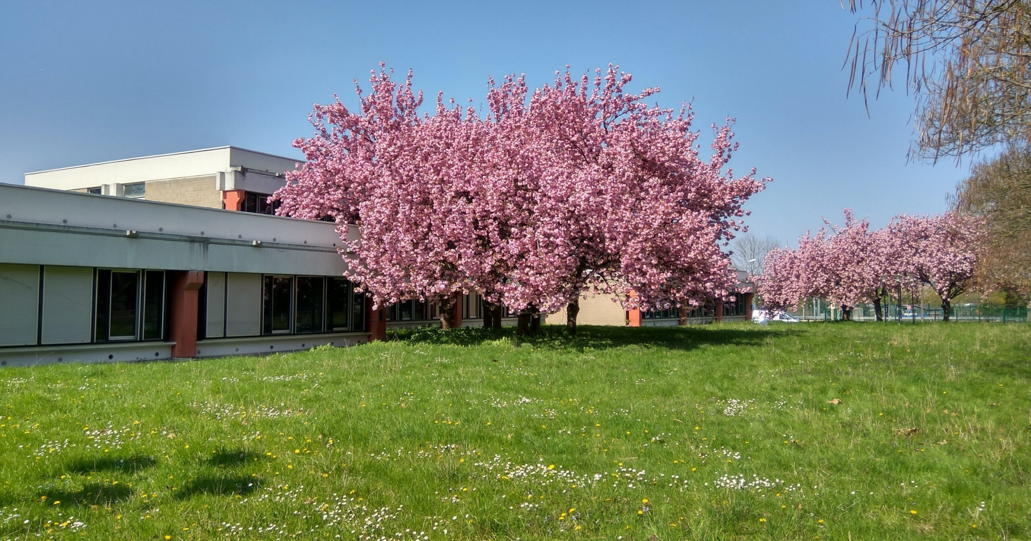
Questions/remarks?

