Slide 1
“Theory, Simulation, Verification and Validation” TSVV Task 7: Plasma-Wall Interaction in DEMO Status review meeting 08.11.2022

Slide 2
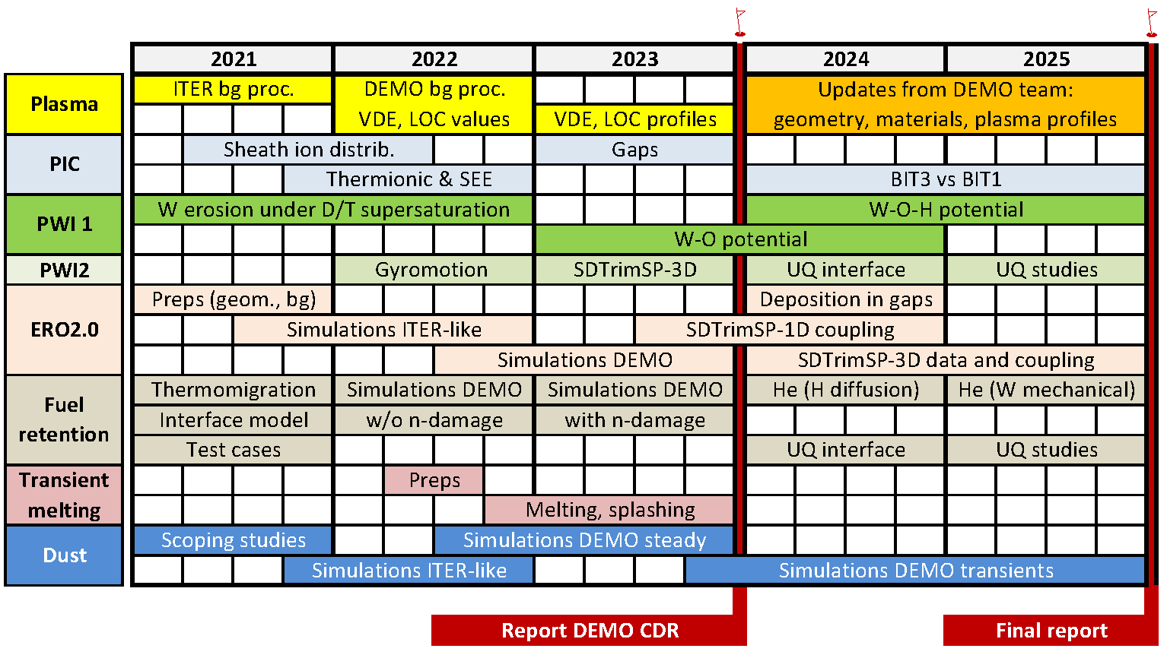
PROJECT TIMELINE

Slide 3
TASKS 2022
1. Perform dedicated PIC studies with BIT-1 for DEMO-relevant high-density (ne~1e22) divertor sheath and provide relevant input for erosion, dust transport and transient melting simulations by ERO2.0, MIGRAINe and MEMOS-U.
2. Perform full 3D ERO2.0 simulations using existing PWI databases, sheath models and the plasma solution agreed upon in the preceding phase of the project (presumably still without kinetic neutrals) and provide erosion-deposition maps and wall lifetime for the main chamber and divertor of DEMO.
3. Perform dedicated dust transport simulations with MIGRAINe for net deposition locations provided by ERO2.0 simulations.
4. Post-process and implemented for erosion and dust transport simulations with ERO2.0 and MIGRAINe the new/improved DEMO plasma solution with kinetic neutrals provided by DCT/WPDES/WPADC.
5. Perform PIC simulations with SPICE to identify whether the escaping current scales with electron thermal velocity (which depends only on Te) or on ion sound speed (which includes the influence of Ti).
6. Run cumulative MD simulations with 10-100 million impacts utilizing available W-H interatomic potentials to simulated supersaturated W surfaces under ion irradiation. Compare to static cases.
7. Implement representative values of surface heat fluxes and halo current densities during DEMO VDEs and surface heat fluxes during DEMO loss of confinement (as external input DCT/WPDES) for transient melting simulations with MEMOS-U.
8. Implement the gyromotion module in SDTrimSP-3D.
9. Implement neutron damage and damage stabilization models in retention codes.
10. Perform TESSIM and FESTIM simulations of fuel accumulation in DEMO PFC and permeation to coolant (so far without neutron effects).
11. Perform detailed analysis of input and output (IO) of all involved codes and summarize how the IO can be reduced to IMAS compatible interfaces. Follow discussions with respective ACH to identify the work program for IMAS compatibility implementation.
MEMENTO

Slide 4
DELIVERABLES 2022
1. Improved results on DEMO-relevant high-density (ne~1e22) divertor sheath characteristics from PIC simulations: plasma profiles; energy, velocity and angular distribution functions at PFC as input for erosion and dust transport modelling.
2. First erosion-deposition maps and wall lifetime in the main chamber and divertor of DEMO based on existing PWI databases, sheath models and the “2021” DEMO geometry and plasma background (ITER-like or DEMO SN).
3. Dust survival rates and accumulation maps for net deposition locations from deliverable 2.
4. New/improved DEMO plasma solution with kinetic neutrals (provided by DCT/WPDES/WPADC) post-processed and implemented for erosion and dust transport simulations.
5. Description of the influence of the ion temperature on the escaping current and conclusions on the validity of existing scalings for simulations of transient melting.
6. Final (cumulative) erosion yields for H supersaturated W from MD simulations are obtained.
7. Representative values of surface heat fluxes and halo current densities during DEMO VDEs and surface heat fluxes during DEMO loss of confinement (as external input from DCT/WPDES) processed and implemented for transient melting simulations.
8. Gyromotion module in SDTrimSP-3D.
9. Neutron damage (not yet validated) model with damage stabilization in retention codes.
10. Predictions of fuel inventory and permeation under DEMO condition (so far without n-damage).
11. Detailed IMAS compatibility requirements and respective work plan.

Slide 5
Meeting agenda
09:00-09:05 Welcome
09:05-09:25 D. Tskhakaya on BIT-1 simulations of DEMO-relevant high-density sheath 09:25-09:45 S. Costea on implementation of non-steady-state sources in BIT-1 09:45-10:05 A. Podolnik on SPICE-2D simulations of thermionic emission 10:05-10:25 A. Podolnik on implementation of new features in SPICE-2D code 10:25-10:45 U. von Toussaint on implementation of gyromodule for SDTrimSP-3D
10:45-10:55 Coffee break
10:55-11:15 L. Vignitchouk on dust transport simulations for DEMO 11:15-11:35 S. Ratynskaia on the MEMENTO code (successor of MEMOS-U) and applications 11:35-11:55 F. Granberg on MD simulations of W erosion in case of D supersaturation 11:55-12:15 C. Baumann on ERO2.0 simulations of W erosion in DEMO 12:15-12:35 E. Hodille on retention modelling for DEMO
12:35-13:00 Open discussions

Slide 6
DISCUSSION
Marconi cycle 7 application → in draft
ACH support:
MIGRAINe → completed in 2022 (VTT)
ERO2.0, SPICE2D → continues in 2023 (BSC)
MEMENTO, RAVETIME → new in 2023 (VTT)
IMASization…
In person team meeting in 2023
Tasks 2023

Slide 7
TASKS 2023
1. Implement the erosion data under DEMO D/T supersaturation obtained in “2022” into ERO2.0.
2. Implement the PIC-inferred sheath characteristics (such as electric field profiles, angular and energy distributions of ions at plasma-facing surfaces, potential influence on plasma-impurity interaction physics) into the ERO2.0 code. Perform full 3D ERO2.0 simulations using updated databases, sheath models and the new plasma solution accounting for kinetic neutrals. Provide erosion-deposition maps and wall lifetime for the main chamber and divertor of DEMO.
3. Perform MEMENTO simulations of PFC response under VDEs and loss of confinement. Assess macroscopic surface modifications in form of melting, melt re-solidification and possibly splashing. In case of splashing, analyze the size and velocity distributions of droplets.
4. Perform dedicated dust transport simulations with MIGRAINe for net deposition locations provided by ERO2.0 simulations.
5. Perform SDTrimSP-3D simulations for rough surfaces of specific morphology and in particular that of re-solidified melt resulting from task 3 to obtain effective erosion yields.
6. Perform PIC simulations with SPICE codes to obtain heat loads and ion penetration into gaps of divertor and limiter monoblocks under DEMO sheath conditions.
7. Perform TESSIM-X and FESTIM simulations of fuel accumulation in DEMO PFC with relevant material structure and fuel permeation to coolant, accounting for neutral damage. Cross-validate the results of both codes.
8. Develop with help of Machine Learning approach an interatomic potential for W-O. Perform with help of ACH GPU enabling of respective computer tools.
9. Prepare an extensive integrated report for the DEMO conceptual design review regarding the DEMO wall lifetime in steady-state and transients and regarding fuel uptake, retention and permeation.
10. Further enable the collaboration with ACH on implementation of IMAS interfaces for main codes.
11. Implement transient plasma profiles representative of VDEs and loss of confinement events in DEMO (as external input from DCT/WPDES) into MIGRAINe.

