Slide 1

WPPrIO Preparation of ITER Operation
FSD Project Board meeting 2023-03-15
X. LITAUDON (PL) , G. FALCHETTO (PSO) on behalf of PrIO team

Slide 2
Context: EFPW-2022 on EUROfusion role in ITER operation & scientific exploitation
Re-optimization of assembly and ITER Research Plan to be carried out in order to minimize impact on start of DD+DT operation. Various options under discussion within IO
  Two stages nuclear licenses, W wall, increase ECRH, merge campaigns … ?
“Research team with large participation of ITER Members specialists is required to execute research and experiment program”
“Time from now to start of operation should be used to develop full capabilities for ITER scientific exploitation: Support from ITER Members R&D institutions is essential”
Main Areas for Collaboration with ITER partners to the Preparation and Execution of ITER Integrated Commissioning and Operations have been identified
  Operations, Commissioning, Technical Documentation and Procedures, Machine Protection, Tools for Operation (and systems), Execution of Experimental Program, Nuclear Safety Training
[A. Loarte EFPW]
[A. Loarte EFPW ]
[I. Nunes EFPW ]

Slide 3
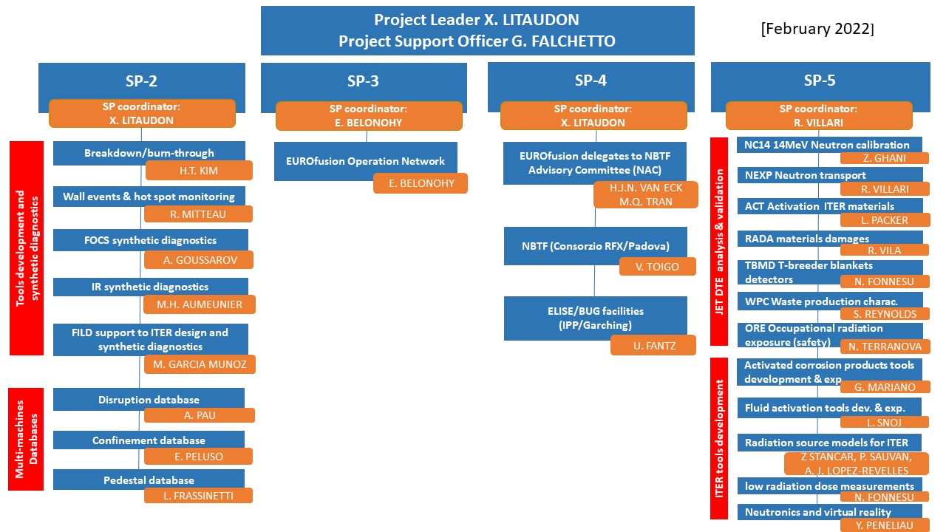
Implementation of some of the 2020 GA recommendations
[EUROfusion role in ITER operation & scientific exploitation EUROFUSION GA (20) 32 - 4.7 ]
SP-1
SP-1. Project management
SP-2. Preparation of ITER first experimental campaigns
SP-3. Plant systems and plasma operation
SP-4. ITER Neutral Beam Test Facility and R&D
SP-5. Neutronics, Nuclear waste and Safety

Slide 4
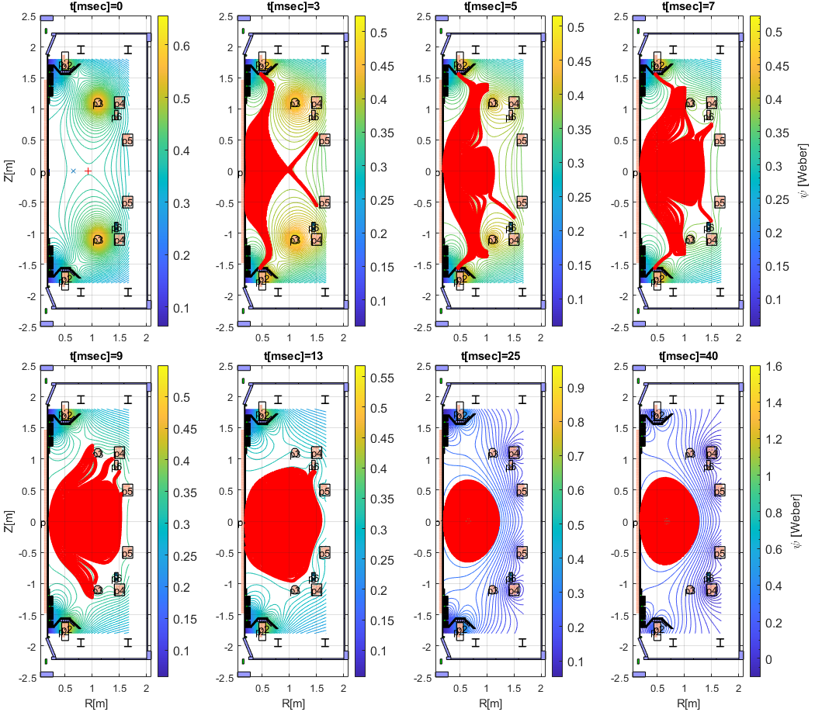
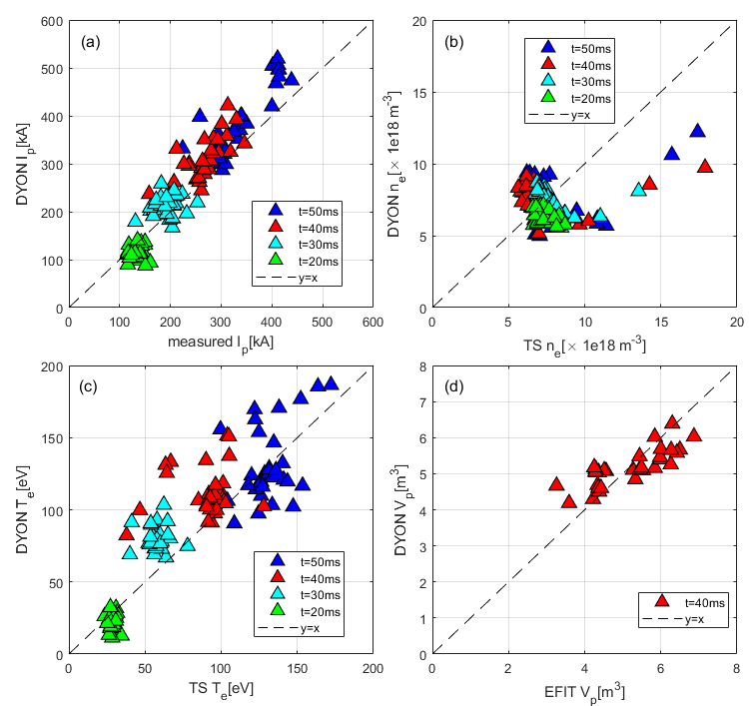
SP-2: Validated Breakdown/Burn-through tools for ITER first operation
Full electromagnetic burn-through model developed and validated on MAST using input as in the control room (with WTE)
  Further validation, IMAS interface development and ITER application
Absorption of EC waves in ITER first plasma start-up conditions in the GRAY-BKD0-CREATEBD framework
[Kim et al. 2022 Nucl. Fusion 62 (2022) 126012]
[Ricci et al. 2022]
#27512 in MAST
International agreement with Korea
[Kim et al 2022 Nucl. Fusion]
[FEC 2023]
Tools ready for ITER first operation

Slide 5
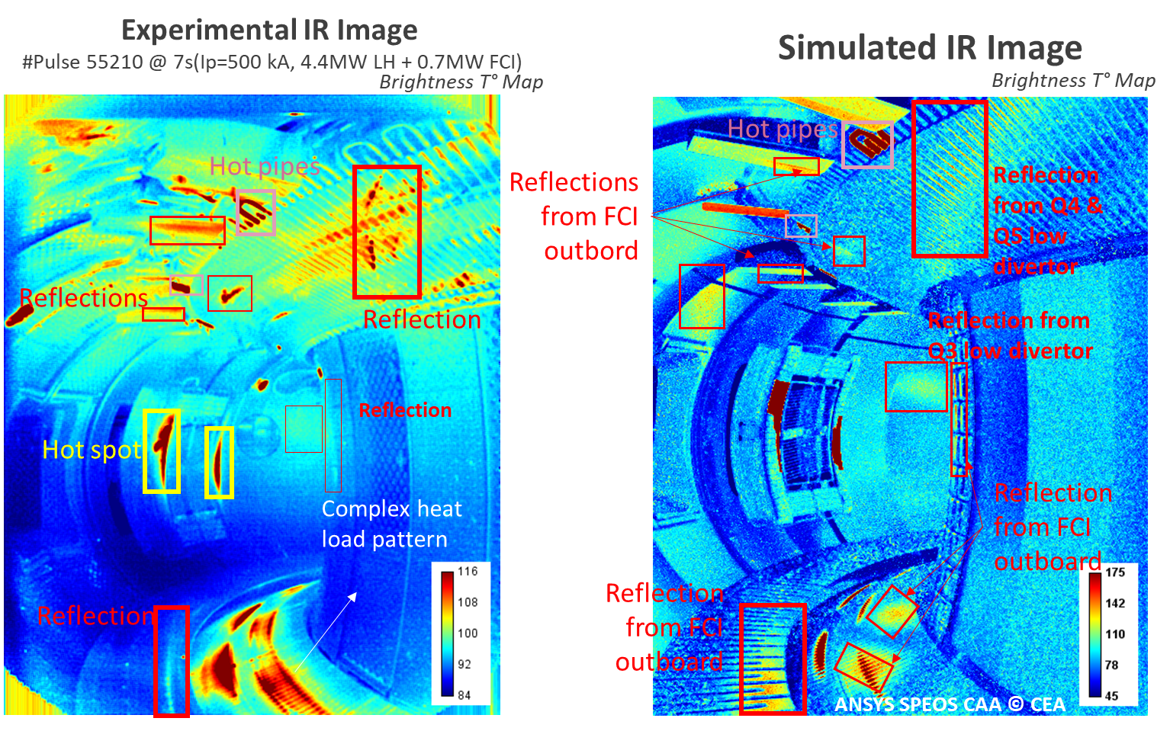
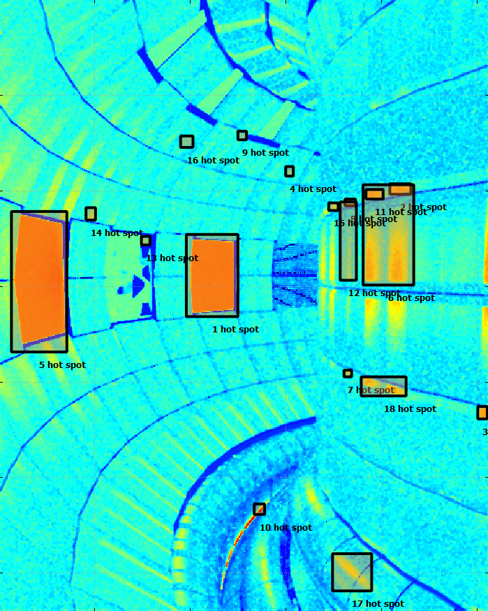

SP-2: IR synthetic diagnostic & wall monitoring for real time protection
Automatic hot-spot detection in ITER simulated IR images
Qualitative comparison on WEST, AUG, W-7X (with TE, W7X)
WEST wide angle TG view
[Aumeunier Nuclear Materials and Energy 2021]
Tools ready for ITER first operation
[Mitteau sub. To PPCF]

Slide 6
SP-2: ITER simulation of transient ELMs in the IR synthetic diagnostic
First demonstration (proof of principle) of ITER IR simulated images during ELMs
Non-linear MHD code JOREK to simulate density distribution (Fig. 2a) and heat loads on PFCs during ELMs (Fig. 2b)
thermal analysis to convert the power deposition on PFCs into surface temperature
3D temperature as input of ray tracing code to take into account materials optical properties i.e. emissivity and reflectance
Extension of the methodology to disruption in 2023
[Aumeunier & Pamela 2023, Aumenier et al. FEC 20023]

Slide 7
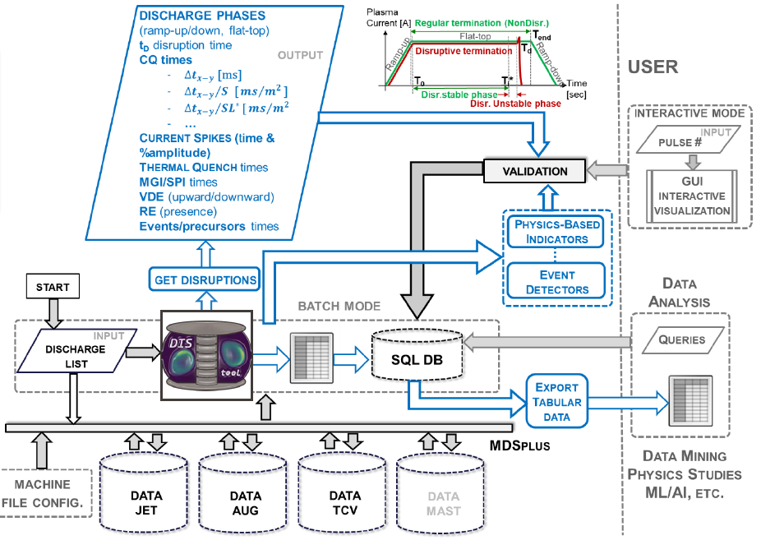
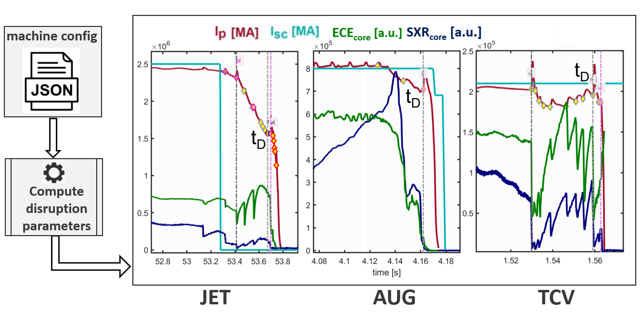
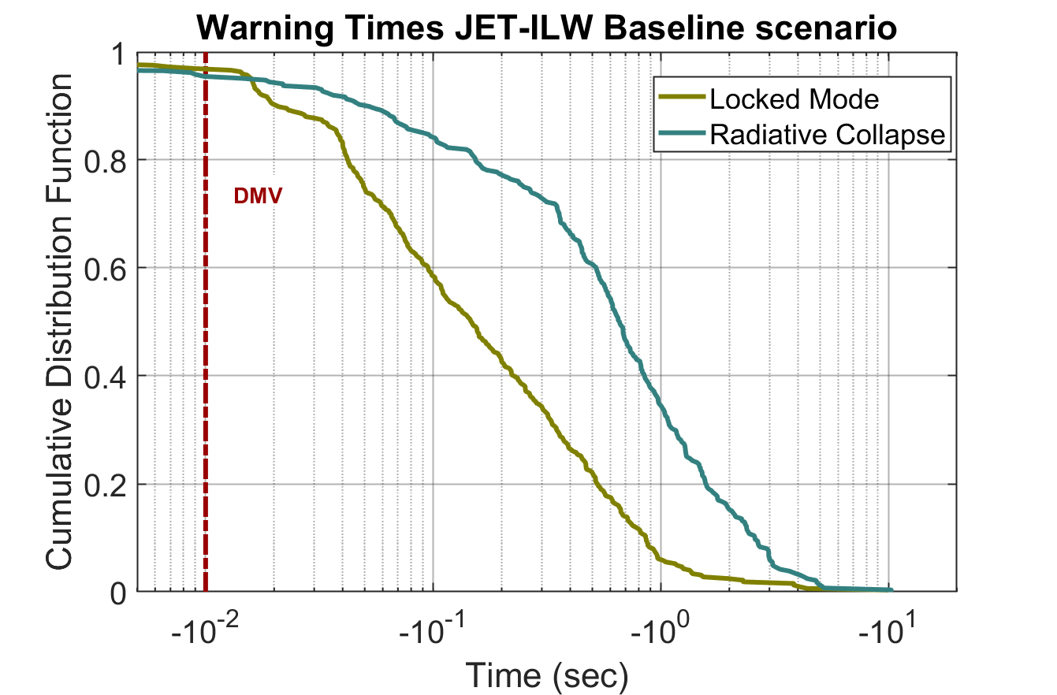
SP-2: Multi-machine workflow for multi-machine disruption analysis
Multi-machine database (JET, AUG and TCV) and scientific exploitation
  Physics of density limits, optimization of JET plasma termination, disruption prevention
Release of JET ILW Disruption Database (4000 pulses) on the Gateway and expand to other facilities (2023)
  Automatized mapping to IMAS/IDS on the Gateway [pending support from the Advanced Computing Hubs]
Joint task with IAEA for Machine Learning AI application
Cumulative Distribution Function of the Warning Times for JET-ILW
Machine generic framework and Events definition
[Paul et al. invited talk 2022 EPS ; Pau et al FEC 2023; M. Giacomin, A. Pau et al PRL 2022]

Slide 8
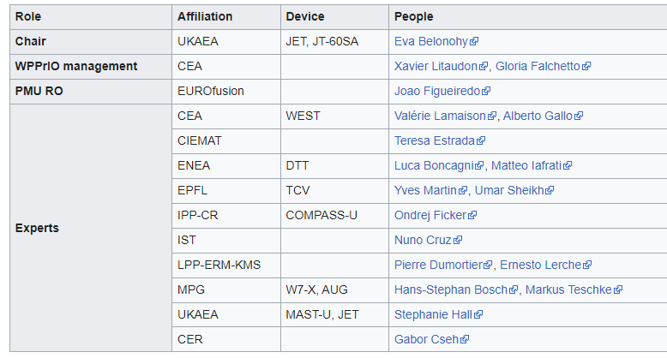
SP-3: Active EUROfusion Operations Network (EON) – Voluntary Contribution – [1/3]
EUROfusion Operations Network (EON) established in 2021 to
  facilitate stronger connection between the operational groups of European facilities
  share operational experience,
  support development and training of operators
  contribute to the EUROfusion preparation for the (integrated) commissioning and operation of ITER.
Resources in 2023 (+2.6PM) achieve PRIO.D.10 Grant Deliverable
  New experts: CEA, CIEMAT, EK-CER, IST
Voluntary contribution in 2022

Slide 9
SP-3: Active EUROfusion Operations Network (EON) - Voluntary Contribution – [2/3]
Survey of the operator roles and training: first analysis presented at 2022 SOFT [E. Belonohy et al. 2022].
The first subnetwork on NBI operation started in May 2022 and hosted 5 events (2hs seminar) with participation from all European and Japanese NBI teams as well as the ITER team.
  Strong positive feedback and participation (65-85+ connections) led to the planned expansion of activities in 2023.
  Unexpected outcome of spare component offers between facilities: provides an additional benefit to EUROfusion Beneficiaries (spare NBI components from AUG to JET – for JET to have a spare PINI)
  2022 Development of EON session leader training course progressed with the collection of JET training material, outline of the topics and structure.
    Lack of funding implies that 2023 activity focus on a small scale test launch (few videos) based on voluntary contributions
Connection to ITER (ITER Operations Division, Diagnostics and Plant Simulator developers) has been strengthened regarding multiple groups and activities, that is reflected in the 2023 EON plans.

Slide 10
SP-3: Operator role and training overview to be completed in 2023 [3/3]
 | Small |  |  | Medium | Large
Example | TJ-II | COMPASS | MAST | ASDEX-Upgrade | JET
Volume |  |  | 8m³ | 13m³ | 80m³
Pulse length |  |  | <0.5s | ~s | ~10s
Plasma current |  |  |  | ~1MA | 4MA
Session Leader training |  |  | ~weeks | ~months | 4+ years
Technical roles (nb of experts) | 8 (31) | 3 (17) | 9 (37+) | 31 (111) | 35 (166)
Scientific roles (nb of experts) | 3 (48) |  | 5 (60+) | 11 | 11 (155)
Supporting roles (nb of experts) | 5 (15) | 5+ |  | 4 | 4 (16)
Operator role and training preliminar overview in EUROfusion devices (ongoing)
Similar number of operator roles between ASDEX Upgrade (3 operational days/week) and JET (10 shifts/week and 24h/7days). Number of experts depends on the number of shifts per week.
Increased device size (plasma current, complexity, nuclear aspects) increases the length of the training from weeks, months to 4+ years.
  Staged licensing can take place in parallel to the staged commissioning of the new device.
Experience from another facility can reduce training time by up to 50-80%.
ITER: support manpower prediction, training overview + materials, could offer short visits and/or training on EUROfusion facilities ?
[E. Belohony for the EUROfusion Operations Network & D. King EFPW 2022]

Slide 11
SP-4: BUG/ELISE (IPP), SPIDER/MITICA (RFX) in a step ladder approach for ITER [1/2]
Two grant deliverables successfully achieved :
  PRIO.D.12 Report on EUROfusion participation in ITER NBTF, ELISE and BUG activities
  PRIO.D.13 Report on long pulse operation 1000s extraction of H- on ELISE facility
From 20 experts funded down to 19 experts from mid-2022 (down to 18 in 2023)
  14 (down to 13 in 2023) at NBTF Padua & 6 down to 5 at IPP-Garching
  Reduction in 2022 & 2023-2025 due to budgetary constraints (budget removed from PrIO)
EUROfusion call (June 2022) “Experts to be seconded to IPP in the Frame of the NBTF Support Activities”
  To replace three experts who left IPP in 2022 by two positions
EUROfusion experts well integrated in IPP team led by F. Ursel and NBFT team led by V. Toigo
  NBTF: shutdown activities; design and procurement; analysis and diagnostics, simulation
  BUG/ELISE: operation; analysis of beam and plasma diagnostics; design; simulation, interpretation and extrapolation to support ITER NBI and NBTF program.

Slide 12
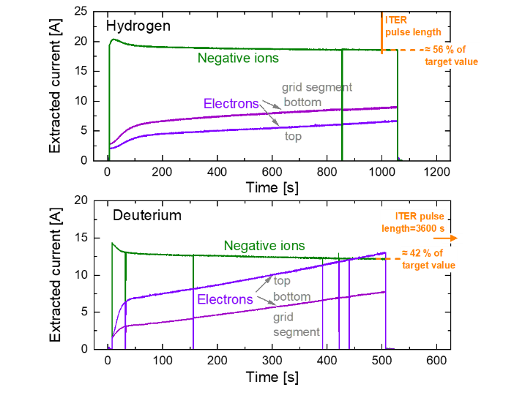
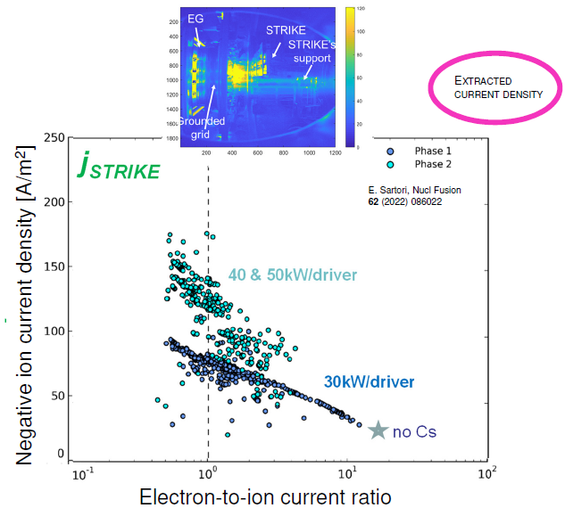
SP-4: BUG/ELISE (IPP), SPIDER/MITICA (RFX) in a step ladder approach for ITER [2/2]
ELISE Long Pulse Operation (>1000s) in H with CW power supply and Calorimeter (summer 2022)
EUROfusion participation (14ppy/y) integrated in the NBTF team as one team approach. EUROfusion member of NAC
SPIDER: first Cs operation in 2021, shutdown for improvement and restart in 2023.
ITER target 386A/m²
  ITER target for extracted negative ion density: 60% reached for H2 and 40% in D2
Target electron-to ion ration reached
[Fantz et al. FEC 2023]
[Toigo et al FEC 2023]

Slide 13


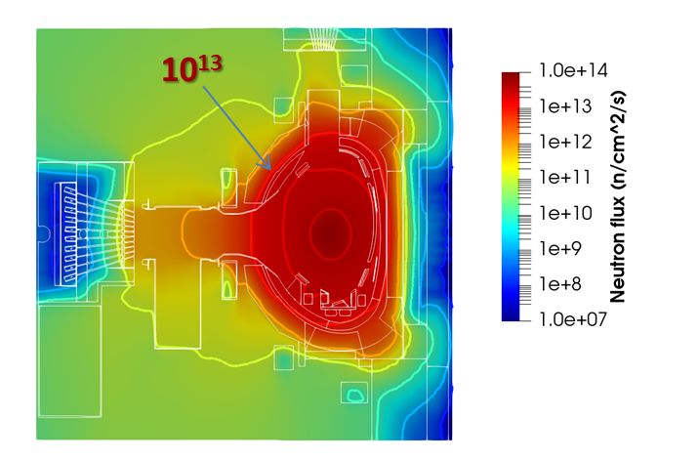
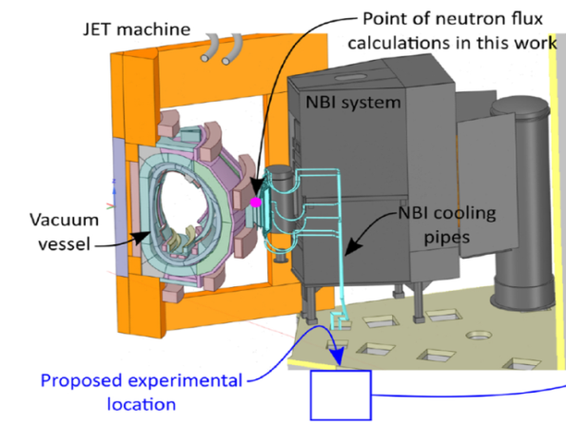

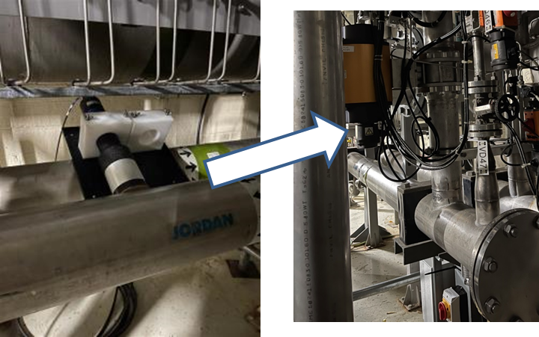
SP-5: Neutronics following successful DTE2 & “two world premieres”
Neutronic code validation (streaming and shutdown dose rate) & analysis of irradiated ITER materials/functionals materials @ 8.5x 10²⁰ DT neutrons
First observation of delayed Be photo-neutrons due to the decay gamma following JET in-vessel 14MeV activation ⇒ photo-neutrons from ⁹Be (γ,n) ⁸Be
First observation of water activation
  high energy γ (¹⁶N16 decay ¹⁶O(n,p)¹⁶N) in proof of principle experiment (summer 2022 D-NBI & 1% T cleaning campaign)
Preparation of Water activation experiment for JET DTE3
JET neutron flux #99971
10¹³ n/cm²/s neutron flux as in rear ITER blanket diagnostic first wall
Same level of shutdown dose rate as in ITER port interspaces and port cells
[Villari Plenary SOFT 2022]

Slide 14
SP-5: Neutron-induced water activation: code development & validation [1/2]
¹⁶O(n,p)¹⁶N and ¹⁷O (n,p)¹⁷N: induce nuclear responses in superconducting magnets, polymer sealants, electronics
Accurate quantification for ITER:
  safety of public, workers & compatibility with operation of radiation-sensitive systems
Novel open-source code FLUNED, calculates activation of irradiated fluid through the coupling of computational fluid dynamics with neutronics calculations: validation with 2019 data from the 14MeV Frascati Neutron Generator
Experimental loop
Simulation: Water velocity &¹⁶N in the ITER First Wall mock-up
Simulation: neutron radiation source of the activated water in the neutron-detector water tank
[M. De Pietri et al FEC 2023 & Nuc. Fusion, sub. 2023]

Slide 15
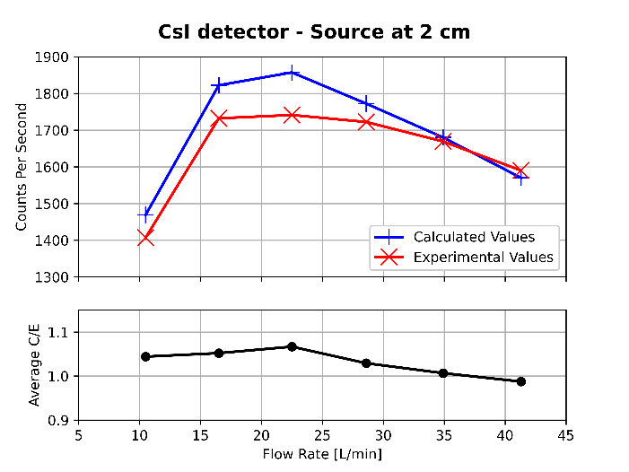
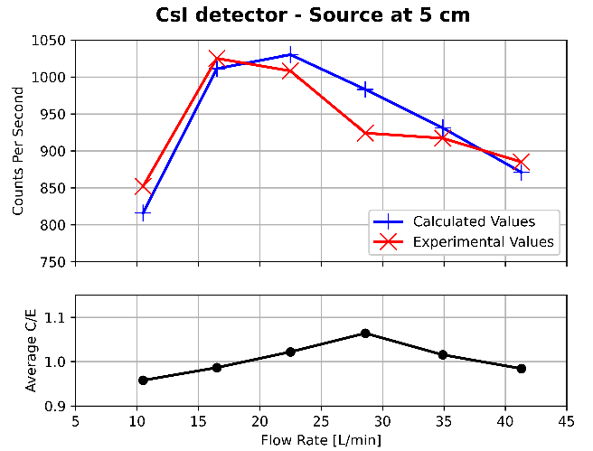
SP-5: Neutron-induced water activation: code validation at 14MeV FNG [2/2]
Calculated and exp. Counts rates per second in photon detector & ratio of calculated to experimental data, C/E, vs flow rate of actived water: neutron source at 2 or 5cm from irradiated water loop.
[M. De Pietri et al FEC 2023 & Nuc. Fusion, sub. 2023]

Slide 16
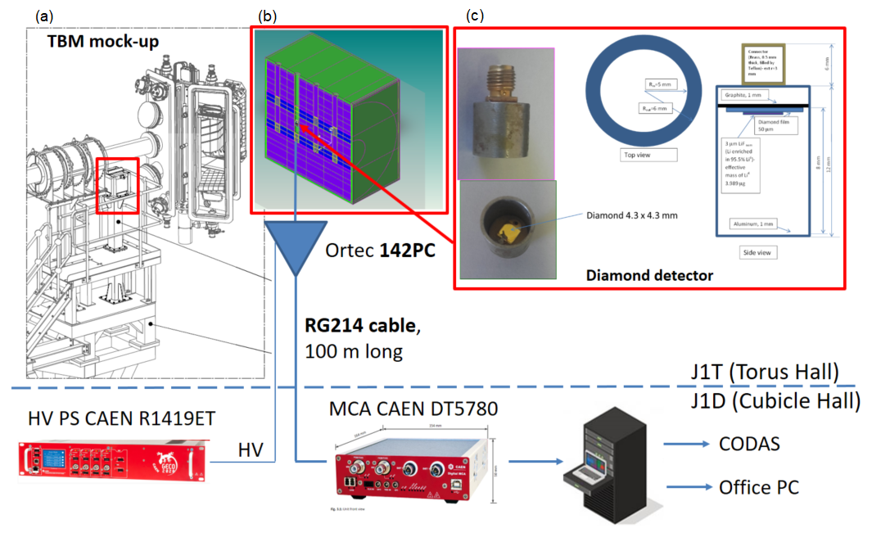
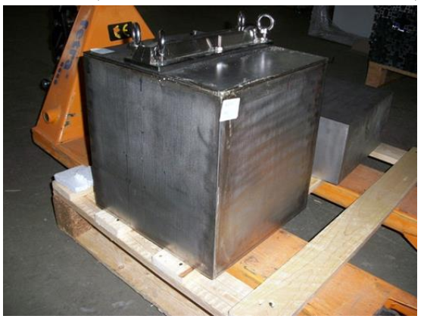
SP-5: Test of n/T detectors in JET DT for breeder blanket [1/2]
The Helium Cooled Pebble Bed Test Blanket Module mock-up (HCPB TBM) located on a dedicated holder near the JET octant 8 (under JET-3/FP-8)
  welded box of stainless steel, filled with beryllium and it contains two steel double cassettes filled with Li₂CO₃ powder simulating the Li₄SiO₄ breeder ceramics of the TBM.
[N. Fonnesu et al, P. Batistoni et al ]

Slide 17
SP-5: Measurement & simulation of the T production for breeder blanket during DTE2 [2/2]
PRIO.D.22 Grant Deliverable achieved “test of n/T detectors in JET DT for breeder blanket”
The tritium production: 1.40x10⁻¹² tritons per neutron (measured by the diamond detector)
The ratio Monte Carlo N-Particle® simulation vs. measured tritium production is 0.77
Improvement of the measuring chain to get data above 10¹⁵ n/s for DTE3
[N. Fonnesu et al, S. Villari et al ]

Slide 18
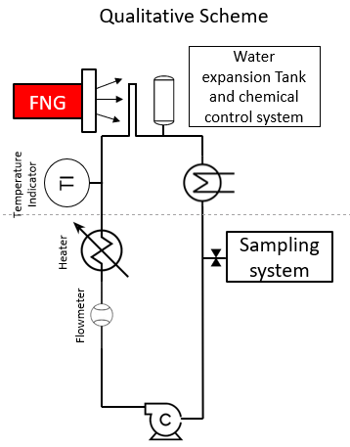
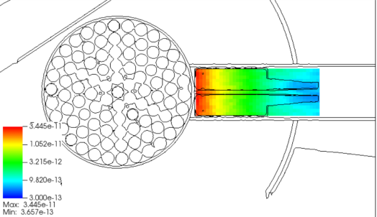
SP-5: Specific ITER activities on neutronics initiated in 2022
Activated corrosion products tools development and experiments
  Develop methodology for assessment of dose contribution due to ACP
  Design, carry-out and analyse experiments at FNG to validate OSCAR-Fusion for ITER
Fluid activation tools development and experiments
  Develop of simulation tools for the determination of water activation considering complex flow pattern
  Design and perform water activation experiments at JSI TRIGA fission reactor to validate ITER prediction
Radiation source model development and simulation of the radiation field
  Develop neutron and gamma sources for neutronics calculations of the radiation fields in early ITER phase
  Develop source of photo-neutrons from Be and perform Shutdown Dose rate assessment in ITER
  Develop neutron sources in ITER NB cell
Techniques for low radiation dose level measurements
  Develop methodology for low dose measurements during ITER operation and shutdown
Neutronics and virtual reality coupling for maintenance operations
  Develop of Virtual Reality (VR) tool coupled with on-line dose rate calculation for ALARA optimization
[ N. Terranova, G Mariano SOFT 2022]
[ D. Kotnik SOFT 2022]
[ R. Villari SOFT 2022]

Slide 19
Status of the 2022 Grant Deliverable
PRIO.D.01 European Plasma Simulator (Python workflow) released to the EUROfusion community including all available IMAS modules and a user friendly interface (TSVV11 responsibility)
PRIO.D.02 Report on the procedure for an automated and systematic validation of predictive integrated modelling including uncertainty quantification (TSVV11 responsibility): Delay Sept 2023
PRIO.D.12 Report on EUROfusion participation in ITER NBTF, ELISE and BUG activities
PRIO.D.13 Report on long pulse operation 1000s extraction of H- on ELISE facility
PRIO.D.22 Report on testing of n/T detectors in JET DT for breeder blanket
PRIO.D.23 Report on Occupational Radiation Exposure and waste data collected at JET in DT operation
  Proposal to delay to Dec. 2024: no new ORE data provided by UKAEA (database infrastructure has been set-up)
  WASTE data collection: JET operation extended up to 2023 without planned intervention before 2024.
PRIO.D.24 Report on calibration verification at JET in DT operation
  Proposal to delay to Dec. 2023 Neutron calibration not finalised by the JET operator

Slide 20
2023 Grant Deliverables
SP-2: Report on the exploitation of the EUROfusion multi-machines database
SP-3: Report on best practices in training of operational staff in EUROfusion facilities
SP-4:
  Report on EUROfusion participation in ITER NBTF, ELISE and BUG activities
  Report on the long pulse operation 3600s extraction of D- on ELISE facility
SP-5
  Report on JET neutronics experiments, validation of nuclear data and codes in JET DT
  Report on neutron induced activation in ITER materials and on radiation damage in functional materials at JET following DT operation
  Report on the implication of JET DT technological program for ITER

Slide 21
SP-5: New Water activation project in 2023-2024 for DTE-3
Detailed analyses, installation, calibration and tests of detectors for water activation measurements with full JET operator support
  Set-up CODAS requirements & interfaces
  Calibration, test, optimisation of Instrument & Control
Perform water activation experiment at JET during DTE3
First analyses in 2023 to be finalised in 2024
Full simulation of the Water loop using different fluid/neutronic codes
FSD Extra resources have transferred to PrIO by end of 2022

Slide 22
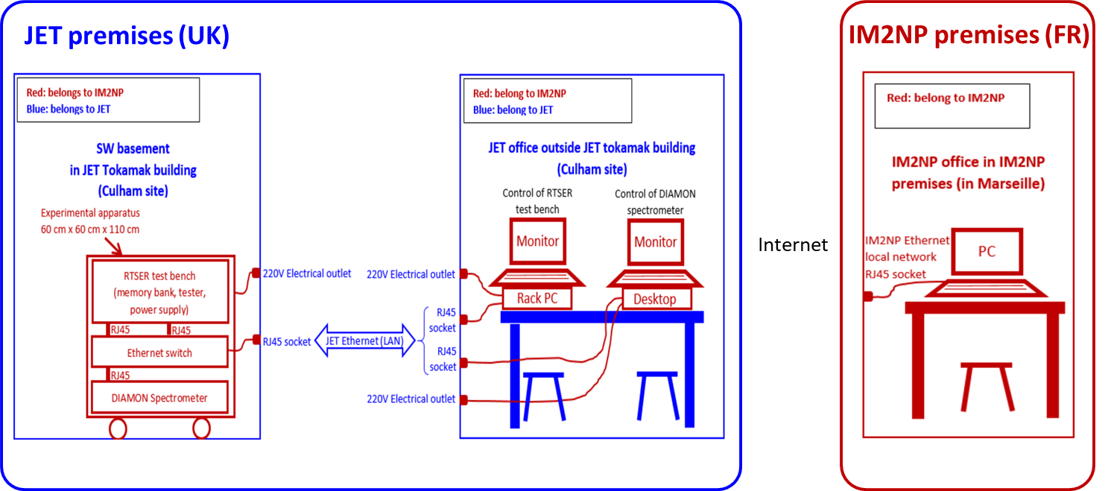
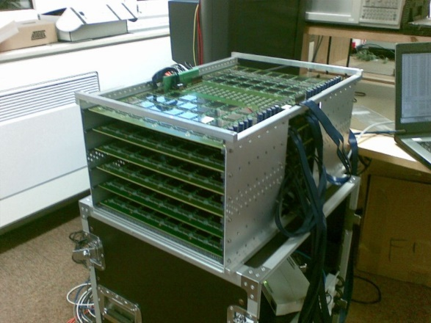
SP-5: ITER-relevant neutron Single Event Effect experiment on electronics during DTE-3
Validation of the prediction of neutron-induced failures in electronic for ITER during DTE-3 to complement D-D experiment on WEST and future experiments at CERN (without impacting the JET campaign)
Compact metal chassis to be installed in JET basement to measure neutron-induced SEEs
Equipment procured and transportation offered using specialized CNRS logistics service ULISSE (International Service and Support Logistics Unit for Experiments).
[M. Dentan (CEA) & J-L Autran Aix-Marseille University IM2NP]

Slide 23
International collaboration: 2 FEC contributions by our international partners
US: 2023-2025 Extension of the Collaboration to Benchmark Neutronics Simulation Computer Codes under the EURATOM-U.S. DOE Agreement in the Field of Fusion Energy Research and Development
  Technical annex finalized and Official letter sent to DOE (FEC 2023)
  Advanced courses on neutronics code ADVANTAG with Oak-Ridge National Laboratory developers is foreseen
Korea: Breakdown simulation, collaboration for DYON upgrade and validation (FEC 2023)
Japan (QST & NIFS): Participation in QST test facilities of Negative Neutral Beam; Comparison of plasma features between RF and filament source
IAEA: Coordinated Research Project (CRP) on Artificial Intelligence for Accelerating Fusion R&D (Disruption database) (adhering to FAIR/Open Science principles). Contribution to the IAEA nuclear database
IEA: Coordination of International Challenges on Long duration Operation, CICLOP group; leader of subtask on Neutronics within IEA TCP Nuclear Technology of Fusion Reactors

Slide 24
WP PrIO - PCR 2023
X. LITAUDON (PL) , G. FALCHETTO (PSO)

Slide 25
Summary of the PCR in 2023 [1/2]
PCR_PrIO.2023.01 - SP3 new EON members
  CEA - Valerie Lamaison (replacing Olivier Baulaigue)
  CIEMAT – Teresa Estrada (replacing Enrique Ascasibar)
  EK-CER Gabor Cseh (new member)
  IST - Nuno Cruz (replacing Ivo Carvalho)
PCR_PrIO.2023.02 - SP4 NBTF secondee
  SP4 secondee at NBTF RFX Basile Pouradier Duteil EPFL contract ended as per 14/2/2023
  Leftover: 10.5PM EPFL NA budget for NBTF to be removed from EPFL and used to cover replacement secondement
  Call for position replacement within the agreed NBTF budget (EUROfusion funding 18ppy)
PCR_PrIO.2023.03 – SP5 new task on "Compact standalone ITER-relevant neutron SEE experiment on electronics at JET during DTE-3 campaign"
  Opportunity of new task at low cost within the remits of SP5 relative to "Neutronics in support to ITER"
  To be implemented as PrIO-5.3.SEE-T001 "Compact standalone ITER-relevant neutron SEE experiment on electronics at JET during DTE-3 campaign"
  Task description: Perform Single Event Effects (SEE) measurements on a bank of bulk 65 nm SRAM memories exposed to DT fusion plasma neutron flux with a spectrum representative of the neutron environment in ITER tokamak building.
  Deliverable: Report on Compact standalone ITER-relevant neutron SEE experiment on electronics at JET during DTE-3 campaign
  Deliverable Owner: Martin Dentan (CEA), Resources 2PM CEA

Slide 26
Summary of the PCR in 2023 [2/2]
PCR_PrIO.2023.04 – SP5 new facility to be added in support to Water Activation Loop experiment at JSI
  New facility: AIFIRA standing for “Applications Interdisciplinaires des Faisceaux d’Ions de Région Aquitaine », irradiation facility located in Bordeaux (France), part of the IN2P3 French Institute.
    nuclear physics, biology, environmental science, materials, and nuclear energy. 200 days of beam time/year for internal and external users.
    3.5 MV Singletron light ion accelerator (H⁺, D⁺, He⁺). The ion energy is in the order of the MeV. It feeds five different ion beams for chemistry analysis, ray characterization, imaging techniques, and neutron interaction with matter. On of the possible use of such ion beam is the testing, qualification and calibration of detectors for nuclear energy applications. Thanks to the high resolution in energy of the ion beam impinging appropriate targets, it is possible to produce well-known neutron and gamma fields used to irradiate detectors.
  Within PrIO, the proton (H⁺) ion beam will be used. Thanks to the reactions of protons on a CaF₂ target, 6 MeV gammas are generated, which are very similar to the gamma produced by the water activation. This gamma field allows a fine calibration of the Thermo-Luminescent Detectors (TLD) for the measurement of the gamma production in the water-loop experiment at JSI.
    Under PrIO-5.2.3-T002-D002 “Water activation cooling loop at JSI TRIGA reactor: design, commissioning, testing and experimental plan”
  CEA deliverable description: TLDs set-up and calibration on AIFIRA
  TBC resources 13,5k€ of operation and human work (CEA)
PCR_PrIO.2023.05 – SP5 UKAEA resources for Water Activation Project (approved in FSD PB#01)
  “Water activation project” approved in FSD PB#01 implemented as PrIO-5.3.WAC, with additional tasks under PrIO5 ACT NEXP TBMD RADA and support from F4E/JOC.
  Project Leader Rosaria Villari (ENEA)
  Additional resources required to cover the UKAEA contribution - not included as part of the 15PM budget transferred from WPTE ENH

Slide 27
Thanks for your attention

Slide 28
Project Milestones
Feb. 2023
  M11 SP-5 Complete the retrieval of the ITER samples on JET and shipment to the EUROfusion beneficiaries for analysis
March 2023
  M12 SP-5 Complete installation water activation measurements and data collection on the NBI cooling loop at JET for DTE3
May 2023
  M9 SP-3 Review the operational roles and their training on the EUROfusion devices and identify best practices
July 2023
  M8 SP-2 At least one multi-machine database(s) on the EUROfusion Gateway for exploitation
  M10 SP-4 Develop stable long pulse operation with stable co-extracted electron current that limit the pulse duration in Deuterium
Dec 2023
  M7 SP-2 Models for plasma burn-through and breakdown adapted to ITER condition

Slide 29
SP-3 EON Foundation Course on Session Leading - voluntary contribution-
Online course on Session Leading in preparation for 2023
Pilot EUROfusion Operations Network training
Collection of EUROfusion SL training material (JET)
Aims:
Provide basic machine-independent background on tokamak/stellarator operation + machine dependent implementations
What is operations for newcomers (from fission, other industries or other engineering/physics roles)
Improve preparation of experimental proposals and experimental sessions
Target audience:
Students (MSc, PhD, Post-doc)
EEGs and ERGs
Scientific Coordinators, task force leaders
Engineers, Researchers
Newcomers (from fission or other fields)
Course outline:
Introduction, Operations Management
Coils and power supplies
Plasma shape control
Vacuum conditioning
Fueling (gas and pellet injection)
Heating systems (NBI, ECRH, ICRH)
Disruptions, predictions and mitigation (MGI, SPI)
Diagnostic setup
Breakdown and current ramp up, runaways
Protection systems
Real-time networks (scientific)
Termination and event handling
Operational tools
Continuous plant systems and IT systems
Plant and Plasma Control
Operation of stellarators
Scaling up operation towards ITER
[E. Belohony]

