Slide 1
Plan for including Molecular Convergent Close-Coupling database into EIRENE
F. Cianfrani

Slide 2
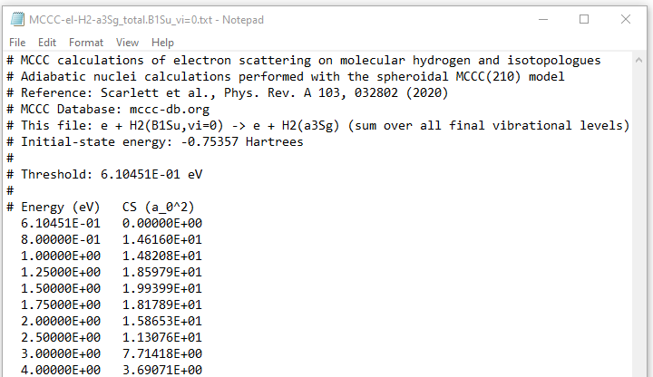
Plan for including MCCCDB into EIRENE
Molecular Convergent Close-Coupling
Electron and positron collisions
Target: H₂ (isot.), H₂⁺ (isot.), HeH⁺
Dissociation, ionizat., excitation + vibrational resolution
output: tabular
FILES: MCCC-el-<target>-….
Dissociation: …DISS.<state_in>.txt
Ionization: …TICS.<state_in>.txt
Excitation: …<state_f>.<state_in>.txt
Excitation&rad decay:
… <state_f>.ERD.<state_in>.txt

Slide 3
Plan for including MCCCDB into EIRENE
reaction
file name
Input file lines:
read_reaclines.f
Data stream: IR, FILNAM, ….
Loop on DB names:
find source file in Database folder
cinit.f
slreac.f
if FILNAM = ADAS
read_tab2d.f
eirmod_comxs.f
Data stream: REACDATA
Data type: adas

Slide 4
Plan for including MCCCDB into EIRENE
reaction
file name
Input file lines:
define input line: _ 1st line: 20 MCCC H.1 <type> EI 0 1
_ 2nd line: <target> <state_f> <state_i>
read_reaclines.f
update read_reaclines.f
Data stream: IR, FILNAM, ….
Loop on DB names:
find source file in Database folder
cinit.f
new params
update cinit.f
include mccc into
Database folder
slreac.f
if FILNAM = ADAS
update slreac.f
read_tab2d.f
eirmod_comxs.f
if FILNAM = MCCC
update eirmod_comxs.f
Data stream: REACDATA
read_tab1d.f
Data type: adas, mccc

Slide 5
Thanks for the attention!

Slide 6
EIRENE routines: src/file-handling
slreac: open data stream and read A&M dataset
if FILNAM= AMJUEL, HYDHEL, METHAN, H2VIBR → read_coeff., set_react._data
if FILNAM= TAB2D, ADAS → tab2d
if FILNAM= CR → colrad
tab2d: read a 2d table of A&M data and put into REACDAT structure
type(adas_data), pointer :: ap → defined in modules/eirmod_comxs

