Slide 1
SP B 5 Be dust formation – plans for 2023 and comparison against JET-ILW results (IAP)
Cristian P. Lungu , Corneliu Porosnicu, Bogdan Butoi, Paul Dinca, Oana Pompilian, Cornel Staicu
IAP – NILPRP (INFLPR)
INFLPR

Slide 2
Be dust generation using milling technique
Be dust generation in air and water environment performed using alumina ball milling
Particle size and morphology determined using SEM microscopy
Preffered cristal orienatation analyzed using XRD
Thermal outgas behavior, using TDS. Were identified: O₂, N₂, H₂O, BeO, Be₃N₂, Be(OH)₂
XRD Measurements
Shifts to small angles: suggesting the spacing of the crystalline planes, due a tensile stress in the Be polycrystalline structure.
The BeO diffraction are present for samples prepared in wet condition.
Alumina and agate used in the milling process appeared too: more obvious in “wet” conditions
TDS analysis of samples:
formation of oxides and nitrides as follows:
BeO, H₂O, N₂, Be(OH)₂ content - higher for wet environment samples
Be, O₂ and Be₃N₂ content - higher for dry condition samples.
This suggests that water is present in Be dust as:
pure H₂O non-reacted;
oxygen to form BeO;
(OH) to form Be(OH)₂ .
The maximum desorption temperatures:
- H₂O: ~ 190ºC;
- BeO: ~ 540ºC.
Particle size and morphology:
Micrometric size particles (30 to 500 μm) were prepared by ball milling and were collected on the different ranges by siewing.
Rough surfaces were identified on dust particles.

Slide 3
Investigate the properties Be dust particles produced in conditions expected in fusion reactors
Scope:
Ensure that the dust applied in laboratory experiments would be representative for fusion-reactor conditions (JET-ILW Campaigns)
Putting all the data available from present devices together to see if extrapolations can be made for metallic dust generation– or if there are gaps that would call for new experimental activities in >2024
Inputs required:
Set-up for Be dust generation
Tasks to be performed:
Carry-out laboratory experiments of Be dust generation in presence of air and water leaks in D2, D2/H2 buffer gas.
Chracterization of the Be dust using SEM, XRD and TDS techniques
Outputs:
Laboratory processes for Be dust generation in presence of water and air-leaks
Database of the characteristics of produced Be dust particles and comparison with data from tokamaks (JET-ILW)

Slide 4
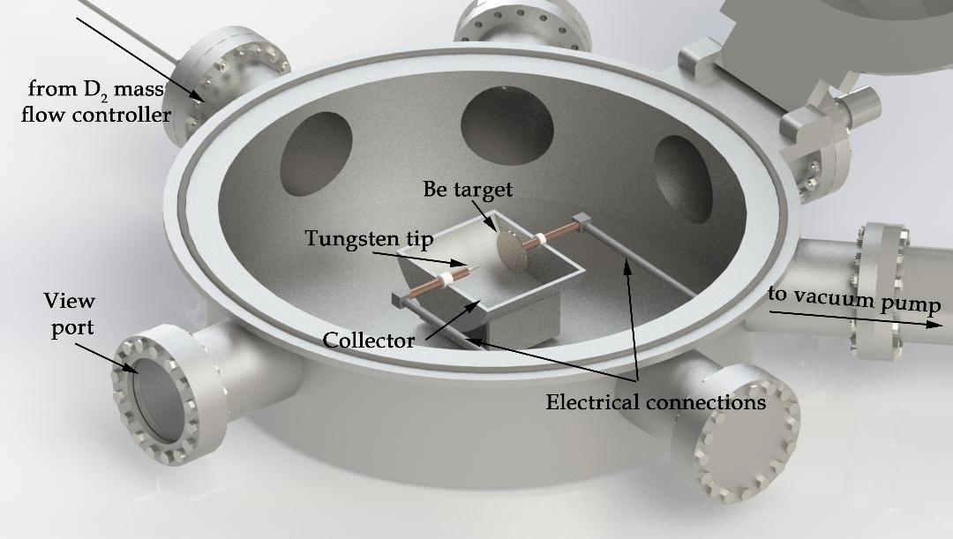
Be dust generation
Investigate the properties Be dust particles produced in conditions expected in fusion reactors
Be dust produced in normal (D₂ atmosphere) and off-normal (air and water leaks) conditions in fusion reactors
Apparatus: a DC / pulsed reactor working in deuterium or H2/D2 mixture gas. Addition of water and air will be performed. An arc discharge will be ignited between a 1 inch Be plate and a W tip.
Operating parameters:
low pressure gas discharge. 1- 100 Mbar
Electrical parameters: 1-100 A, 100 -1000 V
Expected dust sizes: 0.5 -500 µm,

Slide 5
Investigate the properties Be dust particles produced in conditions expected in fusion reactors
Be dust characterization
Analysis capabililties:
Particle size and morphology of the produced dust will be analized using a SEM (Scaning Electron Microscopy) techinque using a FEI Co. Model Inspect microscope.
Crystallite compounds formation will be determined using an XRD Rigaku ULTIMA IV, XRD apparatus, Bragg Brentano configuration and an ESCALAB 250 XPS system
Thermal outgassed compound content (D₂, O, H₂O, BeO, Be(OH)₂) of the dust will be determined using Thermal Desorption Spectrometry (TDS).

