Slide 1
WP PWIE SPE kick-off meeting
Jari Likonen

Slide 2
Goals and agenda of the meeting
The goals of the meeting are to
Introduce and discuss the tasks attached to each Research Unit under SPE
Identify possible gaps and opportunities for collaboration, and
Decide on concrete next steps, to be reviewed in the summer
9:30
9:45
Introduction to PWIE and SP E
Presentations of SP E task holders – please focus on the question ”What will be done in 2023 and what is needed from others/EUROfusion”
Please be brief: each presentation is 5 min + 5 min for quick feedback Discussion
End of the meeting
11:15
11:40
Everybody is invited to contribute to the discussions, also those who are not task holders of any of the SP E activities!

Slide 3
SP E focus points in 2023
I: Coordination activity, sample preparation and distribution for remaining JET ILW3 samples → SP E.1
II: Comparison of hydrogenic retention quantification by different techniques and fuel removal assessment (ITER housekeeping approach) → SP E.2
III: Investigation of material migration from the limiters and the main wall towards the divertor (ITER). Post-mortem analysis of PFCs and other diagnostic components, modelling under SP D → SP E.3

Slide 4
SP E resources 2023
Deliverable Owner | Beneficiary | PM
P. Veis | CU | 3
T. Dittmar | FZJ | 13
E. Grigore/C. Porosnicu | IAP | 14
E. Fortuna-Zaleśna | IPPLM | 6
E. Pajuste | ISSP-UL | 12
E. Alves | IST | 11
M. Mayer | MPG | 3
A. Lagoyannis | NCSRD | 3
D. Primetzhofer | VR | 9
J. Likonen | VTT | 11
Total |  | 85
Device | Beneficiary | Days
Accelerator | IST | 7
Accelerator | MPG | 2
Accelerator | NCSRD | 5
Accelerator | VR | 3
Accelerator | VTT | 2

Slide 5
Contact info and next steps
Your SP E contact
Jari Likonen (jari.likonen@vtt.fi)
Project leader
Sebastijan Brezinsek (s.brezinsek@fz-juelich.de)
Project Support Officer
Michael Reinhart (m.reinhart@fz-juelich.de)
PMU Coordination Officer
David Douai (david.douai@cea.fr)
Kick-off meeting and detailed definition of tasks March 2023
Thematic meetings on more detailed planning of tasks April-May 2023
Midterm meeting of SP E activity areas – latter half of 2023
Review meeting of WPPWIE– October-November 2023
Minutes and slides of the meeting at https://indico.euro-fusion.org/event/2602/

Slide 6
Analysis plan 2023
CU (Comenius University)
Participation in LIBS (and LID-QMS?) experiments at FZJ and VTT
Data analysis of LIBS results (experiment at VTT in 2022)
FZJ
Fuel retention studies using LID-QMS
Poloidal section from HFGC tile and tile 1 (ILW1-3) for LID-QMS
Metallography and microstructure of W lamellae and Langmuir probes (16W)
Samples from W lamellae (B02, B12, B13, B17, B23 and B24)
Metallography and microstructure of Be castellations from IWGL tile with RE damage
IAP
Sample preparation
Fuel retention studies using GDOES and TDS (divertor samples)
XRD and nanoindentation of Be samples from RE damaged IWGL tile
TDS analysis of Be samples (ILW3)
Louvre clips: chemical structure of co-deposits with XPS

Slide 7
Analysis plan 2023
IPPLM (WUT,NCBJ)
Nanoindentation of Langmuir probe 5
FIB cross-sections to assess the grain size in individual zones of LPs
Microstructure of W lamellae (stack B)
ISPP_UL
Fuel retention studies using FC, TDS (divertor samples from tiles 0 and 1, simulation of C39 baking cycle) and SEM
Samples from W lamellae (stack B)
Louvre clips: chemical structure of co-deposits using FT-IR
IST
Fuel retention studies using IBA (divertor samples from tiles 4, 6, 7 and 8)
IBA analyses before and after TDS (for baking studies)
IBA analysis of mirror cassettes (tubes) for metal migration (ERO validation)
MPG
Fuel retention studies using IBA (divertor samples from tiles 0 and 1)

Slide 8
Analysis plan 2023
NCSRD
Further analysis of Tile 0 and 1 samples
Deuterium deposition employing ³He beam
Scanning electron microscopy with EDS analysis
X-ray diffraction
µ-beam analysis of W lamellae (stack B) to compare with stack A samples
VR
Fuel retention studies using HIERDA (divertor samples from tiles 4, 6, 7 and 8)
Analysis of mirror cassettes (tubes) for metal migration (ERO validation) (HIERDA, µ-beam)
VTT
Preparation of divertor samples, cross sections for microscopy
Fuel retention studies using SIMS (divertor samples from tiles 4, 5, 6, 7 and 8)
Participation in TDS experiments jointly with UKAEA

Slide 9
Analysis plan 2023
UKAEA
Fuel retention studies using TDS (divertor samples from tiles 4, 6, 7 and 8, simulation of C39 baking cycle, W lamellae)
Participation in IBA experiments jointly with IST
Microstructure of Langmuir probes (SEM, nanoindentation)

Slide 10
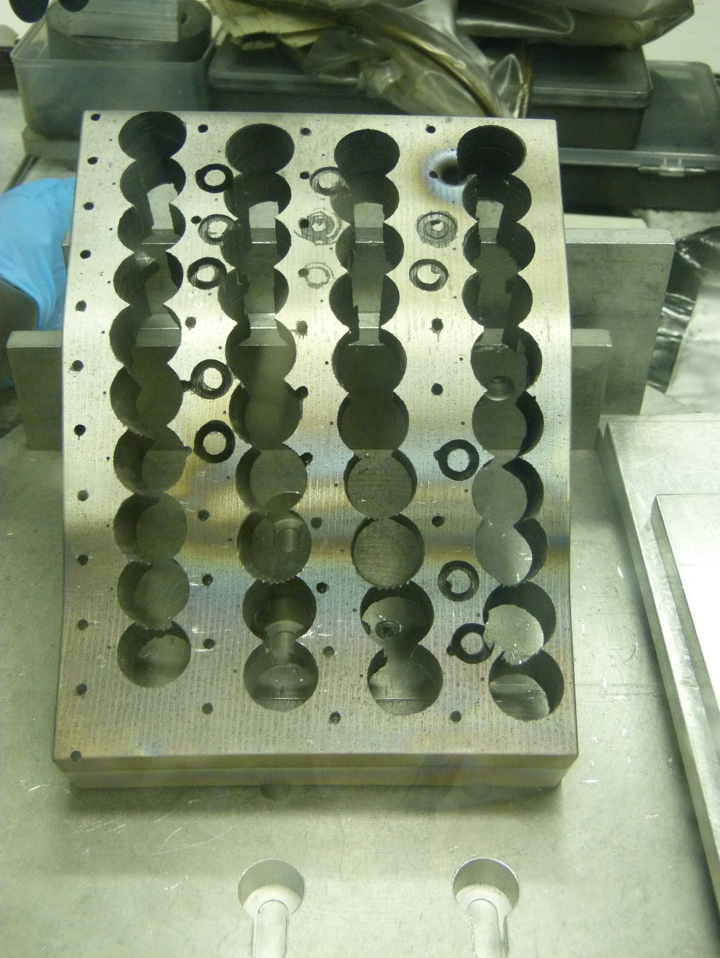
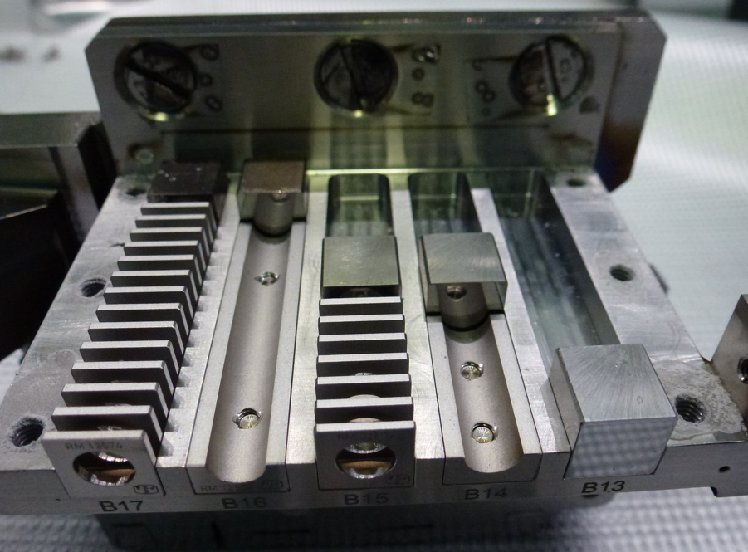
Future actions
Shipment of divertor core samples from VTT to RUs
Tiles 4, 6, 7 and 8 (exposed in ILW2+3)
IBA (IST, VR, NCSRD, MPG)
Tile 0 and 1 pieces to FZJ
Louvre-clips
FT-IR (ISSP_UL)
Cutting?
TDS, XPS (IAP)
Mirror cassettes
IBA analysis of tubes (IST, VR)
14BN G4D (2013-2016)
1
1a
1b
1c
2d
2
2a
2b
2c
3
3a
3b
3c
4
4a
4b
4c
5
5a
5b
5c
6
6d
6a
7d
6b
6c
7
7a
7b
7c
8
8a
8b
8c
9
9a
9b
9c
10
9d
10a
10b
10c

