Slide 1

WP SP E
FZJ contribution to LID-QMS and TDS
SP E2, SP E3
14.03.2023 I M. Zlobinski, T. Dittmar, et al.

Slide 2
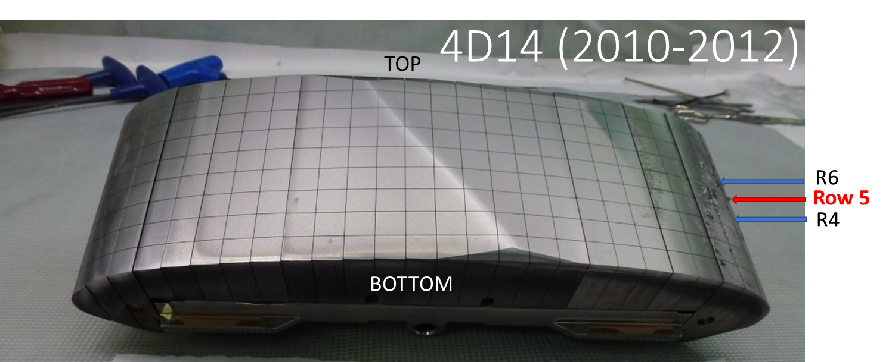
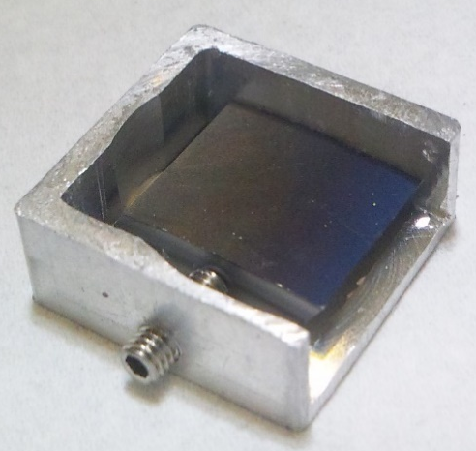
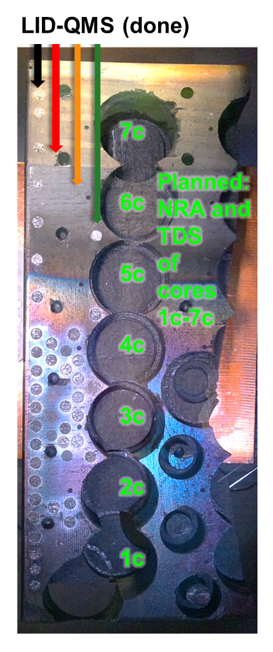
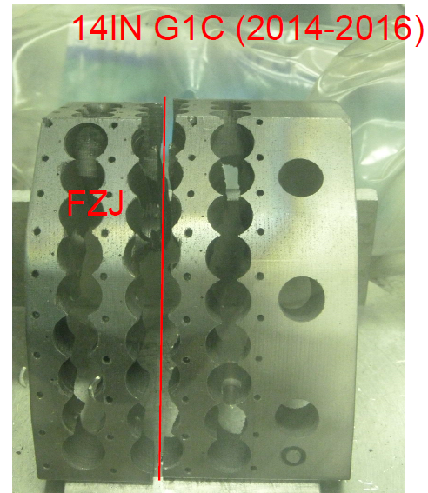
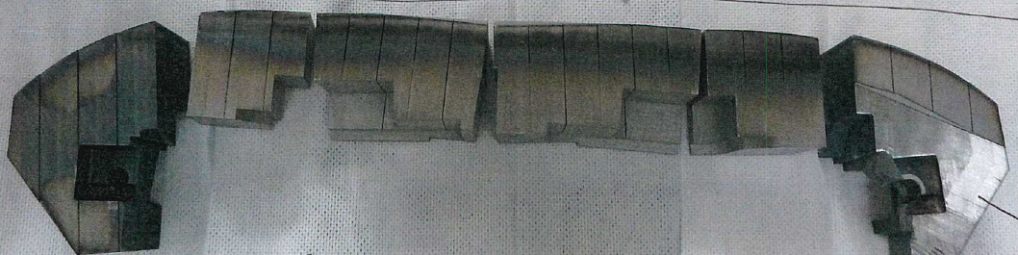
Available JET samples at FZJ for fuel retention analysis by TDS and LID-QMS
TDS:
small Be block samples from 2XR10IWGL,
2B2C dump plate, 4D14WPL (9 from ILW-1, 7 from ILW-2)
9 small Be block samples from 2XR11 and 4D15
(exposed 2011-2016)
Poloidal fraction of HFGC14LH (= divertor tile 0 from ILW3):
cores 1c-7c: for comparison of D retention with LID-QMS and NRA
possible external cooperation: Image Plate (IP) analysis of laser spots
4 W divertor lamellas (A14, B14 from ILW2; B12, B13 from ILW3)
LID-QMS (Laser-Induced Desorption):
Poloidal fraction of 14ING1C (divertor tile 1 from ILW3):
perform poloidal laser scan for D profile
New remaining fragments of tile 0 and 1 (ILW1-3)
W lamella cuts
Cut blocks of Be limiter 2XR10 from ILW3 for poloidal D profile
IWC 4/2 (2011-2016) 19, 32 ???
Divertor tile 1
Divertor tile 0
2XR10

Slide 3
Availability of FREDIS device
FREDIS is back to operation since 2 weeks
FREDIS is probably going out of operation in autumn 2023 due to construction work on the new hot cells in the same room as FREDIS

