Slide 1
VR in SP-E: Research potential and plans
VR SP-E tasks in 2023 (as defined in PMP):
Characterization of JET plasma facing and diagnostics components using ion beam analysis (HIERDA).
I. Samples sectioned at VTT from divertor Tiles 4,6,7,8:
E2, Task D008: 3 PM, 3 accelerator days.
Contents of all species (from H to W) in the surface layer up to the depth of 350 nm.
Concentration ratios: H/D, D/Be, D/C, Be/C, D/N, C/N, D/O, Be/N etc in surface layer up to 360 nm.
II. Samples of PFC and other objects in JET:
E3, Task D008: 7 PM, 0 accelerator days.
In principle any sample can be studied.
The most relevant are studies of Langmuir probes.
Composition of deposits in various regions in the divertor, both on plasma-facing surface and in gaps between lamellae.
Composition of the damaged and molten zones.
Mirrors: for instance H/D ratio over time.
4 accelerators:
5 MeV Tandetron
350 keV Implanter
170 keV Micadas
0.2 – 10 keV Implanter
1300ºC TDS in-situ implantation & IBA
Magnetrons, evaporation cells
Sputter guns
Clean room
Radiological certificate
IBA & IBMM Methods
RBS standard
wide range of NRA &
PIXE micro
ERDA / HI-ERDA (GIC detector)
MEISS
LEISS
AMS
Microscopes, Photospectrometers, etc.
}
Per Petersson, Laura Dittrich, Daniel Primetzhofer, Marek Rubel

Slide 2
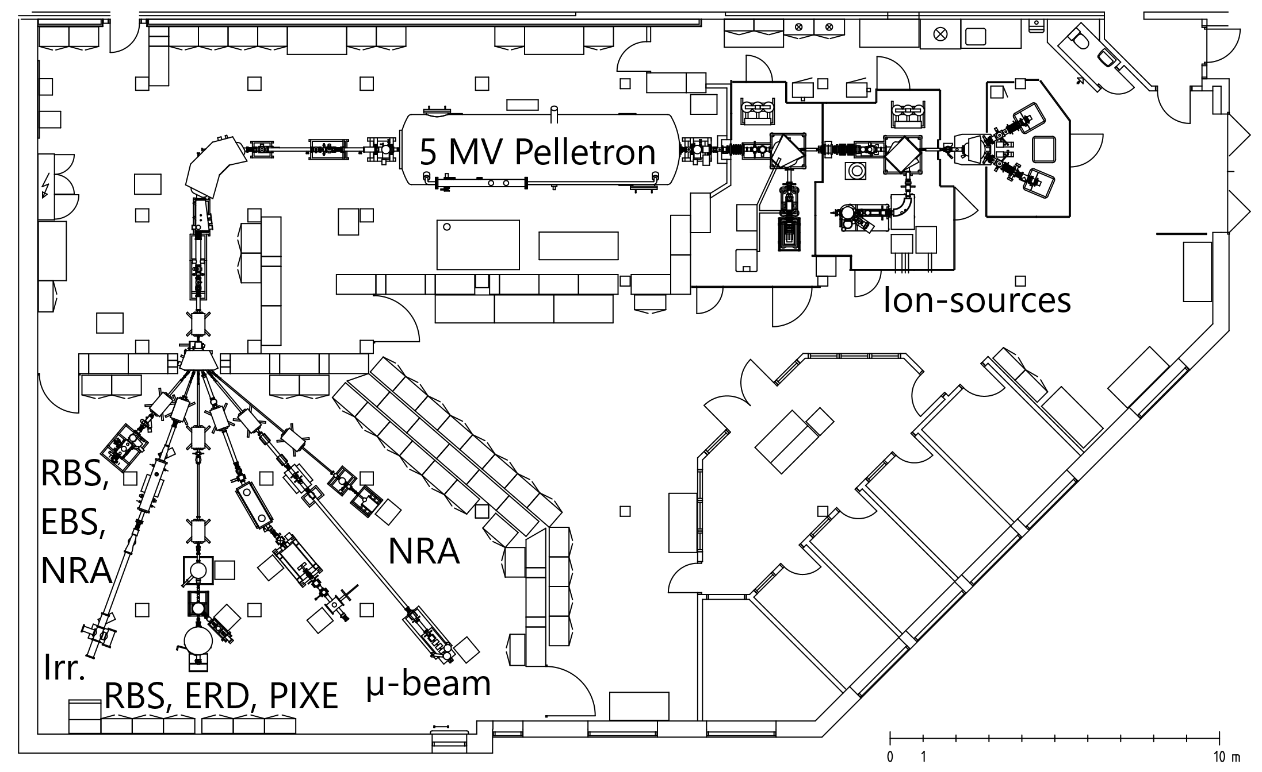
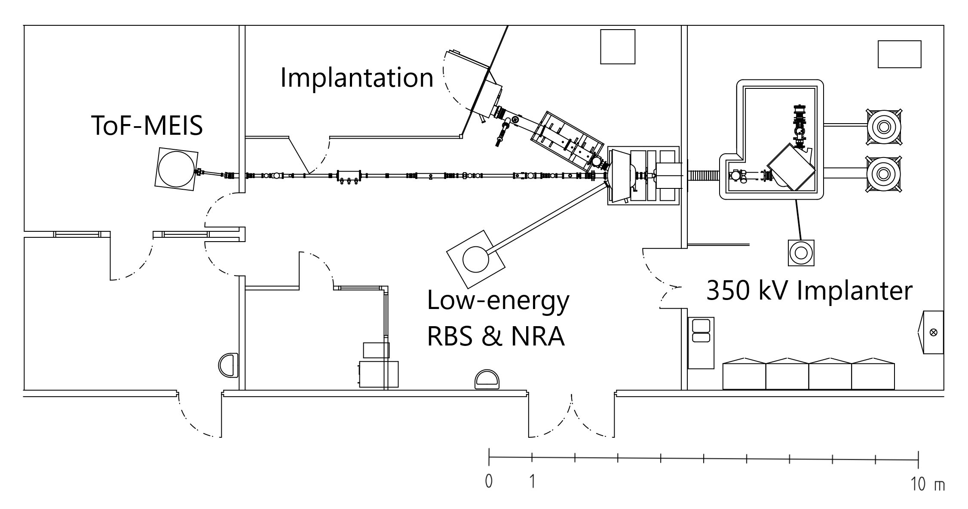
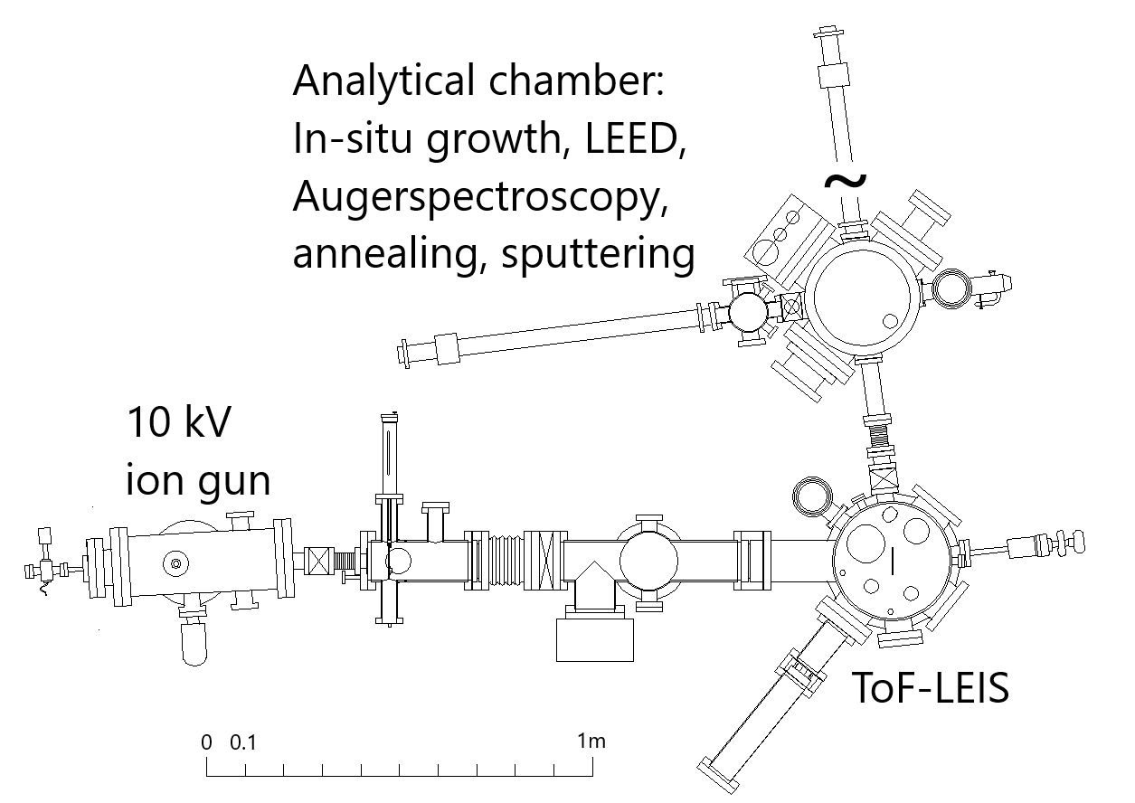
The Tandem Laboratory at Uppsala University
5 MV 15-SDH2 pelletron accelerator
350 kV Danfysik implanter
3 changeable sources: gas, oven, sputter
ToF-LEIS system
AMS
2 gas & 2 sputter ion sources – beams of H, D, ³He, ⁴He, C, N, O, Cu, Br, I, Au
Fusion-related research is carried out in all systems.
P. Ström and D. Primetzhofer, JINST 17 (2022) P04011.
M. Rubel, D. Primetzhofer, P. Petersson, S. Charisopoulos, A. Widdowson, EPJ Tech. Instrum. 10:3 (2023)
Per Petersson, Laura Dittrich, Daniel Primetzhofer, Marek Rubel

Slide 3
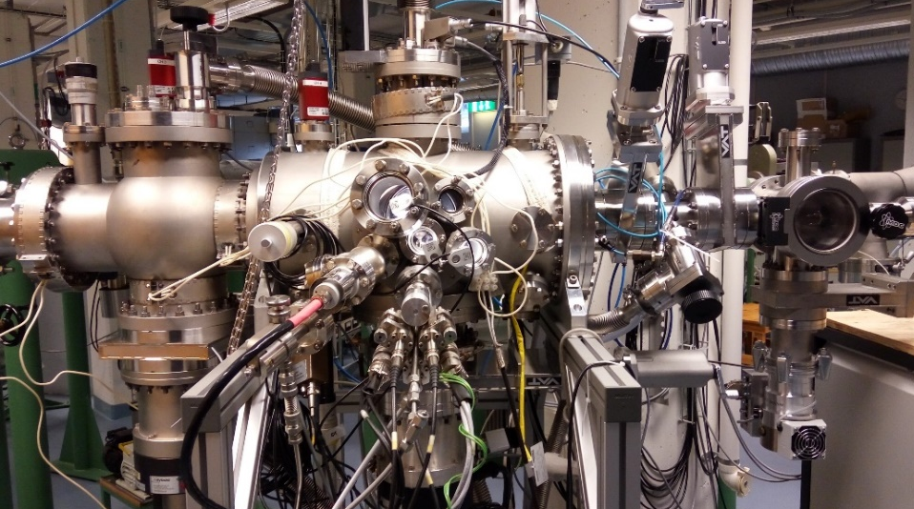
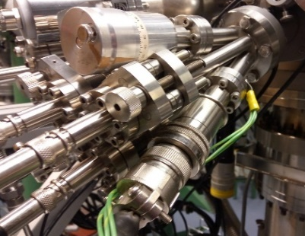
The Tandem Laboratory at Uppsala University:
Multi-method capabilities: In-situ IBA & target modification
IBA with light & heavy ions – RBS, NRA, PIXE,
PIGE, ERDA
Beam energies: 2 – 50 MeV
Large viewport (e.g. optical characterization)
Evaporation: 3 evaporation cells
Sputtering: 1 – 5 keV ion gun
Implantation
Annealing & thermal desorption spectroscopy
Gas analysers
Gas feeds
K. Kantre et al., Nucl. Instr. Meth. B (2020)
P. Ström and D. Primetzhofer, JINST 17 (2022) P04011.
M. Rubel, D. Primetzhofer, P. Petersson, S. Charisopoulos, A. Widdowson, EPJ Tech. Instrum. 10:3 (2023)
Per Petersson, Laura Dittrich, Daniel Primetzhofer, Marek Rubel

